Slide 1
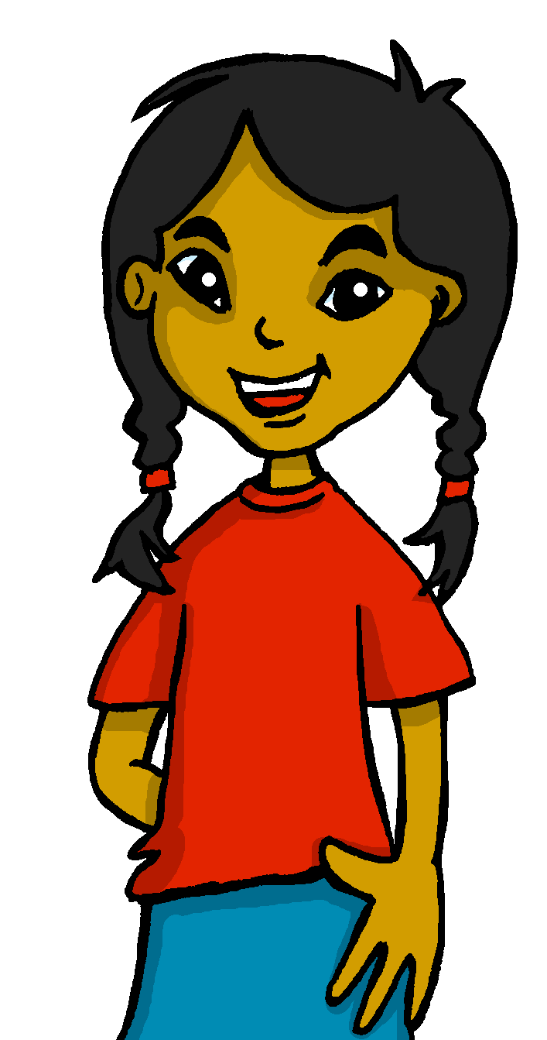
español, con Sofía

Slide 2
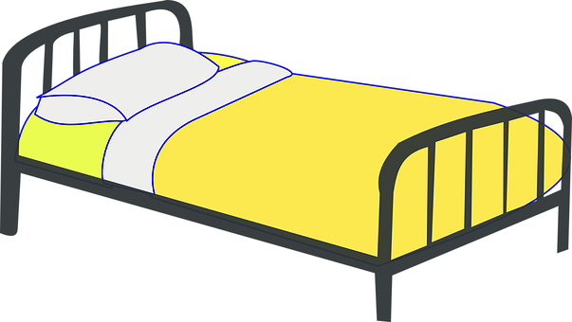
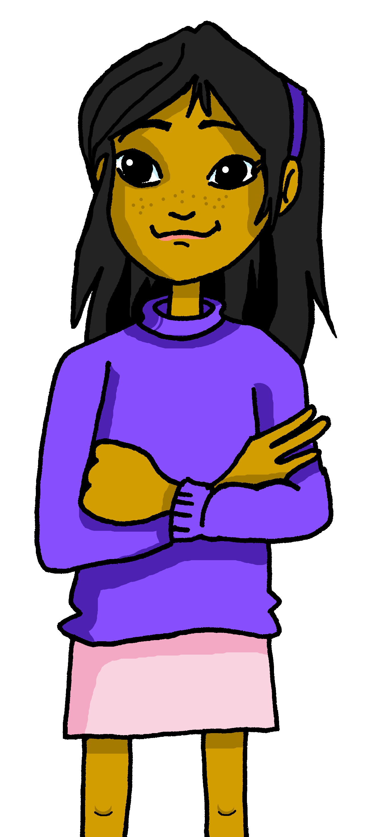
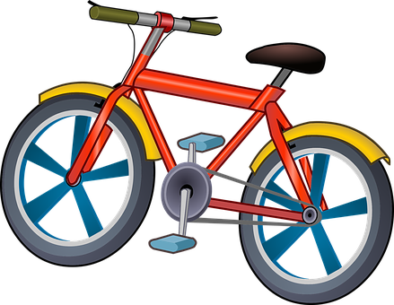
Describing me and others
¿Qué tiene Ángela?
rojo
‘tener’: 1st & 3rd person singular
SSC [ci]
Mi amiga Ángela
💗
Notes:
Artwork by Steve Clarke. All additional pictures selected are available under a Creative Commons license, no attribution required.
The frequency rankings for words that occur in this PowerPoint which have been previously introduced in the resources are given in the SOW (excel document) and in the resources that first introduced and formally re-visited those words.
For any other words that occur incidentally in this PowerPoint, frequency rankings will be provided in the notes field wherever possible.
Phonics: decir [32]
Vocabulary: tiene [19] amigo [210] amiga [210] bicicleta [3684] cama [609] gato [1728]
Frequency of unknown words:
el [1] la [1] practicar [1595] reaccionar [2284] cielo [620] cinco [284] cine [952] ciudad [178] cocina [1214] compañero [551] concierto [1456] diario [966] diciembre [1165] edificio [857] especial [436] objeto [567] paciencia [2357] imposible [1418] posible [427]
Source: Davies, M. and Davies, K. (2018). A frequency dictionary of Spanish: Core vocabulary for learners (2nd ed.). Routledge: London

Slide 3
pronunciar
[ci]
decir
[to say, tell]
Notes:
Timing: 1 minute
Aim: To introduce SSC [ci]
Procedure:
Introduce and elicit the pronunciation of the individual SSC [ci] and then the source word ‘decir’ (with gesture, if using).
Click to bring the picture & get pupils to repeat (with gesture, if using).
Suggested gesture: British sign language for ‘say’ is to lift the right index finger to mouth and then direct it quickly away from the body (as though tracing the trajectory of a string of words coming out of the mouth towards a listener in front). For a video, see here: https://www.signbsl.com/sign/say

Slide 4
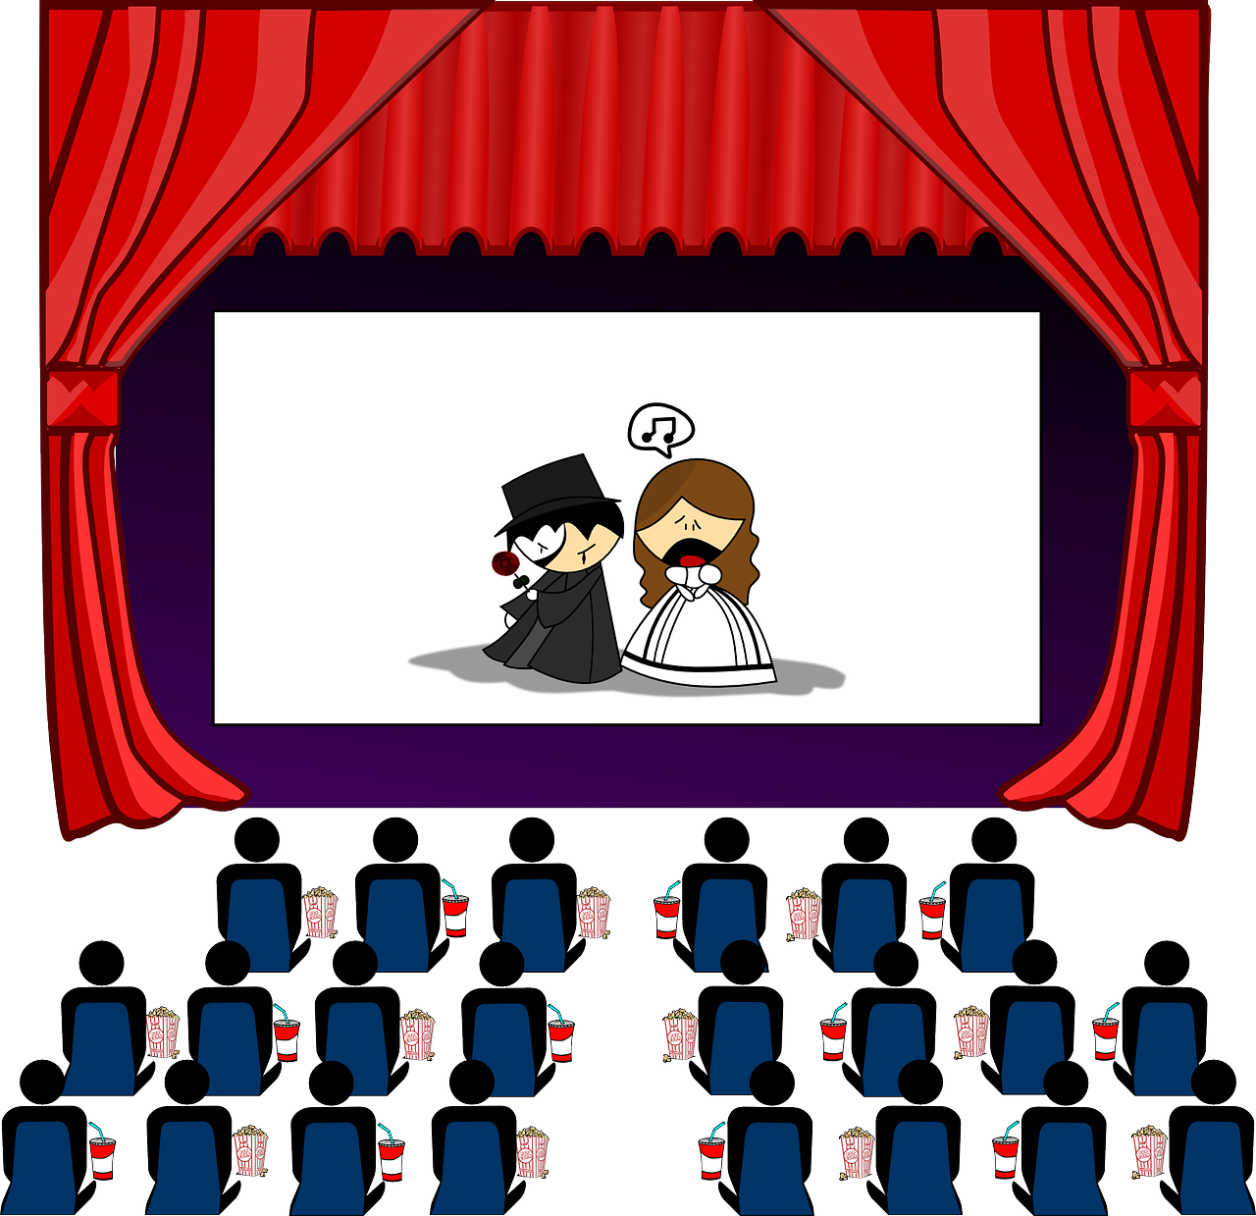
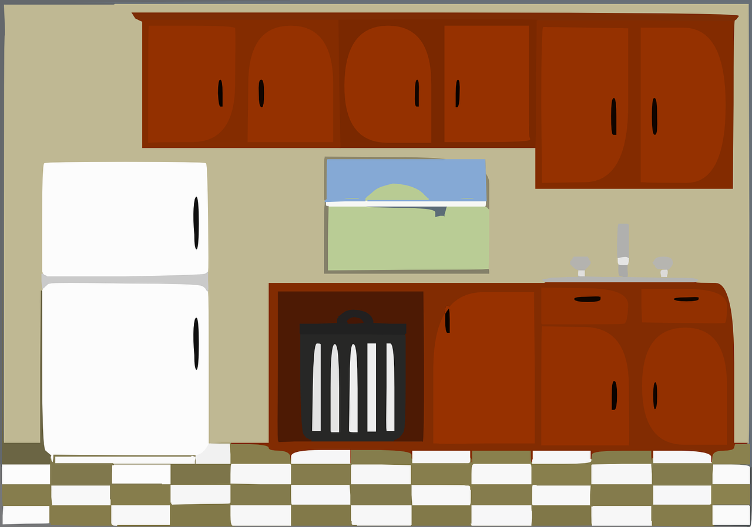
pronunciar
Con un compañero/a, practica
cine
paciencia
cinco
[patience]
cielo
cocina
especial
[sky]
[kitchen]
[special]
ciudad
diciembre
edificio
[city]
[building]
concierto
compañero = partner
practica = practise
[concert]
Notes:
Timing: 5 minutes (two slides)
Aim: to develop phonological awareness of [ci]
Procedure:
In pairs, pupils pronounce the words themselves and apply their SSC knowledge of [ci].
Teacher gives feedback and pupils listen and repeat.
Move to next slide.
Frequency of unknown words and cognates: practicar [1595] cielo [620] cinco [284] cine [952] ciudad [178] cocina [1214] compañero [551] concierto [1456] diciembre [1165] edificio [857] especial [436] paciencia [2357]
Source: Davies, M. & Davies, K. (2018). A frequency dictionary of Spanish: Core vocabulary for learners (2nd ed.). Routledge: London
Note: all these words, though unknown, are very high frequency and most will be explicitly taught later in the SOW.

Slide 5
pronunciar
Con un compañero/a, practica.
paciencia
cinco
[patience]
cine
cielo
cocina
especial
[special]
[sky]
[kitchen]
ciudad
diciembre
edificio
[city]
[building]
concierto
compañero = partner
practica = practise
[concert]
Notes:
Procedure:
Partner A sits with their back to the board whilst partner B reads aloud the first five words that on the first click. Partner A writes the words.
Partner then swap roles. Teacher clicks to bring up the remaining 5 words (and remove the first five for clarity).
Teacher clicks again to bring all words back. Pupils check their spellings.
Teachers should circulate to listen to pupils’ pronunciation and praise/correct as necessary.
Frequency of unknown words and cognates: practicar [1595] cielo [620] cinco [284] cine [952] ciudad [178] cocina [1214] compañero [551] concierto [1456] diciembre [1165] edificio [857] especial [436] paciencia [2357]
Source: Davies, M. & Davies, K. (2018). A frequency dictionary of Spanish: Core vocabulary for learners (2nd ed.). Routledge: London
Note: all these words, though unknown, are very high frequency and most will be explicitly taught later in the SOW.

Slide 6
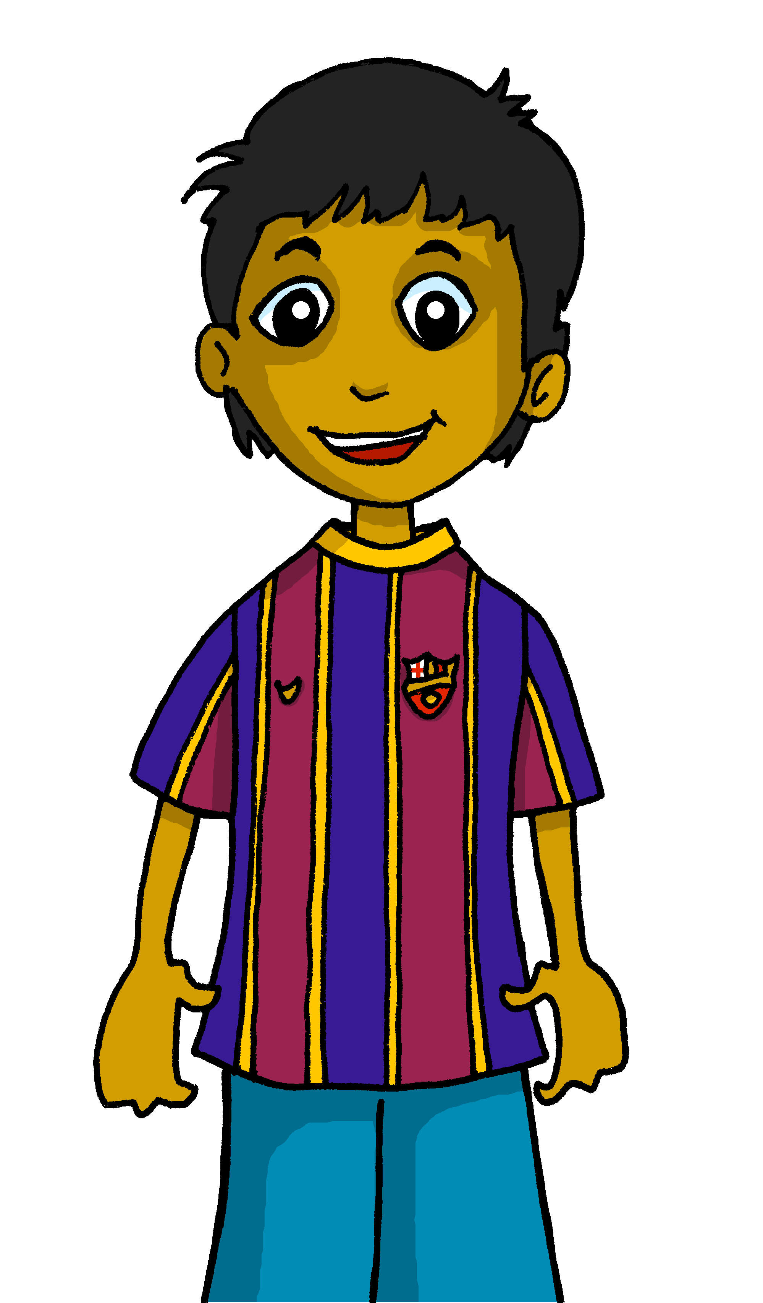
Handout vocabulario
¿Qué es en español?
a b ñ
vocabulario
vocabulario
vocabulario
vocabulario
vocabulario
un bolígrafo
una cama
una amiga
una bicicleta
un amigo
un teléfono
un gato
un cuaderno
In English, we also say ‘bike’. In Spanish, you can say ‘bici’.
a male friend
a female friend
an exercise book
a bicycle
a bed
a cat
a pen
a phone
Notes:
Timing: 3 minutes
Aim: to revisit three words from last week’s vocabulary and introduce five new nouns for this week.
Procedure: 1. Click for an English prompt.
2. Elicit the Spanish word from pupils. 3. Continue until all 8 items have been seen and heard.
4. Click to tell pupils about the abbreviation for bicycle in Spanish (bici).
Note: The new words are also illustrated with a picture; previously learnt words are not illustrated.

Slide 7
Tener:
tiene
[to have | having]: s/he, it has
We know the verb tener means ‘to have’ or ‘having’.
I
S/he, it
To say I have, use ‘tengo’.
To say s/he or it has, use ‘tiene’.
Rubén es un amigo.
Ángela es una amiga.
Tengo un amigo.
Tiene una amiga.
I have a (male) friend.
She has a (female) friend.
Notes:
Timing: 2 minutes
Aim: to revisit 1st and introduce 3rd person singular of ‘tener’.
Procedure:
Click through the paced animations to present the new knowledge.
Elicit English translations for the Spanish examples provided.

Slide 8
leer
Sofía escribe 📝 en el diario.
¿Qué tiene Sofía? ¿y Ángela?
Mi amiga Ángela 💗
Escribe en español 📝.
E Tiene una bicicleta.
Sofía (I) | Ángela(she)
1 Tengo un bolígrafo.
2 Tiene un cuaderno.
bolígrafo
bicicleta
3 Tengo una cama.
cama
cuaderno
4 Tengo un gato.
gato
teléfono
5 Tiene un teléfono.
6 Tengo una amiga.
amiga
el diario = the diary
Notes:
Timing: 4 minutes
Aim: to practise written comprehension of ‘tiene’ and ‘tengo’.
Procedure:
Read the first speech bubble to set the context. Sofía is writing in her diary.
Read the question ‘¿Qué tiene Sofía? ¿y Ángela? Ensure that pupils understand this. What does Sofía have and what does Ángela have?
Click to bring up instruction and table. Ensure pupils understand they are asked to write in Spanish. Paying attention to the verb, pupils write the Spanish word for the object in the correct column. (‘I have’ - tengo’, Sofía talking about herself; or ‘tiene’ - she has, Sofía referring to Ángela).
Do [E] with them to model the task.
Note: the next activity focuses on understanding the meaning of the vocabulary.
Frequency of unknown words and cognates: el [1] diario [966]
Source: Davies, M. & Davies, K. (2018). A frequency dictionary of Spanish: Core vocabulary for learners (2nd ed.). Routledge: London

Slide 9
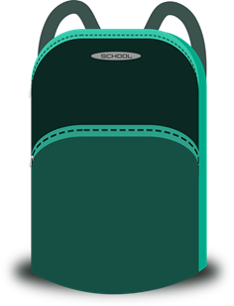
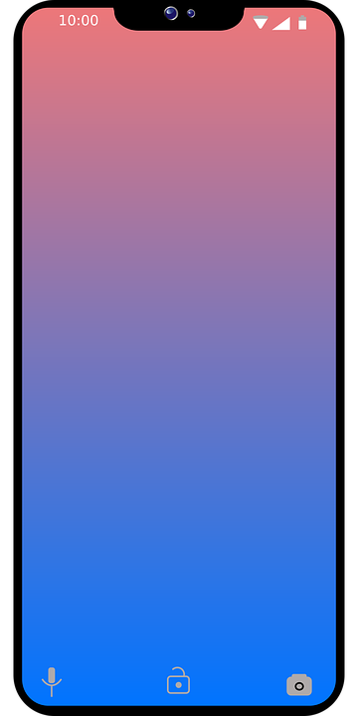
Handout vocabulario
En la mochila
a b ñ
¿Qué objeto es? Escribe a-g
vocabulario
vocabulario
vocabulario
vocabulario
vocabulario
c
a
b
c
E Tiene una bicicleta.
d
1 Tengo un bolígrafo.
g
2 Tiene un cuaderno.
f
d
e
g
3 Tengo una cama.
e
4 Tengo un gato.
f
5 Tiene un teléfono.
b
6 Tengo una amiga.
a
la = the (fem., sing.)
objeto = object
Notes:
Timing: 6 minutes (two slides)
Aim: to practise reading comprehension of both newly introduced and revisited vocabulary.
Procedure:
Read the title – ‘En la mochila’. ‘la’ is glossed. Mochila was learnt last week. Ensure that pupils understand the title.
Do E with pupils. Invite them to tell you which letter/picture matches the sentence.
Give pupils 3 minutes to do items 1-6.
Click to correct.
Frequency of unknown words and cognates: la [1] objeto [567]
Source: Davies, M. & Davies, K. (2018). A frequency dictionary of Spanish: Core vocabulary for learners (2nd ed.). Routledge: London

Slide 10
hablar y escuchar
Lee. ¿Es posible o imposible?
posible = possible
imposible = impossible
¡Reacciona!
hablar
hablar
Persona A
Persona B
E Tiene una bicicleta.
1 Tengo un bolígrafo.
Tiene una bicicleta.
¡Es imposible!
2 Tiene un cuaderno.
3 Tengo una cama.
4 Tengo un gato.
5 Tiene un teléfono.
6 Tengo una amiga.
Notes:
Aim: to practise reading aloud of newly introduced and revisited vocabulary and processing the sentences for meaning.
Procedure:
Pupil take turns to read statements 1-6 and react to them according to whether they are logical in this context (items that would fit in their school bag).
Model the task using E.
Ensure that pupils understand the premise of the activity.
Given them 1 minute to say all 6 statements and react, working in pairs.
Time allowing, the teacher can elicit whole class choral responses to verify pupils’ reactions and judge their confidence in understanding.
Frequency of unknown words and cognates:
reaccionar [2284] posible [427] imposible [1418] Source: Davies, M. & Davies, K. (2018). A frequency dictionary of Spanish: Core vocabulary for learners (2nd ed.). Routledge: London

Slide 11
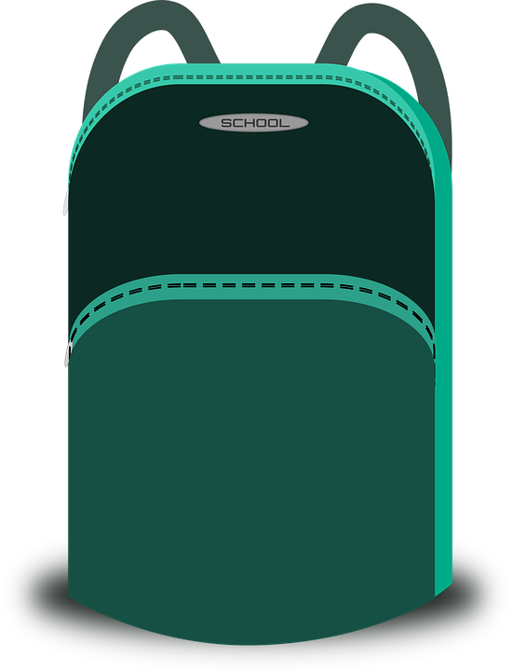
escuchar
En la mochila
Sofía habla. ¿Es Sofía o Quique?
escuchar
Marca
Escribe el objeto en inglés .
 | Sofía (I) | Quique (he) | objeto
E
an idea
1
an exercise book
2
a ball
3
a camera
4
el = the (masc., sing.)
objeto = object
a (piece of) fruit
Notes:
Timing: 5 minutes
Aim: to practise aural comprehension of ‘tengo’ & ‘tiene’.
Procedure:
Read the title and click to bring up the instructions in Spanish.
Do the example (E).
Click to bring up the instruction for the challenge. Encourage most able pupils to write down in English the object.
Listen to items 1-4. Click to bring up the verb answers.
Elicit the English for the objects and click to bring up written versions of the answers.
Transcript
Ej. Tiene una idea.
Tengo un cuaderno.
Tengo una pelota.
Tiene una cámara.
Tiene una fruta.
Frequency of unknown words and cognates: el [1] objeto [567]
Source: Davies, M. & Davies, K. (2018). A frequency dictionary of Spanish: Core vocabulary for learners (2nd ed.). Routledge: London

Slide 12
vocabulario
Escribe en inglés 📝.
a b ñ
Can you get at least15 points?
 | estoy | estar | estás
 | allí | ausente | presente
 | España | aquí | hola
 | eres | de | Inglaterra
 | un amigo | una pelota | tengo
 | una cama | una amiga | una mochila
 | tiene | una bicicleta | un gato
vocabulario
vocabulario
vocabulario
vocabulario
vocabulario
I am (state)
to be|being (state)
you are (state)
x3
there
absent
present
Spain
here
hello
x2
you are (trait)
from
England
a (male) friend
a ball
I have
a bed
a (female) friend
a school bag
x1
s/he, it has
a bicycle
a cat
Notes:
Note: this can be a follow up activity, if needed.
Timing: 6 minutes
Aim: to practise written comprehension of vocabulary from last week and this week.
Procedure: 1. Give pupils a blank grid. They fill in the English meanings of any of the words they know, trying to reach 15 points in total.
Note: The most recently learnt and practised words are pink, words from the previous week are green and those from two weeks ago are blue, thus more points are awarded for them, to recognise that memories fade and more effort (heavy lifting!) is needed to retrieve them.

Slide 13
¡adiós!
rojo

Slide 14
Handout: vocabulario
Escribe en inglés 📝.
a b ñ
Can you get at least15 points?
 | estoy | estar | estás
 | allí | ausente | presente
 | España | aquí | hola
 | eres | de | Inglaterra
 | un amigo | una pelota | tengo
 | una cama | una amiga | una mochila
 | tiene | una bicicleta | un gato
vocabulario
vocabulario
vocabulario
vocabulario
vocabulario
x3
x2
x1
Notes:
Note: this can be a follow up activity, if needed.
Timing: 6 minutes
Aim: to practise written comprehension of vocabulary from last week and this week.
Procedure: 1. Give pupils a blank grid. They fill in the English meanings of any of the words they know, trying to reach 15 points in total.
Note: The most recently learnt and practised words are pink, words from the previous week are green and those from two weeks ago are blue, thus more points are awarded for them, to recognise that memories fade and more effort (heavy lifting!) is needed to retrieve them.

