Slide 1
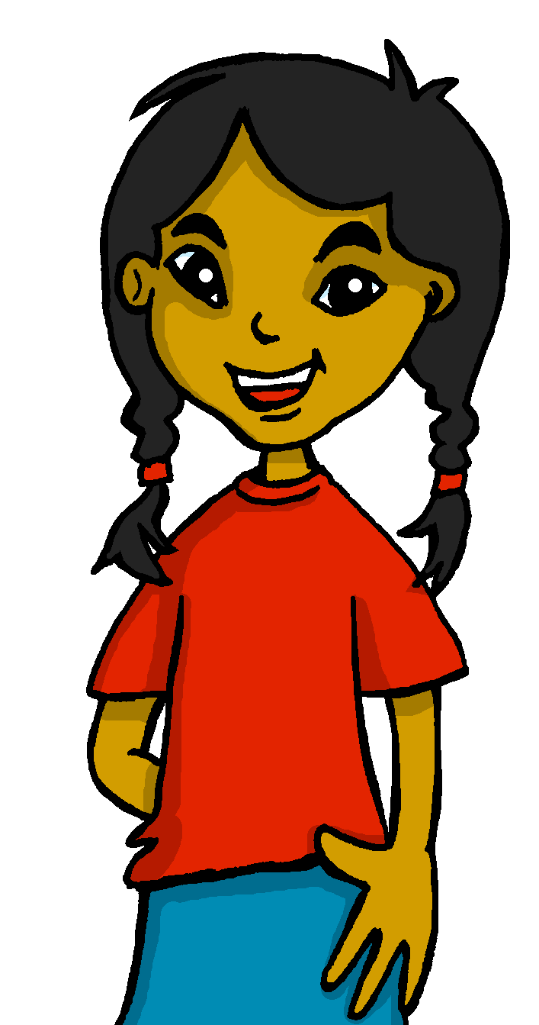
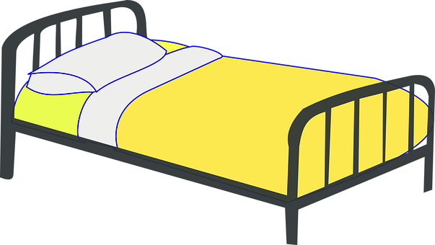
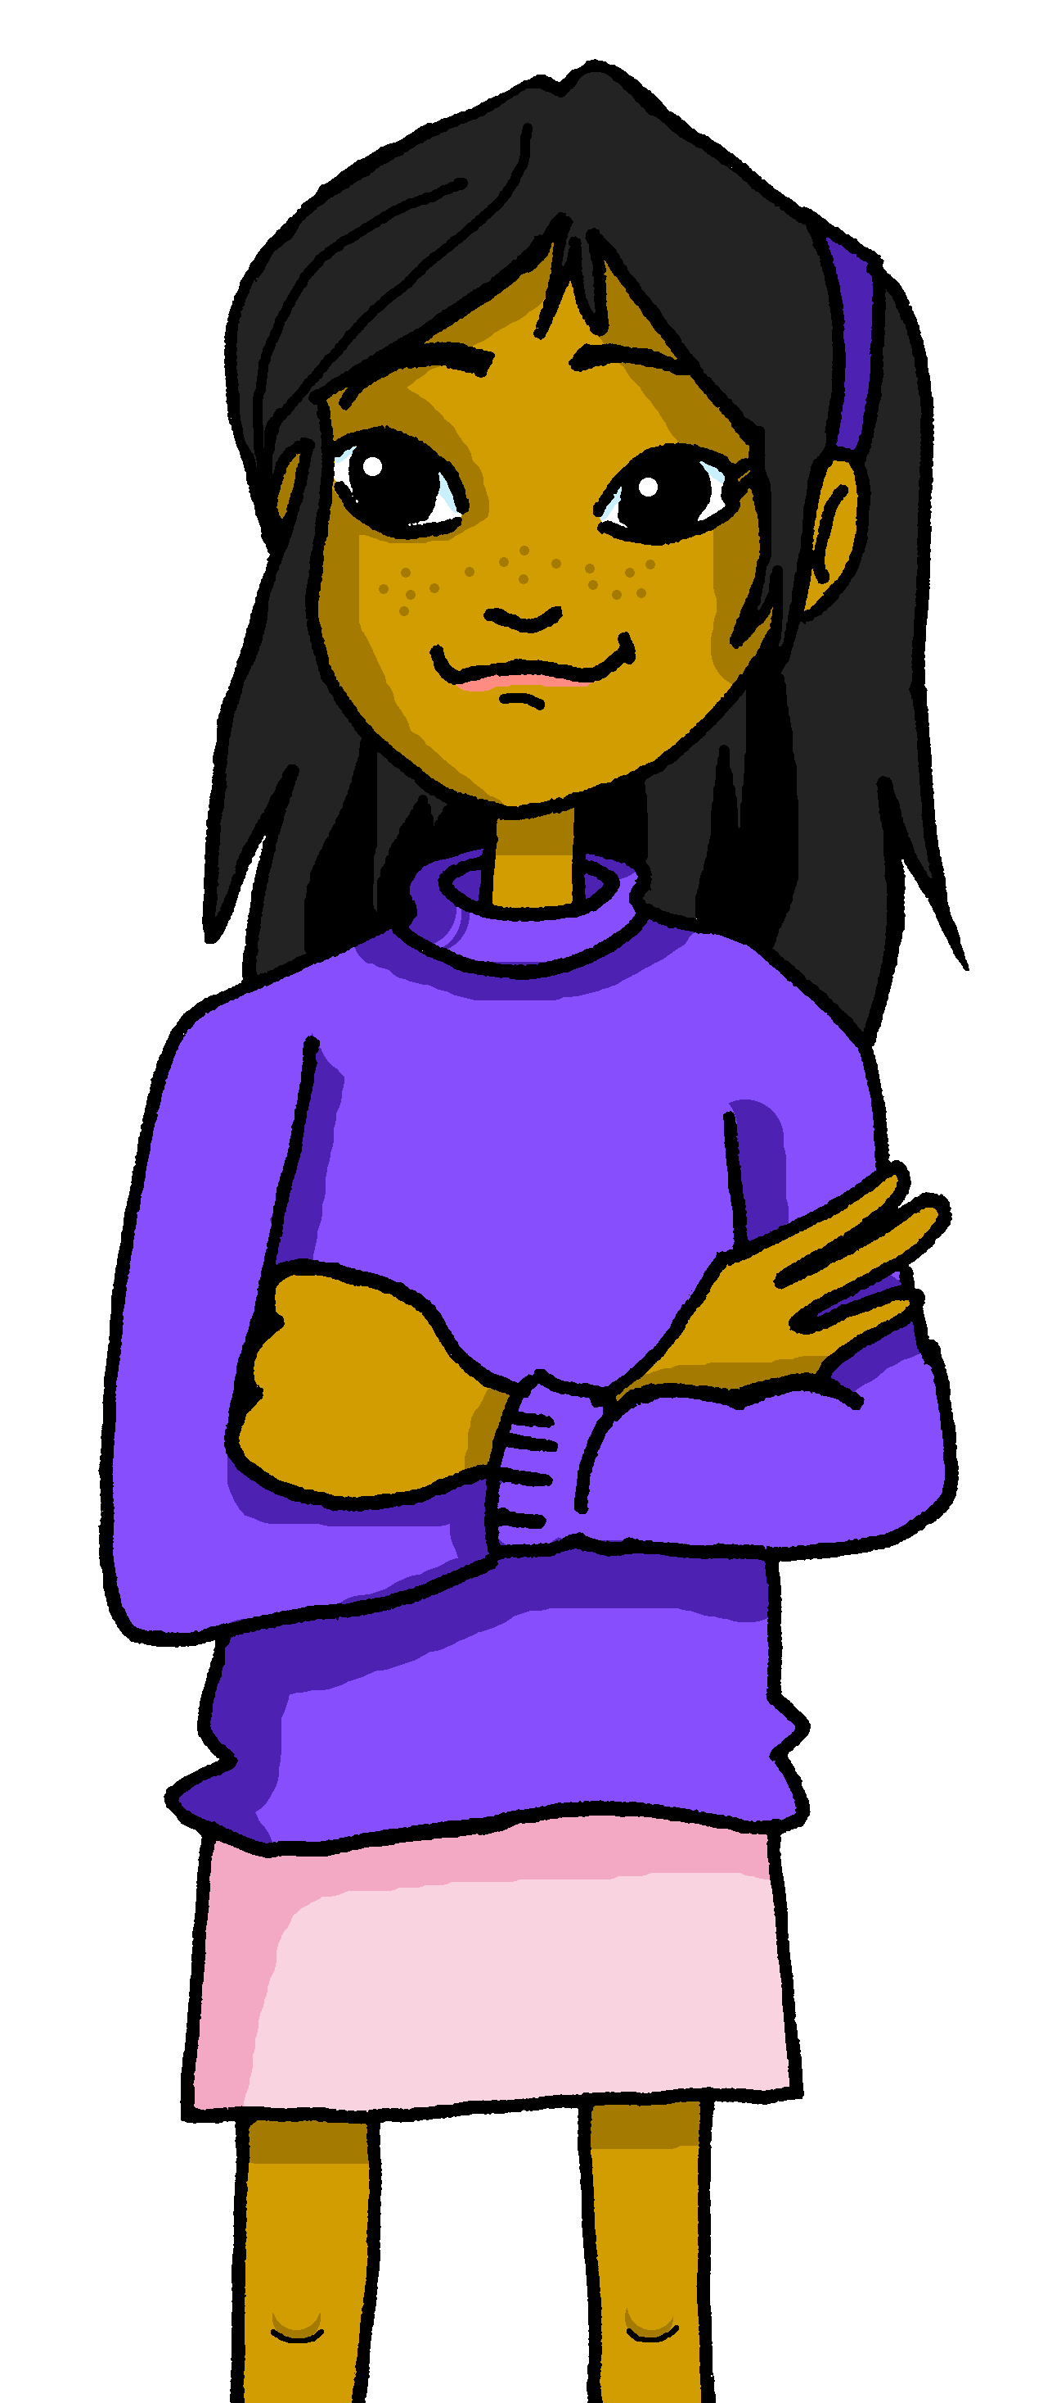
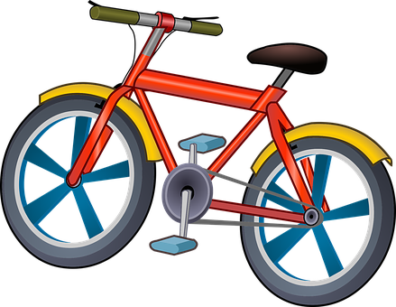
Saying what I and others have
¿Qué tiene Ángela?
rojo
Mi amiga Ángela
💗
Follow ups 1-5
Notes:
Artwork by Steve Clarke. All additional pictures selected are available under a Creative Commons license, no attribution required.
The frequency rankings for words that occur in this PowerPoint which have been previously introduced in the resources are given in the SOW (excel document) and in the resources that first introduced and formally re-visited those words.
For any other words that occur incidentally in this PowerPoint, frequency rankings will be provided in the notes field wherever possible.
Phonics: decir [32]
Vocabulary: tiene [19] amigo [210] amiga [210] bicicleta [3684] cama [609] gato [1728]
Frequency of unknown words:
la [1] espalda [942]
Source: Davies, M. and Davies, K. (2018). A frequency dictionary of Spanish: Core vocabulary for learners (2nd ed.). Routledge: London

Slide 2
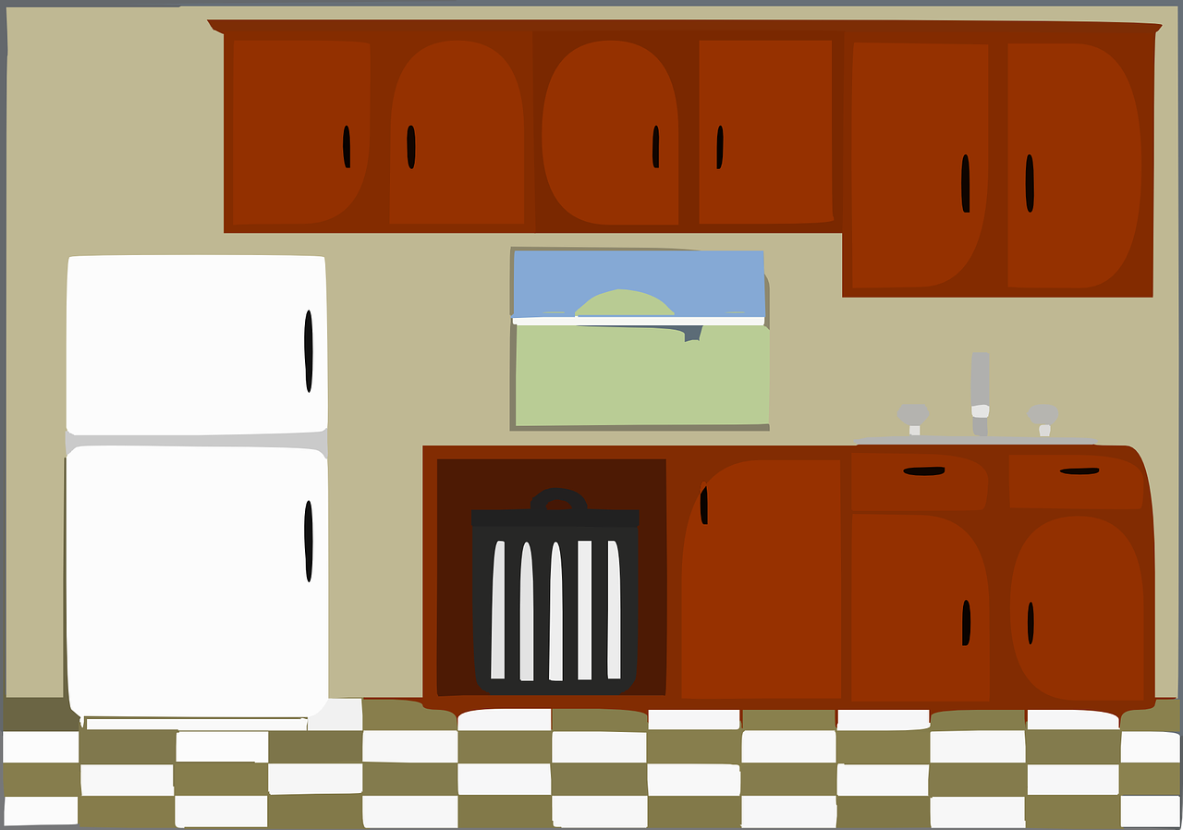
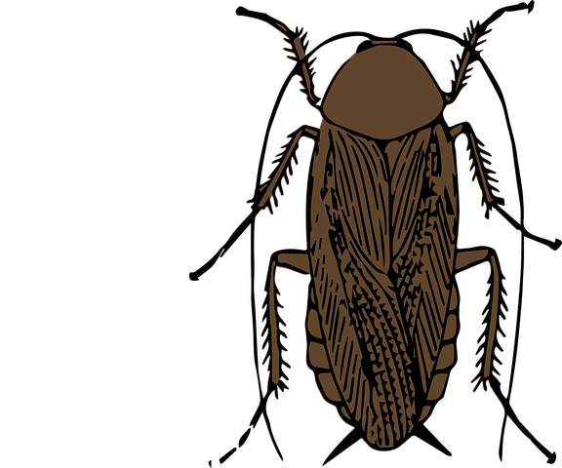
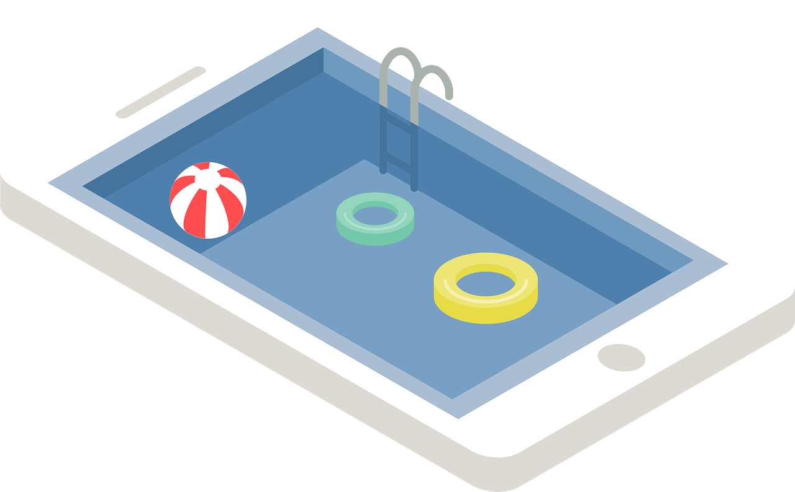
Follow up 1
[ca] [co] [cu] vs. [ce]
[A]
[B]
pronunciar
Escucha y marca .
Escribe 📝en la espalda*.
 | ca | co | cu | ci
 |  |  |  |  | _ _ ma
 |  |  |  |  | _ _ _ _ n a
 |  |  |  |  | _ _ _ _ racha
 |  |  |  |  | _ _ en
 |  |  |  |  | _ _ la
 |  |  |  |  | pis _ _ na
¡Pronuncia!
E
c i
cima cien cocina
diciembre piscina cine
paciencia ciudad
dieciséis cielo concierto
1
c o
c i
2
c u
c a
3
ci
100
4
c o
5
c i
la = the (fem, sing.)
espalda = back
Notes:
Timing: 5 minutes
Aim: to develop phonological awareness of [ci] in contrast with [ca] [co] [cu] and practise SSC [ci] in a read aloud task.
Procedure:
Click to bring up the instruction.
Click to bring up table and do example together (E).
pupils tick and/or write the correct sound [ca] [co] [cu] [ci]
4. Click to bring up Part B and read instructions.
5. Partner A writes down 4 words from the board.
6. Partner B continues to face the board. Partner A, with their finger, writes the four chosen words on Partner B’s back. Partner B says the word as soon as s/he recognises it. Partner A can award 1 point for correctly getting the word and 1 for correct pronunciation.
7. Partner then swap roles.
Teachers circulate to listen to pupils’ pronunciation and praise/correct as necessary.
Transcript [EJ] cima
[1] cocina
[2] cien
[3] cucaracha [4] cama
[5] piscina
Frequency of unknown words:
la [1] espalda [942]
Source: Davies, M. and Davies, K. (2018). A frequency dictionary of Spanish: Core vocabulary for learners (2nd ed.). Routledge: London

Slide 3
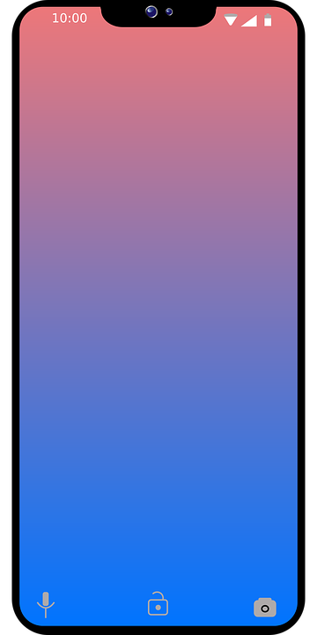
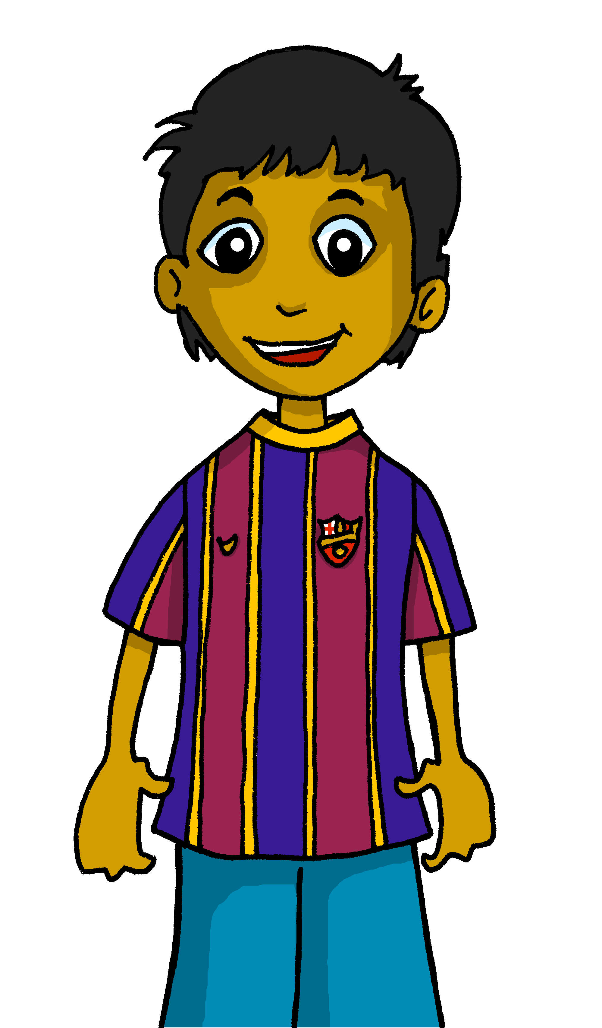
Follow up 2:
Clasifica las palabras.
leer
gato cama bolígrafo amigo cámara
cuaderno bicicleta amiga teléfono pelota
un
una
1
2
3
4
5
gato
3
cama
5
bolígrafo
4
cámara
6
amigo
bicicleta
8
6
7
8
9
10
9
cuaderno
10
amiga
7
teléfono
2
pelota
1
Notes:
Timing: 5 minutes
Aim: to practise written comprehension of new vocabulary and its correct association with the appropriate indefinite article (word for ‘a/an’).
Procedure:
1. Read the instruction in Spanish.
2. Pupils to identify the gender of the nouns (all nouns introduced in week 9 or 10) and write down the words in the correct column.
3. Answers appear on click in the order the words are listed (top left to right) to allow individual pupils to volunteer answers. 4. Teacher to elicit English word meanings (or numbers, if known in Spanish) and click to reveal correct answers.

Slide 4
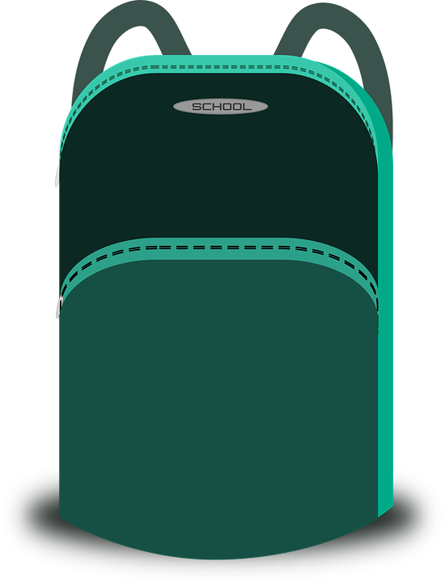
Follow up 3:
Escucha y escribe 📝.
[1/5]
escuchar
escribir
Tengo
1. _______ una mochila y un teléfono.
3
I
s/he
2
a
b
c
1
¡escribe!
Notes:
Slide 1/5
Timing: 8 minutes
Aim: to practise listening out for the verbs ‘tengo’ & ‘tiene’ and process the person of the verb they refer to. To then practise processing the meaning of both the newly introduced and revisited vocabulary.
Procedure:
Read the instructions in Spanish. The following instructions apply to the next 5 slides.
Tell pupils this is a delayed dictation activity. They will hear a sentence out loud twice and they will have to retain that sentence in their working memory (picturing it in their heads!) for 3 seconds.
Note: they can choose to use the help on the board or turn away to do the full sentence without looking – encourage pupils to choose their own level of challenge.
Click the audio button to hear the audio. Click to start timer once you’ve played the sentence twice.
Once the time is up, the instruction ‘escribe’ will come up and they need to write the whole sentence.
Click to reveal the verb, again to show its meaning, and again to show the vocabulary meanings.

Slide 5
Follow up 3:
Escucha y escribe 📝.
[2/5]
escuchar
escribir
Tiene
1. _______ una fruta y una bicicleta.
3
I
s/he
2
a
b
c
1
¡escribe!
Notes:
Slide 2/5

Slide 6
Follow up 3:
Escucha y escribe 📝.
[3/5]
escuchar
escribir
Tiene
1. _______ una amiga y un cuaderno.
3
I
s/he
2
a
b
c
1
¡escribe!
Notes:
Slide 3/5

Slide 7
Follow up 3:
Escucha y escribe 📝.
[4/5]
escuchar
escribir
Tengo
1. _______ un gato y una pelota.
3
3
I
s/he
2
2
1
a
b
c
1
¡escribe!
¡escribe!
Notes:
Slide 4/5

Slide 8
Follow up 3:
Escucha y escribe 📝.
[5/5]
escuchar
escribir
Tiene
1. _______ una cama y un bolígrafo.
3
I
s/he
2
a
b
c
1
¡escribe!
Notes:
Slide 5/5

Slide 9
Follow up 4:
¿Qué es en español?
You do not need all of the words!
[1/6]
hablar
tiene
fruta
un
20 segundos
Tengo una fruta y un teléfono.
I have a (piece of) fruit and a phone.
pelota
cuaderno
teléfono
una
y
tengo
INICIO
Notes:
Timing: 5 minutes (6 slides)
Aim: to practise oral sentence building, deciding between the target features of tengo and tiene, un and una, and different vocabulary from this week.
Procedure:
1. Click for English sentence and Spanish prompt words. 2. Click Inicio to start the timer.
3. Pupils select from the words given to create and say the sentence out loud before the time elapses. 4. Click for the Spanish sentence to appear. Answer: Tengo una fruta y un teléfono.

Slide 10
Follow up 4:
¿Qué es en español?
You do not need all of the words!
[2/6]
hablar
tiene
mochila
un
20 segundos
Tengo una pelota y una bicicleta.
I have a ball and a bicycle.
bolígrafo
pelota
bicicleta
una
y
tengo
INICIO
Notes:
[2/6] Answer: Tengo una pelota y una bicicleta.

Slide 11
Follow up 4:
¿Qué es en español?
You do not need all of the words!
[3/6]
hablar
tiene
cuaderno
un
20 segundos
Tiene un cuaderno y un bolígrafo.
He has a an exercise book and a pen.
bolígrafo
cama
amiga
una
y
tengo
INICIO
Notes:
[3/6] Answer: Tiene un cuaderno y un bolígrafo.

Slide 12
Follow up 4:
¿Qué es en español?
You do not need all of the words!
[4/6]
hablar
un
tiene
gato
20 segundos
Rubén tiene una amiga y un gato.
Rubén has a female friend and a cat.
cámara
amigo
amiga
una
y
tengo
INICIO
Notes:
[4/6] Answer: Rubén tiene una amiga y un gato.

Slide 13
Follow up 4:
¿Qué es en español?
You do not need all of the words!
[5/6]
hablar
un
tiene
cámara
20 segundos
Santi tiene una pelota y Manchita tiene una cama.
Santi has a ball and Manchita has a bed.
cama
pelota
mochila
una
y
tengo
INICIO
Notes:
[5/6] Answer: Santi tiene una pelota y Manchita tiene una cama.

Slide 14
Follow up 4:
¿Qué es en español?
You do not need all of the words!
[6/6]
hablar
tiene
un
cámara
20 segundos
Tengo una cámara, un teléfono y una mochila.
I have a camera, a phone and a school bag.
cama
teléfono
mochila
una
y
tengo
INICIO
Notes:
[6/6] Answer: Tengo una cámara, un teléfono y una mochila.

Slide 15
Tener:
tiene
[to have | having]: s/he, it has
We know the verb tener means ‘to have’ or ‘having’.
To say s/he or it has, use ‘tiene’.
Tiene un cuaderno.
S/he, it has an exercise book.
Remember that ‘tiene’ can also just mean ‘has’.
Sofía tiene una amiga.
Sofía has a (female) friend.
Notes:
Do before follow up 5
Timing: 1 minute
Aim: to revisit knowledge about tener and draw attention to the multiple translations of tiene.
Procedure:
Click through the paced animations to present the new knowledge.
Elicit English translations for the Spanish examples provided.

Slide 16
Follow up 5:
Escribe en español 📝.
When translating [a] / [an], consider the gender of the noun.
[I have] [a] camera. __________________
2. Rubén [has] [a] (female) friend. ________________________
3. [She has] [a] bicycle. ______________________
4. [I have] [a] cat and [a] (piece of) fruit.
_______________________________________
5. Quique [has] [a] pen and [an] exercise book.
__________________________________________
escribir
Tengo una cámara.
Rubén tiene una amiga.
Tiene una bicicleta.
⚠ Don’t forget capital letters and full stops!
Tengo un gato y una fruta.
cuaderno
Quique tiene un bolígrafo y un cuaderno.
amiga
bicicleta
y
gato
bolígrafo
y
fruta
cámara
Notes:
Timing: 8 minutes
Aim: to correctly use ‘tengo’ & ‘tiene’ ‘un’ and ‘una’ in written production.
Procedure:
Tell pupils to translate the sentences using the vocabulary from the lesson. They can use the words in the frame to support their writing but will have to think carefully about translating ‘I have’ and ‘s/he has’, as well as a /an.
Click to bring up reminder about a / an.
Click to bring up reminder about punctuation and capital letters.

Slide 17
Follow up 5:
Escribe en español 📝.
a b ñ
vocabulario
Can you get at least15 points?
 | I am (state) | you are (state) | to be|being (state)
 | there | absent | present
 | Spain | here | hello
 | you are (trait) | from | England
 | a (male) friend | a ball | I have
 | a bed | a (female) friend | a school bag
 | s/he, it has | a bycicle | a cat
estoy
estás
estar
x3
allí
ausente
presente
España
aquí
hola
x2
eres
de
Inglaterra
un amigo
una pelota
tengo
una cama
una amiga
una mochila
x1
tiene
una bicicleta
un gato
Notes:
Timing: 6 minutes
Aim: to practise written production of vocabulary for this week and previous weeks.
Procedure:
1. Pupils need to write the Spanish for as many words as possible, aiming to get at least 15 points (but more if possible).
2. Click for Spanish answers.

Slide 18
Handout: Follow up 5
a b ñ
Follow up 5:
Escribe en español 📝.
vocabulario
Can you get at least15 points?
 | I am (state) | you are (state) | to be|being (state)
 | there | absent | present
 | Spain | here | hello
 | you are (trait) | from | England
 | a (male) friend | a ball | I have
 | a bed | a (female) friend | a school bag
 | s/he, it has | a bycicle | a cat
x3
x2
x1
Notes:
Timing: 6 minutes
Aim: to practise written production of vocabulary for this week and previous weeks.
Procedure:
1. Pupils need to write the Spanish for as many words as possible, aiming to get at least 15 points (but more if possible).
2. Click for Spanish answers.

