Slide 1


español, con Quique

Slide 2






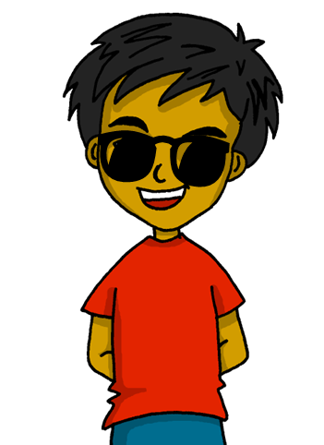
Expressing likes and saying what I and others do
Expressing likes and saying what I and others do
amarillo
- Revisit singular present tense -AR and -ER verbs
- SSC [h]
Notes:
Artwork by Steve Clarke. All additional pictures selected are available under a Creative Commons license, no attribution required.
The frequency rankings for words that occur in this PowerPoint which have been previously introduced in the resources are given in the SOW (excel document) and in the resources that first introduced and formally re-visited those words.
For any other words that occur incidentally in this PowerPoint, frequency rankings will be provided in the notes field wherever possible.
Phonics: Source: helado [3024]
Vocabulary: escuchar [281] hablar [90] lugar [144] música [380] famoso [997] típico [1934]
Revisit 1: calor [1852] frío [1307] miedo [755] sueño [460]
Revisit 2: hay [haber 13] cuántos [580] cuántas [580]
Frequency of unknown words and cognates:
almohada [4267] cohete [>5000] hambre [1262] hospital [1050] humano [243] moneda [1577] ruta [1845] verano [1139] su [12]
Source: Davies, M. & Davies, K. (2018). A frequency dictionary of Spanish: Core vocabulary for learners (2nd ed.). Routledge: London

Slide 3


pronunciar
[h]
helado
pronunciar
pronunciar
Notes:
Timing: 1 minute
Aim: To introduce SSC [h]
Procedure:
To practise and elicit the pronunciation of the individual SSC [h]
Click to bring the picture & get students to repeat (with gesture, if using).
Gesture suggestion: mime holding an ice cream cone and bringing it towards your mouth.

Slide 4
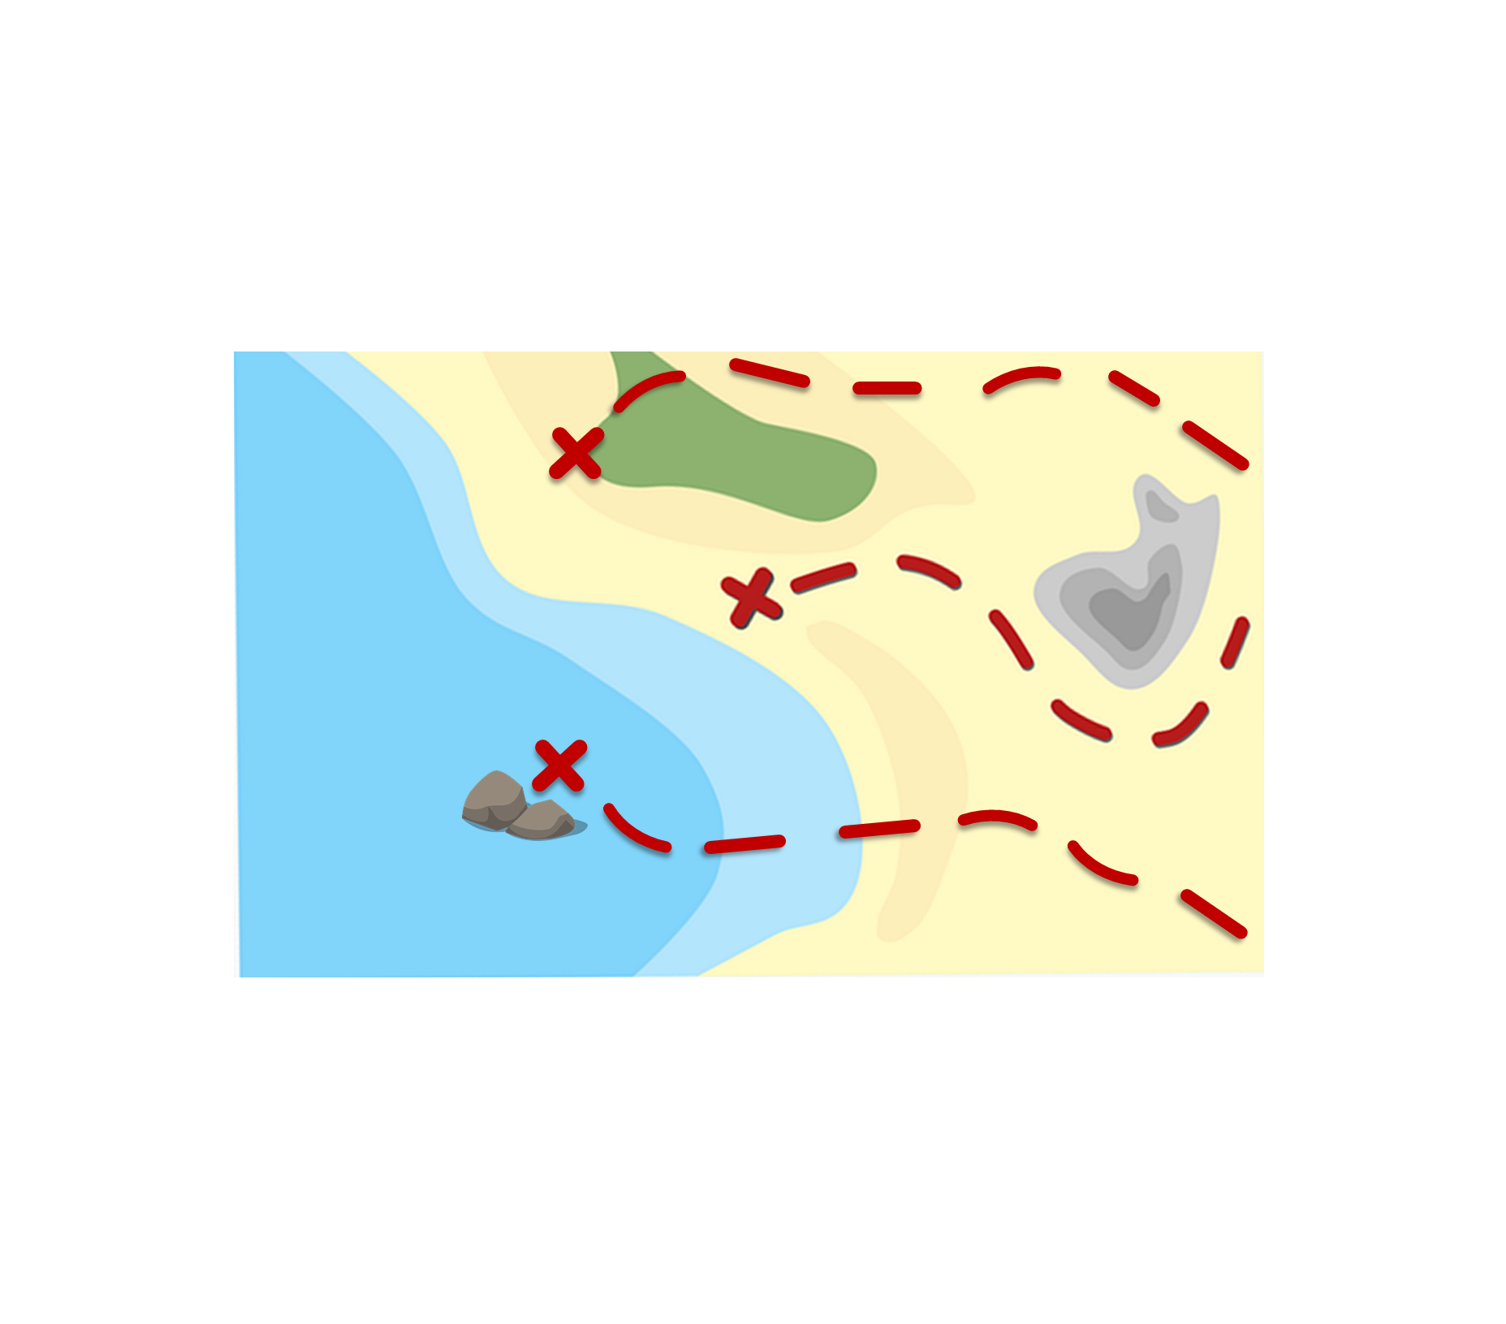


pronunciar
La ruta* de las monedas*
(la) ruta – route
(la) moneda - coin
Pronuncia las palabras y colecciona monedas.
[h]
pronunciar
hay
escuchar
hago
Turno 2: Persona B
estuche
Turno 1: Persona A
humano
helado
hola
hoja
hermano
hoy
mucho
cohete
hace
hablar
inhalar
habitación
chocolate
hospital
ahora
INICIO
Notes:
Timing: 3 minutes
Aim: to apply SSC knowledge for [h]
Timing: 5 minutes
Procedure:
Pupils work in pairs to practise pronunciation. They can choose where to start and have one minute to collect as many coins as possible.
Divide the class in A & B and click to indicate it’s ‘persona A’’s turn.
Pupil A starts from either ‘hola’, ‘hoy’ or ‘ahora’, and follows the path to pronounce the words and collect the corresponding coins.
Click to bring up Persona B’s turn.
NB. A word with SSC [ch] has been intentionally included in each path to revisit [ch] in contrast with ‘h’ in isolation.
Frequency of unknown words and cognates:
almohada [4267] cohete [>5000] hambre [1262] hospital [1050] humano [243] moneda [1577] ruta [1845]
Source: Davies, M. & Davies, K. (2018). A frequency dictionary of Spanish: Core vocabulary for learners (2nd ed.). Routledge: London

Slide 5

vocabulario
1
_
¿Qué palabra es?
e
2
j
_
_
_
u
l
i
o
Abajo ⬇
1. drawing
4. I do / make
7. to play, playing (an instrument)
9. to read, reading
Horizontal ➡
2. July
3. June
5. August
6. new
7. Three
8. There is/are
d
3
_
_
n
i
o
9
l
j
u
_
➡
_
7
t
r
e
_
b
_
s
4
h
6
n
u
o
_
_
_
e
v
_
e
_
a
_
_
_
r
j
c
5
g
8
_
_
_
s
_
o
y
_
o
t
a
a
h
_
o
_
r
➡
7
Notes:
Timing: 5 minutes
Aim: to revisit vocabulary from previous weeks.
Procedure:
1.Teachers model the task by drawing pupils’ attention to the clues on the left-hand side of the slide.
NB. All these words have been introduced and practised before.
2. Ensure the meaning of ‘abajo’ and ‘horizontal’ is clear.
3. Pupils can work in pairs and try to translate as many as they can.
4. Elicit meaning from pupils and click on the numbers to bring up the answers.
NB. Further rounds of learning can be facilitated by one pupil turning away from the board, and his/her partner asking him/her the meanings (‘Cómo se dice X en español?’). This activity can work from L2 → L1 or L1 → L2.

Slide 6
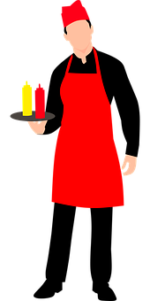




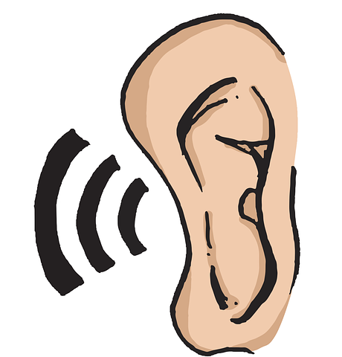
vocabulario
Escucha y repite. 🗣
place
la música
el lugar
l_ m_ _ _c_
el lugar
la música
el trabajo
e_ t_ _ _ _jo
_ l l _ g _ _
el trabajo
[music]
[work(place), job]
famous
famoso
f _ _ _ s _
famoso
escuchar
escuchar
h _ b _ _ _
e _ c _ _ _ a _
hablar
hablar
typical
[to talk, talking]
[to listen, listening]
típico
t _ _ _ c _
típico
Notes:
Timing: 5 minutes
Aim: to introduce key vocabulary for this week.
Procedure:
1.Teacher introduces items one by one (word, picture, English) & pupils practise pronunciation aloud.
Alternatively, pupils work in pairs, reading the Spanish words out loud and looking at the English meanings (1 minute).
2. Then the teacher removes the English words or pictures (on click), and pupils try to recall the English orally (chorally), looking at the Spanish (1 minute).
3. Teacher brings up hints – pupils work in pairs trying to recall the Spanish.
4. Elicit answers from pupils (from left to right).
NB. Further rounds of learning can be facilitated by one pupil turning away from the board, and his/her partner asking him/her the meanings (‘Cómo se dice X en español?’). This activity can work from L2 → L1 or L1 → L2.

Slide 7

Saying who does what
[-ar & -er verbs: I, you, s/he]
In Spanish, the words for ‘I’ and ‘s/he’ (pronouns) are often _____________ and the verb ending __________ to indicate the _____________ who the verb refers to.
unnecessary
changes
person
To mean ‘I’ with –ar or -er verbs, the verb ending is ___.
-o
-as
To mean ‘you’, the verb ending is ____ with –ar verbs and ____ with
–er verbs.
-es
-e
To mean ‘s/he, it’, the verb ending is ___ with –ar verbs and ___ with
–er verbs.
-a
changes -a -es unnecessary -e person -as -o
Notes:
Timing: 4 minutes
Aim: to revisit singular persons of –ar and –er verbs.
Procedure:
Click through the animations to present the information.
Elicit answers from pupils (1-3).
Give pupils 1-2 minutes with a partner to retrieve the different endings for –ar/-er verbs.
Elicit answers from pupils and click to bring up animations.

Slide 8

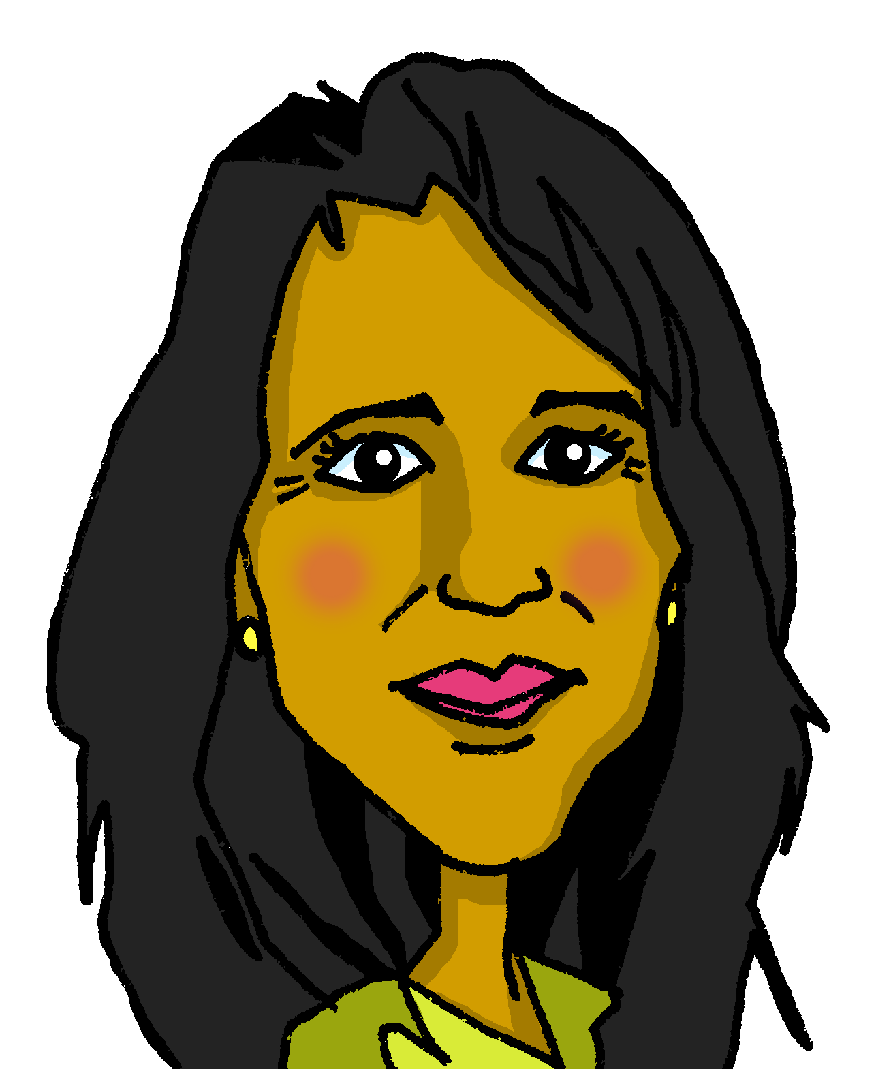
leer
El trabajo de mamá [1/3]
la arquitecta = (the) architect
su = her
Lee el texto ¿Qué es en inglés?
leer
En julio y agosto voy con mamá a su* trabajo. Ella es arquitecta*. Escucha y habla con muchas personas.
she
(the) work
s/he speaks
I go
s/he listens
ella
el trabajo
habla
voy
escucha
Notes:
Timing: 7 minutes (3 slides)
Aim: to introduce the context of the lesson through reading practice of this week’s new and previously taught vocabulary, as well as 1st and 3rd person singular of –ar and –er verbs.
Procedure:
Give pupils 2-3 minutes with a partner to find the Spanish meanings for the five English words.
Elicit Spanish responses chorally, prompting with the English, e.g., ‘she?’ ‘ella’, muy bien. ☺
Note: click on each English word to reveal the Spanish translation.
Pupils could be asked to read the text aloud in pairs, taking it in turns to read alternate sentences. There are a few unknown words in the text, and a variety of words that were taught some time ago.
Click on the text box to hear the full text, if desired.
Frequency of unknown words and cognates:
arquitecta [>5000] su [12] voy [ir] [33]
Source: Davies, M. & Davies, K. (2018). A frequency dictionary of Spanish: Core vocabulary for learners (2nd ed.). Routledge: London

Slide 9
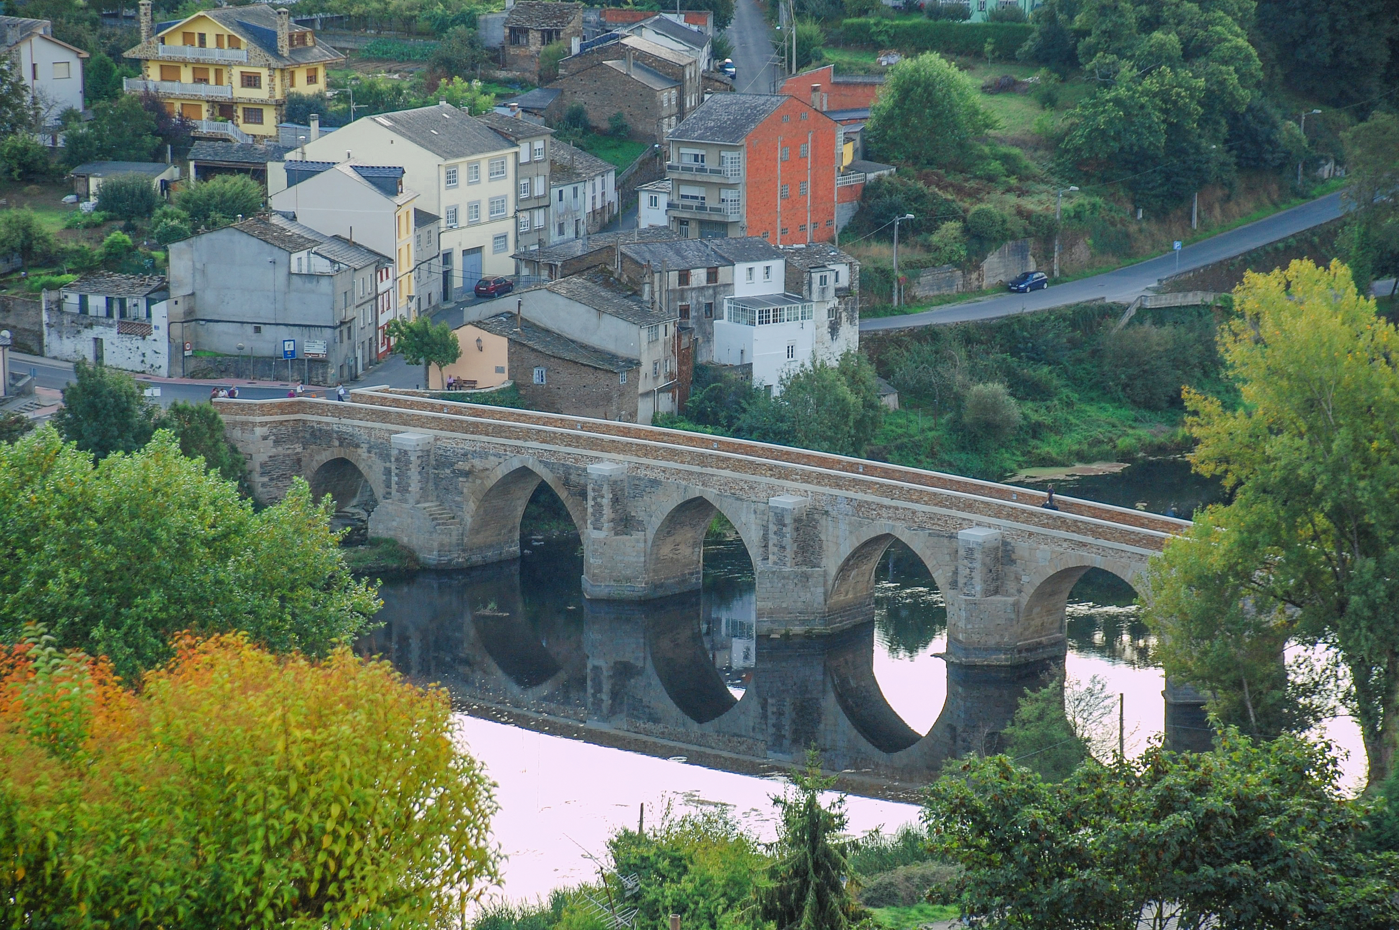
leer
El trabajo de mamá [2/3]
Lee el texto ¿Qué es en inglés?
leer
Estoy en la oficina* con ella. Está en un lugar muy famoso: el puente* romano*.
It is (location)
famous
I am (location)
está
famoso
estoy
very
(the) place
with
muy
el lugar
con
(el) puente = bridge
romano = Roman
Notes:
[2/3]
Frequency of unknown words and cognates:
puente [1715] romano [>5000]
Source: Davies, M. & Davies, K. (2018). A frequency dictionary of Spanish: Core vocabulary for learners (2nd ed.). Routledge: London
Picture attribution:
De Iago Casabiell González, CC BY-SA 4.0, https://commons.wikimedia.org/w/index.php?curid=47963063

Slide 10
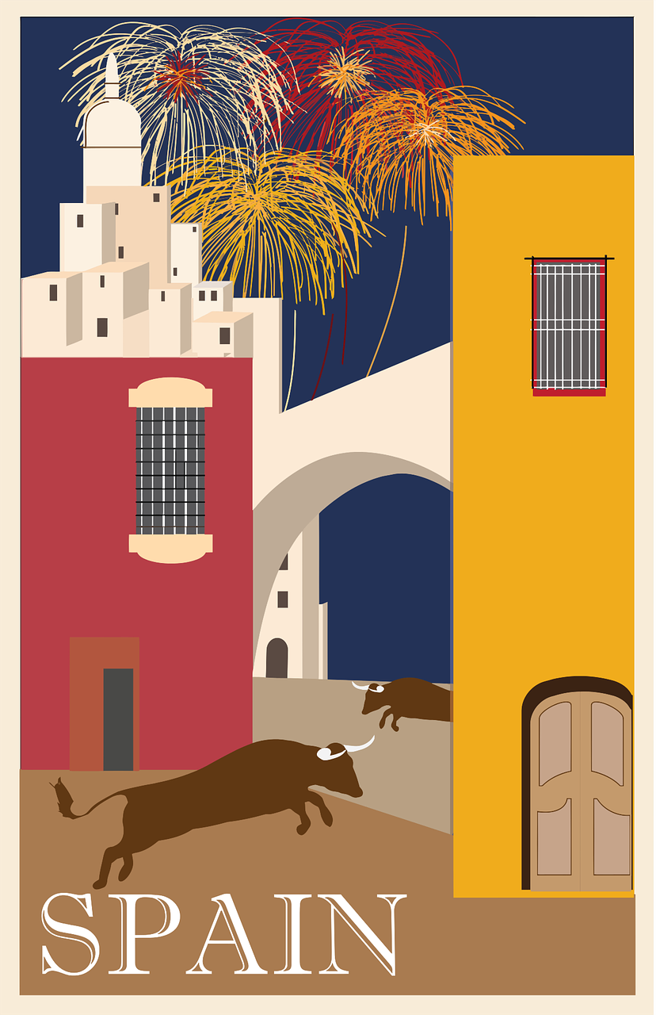

leer
El trabajo de mamá [3/3]
In English we would say I take a nap for ‘hago la siesta’
(el) verano = summer
Lee el texto ¿Qué es en inglés?
leer
Como en casa con Sofía y cuando tengo sueño, hago la siesta*. Es típico. Luego toco música y Sofía lee.
¡Amo el verano 🌞!
el verano = (the) summer
I love
when
I’m tired
typical
amo
cuando
tengo sueño
típico
I play
reads
then
I do
toco
lee
luego
hago
It’s common to take a mid-day break in Spain, also known as ‘siesta time’. The majority of working-age people don’t actually go home to nap though 😉.
Notes:
[3/3]
Frequency of unknown words and cognates:
verano [1139]
Source: Davies, M. & Davies, K. (2018). A frequency dictionary of Spanish: Core vocabulary for learners (2nd ed.). Routledge: London

Slide 11




Leer y hablar
Escucha y traduce para completar el dominó.
Persona 1 lee la tarjeta.
leer
hablar
Persona 2 lee la tarjeta.
Persona 3 lee la tarjeta.
¿Tienes el verbo en inglés?
¿Tienes ‘organiza’ en inglés?
traduce – translate
(la) tarjeta – card
(el) verbo - verb
Notes:
Timing: 5-7 minutes
Aim: aural comprehension of singular persons of key –ar and –er verbs.
Procedure:
Click through the animations to explain the task in Spanish.
Give one domino to each student (if there are more dominoes than students give more able students two dominoes). The students with the domino that starts with inicio' begins by saying the Spanish verb. The student with the matching verb in English says it and then the Spanish verb that forms the other side of their domino. Keep going until the class reaches the final domino.
NB. Teachers can add a competitive element by challenging pupils to get through the whole domino set in less than 3 minutes.
NB. The dominoes last longer if laminated before being used! They can be reused for pair work activity.
traducir [2037] tarjeta [1958] verbo [3443]

Slide 12
adiós
¡adiós!
amarillo

Slide 13


I look for
s/he organises
You eat
s/he eats
You use
You read
inicio
I learn
busco
organiza
comes
come
aprendo
lees
usas
visita
s/he presents
s/he visits
s/he replies
You play
(instrument)
I organise
I read
s/he relaxes
You visit
responde
tocas
organizo
leo
descansa
visits
presenta
aprendes
s/he reads
I play
(instrument)
You love
You reply
s/he looks for
You learn
You eat
I hate
lee
toco
amas
comes
odio
respondes
busca
fin

Slide 14
I look for
s/he organises
You eat
s/he eats
You use
You read
inicio
I learn
busco
organiza
comes
come
aprendo
lees
usas
visita
s/he presents
s/he visits
s/he replies
You play
(instrument)
I organise
I read
s/he relaxes
You visit
responde
tocas
organizo
leo
descansa
visits
presenta
aprendes
s/he reads
I play
(instrument)
You love
You reply
s/he looks for
You learn
You eat
I hate
lee
toco
amas
comes
odio
respondes
busca
fin

