Slide 1
español, con Quique

Slide 2
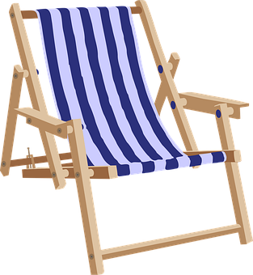
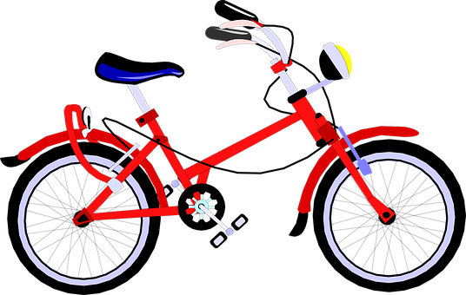
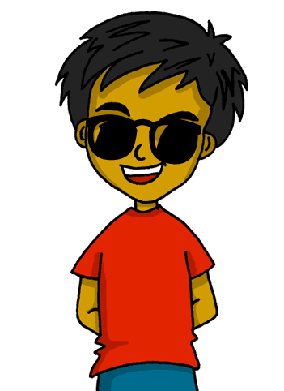
Expressing likes and saying what I and others do
Expressing likes and saying what I and others do
amarillo
- -AR & -ER verbs: I, you, s/he
- SSC [b] [v]
Notes:
Artwork by Steve Clarke. All additional pictures selected are available under a Creative Commons license, no attribution required.
The frequency rankings for words that occur in this PowerPoint which have been previously introduced in the resources are given in the SOW (excel document) and in the resources that first introduced and formally re-visited those words.
For any other words that occur incidentally in this PowerPoint, frequency rankings will be provided in the notes field wherever possible.
Phonics: Source: ver [38] abuela [783] Cluster: bajar [484] buscar [179] subir [410] abeja [>5000] avispa [>5000] banco [728] bus [3709] vaca [2775] vela [2247] viento [814]
Vocabulary: buscar [179] organizar [1053] tocar [327] cocina [1214] cada [107] luego [150]
Revisit 1: ciudad [178] color [358] fiesta [796] persona [108] mi [37] tu [53] preferido [n/a]
Revisit 2: tiene [19] unos [6] unas [6] boca [465] cabeza [265] dedo [465] ojo [169] oreja [2095] pie [365]
Frequency of unknown words:
bajar [484] buscar [179] subir [410] abeja [>5000] avispa [>5000] banco [728] bus [3709] sonido [1040] vaca [2775] vela [2247] verano [1139] viento [814]
Source: Davies, M. & Davies, K. (2018). A frequency dictionary of Spanish: Core vocabulary for learners (2nd ed.). Routledge: London

Slide 3
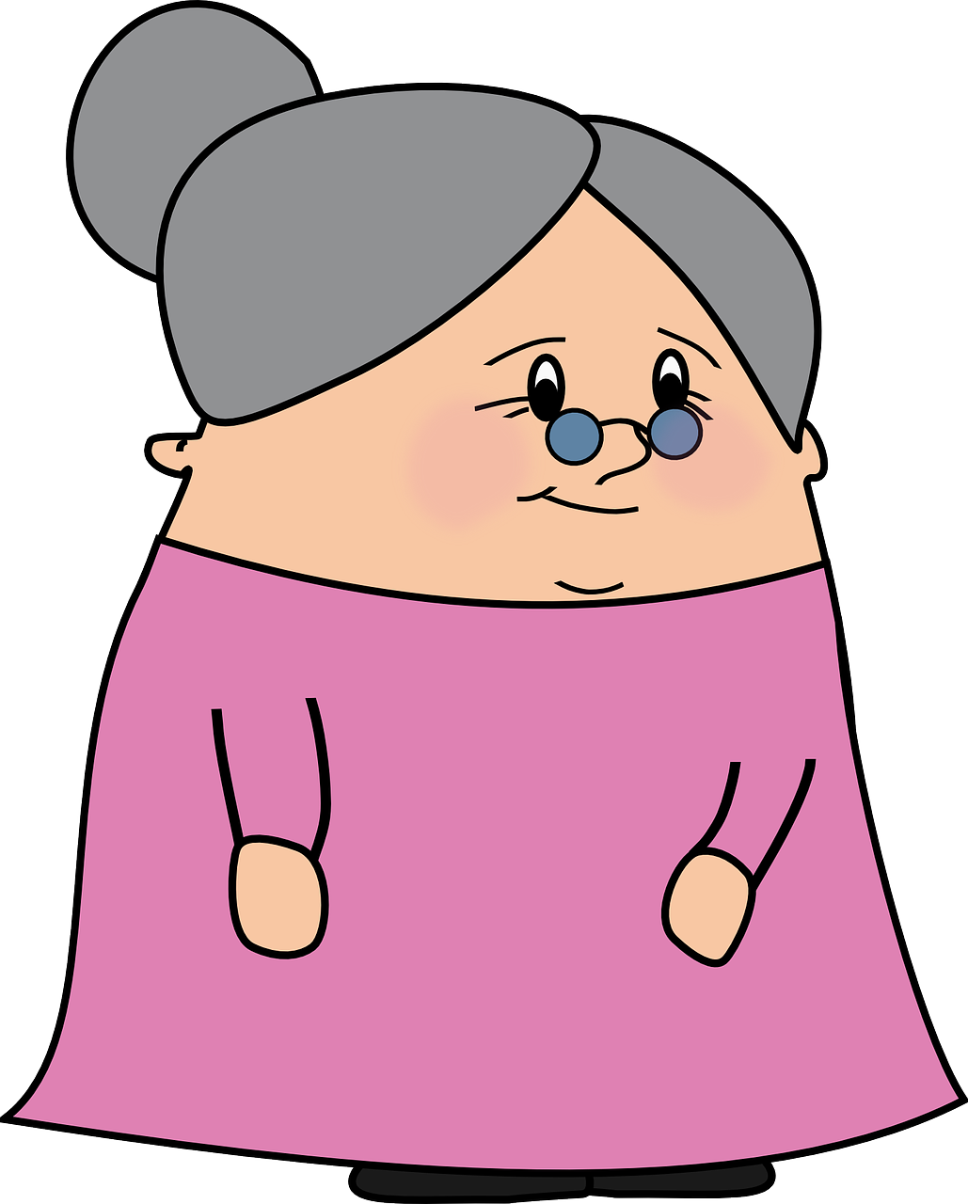
pronunciar
[b]
abuela
Notes:
Timing: 1 minute
Aim: To revisit SSC [b]
Procedure:
To recap and elicit the pronunciation of the individual SSC [b]
Click to bring the picture & get students to repeat (with gesture, if using).
Gesture suggestion: https://www.signbsl.com/sign/grandma
BSL for grandma is placing one loose fist on top of the other briefly (as if you’re starting the song ‘one potato, two potato…’) and then tap the index and middle fingers of the right hand onto the palm of the left hand.

Slide 4
pronunciar
[v]
ver
Notice [v] has the same sound as [b] ☺.
Notes:
Timing: 1 minute
Aim: to revisit SSC [v]
Procedure:
To recap and elicit the pronunciation of the individual SSC [v]
Click to bring the picture & get students to repeat (with gesture, if using).
Gesture suggestion: Point index and middle fingers towards own eyes and then away from the body 2-3 times in quick succession – in a gesture suggesting ‘I have my eye on you’.

Slide 5
pronunciar
[b]
abuela
[v]
ver
¡No!
¿El sonido es diferente?
(el) sonido - sound
Notes:
Timing: 1 minute
Aim: to practise SSC [b] [v]
Procedure:
To recap and elicit the pronunciation of the individual SSC [v] [b]
Click to bring the SSC [b] and elicit the word and picture from pupils.
Repeat with [v]
Click to bring up question ‘¿El sonido es diferente?’ and elicit an answer from pupils.
5. Remind pupils [b] and [v] share the same sound in Spanish.
Frequency of unknown words:
sonido [1040]
Source: Davies, M. & Davies, K. (2018). A frequency dictionary of Spanish: Core vocabulary for learners (2nd ed.). Routledge: London

Slide 6
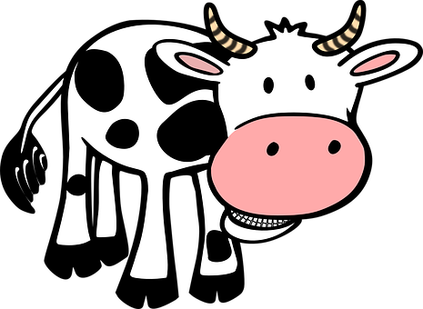
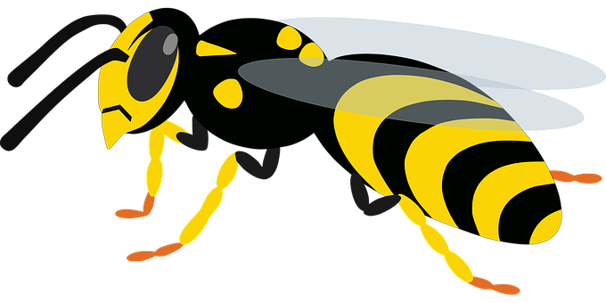
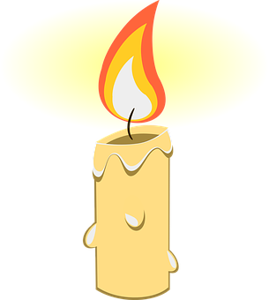
pronunciar
Pronuncia en pareja.
vaca
buscar
abeja
60
bus
banco
celebrar
bajar
avispa
vela
viento
subir
0
INICIO
Notes:
Timing: 3 minutes
Timing: 2 minutes
Aim: to practise SSC [b] [v]
Clarify the context of the task to pupils.
Click to bring up instruction in Spanish and check understanding.
Pupils work in pairs to say out say aloud the words with [b] [v] in order to cross the river. They must make sure they pronounce [b] and [v] correctly (= same sound).
Elicit possible answer from students (there are several combinations).
Click to bring up animations and elicit pronunciation from pupils / whole class.
NB. There is more than one correct path:
NB. Pupils can simply work in pairs to pronounce as many words as they can in 60 seconds.
Frequency of unknown words:
bajar [484] buscar [179] subir [410] abeja [>5000] avispa [>5000] banco [728] bus [3709] vaca [2775] vela [2247] viento [814]
Source: Davies, M. & Davies, K. (2018). A frequency dictionary of Spanish: Core vocabulary for learners (2nd ed.). Routledge: London

Slide 7
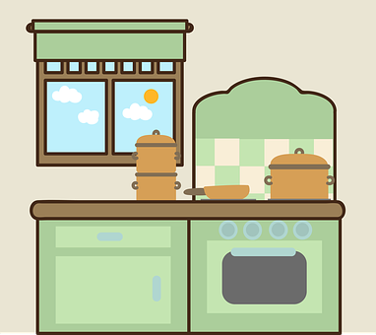
palabras
¿Cómo es en español?
normalmente
siempre
la cocina
la tarde
cada
tocar
organizar
luego
¿Qué palabra no está 👀?
To mean ‘to play’ a sport, Spanish uses a different verb ‘jugar’.
to organise, organising
afternoon, evening
to play, playing
kitchen
normally
each
then, later
always
Notes:
Timing: 5 minutes
Aim: to present and practise written comprehension and read aloud of three items of previously taught vocabulary that we revisit this week and the five new words.
Procedure: 1. Click for an English item. Elicit pronunciation of the Spanish from pupils.
2. In the audio version, the wave animation triggers the audio. (If the sound cuts out half way through the word just rewind the animation and replay and it will work).
3. Continue with the remaining items.

Slide 8
Saying who does what
[-ar & -er verbs: I, you, s/he]
We have learnt that in Spanish, The verb ending changes to indicate the person who is talking.
Whereas –er verbs all have an –e’ in common.
To refer to ‘I’, the ending is the same.
-ar
-er
Organizo una fiesta.
Leo mensajes.
I organise a party.
They all have an –a’ in common.
I read messages.
Organizas una fiesta.
Lees mensajes.
You organise a party.
You read messages.
Organiza una fiesta.
Lee mensajes.
S/he organises a party.
S/he reads messages.
Notes:
Timing: 4 minutes
Aim: to revisit singular persons of –ar and –er verbs.
Procedure:
Click through the animations to present the information.
Elicit English translations for the Spanish examples provided.

Slide 9
leer
Lee las frases ¿Qué persona es?
hablar
E
Toco un instrumento.
yo
tú
él,ella
Notes:
Timing: 3 minutes (6 slides)
Aim: to recognise the correct verb ending for singular persons of –ar verbs.
Procedure:
Introduce the task.
Click to bring the sentence, and focus pupils attention to the verb in bold.
Elicit response from pupils.
There are 5 sentences in total, plus the example.

Slide 10
leer
[1/5]
Lee las frases ¿Qué persona?
Lee las frases ¿Qué persona es?
hablar
1
Aprende palabras nuevas.
yo
tú
él,ella
Notes:
Timing: 3 minutes
Aim: to recognise the correct verb ending for singular persons of –ar verbs.
Procedure:
Introduce the task.
Click to bring the sentence, and focus pupils attention to the verb in bold.
Elicit response from pupils.
There are 5 sentences in total, plus the example.

Slide 11
leer
[2/5]
Lee las frases ¿Qué persona?
Lee las frases ¿Qué persona es?
hablar
2
Descansas en la cocina.
yo
tú
él,ella
Notes:
Timing: 3 minutes
Aim: to recognise the correct verb ending for singular persons of –ar verbs.
Procedure:
Introduce the task.
Click to bring the sentence, and focus pupils attention to the verb in bold.
Elicit response from pupils.
There are 5 sentences in total, plus the example.

Slide 12
leer
[3/5]
Lee las frases ¿Qué persona?
Lee las frases ¿Qué persona es?
hablar
3
Lees un libro.
yo
tú
él,ella
Notes:
Timing: 3 minutes
Aim: to recognise the correct verb ending for singular persons of –ar verbs.
Procedure:
Introduce the task.
Click to bring the sentence, and focus pupils attention to the verb in bold.
Elicit response from pupils.
There are 5 sentences in total, plus the example.

Slide 13
leer
[4/5]
Lee las frases ¿Qué persona?
Lee las frases ¿Qué persona es?
hablar
4
Organiza una fiesta.
yo
tú
él,ella
Notes:
Timing: 3 minutes
Aim: to recognise the correct verb ending for singular persons of –ar verbs.
Procedure:
Introduce the task.
Click to bring the sentence, and focus pupils attention to the verb in bold.
Elicit response from pupils.
There are 5 sentences in total, plus the example.

Slide 14
leer
[5/5]
Lee las frases ¿Qué persona?
Lee las frases ¿Qué persona es?
hablar
5
Veo a mi familia.
yo
tú
él,ella
Notes:
Timing: 3 minutes
Aim: to recognise the correct verb ending for singular persons of –ar verbs.
Procedure:
Introduce the task.
Click to bring the sentence, and focus pupils attention to the verb in bold.
Elicit response from pupils.
There are 5 sentences in total, plus the example.

Slide 15
escuchar
En verano 🌞
Quique habla con Rubén.
¿Quién es?
¿Rubén o Ángela?
 | (tú) Rubén | (ella) Ángela
 | (tú) Rubén | (ella) Ángela
E
3
 | (tú) Rubén | (ella) Ángela
 | (tú) Rubén | (ella) Ángela
🕶
1
4
 | (tú) Rubén | (ella) Ángela
 | (tú) Rubén | (ella) Ángela
2
5
Notes:
Timing: 5 minutes
Aim: aural recognition the correct verb ending for singular persons of –ar & -er verbs; aural comprehension of vocabulary.
Procedure:
Introduce the task and do the example with them. At this stage pupils focus on recognising the person of the verb and whether it is 2nd or 3rd person.
Click to bring up answers.
Move to next slide to complete part two (comprehension). .
Transcript
E. Visita a la abuela en casa.
1. Paseas por la ciudad con mamá.
2. Buscas plantas por el campo.
3. Lees una revista de España.
4. Aprende los colores en inglés.
5. Ve las notícias el viernes.

Slide 16
escuchar
En verano 🌞
verano = summer
¿Qué actividad es?
 | verbo
 | She
 | You
 | You
 | You
 | She
 | She
Información extra
friend|grandma
in the countryside | in the cirty
plants | flowers
a song | a magazine
the cards | the colours
the news| the festival
visits
at home | in the square
with mum | dad
in the mountain | countryside
about Perú | Spain
in Spanish | English
on Sunday | Friday
E
1
go for a walk
2
look for
3
read
4
learns
5
watches
Notes:
Timing: 7 minutes
Aim: aural recognition the correct verb ending for singular persons of –ar & -er verbs; aural comprehension of vocabulary.
Procedure:
Introduce the task and do the example with them. At this stage pupils focus on understanding more information about each sentences.
Pupils write the meaning of the verb and can select any extra info they pick up.
Click to bring up answers.
Transcript
E. Visita a la abuela en casa.
1. Paseas por la ciudad con mamá.
2. Buscas plantas por el campo.
3. Lees una revista de España.
4. Aprende los colores en inglés.
5. Ve las notícias el viernes.
Frequency of unknown words:
verano [1139]
Source: Davies, M. & Davies, K. (2018). A frequency dictionary of Spanish: Core vocabulary for learners (2nd ed.). Routledge: London

Slide 17
¡adiós!
amarillo

