Slide 1
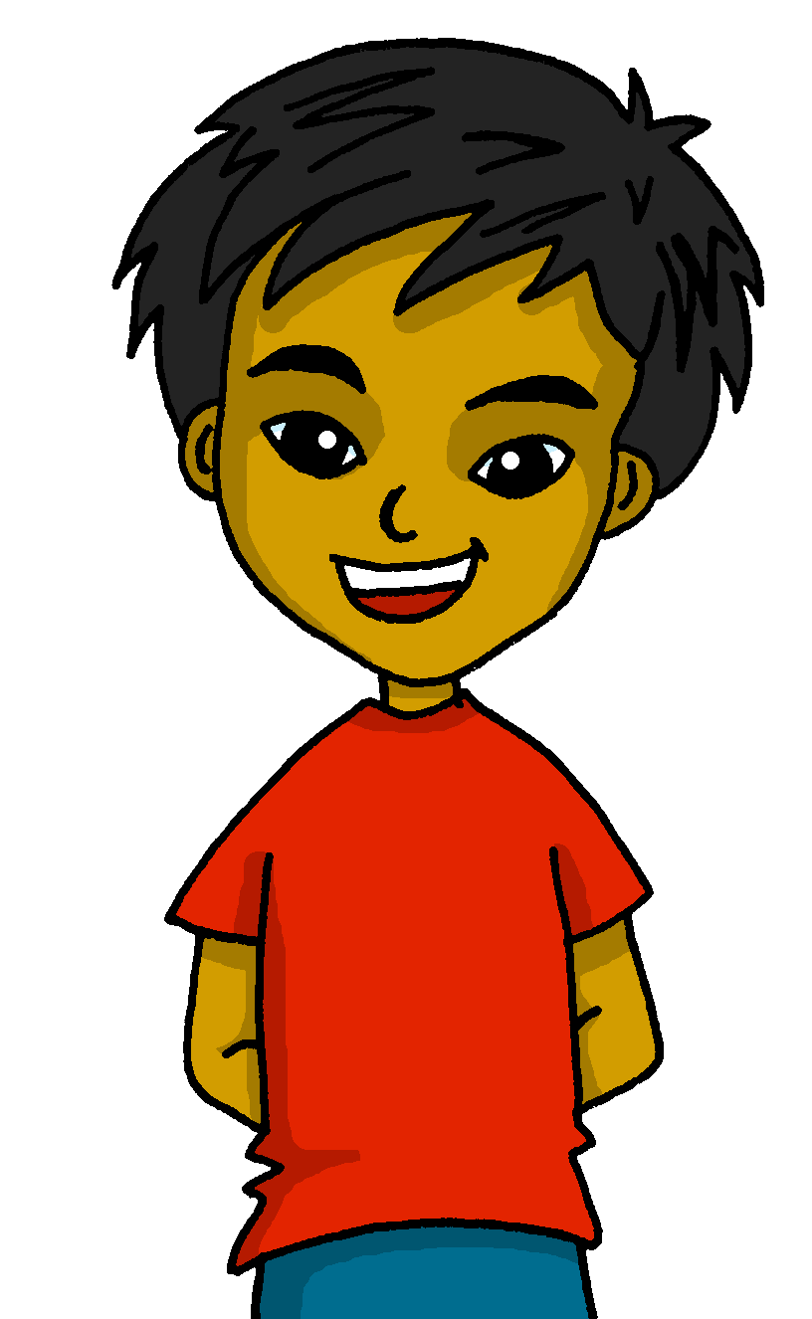
español, con Quique

Slide 2
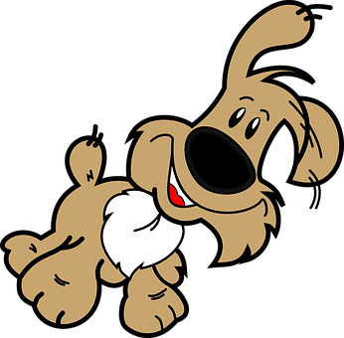
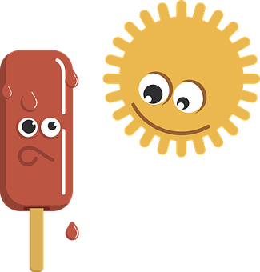
Describing things and people
💗
💗
💗
💗
💗
💗
💗
💗
💗
💗
💗
💗
💗
💗
💗
💗
amarillo
💗
- Definite articles
(el, la, los, las)
- Opinion (odiar, amar)
- SSC [r] [rr]
Notes:
Artwork by Steve Clarke. All additional pictures selected are available under a Creative Commons license, no attribution required.
The frequency rankings for words that occur in this PowerPoint which have been previously introduced in the resources are given in the SOW (excel document) and in the resources that first introduced and formally re-visited those words.
For any other words that occur incidentally in this PowerPoint, frequency rankings will be provided in the notes field wherever possible.
Phonics: [r]|[rr] Source: parar [706] correr [343] Cluster: caro [2179] carro [1857] pera [>5000] perra [888]
Vocabulary: amar [700] odiar [2211] las [1] los [1] carta [627] domingo [693] lunes [1370] museo [1114] parque [1354] viernes [1259] difícil [374] fácil [584]
Revisit 1: él [9] ella [72] tú [184] yo [28] chico [727] chica [1159] débil [1946] fuerte [435] grande [66] independiente [1177] pero [30]
Revisit 2: uno [425] dos [64] tres [134] cuatro [241] cinco [284] seis [438] siete [603] ocho [641] nueve [991] diez [449] once [1700] doce [1138]
Source: Davies, M. & Davies, K. (2018). A frequency dictionary of Spanish: Core vocabulary for learners (2nd ed.). Routledge: London

Slide 3
pronunciar
[r]
parar
Notes:
Timing: 1 minute
Aim: To introduce SSC [r]
Procedure:
To recap and elicit the pronunciation of the individual SSC [r].
Click to bring up the picture and get students to repeat (with gesture, if using).
Gesture suggestion: hold one hand up, palm open and facing away, to signal ‘stop’.

Slide 4
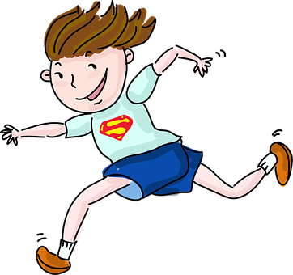
pronunciar
[rr]
correr
Notes:
Timing: 1 minute
Aim: To revisit SSC [rr].
Procedure:
To recap and elicit the pronunciation of the individual SSC [rr].
Click to bring the picture & get students to repeat (with gesture, if using).
Gesture suggestion: Using index and middle fingers to be ‘legs’ mime a fast running movement, moving the hand from right to left across the body.

Slide 5
palabras
¿Cómo es en español?
difícil
el museo
fácil
la tarde
supercalifragilisticoespialidoso
1+1 = 2
amar
el calor
odiar
el español
to love, loving
difficult
Spanish
afternoon
to hate, hating
museum
heat
easy
Notes:
Timing: 5 minutes
Aim: to present and practise written comprehension and read aloud of four items of previously taught vocabulary that we revisit this week and the four new words.
Procedure: 1. Click for an English item. Elicit pronunciation of the Spanish from pupils.
2. Click to highlight the answer. (In the audio version, this triggers the audio).
3. Continue with the remaining items.

Slide 6
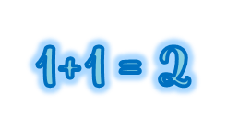
palabras
¿Qué palabra es?
el mu | la tar | fá | di
am | el ca | el espa | o
seo | de | ar | lor
ñol | diar | fícil | cil
60s
pm
odiar
la tarde
difícil
fácil
el español
el museo
amar
b
d
g
pm
1+1 = 2
a
el calor
c
f
h
i
supercalifragilisticoespialidoso
START
Notes:
Timing: 5 minutes
Aim: to present and practise written comprehension and read aloud of three items of previously taught vocabulary that we revisit this week and the four new words.
Procedure: 1. Pupils work in pairs to match up the syllables in order to say the Spanish words introduced and practised in the previous slide. Draw their attention to pictures a-i to help them.
2. Click to make the pictures disappear and elicit the Spanish word for the pictures that will appear on click.

Slide 7
Singular and plural definite articles
[the]
We have learned that to say the before a singular noun, you use ‘el’ or ‘la’, depending on whether the noun is masculine or feminine.
Masculine
Feminine
el
museo
the museum
la
fiesta
the festival
To say ‘the’ before a plural noun (more than one), use ‘los’ or ‘las’.
los
museos
the museums
las
fiestas
the festivals
Notes:
Timing: 4 minutes
Aim: to introduce plural form of definite articles, building in prior knowledge of singular definite articles.
Procedure:
Read the grammar explanation on singular definite articles.
Click to bring up examples and elicit English meanings.
Introduce the plural definite articles.
Click to bring up examples and elicit English meanings.

Slide 8
hablar
[1/8]
Clasifica las palabras.
leer
1
las
la planta → ______ plantas
masculine
feminine
los
las
Notes:
Timing: 5 minutes (8 slides)
Aim: to use the correct plural definite article with a range of previously introduced nouns and new vocabulary from this week.
Procedure:
Introduce the task.
Click to bring noun with definite article and encourage the correct plural form from pupils.
There are 8 nouns in total.

Slide 9
hablar
[2/8]
Clasifica las palabras.
leer
2
los
el hermano → ______ hermanos
masculine
feminine
los
las
Notes:
[2/8]

Slide 10
hablar
[3/8]
Clasifica las palabras.
leer
3
los
el caballo → ______ caballos
masculine
feminine
los
las
Notes:
[3/8]

Slide 11
hablar
⚠ Remember that nouns that en in –e can be either masculine or feminine.
[4/8]
Clasifica las palabras.
leer
4
las
la tarde → ______ tardes
masculine
feminine
los
las
Notes:
[4/8]

Slide 12
hablar
[5/8]
Clasifica las palabras.
leer
5
los
el sábado→ ______ sábados
masculine
feminine
los
las
Notes:
[5/8]

Slide 13
hablar
[6/8]
Clasifica las palabras.
leer
6
los
el bocadillo → ______ bocadillos
masculine
feminine
los
las
Notes:
[6/8]

Slide 14
hablar
[7/8]
Clasifica las palabras.
leer
7
los
el lunes → ______ lunes
masculine
feminine
los
las
Notes:
[7/8]

Slide 15
hablar
[8/8]
Clasifica las palabras.
leer
8
las
la fruta→ ______ frutas
masculine
feminine
los
las
Notes:
[8/8]

Slide 16
Giving your opinion
In English, we often don’t translate the article (e.g., ‘I love birthdays’).
[amar, odiar]
We use the definite article after opinion verbs (amar, odiar).
Amo los cumpleaños.
Odio los lunes.
I love birthdays.
I hate Mondays.
Notice that in English, the verb also changes when referring to s/he, it ☺.
To mean ‘s/he, it’ with ‘odiar’ and ‘amar’, we remove –ar and add –a.
Ama la clase.
Odia el frío.
S/he loves the classroom.
S/he hates the cold.
Notes:
Timing: 4 minutes
Aim: to introduce 2 opinion verbs in 1st and 3rd person singular; to introduce the use of articles with opinion verbs.
Procedure:
Click through the animations to present the information.
Elicit English translations for the Spanish examples provided.

Slide 17
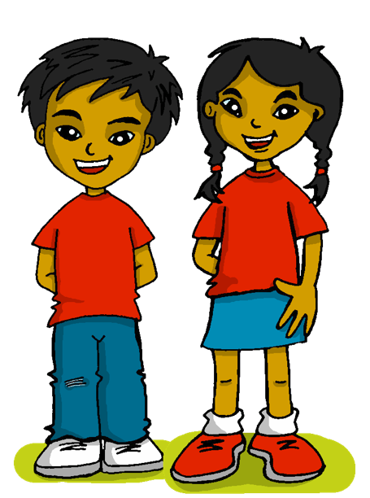
escuchar
Quique habla.
¿Qué opina? Escribe 💗 o 😖.
¿Es Sofía o Quique? Marca ✅
[1-5]
hablar
Sofía (she) | Quique (I)
Sofía (she) | Quique (I)
E
3
Sofía (she) | Quique (I)
Sofía (she) | Quique (I)
1
4
Sofía (she) | Quique (I)
Sofía (she) | Quique (I)
2
5
Notes:
Timing: 8 minutes [Part 1 ]
Aim: aural recognition of amar and odiar, linking with the right person.; aural comprehension of vocabulary.
Procedure:
Introduce the task and do the example with them. At this stage pupils focus on recognising the person of the verb and whether it is amar or odiar.
Move to next slide to complete part two (vocab comprehension). .
Transcript
E Amo los libros.
1 Odia el verde.
2 Amo las fiestas.
3 Ama el calor.
4 Ama la clase de español
5 Odio las tardes.

Slide 18
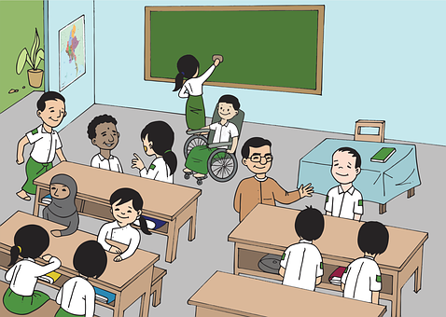
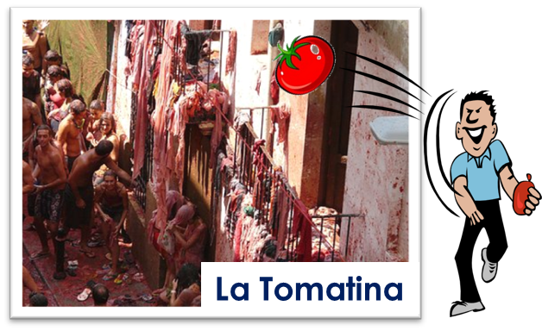
escuchar
Quique habla.
Escucha. Escribe la palabra.
hablar
 | Amo ____________ .
 | Odia ____________ .
 | Amo ____________ .
 | Ama ____________ .
 | Ama ____________ .
 | Odio ____________ .
E
los libros
3
4
1
el verde
E
a
b
c
¡hola!
2
las fiestas
3
el calor
2
1
4
la clase
5
pm
d
e
f
5
las tardes
Notes:
Timing: 8 minutes [Part 2]
Aim: aural recognition of amar and odiar, linking with the right person; aural comprehension of vocabulary.
Procedure:
Introduce the task.
Encourage pupils to write the words. Alternatively, they can write the letters (a-f).
Teachers can also elicit English translations to reinforce the noticing of the missing article in some of the English sentences.
Transcript:
E Amo los libros.
1 Odia el verde.
2 Amo las fiestas.
3 Ama el calor.
4 Ama la clase de español
5 Odio las tardes.

Slide 19
adiós
¡adiós!
adiós
amarillo

