Slide 1


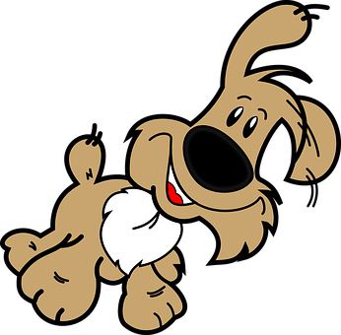


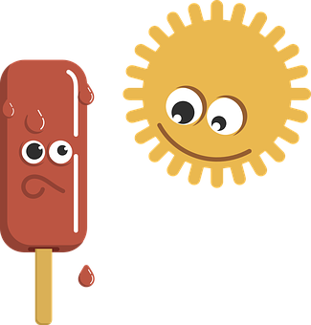



Describing things and people
Mi
💗
💗
💗
💗
💗
💗
💗
💗
💗
💗
💗
💗
💗
💗
💗
💗
amarillo
💗
Follow ups 1-5
Notes:
Artwork by Steve Clarke. All additional pictures selected are available under a Creative Commons license, no attribution required.
The frequency rankings for words that occur in this PowerPoint which have been previously introduced in the resources are given in the SOW (excel document) and in the resources that first introduced and formally re-visited those words.
For any other words that occur incidentally in this PowerPoint, frequency rankings will be provided in the notes field wherever possible.
Artwork by Steve Clarke. All additional pictures selected are available under a Creative Commons license, no attribution required.
The frequency rankings for words that occur in this PowerPoint which have been previously introduced in the resources are given in the SOW (excel document) and in the resources that first introduced and formally re-visited those words.
For any other words that occur incidentally in this PowerPoint, frequency rankings will be provided in the notes field wherever possible.
Phonics: [r]|[rr] Source: parar [706] correr [343] Cluster: caro [2179] carro [1857] pera [>5000] perra [888]
Vocabulary: amar [700] odiar [2211] las [1] los [1] carta [627] domingo [693] lunes [1370] museo [1114] parque [1354] viernes [1259] difícil [374] fácil [584]
Revisit 1: él [9] ella [72] tú [184] yo [28] chico [727] chica [1159] débil [1946] fuerte [435] grande [66] independiente [1177] pero [30]
Revisit 2: uno [425] dos [64] tres [134] cuatro [241] cinco [284] seis [438] siete [603] ocho [641] nueve [991] diez [449] once [1700] doce [1138]
Frequency of unknown words and cognates:
dar [42] decir [31] arroz [2882] barril [>5000] burro [4626] carro [1857] ferrocarril [3222] guitarra [2705] tierra [259] aburrido [3917] su [12]
Source: Davies, M. & Davies, K. (2018). A frequency dictionary of Spanish: Core vocabulary for learners (2nd ed.). Routledge: London

Slide 2







Follow up 1:
[r] [rr]
Escucha. ¿Es una ‘r’ o dos (‘rr’)?
escuchar
30s
 | guita __ a
 | a __ oz
 | pe __ o
 | a __ aña
 | ba __ il
 | a __ iba
 | abu __ ido
E
rr
Practica con tu compañero/a.
1
rr
2
r
3
r
4
rr
5
rr
rr
🥱
0
6
START
Notes:
Timing: 5 minutes
Aim: to practise applying knowledge of [r] [rr] to known and unknown words.
Procedure:
Click to bring up the instruction.
Click to bring table and do example together (E).
Students write the correct sound [r] [rr]
Part B
Procedure:
Read the instruction in Spanish.
3. Click on ‘inicio’ to start the timer.
4. Pupils work in pairs to read the words.
Transcript
E. Guitarra
Arroz
Pero
Araña
Barril
Arriba
aburrido

Slide 3


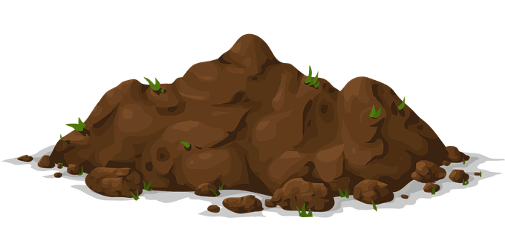

Follow up 1:
[A] Escucha y canta 🎤.
[B] Completa las frases.
hablar
escuchar
Erre con erre _____________.
Erre con erre _________.
Corriendo van los carros por el ferrocarril. [x2]
Este carro lleva ______, ______, _____.
Este carro lleva ______, ______, _____.
Todo el mundo ______, ______, ______.
Todos hagan como un _____, _____, _____.
Todos hagan como un _____, _____, _____.
Todos cara de _______, _______, _______.
Todo el mundo ______, ______, ______.
guitarra
barril
Corriendo van los carros por el ferrocarril. [x2]
arroz
arroz
arroz
tierra
tierra
tierra
arriba
arriba
arriba
perro
perro
perro
(el) ferrocarril = railway
(el) carro = carriage, car (Lat. Am.)
burro
burro
burro
aburrido
aburrido
aburrido
🥱
arriba
arriba
arriba
Notes:
Timing: 5 minutes
Aim: to revisit [rr] sound.
Procedure:
Read and clarify the instruction.
Listen once for pupils to appreciate and become familiar with the rhythm
Listen one more time and encourage pupils to sing along
Frequency of unknown words:
arroz [2882] barril [>5000] burro [4626] carro [1857] ferrocarril [3222] guitarra [2705] tierra [259] aburrido [3917]
Source: Davies, M. & Davies, K. (2018). A frequency dictionary of Spanish: Core vocabulary for learners (2nd ed.). Routledge: London
Video source:
https://www.youtube.com/watch?v=e0QmByznBXE&ab_channel=123Andr%C3%A9s

Slide 4
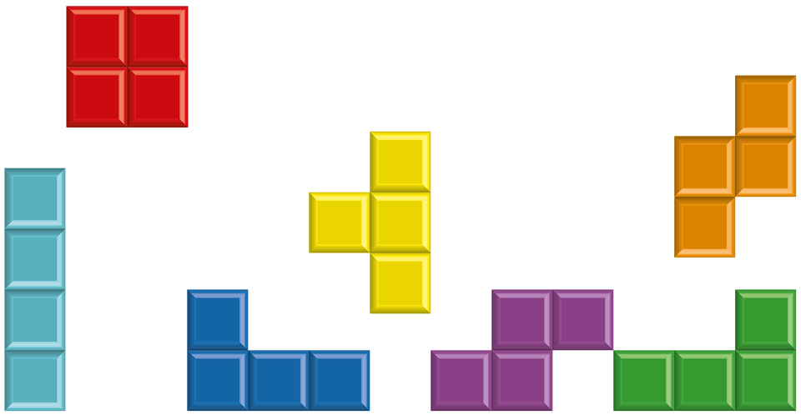

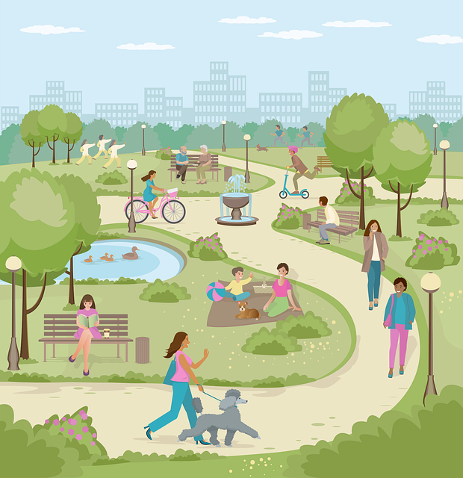
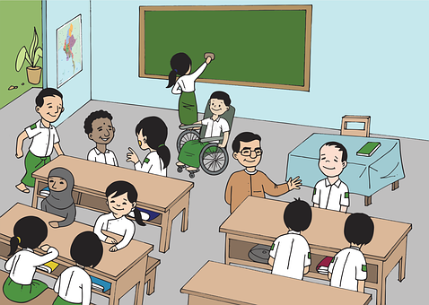



Follow up 2a
Lee la palabra.
Ahora, escribe en inglés.
hablar
palabras
¿el, la, los o las?
pm
____ libros
____ parques
____ clase
____ tarde
Friday
____ viernes
amar
odiar
____ español
Notes:
Timing: 5 minutes
(There is a faster version of the same activity on the next slide)
Aim: to practise spoken production of the Spanish words (including the article) within a limited time; to practise written comprehension of the vocabulary (by replaying the slide).
Procedure:
Explain to pupils that they need to say all the Spanish words with the correct word for the before they are covered.
Click to start the animation sequence (but don’t click again until it is finished).
Go back and replay the slide. This time, pupils write down the English translations of each word before they are covered.
Use slide 6 to check answers.

Slide 5

Follow up 2b
Súper rápido
Lee la palabra.
Ahora, escribe en inglés.
hablar
palabras
¿el, la, los o las?
pm
____ libros
____ parques
____ clase
____ tarde
Friday
____ viernes
amar
odiar
____ español
Notes:
Timing: 5 minutes [A faster version of the previous task]
Aim: to practise spoken production of the Spanish words (including the article) within a limited time; to practise written comprehension of the vocabulary (by replaying the slide).
Procedure:
Explain to pupils that they need to say all the Spanish words with the correct word for the before they are covered.
Click to start the animation sequence (but don’t click again until it is finished).
Go back and replay the slide. This time, pupils write down the English translations of each word before they are covered.
Use slide 5 to check answers.

Slide 6
Follow up 2:
Respuestas
hablar
palabras
pm
los libros
los parques
la clase
la tarde
(parks)
(classroom)
(afternoon)
(books)
Fridays
los viernes
amar
odiar
el español
(to love, loving)
(to hate, hating)
(Spanish)
Notes:
ANSWERS
Procedure:
Click to reveal the English for pupils to check.
After each, elicit the Spanish orally from pupils for additional practice.
Click to reveal.

Slide 7


Follow up 3:
Knowing whose opinion it is
[amar | odiar: ‘I’,‘you’ & ‘she’]
Remember, to mean ‘I’, ‘s/he,it’ or ‘you’ with a verb, the verb ending changes.
I
S/he, it
you
Amo el español.
Ama el español.
Amas el español.
I love Spanish.
S/he loves Spanish.
You love Spanish.
Remember!
In English we often don’t need an article (the) after opinion verbs. In Spanish we always do.
Notes:
Timing: 10 minutes in total (2 slides) Grammar info (3 minutes) + reading task (7 minutes)
Aim: to revisit singular persons in the present tense for –ar verbs using amar and odiar.
Procedure:
Click through the animations to present the new information.
Elicit English translations for the Spanish examples provided.

Slide 8




Follow up 3
Lee los mensajes. ¿Qué persona es?
Remember!
We use ‘a’ after the verb with a person, or an animal we are fond of.
I
leer
E
Ama los sábados.
you
s/he
I
3
I
1
Odias la clase de inglés. Es difícil.
Amas a tu abuelo.
you
you
s/he
s/he
2
I
4
I
  Odia los bocadillos.
Odio los museos.
you
you
s/he
s/he
Notes:
Timing: 5 minutes
Aim: to recognise singular persons in the present tense for –ar verbs using amar and odiar.
Procedure:
Read the context. Tell students Quique is receiving messages from different friends.
Read the first message. Ask pupils to identify amar (is it to hate or to love?). Then they need to identify the person it refers to.
Click to reveal the answer.
Continue with items 2 – 4.
Teachers can also elicit Engilsh translation to reinforce the absence of article in some of the English sentences.

Slide 9

Follow up 4:
Quique da su opinión [1/6]
da – s/he gives
su - her
dice – s/he says
escribir
¿Qué dice? Escribe la frase en español.
1
¡Hola!
¡Es fácil! 😍
Amo la clase de español.
Notes:
Timing: 5 minutes
Aim: to practise spoken production of amar / odiar in the singular persons.
Procedure:
Do number 1 with pupils to model the task.
Click to reveal the answer.
Give pupils 30 seconds to say / practise the next sentence with a partner.
Elicit the sentence from the whole class chorally, then click to confirm.
Repeat steps 3-4 for the remaining sentences.
Frequency of unknown words and cognates:
dar [42] su [12] decir [31]
Source: Davies, M. & Davies, K. (2018). A frequency dictionary of Spanish: Core vocabulary for learners (2nd ed.). Routledge: London

Slide 10
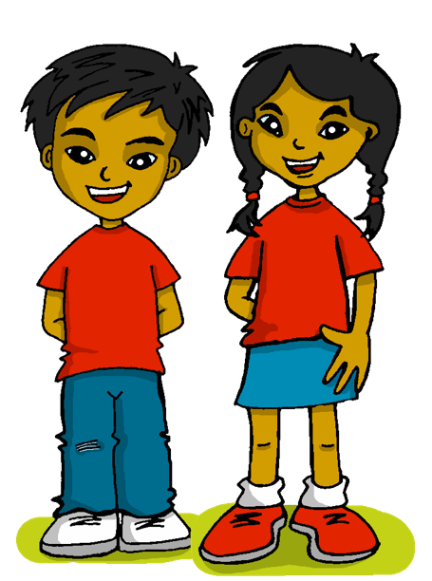
Follow up 4:
Quique da su opinión [2/6]
da – s/he gives
su - her
dice – s/he says
escribir
2
Saturdays
Ama los sábados.

Slide 11


Follow up 4:
Quique da su opinión [3/6]
da – s/he gives
su - her
dice – s/he says
escribir
3
you
Amas los mercados.

Slide 12
Follow up 4:
Quique da su opinión [4/6]
da – s/he gives
su - her
dice – s/he says
escribir
4
Odia los libros en español.

Slide 13
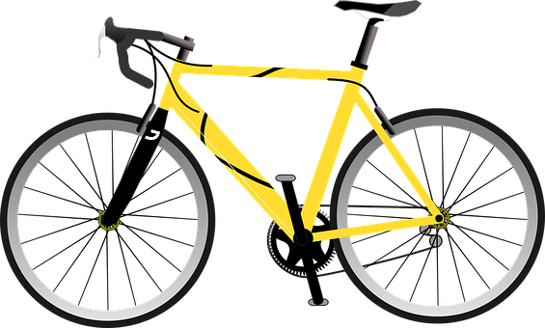
Follow up 4:
Quique da su opinión [5/6]
da – s/he gives
su - her
dice – s/he says
escribir
5
you
Odias las bicicletas.

Slide 14


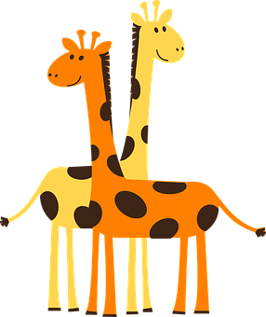
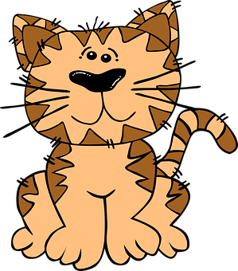

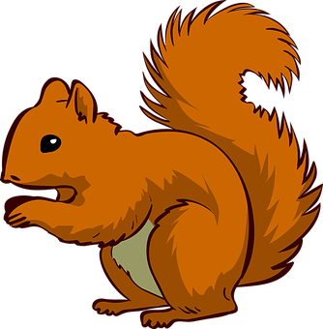
Follow up 4:
Quique da su opinión [6/6]
da – s/he gives
su - her
dice – s/he says
escribir
6
Ama los animales.

Slide 15
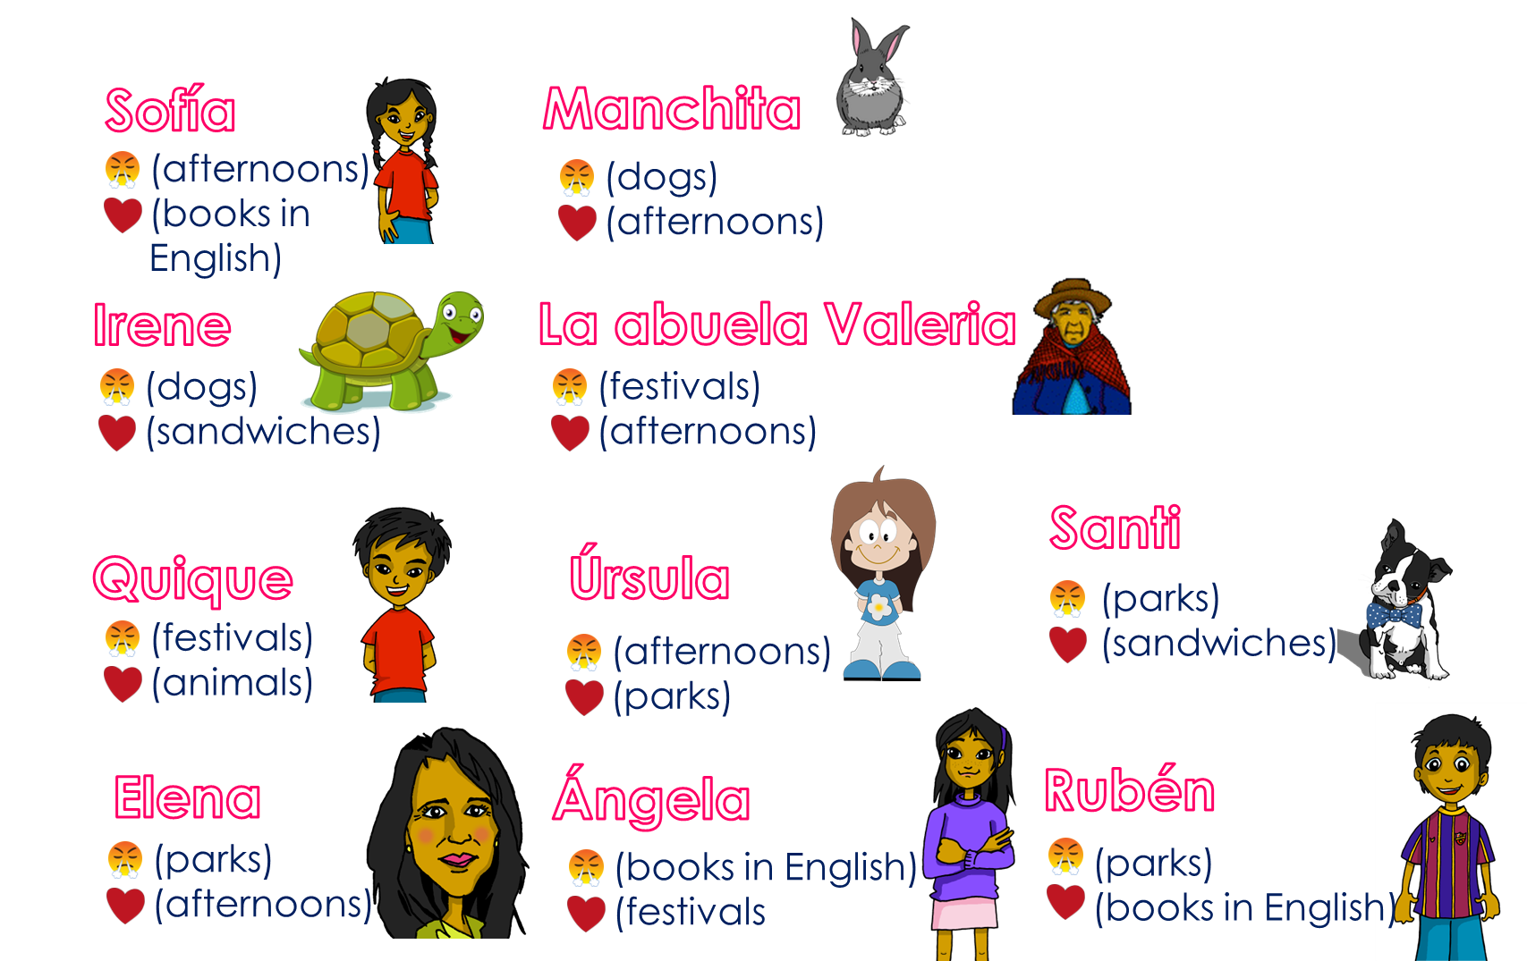
Follow up 5
Ask and guess!
Ask your partner questions to guess their secret character.
hablar
¡Eres Manchita!
60
s
Odias [las fiestas] ?
Odias [los parques] ?
¿Odias [las tardes] ?
¿Amas [las tardes] ?
No…
No…
No…
¡Sí!
0
INICIO
Notes:
Time: 8-10 minutes
Aim: To use raised intonation and adjectival agreement in oral production to guess their partner’s characters.
Read the title in Spanish and click to bring a brief explanation of the instructions.
Tell students they are going to work in pairs. Partners take it in turns to ask yes/no questions to try to figure out the other player’s character. The partner guessing needs to use amar and odiar in the 2nd person singular and the correct definite article and noun to narrow down their options correctly! Explain this to the pupils - they have to pronounce the adjective correctly, with the correct ending, otherwise their partner cannot guess who they are.
Click x2 to bring the speech bubbles to make sure students are clear about what the exchange should look like (¿Odias ..? / Sí / No).
Click x2 to model an example of how correct adjective ending is key for the task. – read the speech bubbles (“¿Odias las tardes?” / ¡Sí!). Show students on the board how that narrows down their options and click to bring X shape to cover up. Click x2 to trigger the next question now with the adjective in the male form. The response is “Yes” so we now know it’s “Manchita”.
2. Teachers can model another round with the whole class (getting students to ask the questions) before getting them started in pairs.
3. Give students 30 seconds to write down 4 names (mixture of male/female). Click on “Inicio” to trigger timer.
4. The aim is to work with your partner, to identify all 8 people as quickly as possible.
NB. Print the template slide (slide 20) in A5 so that students can cross out as they play.
Nouns used in the task:
las tardes
los libros en inglés
los perros
los bocadillos
las fiestas
los animals
los parques

Slide 16
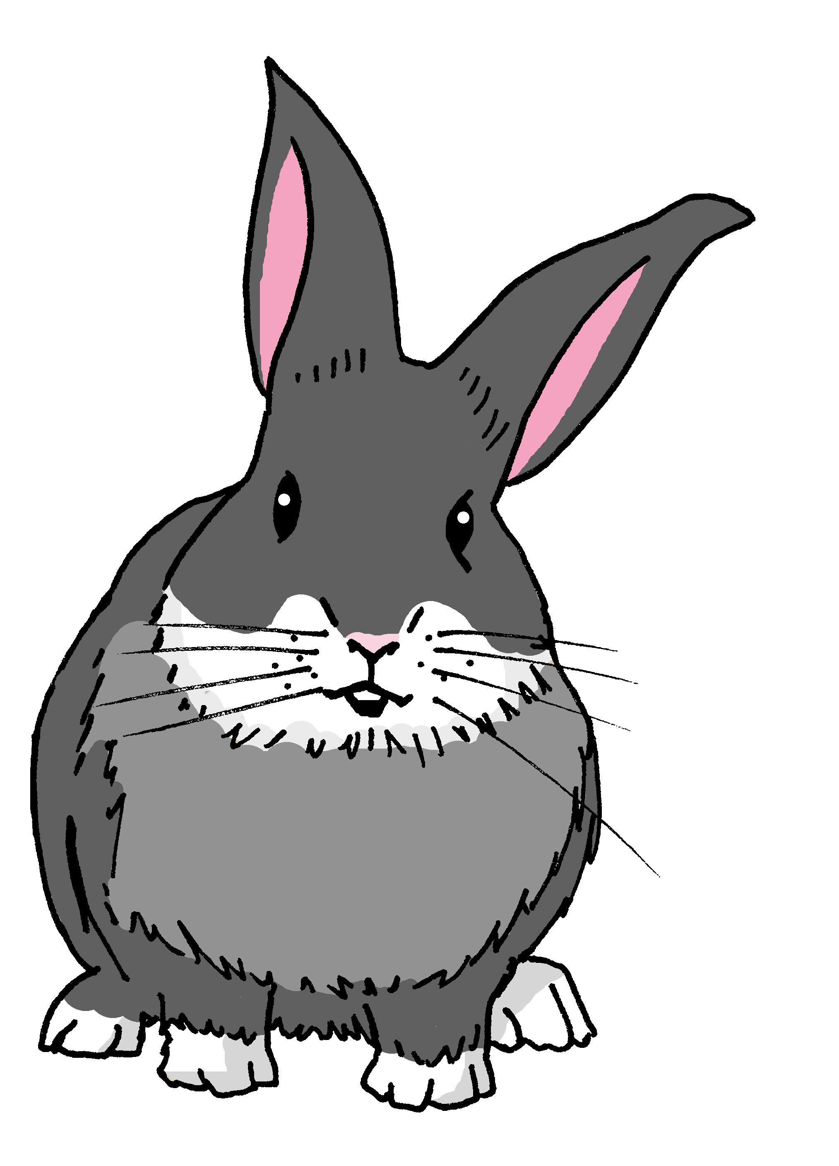

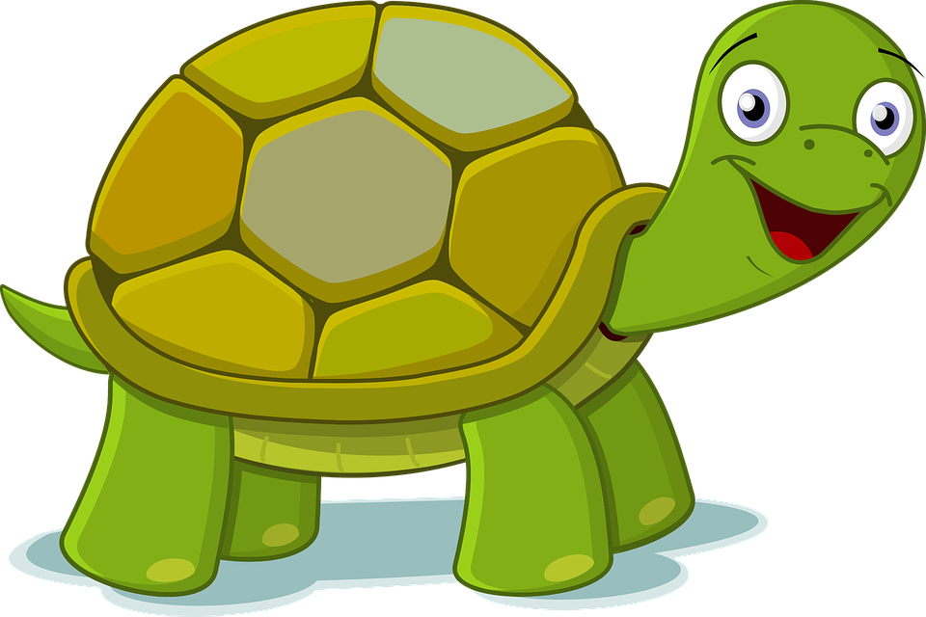

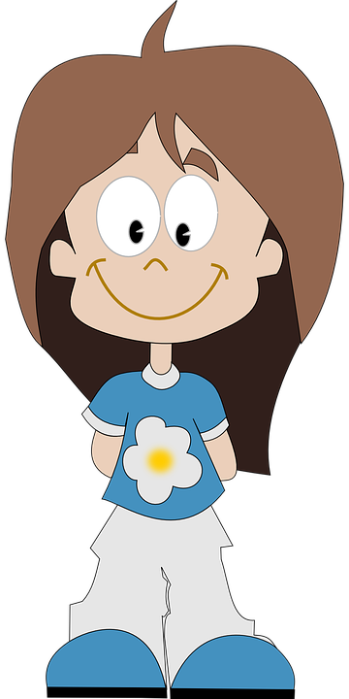
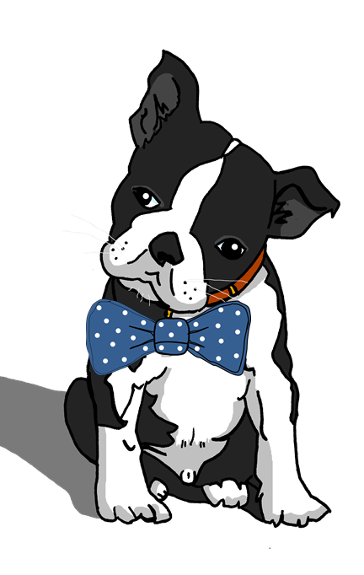
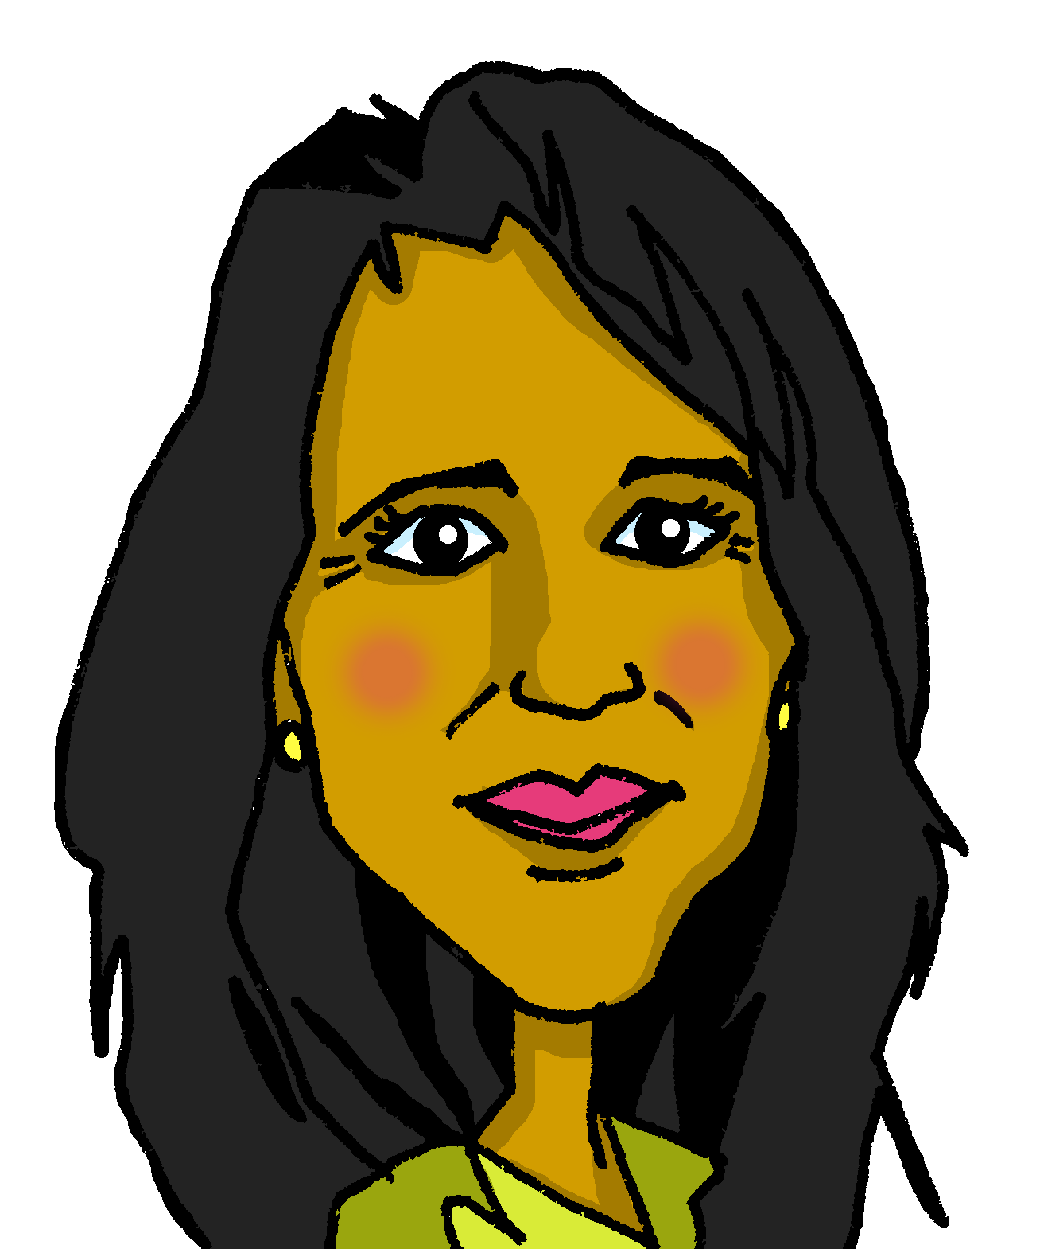
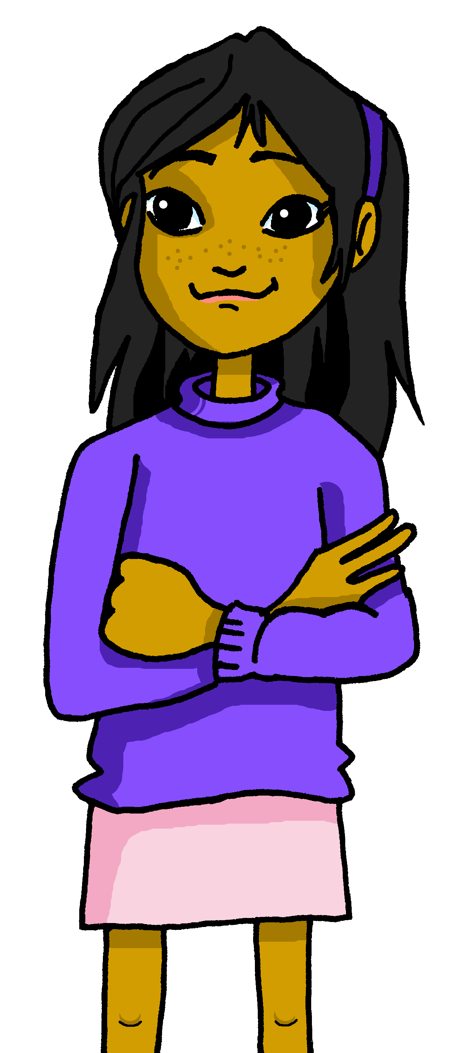
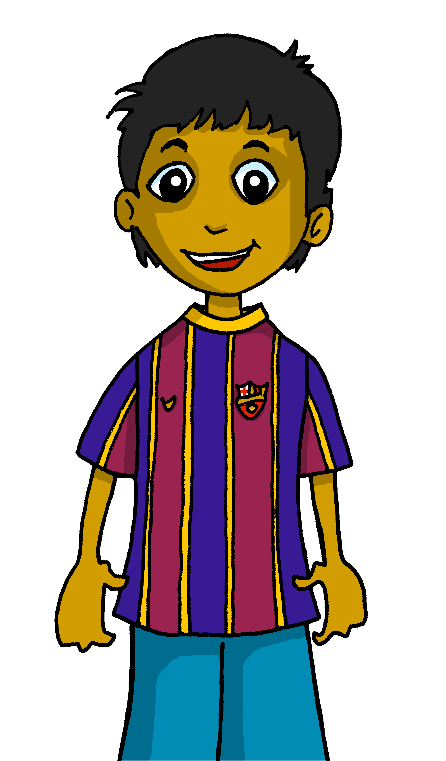
Follow up 5
⚠ Remember the article (el, la, los, las).
¿Amas…?
¿Odias…?
Sofía
Manchita
(afternoons)
(books in English)
(dogs)
(afternoons)
Irene
La abuela Valeria
(dogs)
(sandwiches)
(festivals)
(afternoons)
¡Sí! ¡No!
Odio…
Amo..
Santi
Quique
Úrsula
(parks)
(sandwiches)
(festivals)
(animals)
(afternoons)
(parks)
Elena
Ángela
Rubén
(parks)
(afternoons)
(books in English)
(festivals
(parks)
(books in English)
Notes:
Master slide for guess who game. Print the template slide in A5 so that students can cross out as they play.

Slide 17



Follow up extra [a]:
Escribe en inglés 📝: Can you get at least 15 points?
 | ocho | seis | once
 | doce | nueve | cuatro
 | débil | pero | él
 | ella | tú | fuerte
 | difícil | odiar | los
 | amar | fácil | las
eight
six
eleven
vocabulario
x3
twelve
nine
four
weak
but
he
x2
she
you
strong
difficult
to hate, hating
the (m. pl.)
x1
to love, loving
easy
the (f., pl.)
Notes:
Timing: 5 minutes
Aim: to practise written production of vocabulary from this week and this week’s revisited sets.
Procedure:
1. Give pupils a blank grid. They fill in the English meanings of any of the words they know, trying to reach 15 points in total.
Note:
The most recently learnt and practised words are pink, words from the first revisit are green and those from the second revisit are blue, thus more points are awarded for them, to recognise that memories fade and more effort (heavy lifting!) is needed to retrieve them.

Slide 18
Follow up extra [b]:
Escribe en español 📝: Can you get at least 15 points?
 | nine | eight | four
 | eleven | six | twelve
 | he | you | weak
 | she | strong | but
 | difficult | to love, loving | easy
 | the (f., pl.) | to hate, hating | the (m., pl.)
nueve
vocabulario
ocho
cuatro
x3
once
seis
doce
él
tú
débil
x2
ella
fuerte
pero
difícil
amar
fácil
x1
las
odiar
los
Notes:
Timing: 5 minutes
Aim: to practise written production of vocabulary from this week and this week’s revisited sets.
Procedure:
1. Give pupils a blank grid. They fill in the Spanish meanings of any of the words they know, trying to reach 15 points in total.
Note:
The most recently learnt and practised words are pink, words from the first revisit are green and those from the second revisit are blue, thus more points are awarded for them, to recognise that memories fade and more effort (heavy lifting!) is needed to retrieve them.

Slide 19
¡adiós!
amarillo

Slide 20
Handout: Follow up extra [a]
Escribe en inglés 📝: Can you get at least 15 points?
 | ocho | seis | once
 | doce | nueve | cuatro
 | débil | pero | él
 | ella | tú | fuerte
 | difícil | odiar | los
 | amar | fácil | las
vocabulario
x3
x2
x1
Notes:
Timing: 5 minutes
Aim: to practise written comprehension of vocabulary from this week and this week’s revisited sets.
Procedure:
1. Give pupils a blank grid. They fill in the English meanings of any of the words they know, trying to reach 15 points in total.
Note:
The most recently learnt and practised words are pink, words from the first revisit are green and those from the second revisit are blue, thus more points are awarded for them, to recognise that memories fade and more effort (heavy lifting!) is needed to retrieve them.

Slide 21
Handout: Follow extra [b]
Escribe en español 📝: Can you get at least 15 points?
vocabulario
 | nine | eight | four
 | eleven | six | twelve
 | he | you | weak
 | She | strong | but
 | difficult | to love, loving | easy
 | the (f., pl.) | to hate, hating | the (m., pl.)
x3
x2
x1
Notes:
Timing: 5 minutes
Aim: to practise written production of vocabulary from this week and this week’s revisited sets.
Procedure:
1. Give pupils a blank grid. They fill in the Spanish meanings of any of the words they know, trying to reach 15 points in total.
Note:
The most recently learnt and practised words are pink, words from the first revisit are green and those from the second revisit are blue, thus more points are awarded for them, to recognise that memories fade and more effort (heavy lifting!) is needed to retrieve them.

