Slide 1


español, con Quique

Slide 2





Describing things and people
¡Tengo calor!
¡Tengo frío!
Tengo sueño.
Tengo miedo.
🕷
👻
amarillo
tener
SSC [ñ] vs. [n]
Notes:
Artwork by Steve Clarke. All additional pictures selected are available under a Creative Commons license, no attribution required.
The frequency rankings for words that occur in this PowerPoint which have been previously introduced in the resources are given in the SOW (excel document) and in the resources that first introduced and formally re-visited those words.
For any other words that occur incidentally in this PowerPoint, frequency rankings will be provided in the notes field wherever possible.
Phonics: [ñ]|[n] español [262] mano [135]
Vocabulary: calor [1852] frío [1307] miedo [755] sueño [460]
Revisit 1: cumpleaños [3372] mes [288] enero [1173] febrero [1419] marzo [1231] abril [1064] mayo [909] junio [1035] julio [659] agosto [931] septiembre [1150] octubre [1242] noviembre [1434] diciembre [1165] cuándo [138] mi [37] tu [53] en [5]
Revisit 2: comer [347] hacer, hago, hace [26] responder (a) [464] actividad [344] bocadillo [>5000] ejercicio [1162] naranja [2924] ordenador [2624]
Frequency of unknown words and cognates:
año [46] chaqueta [2428]
Source: Davies, M. & Davies, K. (2018). A frequency dictionary of Spanish: Core vocabulary for learners (2nd ed.). Routledge: London
For any other words that occur incidentally in this PowerPoint, frequency rankings will be provided in the notes field wherever possible.
Picture attribution:
https://emojipedia.org/hot-face/ (CC BY-SA 4.0)

Slide 3




pronunciar
[n]
mano
español
[ñ]
¡hola!
Notes:
Timing: 1 minute
Aim: To introduce SSC [n] [ñ]
Procedure:
To recap and elicit the pronunciation of the individual SSC [n] [ñ]
Click to bring the picture & get students to repeat (with gesture, if using).
Gesture suggestion : handshake
Gesture suggestion: mouthe the words ‘hola’ and make a talking gesture with your hand (like a puppet is talking)
Frequency of unknown words:
mano [135]
Source: Davies, M. & Davies, K. (2018). A frequency dictionary of Spanish: Core vocabulary for learners (2nd ed.). Routledge: London

Slide 4



pronunciar
Pilla al intruso: ¿[ñ] o [n]?
Pronuncia las palabras para tu compañero/a.
Él/ella identifica el intruso.
A
B
 | lunes| viernes | cumpleaños
 | alemán | español | inglés
 | Señora | compañera | Elena
días
(days)
1
idiomas (languages)
2
3
personas
(people)
 | serpiente | araña | conejo
 | descansar | aprender | acompañar
 | España | Inglaterra | Gran Bretaña
 | lasaña | plátano | naranja
animales
(animals)
4
verbos
verbs
5
países
(countries)
6
7
comida (food)
Notes:
Timing: 5 minutes
Aim: To consolidate SSC [ñ] and [n].
Procedure:
Introduce the task. Explain that pupil B will turn away from the board, pupil A will pronounce 3 x words and B has to identify the odd one out – the one that has a different [n] (i.e., [n] or [ñ]) sound from the other two.
Pupil Bs turn away. Click for the table of words.
Pupil As pronounce the words. Pupils Bs write down the one they think is the odd one out for all three sets.
Pupil Bs turn back to face the board and the teacher elicits the responses and clicks to confirm.
Repeat steps 2 – 4 with Pupil As.
Optional additional activity (vocabulary) – all pupils turn away from the board and listen to the words again. They try to write down a category in Spanish – or English - for each set of 3 words.
Suggested answers appear on successive mouse clicks.
Transcript:
1. lunes – viernes – cumpleaños
2. Alemán – español – inglés
3. Señora – compañera – Elena
4. Serpiente – araña – conejo
5. Descansar – aprender – conejo
6. España – Inglaterra – Gran Bretaña
7. Lasaña – plátano - naranja

Slide 5





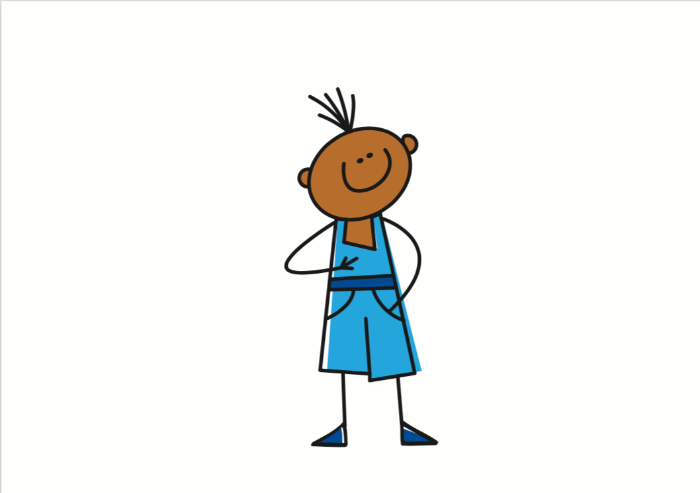
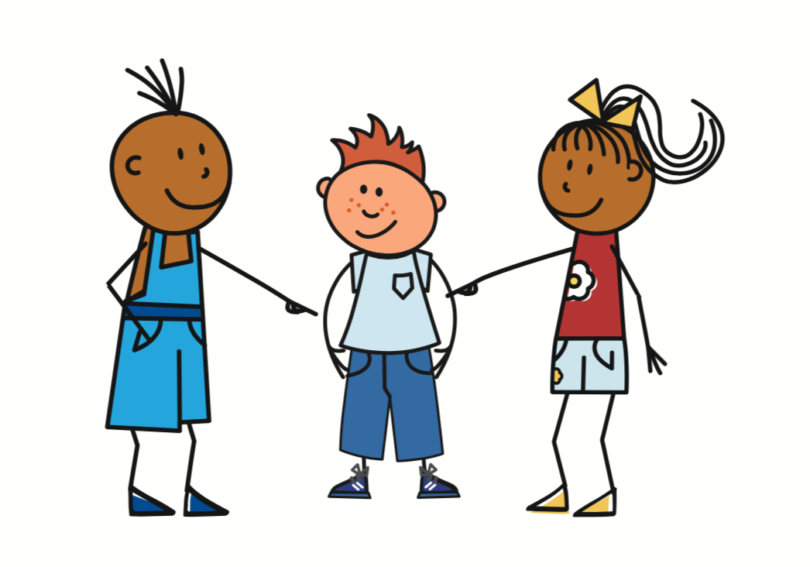
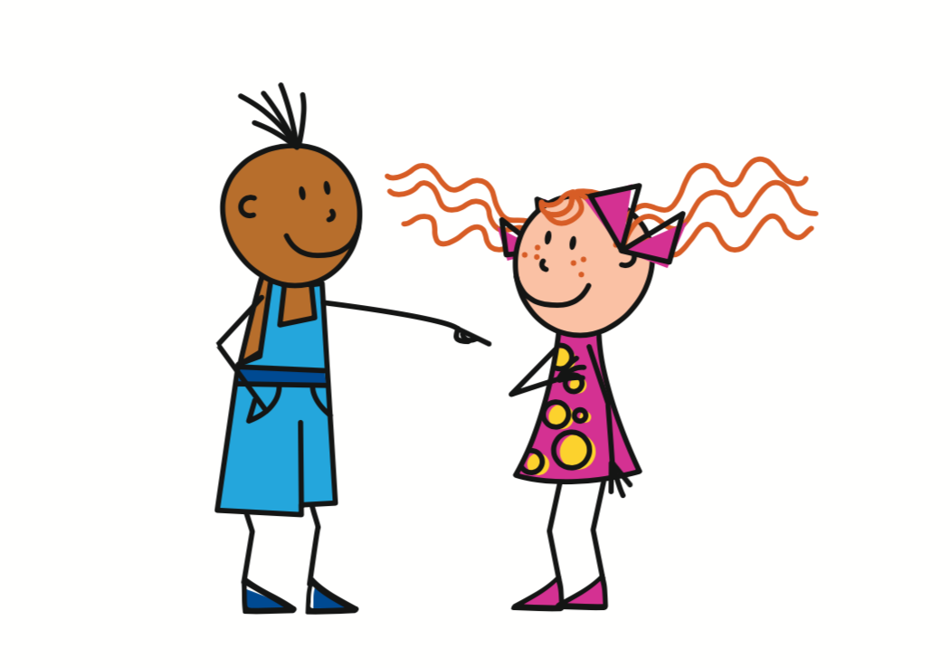
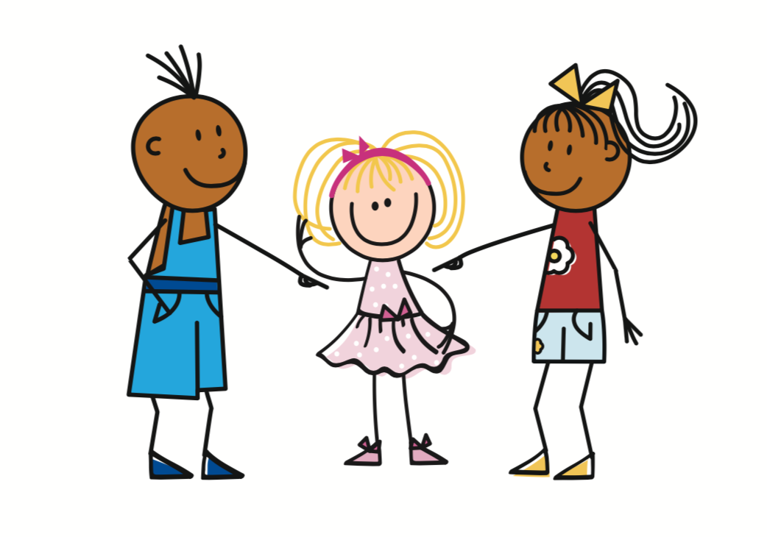
vocabulario
¿Cómo es en español? [1/2]
🕷
👻
la hermana
el miedo
la noticia
la idea
news
fear
idea
sleepiness
el sueño
el calor
heat
(the) sister
news
You have
idea
cold
I have
fear
S/he, it has
heat
sleepiness
tengo
tienes
[have]
tiene
[have]
el frío
[have]
cold
Notes:
Timing: 10 minutes [2 slides]
Aim: to present and practise written comprehension and read aloud of six items of previously taught vocabulary that we revisit this week and the four new words.
Procedure:
Click for an English item. Elicit pronunciation of the Spanish from pupils.
Move to the next slide.

Slide 6

vocabulario
¿Cómo es en español?
🕷
👻
el
m_ _ d_
la h_ _ m_ n_
la n_ t_ c_ _
la i_ d _ _
you have
news
sister
idea
sleepiness
fear
cold
I have
heat
el c_ l _ r
el s_ _ _ o
[have]
[have]
t_ _ g _
[have]
t_ _ n _
t_ _ n _ _
el f_ _ _
Notes:
[2/2]
Procedure:
1. Click for English prompts - elicit Spanish from pupils.
2. Continue with the remaining items.
[NB] For additional support, click on the support icon (left-hand side of the slide). Clues for each Spanish word will appear.

Slide 7


Tener
You know that tener means ‘to have, having’:
Tengo un perro.
I have a dog.
Tiene un lápiz.
S/he has a pencil.
In Spanish, we sometimes also use tener to mean ‘to be, being’:
We also use tener to say our age:
Tengo calor.
I am hot.
Tengo nueve años.
I am nine years old.
Tengo frío.
I am cold.
Tiene sueño.
S/he is sleepy.
Tiene miedo.
S/he is scared.
⚠ These literally mean:
I have heat.
I have cold.
S/he has sleepiness.
S/he has fear.
⚠ Word for word, this means ‘I have nine years’.
Notes:
Timing: 3 minutes
Aim: to present new uses of tener expressions meaning ‘be’.
Procedure:
1. Click to present the information.
2. Elicit responses from pupils, following the animated question marks.

Slide 8

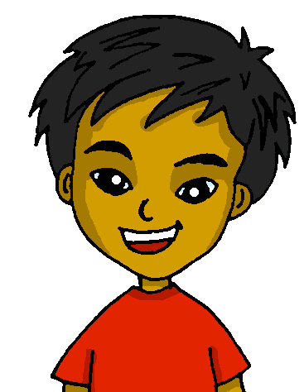
leer
Quique habla.
años = years
(la) chaqueta = jacket
Lee las frases. ¿Qué palabra es correcta?
Es lunes.
¡Tengo sueño!
¿Tienes noticias, Sofía?
____
1
_____!
4
Hoy es el cumpleaños* de Toñi. Tiene diez años*.
¿Dónde está mi chaqueta*?
¡Tengo frío!
5
2
____
___!
Tengo miedo. ¿Dónde está mi papá?
_______
Es agosto y estoy en España. ¡Tengo calor!
3
6
____!
miedo | tiene | calor | sueño | tienes | frío
Notes:
Timing: 5 minutes
Aim: to consolidate written comprehension of this week’s vocabulary and a range of previously taught vocabulary.
Procedure:
1. Pupils write 1-6 for each speech bubble they note the missing word.
2. Elicit the answers from pupils (for additional pronunciation practice)
3. Click to reveal the written answers.
4. Click on the speech bubble to hear the full audio, if desired. Alternatively use it as a listen and check stage.
Frequency of unknown words and cognates:
año [46] chaqueta [2428]
Source: Davies, M. & Davies, K. (2018). A frequency dictionary of Spanish: Core vocabulary for learners (2nd ed.). Routledge: London

Slide 9
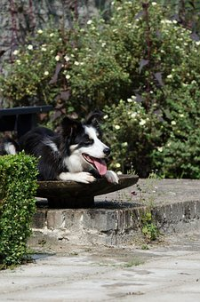


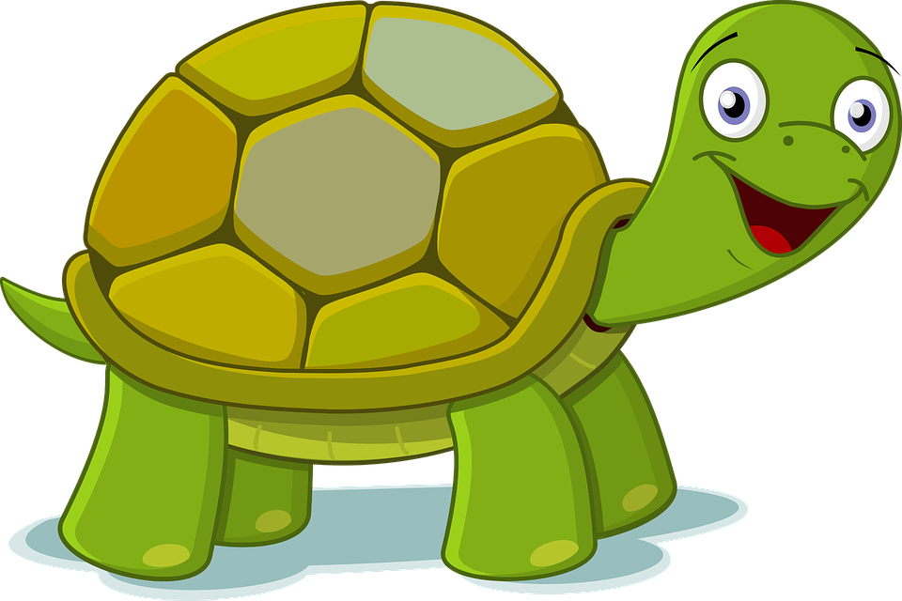
hablar
Observa las imágenes y lee la frase correcta.
📢 [1/5]
Read the sentence aloud with your partner before Irene gets to the door.
leer
sueño
frío
Tengo…
miedo
calor
Notes:
Timing: 5 mins [5 slides in total] [1/5]
Aim: to revisit the newly introduced vocabulary and three persons of tener (tengo, tiene, tienes) in guided oral production.
Procedure:
Read the Spanish instruction out loud.
Read the English instruction and ensure the task is clear.
Click to start the Irene (tortoise) timer. Pupils work in pairs to say the sentence aloud in Spanish. Encourage most able to translate it too.
Once Irene disappears, elicit answers from students.
Click to bring up the answer confirmation. In the audio version of the lesson, audio is attached to the animated ticks.

Slide 10

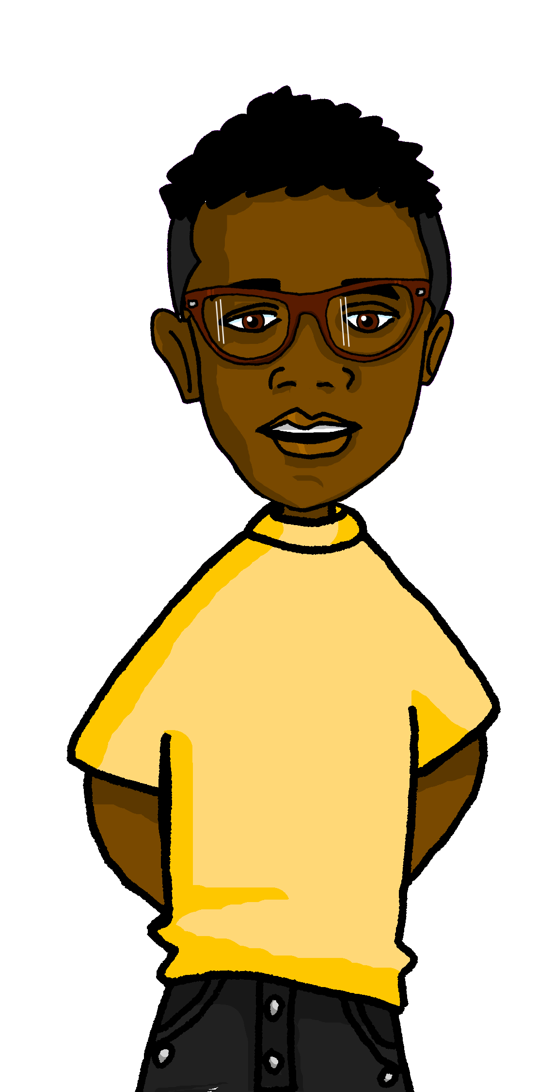
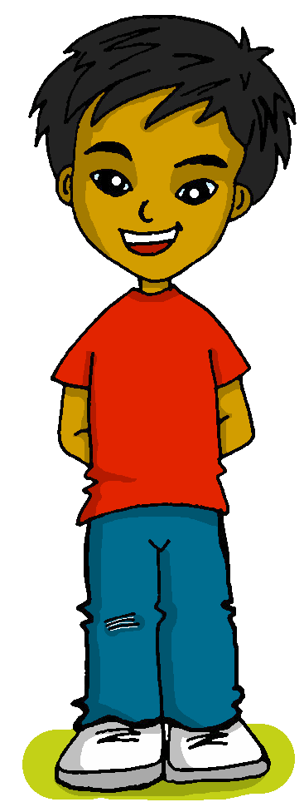
hablar
Observa las imágenes y lee la frase correcta.
📢 [2/5]
leer
¿______ nueve años?
tienes
tengo
tiene
Notes:
[2/5]

Slide 11
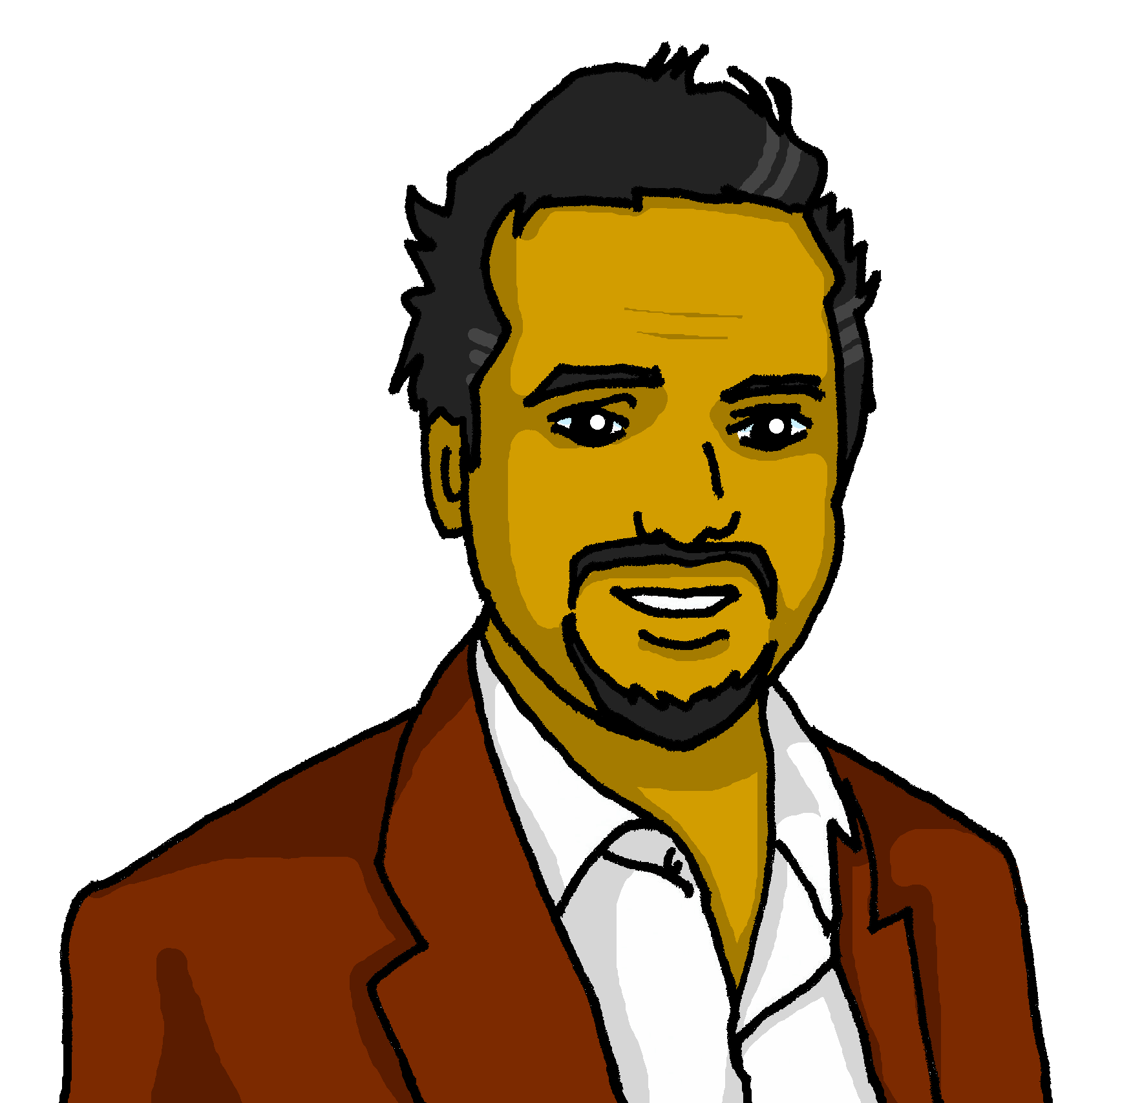
hablar
Observa las imágenes y lee la frase correcta.
📢 [3/5]
leer
Sofía _____ 🥶.
miedo
tienes
sueño
tengo
frío
tiene
calor
Notes:
[3/5]

Slide 12


hablar
Observa las imágenes y lee la frase correcta.
📢 [4/5]
leer
Examen de inglés
miedo
Tengo…
sueño
frío
calor
Notes:
[4/5]

Slide 13
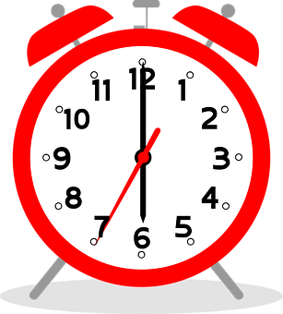
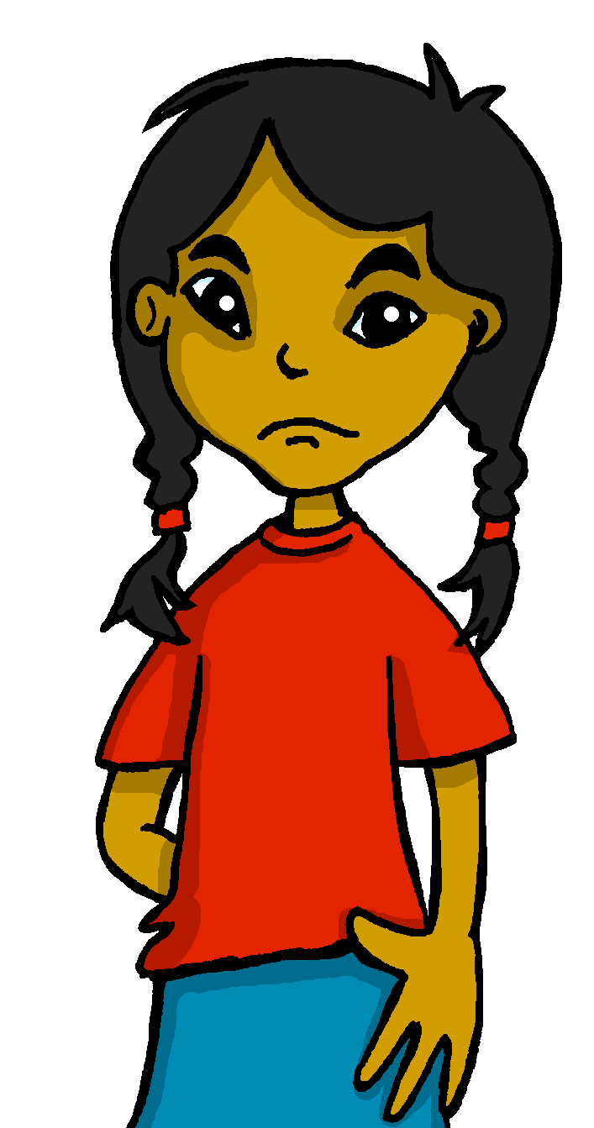
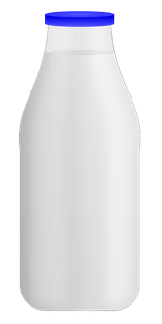
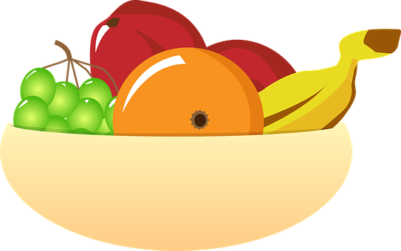

hablar
Observa las imágenes y lee la frase correcta.
📢 [5/5]
leer
sueño
frío
Tengo…
miedo
calor
Notes:
[5/5]

Slide 14
¡adiós!
amarillo

