Slide 1
Describing things and people
Mi
¡Tengo calor!
¡Tengo frío!
Tengo sueño.
Tengo miedo.
🕷
amarillo
👻
Follow ups 1-5
Notes:
Artwork by Steve Clarke. All additional pictures selected are available under a Creative Commons license, no attribution required.
The frequency rankings for words that occur in this PowerPoint which have been previously introduced in the resources are given in the SOW (excel document) and in the resources that first introduced and formally re-visited those words.
For any other words that occur incidentally in this PowerPoint, frequency rankings will be provided in the notes field wherever possible.
Phonics: [ñ]|[n] español [262] mano [135]
Vocabulary: calor [1852] frío [1307] miedo [755] sueño [460]
Revisit 1: cumpleaños [3372] mes [288] enero [1173] febrero [1419] marzo [1231] abril [1064] mayo [909] junio [1035] julio [659] agosto [931] septiembre [1150] octubre [1242] noviembre [1434] diciembre [1165] cuándo [138] mi [37] tu [53] en [5]
Revisit 2: comer [347] hacer, hago, hace [26] responder (a) [464] actividad [344] bocadillo [>5000] ejercicio [1162] naranja [2924] ordenador [2624]
Frequency of unknown words and cognates: año [46] uña [2578] araña [4427] moño [>5000] pena [743] puño [3060] campana [3374] ordeñar [>5000] leña [4785] panal [>5000] paño [>5000] correctamente [4173]
Source: Davies, M. & Davies, K. (2018). A frequency dictionary of Spanish: Core vocabulary for learners (2nd ed.). Routledge: London
Picture attribution:
https://emojipedia.org/hot-face/ (CC BY-SA 4.0)

Slide 2
Follow up 1
[n] [ñ]
correctamente = correctly
Lee las palabras correctamente.
pronunciar
escuchar
Escucha bien. Es [ñ] o [n]?
60
araña [spider]
uña
[nail]
mano
[hand]
S
araña |  | uña | mano | plátano
moño |  | niña |  | montaña |  | panal
leña | puño | Nina |  | pena | paño | año
plátano
[banana]
panal
[honey-comb]
_
_
_
_
moño
[bun]
niña
[girl]
montaña
[mountain]
_
_
_
_
año
[year]
leña
[wood]
puño
[fist]
Nina [girl’s name]
pena
[sadness]
paño
[cloth]
_
_
_
_
_
_
0
START
Notes:
Timing: 5 minutes
Aim: to practise applying knowledge of [n] [ñ] to known and unknown words.
Procedure:
Part 1:
Read the instruction in Spanish. Tell pupils they need to identify whether the following words contain n / ñ. Click on the individual pictures to hear the word, then click to bring up the whole word.
Part 2: 1. Click to bring up instruction in Spanish and read.
3. Click to bring up all the words with arrows.
2. Pupil A tries to read aloud all of the words pronouncing n / ñ correctly, within the 60 seconds allowed.
3. Start the timer.
4. Pupil B listens. If Pupil A mispronounces n or ñ by mistake, Pupil B can direct him/her to start again from the beginning. 5. They swap roles and repeat the task.
6. Click again to make the words disappear.
6. Teacher then uses animations to elicit pronunciations chorally, with words appearing one by one (with audio).
Frequency of unknown words and cognates: año [46] uña [2578] araña [4427] moño [>5000] pena [743] puño [3060] campana [3374] ordeñar [>5000] leña [4785] panal [>5000] paño [>5000] correctamente [4173]
Source: Davies, M. & Davies, K. (2018). A frequency dictionary of Spanish: Core vocabulary for learners (2nd ed.). Routledge: London

Slide 3
follow up 2:
Escribe en inglés 📝: Can you get at least 15 points?
 | el bocadillo | hace | comer
 | responder (a) | hago | el ordenador
 | ¿cuándo? | el cumpleaños | mi
 | marzo | enero | mayo
 | tengo | el miedo | el sueño
 | el calor | el frío | tiene
s/he, it makes/does
(the) sandwich
vocabulario
to eat, eating
x3
to reply to
I do / make
(the) computer
When?
(the) birthday
my
x2
March
January
May
I have
(the) fear
(the) sleepiness
x1
(the) heat
(the) cold
s/he,it has
Notes:
Timing: 5 minutes
Aim: to practise written production of vocabulary from this week and this week’s revisited sets.
Procedure: 1. Give pupils a blank grid. They fill in the English meanings of any of the words they know, trying to reach 15 points in total.
Note: The most recently learnt and practised words are pink, words from the first revisit are green and those from the second revisit are blue, thus more points are awarded for them, to recognise that memories fade and more effort (heavy lifting!) is needed to retrieve them.

Slide 4
Follow up 3:
Escucha. ¿Qué opción es correcta?
escuchar
Luego, escribe la frase en inglés.
calor | bicicleta | I have a bicycle.
frío | instrumento | I am cold.
miedo| mensaje | I have a message.
una idea | sueño | I am sleepy.
perro | calor | I have a brother.
frío | fiesta favorita | I have a favourite festival.
miedo | un hermano | I am scared.
calor | carta | I have a letter.
1
____________________________________
2
____________________________________
3
____________________________________
4
____________________________________
5
____________________________________
6
____________________________________
7
____________________________________
8
____________________________________
Notes:
Timing: 10 minutes
Aim: to practise aural distinction between tener + noun (with indefinite article) and tener meaning ‘be’ with no article.
Procedure:
Pupils write 1-8.
They listen to each sentence and decide which word completes it, based on the presence or absence of an article.
They then either write or feed back orally the meaning of the sentence.
Click to reveal the correct end to the sentence and the English meaning.
Draw pupils attention to the meaning of tengo as both I have (+ article + noun) and I am + noun (no article).
Transcript:
Tengo una [bicicleta].
Tengo [frio].
Tengo un [mensaje].
Tengo [sueño].
Tengo un [perro].
Tengo una [fiesta favorita].
Tengo [miedo].
Tengo una [carta].

Slide 5
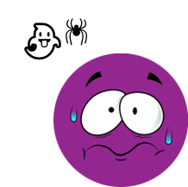
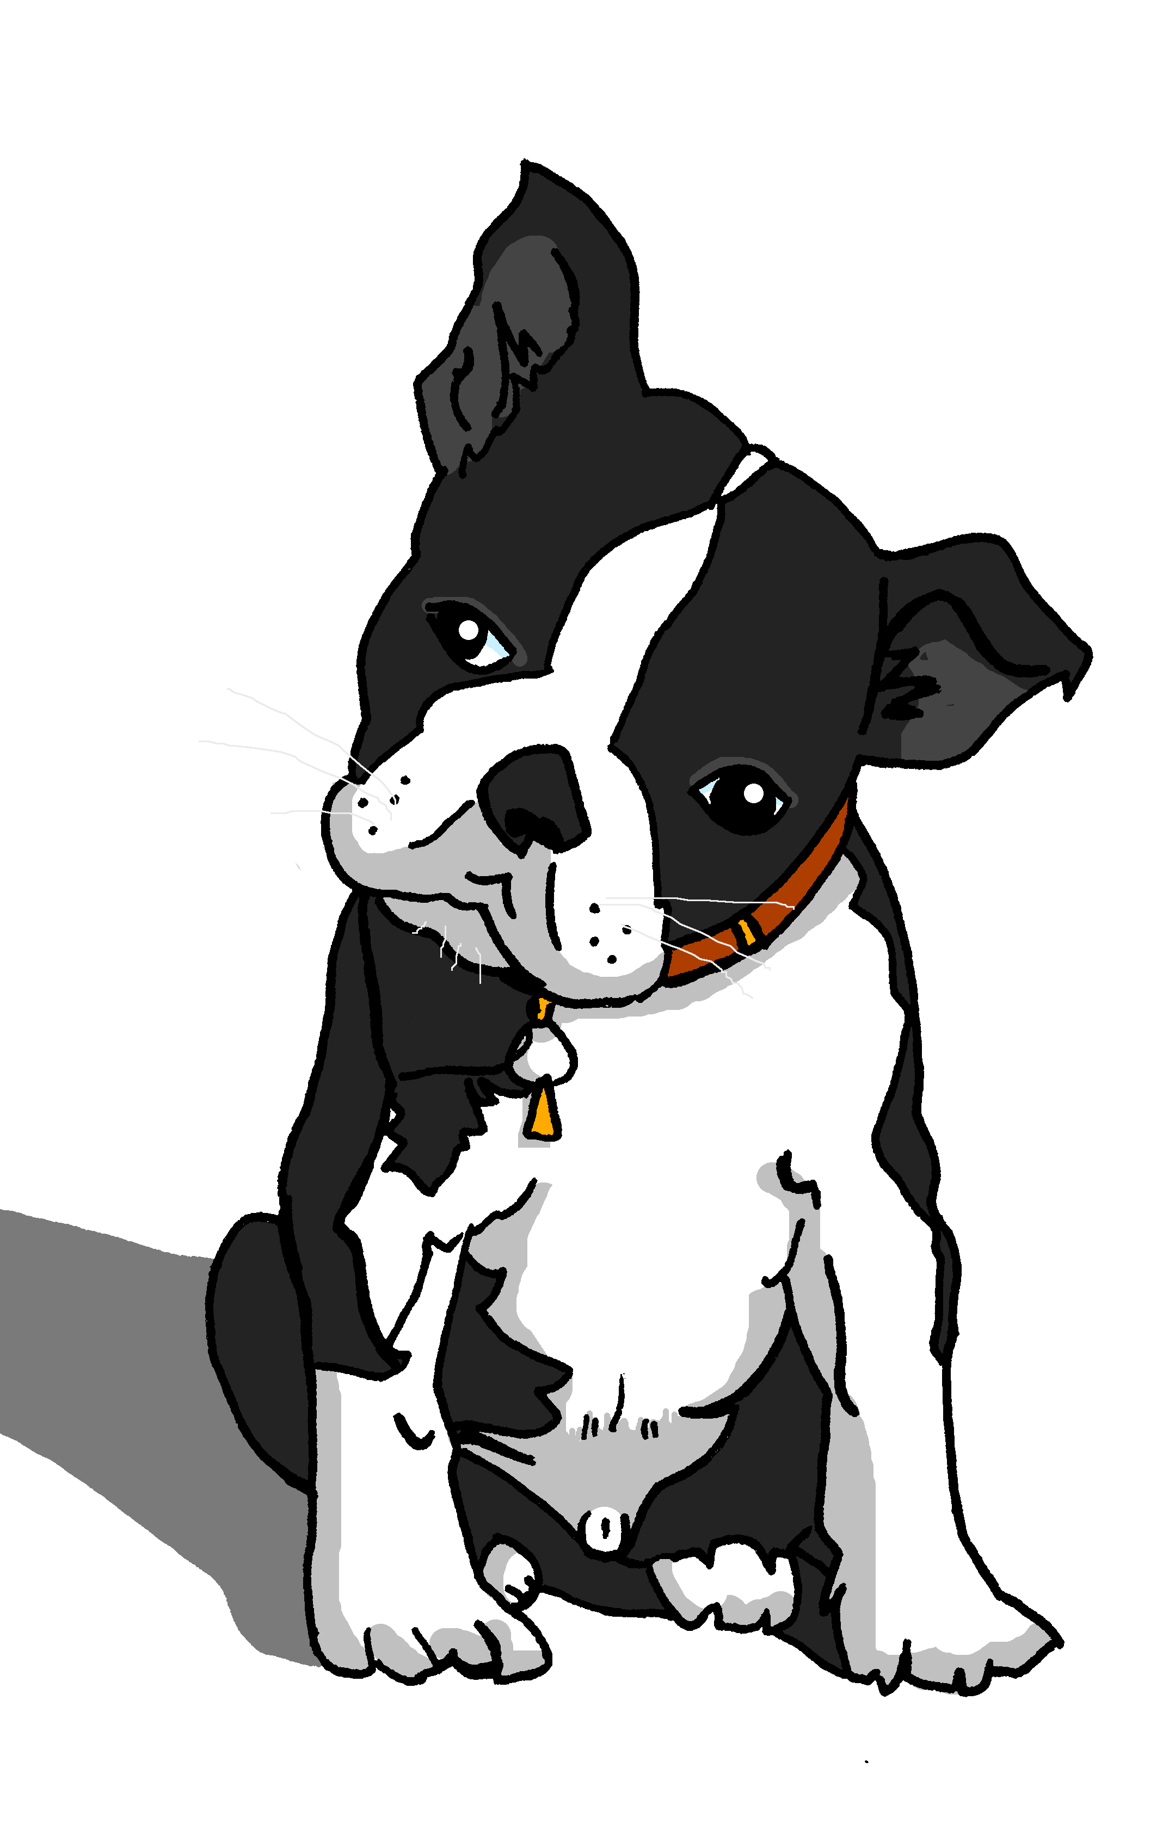
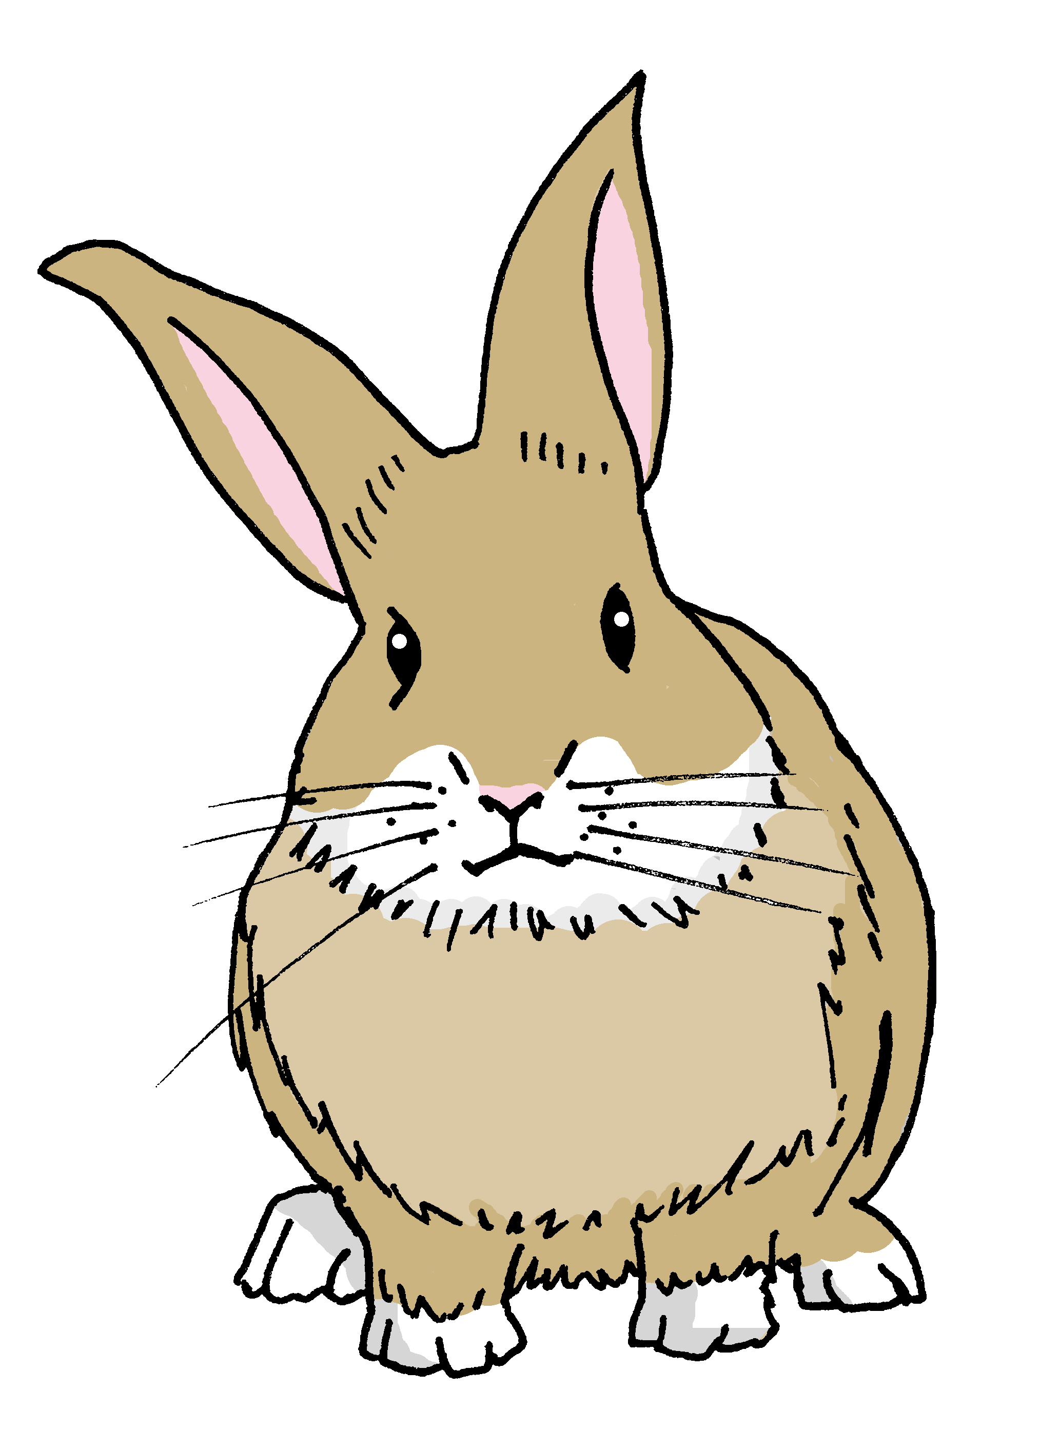
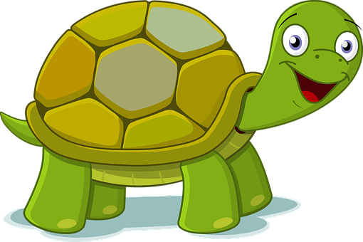
Follow up 4
Habla con tu compañero/a.
Soy Pancho. ¡Tengo una hermana!
Soy Manchita. ¡Tengo sueño!
Soy Rubén. ¡Tengo miedo!
Soy Santi. ¡Tengo sueño!
Soy Ángela. ¡Tengo frío!
Soy Irene. ¡Tengo una naranja!
Soy Quique. ¡Tengo calor!
Soy Sofía. ¡Tengo un ordenador!
hablar
1
2
3
4
😴
[sister]
8
9
10
11
¡ñam, ñam!
Ñam ñam
Notes:
Timing: 5 minutes
Aim: to practise spoken production of the new structure ‘tener’ (its idiomatic use with nouns such as ‘miedo’, ‘calor’, ‘frío’, ‘sueño’), as well as other nouns to express possession.
Procedure:
Do number 1 with pupils to model the task.
Click to reveal the answer.
Give pupils 30 seconds to say / practise the next sentence with a partner.
Elicit the sentence from the whole class chorally, then click to confirm.
Repeat steps 3-4 for the remaining sentences.

Slide 6
Follow up 5:
1 Escribe el número correcto.
escribir
leer
tres
A | nueve | + | ______ | = | doce
B | ocho | + | ______ | = | nueve
C | cinco | + | ______ | = | siete
D | tres | + | ______ | = | seis
E | seis | + | ______ | = | once
F | ocho | + | ______ | = | diez
uno
dos
tres
cinco
2 Escribe el número correcto.
dos
cuatro
1. seis - dos = __________________
2. cinco + siete = _________________
3. cuatro + cuatro = ______________
4. nueve – tres = _________________
5. once – seis = ______________
6. ocho – tres + dos + cuatro – cinco + seis – tres =_________
doce
ocho
seis
cinco
nueve
Notes:
Timing: 5 minutes
Aim: To practise written production of numbers.
Procedure:
Teachers read the instruction and clarify the meaning.
Pupils write the answers in words to activities 1 and 2.
Click to elicit from pupils and correct.

Slide 7
follow up extra:
Escribe en español 📝: Can you get at least 15 points?
 | s/he does, makes | to reply, replying | .(the) computer
 | I do, make | to eat, eating | (the) sandwich
 | (the) birthday | When? | January
 | May | March | my
 | s/he has | (the) sleepiness | I have
 | (the) cold | (the) fear | (the) heat
vocabulario
hace
responder
el ordenador
x3
hago
comer
el bocadillo
el cumpleaños
¿Cuándo?
enero
x2
mayo
marzo
mi
tiene
el sueño
tengo
x1
el frío
el miedo
el calor
Notes:
Timing: 5 minutes
Aim: to practise written production of vocabulary from this week and this week’s revisited sets.
Procedure: 1. Give pupils a blank grid. They fill in the Spanish meanings of any of the words they know, trying to reach 15 points in total.
Note: The most recently learnt and practised words are pink, words from the first revisit are green and those from the second revisit are blue, thus more points are awarded for them, to recognise that memories fade and more effort (heavy lifting!) is needed to retrieve them.

Slide 8
¡adiós!
amarillo

Slide 9
Handout: Follow up 2
Escribe en inglés 📝: Can you get at least 15 points?
 | el bocadillo | hace | comer
 | responder (a) | hago | el ordenador
 | ¿Cuándo? | el cumpleaños | mi
 | marzo | enero | mayo
 | tengo | el miedo | el sueño
 | el calor | el frío | tiene
vocabulario
x3
x2
x1
Notes:
Timing: 5 minutes
Aim: to practise written comprehension of vocabulary from this week and this week’s revisited sets.
Procedure: 1. Give pupils a blank grid. They fill in the English meanings of any of the words they know, trying to reach 15 points in total.
Note: The most recently learnt and practised words are pink, words from the first revisit are green and those from the second revisit are blue, thus more points are awarded for them, to recognise that memories fade and more effort (heavy lifting!) is needed to retrieve them.

Slide 10
Handout: Follow extra
Escribe en español 📝: Can you get at least 15 points?
 | s/he does, makes | to reply, replying | .(the) computer
 | I do, make | to eat, eating | (the) sandwich
 | (the) birthday | When? | January
 | May | March | my
 | s/he has | (the) sleepiness | I have
 | (the) cold | (the) fear | (the) heat
vocabulario
x3
x2
x1
Notes:
Timing: 5 minutes
Aim: to practise written production of vocabulary from this week and this week’s revisited sets.
Procedure: 1. Give pupils a blank grid. They fill in the Spanish meanings of any of the words they know, trying to reach 15 points in total.
Note: The most recently learnt and practised words are pink, words from the first revisit are green and those from the second revisit are blue, thus more points are awarded for them, to recognise that memories fade and more effort (heavy lifting!) is needed to retrieve them.

