Slide 1
español, con Quique

Slide 2
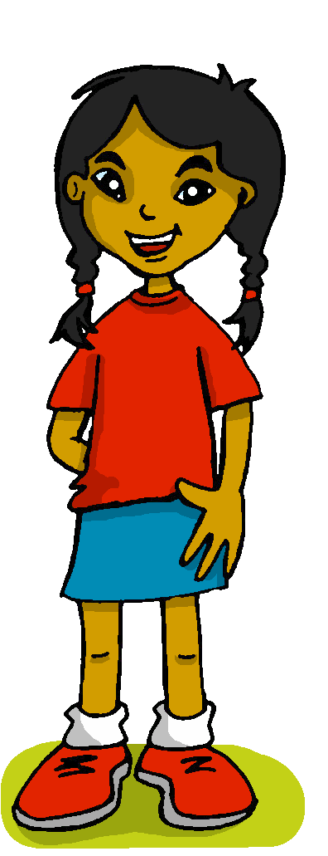
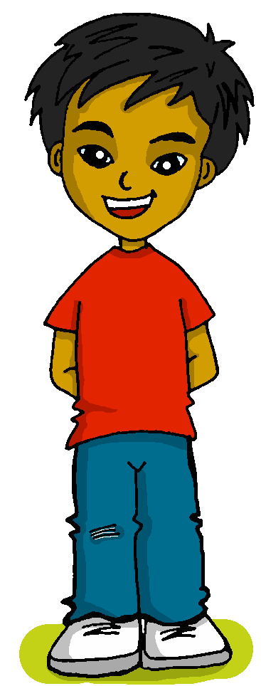
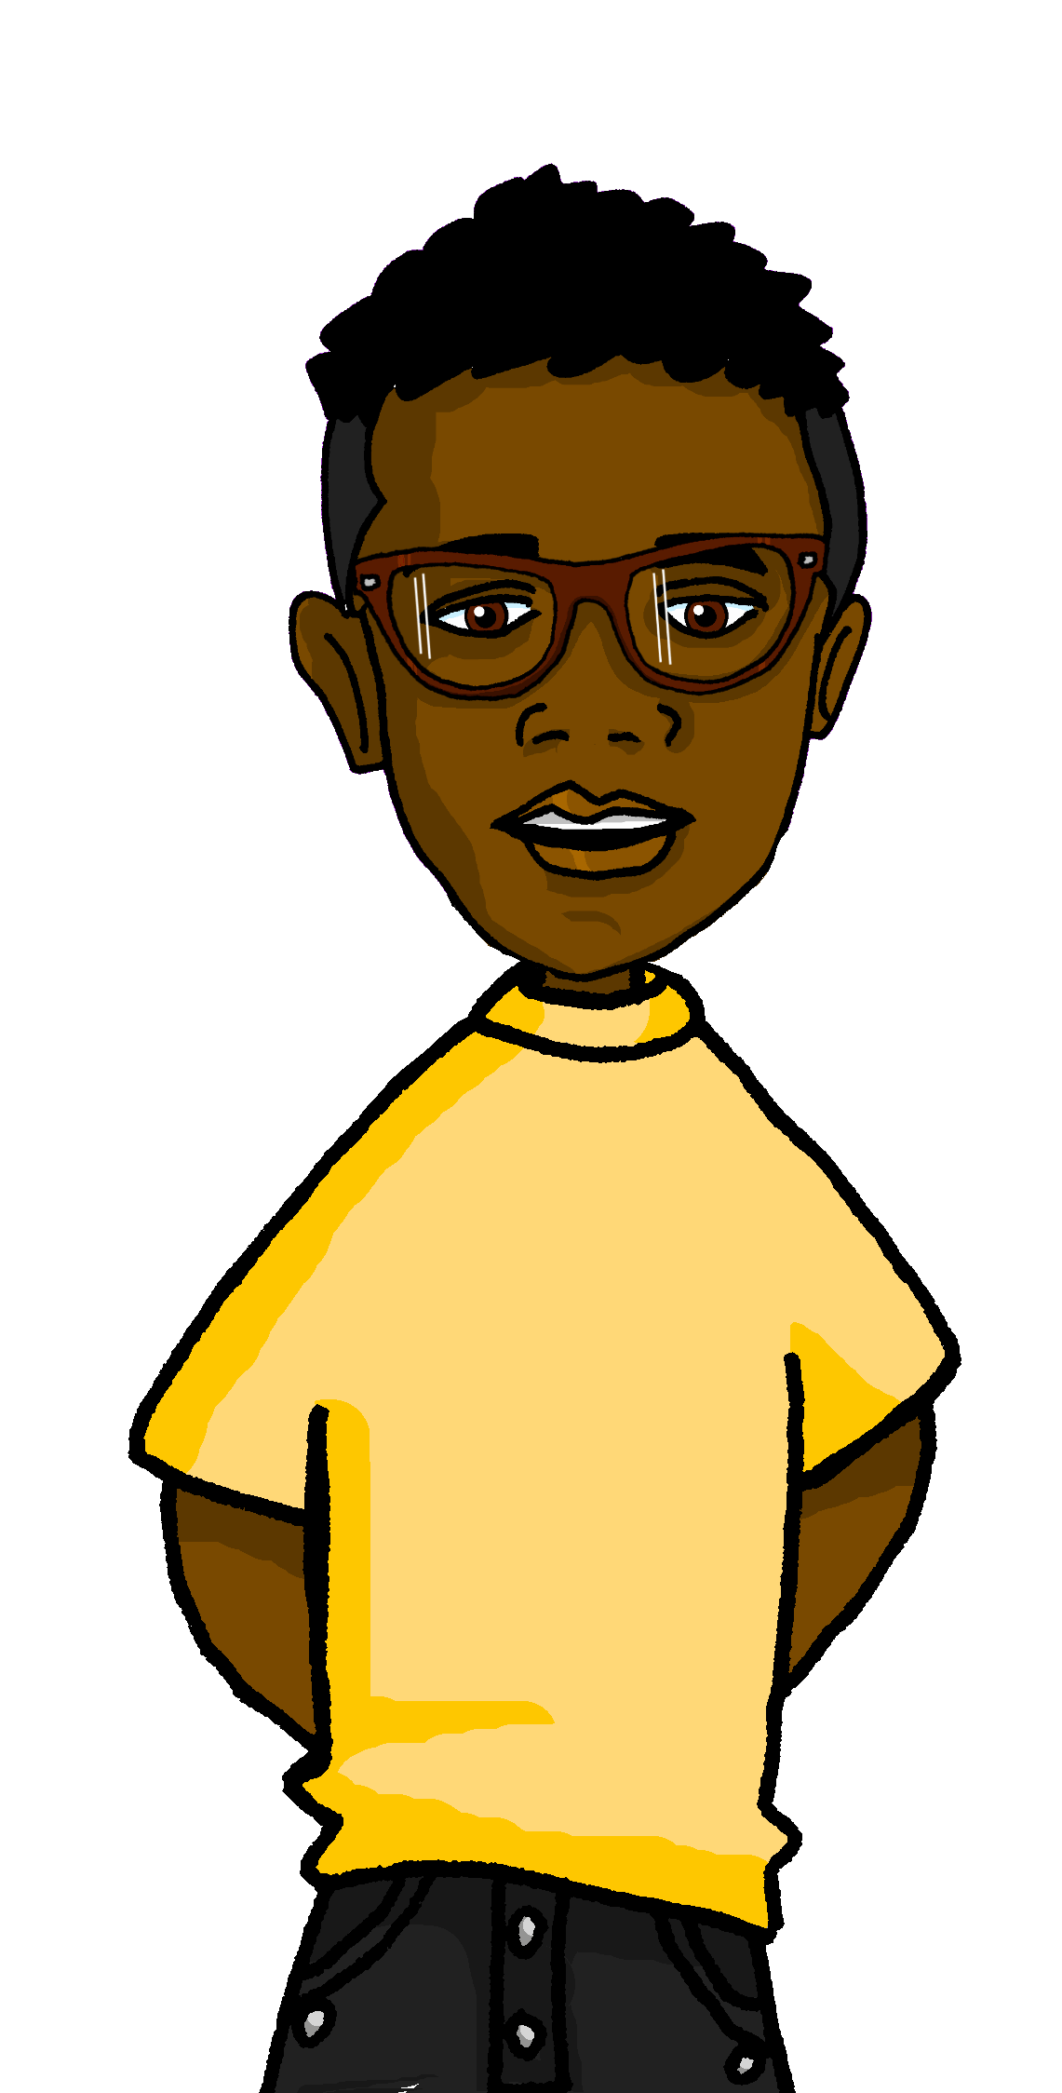
Describing things and people
favourite
>
Los colores
España
Inglaterra
amarillo
- possessives mi, tu
- revisit SSC [ga] [go] [gu] [ge] [gi] [j]
Perú
Notes:
Artwork by Steve Clarke. All additional pictures selected are available under a Creative Commons license, no attribution required.
The frequency rankings for words that occur in this PowerPoint which have been previously introduced in the resources are given in the SOW (excel document) and in the resources that first introduced and formally re-visited those words.
For any other words that occur incidentally in this PowerPoint, frequency rankings will be provided in the notes field wherever possible.
Phonics: Revisit [ga] [go] [gu] [ge] [gi] [j]
Vocabulary: ciudad [178] color [358] fiesta [796] persona [108] mi [37] tu [53] preferido [n/a]
Revisit 1: alto [231] bajo [452] blanco [372] negro [307] verde [812]
Revisit 2: aprender [428] leer [209] carta [627] noticia [859] revista [920] español [262] inglés [583] de2 [2]
Frequency of unknown words and cognates:
elefante [>5000] película [944]
Source: Davies, M. & Davies, K. (2018). A frequency dictionary of Spanish: Core vocabulary for learners (2nd ed.). Routledge: London

Slide 3
pronunciar
Pilla al intruso*
el intruso – odd one out
Pronuncia las palabras para tu compañero/a.
A
Él/ella identifca el intruso.
B
 | conejo | elegante | genial
 | guante | gemelo | imagen
 | gris | mensaje | luego
1
2
3
 | Inglaterra | Bulgaria |Georgia
 | tengo | abajo | organizar
 | lugar | tortuga | genio
4
5
6
Notes:
Timing: 5 minutes
Aim: To revisit SSC [ga] [go] [gu] [ge] [gi] [j]
Procedure:
Introduce the task. Explain that pupil B will turn away from the board, pupil A will pronounce 3 x words and B has to identify the odd one out – the one that has a different [g] sound from the other two.
Pupil Bs turn away. Click for the table of words.
Pupil As pronounce the words. Pupils Bs write down the one they think is the odd one out for all three sets.
Pupil Bs turn back to face the board and the teacher elicits the responses and clicks to confirm.
Repeat steps 2 – 4 with Pupil As.
Frequency of unknown words and cognates:
colegio [628] elegante [2742] genial [2890] gemelo [>5000] imagen [384] gris [1751] luego [150] organizar [144] tortuga [>5000] genio [2965]
Source: Davies, M. & Davies, K. (2018). A frequency dictionary of Spanish: Core vocabulary for learners (2nd ed.). Routledge: London

Slide 4
hablar
Quique ayuda a Max con el vocabulario.
palabras
leer
el libro
la fiesta
preferida
la persona
mi
tu
preferido
el color
00
00
00
00
_ _
your
00
_ _ l_ _ _ _
book
00
00
_ _ c_ _ _ _
colour
p_ _ f _ _ _ _ _
preferred (f)
00
_ _ f_ _ _ _ _
party / holiday
p_ _ f _ _ _ _ _
preferred (m)
_ _
my
_ _ p_ _ _ _ _ _
person
Notes:
Timing: 5 minutes [2 slides] 1/2
Aim: to revisit vocabulary from term 2 and introduce 4 items of vocabulary (color, preferido, persona, preferido)
Procedure: 1. Pupils either work in pairs or chorally as a class, reading the Spanish words out loud.
2. Click to start the animation sequence.
3. Pupils call out the Spanish & English (e.g. colour – el color) before the flashcard disappears.
NB. Teacher can do another round to check comprehension, eliciting English meaning of the words on the board (i.e. ¿’Qué es el libro en inglés?), before moving to next slide.
Note: Each flashcard animation sequence is started on a mouse click.

Slide 5
hablar
Quique ayuda a Max con el vocabulario.
palabras
leer
el color
tu
la fiesta
mi
la persona
el libro
preferido
00
00
00
00
_ _
your
00
_ _ l_ _ _ _
book
00
00
_ _ c_ _ _ _
colour
p_ _ f _ _ _ _ _
preferred (f)
00
_ _ f_ _ _ _ _
party / holiday
p_ _ f _ _ _ _ _
preferred (m)
_ _
my
preferida
_ _ p_ _ _ _ _ _
person
Notes:
[2/2]
Procedure: 1. Pupils either work in pairs or chorally as a class, saying the Spanish words out loud, using the hints in the flashcard(s).
2. Click to start the animation sequence.
3. Pupils call out the Spanish & English (e.g. person – la persona) before the flashcard disappears. The Spanish words appears on the board after the flashcards has disappeared completely.
Note: Each flashcard animation sequence is started on a mouse click.

Slide 6
Possessive adjectives
[mi (my) | tu (your)]
To say ‘my’ in Spanish before a singular noun use mi.
To say ‘your’ in Spanish before a singular noun use tu.
It doesn’t matter if the noun is masculine or feminine.
Mi cama es cómoda.
My bed is comfortable.
Tu amigo es importante.
Your friend is important.
Remember! Tú (with an accent) means ‘you’.
Notes:
Timing: 2 minutes
Aim: to introduce singular possessive adjectives ‘mi’ and ‘tu’.
Procedure:
Click through the animations to present the information.
Elicit English translations for the Spanish examples given.

Slide 7
leer
Quique and Max talk about their things.
Lee las frases. ¿Es Quique (my) o Max (your)?
¿Qué es? ¿Cómo es?
 |  | Quique (my) Max (your) | ¿Qué? | Descripción
E | Mi clase es muy pequeña. | Quique | classroom | very small
1 | Tu bolsa es blanca. | Max | bag | white
2 | Mi hermana es muy positiva. | Quique | sister | very positive
3 | Mi libro es en español. | Quique | book | in Spanish
4 | Tu libro es en inglés. | Max | book | in English
5 | Tu profesora es nueva. | Max | (female) teacher | new
6 | Tu bicicleta es verde. | Max | bicycle | green
7 | Mi ciudad es interesante. | Quique | city | interesting
1
2
3
4
5
6
7
8
Notes:
Timing: 8 minutes
Aim: to practise understanding the new grammar features ‘mi’ and ‘tu’ (reading activity). Attention to the meaning of the vocabulary is also needed to complete the second and third columns.
Procedure:
Do the example with pupils to model the first part of the task. Read the sentence and work out if it refers to ‘Quique’ (my) or ‘Max’ (your).
Pupils then do items 1-7.
Teacher elicits answers ‘Quique’ or Max’ and clicks to reveal.
Pupils then complete the remaining two columns with the object and the description of it (adjective).
Click to reveal answers one by one.

Slide 8
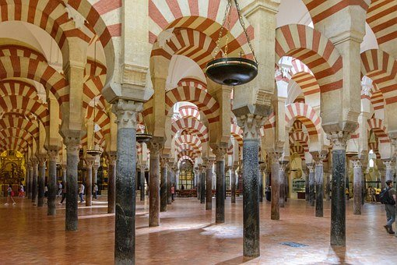
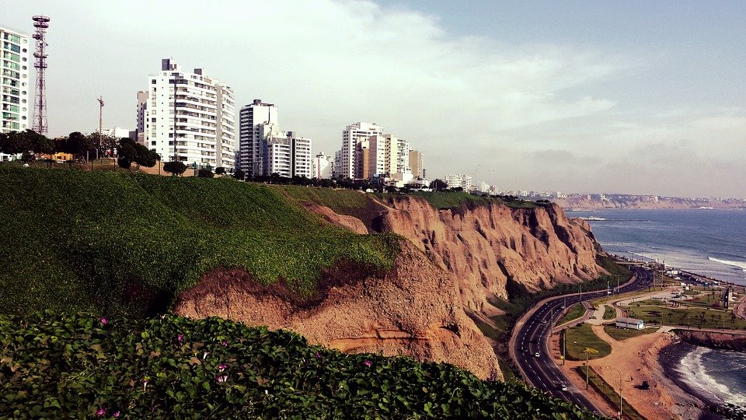
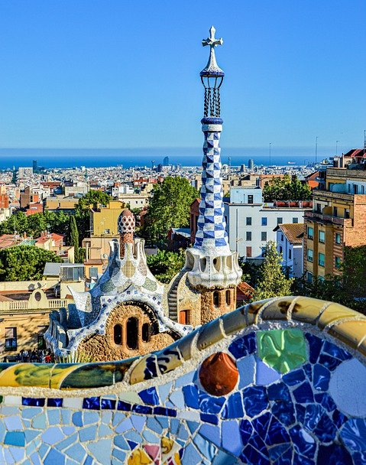
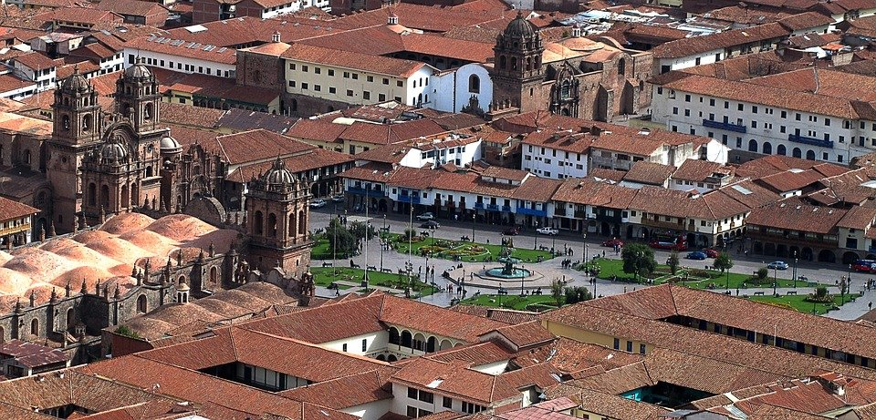
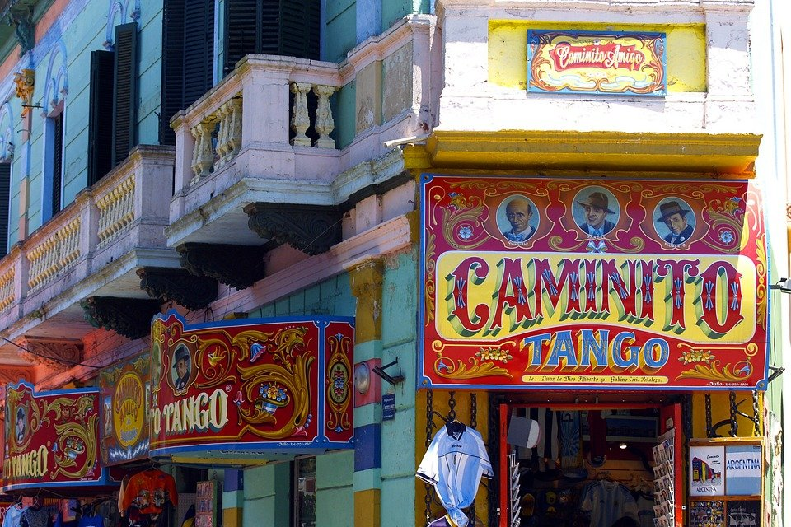
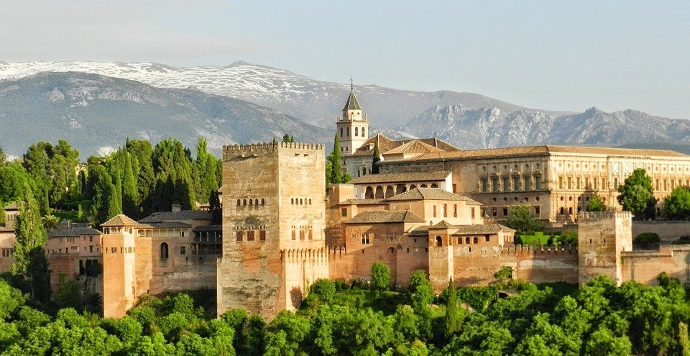
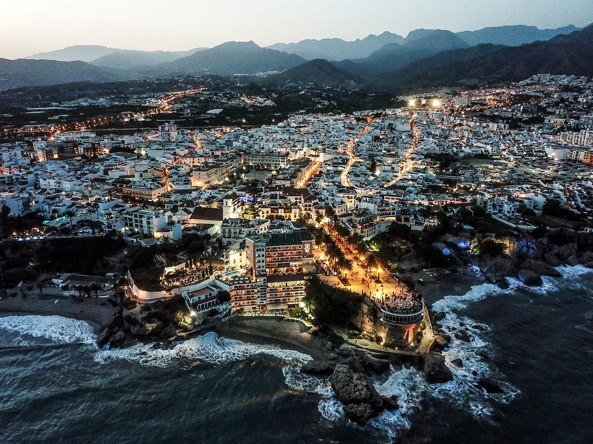
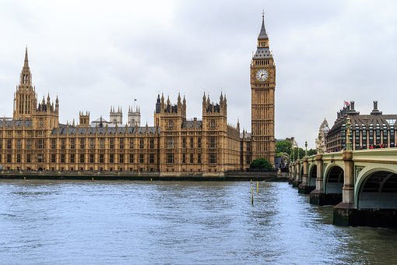
hablar
La ciudad preferida de Max es Barcelona.
Y tú, ¿tu ciudad preferida es Barcelona?
A
Mi ciudad preferida es _____________ .
Keep talking until you have mentioned all 8 cities! Choose the cities in any order.
Buenos Aires.
Mi ciudad preferida es ___________ .
Granada
B
A
Mi ciudad preferida es ___________ .
Cusco
Perú
Córdoba
Lima
Argentina
Barcelona
Inglaterra
Buenos Aires
Granada
Londres
Cusco
Málaga
Notes:
Timing: 2 minutes
Aim: to practise saying what their favourite city is using the new adjective ‘preferido’. (ciudad / preferida); to practise reading aloud.
Procedure:
Model the task with pupils, using the sequence provided.
Pupils keep talking until they have used all the cities.
Provide support as needed for the class or individuals.
If needed, the pronunciation of each city can be heard by click on the image.

Slide 9
Tú (you) and tu (your)
In English we stress the pronoun with our voice.
Remember, we sometimes use a pronoun for emphasis or clarity:
Tú aprendes inglés.
You learn/are learning English.
Tú (you) always goes before a verb.
Tu (your) always goes before a noun:
Tu color preferido es el verde.
Your favourite colour is green.
Tú (you) and tu (your) sound the same, but you can tell the meaning from the word that follows – verb or noun?
This is exactly the same in questions:
¿Tú ves el elefante?
Do you see the elephant?
¿Tu libro preferido es ‘El Grúfalo’?
Is your favourite animal an elephant?
Notes:
Timing: 2 minutes
Aim: to make the difference between tú (you) and tu (your) clear, as they sound the same. We are going to practise the difference in the next task.
Procedure:
Click through the animations to present the information.
Elicit English translations for the Spanish examples provided.

Slide 10
leer
La clase de Quique prepara preguntas para una clase en Inglaterra.
Lee las preguntas. ¿Es tú (you) o tu (your)?
Escribe la palabra correcta. Escribe la pregunta en inglés.
 |  | tú (you) tu (your) | Pregunta en inglés
1 | ¿Tú tienes un instrumento? | tú | Do you have an instrument?
2 | ¿Tú lees revistas en español? | tú | Do you read magazines in Spanish?
3 | ¿Tu libro preferido es ‘El Grúfalo’? | tu | Is TG your favourite book?
4 | ¿Tú visitas museos con papá? | tú | Do you visit museums with dad?
5 | ¿Tu deporte preferido es el tenis? | tu | Is your favourite sport tennis?
6 | ¿Tu película preferida es Spiderman? | tu | Is Spiderman your favourite film?
7 | ¿Tu animal preferido es el elefante? | tu | Is your favourite animal an elephant?
1
2
3
4
5
6
7
(la) película = film
(el) elefante = elephant
Notes:
Timing: 8 minutes
Aim: to practise written understanding of the difference between tú and tu. Attention to the meaning of the vocabulary is also needed to complete the 2nd column.
Procedure:
Pupils write tú or tu, paying attention to the word that follows the gap.
Teacher elicits answers - for tú pupils can say the word and gesture the writing of the accent, to differentiate from tu.
Pupils then complete the remaining column with the meanings of the questions in English.
Teacher clicks to reveal answers one by one.
Frequency of unknown words and cognates:
elefante [>5000] película [944]
Source: Davies, M. & Davies, K. (2018). A frequency dictionary of Spanish: Core vocabulary for learners (2nd ed.). Routledge: London

Slide 11
¡adiós!
amarillo

