Slide 1





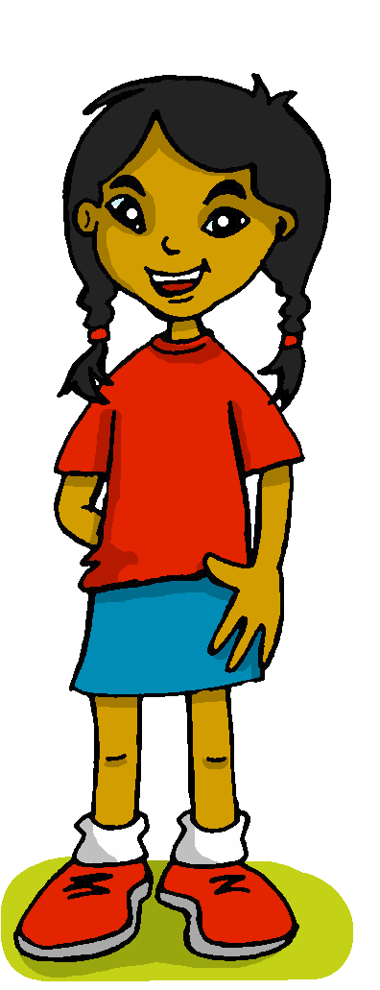

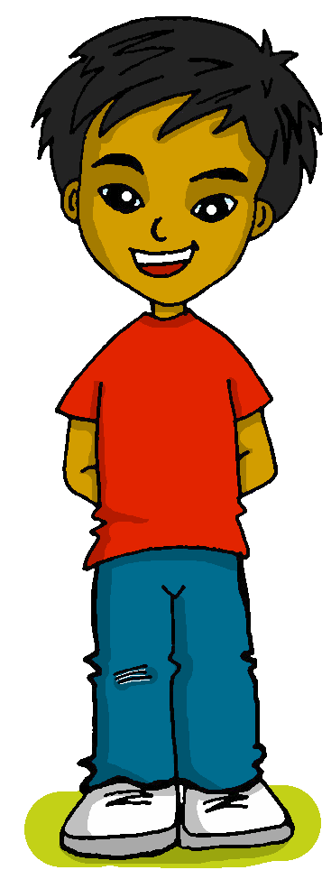
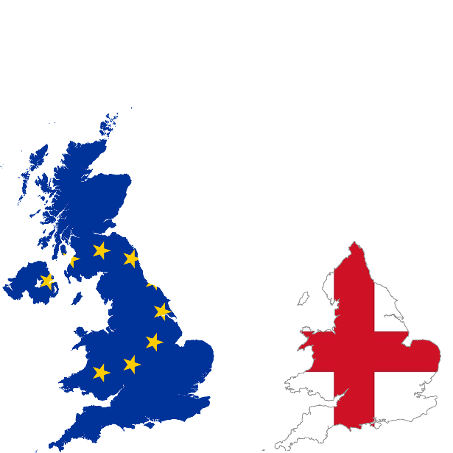

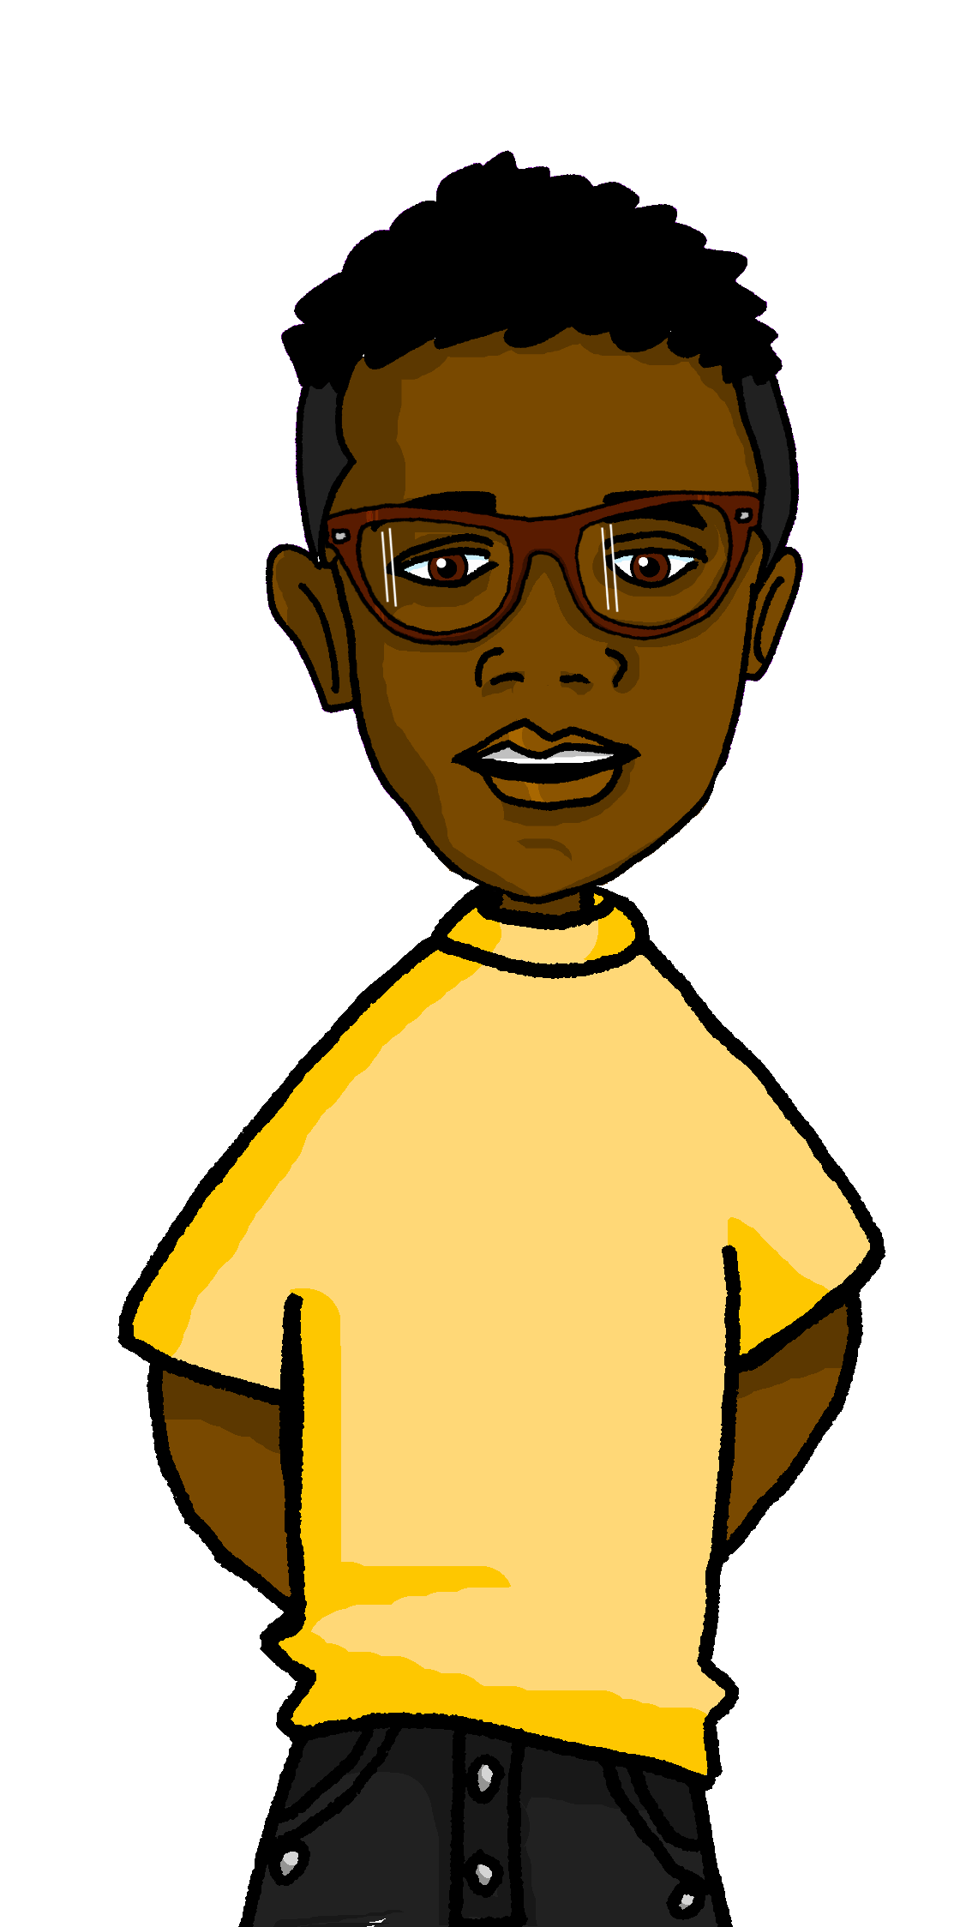

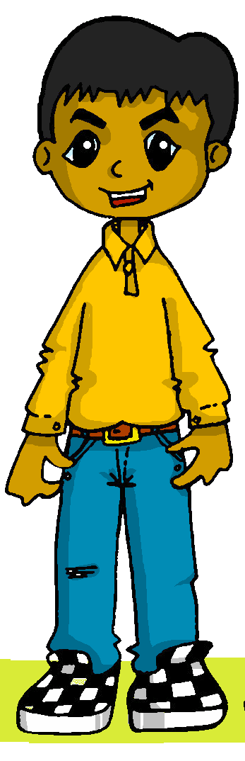

Describing things and people
Mi
favourite
>
Los colores
Inglaterra
amarillo
Follow ups 1-5
Perú
Notes:
Artwork by Steve Clarke. All additional pictures selected are available under a Creative Commons license, no attribution required.
The frequency rankings for words that occur in this PowerPoint which have been previously introduced in the resources are given in the SOW (excel document) and in the resources that first introduced and formally re-visited those words.
For any other words that occur incidentally in this PowerPoint, frequency rankings will be provided in the notes field wherever possible.
Phonics: Revisit [ga] [go] [gu] [ge] [gi] [j]
Vocabulary: ciudad [178] color [358] fiesta [796] persona [108] mi [37] tu [53] preferido [>5000]
Revisit 1: alto [231] bajo [452] blanco [372] negro [307] verde [812]
Revisit 2: aprender [428] leer [209] carta [627] noticia [859] revista [920] español [262] inglés [583] de2 [2]
Source: Davies, M. & Davies, K. (2018). A frequency dictionary of Spanish: Core vocabulary for learners (2nd ed.). Routledge: London

Slide 2





Follow up 1:
¡A practicar!
Lee las frases.
Tu compañero/a escucha y marca
pronunciar
A
Lee 💬
B
Escucha y marca ✅
[ga/go/gu]
[j/ge/gi]
[gue/gui]
La jirafa Jacinta tiene un regalo para Gema.
Mi tortuga Miguel lleva guantes cuando come guisantes.
El mago Gerónimo tiene un amigo gusano en el gimnasio.
[4]
1
2
[4]
3
[5]
Notes:
Timing: 5 minutes
Aim: to practise aural distinction between hard g [ga/go/go], soft g [j/ge/gi/] and [gue/gui] in a mixture of known and unknown words.
Procedure:
Read the explanation and ensure pupils understand the task.
Pupil Bs turn away from the board, having written 1, 2, 3 and made 3 x columns for [ga/go/gu], [/j/ge/gi] and [gue/gui]
Click to reveal the sentences.
Pupil A reads each sentence (Pupil B may say ‘¡Repite!’, as necessary).
Pupil B ticks his/her columns according to the sounds s/he hears.
Click to correct. Animations appear in the order of the sound that appears first.
Pupil As turn away. Repeat steps 3 – 6.
Transcript:
1. La jirafa Jacinta tiene un regalo para Gema.
2. Mi tortuga Miguel lleva guantes cuando come guisantes.
3. El mago Gerónimo tiene un amigo gusano en el gimnasio.
Frequency of unknown words and cognates:
gimnasio [>5000] girasol [>5000] guantes [4008] guerra [282] guisante [>5000] gusano [4217] jardín [1195] jirafa [19860] juguete [3162] regar [4087] tortuga [>5000]

Slide 3
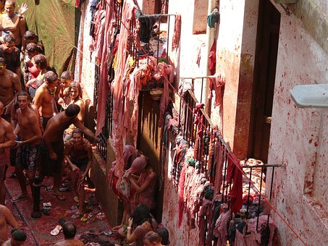
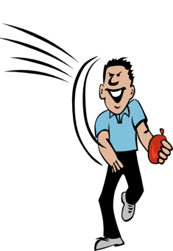

Follow up 1:
¡A practicar!
Lee las frases.
Tu compañero/a escucha y marca
pronunciar
B
Lee 💬
A
Escucha y marca ✅
La Tomatina
[ga/go/gu]
[j/ge/gi]
[gue/gui]
El juguete preferido de Gala es una guitarra.
La Tomatina es una guerra de tomates en agosto, dice Gerardo.
Es domingo y Genoveva riega el girasol en el jardín.
4
[4]
5
[3]
6
[5]
Notes:
[2/2]
Procedure:
Pupil As turn away from the board, having written 1, 2, 3 and made 3 x columns for [ga/go/gu], [/j/ge/gi] and [gue/gui]
Click to reveal the sentences.
Pupil B reads each sentence (Pupil A may say ‘¡Repite!’, as necessary).
Pupil A ticks his/her columns according to the sounds s/he hears.
Click to correct. Animations appear in the order of the sound that appears first.
Transcript:
4. El juguete preferido de Gala es una guitarra.
5. La Tomatina es una guerra de tomates en agosto, dice Gerardo.
6. Es domingo y Genoveva riega el girasol en el jardín.
Frequency of unknown words and cognates:
gimnasio [>5000] girasol [>5000] guantes [4008] guerra [282] guisante [>5000] gusano [4217] jardín [1195] jirafa [19860] juguete [3162] regar [4087] tortuga [>5000]

Slide 4

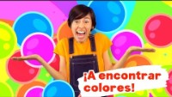

Follow up 2:
We’re going to find colours!
[A] Escucha y canta 🎤.
[B] Completa las frases.
hablar
escuchar
El pollito 🐣 es _____________.
El sol 🌞es _____________.
El cielo es _____________.
El océano 🌊 es ___________.
El tomate 🍅 es ____________.
La fresa 🍓 es _____________.
La hoja 🍃es _____________.
El sapo 🐸 es _____________.
amarillo
amarillo
azul
azul
rojo
roja
verde
verde
rojo | azul | amarillo
verde | roja | amarilla
Vamos a = we’re going to
encontrar = to find, finding
Notes:
Timing: 5 minutes
Aim: to revisit colours in a song; to revisit adjectival agreement.
Procedure:
Read and clarify the instruction.
Listen once for pupils to appreciate and become familiar with the rhythm
Listen one more time and encourage pupils to sing along
Click to bring up task B. Pupils either work in pairs or chorally as a class to say each line, using an appropriate adjective (colour).
NB. Note that the goal of this task is not to learn more colours (pupils have learned amarillo, blanco, negro, verde),. The song might provide an opportunity for incidental learning for some pupils, but the goal is to reinforce the vocabulary previously introduced (amarillo, verde, hoja) as well as to revisit adjectival agreement. If Rojo materials have been taught before amarillo lessons (meaning this is the second year of lower KS2), ‘sol, cielo and rojo’ are revisited rather than encountered for the first time.
Frequency of unknown words:
cantar [717] cielo [620] ] fresa [>5000] océano [2608] pollito [>] sapo [>5000] sol [383] tomate [4506
Source: Davies, M. & Davies, K. (2018). A frequency dictionary of Spanish: Core vocabulary for learners (2nd ed.). Routledge: London
Video source:
https://youtu.be/d84yrllvIhw

Slide 5


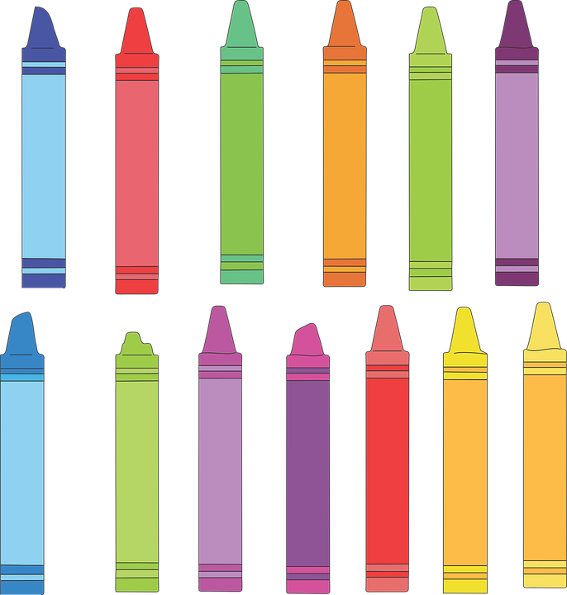



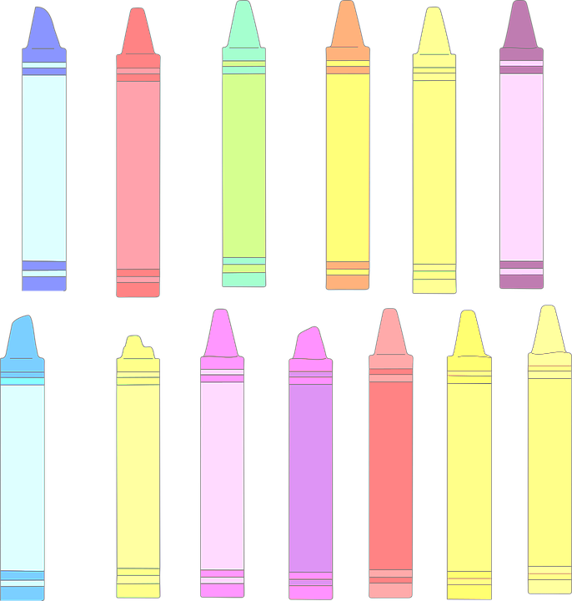

Follow up 3:
El color preferido de Max es el verde.
Y tú, ¿tu color preferido es el verde?
A
hablar
Mi color preferido es el rosa.
⚠ Note: in Spanish we say ‘My favourite colour is
‘the blue, the pink etc.’
Mi color preferido es el azul.
B
Keep talking until you have used all 12 colours! Choose the colours in any order.
A
Mi color preferido es el naranja.
el amarillo
el rojo
el blanco
el negro
el morado
el verde
el azul
el gris
el marrón
el rosa
el naranja
Notes:
Timing: 5 minutes
Aim: to practise spoken production of le/la and its connection with masculine/feminine nouns; to practise read aloud of mainly unknown nouns; to practise saying what your favourite/preferred colour is using the new adjective ‘preferido’.
Procedure:
Model the task with pupils, using the sequence provided.
Pupils keep talking until they have used all the colours.
Provide support as needed for the class or individuals.
If needed, the pronunciation of each colour and its articles can be heard by click on the image of the colour.

Slide 6


sus - his
Follow up 4: Max describe sus* cosas preferidas.
Escribe las frases en español.
leer
escribir
 | M_ c_ _ _ _ f_ _ _ _ _ _ _ e_ e_ v _ _ _ _. My favourite colour is green.
 | M_ p_d_ _ e_ f_ _ t_, i_ _ _ _ t_ _ t_ y d_ _ _ _ t_ _ _. My dad is strong, important and funny.
 | A_r_ _ _ _ e_ _ _ ñ_ _ e_ c_ _ _ _. I learn Spanish in class.
 | N_ _ _ _ _ m_ _ _ _ l_ _ c_ _ _ _ s e_ e_ _ _ñ_ _. Normally I read letters in Spanish.
 | M_ p_ _ _ _n_ p_ _ _ _ _ _d_ e_ m_ a_ _ _ _, K_ _ n_. My favourite person is my friend (f), Krina.
Mi color preferido es el verde.
E
Mi padre es fuerte, importante y divertido.
1
Aprendo español en clase.
2
Normalmente leo cartas en español.
3
Mi persona preferida es mi amiga, Krina.
4
Notes:
Timing: 5 minutes
Aim: to practise written production of vocabulary from this week and previous weeks.
Procedure:
Pupils write the sentences.
Click to correct.

Slide 7


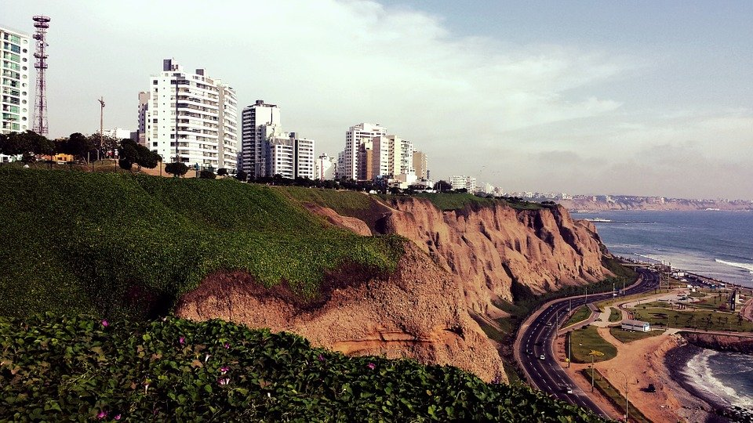



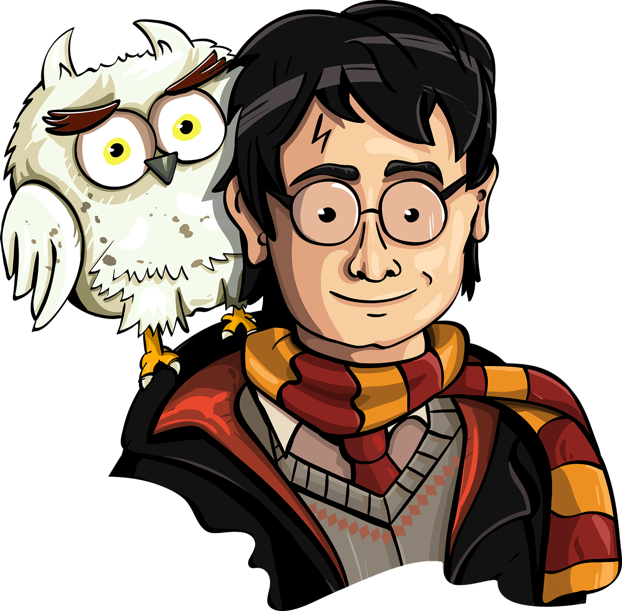
Follow up 5: ¿Quién eres?
A: Ask questions to work out who B has chosen to be.
B: Answer according to your chosen image.
hablar
¿Eres D?
¡Sí!
No.
¿Lees libros en español?
D
B
C
Sí.
¿Tu persona preferida es tu mamá?
D
B
Lima
C
mum
mum
friend (f)
Notes:
Timing: 8-10 minutes (3 slides)
Aim: to practise asking and answering questions.
Procedure:
1. Use this slide to model the task.
2. Click through the animations and ensure that pupils are clear about the task.
3. If needed, teachers can elicit the 4 questions that are needed for this game from pupils to refresh the knowledge before they start:
↕Tu persona preferida es tu mamá?
¿Lees libros en español?
Further questions could be:
¿Tu color preferido es el verde?
¿Tu ciudad preferida es Lima?
4. Move to the next slide to do the activity.

Slide 8
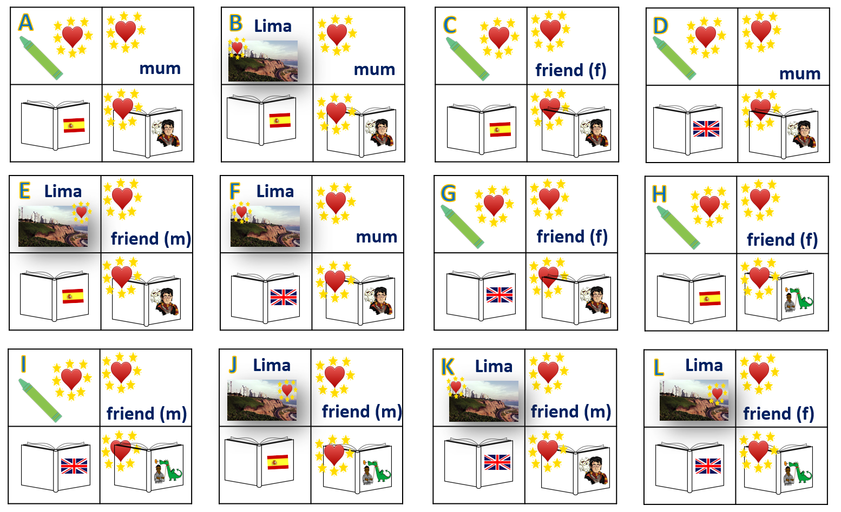
Follow up 5: ¿Quién eres? [1/2]
hablar
Notes:
DISPLAY THIS SLIDE
Timing: 8-10 minutes
Aim: to practise asking and answering questions.
Procedure:
1. Pupil B chooses one letter – that is the ‘person’ they are.
2. A asks yes/no questions to work out who B is.
The four questions are:
¿Tu color preferido es…?
¿Tu libro preferido es …?
¿Lees libros en español/inglés?
¿Tu persona preferida es…?
3. Pupil B sí or no.
4. Pupil A keeps going until s/he has worked out which letter B is.
5. Swap roles and play again.
Note:
this round of the game can be played several times, with pupils taking it in turns.
There is a further round of the game with different language to practise on the next slide.
Click the audio buttons to hear the questions, if required.

Slide 9
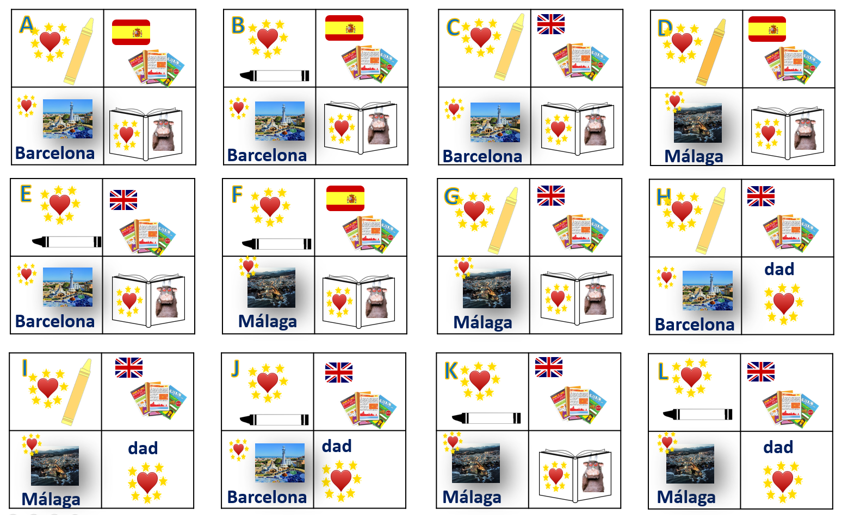
Follow up 5: ¿Quién eres? [2/2]
hablar
Notes:
DISPLAY THIS SLIDE
This is the 2nd version of the game.
Aim: to practise asking and answering questions.
Procedure:
1. Pupil A chooses one letter – that is the ‘person’ they are.
2. B asks yes/no questions to work out who A is.
The four questions are:
¿Tu color preferido es el amarillo/blanco?
¿Lees revistas en inglés/español?
¿Tu ciudad preferida es BCN / Málaga?
¿Tu persona preferida es papá?
¿Tu libro favorito es The Gruffalo?
3. Pupil A says sí or no.
4. Pupil B keeps going until s/he has worked out which letter A is.
5. Swap roles and play again.
Note:
this round of the game can be played several times, with pupils taking it in turns.
There is a further round of the game with different language to practise on the next slide.
Click the audio buttons to hear the questions, if required.

Slide 10




follow up Extra 1a:
Escribe en inglés 📝: can you get at least 15 points?
 | la revista | español | de
 | aprender | leer | la carta
 | alta | verde | blanco
 | bajo | alto | negra
 | tu | preferida | la ciudad
 | la persona | mi | el color
vocabulario
magazine
Spanish
of
x3
to learn, learning
to read, reading
letter
tall (f)
green
white (m)
x2
short (m)
tall (m)
black (f)
your
preferred (f)
city
x1
person
my
colour
Notes:
Timing: 5 minutes
Aim: to practise written production of vocabulary from this week and this week’s revisited sets.
Procedure:
1. Give pupils a blank grid. They fill in the English meanings of any of the words they know, trying to reach 15 points in total.
Note:
The most recently learnt and practised words are pink, words from the first revisit are green and those from the second revisit are blue, thus more points are awarded for them, to recognise that memories fade and more effort (heavy lifting!) is needed to retrieve them.

Slide 11
follow up extra 1b:
Escribe en español 📝: can you get at least 15 points?
 | to learn | maganize | letter
 | of | Spanish | to read
 | tall (f) | white (m) | short (m)
 | black (f) | green | tall (m)
 | my | your | colour
 | person | preferred (f) | city
vocabulario
aprender
la revista
la carta
x3
de
español
leer
alta
blanco
bajo
x2
negra
verde
alto
mi
tu
el color
x1
la persona
preferida
la ciudad
Notes:
Timing: 5 minutes
Aim: to practise written production of vocabulary from this week and this week’s revisited sets.
Procedure:
1. Give pupils a blank grid. They fill in the Spanish meanings of any of the words they know, trying to reach 15 points in total.
Note:
The most recently learnt and practised words are pink, words from the first revisit are green and those from the second revisit are blue, thus more points are awarded for them, to recognise that memories fade and more effort (heavy lifting!) is needed to retrieve them.

Slide 12
follow up 2b:
Follow up Extra 1a: Handout
Escribe en inglés 📝: can you get at least 15 points?
 | la revista | español | de
 | aprender | leer | la carta
 | alta | verde | blanco
 | bajo | alto | negra
 | tu | preferida | la ciudad
 | la persona | mi | el color
vocabulario
x3
x2
x1
Notes:
HANDOUT 5

Slide 13
follow up 2b:
Follow up extra 1b: Handout
Escribe en español 📝: can you get at least 15 points?
 | to learn | maganize | letter
 | of | Spanish | to read
 | tall (f) | white (m) | short (m)
 | black (m) | green | short (f)
 | my | your | colour
 | person | preferred (f) | city
vocabulario
x3
x2
x1
Notes:
HANDOUT 5

Slide 14
¡adiós!
amarillo

