Slide 1


español, con Quique

Slide 2

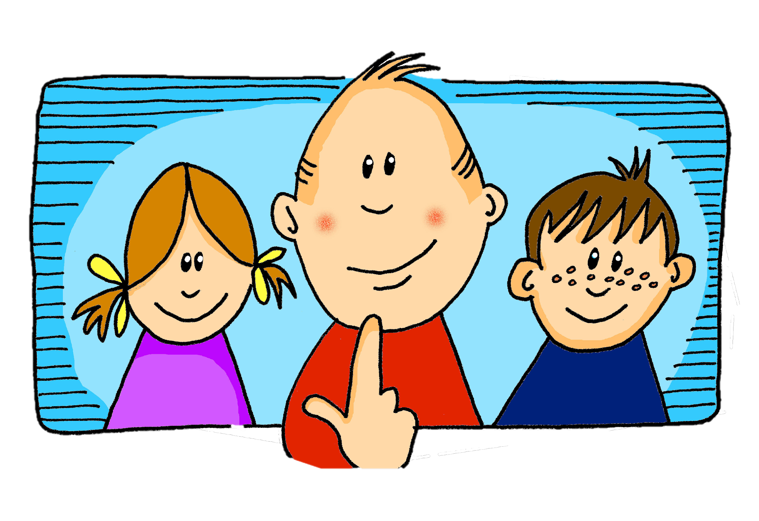
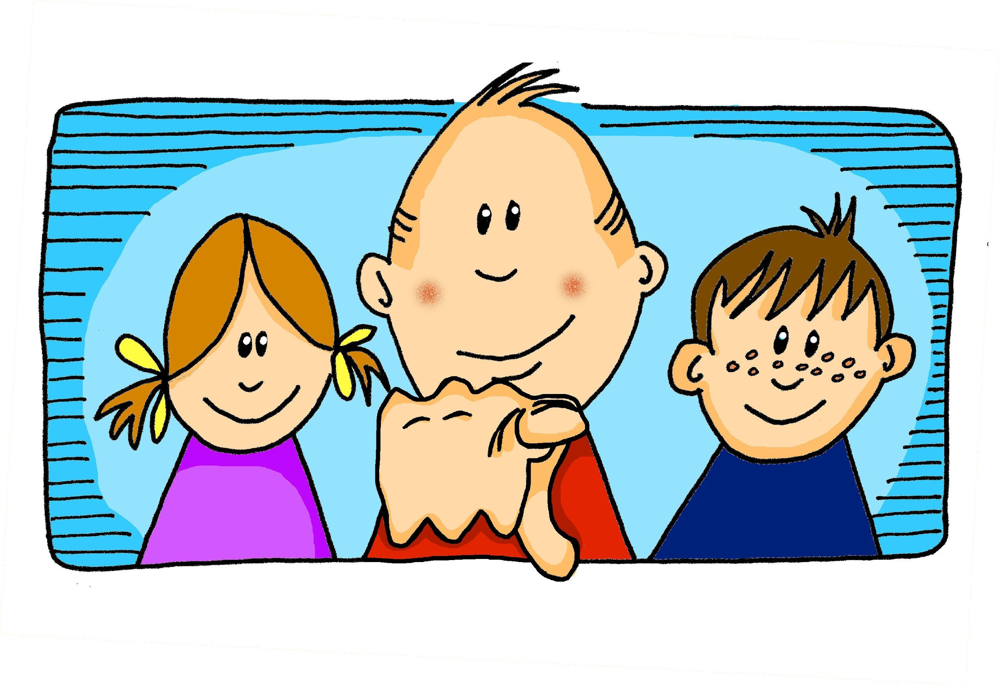
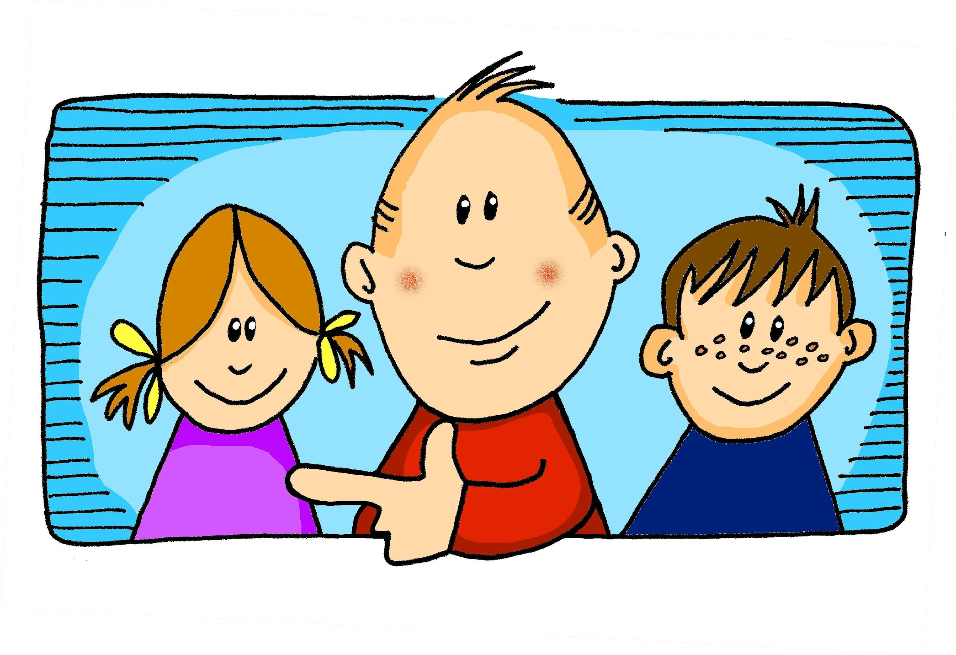
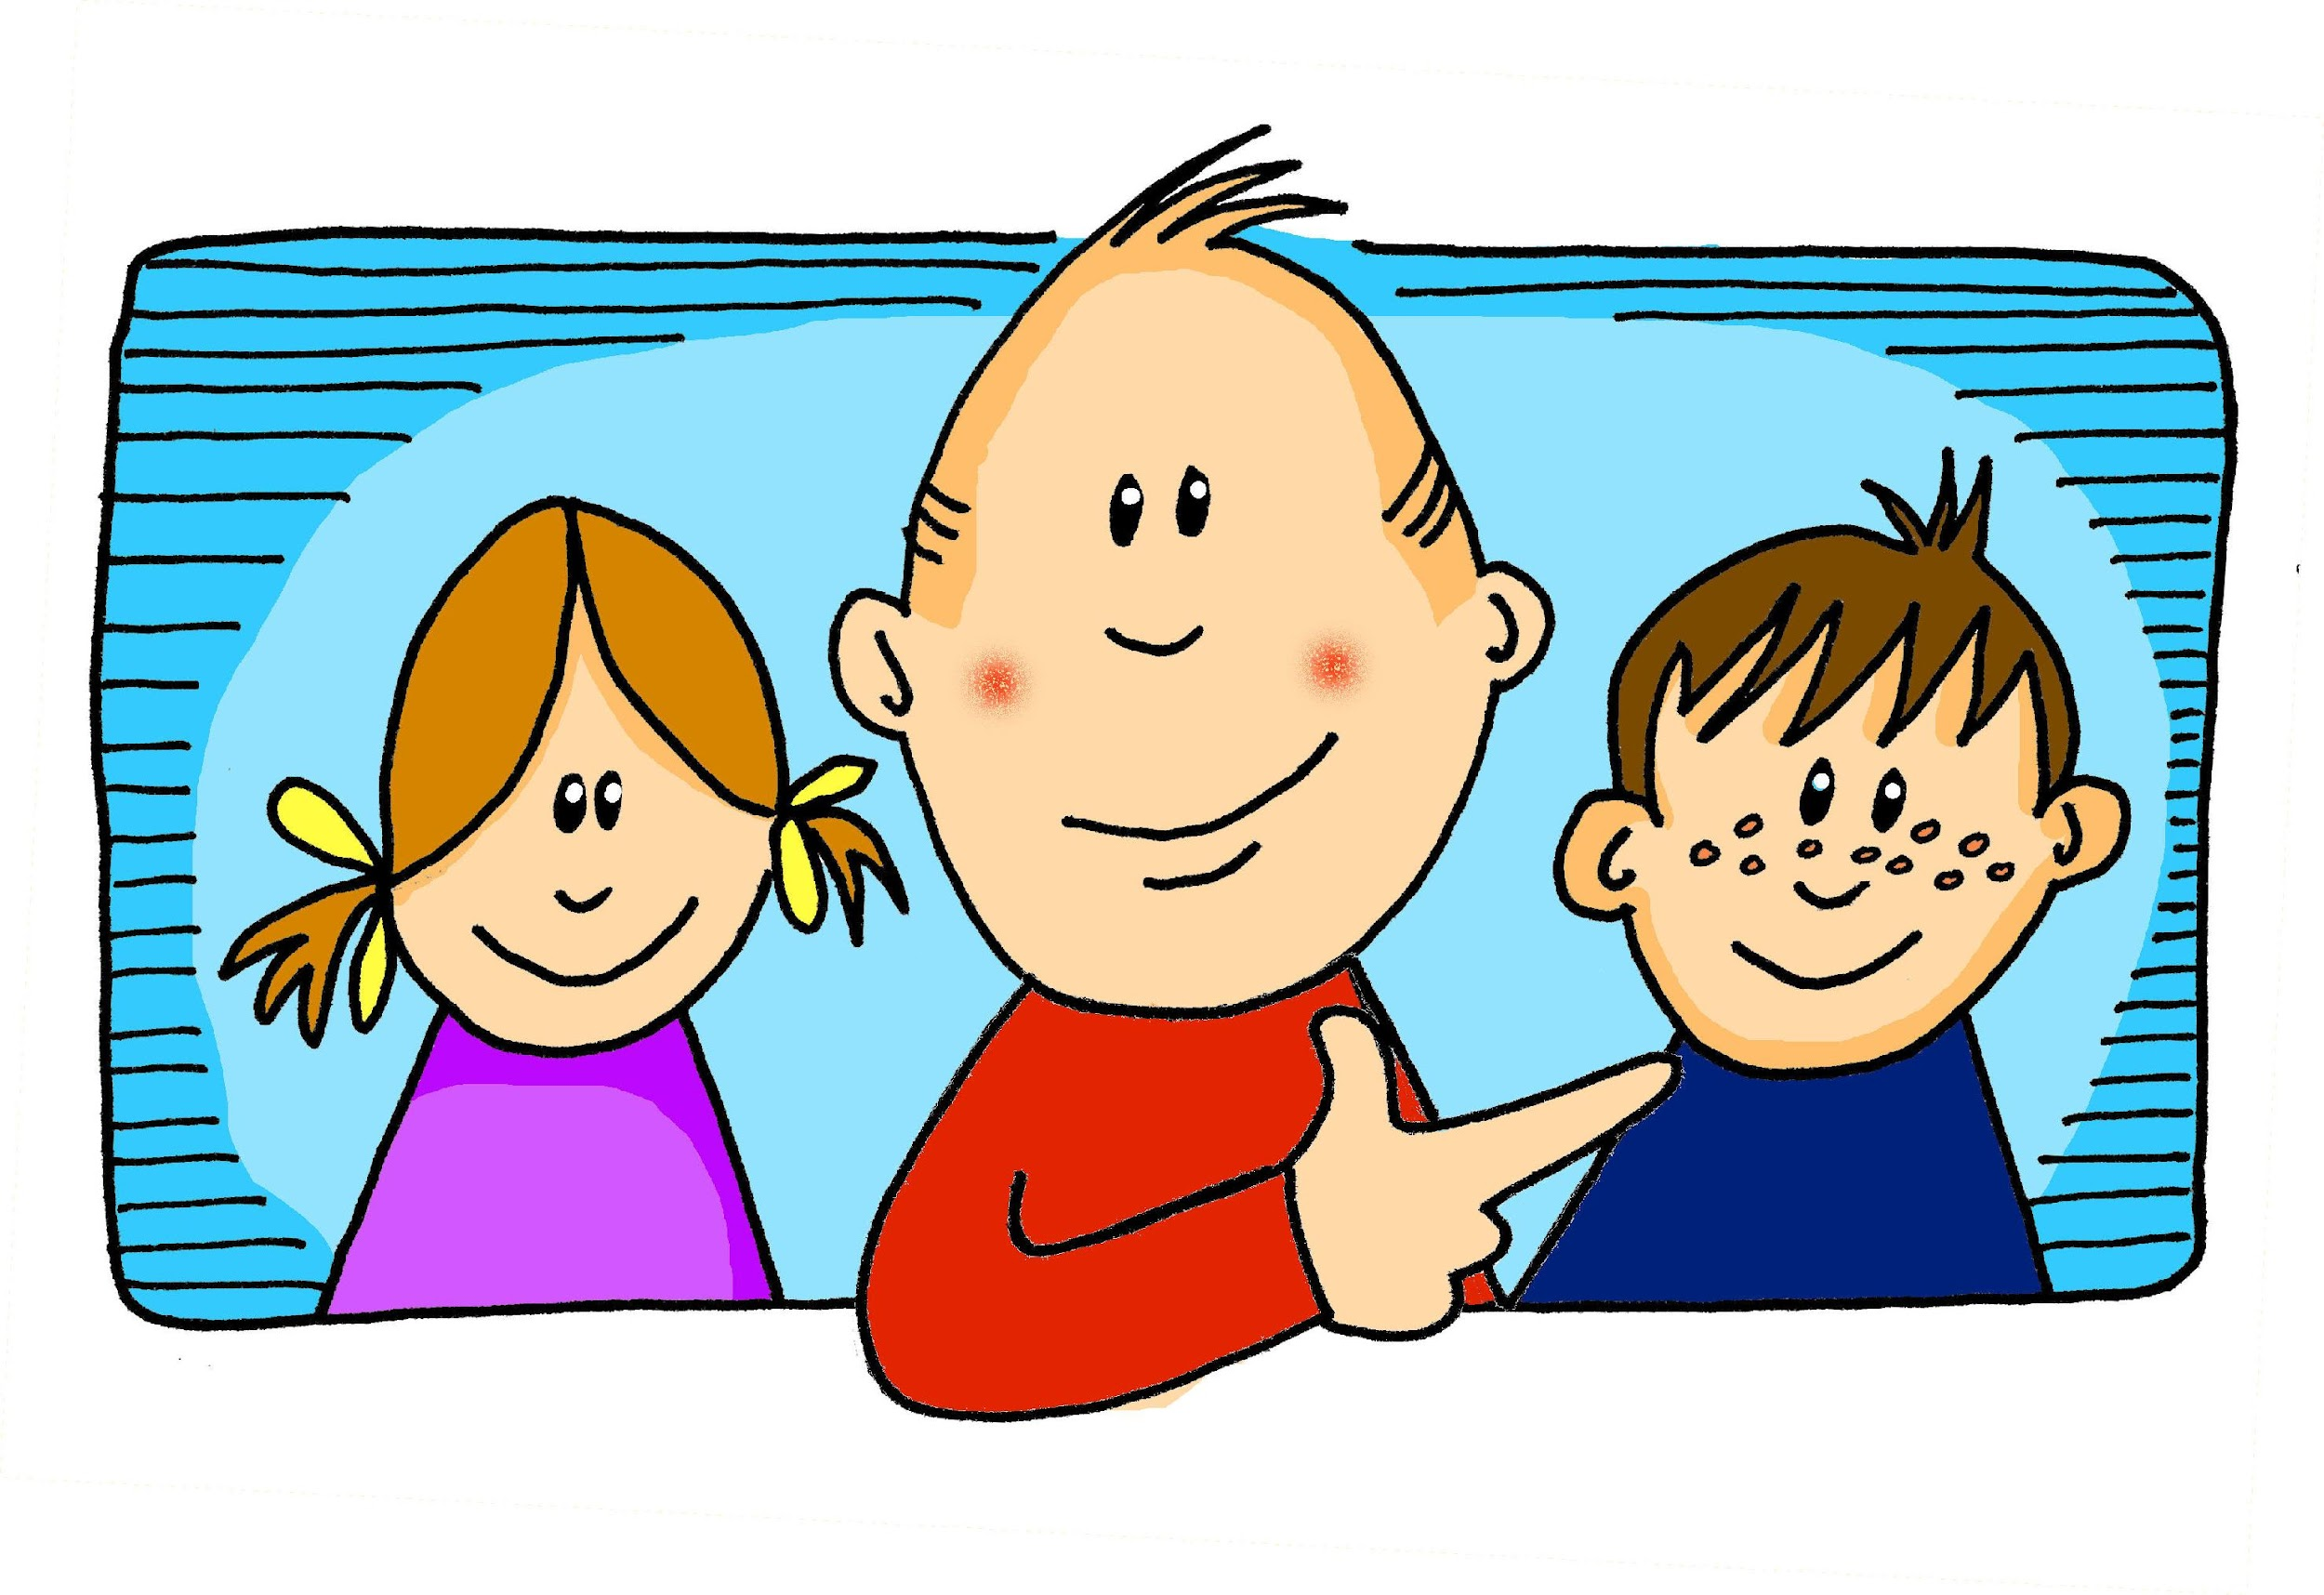
Saying what I and others do
¿Cómo es?
adjective agreement
SSC [ga] [go] [gu]
[ge] [gi]
amarillo
Notes:
Artwork by Steve Clarke. All additional pictures selected are available under a Creative Commons license, no attribution required.
The frequency rankings for words that occur in this PowerPoint which have been previously introduced in the resources are given in the SOW (excel document) and in the resources that first introduced and formally re-visited those words.
For any other words that occur incidentally in this PowerPoint, frequency rankings will be provided in the notes field wherever possible.
Phonics: revisit SSC [gue] [gui] guitarra [2705] juguete [3162]
Vocabulary: él [9] ella [72] tú [184] yo [28] chico [727] chica [1159] débil [1946] fuerte [435] grande [66] independiente [1177] pero [30]
Revisit 1: hay [haber 13] cuántos [580] cuántas [580]
Revisit 2: montar [1446] pasear [1741] bicicleta [3684] estadio [2581] madre [226], padre [162] ciudad [178] el [1] la [1] de2 [2] por1 [15]
Frequency of unknown words and cognates:
seguir [99] águila [>5000] hamburguesa [>5000] guerra [282] también [49]
Source: Davies, M. & Davies, K. (2018). A frequency dictionary of Spanish: Core vocabulary for learners (2nd ed.). Routledge: London

Slide 3

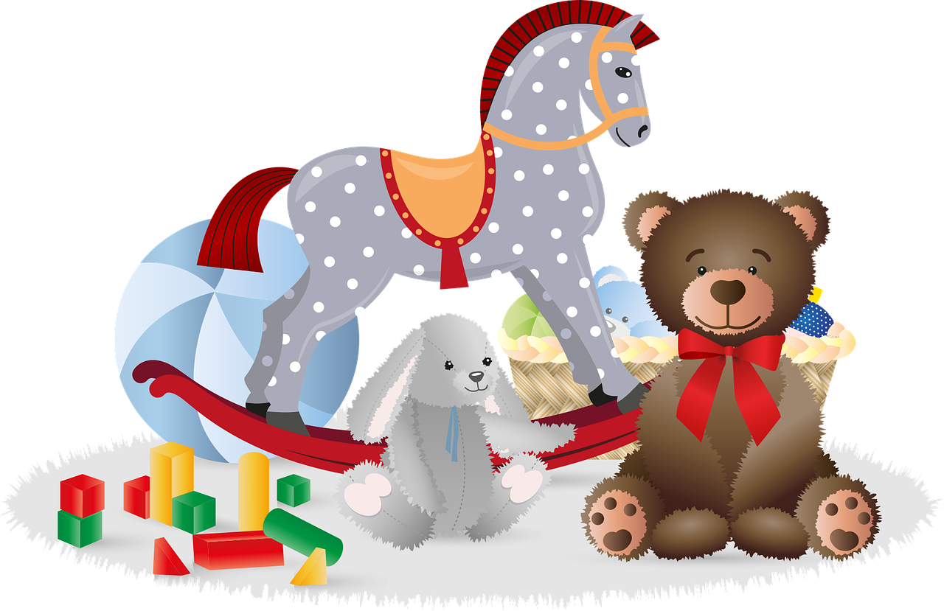
[gue]
pronunciar
[toy]
juguete
Notes:
Timing: 1 minute
Aim: To introduce SSC [gue].
Procedure:
Introduce and elicit the pronunciation of the individual SSC [gue] and then the source word ‘juguete’ (with gesture, if using).
Click to bring up the picture and get pupils to repeat (with gesture, if using).
Pupils to practise in pairs.
Gesture suggestion: put hands out in front (as though holding a toy) and do three short movements with the shoulders (right-left-right) to match the number of syllables as you say the word ‘ju-gue-te’.

Slide 4

[gui]
pronunciar
guitarra
Notes:
Timing: 1 minute
Aim: To introduce SSC [gui].
Procedure:
Introduce and elicit the pronunciation of the individual SSC [gui] and then the source word ‘guitarra’ (with gesture, if using).
Click to bring up the picture and get pupils to repeat (with gesture, if using).
Pupils to practise in pairs.
Gesture suggestion: mime playing a guitar.

Slide 5



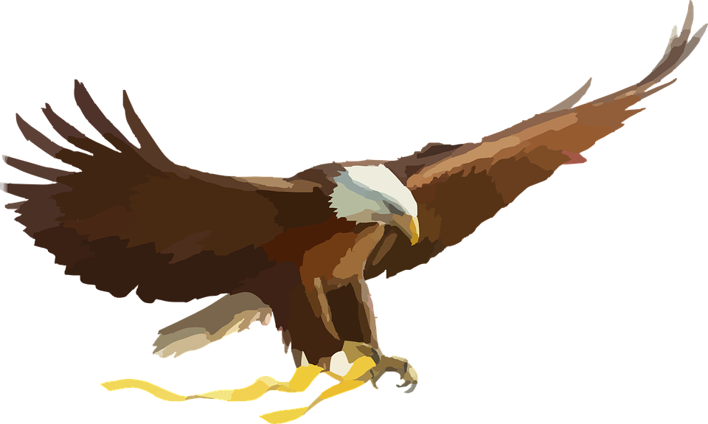
[gue]
[gui]
pronunciar
[toy]
[war]
juguete
hamburguesa
guerra
[to follow]
guitarra
seguir
águila
Notes:
Timing: 2 minutes
Aim: To consolidate SSC [gue] and [gui].
Procedure:
Introduce and elicit the pronunciation of the individual SSC and then the source words ‘juguete’ and guitarra’ (with gestures, if using).
Then click to bring up two cluster words for each SSC and elicit the pronunciation from pupils.
Pupils to practise in pairs.
Frequency of unknown words and cognates:
seguir [99] águila [>5000] hamburguesa [>5000] guerra [282]
Source: Davies, M. & Davies, K. (2018). A frequency dictionary of Spanish: Core vocabulary for learners (2nd ed.). Routledge: London

Slide 6


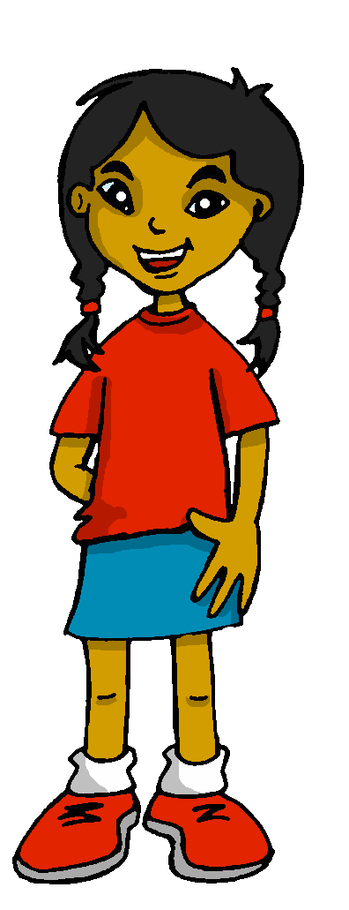


vocabulario
¿Cómo es en español?
I
but
weak
yo
pero
débil
la chica
independent
independiente
weak
grande
but
he
you
strong
girl
I
independent
big
boy
you
strong
he
el chico
tú
fuerte
él
Notes:
Timing: 5 minutes
Aim: to present and practise written comprehension and read aloud of previously taught vocabulary and three new words for this week.
Procedure:
1. Click for an English item. Elicit pronunciation of the Spanish from pupils.
2. Click to cover the Spanish word with a picture.
3. Continue with the remaining items.
4. Optional at this stage: elicit the Spanish from pupils.

Slide 7


SER | ESTAR
[to be [trait] | to be [location, state]
Remember, there are two ways to say ‘is’ in Spanish:
está
Use ______ for location or temporary state.
es
The adjective ends in –a so we can tell that this means ‘she is’.
Use ______ for permanent traits.
She is tall. (trait)
Es alta.
She is independent. (trait)
Es independiente.
Está débil.
When an adjective ends in –e or consonant, it can describe a masculine or feminine noun, so we don’t know if it’s she or he.
He is weak. (state)
With estar English often uses –ing, e.g. S/he is feeling weak (today).
Notes:
Timing: 2 minutes
Aim: to revisit the 3rd person singular of SER and ESTAR and give a reminder about adjective agreement.
Procedure:
Click through the animations to present the information.
Elicit Spanish translations for the English examples provided as this is revision.

Slide 8




leer
Hoy, Ángela está en clase. Rubén, también.*
también = too, as well
Lee las frases. ¿Es ‘hoy’ (temporary state) o ‘siempre’ (trait)?
¿Quién es? ¿Es Ángela, Rubén o ‘ ’?
If you can’t tell from the adjective, then put ‘?’
 |  | Hoy | Siempre |  | En inglés
E | Está fuerte. |  |  | / | S/He is (feeling) strong.
1 | Es alta. |  |  | Ángela | She is (a) tall person.
2 | Es feliz. |  |  |  | S/he is (a) happy (person).
3 | Es interesante. |  |  |  | S/he is (an) interesting (person).
4 | Está pesada. |  |  | Ángela | She is (being) annoying.
5 | Está perdido. |  |  | Rubén | He is (feeling) lost.
6 | Es positivo. |  |  | Rubén | He is (a) positive (person).
Ángela, Rubén o
E
1
2
3
4
5
6
Notes:
Timing: 8 minutes
Aim: to practise differentiating between ‘está’ for temporary state and ‘es’ for trait. Adjective agreement is also practised here.
Procedure:
Do the example with pupils to model the first part of the task. Read the sentence and work out if it refers to ‘hoy’ (today) or ‘siempre’ (always).
Pupils then do items 1-6.
Teacher elicits answers ‘hoy’ or ‘siempre’ and clicks to reveal.
The teacher then clicks to bring up the callout reminding pupils about adjective endings.
Pupils fill in the Rubén or Ángela or ‘either’ column by looking at the ending of the adjective.
The teacher then goes through the answers.
The teacher then elicits and reveals the English meanings.

Slide 9
Subject pronouns (she, he)
Remember, the adjective often tells us if the sentence refers to she or he:
Está preparado.
He is (feeling) ready.
Es postiva.
She is (a) positive(person).
If the adjective doesn’t help us, we can use the pronouns ella (she)and él (he) with the verb, instead:
We use the pronouns to avoid confusion and make it clear who we are talking about.
Ella es fuerte.
She is (a) strong (person).
Él está feliz.
He is (feeling) happy.
Notes:
Timing: 2 minutes
Aim: to introduce the subject pronouns él and ella and one reason for using them.
Procedure:
Click through the animations to present the information.
Elicit English translations for the Spanish examples provided.

Slide 10

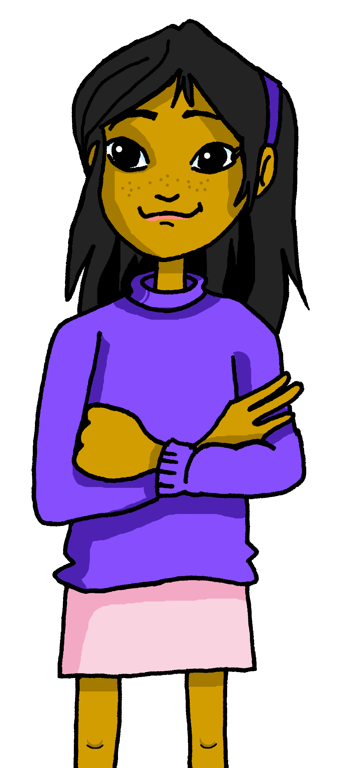
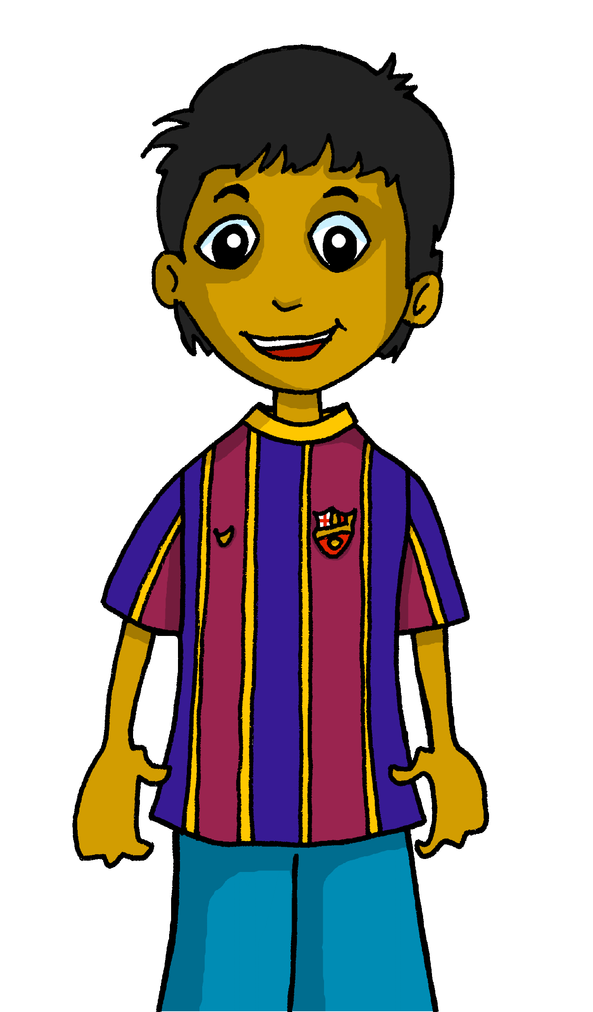
escuchar
Sofía describe a los amigos. ¿Quién es? Ángela o Rubén?
Escucha. ¿Es necesario ‘él|ella’?
E
Ella es importante.
Ángela
Rubén
Notes:
[1/7]
Timing: 9 minutes (7 slides)
Aim: to practise aural comprehension of adjectives and connect their gendered forms to the correct subject; the recognise when this is not possible and a subject pronoun can be used.
Procedure:
Read the context and click to bring up further instruction.
Pupils write 1-6 in their books.
Click to listen to the example. Pupils decide whether the sentence applies to Ángela or Rubén (or if they cannot tell).
In this case they cannot tell because the adjective ends in –e. Click to show this with a ? that appears between the two friends.
Click to bring up an arrow to highlight who the sentence is about. (arrow highlights Ángela).
Elicit the subject pronoun ‘ella’ and the rest of the sentence ‘Ella es amable’.
Click to bring up Sofía’s speech bubble with the full sentence.
Move to the next slide to complete items 1-6.
Transcript:
Ej. Es importante.
Ella es importante.

Slide 11
escuchar
Sofía describe a los amigos. ¿Quién es? Ángela o Rubén?
Escucha. ¿Es necesario ‘él|ella’?
1
Es bajo.
Ángela
Rubén
Notes:
[2/7]
Procedure:
Click to listen to the example. Pupils decide whether the sentence applies to Ángela or Rubén (or if they cannot tell).
In this case they can tell because the adjective ends in –o.
Elicit this answer from pupils and click to confirm.
Click again to bring up Sofía’s speech bubble with the full sentence.
Move to the next slide.
Transcript:
Es bajo.

Slide 12
escuchar
Sofía describe a los amigos. ¿Quién es? Ángela o Rubén?
Escucha. ¿Es necesario ‘él|ella’?
2
Es divertida.
Ángela
Rubén
Notes:
[3/7]
Procedure:
Click to listen to the example. Pupils decide whether the sentence applies to Ángela or Rubén (or if they cannot tell).
In this case they can tell because the adjective ends in –a.
Elicit this answer from pupils and click to confirm.
Click again to bring up Sofía’s speech bubble with the full sentence.
Move to the next slide.
Transcript:
Es divertida.

Slide 13
escuchar
Sofía describe a los amigos. ¿Quién es? Ángela o Rubén?
Escucha. ¿Es necesario ‘él|ella’?
3
Él es independiente.
Ángela
Rubén
Notes:
[4/7]
Procedure:
Click to listen to the example. Pupils decide whether the sentence applies to Ángela or Rubén (or if they cannot tell).
In this case they cannot tell because the adjective ends in –e. Click to show this with a ? that appears between the two friends.
Click to bring up an arrow to highlight who the sentence is about. (arrow highlights Rubén).
Elicit the subject pronoun ‘él’ and the rest of the sentence ‘él es inteligente’.
Click again to bring up Sofía’s speech bubble with the full sentence.
Move to the next slide.
Transcript:
Es independiente.
Él es independiente.

Slide 14
escuchar
Sofía describe a los amigos. ¿Quién es? Ángela o Rubén?
Escucha. ¿Es necesario ‘él|ella’?
4
Él está feliz.
Ángela
Rubén
Notes:
[5/7]
Procedure:
Click to listen to the example. Pupils decide whether the sentence applies to Ángela or Rubén (or if they cannot tell).
In this case they cannot tell because the adjective ends in –e. Click to show this with a ? that appears between the two friends.
Click to bring up an arrow to highlight who the sentence is about. (arrow highlights Rubén).
Elicit the subject pronoun ‘él’ and the rest of the sentence ‘él es elegante’.
Click again to bring up Sofía’s speech bubble with the full sentence.
Move to the next slide.
Transcript:
Está feliz.
Él está feliz

Slide 15
escuchar
Sofía describe a los amigos. ¿Quién es? Ángela o Rubén?
Escucha. ¿Es necesario ‘él|ella’?
5
Está perdido.
Ángela
Rubén
Notes:
[6/7]
Procedure:
Click to listen to the example. Pupils decide whether the sentence applies to Ángela or Rubén (or if they cannot tell).
In this case they can tell because the adjective ends in –o.
Elicit this answer from pupils and click to confirm.
Click again to bring up Sofía’s speech bubble with the full sentence.
Move to the next slide.
Transcript:
Está perdido.

Slide 16
escuchar
Sofía describe a los amigos. ¿Quién es? Ángela o Rubén?
Escucha. ¿Es necesario ‘él|ella’?
6
Ella está débil.
Ángela
Rubén
Notes:
[7/7]
Procedure:
Click to listen to the example. Pupils decide whether the sentence applies to Ángela or Rubén (or if they cannot tell).
In this case they cannot tell because the adjective ends in –e. Click to show this with a ? that appears between the two friends.
Click to bring up an arrow to highlight who the sentence is about. (arrow highlights Ángela).
Elicit the subject pronoun ‘elle’ and the rest of the sentence ‘ella está feliz’.
Click again to bring up Sofía’s speech bubble with the full sentence.
Move to the next slide.
Transcript:
Está débil.
Ella está débil.

Slide 17

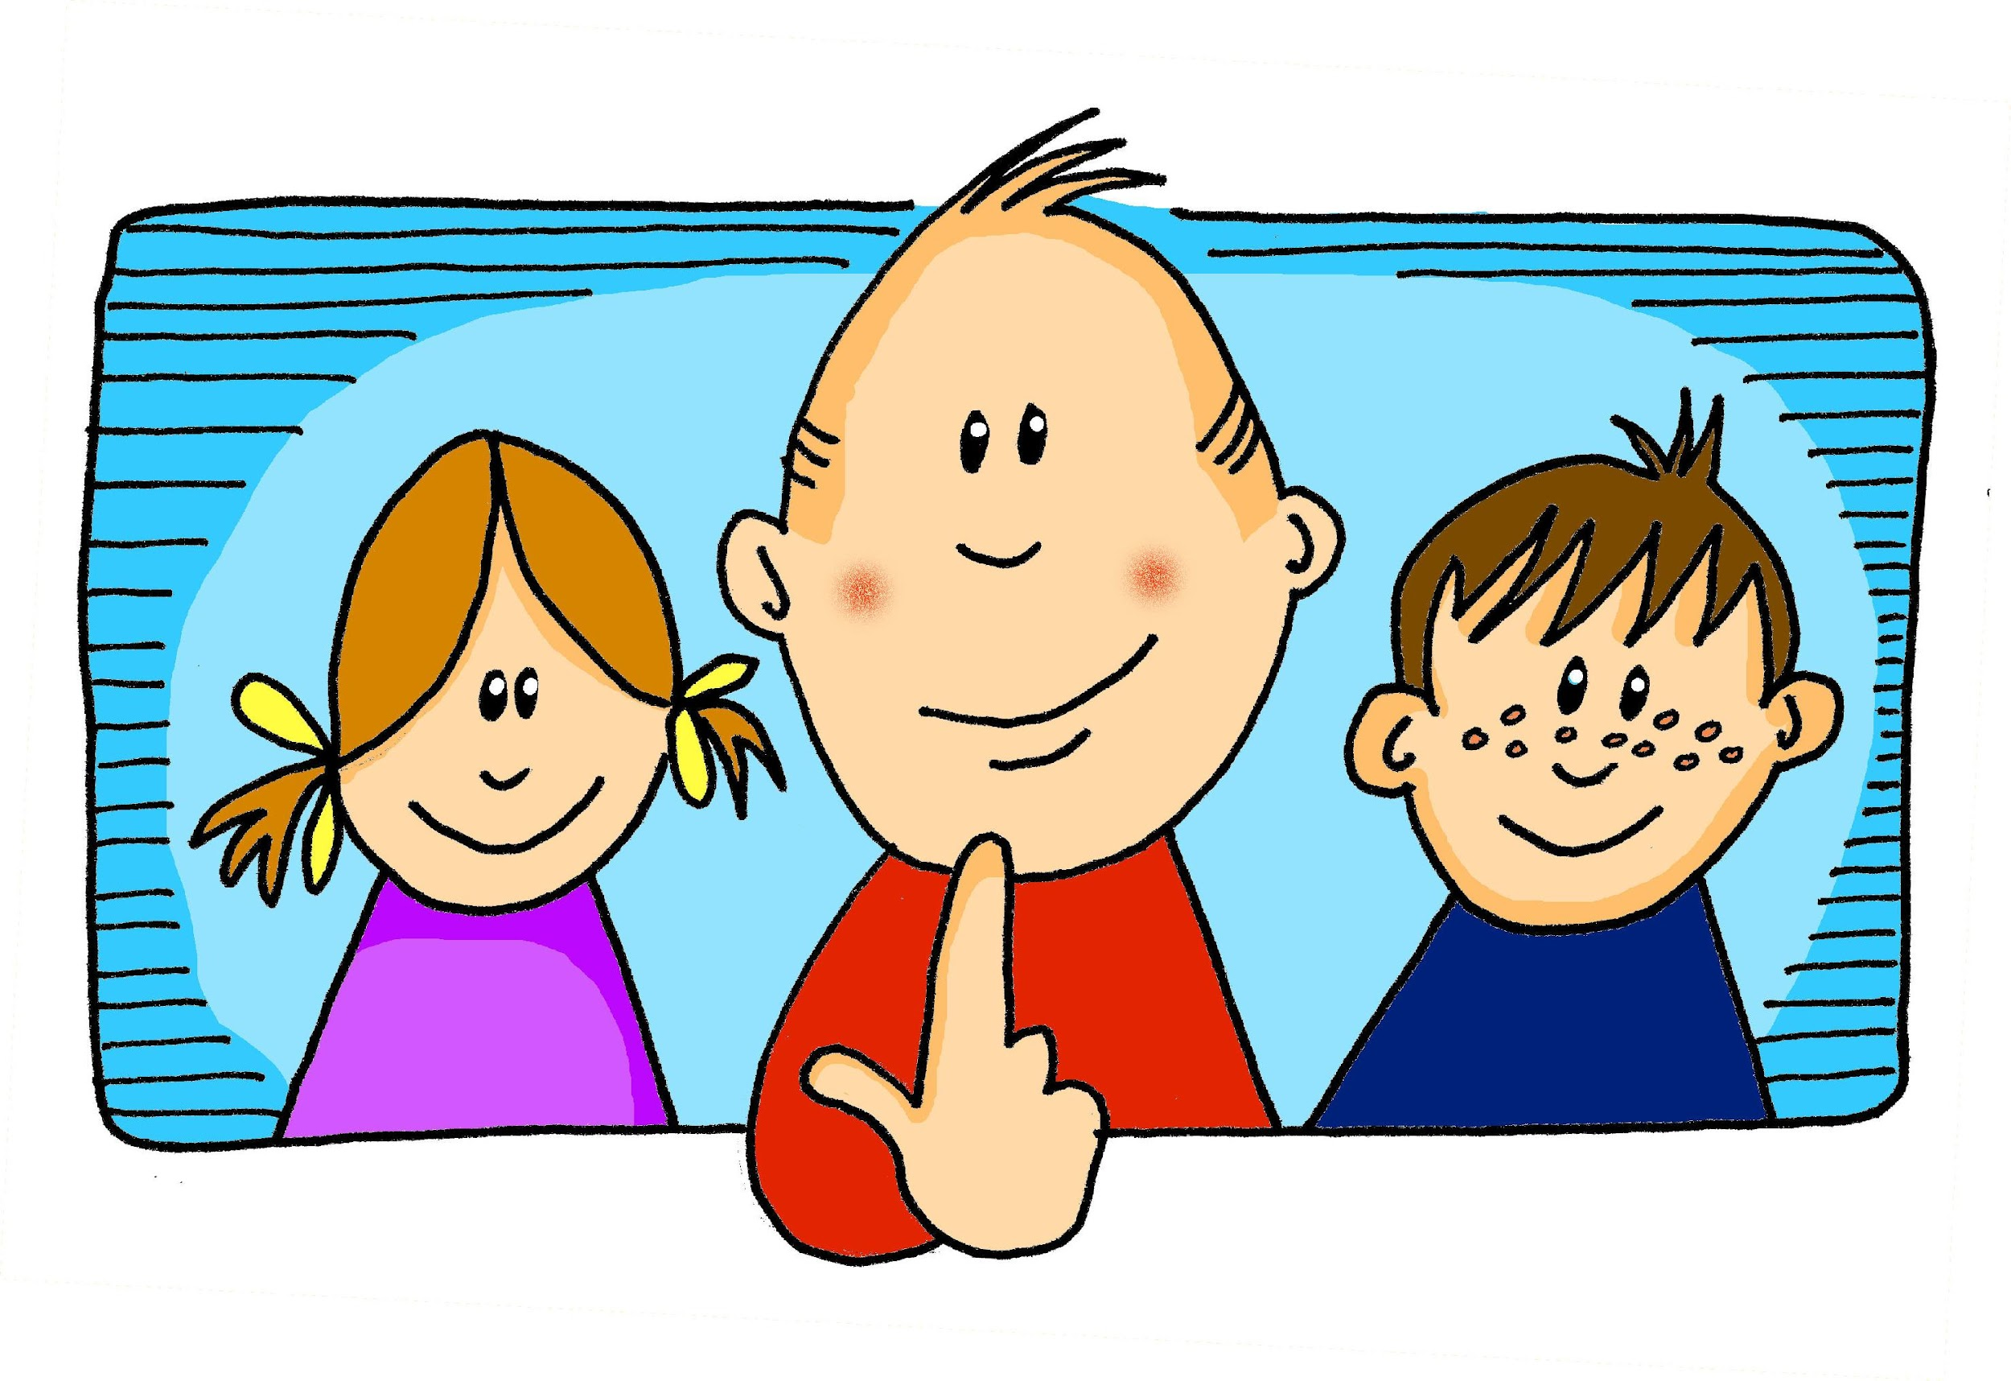
vocabulario
¡A practicar!
ella
él
pero
yo
tú
Notes:
Timing: 5 minutes
Aim: to consolidate ‘ella’ and ‘él’ and practise three other new words from this week.
Procedure:
1. Click for the Spanish word. Pupils repeat.
2. Click for the image. Pupils say the Spanish word. (Pupils may enjoy doing gestures for the pronouns, and teachers can also use gestures to elicit the words from pupils. The gesture for ‘but’ can be putting the right hand up, palm facing forwards, as if to indicate an objection, say no.)
3. After all words have been presented, elicit the English meanings in a jumbled order from pupils (if needed, click on the pictures to hear the audio again).
4. Then elicit the Spanish, giving pupils the English (again in a jumbled order).

Slide 18
¡adiós!
amarillo

