Slide 1


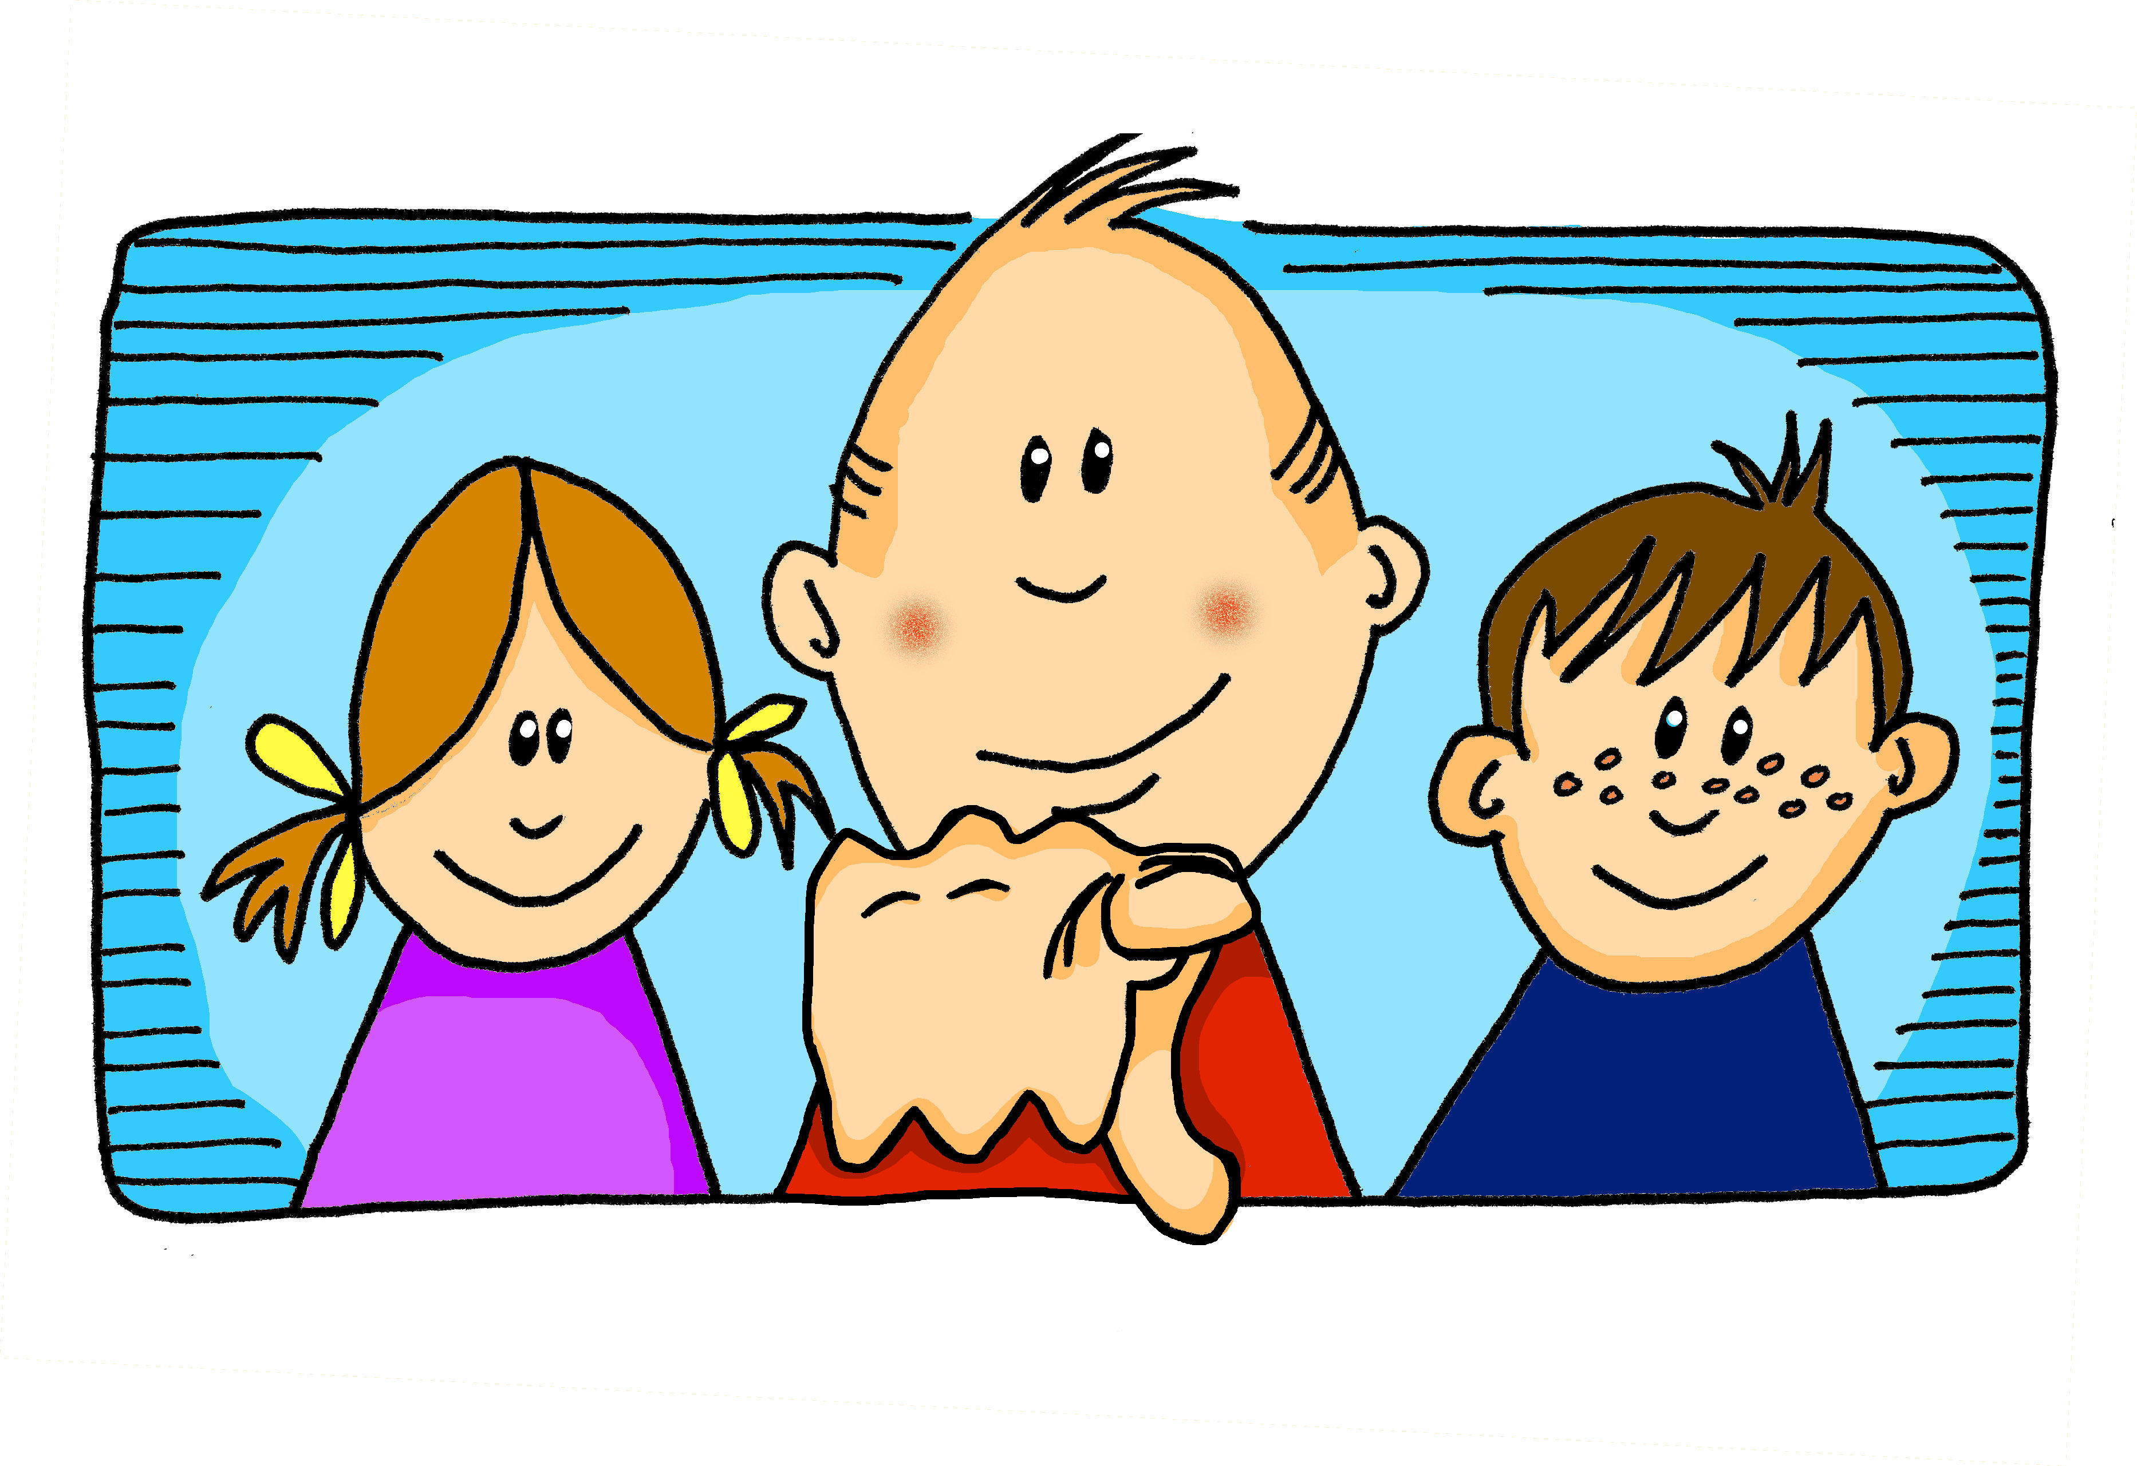
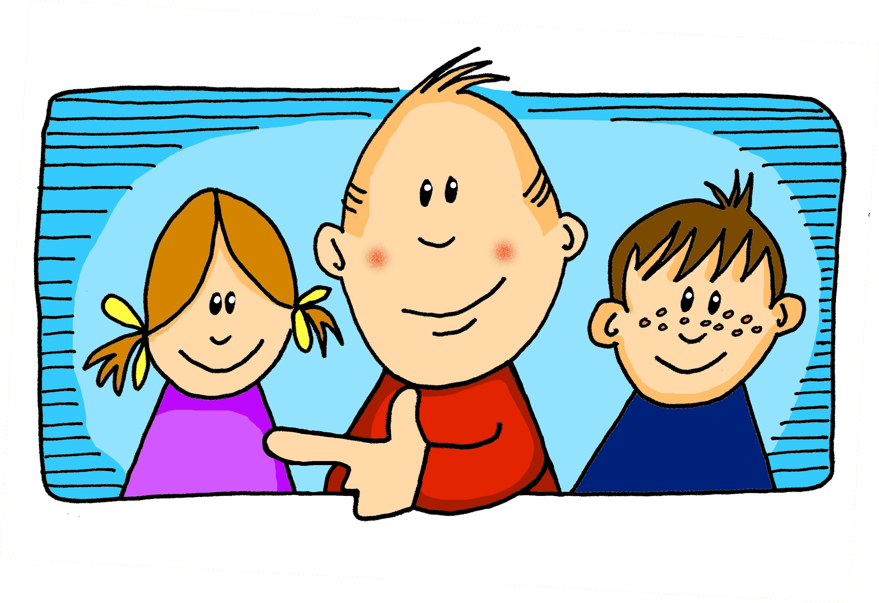
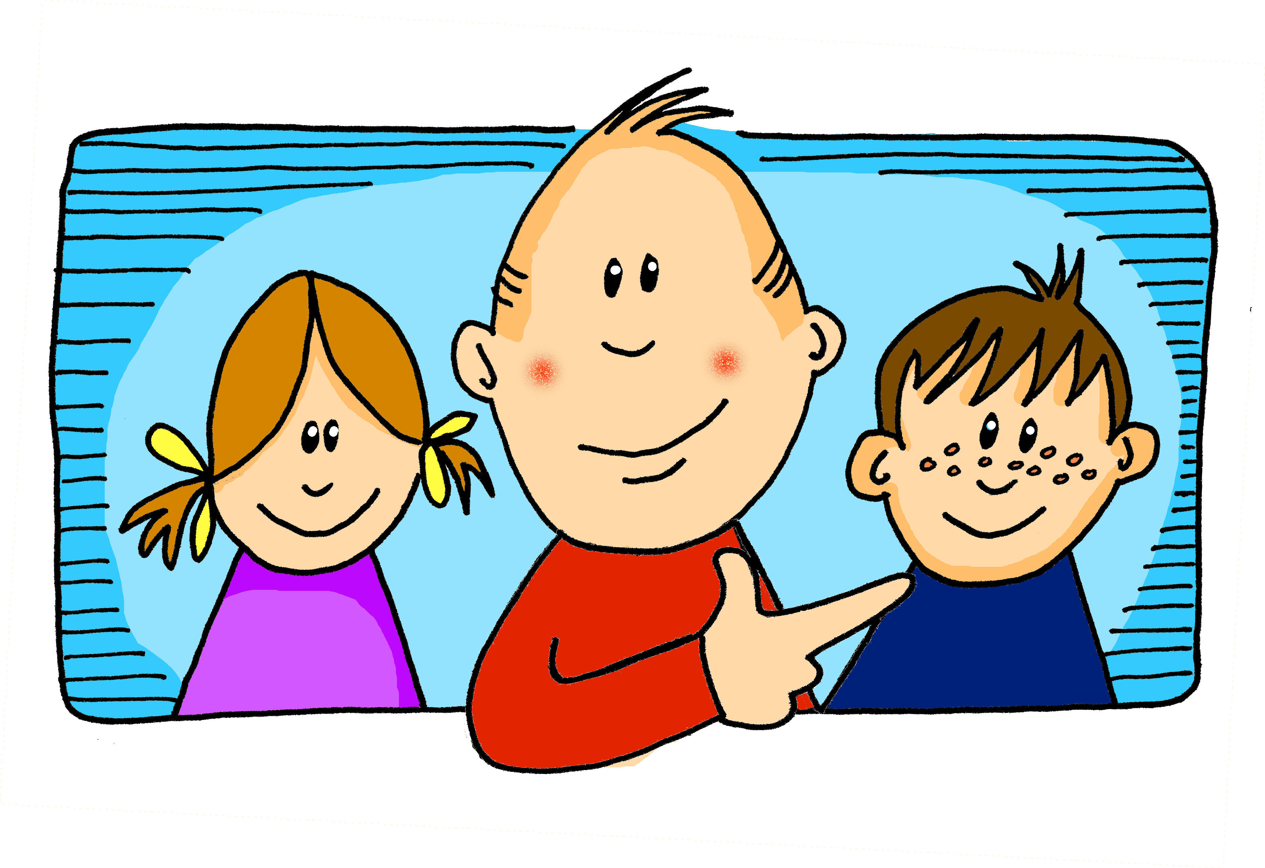
Saying what I and others do
Mi
amarillo
Follow ups 1-5
Notes:
Artwork by Steve Clarke. All additional pictures selected are available under a Creative Commons license, no attribution required.
The frequency rankings for words that occur in this PowerPoint which have been previously introduced in the resources are given in the SOW (excel document) and in the resources that first introduced and formally re-visited those words.
For any other words that occur incidentally in this PowerPoint, frequency rankings will be provided in the notes field wherever possible.
Phonics: revisit SSC [gue] [gui] guitarra [2705] juguete [3162]
Vocabulary: él [9] ella [72] tú [184] yo [28] chico [727] chica [1159] débil [1946] fuerte [435] grande [66] independiente [1177] pero [30]
Revisit 1: hay [haber 13] cuántos [580] cuántas [580]
Revisit 2: montar [1446] pasear [1741] bicicleta [3684] estadio [2581] madre [226], padre [162] ciudad [178] el [1] la [1] de2 [2] por1 [15]
Frequency of unknown words and cognates:
seguir [99] águila [>5000] hamburguesa [>5000] guerra [282] también [49]
Source: Davies, M. & Davies, K. (2018). A frequency dictionary of Spanish: Core vocabulary for learners (2nd ed.). Routledge: London

Slide 2







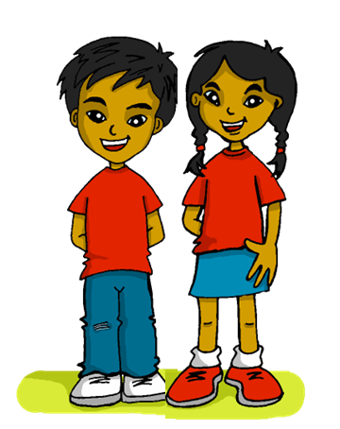





Follow up 1:
Escucha. ¿[gue/gui] o [ge/gi]?
¡A practicar!
pronunciar
gue
gui
ge
gi
gue
gui
ge
gi
guía
gemelos
manguera
guisantes
gimnasio
geografía
hoguera
girar
1
5
2
6
7
3
4
8
Notes:
Timing: 5 minutes
Aim: to practise aural distinction between [gue/gui] and [ge/gi] in mainly unknown words (pictures provided to support meaning).
Procedure:
Read the explanation and ensure pupils understand the task.
Click to listen. Pupils note either gue/gui or ge/gi.
Click to reveal the words.
Click to bring up next prompt – to practise. Pupils do whole-class choral practice, i.e. all speaking simultaneously.
Transcript:
guía
gemelos
manguera
Guisantes
Gimnasio
geografía
hoguera
girar

Slide 3


SER | ESTAR
Remember that in Spanish there are two ways to say ‘you are’:
estás
Use ______ for location or temporary state.
eres
Use ______ for permanent traits.
¿Cómo estás?
Estoy preparado.
How are you?
I am (feeling) ready.
¿Cómo eres?
What are you like?
Soy muy positivo.
I am (a) very positive (person).
Notes:
DO BEFORE FOLLOW UP 2
Timing: 2 minutes
Aim: to revisit estoy/estás and soy/eres and the two questions.
Procedure:
Click through the animations to present the information.
Elicit English translations for the Spanish examples provided.

Slide 4





Follow up 2: Dos niños* en la clase de Max
Escucha. ¿Es hoy o siempre? ¿Niño o niña o ?
escuchar
(los) niños = children
 | hoy | siempre | niño | niña | | ¿Cómo estás? | ¿Cómo eres?
E
1
2
3
4
5
Notes:
Timing: 5 minutes
Aim: to practise aural comprehension of estoy/soy and previously taught adjectives.
Procedure:
Explain the context: there are new pupils in Max’ Spanish class. They answer questions about themselves. What do they say about themselves? And which question are they answering?
Do the example for part 1 of the task. Click to listen. Pupils listen for estoy/soy and note either ‘hoy’ or ‘siempre’. Click to reveal the answer.
Click to listen again – part 2. Is the new pupil a boy or girl or is it impossible to tell? Click to reveal.
Click to listen again – part 3. Which question would have been asked? ¿Cómo estás (how are you) or ¿Cómo eres? (what are you like) Click to reveal.
Repeat all three steps with items 1-5.
Transcript:
E. Soy alto.
Estoy preparado.
Soy importante.
Estoy pesada.
Estoy feliz.
Soy fuerte.

Slide 5



Follow up 3: ¿Cómo estás? ¿Cómo eres?
A: Ask the questions on your card in order 1-5. Write B’s answer down.
B: Answer according to your cards 1-5.
hablar
Soy imposible.
¿Cómo eres?
hoy
normalmente
Ask:
annoying
impossible
‘How are you (usually)?
imposible
Notes:
Timing: 8-10 minutes
Aim: to practise oral production from memory of ser/estar in 1st and 2nd persons singular; to develop understanding of the differences between ‘ser’ and ‘estar’.
Procedure:
1. Pupil A asks the questions on his/her card in the given order. (See end of PPT for handouts).
2. Pupil B answers by selecting the correct response.
3. After 5 questions/answers, swap roles and repeat the task.

Slide 6
Follow up 3: Round 1- A
Follow up 3: Round 1 B
hoy
Soy imposible
Ask:
‘How are you (usually)?
normalmente
imposible
annoying
impossible
Estoy positivo/a.
‘How are you (today)?
hoy
normalmente
Ask:
positivo/a
positive
interesting
hoy
normalmente
‘How are you (today)?
Estoy independiente.
Ask:
independiente
independent
weak
hoy
normalmente
Ask:
‘How are you (usually)?
Soy feliz.
feliz
ready
happy
Estoy increíble.
‘How are you (today)?
hoy
normalmente
Ask:
increíble
incredible
Fun,funny
Notes:
ROUND 1 ANSWERS: DO NOT DISPLAY
Click on the pencil to hear the correct question each time.

Slide 7
Follow up 3: Round 2 B
Follow up 3: Round 2 A
Estoy perdido/a.
Ask:
‘How are you (today)?
hoy
normalmente
perdido/a
lost
fun, funny
hoy
Soy independiente.
Ask:
‘How are you (usually)?
normalmente
independiente
happy
independent
‘How are you (today)?
hoy
normalmente
Ask:
Estoy increíble.
increíble
incredible
strong
hoy
Soy positivo/a.
Ask:
‘How are you (usually)?
normalmente
positivo/a
weak
positive
hoy
Soy pesado/a.
Ask:
‘How are you (usually)?
normalmente
pesado/a
impossible
annoying
Notes:
ROUND 2 ANSWERS: DO NOT DISPLAY

Slide 8
Subject pronouns (I, you)
The verb (or verb ending) often tells us who the sentence refers to:
Estoy feliz.
I am (feeling) happy.
Estás divertido.
You are (in a) funny (mood).
Sometimes, when comparing, we use subject pronouns to emphasise the difference:
Yo soy débil pero tú eres fuerte.
I am weak but you are strong.
In English we stress the contrast with our voice.
Yo estoy positivo pero tú estás imposible.
I am (feeling) positive but you are (being) impossible.
Notes:
DO BEFORE FOLLOW UP 4
Timing: 2 minutes
Aim: to introduce a second reason for using the subject pronouns with examples using yo and tú.
Procedure:
Click through the animations to present the information.
Elicit English translations for the Spanish examples provided.

Slide 9


Follow up 4:
Max se compara* con Quique.
se compara = compares himself
Lee los mensajes. ¿Es yo o tú?
leer
Hoy yo estoy preparado pero
tú estás pesado.
Tú paseas por el campo pero yo paseo por la ciudad.
Quique
(you)
Max (I)
E
1
E | am ready | are annoying
1 | go for a walk in the city | go for a walk in the countryside
2 | have Spanish class | have an English class
3 | read a book | read a magazine
4 | eat in school | eat at home
5 | visit my grandma | visit a museum
Tú tienes una clase de inglés pero yo tengo una clase de español.
Yo leo un libro pero tú lees una revista.
2
3
Yo como en el colegio pero
tú comes en casa.
Tú visitas un museo pero yo visito a mi abuela.
4
5
Notes:
Timing: 7 minutes
Aim: to practise written comprehension of 1st and 2nd person singular (previously taught) verbs; to understand the use of subject pronouns for emphasising a comparison.
Procedure:
Remind pupils that in Spanish we can often just use verb endings/forms on their own without pronouns (especially I/you forms as they are always different, but that when comparing two people (or things) we often use subject pronouns for emphasis.
Introduce the context – Max is comparing himself with Quique in these messages so for emphasis he used pronouns but the phone screen has smudges on it and we can’t see them.
Do the example. Pupils read the message and work out which pronoun is missing (yo/tú) by looking at the verb that follows the gap.
Teacher elicits the pronoun from pupils, encouraging them to read the whole message aloud, with the pronouns included.
Click to reveal the answer.
Then elicit the key information in English and click to reveal it in the table.
Pupils complete items 1-5 and teacher gives feedback on each item, as above.

Slide 10




follow up 5a:
Escribe en inglés 📝: can you get at least 15 points?
 | la madre | la ciudad | el padre
 | el estadio | el | de
 | montar | pasear | ¿Cuántos?
 | hay | ¿Cuántas? | la bicicleta
 | él | fuerte | la chica
 | yo | ella | pero
vocabulario
(the) mother
(the) city
(the) father
x3
(the) stadium
the (m)
of, from
to go on a walk, going on a walk
to ride, riding
How many? (m)
x2
there is/are
How many? (f)
(the) bicycle
he
strong
(the) girl
x1
I
she
but
Notes:
Timing: 5 minutes
Aim: to practise written production of vocabulary from this week and this week’s revisited sets.
Procedure:
1. Give pupils a blank grid. They fill in the English meanings of any of the words they know, trying to reach 15 points in total.
Note:
The most recently learnt and practised words are pink, words from the first revisit are green and those from the second revisit are blue, thus more points are awarded for them, to recognise that memories fade and more effort (heavy lifting!) is needed to retrieve them.

Slide 11
follow up 5b:
Escribe en español 📝: can you get at least 15 points?
 | (the) stadium | from , of | (the) father
 | (the) mother | (the) city | the (m)
 | (the) bicycle | to go on a walk | to ride, riding
 | How many? (f) | How many? (m) | There is /are
 | you | but | (the) girl
 | he | she | I
vocabulario
el estadio
de
el padre
x3
la madre
la ciudad
el
la bicicleta
pasear
montar
x2
¿Cuántas?
¿Cuántos?
hay
tú
pero
la chica
x1
él
ella
yo
Notes:
Timing: 5 minutes
Aim: to practise written production of vocabulary from this week and this week’s revisited sets.
Procedure:
1. Give pupils a blank grid. They fill in the Spanish meanings of any of the words they know, trying to reach 15 points in total.
Note:
The most recently learnt and practised words are pink, words from the first revisit are green and those from the second revisit are blue, thus more points are awarded for them, to recognise that memories fade and more effort (heavy lifting!) is needed to retrieve them.

Slide 12
¡adiós!
amarillo

Slide 13
follow up 2b:
Follow up 5b: Handout
Escribe en inglés 📝: can you get at least 15 points?
 | la madre | la ciudad | el padre
 | el estadio | el | de
 | montar | pasear | ¿Cuántos?
 | hay | ¿Cuántas? | la bicicleta
 | él | fuerte | la chica
 | yo | ella | pero
vocabulario
x3
x2
x1
Notes:
HANDOUT 5

Slide 14
follow up 2b:
Follow up 5b: Handout
Escribe en español 📝: can you get at least 15 points?
 | (the) stadium | from , of | (the) father
 | (the) mother | (the) city | the (m)
 | (the) bicycle | to go on a walk | to ride, riding
 | How many? (f) | How many? (m) | There is /are
 | you | but | (the) girl
 | he | she | I
vocabulario
x3
x2
x1
Notes:
HANDOUT 5

Slide 15
Follow up 3: Round 1 B
Follow up 3: Round 2 B
hoy
normalmente
Ask:
‘How are you (usually)?
annoying
impossible
‘How are you (today)?
hoy
normalmente
Ask:
positive
interesting
‘How are you (today)?
hoy
normalmente
Ask:
independent
weak
hoy
normalmente
Ask:
‘How are you (usually)?
ready
feliz
‘How are you (today)?
hoy
normalmente
Ask:
incredible
fun/funny
Notes:
HANDOUT B

Slide 16
Follow up 3: Round 1 A
Follow up 3: Round 2 A
Ask:
‘How are you (usually)?
hoy
normalmente
lost
fun, funny
‘How are you (today)?
hoy
normalmente
Ask:
happy
independent
‘How are you (today)?
hoy
normalmente
Ask:
incredible
strong
Ask:
‘How are you (usually)?
hoy
normalmente
weak
positive
‘How are you (today)?
hoy
normalmente
Ask:
impossible
annoying
Notes:
HANDOUT A

