Slide 1
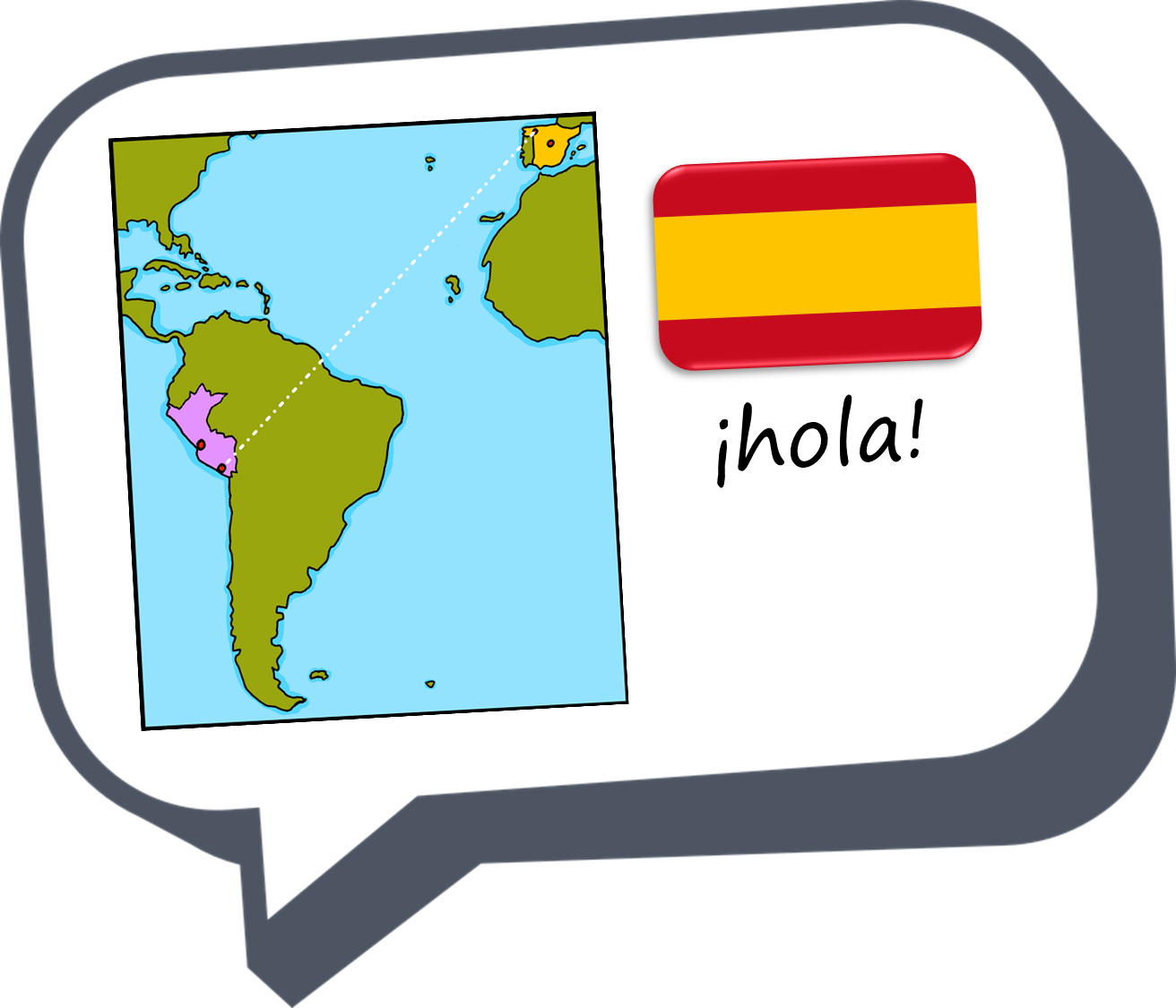

Saying what I and others do
Mi
amarillo
Follow ups 1-5
Notes:
Artwork by Steve Clarke. All additional pictures selected are available under a Creative Commons license, no attribution required.
The frequency rankings for words that occur in this PowerPoint which have been previously introduced in the resources are given in the SOW (excel document) and in the resources that first introduced and formally re-visited those words.
For any other words that occur incidentally in this PowerPoint, frequency rankings will be provided in the notes field wherever possible.
SSC: [revisit]
Phonics: revisit SSC [ga] [go] [gu] [ge] [gi]
Vocabulary: cumpleaños [3372] mes [288] enero [1173] febrero [1419] marzo [1231] abril [1064] mayo [909] junio [1035] julio [659] agosto [931] septiembre [1150] octubre [1242] noviembre [1434] diciembre [1165] cuándo [138] mi [37] tu [53] en [5]
Revisit 1: hay [haber 13] cuántos [580] cuántas [580]
Revisit 2: montar [1446] pasear [1741] bicicleta [3684] estadio [2581] madre [226], padre [162] ciudad [178] el [1] la [1] de2 [2] por1 [15]
Frequency of unknown words and cognates:
caer [251] Llegar [75] terminar [253] colegio [628] encuesta [2077] lluvia [986] paquete [3235] orden [421] viento [814] raqueta [>5000] regalo [1986] correcto [1467]
Source: Davies, M. & Davies, K. (2018). A frequency dictionary of Spanish: Core vocabulary for learners (2nd ed.). Routledge: London

Slide 2





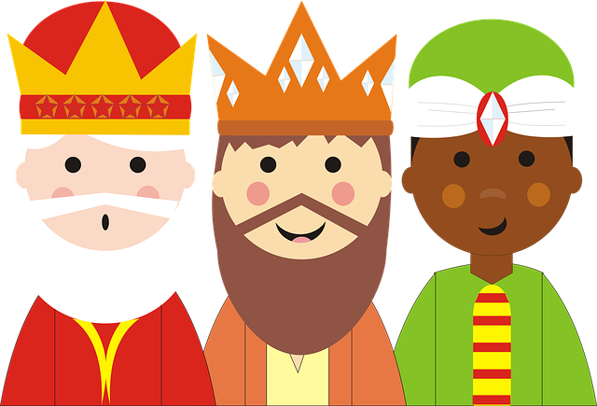






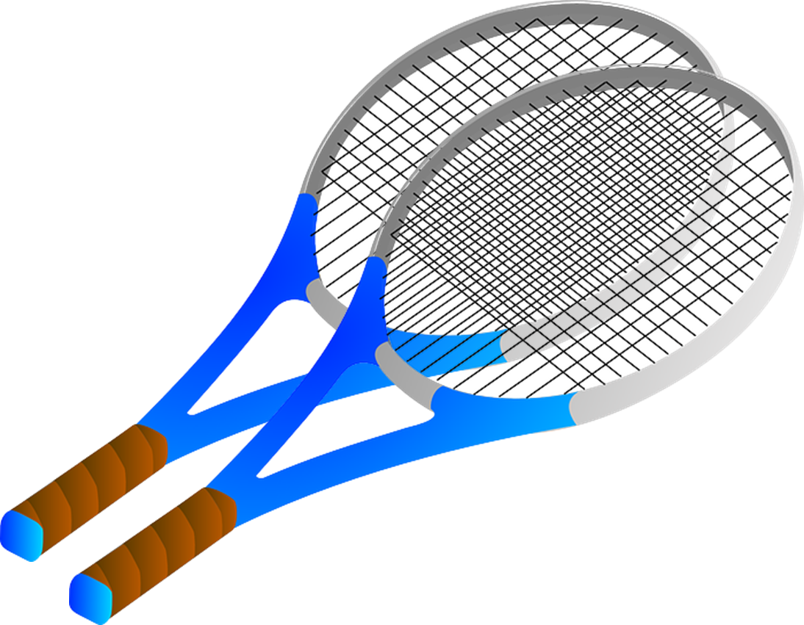
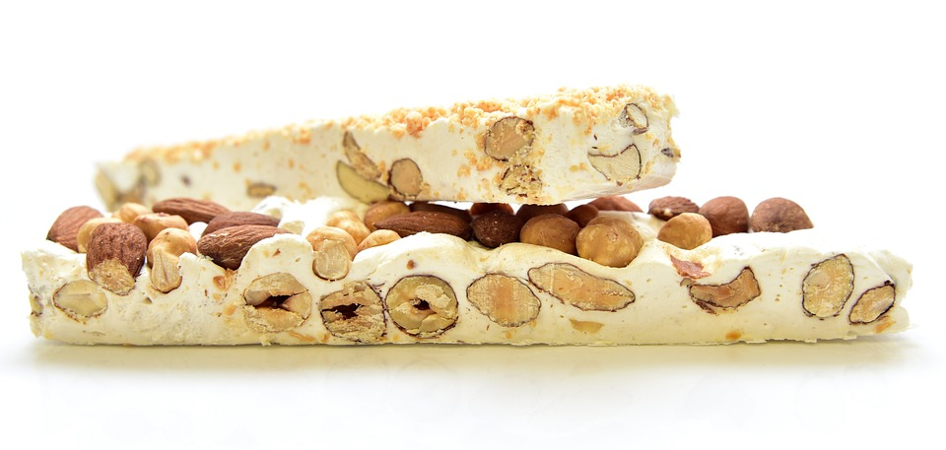


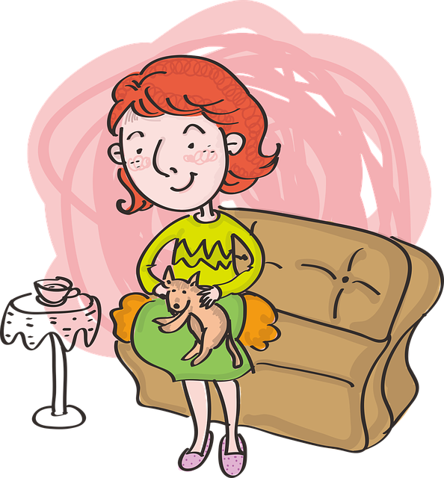
Follow up 1
Revisit:
[que] [qui] [ll] [l] [ga] [go] [gu]
Lee con tu compañero/a.
A Escucha y completa el poema.
pronunciar
Un pa_____te en enero
El Carnaval ___ega* en febrero
En marzo y abril, viento y __uvias mil**.
En mayo unas ra____tas para mamá
En junio unos re___los para papá
En julio termina* el co__e
En agosto descanso con ____nzo
En septiembre con amigos al cole
Y en octubre caen* las hojas
Unas castañas en noviembre
y turrón en diciembre.
1
que
8
1 minuto
2
ll
9
3
ll
10
4
que
11
5
ga
6
l
llega = it arrives termina = it finishes
mil = 1000
caen = they fall
7
Go
INICIO
Notes:
Timing: 5 minutes
Aim: to practise aural recognition of revisited SSC [que] [qui] [ll] [l] [ga] [go] [gu]
Procedure:
Part A
Students write the correct sound [que] [qui] [ll] [l] [ga] [go] [gu]
Click to bring up answers and pictures to reinforce meaning.
Click to bring up further instruction. Pupils work in pairs to read the poem aloud.
Frequency of unknown words and cognates:
caer [251] llegar [75] terminar [253] paquete [3235] viento [814] lluvia [986] raqueta [>5000] regalo [1986] colegio [628]
Source: Davies, M. & Davies, K. (2018). A frequency dictionary of Spanish: Core vocabulary for learners (2nd ed.). Routledge: London

Slide 3









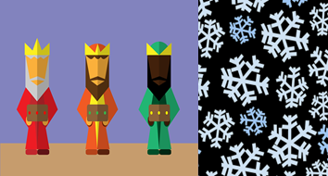


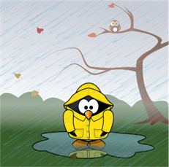

Follow up 2
(el) orden = it arrives correcto = correct
Lee en el orden correcto.
palabras
leer
octubre
1 minuto
febrero
julio
abril
mayo
junio
agosto
enero
septiembre
diciembre
marzo
noviembre
INICIO
Notes:
Timing: 2 minutes
Aim: to consolidate months of the year
Procedure:
Read the instruction in Spanish.
In pairs, ask students to read the months of the year in the correct order.
Click “inicio” to trigger timer.
Go to next slide for answers.
Frequency of unknown words and cognates:
orden [421] correcto [1467]
Source: Davies, M. & Davies, K. (2018). A frequency dictionary of Spanish: Core vocabulary for learners (2nd ed.). Routledge: London

Slide 4


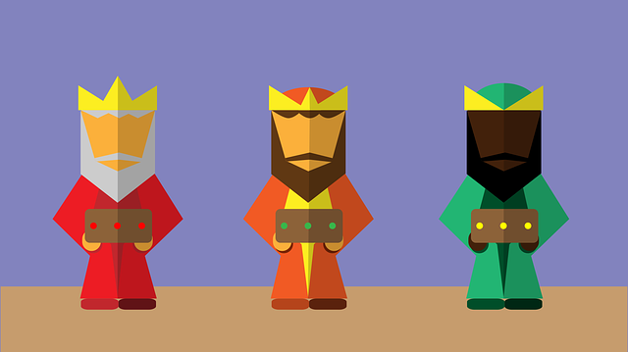






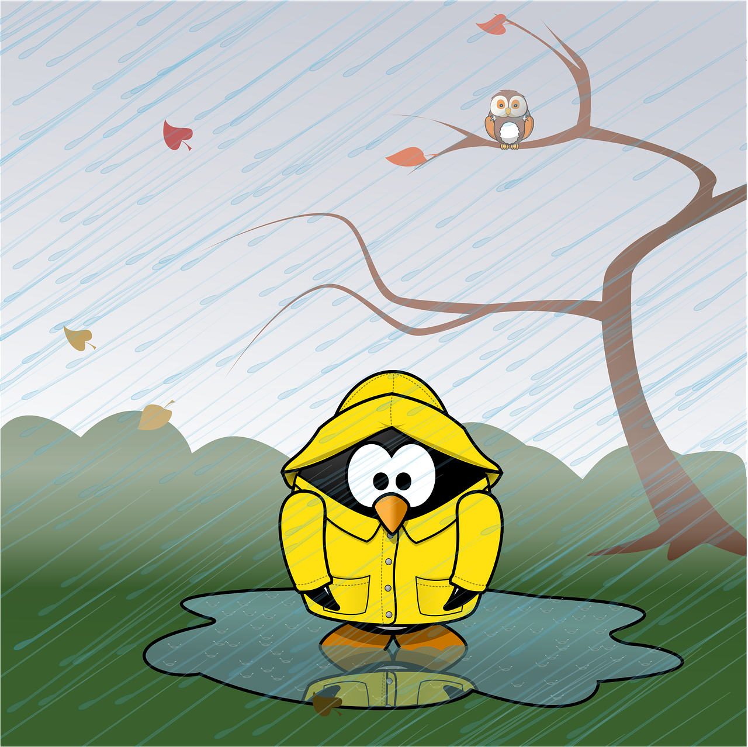

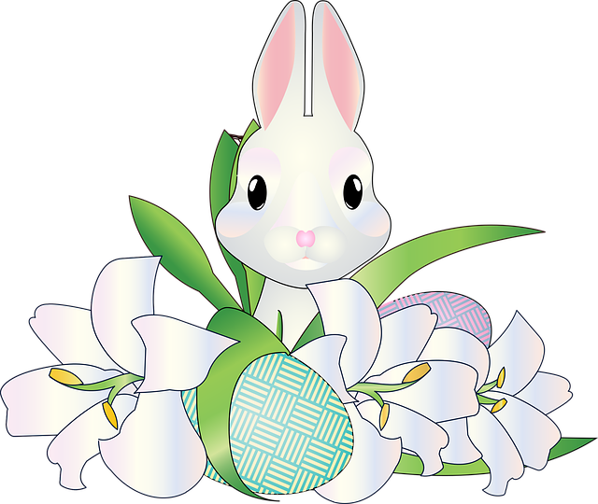


Follow up 2
(el) orden = order
correcto = correct
Lee en el orden correcto.
palabras
leer
m_ _ _ o
1 minuto
e_ _ _ o
j_ _ _o
m_ _ o
j_ _ _o
f _ _ _ _ _ o
d_ _ie_ _ _ e
s _ _ _ ie_ _ _e
a_ _ _ o
n _ _ie_ _ _e
a _ _ _ l
o_ _ _ _ _e
INICIO
Notes:
[ALTERNATIVE SLIDE WITH LESS SUPPORT]
Timing: 2 minutes
Aim: to consolidate months of the year
Procedure:
Read the instruction in Spanish.
In pairs, ask students to read the months of the year in the correct order.
Click “inicio” to trigger timer.
Go to next slide for answers.
Frequency of unknown words and cognates:
orden [421] correcto [1467]
Source: Davies, M. & Davies, K. (2018). A frequency dictionary of Spanish: Core vocabulary for learners (2nd ed.). Routledge: London

Slide 5











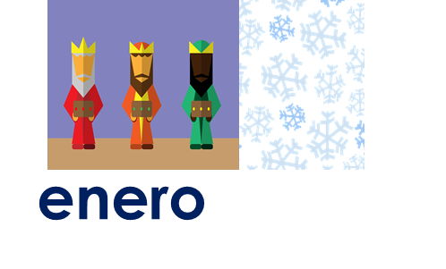
Follow up 2
abril
julio
octubre
enero
palabras
leer
febrero
mayo
agosto
noviembre
marzo
junio
septiembre
diciembre
Notes:
Answers: Each month of the year disappears on click, click again to bring the correct answer.
NB. You can use this slide for extra practice. Give students another minute to say the days of the week in the right order. This time without picture support.

Slide 6

Follow up 3:
Using ‘es’ with months of the year
[ser]
We use ser when talking about what month it is.
To say ‘it is’ and ‘is’ + month of the year, we use es.
Por ejemplo:
Es mayo.
It is May.
Notes:
Time: 2 minutes [2 slides in total]
Aim: to learn about the use of ‘ser’ when taking about what month it is.
Note: this is a specific use of ser that doesn’t follow the rules learnt so far for using ser (traits, origin). However, it is congruent with the notion of essential characteristic or trait in the sense that December is always December (for the length of the 31 day period of one month). It doesn’t unexpectedly change its mood or state and become January.
Procedure:
1. Teachers present the new information. It is animated to allow for a paced, interactive delivery.
2. Elicit the English translation for the examples.

Slide 7


Follow up 3:
A Escucha. ¿Qué palabra es?
escuchar
E
June | August | March
1
It is (perm.) | I am | It is (state)
2
There is | It has | It is (perm.)
3
How many? (f) | What? | How many? (m)
4
November | October | September
5
June | January | July
6
Some (f) | Some (m) | a/an
Notes:
Timing: 5 minutes [Read previous slide before]
Aim: to practise aural comprehension of this week’s new vocabulary (months) and vocab from week 8 & 9.
Procedure:
(Part A) Click to listen. Pupils circle the correct word (if they have the sheet printed). If not, they can use numbers 1,2,3,4. Click for answers.
(Part B) Pupils listen to 1-5 and write the sentences, selecting from the options given (there are additional words that are not needed).
Click to reveal answers.
Transcript:
Ejemplo: marzo
1. Es diciembre.
2. hay
3. ¿Cuántos libros hay?
4. octubre
5. enero
6. unas

Slide 8

Follow up 4
(la) encuesta = a survey
Pregunta y completa la encuesta*.
hablar
enero | febrero | marzo | abril | mayo | junio | julio | agosto | septiembre | octubre | noviembre | diciembre
A: ¿Cuándo es tu cumpleaños?
B: Mi cumpleaños es en abril.
B: ¿Cuándo es tu cumpleaños?
A: Mi cumpleaños es en octubre
X
Notes:
Timing: 8 minutes
Aim: to practise oral production and comprehension of this week’s new vocabulary (months).
Read the title.
Tell students they are going to conduct a survey in the class to figure how the most popular birthday months.
Click to bring key speech bubbles to model the dialogue. A ¿Cuándo es tu cumpleaños? & click to bring B’s sample answer and follow up question. Click to model how to use the survey sheet.
Tell students they have 5 minutes to ask as many students in the class. They should aim to ask and answer the questions, from memory, by the end of the survey.
NB. Some pupils might benefit from writing their response beforehand. Techers can give a couple of minutes to do this after modelling the exchange.
NB. Some pupils might attempt to also say the exact day but we haven’t seen this yet (Mi cumpleaños es el X de ______).
Frequency of unknown words and cognates:
encuesta [2077]
Source: Davies, M. & Davies, K. (2018). A frequency dictionary of Spanish: Core vocabulary for learners (2nd ed.). Routledge: London

Slide 9



Follow up 5a :
Escribe en inglés 📝:
Can you get at least 15 points?
 | el padre | el | la ciudad
 | la madre | por | de
 | ¿Cuántas? | la bicicleta | ¿cuántos?
 | pasear | el estadio | hay
 | abril | agosto | noviembre
 | julio | ¿Cuándo? | marzo
 | mayo | es | enero
vocabulario
(the) city
vocabulario
(the) father
the (m)
x3
(the) mother
around, along
from
How many? (fpl)
(the) bicycle
How many? (mpl)
x2
to walk
(the) stadium
there are
April
August
November
July
When?
March
x1
January
May
It is
Notes:
Timing: 5-10 minutes
Aim: to practise reading comprehension of vocabulary for this week and previous weeks.
Procedure:
1. Pupils need to write the English for as many words as possible, aiming to get at least 15 points (but more if possible).
2. Click for English answers.

Slide 10
Follow up 5b:
Escribe en español 📝:
Can you get at least 15 points?
 | stadium | father | the (m)
 | city | the (f) | around, along
 | How many? (m) | How many? (f) | to walk, walking
 | There is | There are | bicycle
 | When? | Februrary | June
 | April | It is | May
 | March | November | January
vocabulario
el estadio
el padre
el
vocabulario
x3
la ciudad
la
por
¿cuántos?
¿cuántas?
pasear
x2
hay
hay
la bicicleta
¿Cuándo?
febrero
junio
abril
es
mayo
x1
marzo
noviembre
enero
Notes:
Timing: 5-10 minutes
Aim: to practise written production of vocabulary for this week and previous weeks.
Procedure:
1. Pupils need to write the English for as many words as possible, aiming to get at least 15 points (but more if possible).
2. Click for English answers.

Slide 11
¡adiós!
amarillo

Slide 12
Handout Follow up 5a:
Escribe en inglés 📝:
Can you get at least 15 points?
 | el padre | el | la ciudad
 | la madre | por1 | de
 | ¿Cuántas? | la bicicleta | ¿cuántos?
 | pasear | el estadio | hay
 | abril | agosto | noviembre
 | julio | ¿Cuándo? | marzo
 | mayo | es | enero
vocabulario
vocabulario
x3
x2
x1
Notes:
Timing: 5-10 minutes
Aim: to practise reading comprehension of vocabulary for this week and previous weeks.
Procedure:
1. Pupils need to write the English for as many words as possible, aiming to get at least 15 points (but more if possible).
2. Click for English answers.

Slide 13
Handout Follow up 5b:
Escribe en español 📝:
Can you get at least 15 points?
 | stadium | father | the (m)
 | city | the (f) | around, along
 | How many? (m) | How many? (f) | to walk, walking
 | There is | There are | bicycle
 | When? | Februrary | June
 | April | It is | May
 | March | November | January
vocabulario
vocabulario
x3
x2
x1
Notes:
Timing: 5-10 minutes
Aim: to practise written production of vocabulary for this week and previous weeks.
Procedure:
1. Pupils need to write the English for as many words as possible, aiming to get at least 15 points (but more if possible).
2. Click for English answers.

