Slide 1


español, con Quique

Slide 2

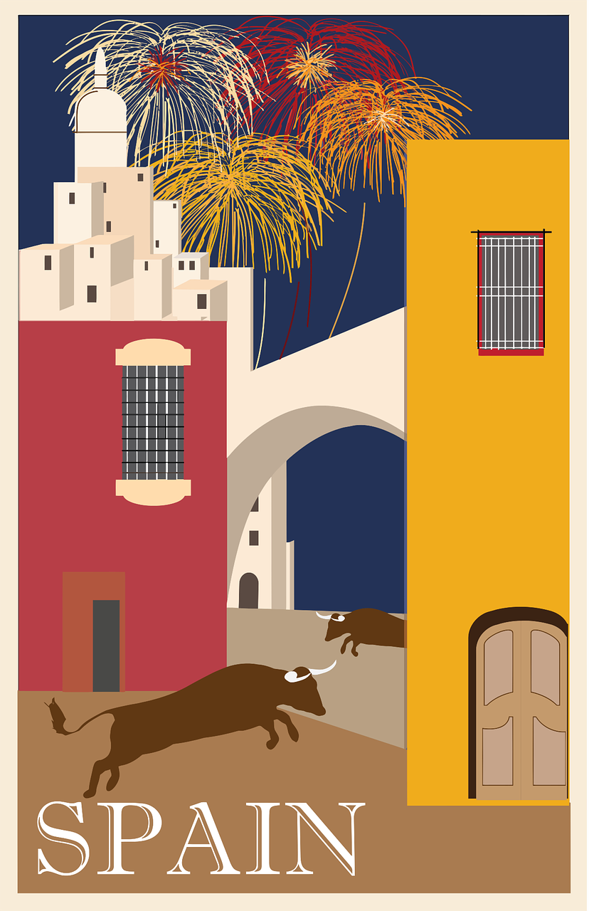

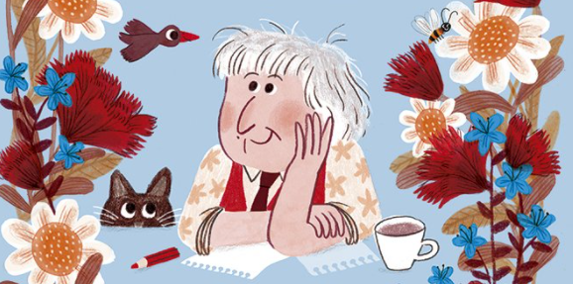
Saying what I and others do
amarillo
- Using a word list for reference
- Revisit postnominal adjective - SSC [ge] [gi]
Notes:
Artwork by Steve Clarke. All additional pictures selected are available under a Creative Commons license, no attribution required.
The frequency rankings for words that occur in this PowerPoint which have been previously introduced in the resources are given in the SOW (excel document) and in the resources that first introduced and formally re-visited those words.
For any other words that occur incidentally in this PowerPoint, frequency rankings will be provided in the notes field wherever possible.
SSC: gesto [928] página [598]
Vocabulary: alto [231] bajo [452] blanco [372] negro [307] verde [812]
Revisit 1: tiene [19] unos [6] unas [6]boca [465] cabeza [265] dedo [465] ojo [169] oreja [2095] pie [365]
Revisit 2: visitar [792] iglesia [437] mamá [675] museo [1114] papá [865] parque [1354] plaza [806] con [14]
Source: Davies, M. & Davies, K. (2018). A frequency dictionary of Spanish: Core vocabulary for learners (2nd ed.). Routledge: London
Marta Altés, ‘El libro de Gloria Fuertes para niñas y niños’, Blackie Books. https://blackiebooks.org/catalogo/el-libro-de-gloria-fuertes-para-ninas-y-ninos/

Slide 3


[ge]
gesto
pronunciar
Notes:
Timing: 1 minute
Aim: To introduce SSC [ge]
Procedure:
Introduce and elicit the pronunciation of the individual SSC [ge] and then the source word ‘ge’ (with gesture, if using).
Click to bring the picture & get students to repeat (with gesture, if using).
Students to practise in pairs
Gesture suggestion: select two gestures, for example: a thumbs up and a wave, and do one on the first syllable ‘ge-’ and the other when you say the second syllable ‘-sto’.

Slide 4

[gi]
página
pronunciar
Notes:
Timing: 1 minute
Aim: To introduce SSC [ge]
Procedure:
Introduce and elicit the pronunciation of the individual SSC [ge] and then the source word ‘ge’ (with gesture, if using).
Click to bring the picture & get students to repeat (with gesture, if using).
Students to practise in pairs
Gesture suggestion: hold an imaginary open book on the open palm of your left hand and mime turning the page.

Slide 5


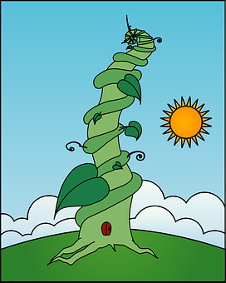
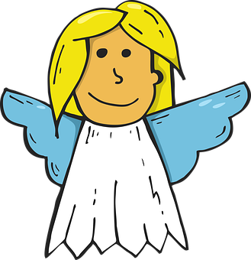
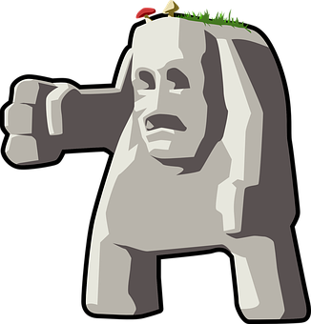

pronunciar
¡A practicar!
El genio
Eugenio
es muy ingenuo.
(The genie Eugenio is very gullible)
¡Repite 🔁!
45
segundos
Arriba un ángel
y el sol
Abajo el gigante
y el girasol
(Above an angel and the sun,
below the giant and the sunflower)
¡Repite 🔁!
INICIO
Notes:
Timing: 2 minutes
Aim: to practise reading aloud [j] unknown words (pictures provided to support meaning).
Procedure:
Read the explanation and ensure pupils understand the task.
Start the timer.
Whole-class choral practice.

Slide 6

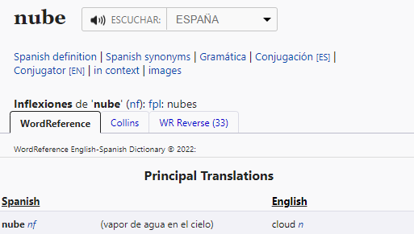
Using reference materials
[understanding symbols]
All dictionaries have symbols with useful information about the type of word, (e.g., noun, adjective) and noun gender (masculine or feminine).
www.wordreference.com
n = noun
m = masculine
f = feminine
Nouns that end in –e could be masculine or feminine, so let’s use a dictionary to figure out the gender.
This can help us find out the grammatical gender of a noun.
feminine
______ nube [the cloud]
la
Ejemplo: nube
una
______ nube [a cloud]
Notes:
Timing: 3 minutes
Aim: to introduce pupils to reference skills – understanding codes in a dictionary in order to find out the gender of a noun.
Procedure:
1. Teachers click to present the information on the slide.
2. Pupils can volunteer the articles.

Slide 7



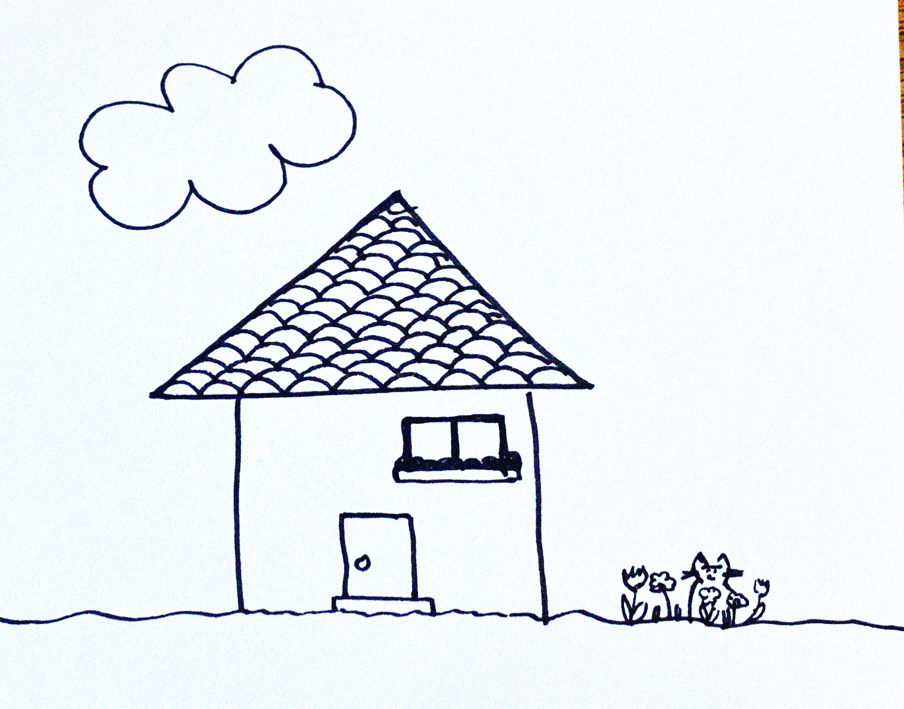
Leer y hablar
Lee el poema*
¿Qué artículo es? [1/7]
hablar
leer
gato (nm) = cat
nube (nf) = cloud
tejado (nm) = roof
el | la
un | una
____ nube arriba,
____ gato abajo,
en el medio, ___ casa.
con ______ tejado
la
[the cloud above]
el
[the cat below]
una
[and, in the middle, a house]
un
[with a roof]
Notes:
Timing: 7 minutes [7 slides]
Aim: To use gender codes in order to be able to use the correct definite and indefinite articles with unknown nouns.
Procedure:
Teachers read the instruction and clarify the meaning of artículo.
Teachers draw pupils’ attention to the codes for each of the nouns (frío, nieve, río).
3. Pupils work in pairs to read the poem aloud, selecting the correct translation for ‘the’ or ‘a/an’.
4. Teacher elicits answers from pupils.
5. Click the picture to hear the full text for the poem, if desired.
6. Pupils can read aloud again (whole class) to practise SSC knowledge, time allowing.
Frequency of unknown words and cognates:
casa [106] gato [1728] tejado [>5000]
Source: Davies, M. & Davies, K. (2018). A frequency dictionary of Spanish: Core vocabulary for learners (2nd ed.). Routledge: London

Slide 8
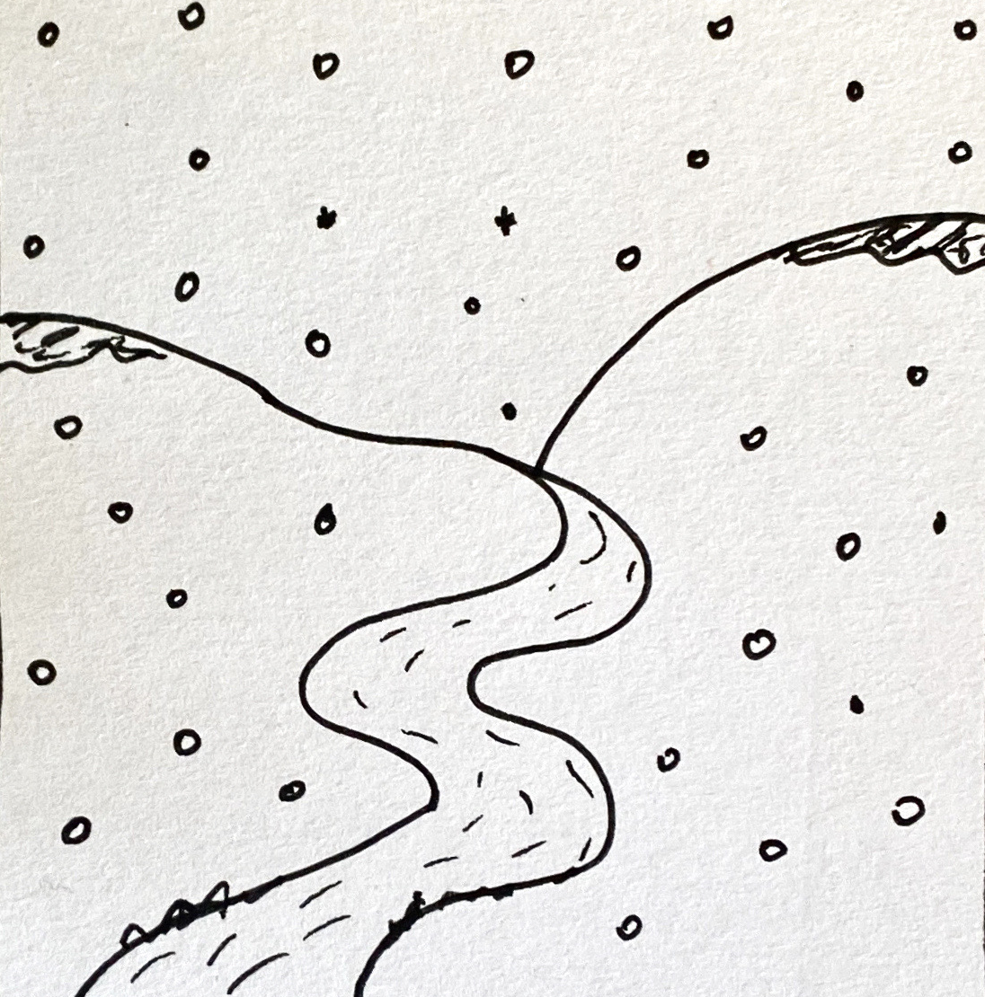
Leer y hablar
Lee el poema*
el | la
un | una
¿Qué artículo es? [2/7]
hablar
leer
frío (nm) = cold
nieve (nf) = snow
río (nm) = river
____ nieve,
____ frío,
y, en el medio, ___ río.
la
[the snow]
el
[the cold]
un
[and, in the middle, a river]
Notes:
[2/7]
Frequency of unknown words and cognates:
nieve [3175] frío [1020]
Source: Davies, M. & Davies, K. (2018). A frequency dictionary of Spanish: Core vocabulary for learners (2nd ed.). Routledge: London

Slide 9
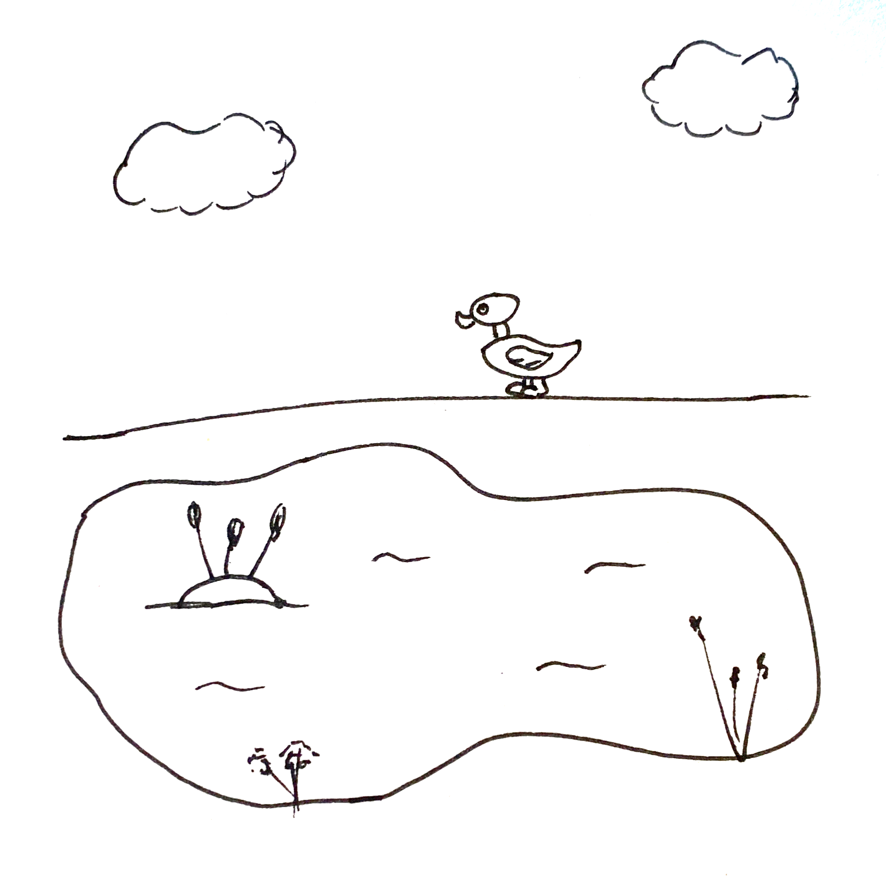
Leer y hablar
Lee el poema*
el poema = poem
¿Qué artículo es? [3/7]
hablar
leer
el | la
un | una
lago (nm) = lake
cielo (nm) = sky
pato (nm) = duck
___cielo
____ lago
y, en el medio, ___ pato.
el
[the sun]
el
[the sea]
un
[and, in the middle, a duck]
Notes:
[3/7]
Frequency of unknown words and cognates:
cielo [620] pato [4857] poema [1430] lago [2151]
Source: Davies, M. & Davies, K. (2018). A frequency dictionary of Spanish: Core vocabulary for learners (2nd ed.). Routledge: London

Slide 10
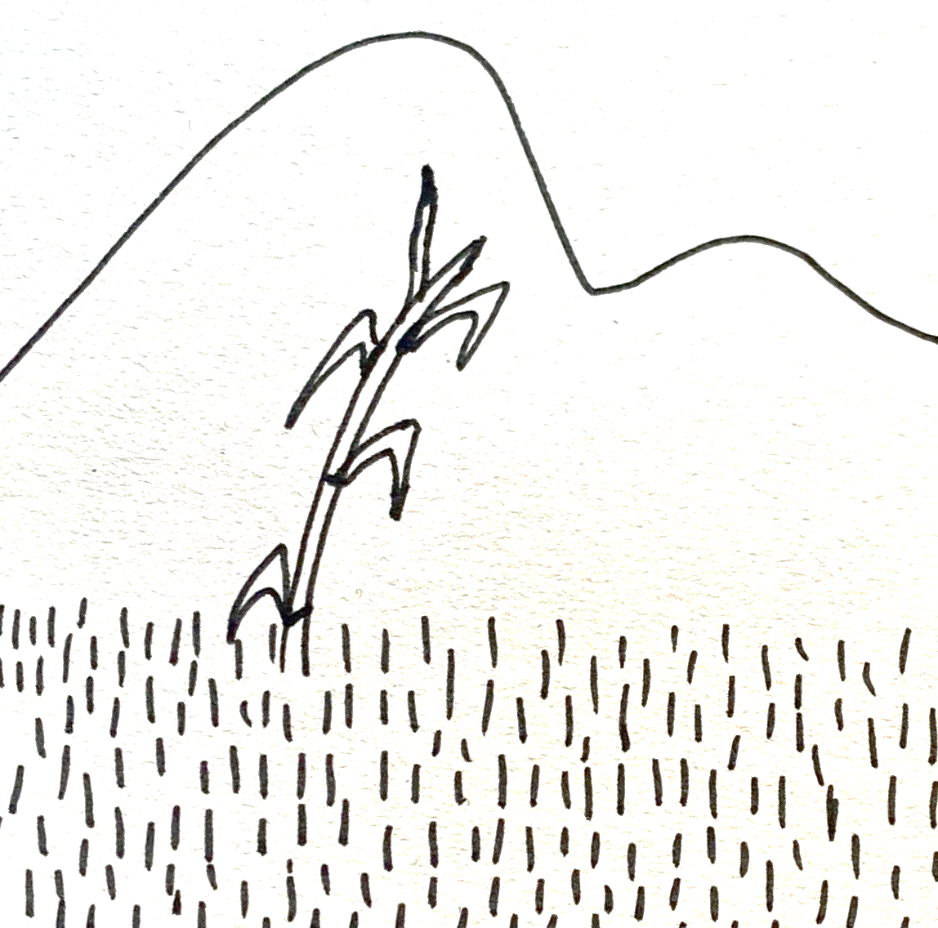
Leer y hablar
Lee el poema*
el poema = poem
¿Qué artículo es? [4/7]
hablar
leer
el | la
un | una
caña (nf) = cane
prado (nm) = meadow
____ prado,
____ montaña,
y, en el medio, ___ caña.
el
[the meadow]
la
[the mountain]
una
[and, in the middle, a cane]
Notes:
[4/7]
Frequency of unknown words and cognates:
caña [2837] prado [3614] poema [1430]
Source: Davies, M. & Davies, K. (2018). A frequency dictionary of Spanish: Core vocabulary for learners (2nd ed.). Routledge: London

Slide 11
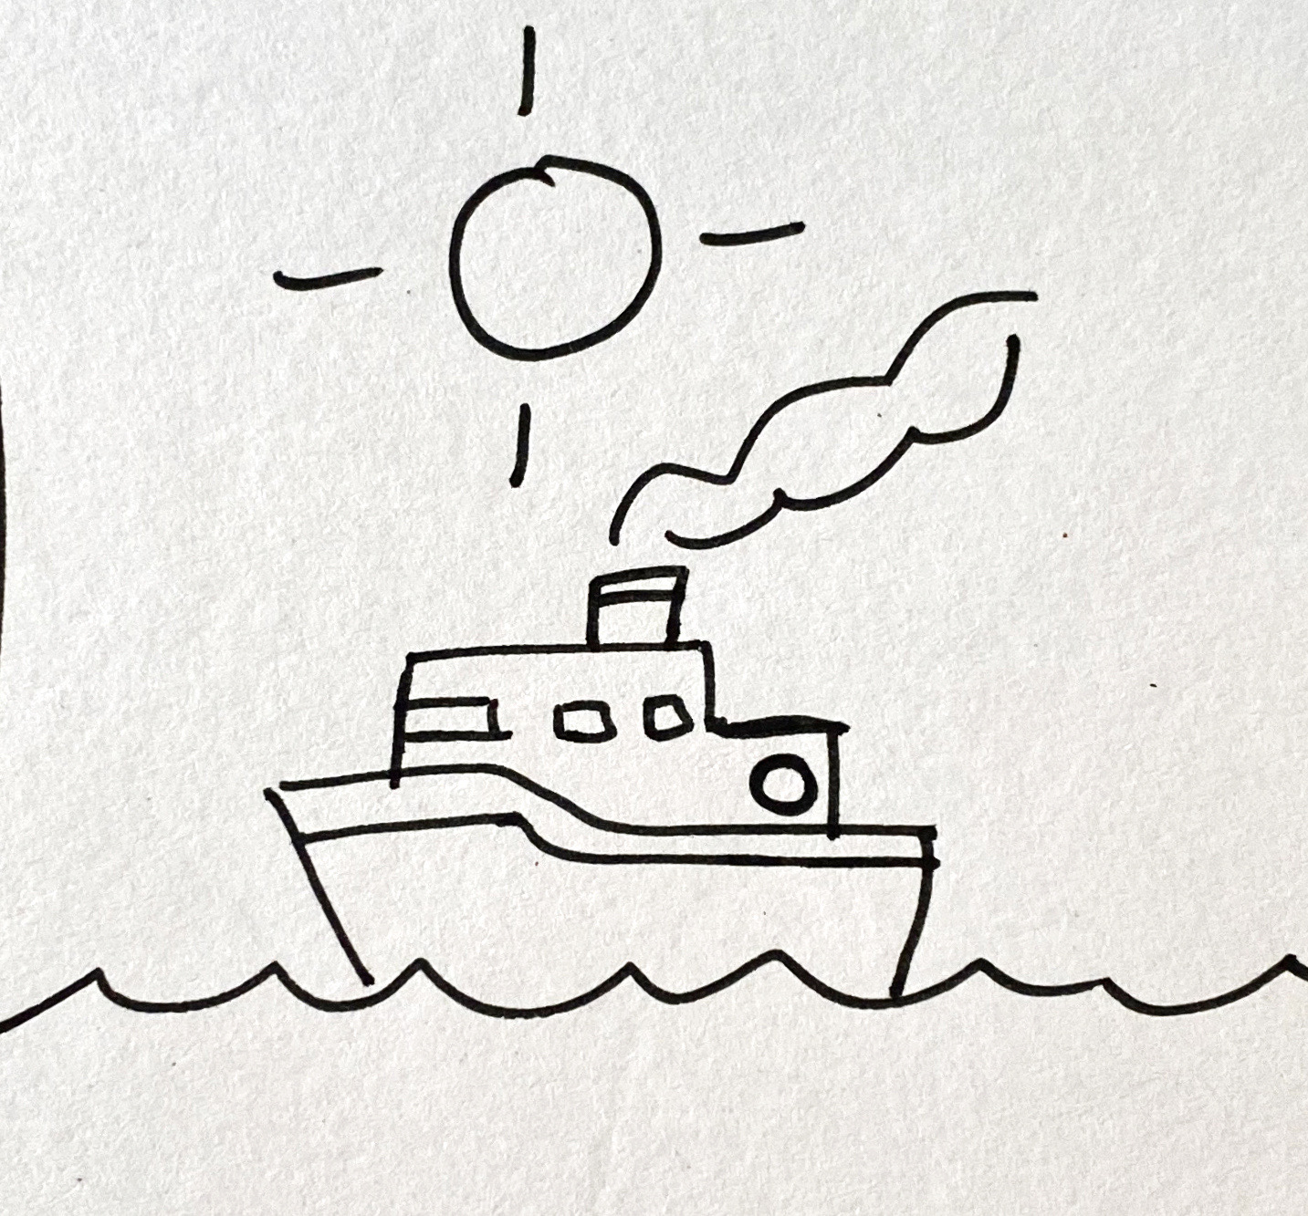
Leer y hablar
Lee el poema*
el poema = poem
¿Qué artículo es? [5/7]
hablar
leer
el | la
un | una
barco (nm) = boat
sol (nm) = sun
mar (nm) = sea
___sol arriba
____ mar abajo
y, en el medio, ___ barco.
el
[the sun above]
el
[the sea below]
un
[and, in the middle, a boat]
Notes:
[5/7]
Frequency of unknown words and cognates:
mar [480] poema [1430] sol [383]
Source: Davies, M. & Davies, K. (2018). A frequency dictionary of Spanish: Core vocabulary for learners (2nd ed.). Routledge: London

Slide 12
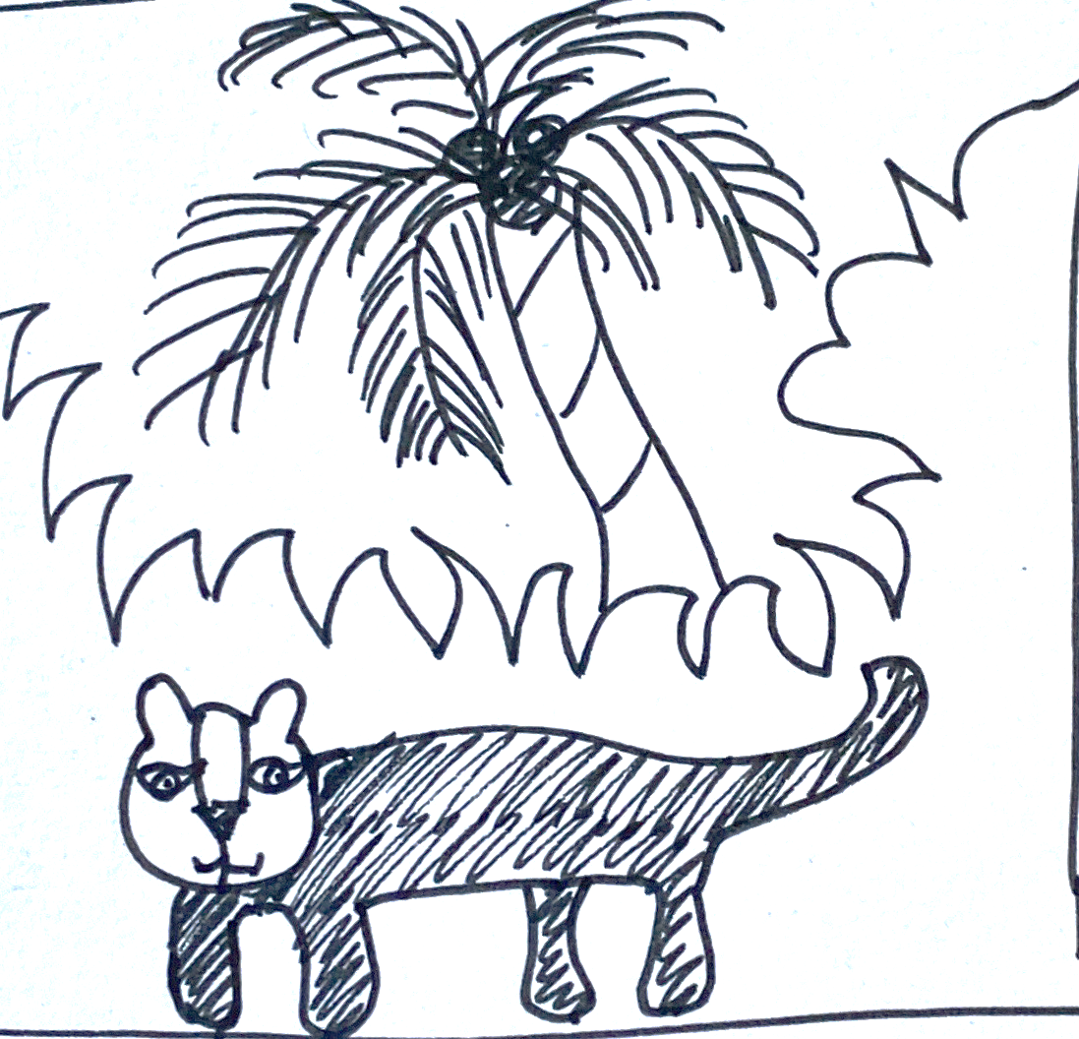
Leer y hablar
Lee el poema*
el poema = poem
¿Qué artículo es? [6/7]
hablar
leer
el | la
un | una
palmera (nf) = palm tree
pantera (nf) = panther
selva (nm) = jungle
la
[the jungle]
____ selva,
___ palmera,
y, en el medio, ___ pantera.
la
[the palm tree]
una
middle
[and, in the _______, a panther]
Notes:
[6/7]
Frequency of unknown words and cognates:
palmera [4780] pantera [>5000] poema [1430] selva [2768]
Source: Davies, M. & Davies, K. (2018). A frequency dictionary of Spanish: Core vocabulary for learners (2nd ed.). Routledge: London

Slide 13
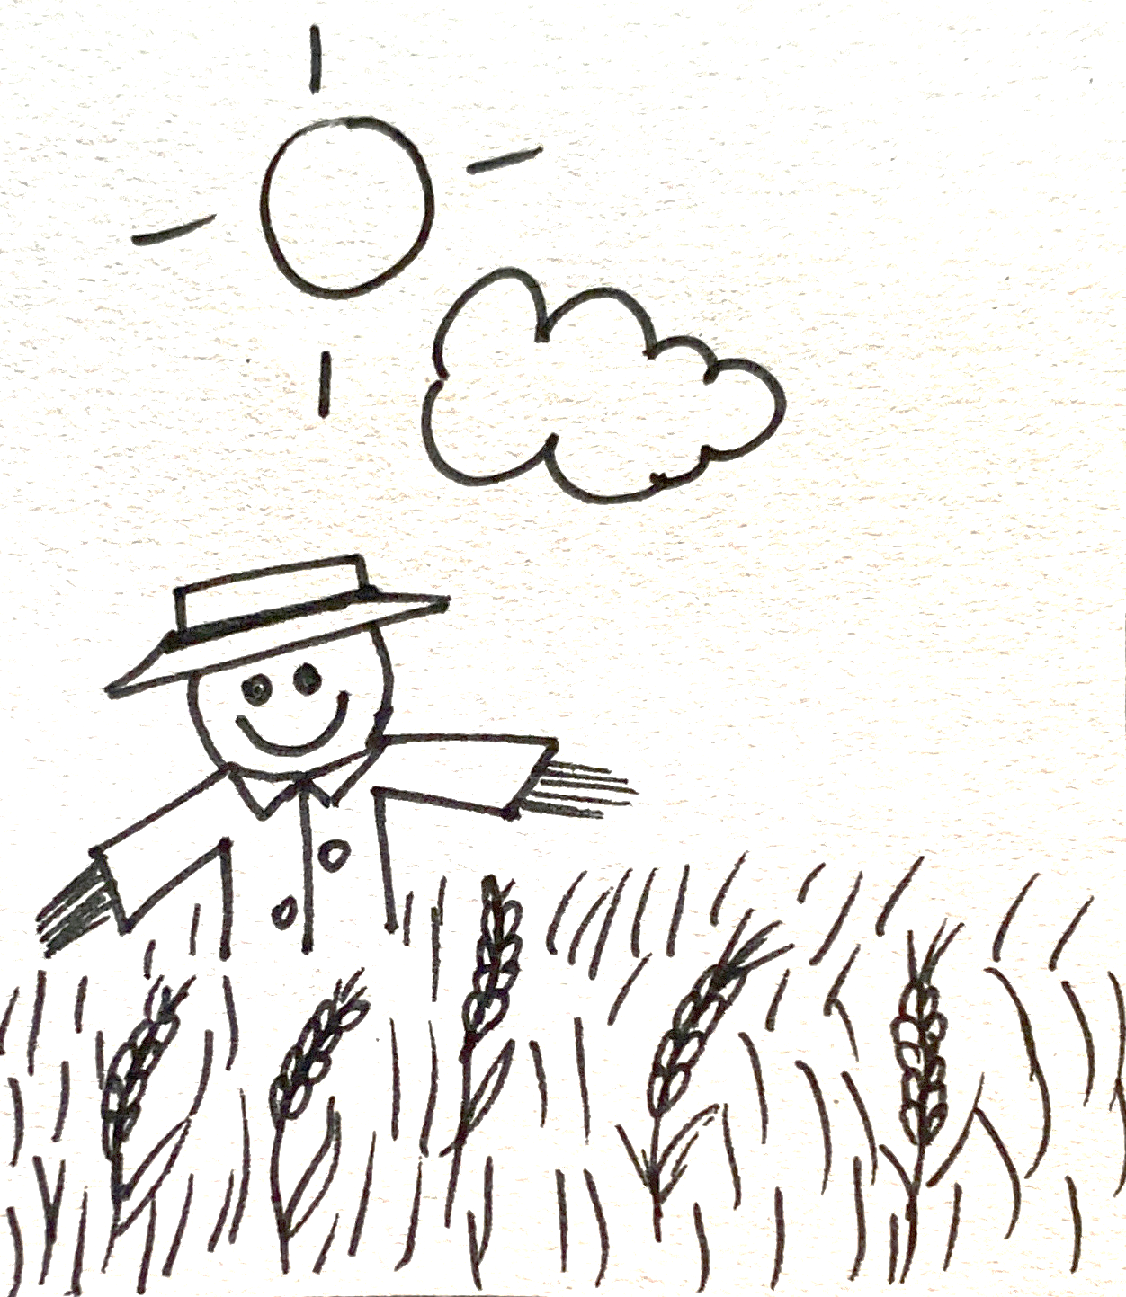
Leer y hablar
Lee el poema*
el poema = poem
¿Qué artículo es? [7/7]
hablar
leer
el | la
un | una
espantapájaros (nm)
= scarecrow
trigo (nm) = wheat
sol (nm) = sun
el
above
[the sun _______]
____ sol arriba,
___ nube abajo,
y, en el medio, ___ trigo
y ____ espantapájaros.
la
below
[the cloud _______]
el
middle
[and, in the _______, the wheat]
un
[and a scarecrow]
Notes:
[7/7]
Frequency of unknown words and cognates:
espantapájaros [>5000] poema [1430] sol [383] trigo [3975]
Source: Davies, M. & Davies, K. (2018). A frequency dictionary of Spanish: Core vocabulary for learners (2nd ed.). Routledge: London

Slide 14

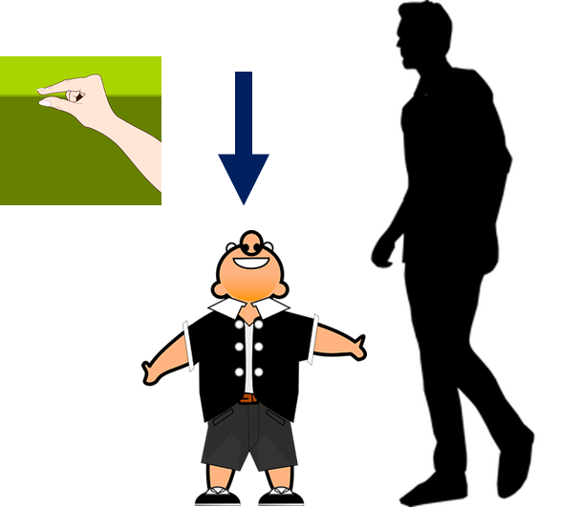
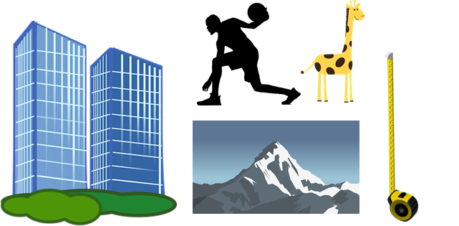



vocabulario
Escucha y repite 🗣
a _ _ _
alto
alto
b _ _ _
bajo
bajo
[tall]
[short]
blanco
n_ _ _o
v_ _ _e
b_ _ _ c_
negro
verde
[white]
[black]
[green]
Notes:
Timing: 5 minutes
Aim: to introduce key vocabulary for this week.
Procedure:
1.Teacher introduces items one by one (word, picture, English) & pupils practise pronunciation aloud.
Alternatively, pupils work in pairs, reading the Spanish words out loud and looking at the English meanings (1 minute).
2. Then the teacher removes the English words or pictures, and pupils try to recall the English orally (chorally), looking at the Spanish (1 minute).
3. Teacher brings up hints – pupils work in pairs trying to recall the Spanish.
4. Elicit answers from pupils (from left to right).
NB. Further rounds of learning can be facilitated by one pupil turning away from the board, and his/her partner asking him/her the meanings (‘Cómo se dice X en español?’). This activity can work from L2 → L1 or L1 → L2.
blanco [372] negro [307] verde [812]

Slide 15
vocabulario
Vocabulario
viejo
importante
raro
negra
nuevo
blanca
divertida
verde
interesante
alto
black (f)
old (m)
interesting (m+f)
white (f)
fun (f)
new (m)
weird (m)
important (f+m)
green (m+f)
tall (m)
Notes:
Timing: 3 minutes
Aim: to revisit adjectives from previous weeks (and the four introduced this week).
Procedure:
1. Click for an English prompt.
2. Elicit the Spanish word from pupils.
3. Continue until all 8 items have been seen and heard.

Slide 16
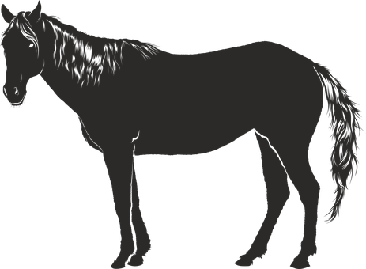


Adjectives following the noun
In English the adjective comes before the noun.
We have already learnt that many adjectives follow the noun:
un caballo negro
una iglesia alta
a black horse
a tall church
⚠ Remember, adjectives change depending on whether the noun (person, animal, place or thing) they describe is masculine or feminine.
When an adjective ends in –e or consonant, it can describe a feminine or masculine noun.
una planta verde
un monstruo verde
a green plant
a green monster
Notes:
Timing: 2 minutes
Aim: to revisit post-nominal adjective agreement.
Procedure:
Click through the animations to present the new information.
Elicit English translations for the Spanish examples provided.

Slide 17

escuchar
Escucha. ¿Cómo es?
Escribe.
¿Qué describe en inglés?
Rodea el adjetivo correcto.
escuchar
descripción | ¿qué?
divertido | divertida
alto | alta
blanco | blanca
negro | negra
verde | negro
nuevo | nueva
E
a (male) teacher
E
1
a brother
1
2
a bag
2
a horse
3
3
4
a plant
4
5
a word
5
Notes:
Timing: 7 minutes
Aim: to practise both retrieval of vocabulary and processing of the word order change from Spanish to English and adjectival agreement; aural comprehension of vocabulary.
Procedure:
Read the context and click to bring up further instruction.
Pupils write 1-5 in their books.
Click to listen to the example. Pupils circle / write the correct form of the adjective and write the noun mentioned, in English.
Click to reveal the correct adjective form and the noun. Then, elicit the Spanish from all pupils, chorally. (e.g. un professor divertido). Click the 2nd audio button (on the right) to hear the full phrase and check it.
Complete the task with items 1-5.
Click to reveal answers, using the same routine as for the example.
Transcript:
E. Un profesor [divertido]
1. Un hermano [alto]
2. Una bolsa [blanca]
3. Un caballo [negro]
4. Un planta [verde]
5. Una palabra [nueva]

Slide 18
adiós
¡adiós!
amarillo

