Slide 1

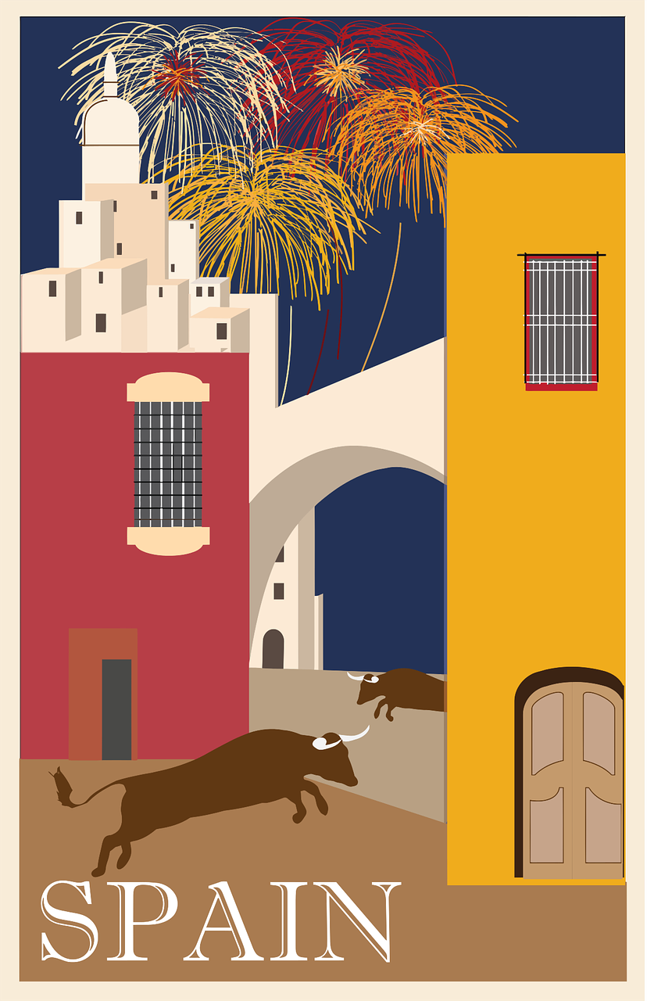

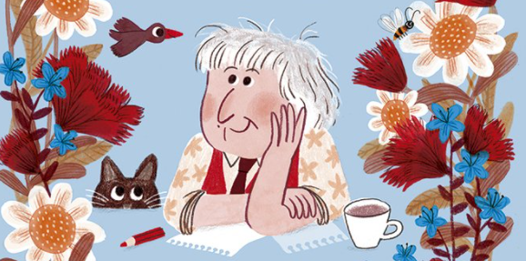
Saying what I and others do
Mi
amarillo
Follow ups 1-5
Notes:
Artwork by Steve Clarke. All additional pictures selected are available under a Creative Commons license, no attribution required.
The frequency rankings for words that occur in this PowerPoint which have been previously introduced in the resources are given in the SOW (excel document) and in the resources that first introduced and formally re-visited those words.
For any other words that occur incidentally in this PowerPoint, frequency rankings will be provided in the notes field wherever possible.
SSC: gesto [928] página [598]
Vocabulary: alto [231] bajo [452] blanco [372] negro [307] verde [812]
Revisit 1: tiene [19] unos [6] unas [6]boca [465] cabeza [265] dedo [465] ojo [169] oreja [2095] pie [365]
Revisit 2: visitar [792] iglesia [437] mamá [675] museo [1114] papá [865] parque [1354] plaza [806] con [14]
Frequency of unknown words and cognates glossed:
completar [2003] empezar [175] crecer [560] sembrar [2865] poema [1430] propio [183]
Source: Davies, M. & Davies, K. (2018). A frequency dictionary of Spanish: Core vocabulary for learners (2nd ed.). Routledge: London
Marta Altés, ‘El libro de Gloria Fuertes para niñas y niños’, Blackie Books. https://blackiebooks.org/catalogo/el-libro-de-gloria-fuertes-para-ninas-y-ninos/

Slide 2
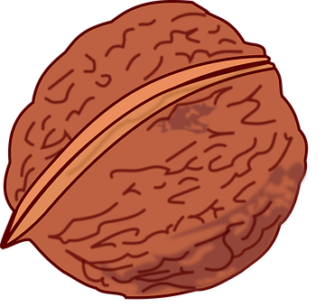






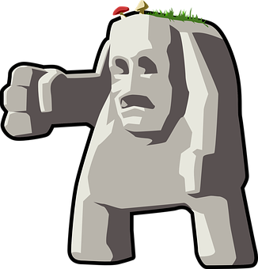
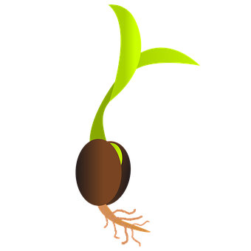
Follow up 1
[ge] [gi]
A Escucha. ¿Qué sonido es?
B ¡A cantar!
Marca
 | ge | gi
 |  |  | reli _ _ ón
 |  |  | _ _ ma
 |  |  | cole _ _ o
 |  |  | ima _ _ nar
 |  |  | _ _ rasol
 |  |  | _ _ rminar
E
gi
1
ge
2
gi
3
gi
4
gi
5
ge
gente
girasol
germinar
gigante
sembrar = to plant | empezar = to start
crecer = grow
Notes:
Timing: 5 minutes
Aim: to develop phonological awareness of [ge] [gi]
Procedure:
Click to bring up the instruction.
Click to bring up the table and do example together (E).
Students tick and/or write the correct sound [ge] [gi] – they may also challenge themselves to write the whole word.
4. Click to bring up Part B and read instructions. The video includes lyrics to follow along to – there are some unknown words but there are many examples of the [ge] and [gi] sounds to join in with and lots of repetition.
Transcript
[EJ] religión
[1] gema
[2] colegio
[3] imaginar
[4] girasol
[5] germinar
https://www.youtube.com/watch?v=r6VNcdPZaX0&ab_channel=123Andr%C3%A9s
© 123 Andrés. All rights reserved.
Frequency of unknown words and cognates:
sembrar [2865] empezar [175] crecer [560]
Source: Davies, M. & Davies, K. (2018). A frequency dictionary of Spanish: Core vocabulary for learners (2nd ed.). Routledge: London

Slide 3


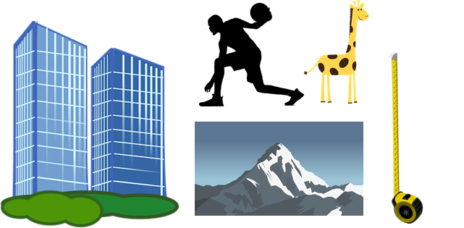
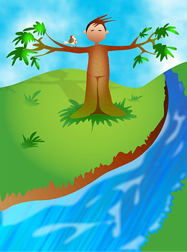
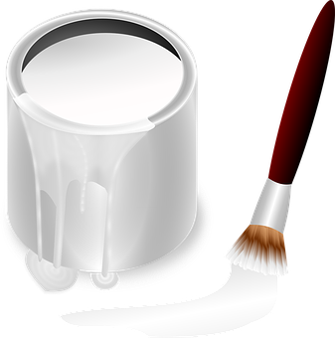

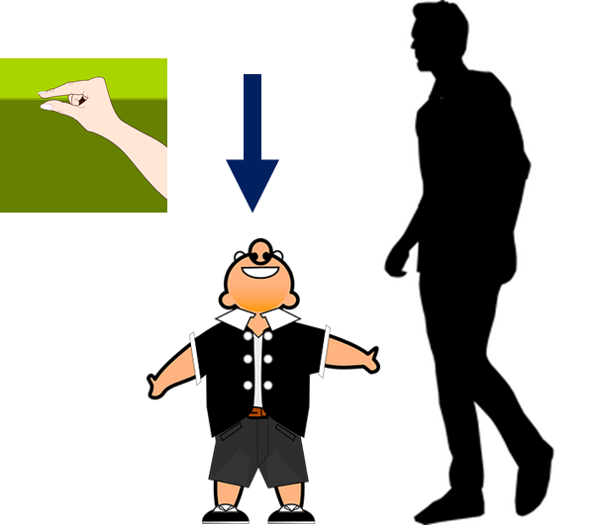
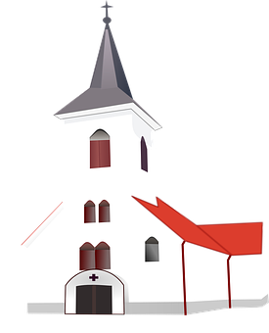
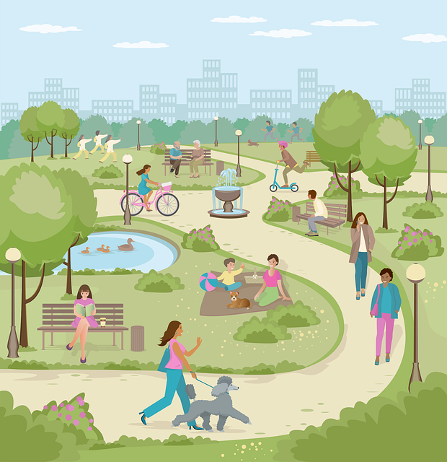
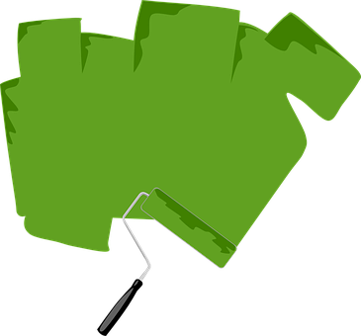
Follow up 2:
¿Qué palabra es?
alto
hablar
palabras
toal
[above]
negro
grone
[below]
arriba
barria
abajo
baajo
orí
coblan
río
blanco
benu
nube
[middle]
bajo
joba
medio
diome
parque
quepar
iglesia
dever
glesiai
verde
Notes:
Timing: 5 minutes (this slide has more support – see the next slide for a more challenging alternative)
Aim: to practise key vocabulary (newly introduced this week and from previous weeks).
Procedure:
1. Pupils work in pairs to put the syllables in the correct order.
2. Teacher elicits answers from pupils. Answer appear on click the picture.
For a more challenging version see next slide.

Slide 4
Follow up 2:
¿Qué palabra es?
[m]
palabras
hablar
palabras
alto
hablar
a_ _ _
[above]
n _ _ _ _
negro
[below]
arriba
a_ _ _ _ a
abajo
a_ _ _ _
río
b_ _ _ c_
r_ _
blanco
[middle]
[m]
n _ _ _
nube
m _ _ _ _
medio
bajo
b_ j _
p_ _ q_ _
parque
i _ _ _ _ _
v_ _ d _
iglesia
verde
Notes:
Timing: 5 minutes (this slide has more support – see the next slide for a more challenging alternative)
Aim: to practise key vocabulary (newly introduced this week and from previous weeks).
Procedure:
1. Pupils work in pairs to put the syllables in the correct order.
2. Teacher elicits answers from pupils. Answer appear on click the picture.
For a more challenging version see next slide.

Slide 5

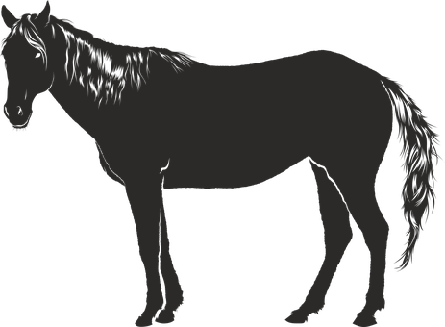


Adjectives following the noun
In English the adjective comes before the noun.
We have already learnt that many adjectives follow the noun:
un caballo negro
una iglesia alta
a black horse
a tall church
⚠ Remember, adjectives change depending on whether the noun (person, animal, place or thing) they describe is masculine or feminine.
When an adjective ends in –e or consonant, it can describe a feminine or masculine noun.
una planta verde
un monstruo verde
a green plant
a green monster
Notes:
Timing: 2 minutes
Aim: to revisit post-nominal adjective agreement.
Procedure:
Click through the animations to present the new information.
Elicit English translations for the Spanish examples provided.

Slide 6


Follow up 3:
Escribe 📝detalles en los poemas.
blanca
escribir
leer
La nube _____________ arriba,
El parque_____________ abajo,
y un espantapájaros _____________.
[white]
verde
[green]
cómodo| cómoda
alto | alta
bajo | baja
divertido | divertida
verde
blanco | blanca
negro | negra
raro | rara
nuevo | nueva
viejo | vieja
increíble
interesante
feliz
feliz
[happy]
blanca
La nieve _____________ ,
el frío _____________,
y, en el medio, un río _____________.
[white]
raro
[blue]
increíble
[incredible]
alto
El sol _____________ arriba
el mar _____________ abajo
y, en el medio,
un barco _____________.
[tall]
viejo
[old]
nuevo
[new]
(el) poema = poem
Notes:
Timing: 5 minutes
Aim: to practise key vocabulary (positions and nouns) & adjectival agreement.
Procedure:
1. Pupils use the list of adjectives and select the correct form (masculine / feminine).
2. For additional challenge, remove the adjectives box or cover most/some of the words, a needed.
3. Click the green audio buttons to listen and check each verse and click to bring up the written answers.

Slide 7
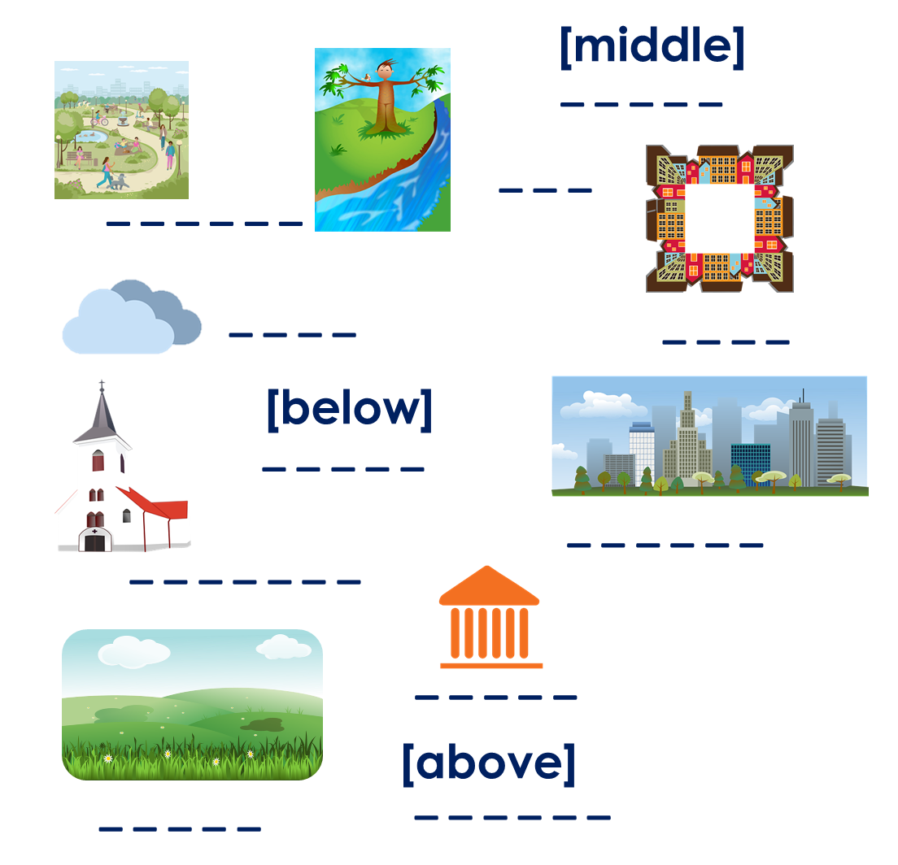
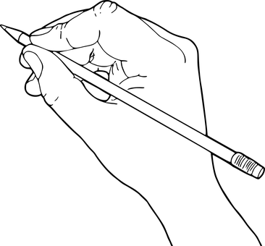
Follow up 4:
completar = to complete
(el) poema = poem
propio = own (m)
Parte 1: Crea tu propio poema.
escribir
_________ [adjective] [position],
_________ [adjective] [position],
y, [position], un _________[adjective]
Parte 2: Dibuja tu poema.
Other masculine nouns:
país, estadio, monstruo, hermano, bocadillo, libro, padre, animal, papel, instrumento, lápiz, perro, profesor, caballo, barco,
Other feminine nouns:
bicicleta, hermana, naranja, revista, carta, madre, regla, hoja, palabra, profesora, puerta, mesa, planta, bolsa, cama
Adjetivos
activo, enfermo, preparado, cómodo, alto, bajo, divertido, verde, blanco, negro, raro, nuevo, viejo, increíble, interesante, feliz
Notes:
Timing: 5 minutes
Aim: guided written production of pupil’s own poem.
Procedure:
For part 1, pupils can use the frame provided (or the poems used in the lessons) to write their own poem, including adjectives.
Pupils to draw their poem. This would do a very nice display!
Frequency of unknown words and cognates:
completar [2003] poema [1430] propio [183]
Source: Davies, M. & Davies, K. (2018). A frequency dictionary of Spanish: Core vocabulary for learners (2nd ed.). Routledge: London

Slide 8



Handout: follow up 5
Follow up 5:
Escribe en inglés📝: can you get at least 15 points?
 | el museo | visitar | con
 | la plaza | el parque | la iglesia
 | la boca | el ojo | la cabeza
 | el dedo | some (mpl) | some (fpl)
 | negro | alto | el medio
 | bajo | verde | blanca
vocabulario
the museum
to visit, visiting
with
x3
(the) square
(the) park
the church
(the) mouth
(the) eye
(the) head
x2
(the) finger
unos
unas
black (m)
tall (m)
(the) middle
x1
short (m)
green
white (f)
Notes:
Timing: 5 minutes
Aim: to practise written production of vocabulary from this week and this week’s revisited sets.
Procedure:
1. Give pupils a blank grid. They fill in the English meanings of any of the words they know, trying to reach 15 points in total.
Note:
The most recently learnt and practised words are pink, words from the first revisit are green and those from the second revisit are blue, thus more points are awarded for them, to recognise that memories fade and more effort (heavy lifting!) is needed to retrieve them.

Slide 9
follow up 5:
Escribe en español📝: can you get at least 15 points?
 | (the) church | (the) park | with
 | to visit, visiting | (the) museum | (the) square
 | (the) eye | (the) head | (the) finger
 | (the) mouth | some (mpl) | some (fpl)
 | (the) middle | green | white (m)
 | tall (f) | black (f) | short (m)
vocabulario
la iglesia
el parque
con
x3
visitar
el museo
la plaza
el ojo
la cabeza
el dedo
x2
la boca
unos
unas
el medio
verde
blanco
x1
alta
negra
bajo
Notes:
Timing: 5 minutes
Aim: to practise written production of vocabulary from this week and this week’s revisited sets.
Procedure:
1. Give pupils a blank grid. They fill in the Spanish meanings of any of the words they know, trying to reach 15 points in total.
Note:
The most recently learnt and practised words are pink, words from the first revisit are green and those from the second revisit are blue, thus more points are awarded for them, to recognise that memories fade and more effort (heavy lifting!) is needed to retrieve them.

Slide 10
¡adiós!
amarillo

Slide 11
Follow up 5: handout
Parte 1: Crea tu propio poema.
Parte 1: Crea tu propio poema.
_________ [adjective] [position],
_________ [adjective] [position],
y, [position], un _________[adjective].
_________ [adjective] [position],
_________ [adjective] [position],
y, [position], un _________[adjective].
_________ _____________ ______________,
_________ _____________ _____________,
y, _____________, un _________ _____________.
_________ _____________ ______________,
_________ _____________ _____________,
y, _____________, un _________ _____________.
Parte 2: Dibuja tu poema.
Parte 2: Dibuja tu poema.
Notes:
Handout

Slide 12
Handout: follow up 5
Follow up 5:
Escribe en inglés📝: can you get at least 15 points?
 | el museo | visitar | con
 | la plaza | el parque | la iglesia
 | la boca | el ojo | la cabeza
 | el dedo | some (mpl) | some (fpl)
 | negro | alto | el medio
 | bajo | verde | blanca
vocabulario
x3
x2
x1
Notes:
Timing: 5 minutes
Aim: to practise written production of vocabulary from this week and this week’s revisited sets.
Procedure:
1. Give pupils a blank grid. They fill in the English meanings of any of the words they know, trying to reach 15 points in total.
Note:
The most recently learnt and practised words are pink, words from the first revisit are green and those from the second revisit are blue, thus more points are awarded for them, to recognise that memories fade and more effort (heavy lifting!) is needed to retrieve them.

Slide 13
follow up 5:
Escribe en español📝: can you get at least 15 points?
 | (the) church | (the) park | with
 | to visit, visiting | (the) museum | (the) square
 | (the) eye | (the) head | (the) finger
 | (the) mouth | some (mpl) | some (fpl)
 | (the) middle | green | white (m)
 | tall (f) | black (f) | short (m)
vocabulario
x3
x2
x1
Notes:
HANDOUT

