Slide 1

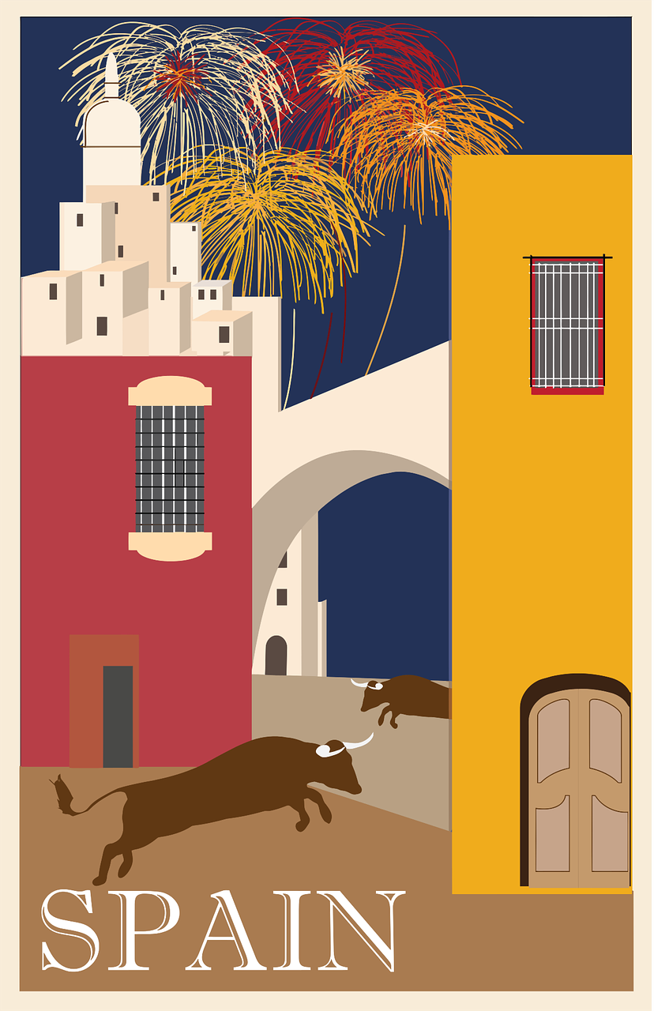

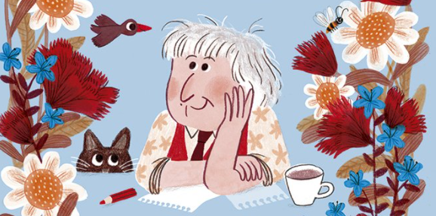
Saying what I and others do
Mi
amarillo
Follow ups 1-5
Notes:
Artwork by Steve Clarke. All additional pictures selected are available under a Creative Commons license, no attribution required.
The frequency rankings for words that occur in this PowerPoint which have been previously introduced in the resources are given in the SOW (excel document) and in the resources that first introduced and formally re-visited those words.
For any other words that occur incidentally in this PowerPoint, frequency rankings will be provided in the notes field wherever possible.
SSC: [j] ojo [169] rojo [534] pájaro [1607] jueves [1650] jirafa [>5000]
Vocabulary: medio [395] nube [1499] río [496] arriba [690] abajo [788]
Revisit 1: un [6] dos [64] tres [134] cuatro [241] cinco [284] seis [438] siete [603] ocho [641] nueve [991] diez [449] once [1700] doce [1138]
Revisit 2: buscar [179] crear [239] presentar [235] usar [317] información [326] país [109] importante [171] divertido [2465] interesante [616]
Frequency of unknown words and cognates glossed:
completar [2003] empezar [175] poema [1430] propio [183]
Source: Davies, M. & Davies, K. (2018). A frequency dictionary of Spanish: Core vocabulary for learners (2nd ed.). Routledge: London
Marta Altés, ‘El libro de Gloria Fuertes para niñas y niños’, Blackie Books. https://blackiebooks.org/catalogo/el-libro-de-gloria-fuertes-para-ninas-y-ninos/

Slide 2



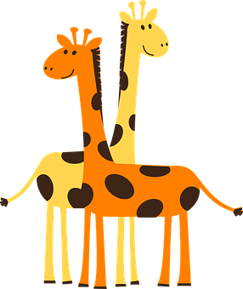




Follow up 1
[j] ojo
A Escucha. ¿Qué sonido es?
Marca
 | ja | je | ji | jo | ju
B ¡Practica la frase!
E
45
segundos
La jirafa Jimena
es una jefa joven;
juega con el jaguar
en la jaula normal.
1
[Jimena the giraffe]
2
[is a young boss];
3
4
[she plays with the jaguar]
5
[in the regular cage].
INICIO
Notes:
Timing: 5 minutes
Aim: to develop phonological awareness of [j]
Procedure:
1. Click to bring up the instruction.
2. Click to bring table and do example together (E).
3. Students tick and/or write the correct sound [ja] [je] [ji] [jo] [ju]
4. Click to bring up Part B and read instructions.
5. Practise as a whole class and then allow students to work in pairs.
6. In Part B, click on the pictures to hear each line.
Transcript 1
[EJ] jirafa
[1] juega
[2] jefa
[3] jaguar
[4] jaula
[5] joven
Transcript 2
La jirafa Jimena
es una jefa joven
juega con el jaguar
en la jaula normal

Slide 3

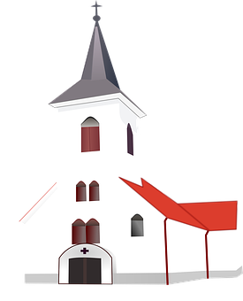

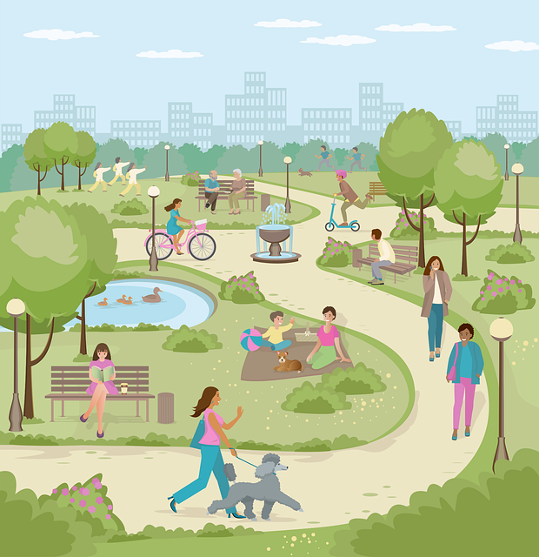

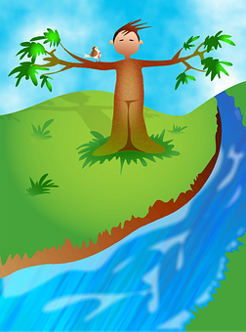



Follow up 2.1a
hablar
palabras
parque
quepar
iglesia
glesiai
plaza
zapla
[above]
arriba
barria
[below]
abajo
nube
río
baajo
benu
orí
dadciu
[middle]
ciudad
osemu
medio
museo
diome
campo
pocam
Notes:
Timing: 5 minutes (two slides – there are two levels of challenge for slide 1)
Aim: to practise key vocabulary (newly introduced this week and from previous weeks).
Procedure:
[Part 1 / slide 1 and/or 2]
1. Pupils work in pairs to put the syllables in the correct order.
2. Teacher elicits answers from pupils. Answers appear on clicking the picture.
For a more challenging version see next slide.

Slide 4
Follow up 2.1b
parque
hablar
palabras
_ _ _ _ _ _
iglesia
_ _ _ _ _ _ _
plaza
_ _ _ _ _
[above]
arriba
_ _ _ _ _ _
[below]
abajo
_ _ _ _ _
nube
_ _ _ _ _
río
_ _ _
ciudad
[middle]
_ _ _ _ _ _
medio
museo
_ _ _ _ _
_ _ _ _ _
campo
_ _ _ _ _
Notes:
A more challenging version of Part 1
Procedure:
1. Pupils work in pairs to recall the words orally.
2. Teacher elicits Spanish words from pupils. Answers appear on clicking the picture.

Slide 5
Follow up 2.2
empieza = it starts
[middle]
_ _ _ _ _
palabras
Veo veo
_ _ _
¿Qué ves?
_ _ _ _ _ _
_ _ _ _
_ _ _ _
Una cosita
[below]
¿Qué cosita es?
_ _ _ _ _
_ _ _ _ _ _
_ _ _ _ _ _ _
¿Qué es, qué es, qué es?
_ _ _ _ _
Empieza con la letra…
[above]
_ _ _ _ _
_ _ _ _ _ _
Notes:
Aim: to practise key vocabulary (newly introduced this week and from previous weeks).
Procedure:
[Part 2]
Tell students they need to guess the word the teacher is thinking of (s/he might write it down unseen on a mini whiteboard as part of the process)
Teacher models the game by reading the first (pink) speech bubble and pupils respond (green speech bubble).
Pupils suggest different words in Spanish (from the prompts shown on the left) until they guess the word and the teacher reveals it.
Do a couple of rounds, then pupils can work in pairs to guess each other’s word.
Note: this is the ‘I spy’ game; the meaning of the spoken routine is as follows:
- Veo, veo. (I see, I see or I spy, I spy)
- ¿Qué ves? (What do you see?)
- Una cosita (a little thing)
- ¿Qué cosita es? (what little thing is it?)
- Empieza con la letra… (it starts with the letter…)
Frequency of unknown words and cognates glossed:
empezar [175]
Source: Davies, M. & Davies, K. (2018). A frequency dictionary of Spanish: Core vocabulary for learners (2nd ed.). Routledge: London

Slide 6


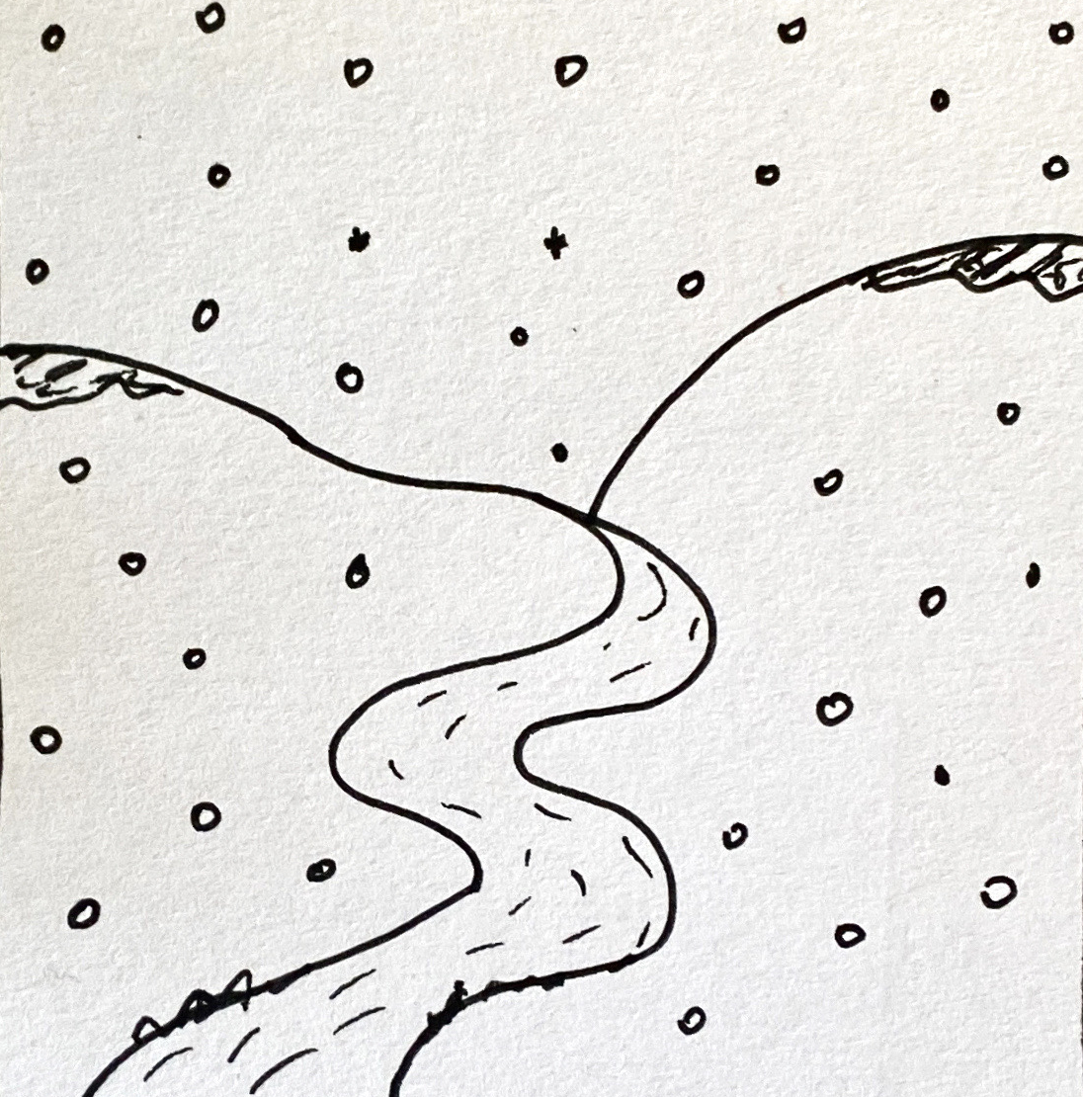
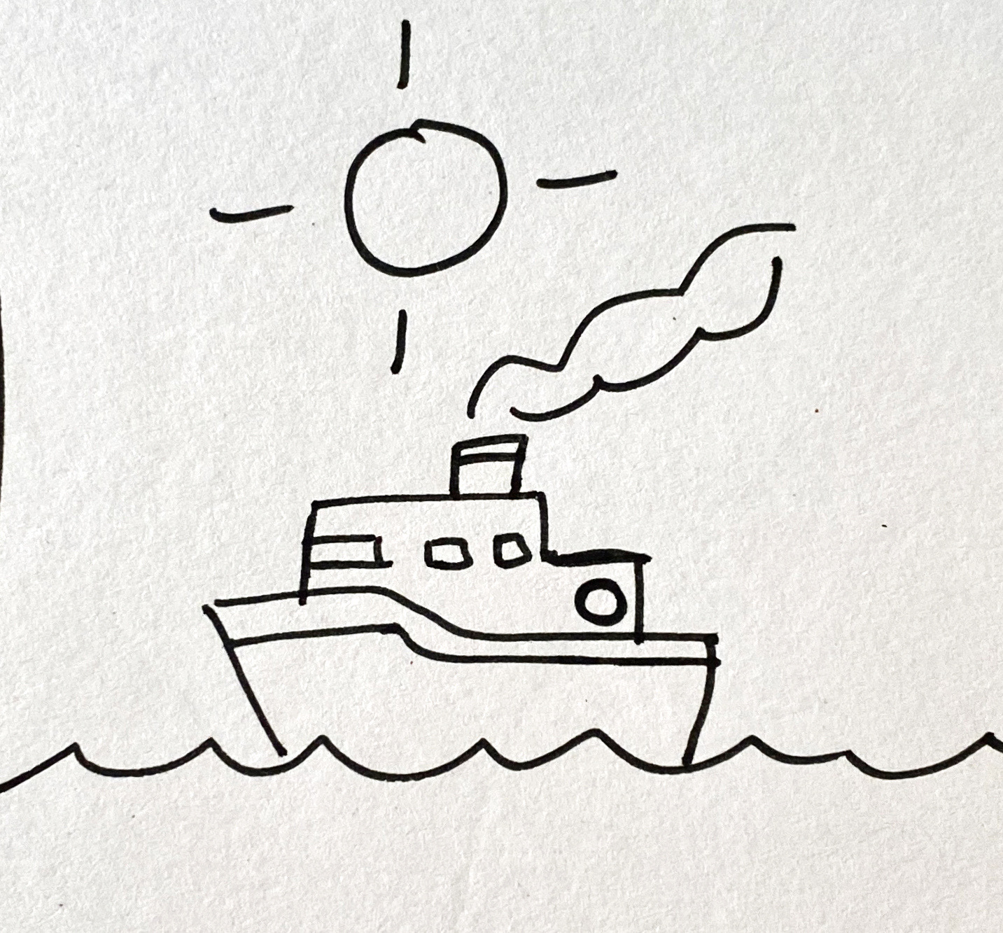
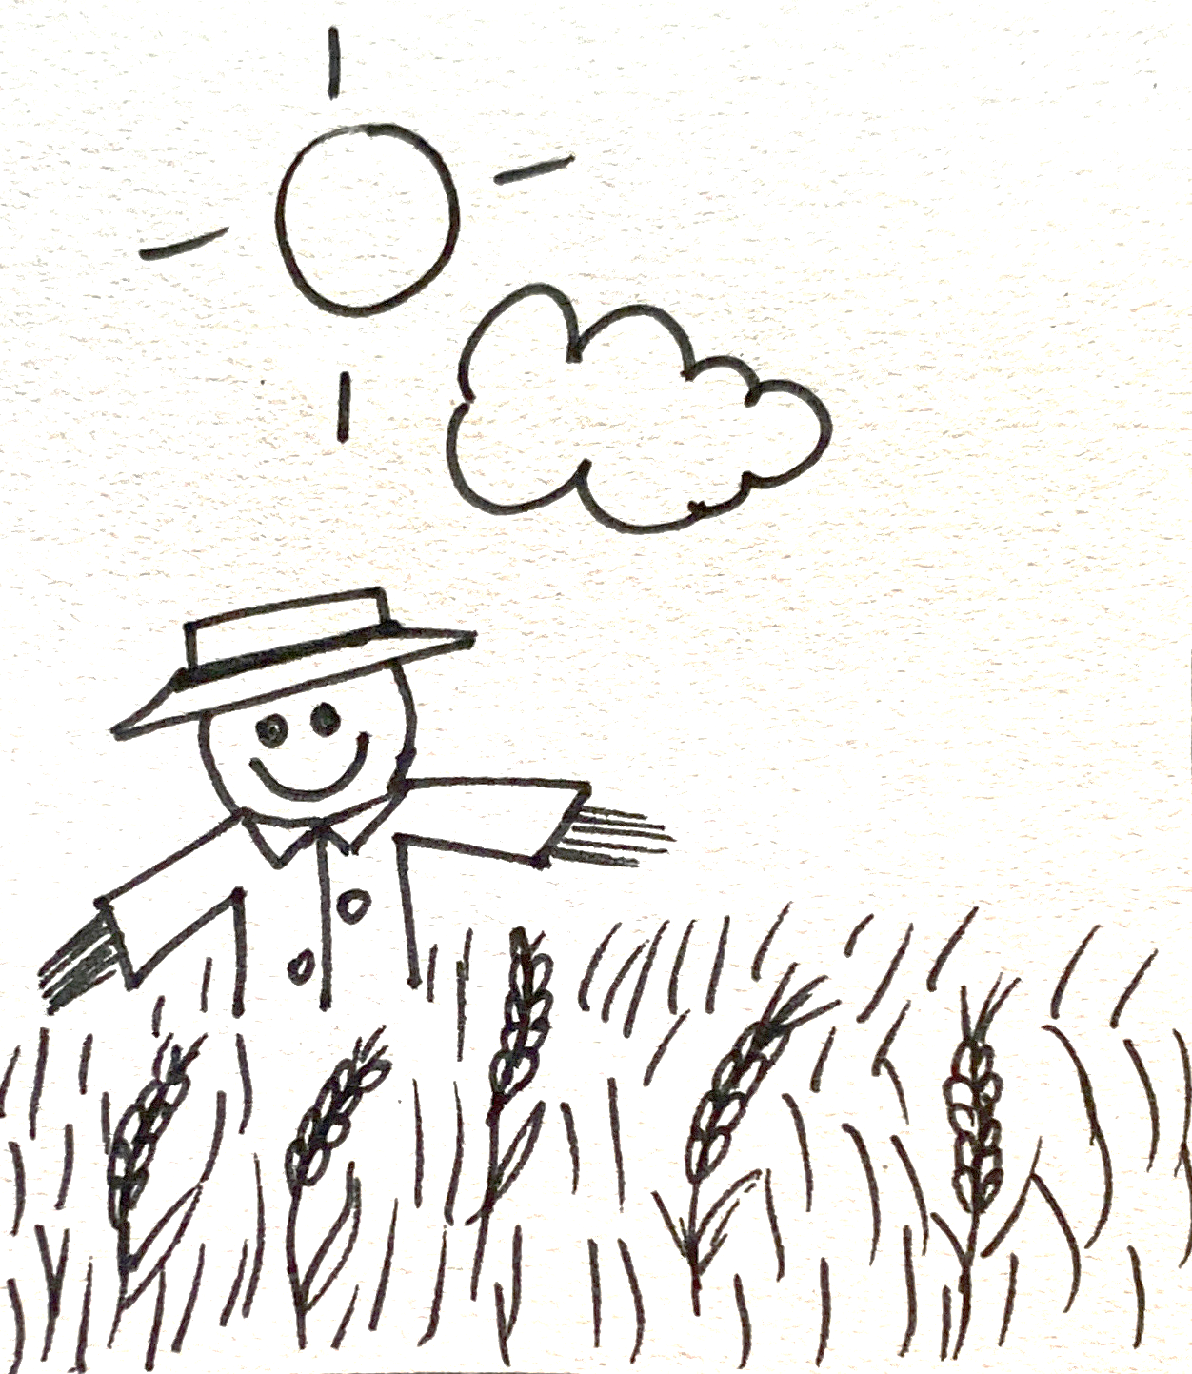
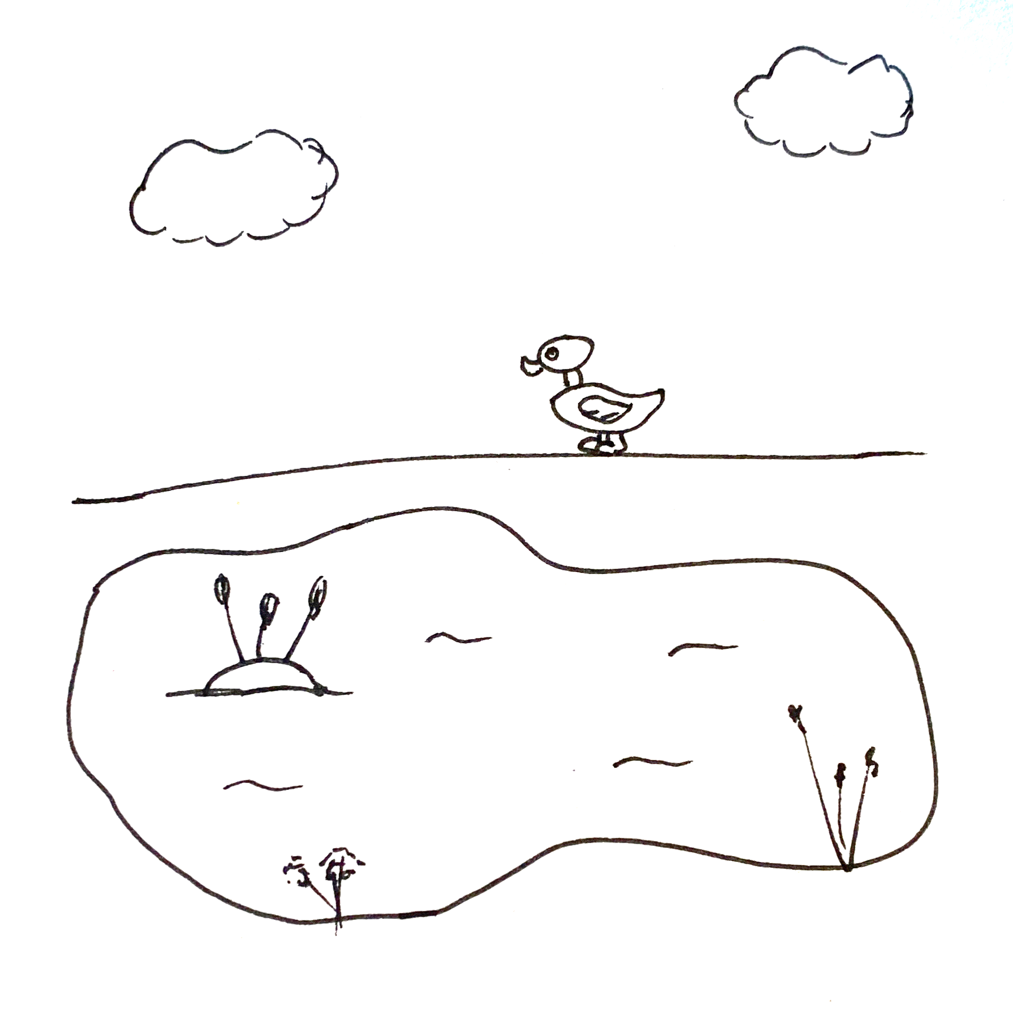
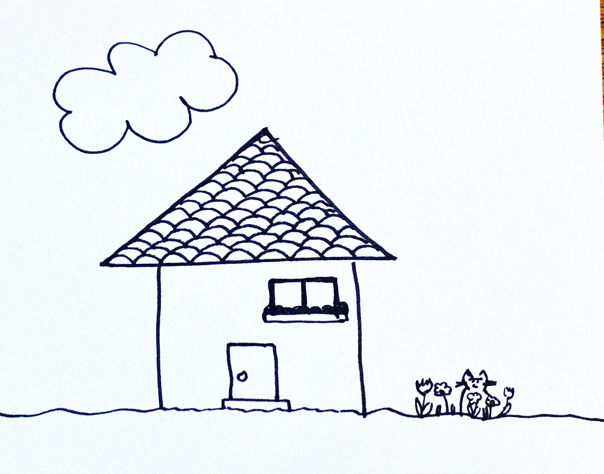
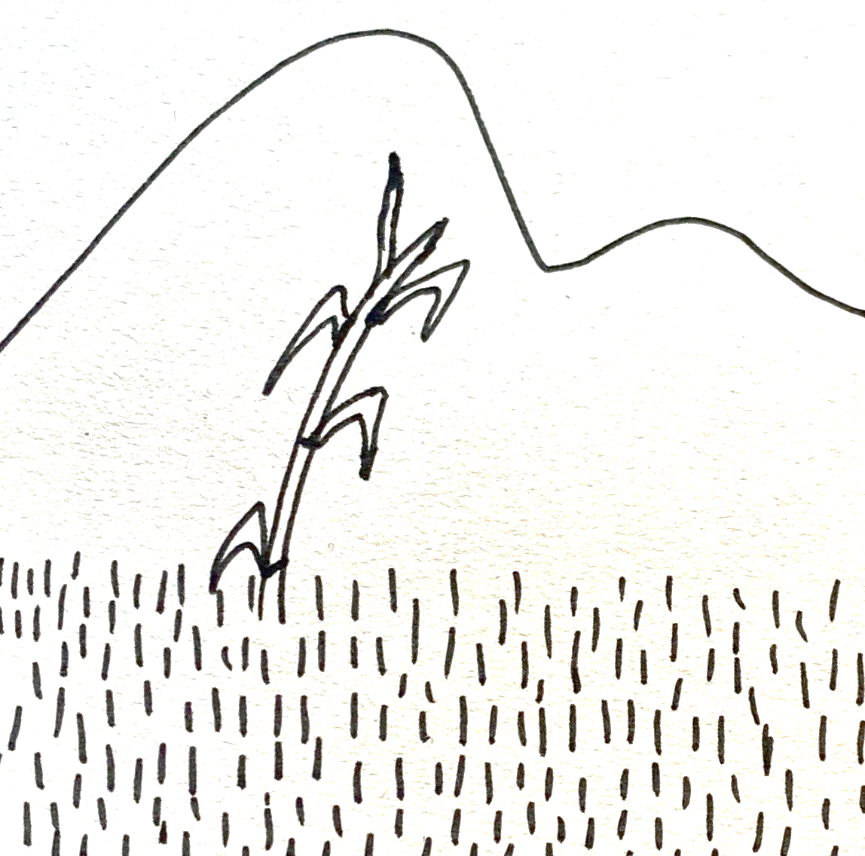
Follow up 3:
Lee: ¿Qué dibujo es?
1
2
3
leer
3
a
El sol arriba,
la nube abajo,
y, en el medio, el trigo
y un espantapájaros.
4
5
6
c
El sol arriba
el mar abajo
y, en el medio,
un barco.
2
La nieve,
el frío,
y, en el medio, un río.
5
d
1
b
La nube arriba
el gato abajo
en el medio una casa
con un tejado
Notes:
Timing: 5 minutes
Aim: to practise key vocabulary from this week.
Procedure:
1. Pupils read the texts and identify the pictures that match each of the four poems. (Two pictures are not needed).
2. To bring up answers, click on the pink letter next to each poem.
3. Click on the number that appears next to each poem to hear the full audio.

Slide 7
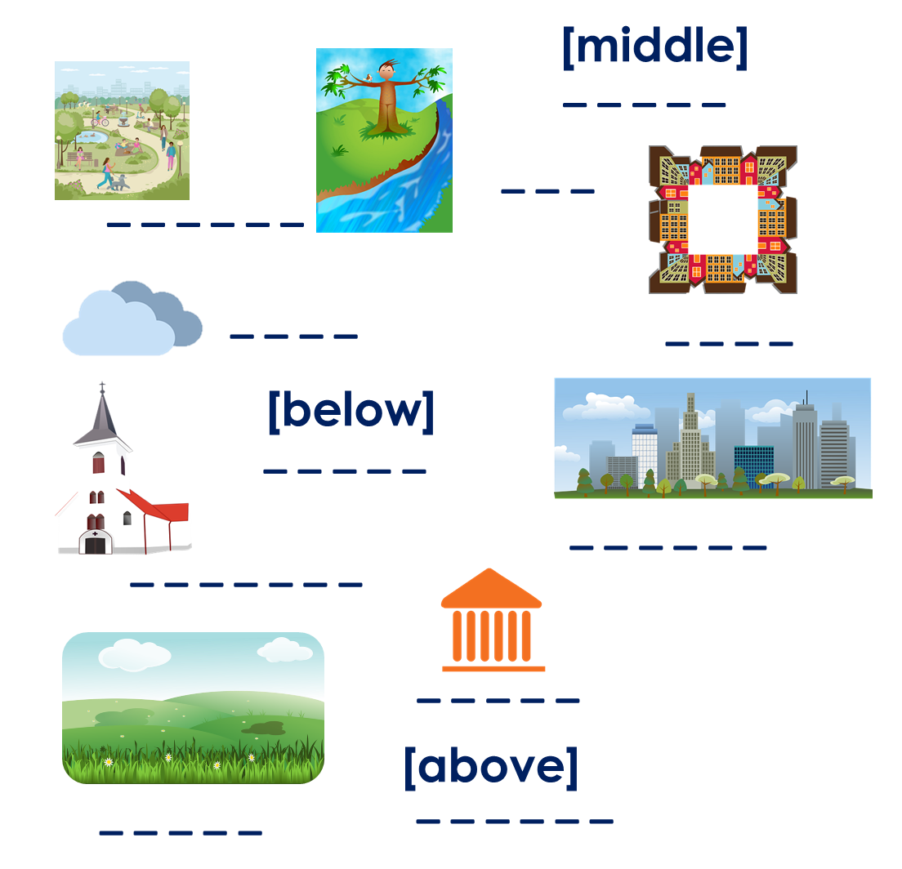


Follow up 4:
completar = to complete
(el) poema = poem
propio = own (m)
Parte 1: Completa el poema con una palabra correcta.
escribir
El _________ [position],
la _________ [position],
y, en el medio, un _________
Parte 2: Crea tu propio poema.
Other masculine nouns:
país, estadio, monstruo, hermano, bocadillo, libro, padre, animal, papel, instrumento, lápiz, perro, profesor, caballo, barco,
Other feminine nouns:
bicicleta, hermana, naranja, revista, carta, madre, regla, hoja, palabra, profesora, puerta, mesa, planta, bolsa, cama
_________ [position],
_________ [position],
y, [position], un _________
Parte 3: Dibuja tu poema.
Notes:
Timing: 10 minutes
NB. See next slide for a more accessible task
Aim: to practise supported creative writing
Procedure:
For part 1, pupils are prompted to use nouns of a specific gender. Point at the vocabulary we are practising this week as well as the suggested masculine / feminine nouns.
For part 2, pupils can use the frame provided (or the poems used in the lessons) to write their own poem.
Pupils to draw their poem. This would make a very nice display!
Frequency of unknown words and cognates glossed:
completar [2003] poema [1430] propio [183]
Source: Davies, M. & Davies, K. (2018). A frequency dictionary of Spanish: Core vocabulary for learners (2nd ed.). Routledge: London

Slide 8




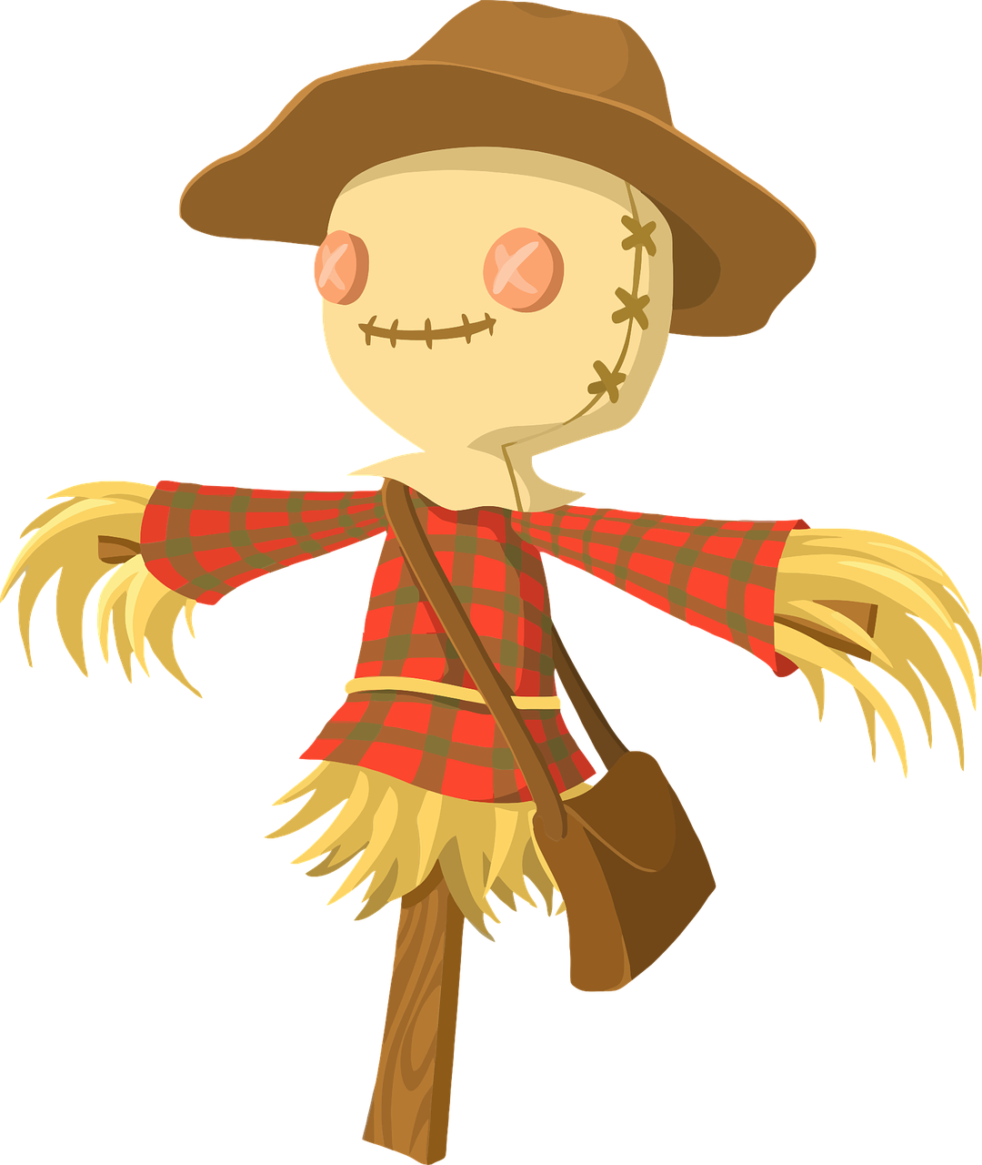
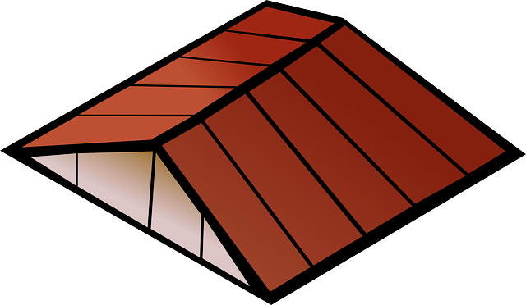
Follow up 4:
Completa* el pictograma.
m_ _ _
n_ _ _
g_ _ _
escribir
leer
espantapájaros
c_ _ _
ab_ _ _
n_ _ _
sol
tejado
ab_ _ _
arr_ _ _
m_ _ _
arr_ _ _
trigo
[The]
______ _________ __________
[The]
______ _________ __________
[And in the] [the]
___ ____ _____ _________ ____ __________
[And a]
_____ _______ ______________
[The]
______ _________ __________
[The]
______ _________ __________
[And in the] [a]
___ _____ _____ __________ ___ ________
with a
______ _________
El sol arriba
La nube arriba
la nube abajo
el gato abajo
y en el medio el trigo
y en el medio una casa
y un espantapájaros
con un tejado
completar = to complete
Notes:
Timing: 10 minutes [More accessible writing task. It could be used in preparation for the writing task or as an alternative for pupils who might find creative writing challenging]
Aim: to practise supported writing and written comprehension.
Procedure:
1. Pupils use the support box and their knowledge of this week’s new words to write each line of the poem.
2. Click to correct.
Frequency of unknown words and cognates glossed:
completar [2003]
Source: Davies, M. & Davies, K. (2018). A frequency dictionary of Spanish: Core vocabulary for learners (2nd ed.). Routledge: London

Slide 9



Follow up 5:
Escribe en español: Can you get at least 15 points?
 | to present, presenting | important (m/f) | interesting (m/f)
 | fun (f) | information | country
 | to search, searching | to use, using | to create, creating
 | four | eleven | nine
 | five | seven | ten
 | the middle | up, above | down, below
 | the (m, f) | river | cloud
presentar
importante
interesante
vocabulario
divertida
la información
el país
x3
buscar
usar
crear
cuatro
once
nueve
x2
cinco
siete
diez
el medio
arriba
abajo
x1
el, la
el río
la nube
Notes:
Timing: 6 minutes
Aim: to practise written production of vocabulary for this week and previous weeks.
Procedure:
1. Pupils need to write the Spanish for as many words as possible, aiming to get at least 15 points (but more if possible).
2. Click for Spanish answers.

Slide 10
¡adiós!
amarillo

Slide 11
Handout (follow up 5)
Parte 1: Completa el poema con una palabra correcta.
Parte 1: Completa el poema con una palabra correcta.
El _________ [position],
la _________ [position],
y, en el medio, un _________
El _________ [position],
la _________ [position],
y, en el medio, un _________
Parte 2: Crea tu propio poema.
Parte 2: Crea tu propio poema.
_________ [position],
_________ [position],
y, [position], un _________
_________ [position],
_________ [position],
y, [position], un _________
Notes:
Handout

Slide 12
Handout: Follow up 4 [EN-SP]
Follow up 4 :
Escribe en español 📝:
Can you get at least 15 points?
 | to present, presenting | important (m/f) | interesting (m/f)
 | fun (f) | information | country
 | to search, searching | to use, using | to create, creating
 | four | eleven | nine
 | five | seven | ten
 | the middle | up, above | down, below
 | the (m, f) | river | cloud
vocabulario
vocabulario
x3
x2
x1
Notes:
Timing: 5-10 minutes
Aim: to practise written production of vocabulary for this week and previous weeks.
Procedure:
1. Pupils need to write the English for as many words as possible, aiming to get at least 15 points (but more if possible).
2. Click for English answers.

