Slide 1


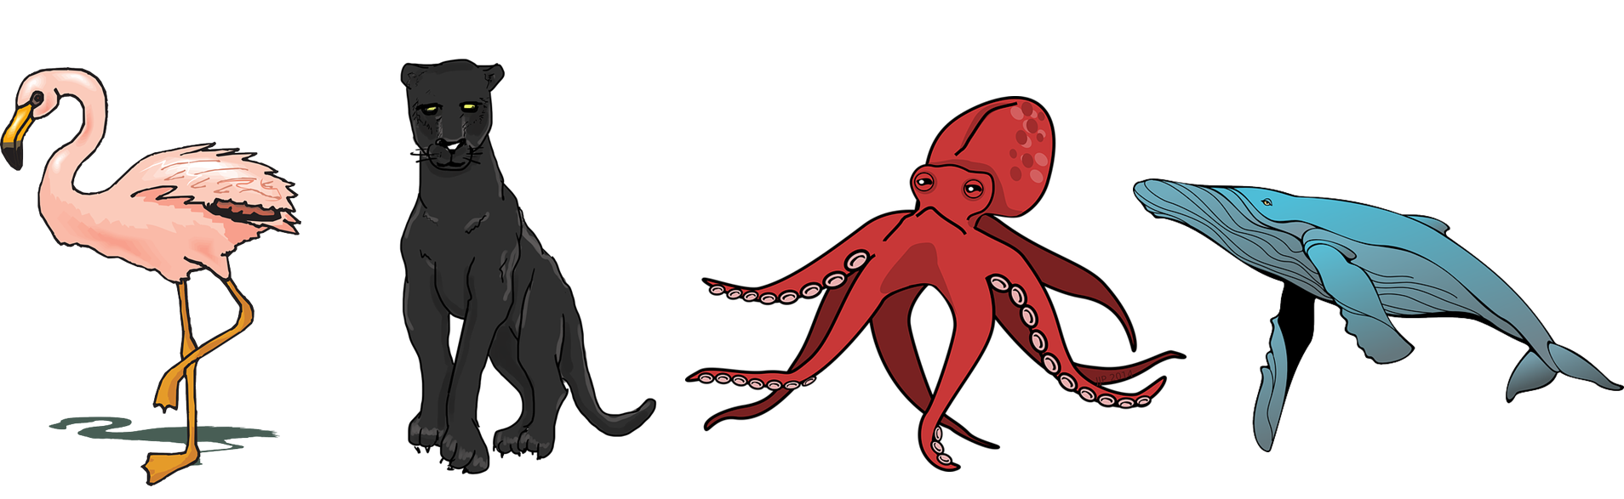

Un poema
Mi
Un poema
amarillo
Follow ups 1-5
Term 3 Week 13
Notes:
Artwork by Steve Clarke. All additional pictures selected are available under a Creative Commons license, no attribution required.
The frequency rankings for words that occur in this PowerPoint which have been previously introduced in the resources are given in the SOW (excel document) and in the resources that first introduced and formally re-visited those words.
For any other words that occur incidentally in this PowerPoint, frequency rankings will be provided in the notes field wherever possible.
Vocabulary: N/A
Revisit 1: buscar [179] organizar [1053] tocar [327] cocina [1214] cada [107] luego [150]
Revisit 2: alto [231] bajo [452] blanco [372] negro [307] verde [812]
Frequency of unknown words and cognates:
brazo [470] corazón [475] carbón [3331] mar [480] oso [4449] poema [1430] curioso [1811] mayor [154] primero [82] rápida [870] su [12] como [20]
Source: Davies, M. & Davies, K. (2018). A frequency dictionary of Spanish: Core vocabulary for learners (2nd ed.). Routledge: London
Source: Davies, M. & Davies, K. (2018). A frequency dictionary of Spanish: Core vocabulary for learners (2nd ed.). Routledge: London

Slide 2





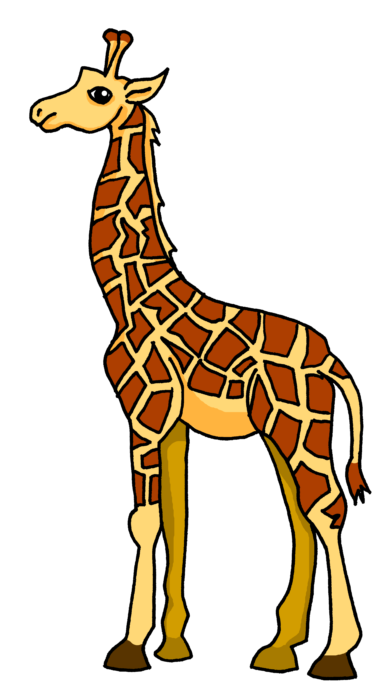

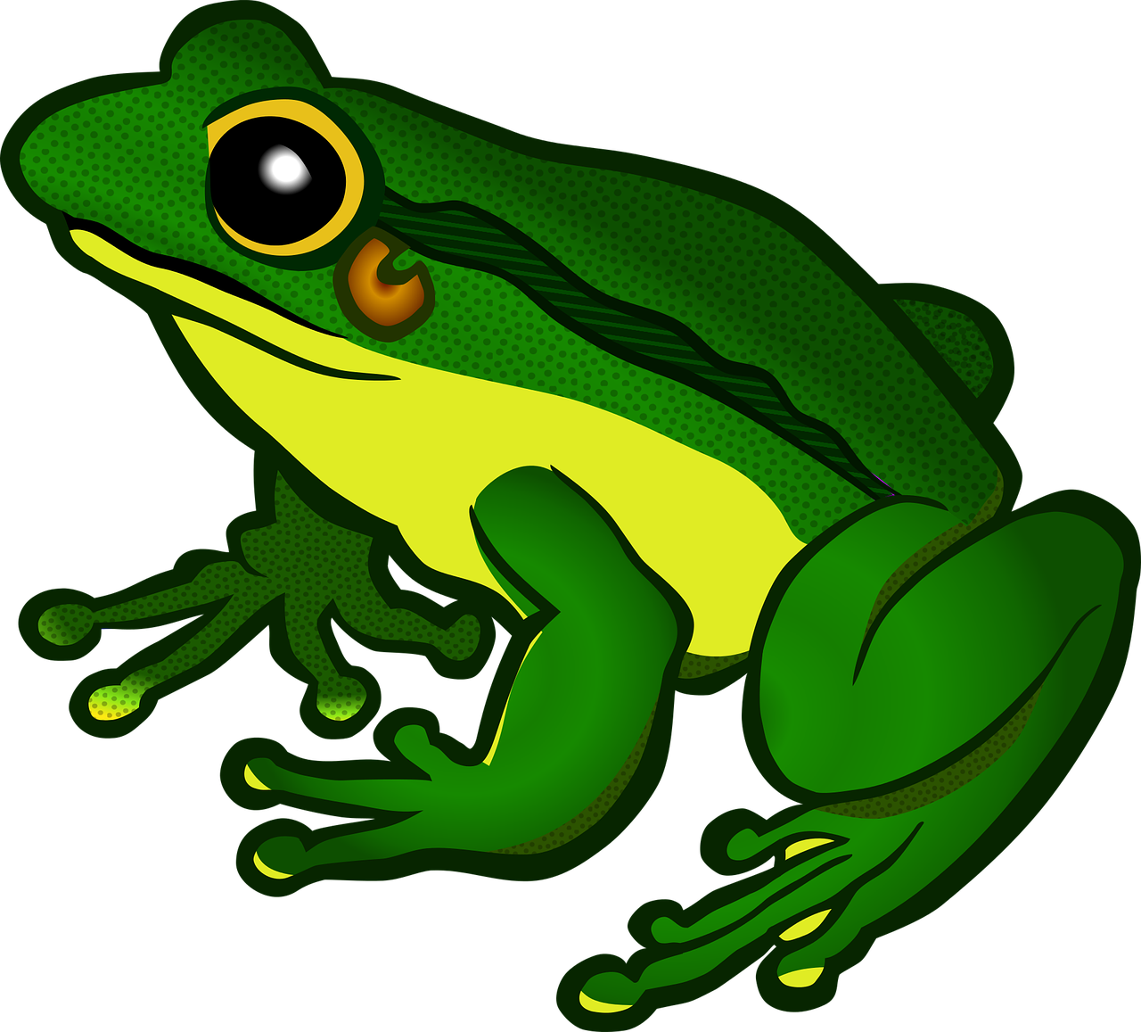


Follow up 1:
Reescribe el poema.
escribir
La pantera es negra como el carbón.
Cuando tiene miedo o frío,
su color no es diferente,
pero es rápida como un avión.
La pantera es única y especial.
La jirafa
amarilla
el sol
oso (m)
gorila (m)
animales
cosas
adjetivos
tortuga (f)
jirafa (f)
sueño
calor
tigre (m)
rana (f)
cebra (f)
erizo (m)
su color no es diferente,
bicicleta
sueño 😴
alta
una iglesia
barco
calor 🥵
La jirafa
importante
iglesia
importante
divertida
sol 🌞
interesante
alto/a
rojo/a
imposible
bajo/a
amarillo/a
increíble
divertido/a
verde
importante
activo/a
blanco/a
interesante
Notes:
Timing: 15 minutes
Aim: to write their own version of the poem.
Procedure:
1. Tell pupils they are going to write their own version of the poem in Spanish. Get them excited about this! A whole story in Spanish ☺
2. Click through the animations to model how to adapt a stanza.
There are easy and more challenging ways to do these variations on a theme.
E.g.
OR
Choose two or three nouns (the animals OR the adjectives)
OR
Change only one stanza
OR
Change everything except the essential structure (Remind them about the message of the poem. They could write about their different people in their lives and what makes them unique).
Pupils can use ideas from the table, use KOs or a dictionary.
NB. This could be done as a collaborative writing exercise.
See next slide for more ideas.

Slide 3
Follow up 1:
Reescribe el poema.
escribir
La pantera es negra como el carbón.
Cuando tiene miedo o frío,
su color no es diferente,
pero es rápida como un avión.
La pantera es única y especial.
La ballena azul
es grande como un autobús.
Porque es enorme y vive en el mar,
la ballena azul es única y especial.
El flamenco es blanco primero
y cuando es mayor,
es rosa como una flor.
Como la pantera,
el flamenco, es único y especial
El pulpo es curioso como un oso
y con sus ocho brazos
Y tres corazones
El pulpo también es único y especial.

Slide 4




follow up 2a:
Escribe en inglés 📝: can you get at least 15 points?
 | baja | tiene | grande
 | alto | negro | verde
 | tocar | cada | luego
 | buscar | organizar | la cocina
 | cuando | también | pero
 | blanco | diferente | es
vocabulario
short (f)
s/he, it has
big
x3
tall (m)
black (m)
green
to play (inst.)
each
then
x2
to look for
to organise
(the) kitchen
when
also
but
x1
white (m)
different
It is (trait)
Notes:
Timing: 5 minutes
Aim: to practise written production of vocabulary from this week and this week’s revisited sets.
Procedure:
1. Give pupils a blank grid. They fill in the English meanings of any of the words they know, trying to reach 15 points in total.
Note:
The most recently learnt and practised words are pink, words from the first revisit are green and those from the second revisit are blue, thus more points are awarded for them, to recognise that memories fade and more effort (heavy lifting!) is needed to retrieve them.

Slide 5
follow up 2b:
Escribe en español 📝: can you get at least 15 points?
 | green | big | black (f)
 | short (f) | s/he, it has | tall (m)
 | (the) kitchen | to organise | to play (inst.)
 | each | to look for | then
 | also | when | It is (trait)
 | white (m) | but | different
vocabulario
verde
grande
negra
x3
baja
tiene
alto
la cocina
organizar
tocar
x2
cada
buscar
luego
también
cuando
es
x1
blanco
pero
diferente
Notes:
Timing: 5 minutes
Aim: to practise written production of vocabulary from this week and this week’s revisited sets.
Procedure:
1. Give pupils a blank grid. They fill in the Spanish meanings of any of the words they know, trying to reach 15 points in total.
Note:
The most recently learnt and practised words are pink, words from the first revisit are green and those from the second revisit are blue, thus more points are awarded for them, to recognise that memories fade and more effort (heavy lifting!) is needed to retrieve them.

Slide 6
¡adiós!
amarillo

Slide 7
follow up 2b:
Follow up Extra 1a: Handout
Escribe en inglés 📝: can you get at least 15 points?
 | baja | tiene | grande
 | alto | negro | verde
 | tocar | cada | luego
 | buscar | organizar | la cocina
 | cuando | también | pero
 | blanco | diferente | es
vocabulario
x3
x2
x1
Notes:
HANDOUT 5

Slide 8
follow up 2b:
Follow up extra 1b: Handout
Escribe en español 📝: can you get at least 15 points?
 | green | big | black (f)
 | short (f) | s/he, it has | tall (m)
 | (the) kitchen | to organise | to play (inst.)
 | each | to look for | then
 | also | when | It is (trait)
 | white (m) | but | different
vocabulario
x3
x2
x1
Notes:
HANDOUT 5

