Slide 1


español, con Quique

Slide 2


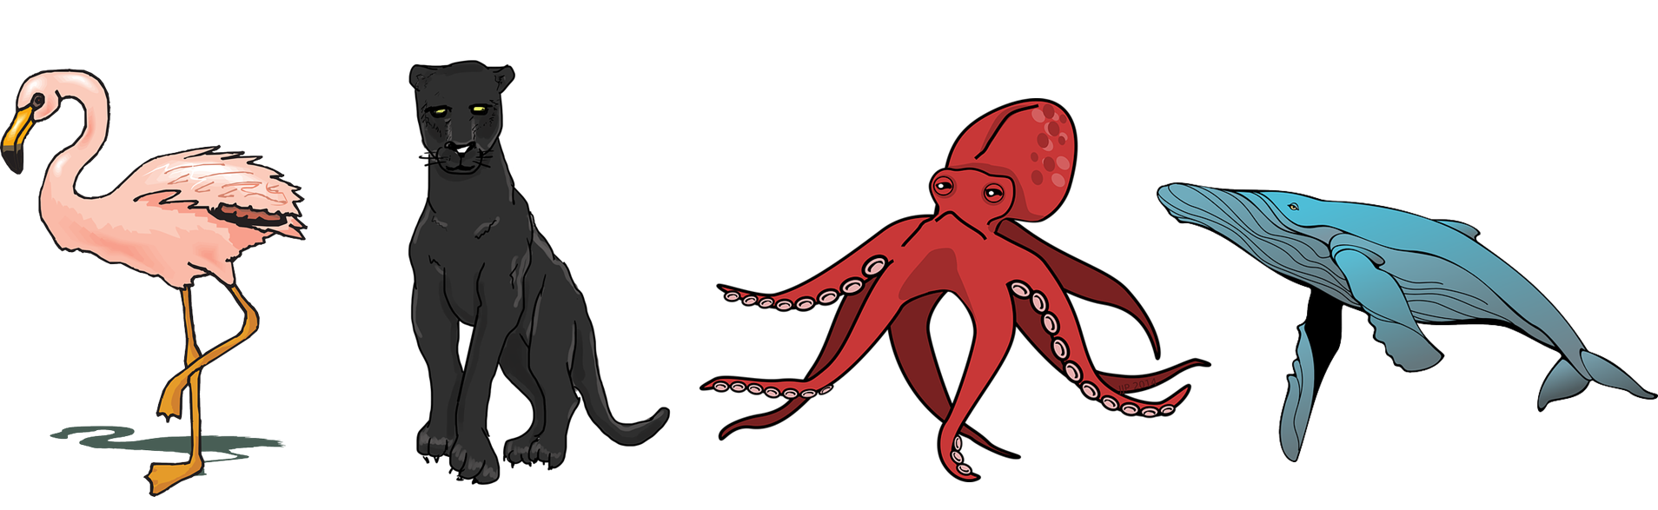
Expressing likes and saying what I and others do
Un poema
Un poema
amarillo
Term 3 Week 12
Notes:
Artwork by Steve Clarke. All additional pictures selected are available under a Creative Commons license, no attribution required.
The frequency rankings for words that occur in this PowerPoint which have been previously introduced in the resources are given in the SOW (excel document) and in the resources that first introduced and formally re-visited those words.
For any other words that occur incidentally in this PowerPoint, frequency rankings will be provided in the notes field wherever possible.
Vocabulary: N/A
Revisit 1: amar [700] odiar [2211] las [1] los [1] calor [1852] clase [320] cumpleaños [3372] español [262] fiesta [796] frío [1307] libro [230] lunes [1370] museo [1114] tarde [392] verde [812] difícil [374] fácil [584]
Revisit 2: medio [395] nube [1499] río [496] arriba [690] abajo [788]
Frequency of unknown words and cognates:
brazo [470] corazón [475] carbón [3331] mar [480] oso [4449] poema [1430] tarjeta [1958] bonito [891] su [12] mayor [154] primero [82] rápida [870] como [20]
Source: Davies, M. & Davies, K. (2018). A frequency dictionary of Spanish: Core vocabulary for learners (2nd ed.). Routledge: London
Source: Davies, M. & Davies, K. (2018). A frequency dictionary of Spanish: Core vocabulary for learners (2nd ed.). Routledge: London

Slide 3


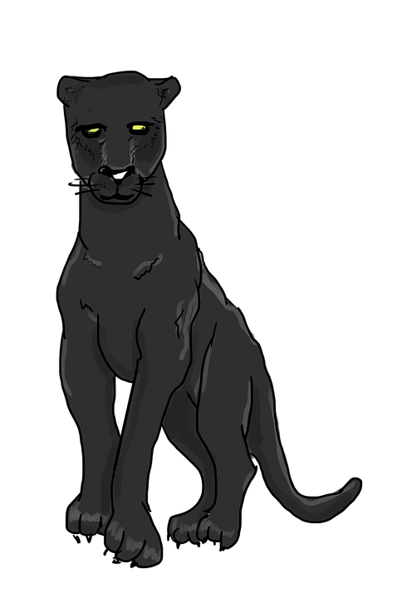
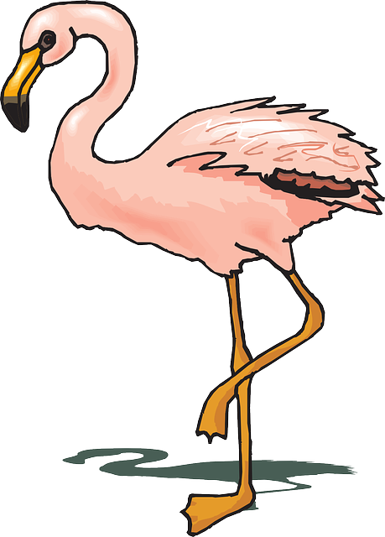
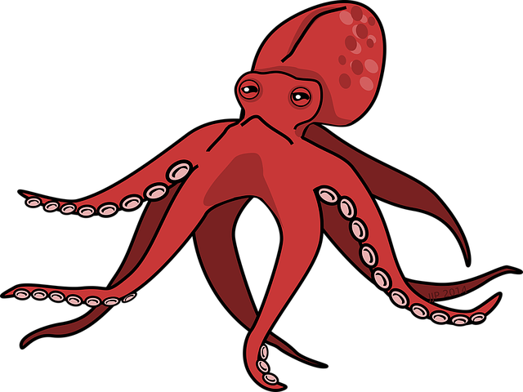
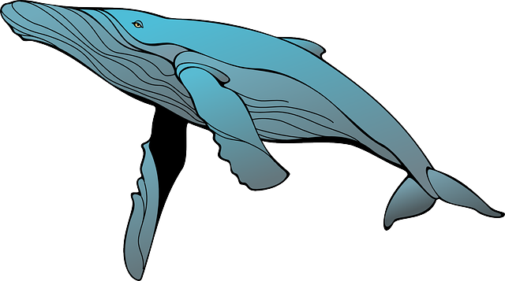




vocabulario
Escucha y repite.
¿Qué animal es?
a
b
c
d
el pulpo
la ballena
el flamenco
la pantera
Notes:
Timing: 4 minutes
Aim: to introduce the four animals which will feature in this sequence (week 12 and 13)
Procedure:
1.Teachers read the instruction and click to bring up each animal and get pupils to repeat chorally.
2. Click to bring up further question: ¿Qué animal es?. Starting from the elicit, elicit answers from pupils (i.e ‘el pulpo es c’)
NB. We haven’t formally introduced the alphabet so teachers can model by practising ‘a’, ‘be’, ‘ce’, ‘de’, or simply elicit the animal in English from pupils.
NB. Further rounds of learning can be facilitated by one pupil turning away from the board, and his/her partner asking him/her the meanings (‘Cómo se dice X en español?’). This activity can work from L2 → L1 or L1 → L2.

Slide 4
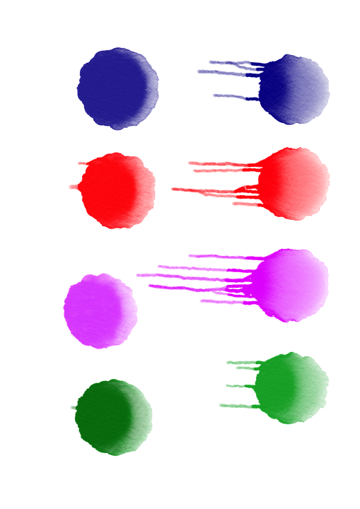


vocabulario
¿Qué color es?
c
a
b
d
e
rosa
azul
rojo
negro
verde
Notes:
Timing: 3 minutes
Aim: to practice written comprehension of 5 colours.
Procedure:
1. Teachers read the instruction ‘¿Qué color es?’.
2. Pupils can practise reading the colours aloud before providing with an answer.
3. Starting from left to write, elicit answers from pupils.
NB. ‘Rojo’, ‘rosa’ and ‘azul’ have not been formally introduced in amarillo although they featured in term 3 week 5.
NB. Further rounds of learning can be facilitated by one pupil turning away from the board, and his/her partner asking him/her the meanings (‘Cómo se dice X en español?’). This activity can work from L2 → L1 or L1 → L2.
NB. Teachers can also ask what other colours they know (amarillo, blanco)

Slide 5
vocabulario
_____________ es rosa.
¿Qué animal es?
El flamenco
a
b
c
d
el flamenco
la pantera
el pulpo
la ballena
_______________ es rojo.
_____________ es negra.
El pulpo
La pantera
‘rosa’ is both masculine and feminine.
_______________ es azul.
La ballena
Notes:
Timing: 3 minutes
Aim: to revisit adjectival agreement.
Procedure:
1. Teachers read the instruction and draw pupils’ attention to the speech bubble. Pupils can work in pairs to say the sentence aloud.
2. Repeat x4.
NB. A speech bubble clarifies that ‘rosa’ does not change and it’s both the masculine and feminine form.

Slide 6


Leer y hablar
El poema preferido de Quique
(el) poema = poem
¿Cómo es el título en inglés?
leer
Mi poema preferido es ‘Cada ser es único y especial’.
Notes:
Timing: 2 minutes
Aim: To introduce the context of the lesson – A poem titled ‘Cada ser es único y especial’.
Procedure:
Clarify the context and elicit translation of Quique’s speech bubble.
Click to bring up question & visual support. Once it’s clear the lesson is about the story of some very unique animals, tell pupils they are going to listen to part of the story in Spanish. Get them excited about this! A whole story in Spanish ☺
Frequency of unknown words and cognates:
poema [1430]
Source: Davies, M. & Davies, K. (2018). A frequency dictionary of Spanish: Core vocabulary for learners (2nd ed.). Routledge: London

Slide 7

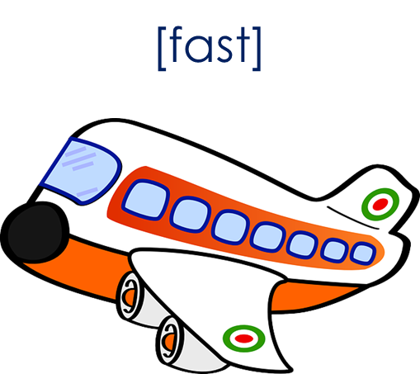
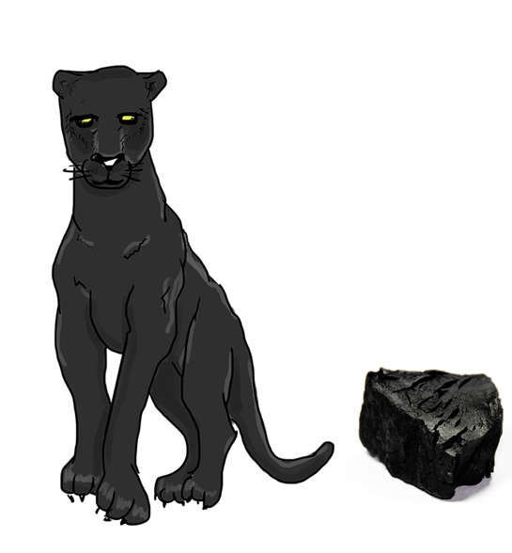
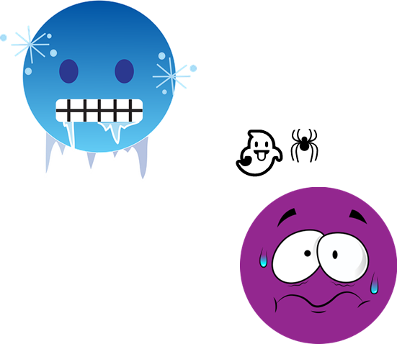

escuchar
Escucha y lee el poema.
(el) poema = poem
(la) tarjeta = card
¿Qué tarjetas? ¡Hay tres!
(el) carbón = charcoal
leer
su = his, her, its
rápida = fast (f)
como = as, like
La pantera es negra como el carbón*.
Cuando tiene miedo o frío,
su* color no es diferente,
pero es rápida* como un avión 🛫.
La pantera es única y especial.
Notes:
Timing: 12 minutes [4 slides]
Aim: to listen and read the story, using visual prompts to reinforce comprehension.
Procedure:
Give out the cards with images before explaining the activity. Pupils can work in pairs or individually.
Read the instruction and click to bring up the question. Ensure pupils understand they need to show you the correct picture to go with the scene of the story they are listening to, and reading.
Click to bring up each sentence.
To check understanding, pupils show you the correct card (three per stanza).
Click to bring up answer.
Frequency of unknown words and cognates:
carbón [3331] poema [1430] tarjeta [1958] su [12] rápida [870] como [20]
Source: Davies, M. & Davies, K. (2018). A frequency dictionary of Spanish: Core vocabulary for learners (2nd ed.). Routledge: London

Slide 8

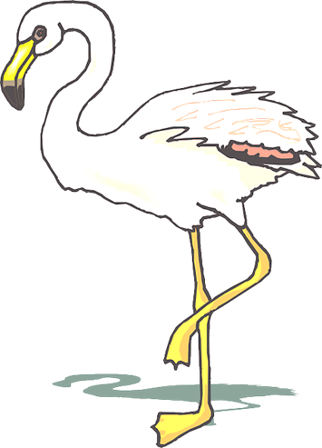

escuchar
Escucha y lee el poema.
primero = first
mayor = old
¿Qué tarjetas? ¡Hay tres!
como = like, as
leer
El flamenco es blanco primero*
y cuando es mayor,
es rosa como una flor.
Como la pantera,
el flamenco, es único y especial.
Notes:
Frequency of unknown words and cognates:
mayor [154] primero [82] como [20]
Source: Davies, M. & Davies, K. (2018). A frequency dictionary of Spanish: Core vocabulary for learners (2nd ed.). Routledge: London

Slide 9


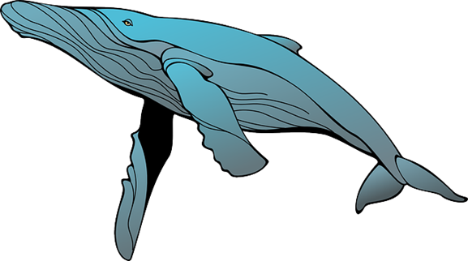
escuchar
Escucha y lee el poema.
(el) mar = sea
¿Qué tarjetas? ¡Hay tres!
leer
La ballena azul
es grande como un autobús.
Porque es enorme* y vive en el mar
La ballena azul es única y especial.
Notes:
Frequency of unknown words and cognates:
mar [480]
Source: Davies, M. & Davies, K. (2018). A frequency dictionary of Spanish: Core vocabulary for learners (2nd ed.). Routledge: London

Slide 10

escuchar
Escucha y lee el poema.
(el) oso = bear
su = his, her, its
¿Qué tarjetas? ¡Hay tres!
(el) brazo = arm
leer
(el) corazón = heart
El pulpo es curioso como un oso*
y con sus ocho brazos*
Y tres corazones
El pulpo también es
único y especial.
8
Notes:
Frequency of unknown words and cognates:
brazo [470] corazón [475] oso [4449] su [12]
Source: Davies, M. & Davies, K. (2018). A frequency dictionary of Spanish: Core vocabulary for learners (2nd ed.). Routledge: London

Slide 11


Leer y hablar
¿Cómo es el poema?
bonito = pretty
¿Cómo es el mensaje?
leer
hablar
El poema es…
positivo
y también…
feliz
[1 minuto]
increíble
divertido
interesante
importante
bonito*
INICIO
Notes:
Timing: 4 minutes
Aim: to appreciate the poem and respond to it by exchanging their opinion with a partner.
Procedure:
Teachers to read the instruction and model the exchange. For example: ‘El poem es bonito’.
Give pupils a minute to exchange their opinion, using two adjectives.
Click to bring up further question: ¿Cómo es el mensaje? and ensure meaning is clear. This is an opportunity to gather ideas on what they think the message of the poem is abot (‘We’re all different, with different characteristics and abilities, and yet of equal value’.).
Give pupils a minute to exchange their opinion on the message of the poem.
Frequency of unknown words and cognates:
bonito [891]
Source: Davies, M. & Davies, K. (2018). A frequency dictionary of Spanish: Core vocabulary for learners (2nd ed.). Routledge: London

Slide 12
adiós
¡adiós!
amarillo

Slide 13



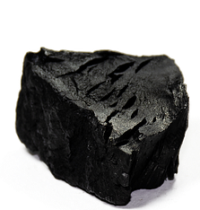
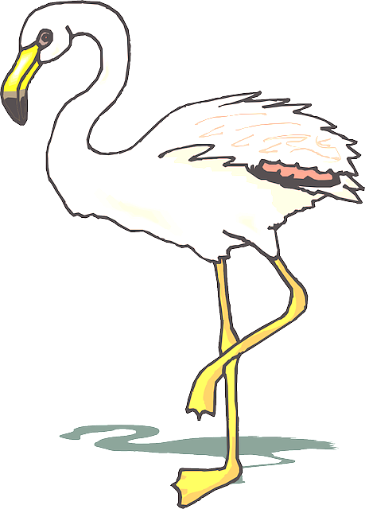


[fast]
👻
🕷
¡18 años!
Notes:
There are 12 cards altogether.
They can be photocopied smaller than this.
Also, pupils can have just 1 x set 12 pictures between two – to work in pairs.

Slide 14
8

Slide 15
La pantera es negra como el carbón*.
Cuando tiene miedo o frío,
su* color no es diferente,
pero es rápida* como un avión.
La pantera es única y especial.
El flamenco es blanco primero*
y cuando es mayor,
es rosa como una flor.
Como la pantera,
el flamenco, es único y especial
La ballena azul
es grande como un autobús.
Porque es enorme* y vive en el mar
La ballena azul es única y especial.
El pulpo es curioso como un oso*
y con sus ocho brazos*
Y tres corazones
El pulpo es también único y especial.

