Slide 1
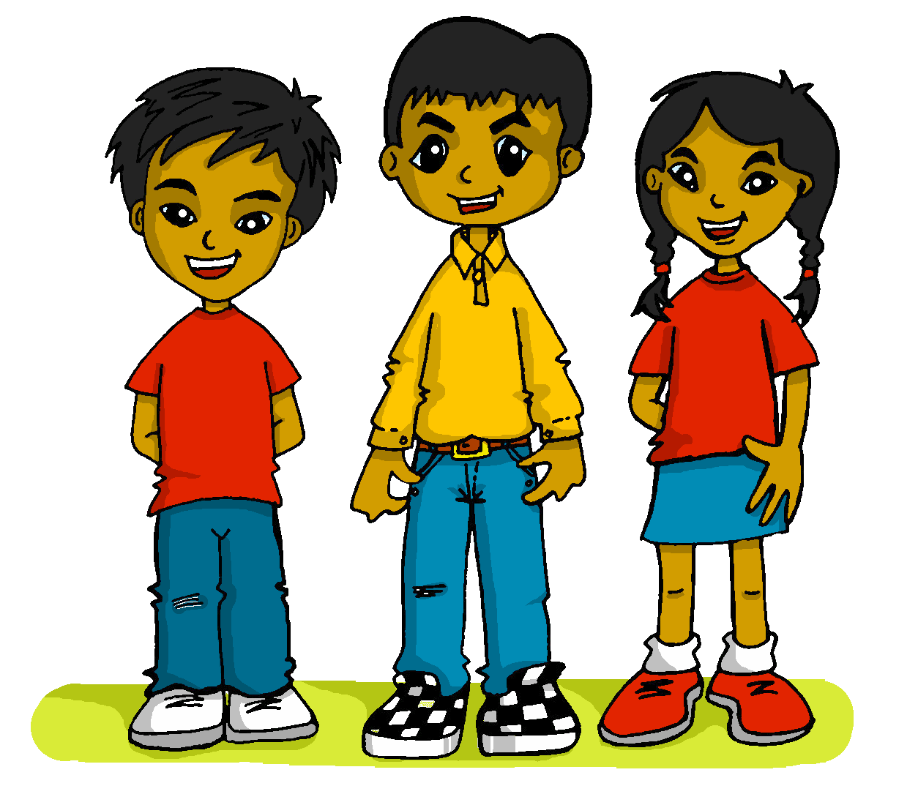
What do I know now?
amarillo
- Phonics quiz
Notes:
Artwork by Steve Clarke. All additional pictures selected are available under a Creative Commons license, no attribution required.
This lesson includes a phonics assessment of the SSC practised this year. The ratio of old to new SSC is 50:50.
Phonics: SSC – [ce] [gi] [gui] [gu] [j] [h] [i] [ll] [ñ] [o] [que] [r-/rr] [v] [z]
Word frequency: alivio [3892] angular [>5000] avance [1562] chaqueta [4565] coro [2683] descalzo [4555] guión [4225] hervir [3852] imaginar [500] muñeca [2562] reloj [1683] sellar [4766] torre [2138] veneno [4344]
Source: Davies, M. & Davies, K. (2018). A frequency dictionary of Spanish: Core vocabulary for learners (2nd ed.). Routledge: London

Slide 2
pronunciar
[o]
[i]
pronunciar
[choir]
[relief]
coro
alivio
Notes:
2

Slide 3
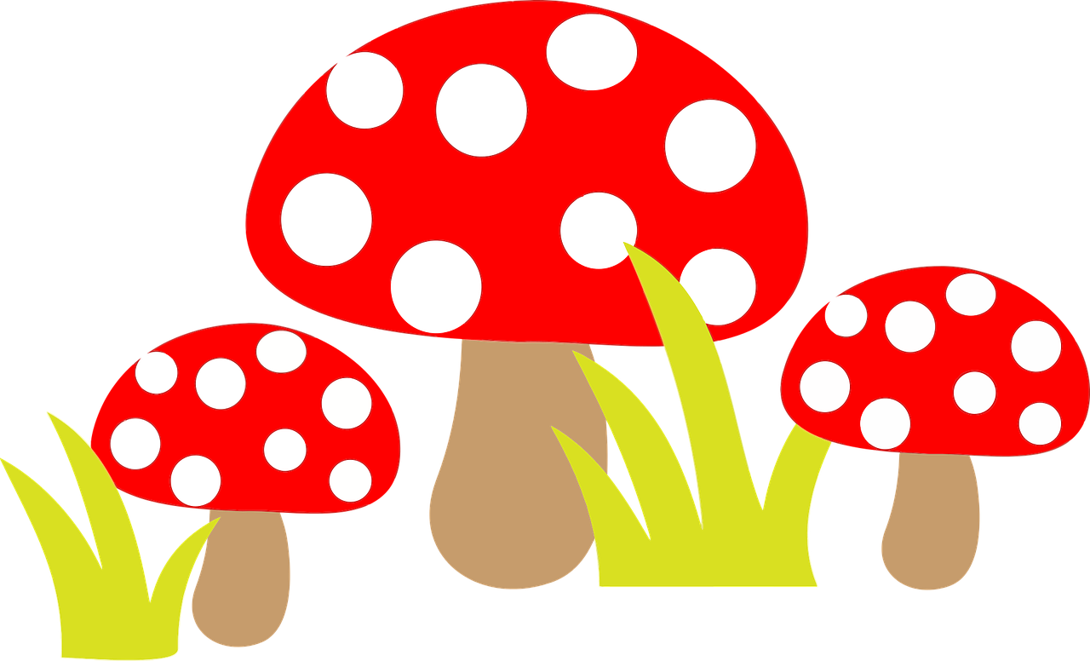
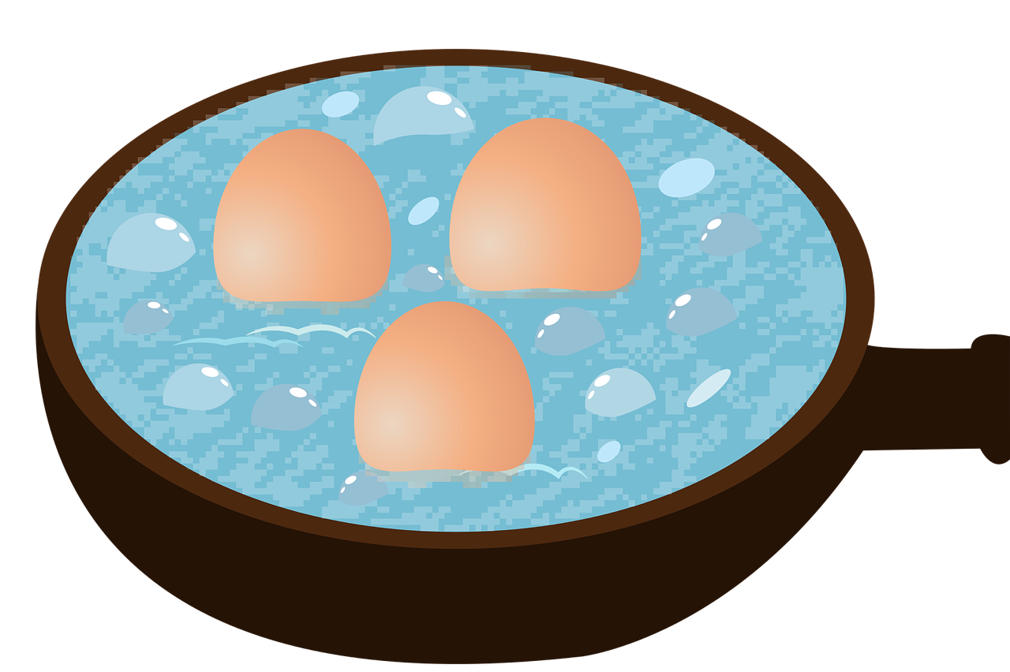
pronunciar
[h]
[v]
pronunciar
[to boil]
[poison]
hervir
veneno
Notes:
3

Slide 4
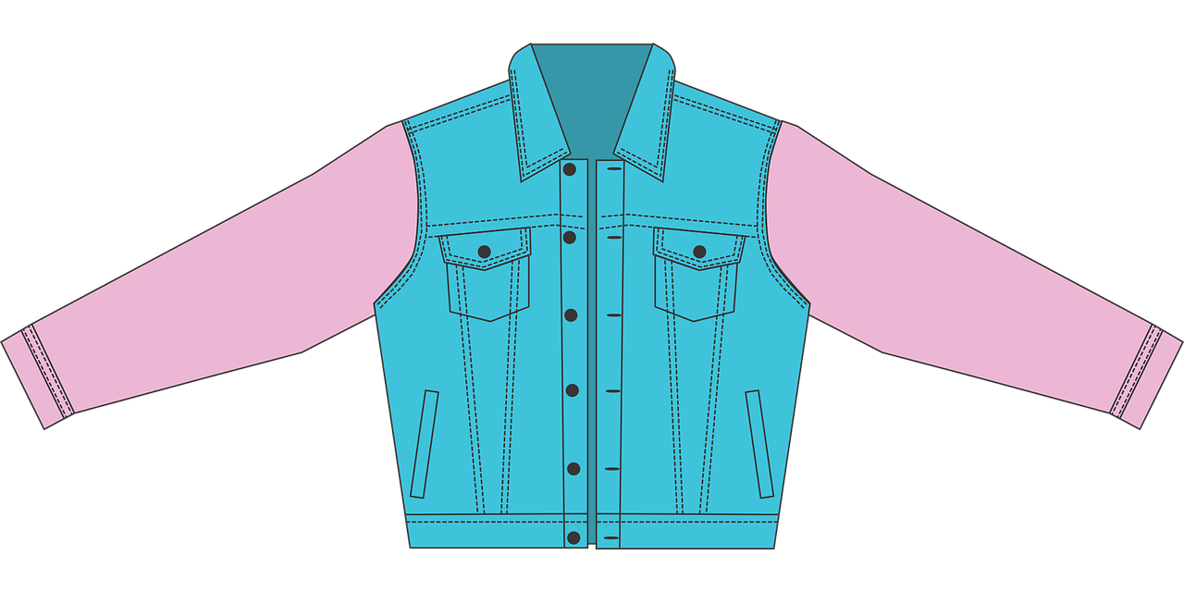
pronunciar
[que]
[ce]
pronunciar
[jacket]
[advance]
chaqueta
avance
Notes:
4

Slide 5
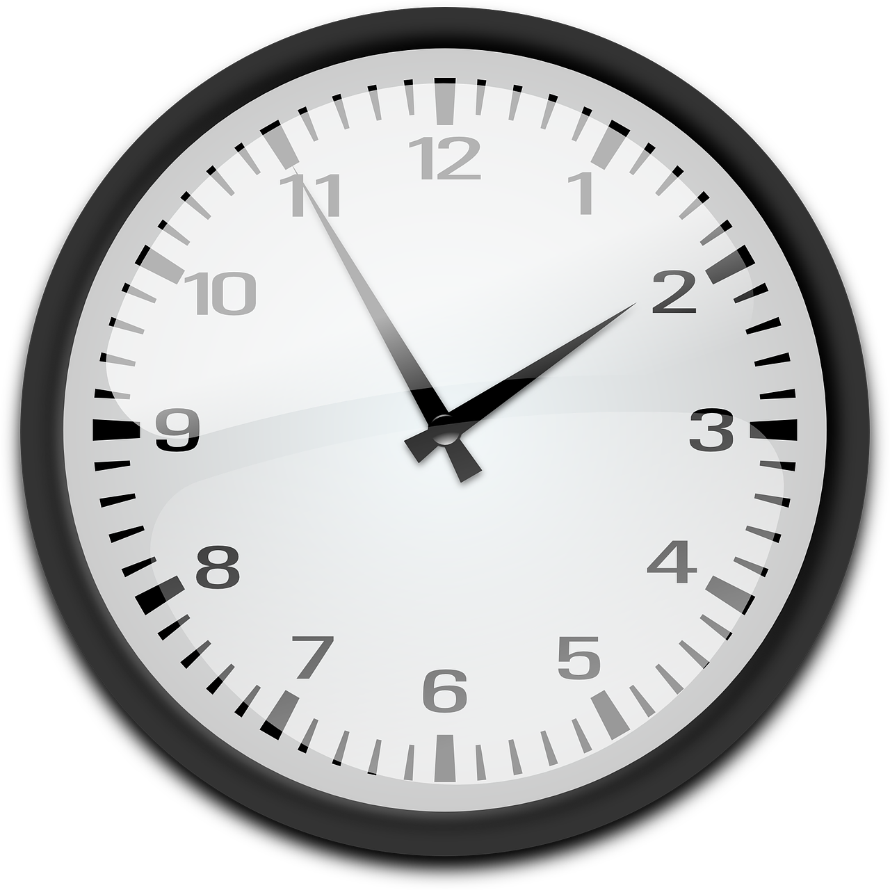
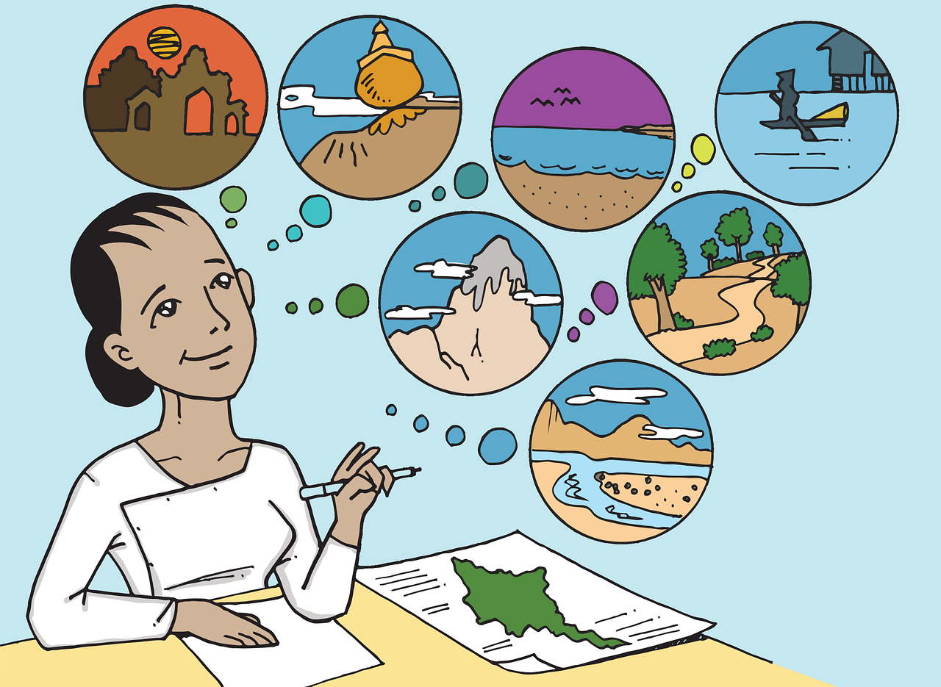
pronunciar
[gi]
[j]
pronunciar
[to imagine]
[clock]
imaginar
reloj
Notes:
5

Slide 6
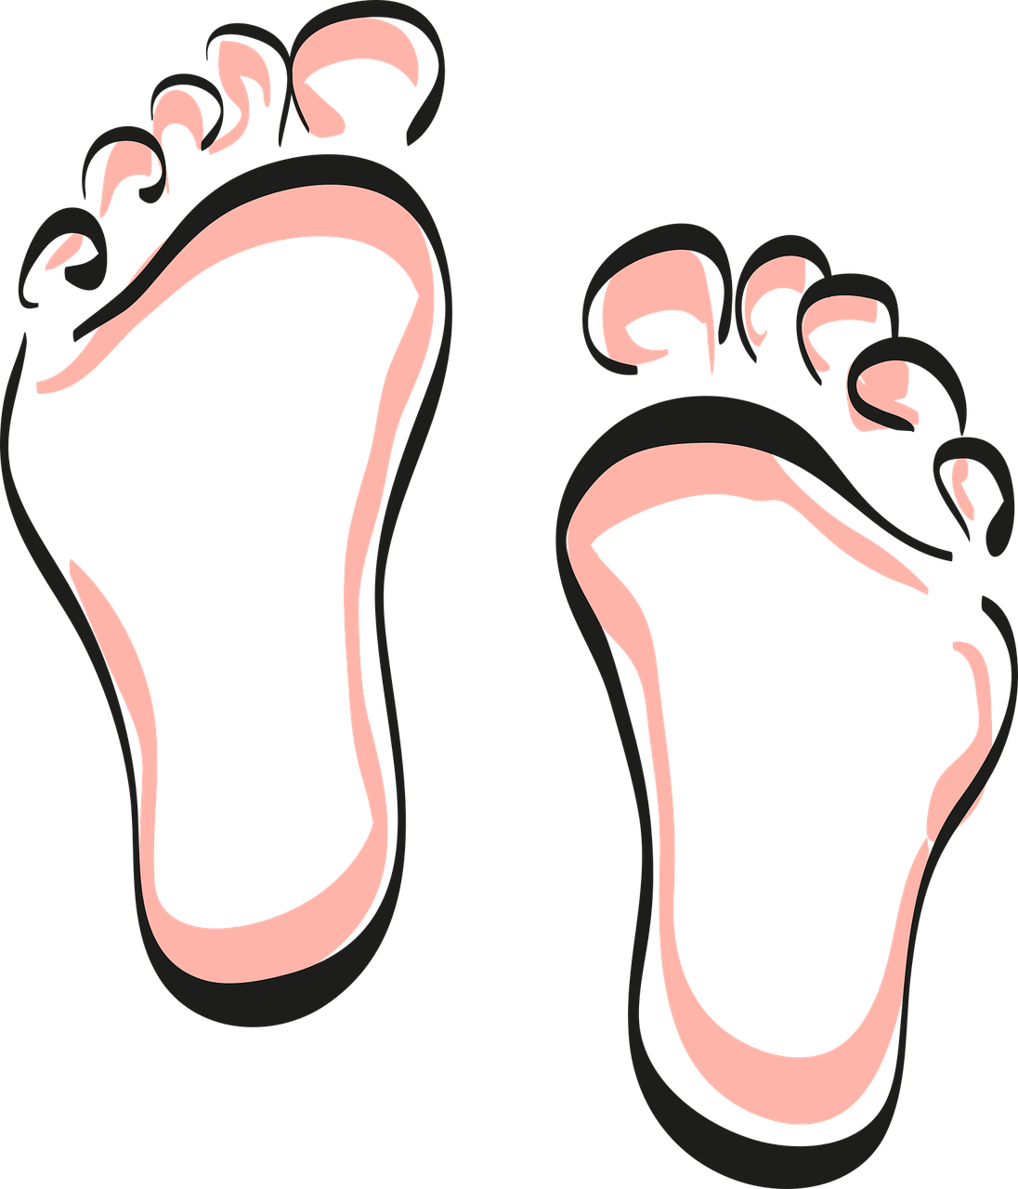
pronunciar
[z]
[ll]
pronunciar
[barefoot]
[to seal, stamp]
descalzo
sellar
Notes:
6

Slide 7
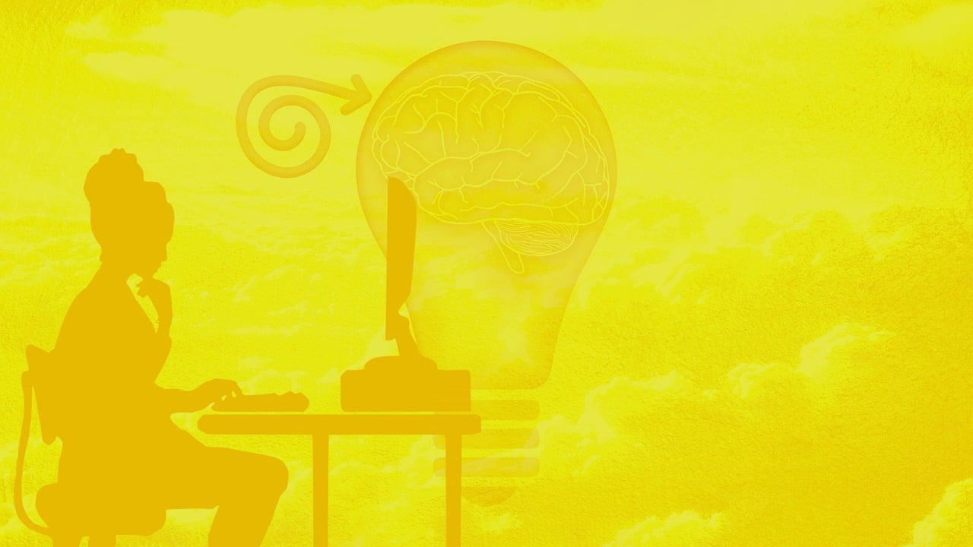
pronunciar
[gui]
[gu]
pronunciar
[script]
guión
angular
Notes:
7

Slide 8
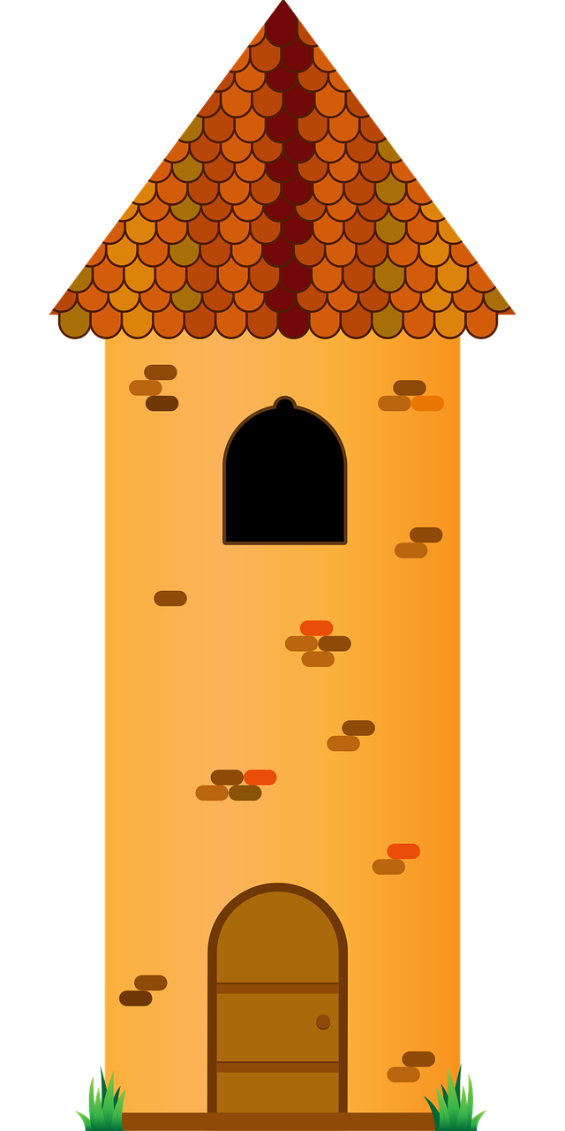
pronunciar
[r-/rr]
[ñ]
pronunciar
[tower]
[doll]
torre
muñeca
Notes:
8

Slide 9
pronunciar
Pupil name:
Pupil name:
SSC and word | px
coro
alivio
hervir
veneno
chaqueta
avance
imaginar
reloj
descalzo
sellar
guión
angular
torre
muñeca
SSC and word | px
coro
alivio
hervir
veneno
chaqueta
avance
imaginar
reloj
descalzo
sellar
guión
angular
torre
muñeca
Notes:
Pupil feedback and assessment sheet
9

Slide 10
Teacher audio version
SSC and word | px
coro
alivio
hervir
veneno
chaqueta
avance
imaginar
SSC and word | px
reloj
descalzo
sellar
guión
angular
torre
muñeca
Notes:
Teacher audio version for preparation
10

