Slide 1
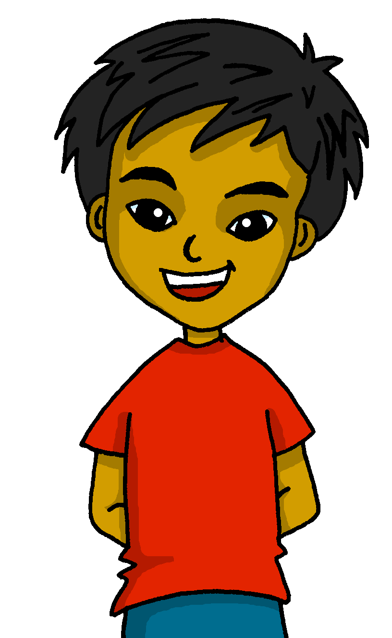
español, con Quique

Slide 2
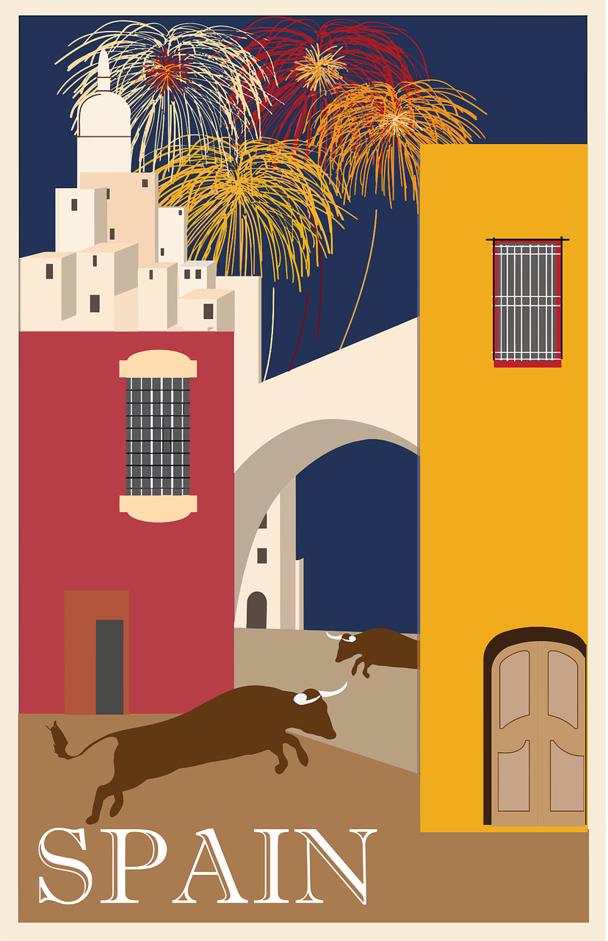
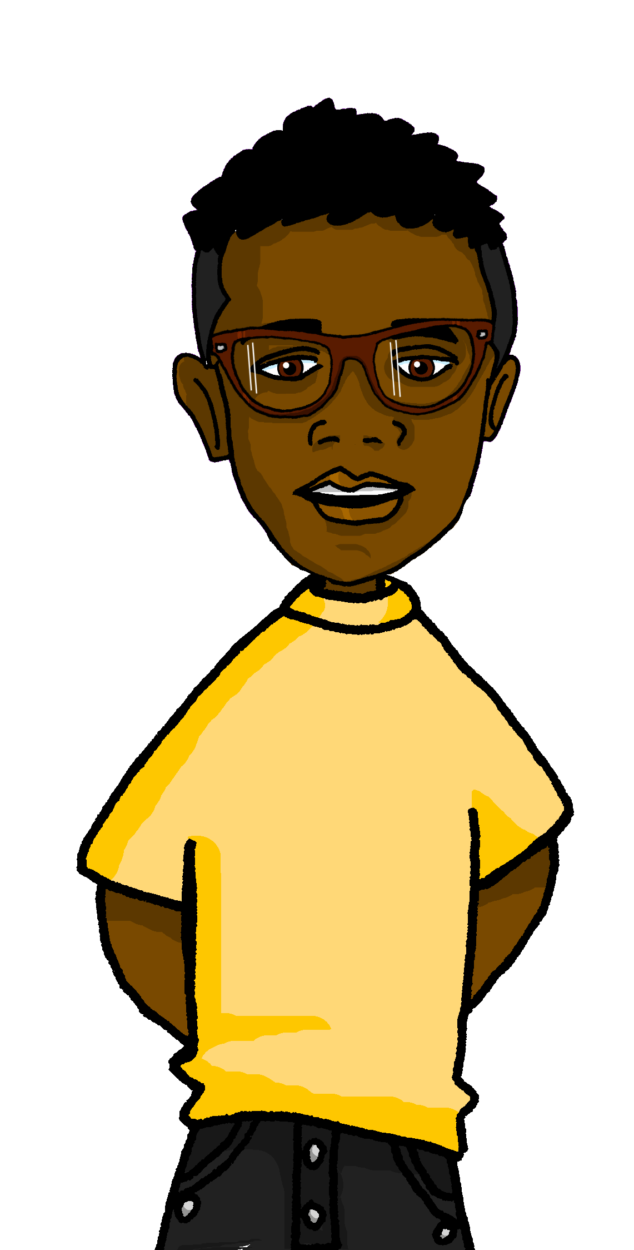
Saying what I and others do
amarillo
- hay
- plural indefinite articles
- SSC [revisit]
Notes:
Artwork by Steve Clarke. All additional pictures selected are available under a Creative Commons license, no attribution required.
The frequency rankings for words that occur in this PowerPoint which have been previously introduced in the resources are given in the SOW (excel document) and in the resources that first introduced and formally re-visited those words.
For any other words that occur incidentally in this PowerPoint, frequency rankings will be provided in the notes field wherever possible.
SSC: [revisit]
Vocabulary: hay [haber 13] unos [6] unas [6] cuántos [580] cuántas [580] enero [1173] febrero [1419] marzo [1231] abril [1064] mayo [909] junio [1035] julio [659] agosto [931] septiembre [1150] octubre [1242] noviembre [1434] diciembre [1165]
Glossed words: cantar [717] completar [2003] mes [288] pregunta [507] respuesta [488] las [1] orden [421] alfabético [>5000]
Source: Davies, M. & Davies, K. (2018). A frequency dictionary of Spanish: Core vocabulary for learners (2nd ed.). Routledge: London

Slide 3
pronunciar
las = the (f., pl.)
(el) orden = order
alfabético = alphabetical
Lee las* palabras en orden* alfabético*.
llamar
collar
collar
equipo
60
galleta
a
↓
z
galleta
paquete
gusano
lavar
lago
lavar
lago
gusano
llamar
quince
paquete
0
equipo
quince
INICIO
Notes:
Timing: 3 minutes
Aim: to revisit SSC knowledge from Spring term 1 [ga] [go] [gu] [l] [ll] [que] [qui]
Procedure:
Read the instruction in Spanish.
Ensure meaning of ‘orden alfabético’ is clear and elicit first word from a volunteer.
3. Click on ‘inicio’ to start the timer.
4. Elicit responses from students. Answers are animated (X2 clicks per word – one for disappearance effect, one for entrance).
Frequency of unknown words and cognates:
llamar [122] collar [4362] galleta [>5000] paquete [2325] lavar [1676] lago [2151] gusano [4217] equipo [373] las [1] orden [421] alfabético [>5000]
Source: Davies, M. & Davies, K. (2018). A frequency dictionary of Spanish: Core vocabulary for learners (2nd ed.). Routledge: London

Slide 4
hablar
comer [347] hacer, hago, hace [26] responder (a) [464] actividad [344] bocadillo [>5000] ejercicio [1162] naranja [2924] ordenador [2624 animal [322] cosa [69] instrumento [1042] papel [393] raro [1005] nuevo [94] viejo [225]
Max es amigo de Quique. Es de Inglaterra y aprende español en la escuela.
palabras
leer
Meridian Primary School
Notes:
Timing: 2 minutes
Aim: to formally introduce Max who will be this week’s main character.
Procedure: 1. Pupils either work in pairs or chorally as a class, reading the Spanish words out loud/

Slide 5
hablar
comer [347] hacer, hago, hace [26] responder (a) [464] actividad [344] bocadillo [>5000] ejercicio [1162] naranja [2924] ordenador [2624 animal [322] cosa [69] instrumento [1042] papel [393] raro [1005] nuevo [94] viejo [225]
Max practica el vocabulario.
palabras
leer
unas cartas
unas cosas
unas naranjas
un ordenador
unos instrumentos
un papel
unos bocadillos
unas hojas
unos ejercicios
00
00
00
___ c_ _ _ s
some things
00
00
00
___ e_ _ _ _ _ _ _ _s
some exercises
___ i_ _ _ _ _ _ _ _ _s
some instruments
__ p_ _ _ l
a paper
___ h_ _ _s
some sheets
00
___ o_ _ _ _ _s
some oranges
00
__ o_ _ _ _ _ _ _ _
a computer
___ c_ _ _ _s
some letters
Notes:
Timing: 5 minutes [2 slides]
Aim: to revisit vocabulary from term 2; practise connecting and producing (orally) plural indefinite articles with previously taught nouns.
Procedure: 1. Pupils either work in pairs or chorally as a class, reading the Spanish words out loud, including the correct article.
2. Click to start the animation sequence.
3. Pupils call out the Spanish & English (e.g. unas hojas – some sheet) before the flashcard disappears.
Note: Each flashcard animation sequence is started on a mouse click.

Slide 6
hablar
comer [347] hacer, hago, hace [26] responder (a) [464] actividad [344] bocadillo [>5000] ejercicio [1162] naranja [2924] ordenador [2624 animal [322] cosa [69] instrumento [1042] papel [393] raro [1005] nuevo [94] viejo [225]
Max practica el vocabulario.
palabras
leer
hacer
responder
rara
nuevo
tener
descansar
buscar
divertido
usar
00
00
b_ _ _ _ _
to search, searching
00
00
h_ _ _ _
to do, make; doing, making
00
00
00
r_ _ _
odd, weird (f)
d_ _ _ _ _ _ _ _
fun
t_ _ _ _
to have, having
r_ _ _ _ _ _ _ _ _
to reply, replying
u_ _ _
to use, using
00
00
n _ _ _ _
new (m)
d_ _ _ _ _ _ _ _
to relax, relaxing
Notes:
Timing: 5 minutes [2 slides]
Aim: to revisit vocabulary from term 2; practise connecting and producing (orally) plural indefinite articles with previously taught nouns.
Procedure: 1. Pupils either work in pairs or chorally as a class, reading the Spanish words out loud, including the correct article.
2. Click to start the animation sequence.
3. Pupils call out the Spanish & English (e.g. unas hojas – some sheet) before the flashcard disappears.
Note: Each flashcard animation sequence is started on a mouse click.

Slide 7
Hay
[there is, there are]
To mean ‘there is’ or ‘there are’ in Spanish use ‘hay’.
Use ‘hay’ with singular and plural nouns.
Hay unos libros.
Hay una hoja.
There are some books.
There is a sheet.
Sentences with ‘hay’ often start with ‘en’.
En mi clase hay unas revistas.
In my classroom there are some magazines.
Notes:
Timing: 2 minutes
Aim: to introduce ‘hay’
Procedure:
Read the grammar explanation on hay (there is / there are).
Elicit English translation for the Spanish examples provided.
NB. Students haven’t yet practised the silent ‘H’ in Spanish phonics (although they have met ‘hablar’ and ‘hoy’), so practise the pronunciation of ‘hay’ here.
It might help students to know that it sounds similar to the English letter ‘I’!

Slide 8
escuchar
Max aprende sobre Lugo.
sobre = about
Escucha y marca ✅.
Ahora escucha y lee.
¿Es diferente? ✅❌
Escribe 📝.
There is | There are
E
unos mensajes
un mensaje
E
1
una hermana
una hermana
1
2
unas palabras
unas palabras
2
3
3
unos monstruos
un monstruo
4
4
una boca
una boca
5
5
unos bocadillos
un bocadillo
6
6
unos dedos
unos dedos
7
7
unas reglas
unas reglas
Notes:
Timing: 8 minutes
Aim: to practise aural comprehension of ‘hay’ and its correct translation into English.
Procedure:
Read the title and click to bring up the instructions in Spanish. Pupils write 1-7.
Do the example (E). Make it clear that the meaning of ‘hay’ in English is dependent on the number (singular/plural) of the noun that follows.
Do 1-7 and click to correct.
Pupils listen again – Does the list coincide with Quique’s dream? Is each item the same or different? Pupils tick or cross. Pupils also transcribe what they hear, as they are able.
Click to correct.
Transcript
[E] Hay un mensaje.
[1] Hay una hermana.
[2] Hay unas palabras.
[3] Hay un monstruo.
[4] Hay una boca.
[5] Hay un bocadillo.
[6] Hay unos dedos.
[7] Hay unas reglas.
Frequency of unknown words and cognates:
sobre [62]
Source: Davies, M. & Davies, K. (2018). A frequency dictionary of Spanish: Core vocabulary for learners (2nd ed.). Routledge: London

Slide 9
pronunciar
¿Cuántos?
⚠ The question word ‘¿cuántas?’ agrees with the gender and number of the noun it describes.
How many?
¿Cuántos museos hay?
[How many museums are there?]
Rachel Hawkes / Emma Marsden
Notes:
Timing: 1 minute
Aim: To introduce question word ¿cuántos?
Procedure:
Pupils listen and repeat the key question word (include gesture if possible).
Display the word and get them to repeat one more time.
Elicit the English meaning.
Reveal the sentence and elicit the English translation from students.
Click to reveal speech bubble with reminder for agreement of this question word.

Slide 10
pronunciar
¿Cuántas?
How many?
¿Cuántas fiestas hay?
[How many festivals are there?]
Rachel Hawkes / Emma Marsden
Notes:
Timing: 1 minute
Aim: To introduce question word ¿cuántos?
Procedure:
Pupils listen and repeat the key question word (include gesture if possible)
Display the word and get them to repeat one more time
Elicit the English meaning.
Reveal the sentence and elicit the English translation from students.
Click to reveal speech bubble with reminder for agreement of this question word.

Slide 11
hablar
completar = to complete, completing
(la) pregunta = question
(la) respuesta = answer
Completa la pregunta y la respuesta.
[1/5]
leer
os
¿Cuánt____
museos hay en Lugo?
museo.
unos
Hay
museos.
unas
estadios.
Notes:
Timing: 3 minutes (5 slides)
Aim: to consolidate the agreement of the question word forms ‘cuántos’ & ‘cuántas’; to practise comprehension of numbers and plural indefinite articles.
Procedure:
Read the question and model it with the two possible answers: cuántos or cuántas.
Elicit answer from students.
Click to bring up the correct ending ‘cuántos’. Click the callout to hear the full question, as required.
Click to make the question disappear.
Elicit the full sentence response, which takes account of information given by the picture (i.e. the number of fingers).
Click on the picture to hear the full sentence response.
Repeat steps 1-6 with the remaining four slides.
Transcript: Cuántos museos hay en Lugo? Hay unos museos.
Frequency of unknown words and cognates:
Completar [2003] pregunta [507] respuesta [488]
Source: Davies, M. & Davies, K. (2018). A frequency dictionary of Spanish: Core vocabulary for learners (2nd ed.). Routledge: London

Slide 12
hablar
completar = to complete, completing
(la) pregunta = question
(la) respuesta = answer
Completa la pregunta y la respuesta.
[2/5]
leer
os
¿Cuánt____
libros hay en clase?
libros.
unas
Hay
plantas.
unos
libro.
Notes:
[2/5]
Transcript: Cuántos libros hay en clase? Hay unos libros.

Slide 13
hablar
completar = to complete, completing
(la) pregunta = question
(la) respuesta = answer
Completa la pregunta y la respuesta.
[3/5]
leer
as
¿Cuánt____ plantas hay en tu habitación?
profesor.
unos
Hay
planta.
unas
plantas.
Notes:
[3/5]
Transcript: Cuántas plantas hay en tu habitación? Hay unas plantas.

Slide 14
hablar
completar = to complete, completing
(la) pregunta = question
(la) respuesta = answer
Completa la pregunta y la respuesta.
[4/5]
leer
os
¿Cuánt____ ejercicios hay en tu cuaderno?
tres
actividad.
Hay
unas
ejercicios.
un
Notes:
[4/5]
Transcript: Cuántos ejercicios hay en tu cuaderno? Hay tres ejercicios.

Slide 15
hablar
completar = to complete, completing
(la) pregunta = question
(la) respuesta = answer
Completa la pregunta y la respuesta.
[5/5]
leer
¿Cuánt____ iglesias hay en Lugo?
as
un
Iglesias.
Hay
unas
planta.
siete
museos
Notes:
[5/5]
Transcript: Cuántas iglesias hay en Lugo? Hay siete Iglesias.

Slide 16
¡adiós!
amarillo

