Slide 1


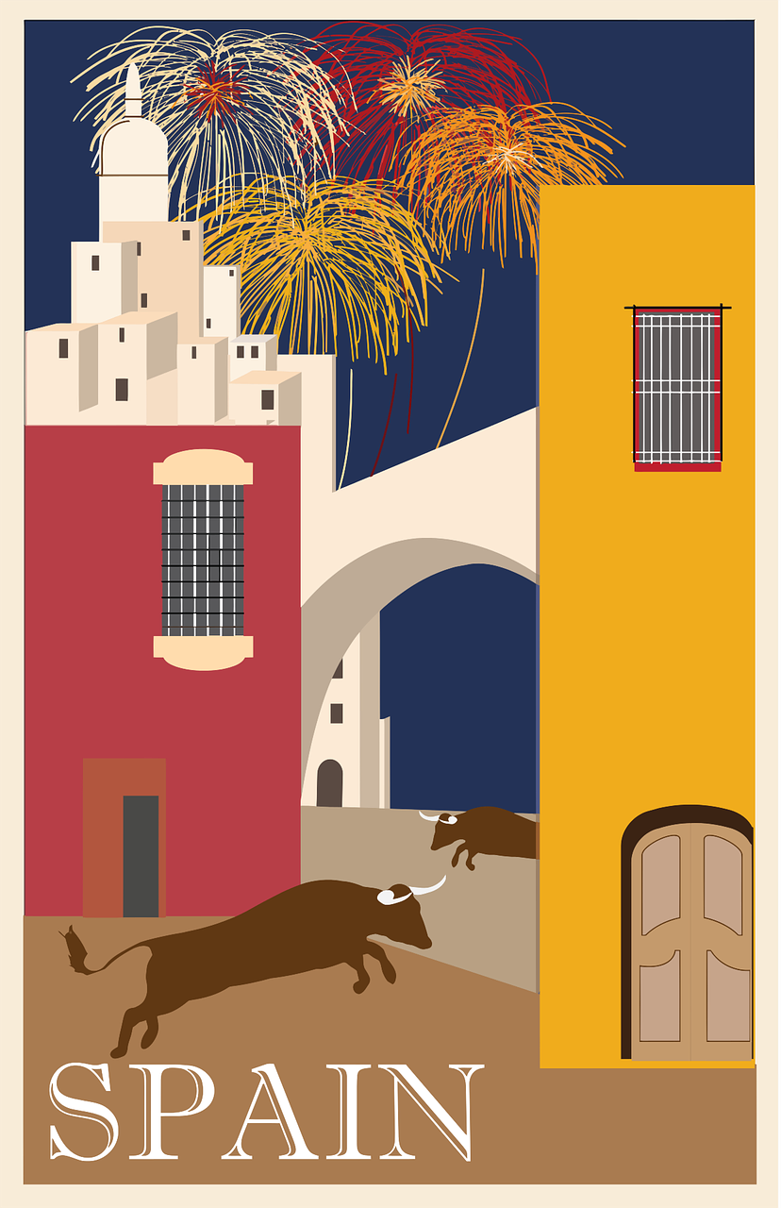



Saying what I and others do
Mi
amarillo
Follow ups 1-5
Notes:
Artwork by Steve Clarke. All additional pictures selected are available under a Creative Commons license, no attribution required.
The frequency rankings for words that occur in this PowerPoint which have been previously introduced in the resources are given in the SOW (excel document) and in the resources that first introduced and formally re-visited those words.
For any other words that occur incidentally in this PowerPoint, frequency rankings will be provided in the notes field wherever possible.
SSC: [revisit]
Vocabulary: hay [haber 13] cuántos [580] cuántas [580]
Revisit 1: comer [347] hacer, hago, hace [26] responder (a) [464] actividad [344] bocadillo [>5000] ejercicio [1162] naranja [2924] ordenador [2624]
Revisit 2: animal [322] cosa [69] instrumento [1042] papel [393] raro [1005] nuevo [94] viejo [225]
Glossed words:
las [1] escribir [198] trabajar [174] frase [1036]
Source: Davies, M. & Davies, K. (2018). A frequency dictionary of Spanish: Core vocabulary for learners (2nd ed.). Routledge: London

Slide 2


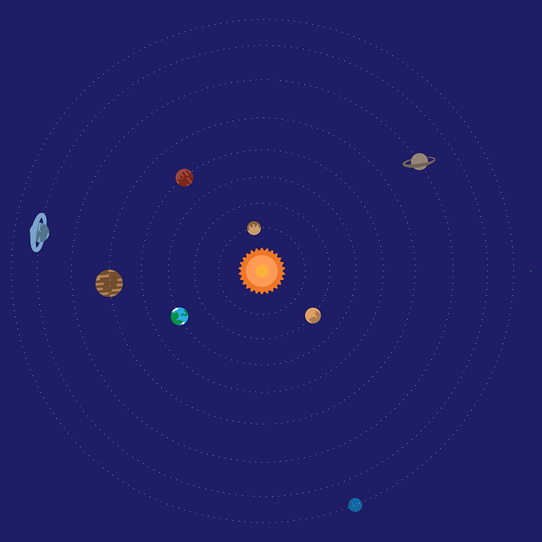

Follow up 1:
Turno 1: Persona A habla 🗣
Persona B marca 📝✅
Space is full of valuable words.
pronunciar
equipo
lobo
llamar
queso
canguro
quince
galleta
llover
lago
Notes:
Timing: 5-7 minutes [3 slides]
Aim: To practise the pronunciation of Spanish words with the SSCs introduced in term 2.
Procedure:
Pupils work in pairs to practise and recognise correct pronunciation.
Divide the class in A & B before explaining the task.
Click to bring instruction in Spanish. Pupil A reads the words aloud and pupil B checks their pronunciation. There are 9 words in total.
NB. There is a handout at the end of the presentation of pupils can simply write 1-9 in their books and tick or cross.
Click to make the spaceship appear. Pupil A pronounces the words.
Pupil B turns their back to the board. Listens and ticks the words pronounced correctly.
Move to next slide for Persona B’s turn.
Pupil A turns their back to the board. Listens and ticks the words pronounced correctly.
Move to slide 4 to show the value of each word. Pupils can compare their results and another round can be played with the same words or swapping A/B.
llamar [122] llama [3059] collar [4362] llover [2134] camello [>5000] equipo [373] lobo [3816] paloma [3182] paquete [2325] queso [3187] quince [1215] raqueta [>5000] galleta [>5000] lago [2151] ganar [295] galleta [>5000] canguro
Source: Davies, M. & Davies, K. (2018). A frequency dictionary of Spanish: Core vocabulary for learners (2nd ed.). Routledge: London

Slide 3
Follow up 1:
Turno 2: Persona B habla 🗣
Persona A marca 📝✅
camello
paloma
paquete
llama
ganar
gusano
raqueta
aquí
lago
Notes:
Timing: 5-7 minutes [3 slides]
Aim: To practise the pronunciation of Spanish words with the SSCs introduced in term 2.
Procedure:
Pupils work in pairs to practise and recognise correct pronunciation.
Divide the class in A & B before explaining the task.
Click to bring instruction in Spanish. Pupil A reads the words aloud and pupil B checks their pronunciation. There are 9 words in total.
NB. There is a handout at the end of the presentation of pupils can simply write 1-9 in their books and tick or cross.
Click to make the spaceship appear. Pupil A pronounces the words.
Pupil B turns their back to the board. Listens and ticks the words pronounced correctly.
Move to next slide for Persona B’s turn.
Pupil A turns their back to the board. Listens and ticks the words pronounced correctly.
Move to slide 4 to show the value of each word. Pupils can compare their results and another round can be played with the same words or swapping A/B.
llamar [122] llama [3059] collar [4362] llover [2134] camello [>5000] equipo [373] lobo [3816] paloma [3182] paquete [2325] queso [3187] quince [1215] raqueta [>5000] galleta [>5000] lago [2151] ganar [295] galleta [>5000] canguro
Source: Davies, M. & Davies, K. (2018). A frequency dictionary of Spanish: Core vocabulary for learners (2nd ed.). Routledge: London

Slide 4

Follow up 1:
How much are your words worth?
pronunciar
Persona B
Persona A
camello 💰
paloma 💰💰
llama 💰
ganar 💰
gusano 💰💰
raqueta 💰💰
paquete 💰
aquí 💰💰
lago 💰
queso 💰
lobo 💰
lago 💰
llover 💰💰
llamar 💰💰
lago 💰
canguro 💰💰
equipo 💰
galleta💰💰
Notes:
Timing: 5-7 minutes [4 slides]
Aim: To practise the pronunciation of Spanish words with the SSCs introduced in term 2.
Procedure:
Pupils can compare their results and another round can be played with the same words or swapping A/B.
If desired, teachers can click on the audio buttons to check pronunciation.
Frequency of unknown words and cognates:
llamar [122] llama [3059] collar [4362] llover [2134] camello [>5000] equipo [373] lobo [3816] paloma [3182] paquete [2325] queso [3187] quince [1215] raqueta [>5000] galleta [>5000] lago [2151] ganar [295] galleta [>5000] canguro
Source: Davies, M. & Davies, K. (2018). A frequency dictionary of Spanish: Core vocabulary for learners (2nd ed.). Routledge: London

Slide 5

Follow up 2:
Escucha y escribe en inglés 📝.
escuchar
 | ____________ _________ | bikes | computers | words.
 | _________ _______ big | church | museum | square.
 | ___________ _______ | stadium |squares| parks.
 | _________ _______ | dogs| horses | bikes.
 | _________ _______ | classrooms | cities | rooms.
E
There are
three
1
There is
a
2
There are
five
3
There are
some
4
There are
five
Notes:
Timing: 5 minutes
Aim: to aural comprehension of hay, indefinite article & previously introduced vocabulary.
Procedure:
Transcript
[E] Hay tres ordenadores.
[1] Hay una plaza grande.
[2] Hay cinco parques.
[3] Hay unas bicis.
[4] Hay cinco habitaciones.

Slide 6



Follow up 3:
Max manda* mensajes a Quique ✉.
Lee las frases*. ¿Qué palabra es?
leer
E
3
Max
Max
¿Cuántas
Marca ✅.
¿Cuántos estadios hay en Lugo?
E
ciudades hay en España?
cuántos | cuántas
1
2
4
1
E
Max
Max
Hay
3
¿Cuántas iglesias hay en la ciudad?
unos museos.
1
4
3
5
5
5
2
Max
Hay
Max
una bicicleta en casa.
¿Cuántos parques hay?
mandar = to send, sending
las = the (f., pl.)| (la) frase = sentence
Notes:
Timing: 10 minutes (slide 1/2)
Aim: to consolidate the agreement of the question word forms ‘cuántos’ & ‘cuántas’; to practise written comprehension of hay.
Procedure:
Read the title & click to explain the context of the task.
Click to bring further instructions in Spanish. For this part, pupils are only looking at E, 1, 3 and 5.
Do [E] with them to model the task and draw their attention to the nouns (estuadios – masculine and singular). It is cuántos or cuántas?
Complete 1, 3 and 5.
Click through the animations to bring up answers. If desired, click on the numbered buttons to hear sentence audio.
NB. Next slides focuses on meaning and correct translation of hay.
Unknown words and/or cognates:
las [1] mandar [588] frase [1036]
Source: Davies, M. & Davies, K. (2018). A frequency dictionary of Spanish: Core vocabulary for learners (2nd ed.). Routledge: London

Slide 7
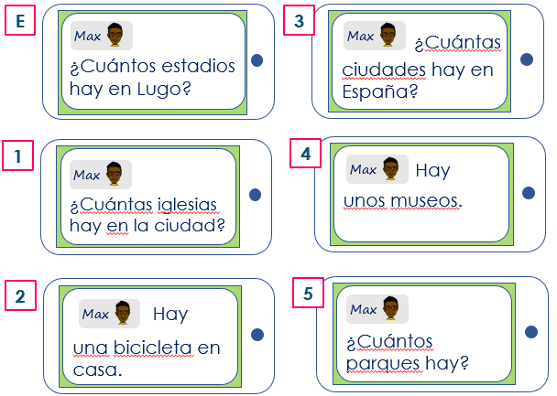
Follow up 3:
Lee las frases* y escribe* en inglés.
leer
H____ m________ s_________ _____ there?
H____ m________ c__________ _____ there i__ the _________?
There _____ ______ b___________ at home.
H____ m________ c_________ _____ there i___ ___________?
There _____ ______ m___________.
H____ m________ p_________ _____ there?
E
ow
any
tadiums
are
ow
any
hurches
are
1
n
city
2
is
a
icycle
ow
any
ities
are
3
n
Spain
4
are
some
useums
5
ow
any
arks
are
las = the (f., pl.)| (la) frase = sentence
ecribe = write
Notes:
[2/2]
Procedure:
Clarify the instruction.
Pupils use the hints on the right-hand side of the slide to translate sentences E-5.
Unknown words and/or cognates:
las [1] escribir [198] frase [1036]
Source: Davies, M. & Davies, K. (2018). A frequency dictionary of Spanish: Core vocabulary for learners (2nd ed.). Routledge: London

Slide 8

Follow up 4:
Trabaja* en grupos de 3.
[1/6]
escribir
hablar
¿Qué hay?
There are three instruments in class.
escuchar
Hay tres instrumentos en clase
trabajar = to work
Notes:
Timing: 5 minutes
Aim: to brings together all the revision from the lesson into a final production activity.
Procedure:
1. Teachers could use this slide to model the requirements of the task. Start by organizing pupils in groups of 3 and telling them whether they are A B or C as this will be important when modelling the task.
2. Here students work in groups of three. The person writing starts the dialogue off by asking the question in the speech bubble.
3. The other two people speaking take it in turns to say alternate words of the answer in Spanish. Sentences are then compared at the end as a whole class or after each item, if preferred.
4. The words for this example’s answers are revealed by clicking on each box.
5. Click on the English sentence to hear the full response in Spanish, if and when required.
6. Suggested order:
1: Persons B&C speak (B says the first word of the response), and person A writes down the Spanish.
2: Person A&C speak (A says the first word of the response), and person B writes down the Spanish.
3: Person A&B speak (B says the first word of the response), and person C writes down the Spanish.
4: Persons B&C speak (B says the first word of the response), and person A writes down the Spanish.
5: Person A&C speak (A says the first word of the response), and person B writes down the Spanish.
6: Person A&B speak (B says the first word of the response), and person C writes down the Spanish
(Teachers can be less prescriptive if students can work out for themselves how to take turns!)
Transcript:
Qué hay?
Hay tres instrumentos en clase.
Notes:
The person writing cannot interrupt if s/he spots a mistake. However, teachers should allow one minute for reflection on the sentences as a group of three, before the answers are revealed. Teachers could consider asking students to undertake the speaking without reference to their exercise books/vocab books and then in the reflection time allowing access to reference materials to allow for successful edits.
Frequency of unknown words.
trabajar [174]

Slide 9
Follow up 4:
Trabaja* en grupos de 3.
[2/6]
escribir
hablar
¿Qué hay?
There is an new square.
escuchar
⚠ Remember: the adjectives comes after the noun.
Hay una plaza nueva.
trabaja = work
Notes:
[2/6]
Transcript:
Qué hay?
Hay una plaza nueva.

Slide 10
Follow up 4:
Trabaja* en grupos de 3.
[3/6]
escribir
hablar
¿Qué hay?
There are some stadiums.
escuchar
Hay unos estadios.
trabaja = work
Notes:
[3/6]

Slide 11
Follow up 4:
Trabaja* en grupos de 3.
[4/6]
escribir
hablar
¿Bocadillos?
How many sandwiches are there in the bag?
escuchar
¿Cuántos bocadillos hay en la bolsa?
trabaja = work
Notes:
Note: here we want pupils to practise asking ‘how many?’ questions so the initial question can only prompt with the target word e.g., Sandwiches? Having the English question prompt in full should make the task clear to pupils, however.
[4/6]
Transcript:
¿Bocadillos?
¿Cuántos bocadillos hay en la bolsa?

Slide 12
Follow up 4:
Trabaja* en grupos de 3.
[5/6]
escribir
hablar
¿Puertas?
How many doors are there in class?
escuchar
¿Cuántas puertas hay en la clase?
trabaja = work
Notes:
[5/6]
Transcript:
¿Puertas?
¿Cuántas puertas hay en la clase?

Slide 13
Follow up 4:
Trabaja* en grupos de 3.
[6/6]
escribir
hablar
¿Bicicletas?
How many bikes are there at home?
escuchar
¿Cuántas bicicletas hay en casa?
trabaja = work
Notes:
[6/6]
Transcript:
¿Bicicletas?
¿Cuántas bicicletas hay en casa?

Slide 14




Follow up 5 :
Escribe en inglés 📝:
Can you get at least 15 points?
 | el papel | vieja | el instrumento
 | la cosa | raro | nueva
 | responder | el ordenador | hago
 | comer | el bocadillo | hacer
 | en | unos | ¿Cuántos?
 | hay | ¿Cuántas? | ocho
 | nueve | es | unas
vocabulario
vocabulario
(the) paper
old (f)
(the) instrument
x3
(the) thing
odd (m)
new (f)
to reply, replying
(the) computer
I do, make
x2
to eat, eating
(the) sandwich
to do, make
in
some (m)
How many? (m)
there is/are
How many? (f)
eight
x1
S/he, it is
nine
some (f)
Notes:
Timing: 5-10 minutes
Aim: to practise reading comprehension of vocabulary for this week and previous weeks.
Procedure:
1. Pupils need to write the English for as many words as possible, aiming to get at least 15 points (but more if possible).
2. Click for English answers.

Slide 15
Follow up 4 :
Escribe en español 📝:
Can you get at least 15 points?
 | old (m) | (the) instrument | (the) thing
 | (the) paper | odd (f) | new (f)
 | to do, make | to eat,eating | (the) sandwich
 | (the) computer | I do, make | to reply to, replying to
 | How many? (f) | some (f) | How many? (m)
 | seven | S/he, it is | some (m)
 | eleven | there is | eight
vocabulario
viejo
el instrmento
vocabulario
la cosa
x3
el papel
rara
nueva
hacer
comer
el bocadillo
x2
el ordenador
hago
responder
¿Cuántas?
unas
¿Cuántos?
siete
es
unos
x1
once
hay
ocho
Notes:
Timing: 5-10 minutes
Aim: to practise written production of vocabulary for this week and previous weeks.
Procedure:
1. Pupils need to write the English for as many words as possible, aiming to get at least 15 points (but more if possible).
2. Click for English answers.

Slide 16
¡adiós!
amarillo

Slide 17
Handout: Follow up 1
|
|
|
|
|
|
|
|
|
|
|
|
|
|
|
|
|
|
|
|
|
|
|
✂
Follow up 1:
Persona B escucha 🎧
Persona A escucha 🎧:
 | ✅❌
queso
lobo
lago
llover
llamar
lago
canguro
equipo
galleta
 | ✅❌
camello
paloma
llama
ganar
gusano
raqueta
paquete
aquí
lago
Notes:
Timing: 5 minutes [3 slides]
Aim: To practise the pronunciation of Spanish words with the SSCs introduced in term 2.
Procedure:
Pupils work in pairs to practise pronunciation. They can choose where to start and have one minute to collect as many coins as possible.
Divide the class in A & B and click to indicate it’s ‘persona A’’s turn.
Click to make the spaceship appear. Pupil A pronounces the words.
Pupil B turns their back to the board. Listens and ticks the words pronounced correctly.
Move to next slide for Persona B’s turn.
Pupil A turns their back to the board. Listens and ticks the words pronounced correctly.
llamar [122] llama [3059] collar [4362] llover [2134] camello [>5000] equipo [373] lobo [3816] paloma [3182] paquete [2325] queso [3187] quince [1215] raqueta [>5000] galleta [>5000] lago [2151] ganar [295] galleta [>5000] canguro

Slide 18
Handout: Follow up 4 [SP to EN]
Follow up 4 :
Escribe en inglés 📝:
Can you get at least 15 points?
 | el papel | vieja | el instrumento
 | la cosa | raro | nueva
 | responder | el ordenador | hago
 | comer | el bocadillo | hacer
 | en | unos | ¿Cuántos?
 | hay | ¿Cuántas? | ocho
 | nueve | es | unas
vocabulario
vocabulario
x3
x2
x1
Notes:
Timing: 5-10 minutes
Aim: to practise reading comprehension of vocabulary for this week and previous weeks.
Procedure:
1. Pupils need to write the English for as many words as possible, aiming to get at least 15 points (but more if possible).
2. Click for English answers.

Slide 19
Handout: Follow up 4 [EN-SP]
Follow up 4 :
Escribe en español 📝:
Can you get at least 15 points?
 | old (m) | instrument | thing
 | paper | odd (f) | new (f)
 | To do, make | to eat,eating | Sandwich
 | computer | I do, make | to reply to, replying to
 | How many? (f) | some (f) | How many? (m)
 | seven | It is | some (m)
 | eleven | There is | eight
vocabulario
vocabulario
x3
x2
x1
Notes:
Timing: 5-10 minutes
Aim: to practise written production of vocabulary for this week and previous weeks.
Procedure:
1. Pupils need to write the English for as many words as possible, aiming to get at least 15 points (but more if possible).
2. Click for English answers.

