Slide 1


español, con Quique

Slide 2


Saying what I and others do
Mi monstruo
amarillo
* plural indefinite articles
* SSC [que] [qui]
Notes:
Artwork by Steve Clarke. All additional pictures selected are available under a Creative Commons license, no attribution required.
The frequency rankings for words that occur in this PowerPoint which have been previously introduced in the resources are given in the SOW (excel document) and in the resources that first introduced and formally re-visited those words.
For any other words that occur incidentally in this PowerPoint, frequency rankings will be provided in the notes field wherever possible.
SSC: paquete [2325] queso [3187] equipo [373] quince [1215]
Vocabulary: tiene [19] unos [6] unas [6] boca [465] cabeza [265] dedo [465] monstruo [3699] ojo [169] oreja [2095] pie [365] hermana [3409] hermano [333]
Revisit 1: aprender [428] leer [209] carta [627] noticia [859] revista [920] español [262] inglés [583] de2 [2]
Revisit 2: tienes [19] hoja [916] idea [247] lápiz [3740] mensaje [847] palabra [192] regla [1380]
Glossed words: dibujar [2218] sueño [460] como [20] otro [35]
Source: Davies, M. & Davies, K. (2018). A frequency dictionary of Spanish: Core vocabulary for learners (2nd ed.). Routledge: London

Slide 3


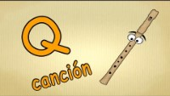
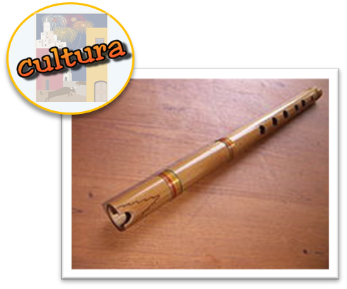
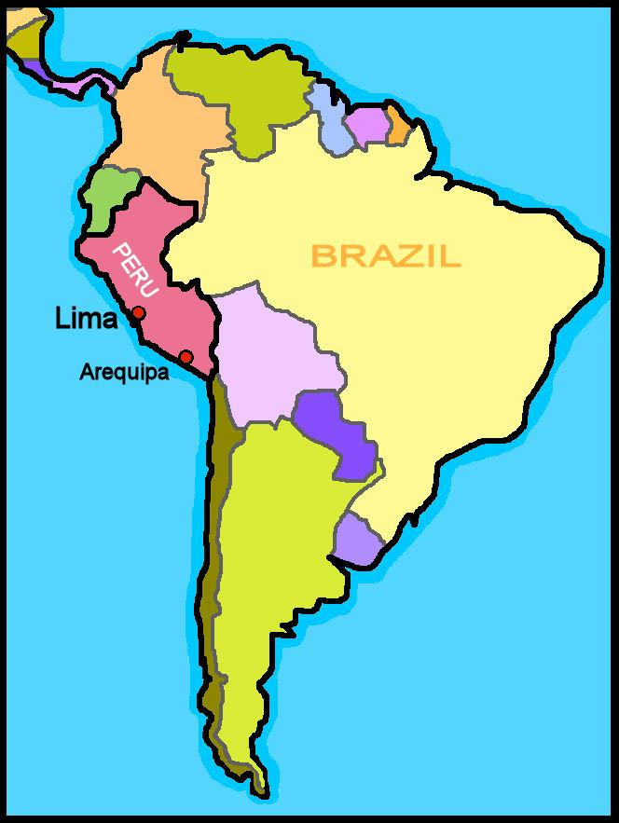
escuchar
Canta 🎤 .
escuchar
‘Q’ como queso
‘Q’ como quemadura
‘Q’ como química
‘Q’ como querubín
‘Q’ como quena
‘Q’ como quince
‘Q’ como quiosco
‘Q’ como quitasol
como = as
Notes:
Timing: 5 minutes
Aim: to revisit ‘qui’ ‘que’ in a song
Procedure:
Read and clarify the instruction.
Listen once for pupils to appreciate and become familiar with the rhythm
Click to bring up the lyrics and give pupils time to practise in pairs
Listen one more time and encourage pupils to sing along
Transcript:
Ninños quieren conocer la letra ‘q’
‘Q’ como queso
‘Q’ como quemadura
‘Q’ como química
‘Q’ como querubín
‘Q’ como quena
‘Q’ como quince
‘Q’ como quiosco
‘Q’ como quitasol
Frequency of unknown words:
quemadura [>5000] quena [>5000] querubín [>5000] queso [3187] quince [1215] quiosco [>5000] quitasol [>5000] como [20]
Source: Davies, M. & Davies, K. (2018). A frequency dictionary of Spanish: Core vocabulary for learners (2nd ed.). Routledge: London
Video source:
https://youtu.be/DOPCclFrO7E

Slide 4





vocabulario
Quique está en la cama y tiene un sueño raro.
¡Hay un monstruo! El monstruo tiene…
(el) sueño = dream
una cabeza
un ojo
una oreja
una boca
un dedo
un pie
Notes:
Timing: 5 minutes
Aim: to set the scene for this week’s lesson, Quique’s dream; and to introduce vocabulary for this week.
Procedure:
1. Read the title and ensure understanding.
2. Click to bring up the speech bubble and elicit the Spanish, prompting ‘¿Qué es ‘un monstruo’? → a monster, muy bien ☺.
3. Click to bring up new items of vocabulary individually. Pupils listen and repeat, then teacher prompts ‘¿Qué es ‘una cabeza’? → A head, perfecto ☺.
Frequency of unknown words and cognates:
sueño [460]
Source: Davies, M. & Davies, K. (2018). A frequency dictionary of Spanish: Core vocabulary for learners (2nd ed.). Routledge: London

Slide 5


Talking about things in the plural
Indefinite articles [unos/unas]
Remember: to mean ‘a’ or ‘an’ before a singular noun, use un or una.
un dedo
una boca
a finger
a mouth
To mean ‘some’ before a plural noun, use unos or unas.
unos ojos
unas orejas
some eyes
some ears
To mean ‘some’ for masculine plural nouns, use _____.
unos
unas
To mean ‘some’ for feminine plural nouns, use ______.
Notes:
Timing: 3 minutes
Aim: to introduce plural indefinite articles.
Procedure:
1. Click to bring up each new part of the explanation.
2. Interactive elicitation: Try to elicit the English meaning in each of the example phrases.
3. After showing the examples (and before showing the final line of text), ask students why it’s ‘unos ojos’ but ‘unas palabras’ to elicit 1) nouns have gender 2) monstruo is masculine and palabra is feminine.
4. Ask students if they can think of any other words that could take ‘unos’ or ‘unas’.

Slide 6








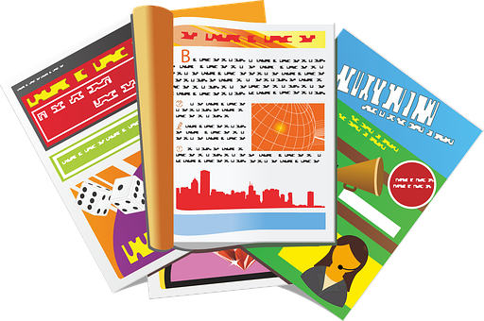



leer
El monstruo de Quique.
dibujar = to draw, drawing
Quique dibuja* unos monstruos.
leer
Is he planning to draw one or more than one?
[B] Escribe el número 📝
[A] Escribe I o I+ 📝.
E
unos ojos
I+
1
una oreja
I
4
2
E
E
1
unas bocas
E
2
I+
3
unos pies
I+
una mochila
7
4
I
E
3
E
5
unos dedos
I+
6
un globo
I
E
6
E
E
E
unas revistas
5
7
I+
Notes:
Timing: 5 minutes
Aim: to practise written recognition of and distinction between singular and plural indefinite articles; to practise written recall of vocabulary meanings.
Procedure:
Elicit the meaning of ‘La lista de Sofía?’ ‘de’ meaning ‘of’ was introduced in week 5.
Pupils write 1-7 in their books.
Bring up the context of the task and instruction.
Do E with pupils to model the task.
Pupils complete 1-7.
Click to correct.
Click to bring up part B of the activity.
Pupils write the English meaning next to their Part A numbers 1-7..
Click to reveal the answers in number order next to the matching pictures. The teacher can use the Spanish for each item to elicit the numbers. E.g. unas pelotas – ¿qué número es? This provides the opportunity for aural recognition of the vocabulary.
If required, click audio buttons to reinforce the indefinite articles with the nouns.
Transcript
[E] unos bolígrafos
[1] una cámara
[2] unas pelota
[3] unos juegos
[4] una mochila
[5] unos conejos
[6] un cuaderno
[7] unas botellas
Frequency of unknown words and cognates:
dibujar [2218]
Source: Davies, M. & Davies, K. (2018). A frequency dictionary of Spanish: Core vocabulary for learners (2nd ed.). Routledge: London

Slide 7

escuchar
Quique tiene otro* sueño*.
otro = another (m., sing.)(el) sueño = dream
Escucha y marca ✅.
Ahora escucha.
Ahora lee.
¿Es posible? ✅❌
unos | unas
E
mensajes
❌
hermanas
E
1
❌
madres
monstruos
1
2
bicicletas
❌
padres
2
3
3
❌
cabezas
dedos
4
4
❌
pies
bocas
5
5
bocadillos
hermanos
6
6
dedos
❌
mochilas
7
7
bocas
orejas
Notes:
Timing: 8 minutes
Aim: to practise aural comprehension of ‘hay’ and its correct translation into English.
Procedure:
Read the title and click to bring up the instructions in Spanish.
Do the example (E) and ask pupils to write 1-7.
Do 1-7 and click to correct.
Click to bring up part two. Pupils to decide which nouns are possible according to the gender. Pupils tick one or two.
Click to correct.
Listen to check which one is mentioned.
Transcript
[E] Tiene unos mensajes.
[1] Tiene unos monstruos.
[2] Tiene unas bicicletas.
[3] Tiene unos dedos.
[4] Tiene unas bocas.
[5] Tiene unos bocadillos y tiene unos hermanos.
[6] Tiene unos dedos.
[7] Tiene unas bocas y tiene unas orejas.
Frequency of unknown words and cognates:
sueño [460] otro [35]
Source: Davies, M. & Davies, K. (2018). A frequency dictionary of Spanish: Core vocabulary for learners (2nd ed.). Routledge: London

Slide 8

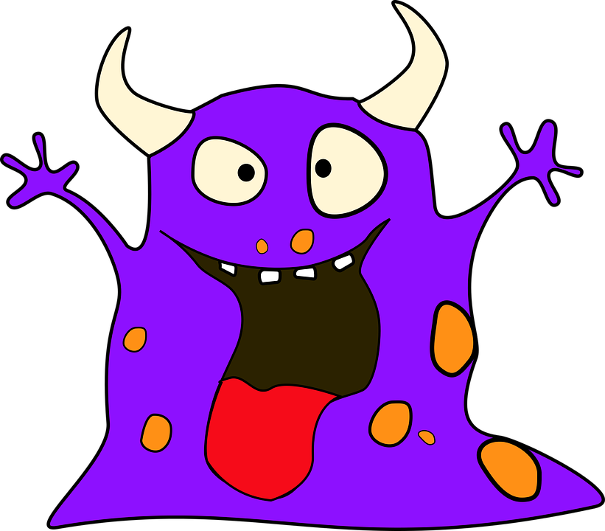
hablar
Completa la respuesta.
[1/5]
leer
doce
dedo.
Tiene
ocho
dedos.
dos
bocas.
Notes:
Timing: 5 minutes (5 slides)
Aim: to consolidate the agreement of the question word forms ‘cuántos’ & ‘cuántas’; to practise comprehension of numbers and plural indefinite articles.
Procedure:
Elicit the full sentence response, which takes account of information given by the picture (i.e. the number of fingers).
Click on the picture to hear the full sentence response.
Repeat steps 1-6 with the remaining four slides.

Slide 9
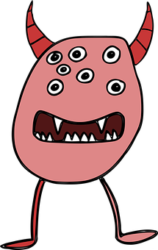
hablar
Completa la respuesta.
[2/5]
leer
unos
pies.
Tiene
ocho
orejas.
siete
ojos.
Notes:
[2/5]

Slide 10
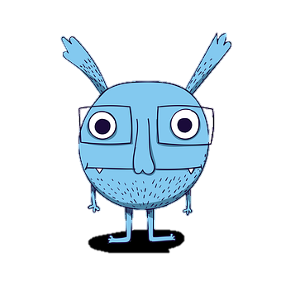



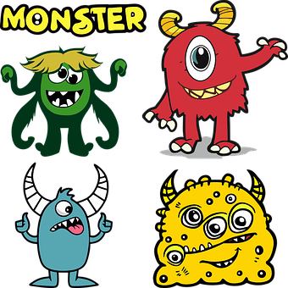


hablar
Completa la respuesta.
[3/5]
leer
nueve
ojos.
Tiene
ocho
bocas.
diez
pies.
Notes:
[3/5]

Slide 11

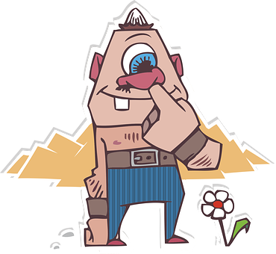
hablar
Completa la respuesta.
[4/5]
leer
cinco
pies.
Tiene
tres
orejas.
unas
cabezas.
Notes:
[4/5]

Slide 12
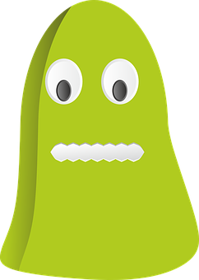
hablar
Completa la respuesta.
[5/5]
leer
unos
dedos.
Tiene
seis
pies.
cuatro
ojos.
Notes:
[5/5]

Slide 13
¡adiós!
amarillo

