Slide 1
Saying what I and others do
Mi
Mi monstruo
amarillo
Follow ups 1-5
Notes:
Artwork by Steve Clarke. All additional pictures selected are available under a Creative Commons license, no attribution required.
The frequency rankings for words that occur in this PowerPoint which have been previously introduced in the resources are given in the SOW (excel document) and in the resources that first introduced and formally re-visited those words.
For any other words that occur incidentally in this PowerPoint, frequency rankings will be provided in the notes field wherever possible.
SSC: paquete [2325] queso [3187] equipo [373] quince [1215]
Vocabulary: tiene [19] unos [6] unas [6] boca [465] cabeza [265] dedo [465] monstruo [3699] ojo [169] oreja [2095] pie [365] hermana [3409] hermano [333]
Revisit 1: aprender [428] leer [209] carta [627] noticia [859] revista [920] español [262] inglés [583] de2 [2]
Revisit 2: tienes [19] hoja [916] idea [247] lápiz [3740] mensaje [847] palabra [192] regla [1380]
Glossed words: adivinar [2201] continuar [396] elegir [561] ver [38] bosque [1444] chaqueta [4565] cien [440] cocina [1214] dulce [1860] esquina [1536] paquete [2325] pez [3579] quince [1215] serie [429] redonda [2470] para [16]
Source: Davies, M. & Davies, K. (2018). A frequency dictionary of Spanish: Core vocabulary for learners (2nd ed.). Routledge: London

Slide 2
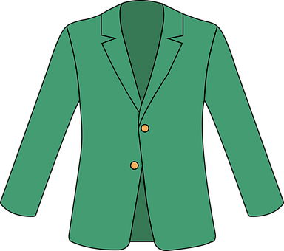
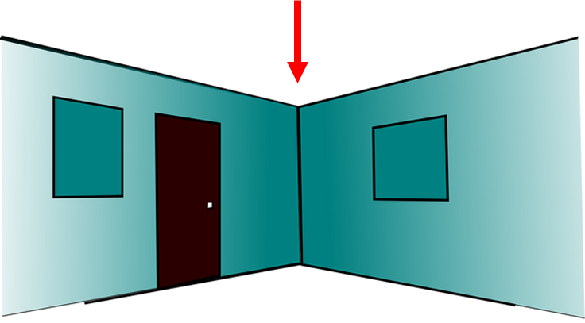
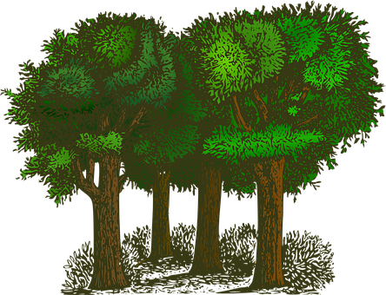
Follow up 1
[qui] [qui] [ce] [ci]
A Escucha. ¿Qué sonido* es?
adivinar = to guess
pronunciar
Escribe cinco palabras en secreto. Tu compañero/a adivina*.
45 segundos
chaqueta
bosque
dulce
esquina
cien
paquete
quince
aquí
cocina
cinco
tranquilo
peces
INICIO
Notes:
Timing: 5 minutes
Aim: to practise reading aloud [que] [qui] [ce] [ci] with some previously taught vocabulary & unknown words (pictures provided to support meaning).
Procedure:
Read the explanation and ensure pupils understand the task.
Start the timer.
Pupils try to guess their partner’s 5 words by saying them aloud, before the 45 seconds is up.
Swap roles and repeat the game.
Frequency of unknown words and cognates:
adivinar [2201] bosque [1444] chaqueta [4565] cien [440] cocina [1214] dulce [1860] esquina [1536] paquete [2325] pez [3579] quince [1215]
Source: Davies, M. & Davies, K. (2018). A frequency dictionary of Spanish: Core vocabulary for learners (2nd ed.). Routledge: London

Slide 3
Follow up 2a:
Ordena el vocabulario de Quique.
palabras
leer
00
___ hojas
some sheets
00
00
__ palabras
some words
__ ojos some eyes
00
00
___ mensajes some messages
00
___ cabezas
some heads
__ pies some feet
00
__ orejas
some ears
00
__ bocas some mouths
00
00
__ dedos some fingers
00
___ lápices
some pencils
___ cartas
some letters
unos
unas
Notes:
Timing: 5 minutes
Aim: to practise connecting and producing (orally) plural indefinite articles with previously taught nouns.
Procedure: 1. Pupils either work in pairs or chorally as a class, reading the Spanish words out loud, including the correct article.
2. Click to start the animation sequence.
3. Pupils call out the Spanish (e.g. unos uniformes) before the flashcard appears on the desk.
Note: Each flashcard animation sequence is started on a mouse click.

Slide 4
Follow up 2b
[B] Continúa la serie.
hablar
 | 1, 2, 3, 4, 5, ___ ___ ___ ___
 | 11, 10, 9, 8, ___ ___ ___ ___
 | 2, 1, 3, 1, 4, 1 ___ ___ ___ ___ ___ ___
 | 4, ___, 8, ___, 12
 | 12, 11, 10, ___ ___ ___ ___
 | 1, 3, 5, ___ ___ ___
 | 11, 9, 7, ___ ___ ___
E
6
7
8
9
1
7
6
5
4
2
5
1
6
1
7
1
3
6
10
4
9
8
7
6
5
7
9
11
6
5
3
1
continuar = to continue, continuing
Notes:
Timing: 5 minutes
Aim: to practise oral production of numbers 1-12.
Procedure:
Clarify Spanish instruction.
Model the example [E] with pupils
Pupils work in pairs to follow the different series of numbers.
Click on the audio buttons to hear the full sequences.
Encourage pupils to join in to increase fluency in production.
Unknown words and/or cognates:
continuar [396] serie [429]
Source: Davies, M. & Davies, K. (2018). A frequency dictionary of Spanish: Core vocabulary for learners (2nd ed.). Routledge: London

Slide 5
Follow up 3:
Escucha y escribe en inglés 📝.
escuchar
 | It has _________ | eyes | ears .
 | It has _______ small | mouth | finger.
 | It has _______ | feet | eyes.
 | It has _______ | hats | feet.
 | It has _______ | fingers | feet.
E
seven
Mi monstruo tiene…
1
a
2
five
3
three
4
some
Notes:
Timing: 5 minutes
Aim: to aural comprehension of hay, indefinite article & previously introduced vocabulary.
Procedure:
Transcript
[E] Tiene siete orejas.
[1] Tiene una boca pequeña.
[2] Tiene cinco ojos.
[3] Tiene tres sombreros.
[4] Tiene unos dedos.

Slide 6
Follow up 4:
Completa el poema*.
En mi cara redonda*
[I have] [eyes] y nariz ,
y también [I have] [a mouth]
para* [to eat, eating] y reír .
Con mis [eyes] veo* todo ,
con mi nariz hago ¡achís!
y con mi [mouth] [I eat]
palomitas de maíz.
hablar
(el) poema = poem redonda = round
para = in order to, to
veo = I watch, see
Notes:
Timing: 5 minutes
Aim: to practise oral production of previously taught vocabulary within a poem; to practice written comprehension of some previously taught vocabulary
Procedure:
Give pupils 2-3 minutes with a partner to go through the poem and come up with the Spanish meanings for the 8 English words.
Elicit Spanish responses chorally, prompting with the English, e.g., ‘face?’ ‘cara’, muy bien. ☺
Pupils could be asked to read the poem aloud in pairs, taking it in turns to read alternate sentences, using gesture to support meaning (pointing at their face for verse 1, their eyes for verse 2, etc.). There are a few unknown words in the text which are glossed.
Click the audio player to hear the full text for each sentece, if desired.
Unknown words and/or cognates:
redonda [2470] para [16] ver [38]
Source: Davies, M. & Davies, K. (2018). A frequency dictionary of Spanish: Core vocabulary for learners (2nd ed.). Routledge: London

Slide 7
Follow up 5
Escribe en español 📝.
unas
tiene
nueve
cinco
dedos
unos
escribir
It has some ears ______________________
2. It has five eyes. _____________________
3. It has a mouth. ______________________
4. It has nine fingers. ______________________________________________.
5. It has some feet. ______________________________________________.
Tiene unas orejas.
una
Don’t forget punctuation: capital letters, full stops and question marks.
Tiene cinco ojos.
Tiene una boca.
orejas
Tiene nueve dedos.
tiene
Tiene unos pies.
tiene
boca
ojos
tiene
pies
tiene
Notes:
Timing: 8 minutes
Aim: guided production of there is, there are, indefinite articles and cuántos & cuántas
Procedure:
Students to translate the sentences using the vocabulary from the lesson. They can use the words in the frame to support their writing.
Remind students about punctuation & use of question marks in Spanish.

Slide 8
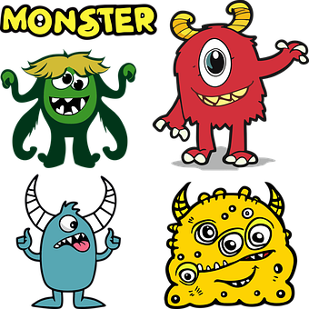
Follow up 5:
Elige* un monstruo y escribe en español. 📝
escribir
Remember to add ‘no’ before the verb to make a sentence negative.
elige = choose
[My monster has…]
1
2
Ejemplo 📝
4
Mi monstruo tiene dos pies y una cabeza.
En la cabeza de mi monstruo hay una boca y siete ojos.
No tiene orejas.
5
3
Notes:
Timing: 8 minutes
Aim: Production of there is, there are, tiene, indefinite articles and numbers.
Procedure:
Students to choose one monster to produce full sentences using the vocabulary from the lesson.
Click to bring up speech bubble – some pupils might want to say what the monster doesn’t have.
3. Read the example together to see use of ‘tiene’ ‘en ... Mi monstro hay’ in context
Unknown words and/or cognates:
elegir [561]
Source: Davies, M. & Davies, K. (2018). A frequency dictionary of Spanish: Core vocabulary for learners (2nd ed.). Routledge: London

Slide 9
Follow up [extra] :
aprender [428] leer [209] carta [627] noticia [859] revista [920] español [262] inglés [583] de2 [2] tienes [19] hoja [916] idea [247] lápiz [3740] mensaje [847] palabra [192] regla [1380]
Escribe en español 📝:
Can you get at least 15 points?
 | message | word | pencil
 | ruler | You have | idea
 | to learn, learning | news | English
 | reading | Spanish | of
 | head | foot | twelve
 | there are | finger | s/he, it has
 | ear | eye | mouth
vocabulario
el mensaje
la palabra
el lápiz
vocabulario
x3
la regla
tienes
idea
aprender
la noticia
inglés
x2
leer
español
de
la cabeza
el pie
doce
hay
el dedo
tiene
x1
la oreja
el ojo
la boca
Notes:
Timing: 6 minutes
Aim: to practise written production of vocabulary for this week and previous weeks.
Procedure:
1. Pupils need to write the English for as many words as possible, aiming to get at least 15 points (but more if possible).
2. Click for English answers.

Slide 10
¡adiós!
amarillo

Slide 11
Follow up [extra] 1
Follow up [extra] :
Escribe en inglés 📝:
Can you get at least 15 points?
 | message | word | pencil
 | ruler | You have | idea
 | to learn, learning | news | English
 | reading | Spanish | of
 | head | foot | twelve
 | There are | finger | s/he, it has
 | ear | eye | mouth
vocabulario
vocabulario
x3
x2
x1
Notes:
HANDOUT

