Slide 1
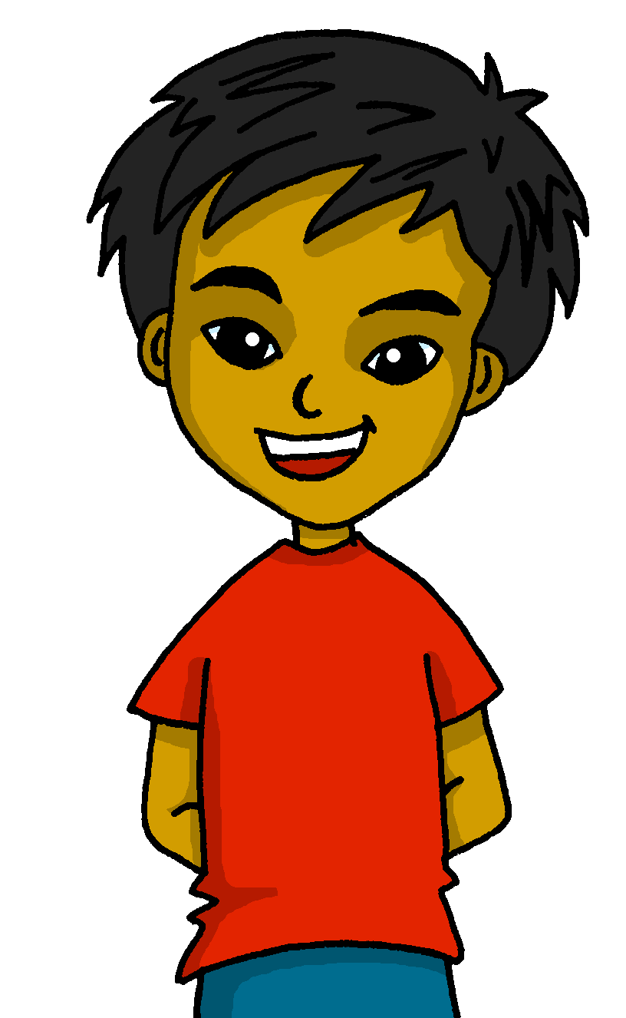
español, con Quique

Slide 2
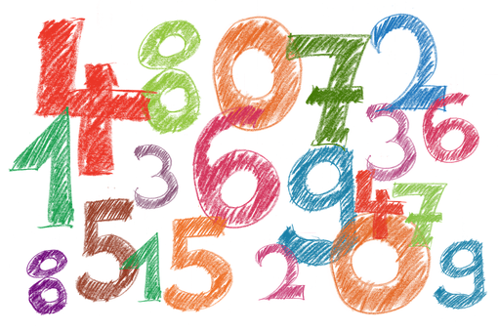
Saying what I and others do
- Numbers
- Singular indefinite article
- regular plural marking on nouns (-s)
- SSC [qui]
amarillo
Notes:
Artwork by Steve Clarke. All additional pictures selected are available under a Creative Commons license, no attribution required.
The frequency rankings for words that occur in this PowerPoint which have been previously introduced in the resources are given in the SOW (excel document) and in the resources that first introduced and formally re-visited those words.
For any other words that occur incidentally in this PowerPoint, frequency rankings will be provided in the notes field wherever possible.
SSC: Source: equipo [373] quince [1215]
Vocabulary: un [6] dos [64] tres [134] cuatro [241] cinco [284] seis [438] siete [603] ocho [641] nueve [991] diez [449] once [1700] doce [1138]
Revisit 1: descansar [1749] campo [342] habitación [1069] tarde [392] por2 [15]
Revisit 2: tiene [19] dibujo [1726] hermano [333] hermana [3409] mesa [525] perro [888] profesor, profesora [501] puerta [274]
Glossed words:
los, las [1] decidir [368] escribir [198] repetir [512] frase [1037] número [324] orden [421] correcto [1467]
Source: Davies, M. & Davies, K. (2018). A frequency dictionary of Spanish: Core vocabulary for learners (2nd ed.). Routledge: London

Slide 3
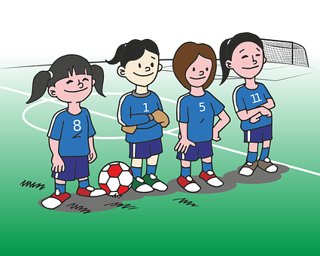
[qui]
equipo
pronunciar
Notes:
Timing: 1 minute
Aim: To introduce SSC [qui]
Procedure:
To present and elicit the pronunciation of the individual SSC [qui]
Click to bring up the picture & get students to repeat (with gesture, if using).
Gesture suggestion : handshake

Slide 4
[qui]
quince
pronunciar
Notes:
Timing: 1 minute
Aim: To present SSC [qui]
Procedure:
To recap and elicit the pronunciation of the individual SSC [qui]
Click to bring up the picture & get students to repeat (with gesture, if using).
Gesture suggestion : mime 3 x 5 by holding up right hand and flashing it three times.

Slide 5
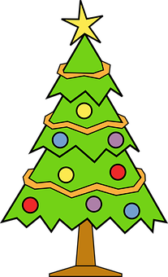
escuchar
Escucha. ¿Es ‘ci’ o ‘qui’?
[left]
E
1
qui
ci
iz____erda
di___embre
3
4
2
qui
ci
___én
silen___o
____nce
qui
Notes:
Timing: 5 minutes
Aim: to differentiate [qui] from previously taught SSC [ci]
Procedure:
Read the instruction and do the example [E] with pupils. Pupils to write the correct SSCs [ci], or [qui].
Do 1-4.
Go through answers by eliciting the Spanish word from pupils, and click to bring up answers.
Give pupils 1 minute to work in pairs to practise pronunciation.
Transcript:
E parque
1 pescado
2 barco
3 quien
4 pequeño

Slide 6
vocabulario
Escucha, repite* y aprende los* números*.
uno
dos
tres
repetir = to repeat, repeating | los = the (m., pl.) | (el) número = number
Notes:
Timing: 5 minutes (8 slides) Aim: to introduce numbers 1-12.
Procedure: 1. For each set of three numbers (123,456,789,101112), first click to present and say (or use audio version) the number, and pupils repeat. Numbers are animated to appear in digit first, then written word. Teachers to say each number twice, and then elicit from pupils.
2. Move to the 2nd slide with the same numbers. This time the digit and gapped written word appear together. Try to elicit from pupils but respond to any hesitation by providing the spoken number again. (In the audio version, click on the digit to hear the audio, as needed). 3. Repeat steps 1-2 for the other 9 numbers. Frequency of unknown words: los [1] repetir [512] número [324]
Source: Davies, M. & Davies, K. (2018). A frequency dictionary of Spanish: Core vocabulary for learners (2nd ed.). Routledge: London

Slide 7
vocabulario
Escucha, repite* y aprende los* números*.
u_o
d_s
tr_s
repetir = to repeat, repeating | los = the (m., pl.) | (el) número = number
Notes:
[2/8]
Frequency of unknown words: Frequency of unknown words: los [1] repetir [512] número [324]
Source: Davies, M. & Davies, K. (2018). A frequency dictionary of Spanish: Core vocabulary for learners (2nd ed.). Routledge: London

Slide 8
vocabulario
Escucha, repite* y aprende los* números*.
cuatro
cinco
seis
repetir = to repeat, repeating | los = the (m., pl.) | (el) número = number
Notes:
[3/8]
Frequency of unknown words: los [1] repetir [512] número [324]
Source: Davies, M. & Davies, K. (2018). A frequency dictionary of Spanish: Core vocabulary for learners (2nd ed.). Routledge: London

Slide 9
vocabulario
Escucha, repite* y aprende los* números*.
c_ _tr_
c_nc_
se_s
repetir = to repeat, repeating | los = the (m., pl.) | (el) número = number
Notes:
[4/8]
Frequency of unknown words: los [1] repetir [512] número [324]
Source: Davies, M. & Davies, K. (2018). A frequency dictionary of Spanish: Core vocabulary for learners (2nd ed.). Routledge: London

Slide 10
vocabulario
Escucha, repite* y aprende los* números*.
siete
ocho
nueve
repetir = to repeat, repeating | los = the (m., pl.) | (el) número = number
Notes:
[5/8]
Frequency of unknown words: los [1] repetir [512] número [324]
Source: Davies, M. & Davies, K. (2018). A frequency dictionary of Spanish: Core vocabulary for learners (2nd ed.). Routledge: London

Slide 11
vocabulario
Escucha, repite* y aprende los* números*.
si_t_
_ch_
n_ev_
repetir = to repeat, repeating | los = the (m., pl.) | (el) número = number
Notes:
[6/8]
Frequency of unknown words: los [1] repetir [512] número [324]
Source: Davies, M. & Davies, K. (2018). A frequency dictionary of Spanish: Core vocabulary for learners (2nd ed.). Routledge: London

Slide 12
vocabulario
Escucha, repite* y aprende los* números*.
diez
once
doce
repetir = to repeat, repeating | los = the (m., pl.) | (el) número = number
Notes:
[7/8]
Frequency of unknown words: los [1] repetir [512] número [324]
Source: Davies, M. & Davies, K. (2018). A frequency dictionary of Spanish: Core vocabulary for learners (2nd ed.). Routledge: London

Slide 13
vocabulario
Escucha, repite* y aprende los* números*.
vocabulario
d_e_
_nc_
d_c_
repetir = to repeat, repeating | los = the (m., pl.) | (el) número = number
Notes:
[8/8]
Frequency of unknown words: los [1] repetir [512] número [324]
Source: Davies, M. & Davies, K. (2018). A frequency dictionary of Spanish: Core vocabulary for learners (2nd ed.). Routledge: London

Slide 14
Leer y hablar
Lee los* números* en el orden* correcto*.
cuatro
once
siete
leer
hablar
diez
cinco
60
dos
doce
seis
ocho
tres
nueve
uno
- - - - - - - - - - - - - - - - - - - - - - - - - - - - - - -
uno
dos
tres
cuatro
cinco
seis
0
siete
ocho
nueve
diez
once
doce
INICIO
los = the (m., pl.) | (el) número = number | orden = order | correcto = correct
Notes:
Timing: 3 minutes
Aim: to consolidate written comprehension and pronunciation of numbers.
Procedure:
Teacher reads the instruction in Spanish.
Pupils work in pairs to say the numbers in order (1-12). They have one minute.
Click to trigger the timer.
After one minute, elicit the answers chorally from the class, click to bring up each answer, just after pupils have said it. (In the audio version, we hear the numbers again, as they appear, in order, underneath.)
Frequency of unknown words: los [1] número [324] orden [421] correcto [1467]
Source: Davies, M. & Davies, K. (2018). A frequency dictionary of Spanish: Core vocabulary for learners (2nd ed.). Routledge: London

Slide 15
Tener: I have & s/he, it has
[to have | having]
We have already seen that the verb tener means ‘to have’.
I
you
tengo
tienes
To mean I have, use ‘______’.
To mean you have, use ‘______’.
Tengo una bicicleta.
Tienes una carta.
You have a/one letter | card.
I have a bicycle.
Tengo dos bicicletas
Tienes cuatro cartas.
I have two bicycles.
You have four letters | cards.
⚠ To talk about something in the plural (more than one), Spanish often adds an ‘s’ to the end of nouns ending in –o, -a or –e.
Notes:
Timing: 2 minutes
Aim: to revisit 1st and 2nd person singular of ‘tener’ & introduce plural marking of regular nouns.
Procedure:
Present the information, using the animated sequence.
Elicit English translation for the Spanish examples provided.

Slide 16
escuchar
Quique compite con Sofía:
¿Quién es? Marca 📝
¿1 o + 1?
 | Quique (I) | Sofía (you)
1 | 1+
número
E
tres
⚠Remember this also means ‘a/an’.
1
un
2
siete
3
una
4
cinco
5
cuatro
competir = to compete, competing
Notes:
Timing: 7 minutes
Aim: to practise aural comprehension of ‘tengo’ & ‘tiene’ and recognition of singular/plural nouns; in addition, to practise transcription of some numbers.
Procedure:
Read the title & click to bring up the instructions in Spanish, and the first two parts of the table.
Do the example (E). At this stage pupils identify if it is I or s/he and if the person has 1 or more than 1 item.
Click to bring up animation / answers.
Click to bring up the 3rd part of the table. Listen again, and pupils write down the numbers in words.
Click to correct.
Note: written comprehension of the sentences is the next activity on the next slide.
Transcript
[E] Tengo tres bocadillos.
[1] Tienes un ordernador.
[2] Tienes siete cosas.
[3] Tengo una profesora.
[4] Tienes cinco lápices.
[5] Tengo cuatro amigas.
Frequency of unknown words: competir [2748]
Source: Davies, M. & Davies, K. (2018). A frequency dictionary of Spanish: Core vocabulary for learners (2nd ed.). Routledge: London

Slide 17
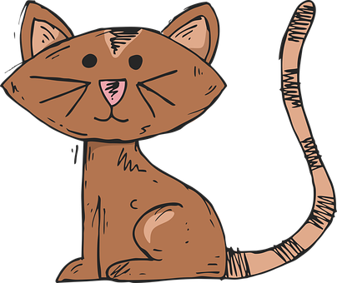
Tener: I have & s/he, it has
[to have | having]
S/he, it
tiene
To mean s/he or it has, use ‘______’.
Ángela tiene un gato.
Ángela has a/one cat.
She has a/one cat.
Ángela tiene dos gatos.
Ángela has two cats.
She has two cats.
Notes:
Timing: 2 minutes
Aim: to revisit 3rd person singular of ‘tener’ & plural marking of regular nouns.
Procedure:
Present the information, using the animated sequence.
Elicit English translation for the Spanish examples provided.

Slide 18
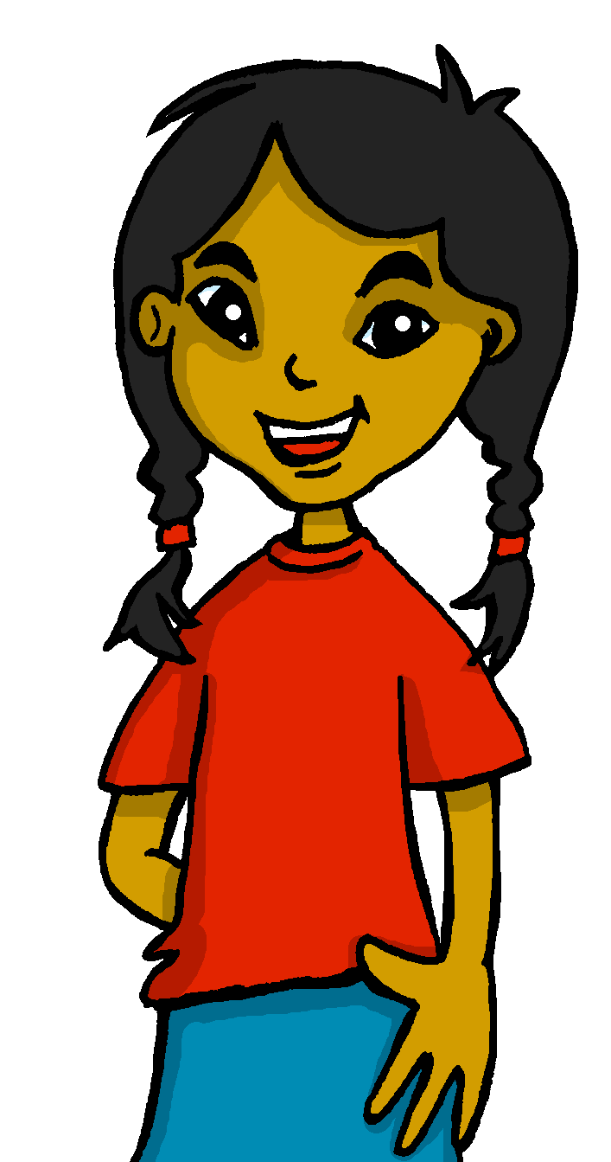
leer
Lee las* frases* y decide*.
Tiene dos libros.
leer
Tengo dos plantas.
las = the (f., pl.)
(la) frase = phrase, sentence
decidir = to decide, deciding
Tiene cuatro revistas.
Tengo cinco revistas.
Tiene una bici.
Tengo tres instrumentos.
a. Who has more items?
b. Who could play music?
c. Who could go on a bike ride?
d. Who could read?
e. Who has more valuable items?
f. Whose possessions do you prefer?
Quique
Quique
Sofía
Quique and Sofía
Notes:
Timing: 4 minutes
Aim: to practise comprehension of 1st and 2nd person singular of –tener, key vocabulary & numbers.
Procedure:
1. Teacher to read the task instruction in Spanish. Quique is talking to Rubén about himself (I) and Sofía (she).
2. Pupils to read the sentences and discuss in pairs questions a-f.
NB. This task brings together comprehension and pupils’ individual perceptions. For e-f, there is no right or wrong answer to the questions.
Frequency of unknown words: las [1] decidir [368] frase [1037]
Source: Davies, M. & Davies, K. (2018). A frequency dictionary of Spanish: Core vocabulary for learners (2nd ed.). Routledge: London

Slide 19
Leer y hablar
Lee los* números en el orden* correcto*.
leer
hablar
60
- - - - - - - - - - - - - - - - - - - - - - - - - - - - - - -
uno
dos
tres
cuatro
cinco
seis
0
siete
ocho
nueve
diez
once
doce
INICIO
los = the (m., pl.) | (el) número = number | orden = order | correcto = correct
Notes:
Timing: 3 minutes
Aim: to consolidate numbers in oral production.
Procedure:
Teacher reads the instruction in Spanish.
Pupils work in pairs to say the numbers in order (1-12). They have one minute.
Click to trigger the timer.
To bring up answers, each number disappears on click, and the correct answer appears. (In the audio version, audio is attached to numbers, as they re-appear.)
Frequency of unknown words: los [1] número [324] orden [421] correcto [1467]
Source: Davies, M. & Davies, K. (2018). A frequency dictionary of Spanish: Core vocabulary for learners (2nd ed.). Routledge: London

Slide 20
escuchar
Escribe* 8 números* 📝.
escribir = to write, writing | (el) número = number
Notes:
Suggested additional activity - Bingo
Aim: to practise aural comprehension of numbers.
Procedure:
Pupils write down 8 digits. They can repeat numbers, if they wish.
The teacher calls out numbers 1-12, in any order.
Pupils call ‘¡Bingo!’ if they have a horizontal row of four numbers checked off, and then play resumes for a full house.
Note: A great alternative is to play ‘strip bingo’; this is where pupils have a strip of paper and write down 6 numbers in any order from left to right. As the teacher calls out numbers, pupils can only rip off matching numbers from either end of their strip, if they hear them called. It is the pupil whose final remaining number is called, who wins.
Frequency of unknown words: escribir [198] número [324]
Source: Davies, M. & Davies, K. (2018). A frequency dictionary of Spanish: Core vocabulary for learners (2nd ed.). Routledge: London

Slide 21
¡adiós!
amarillo

