Slide 1

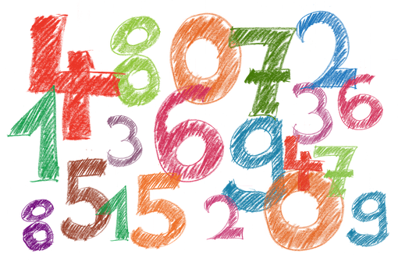
Saying what I and others do
amarillo
Follow ups 1-5
Notes:
Artwork by Steve Clarke. All additional pictures selected are available under a Creative Commons license, no attribution required.
The frequency rankings for words that occur in this PowerPoint which have been previously introduced in the resources are given in the SOW (excel document) and in the resources that first introduced and formally re-visited those words.
For any other words that occur incidentally in this PowerPoint, frequency rankings will be provided in the notes field wherever possible.
SSC: Source: equipo [373] quince [1215]
Vocabulary: un [6] dos [64] tres [134] cuatro [241] cinco [284] seis [438] siete [603] ocho [641] nueve [991] diez [449] once [1700] doce [1138]
Revisit 1: descansar [1749] campo [342] habitación [1069] tarde [392] por2 [15]
Revisit 2: tiene [19] dibujo [1726] hermano [333] hermana [3409] mesa [525] perro [888] profesor, profesora [501] puerta [274]
Glossed words: los, las [1] adivinar [2201] decidir [368] escribir [198] mandar [588] repetir [512] abuela [783] frase [1037] imagen [384] número [324] palabra [192] resultado [502] sonido [1040] suma [2001] vez [59] más [23] igual [263] más [23] menos [117] igual [263] otra [35]
Source: Davies, M. & Davies, K. (2018). A frequency dictionary of Spanish: Core vocabulary for learners (2nd ed.). Routledge: London

Slide 2





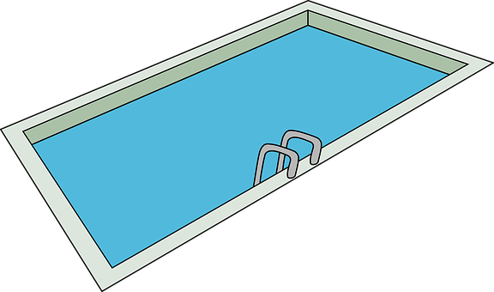
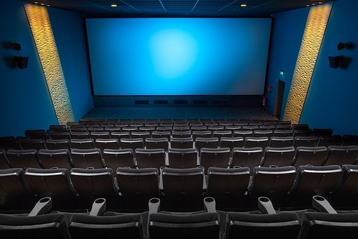

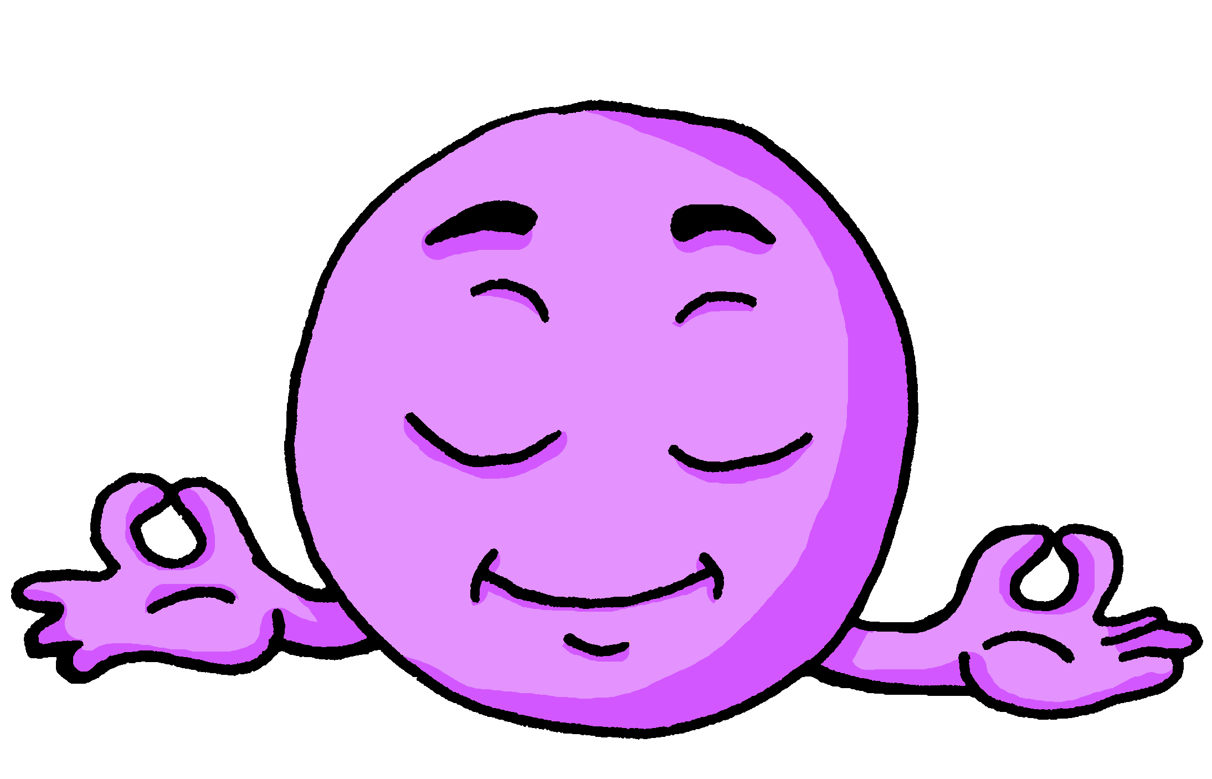
Follow up 1
[qui] [ci]
A Escucha. ¿Qué sonido* es?
pronunciar
This is a ‘k’ sound.
⚠ This is a ‘th’ sound.
B Escribe una palabra*.
Tu compañero/a adivina*.
Marca
 | qui | ci
 |  |  | a ___
 |  |  | pis___ na
 |  |  | ___ ne
 |  |  | po ___ to
 |  |  | mari ___ ta
 |  |  | tran ___ lo
¿Tienes [____] ?
Do you have…?
E
quí
bicicleta
1
ci
cocina
equipo
cine
mariquita
2
ci
aquí
piscina
3
qui
[little bit]
poquito
tranquilo
4
qui
quince
(el) sonido = sound
(la) palabra = word
adivina = guess
5
qui
Notes:
Timing: 5 minutes
Aim: to practise aural distinction and transcription of [qui] and [ci].
Procedure:
Part A
Click to bring up the instruction.
Click to bring up reminder of [qui] [ci] sound-writing correlation.
Click to bring up the table and do example together (E).
Students tick and/or write the correct sound [ci] [qui].
Alternatively, they could turn away from the board and try to transcribe the full word.
Transcript
[EJ] aquí
[1] piscina
[2] cine
[3] poquito
[4] mariquita
[5] tranquilo
Part B
Click to bring up reminder the instructions.
Partner A writes down one word, partner B tries to guess by asking ‘¿tienes…? + one of the words on the board.
Teachers circulate to listen to pupils’ pronunciation and praise/correct as necessary.
Unknown words and/or cognates:
sonido [1040] palabra [192] advivinar [2201]
Source: Davies, M. & Davies, K. (2018). A frequency dictionary of Spanish: Core vocabulary for learners (2nd ed.). Routledge: London

Slide 3



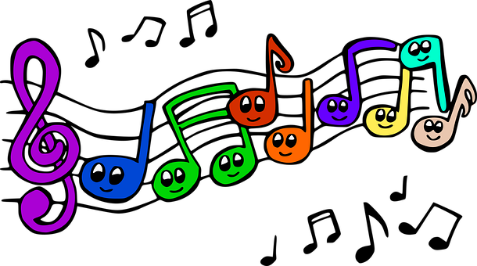
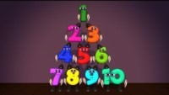



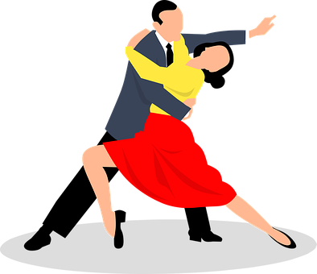
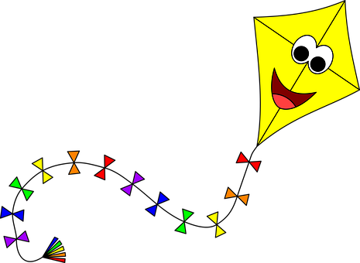

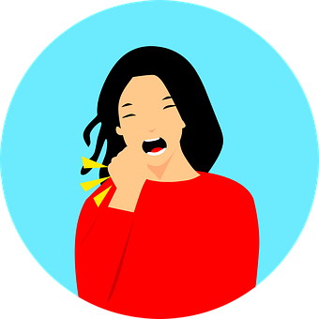
Follow up 2:
Escucha y canta.
¡y cantar!
What number appears at the end?
hablar
Yo soy el cuatro, y me gusta el teatro.
Yo soy el cinco, los charquitos siempre brinco.
Yo soy el seis, siempre bailo ya lo ves.
Yo soy el siete, remonto un barrilete.
Yo soy el ocho, y me como un bizcocho.
Yo soy el nueve, cuando salgo siempre llueve.
Yo soy el diez. ¿La cantamos otra vez?
😊
(I am four, I like drama.)
(I am five, I always jump over puddles.)
(I am six, I always dance as you can see.)
(I am seven, I make a kite)
Yo soy el uno, como yo no hay ninguno.
Yo soy el dos, ahora tengo mucha tos.
Yo soy el tres, doy la vuelta al revés.
(I am one, there’s no one like me.)
(I am eight, I eat a sponge cake.)
(I am two, now I have a lot of cough.)
(I am nine, when I go out it always rains.)
🎤
(I am there, I flip around.)
(I am ten. Shall we sing it again?)
Notes:
Timing: 5 minutes
Aim: to revisit numbers 1-11 in a song.
Procedure:
Click to play the clip and listen and read along. The song repeats twice (First time up to 0:52). The second time is much faster than the first time, but teachers can change the speed on YouTube
When pupils listen a 2nd time, they can try to join in with the first half of each line – i.e. Yo soy el + number.
Song by @efecto3d:
https://youtu.be/zSnhk8O3CAQ
Unknown words and/or cognates:
lo [10] ninguno [256] yo [28] bailar [1323] brincar [>5000] cantamos [cantar 717 ] doy [dar 42 ] gustar [163] hay [haber 13] llueve [llover 2134 ] ves [ver 38] remontar [3698] salir [114] barrillete [>5000] bizcocho [>5000] charco [4538] revés [2790] teatro [605] tos [4735] vez [59] vuelta [1012] mucho [41] otro [35] ya [39] como [20]
Source: Davies, M. & Davies, K. (2018). A frequency dictionary of Spanish: Core vocabulary for learners (2nd ed.). Routledge: London

Slide 4


Follow up 3:
Escribe los números 📝.
escribir
leer
 | la suma | el resultado 📝
 | uno (+) tres =
 | cuatro (+) dos =
 | siete (+) tres =
 | cinco (+) cuatro =
 | doce (-) cuatro =
 | doce (-) nueve =
 | doce (-) siete =
E
cuatro
4
1
seis
6
2
diez
10
3
nueve
9
4
ocho
8
escribir = to write, writing
los = the (m., pl.)
número = number
la suma = sum
el resultado = result
más = plus; more
menos = minus
igual a = equals
5
tres
3
6
cinco
5
Notes:
Timing: 5 minutes
Aim: To practise the reading comprehension of numbers.
Procedure:
Do the example with pupils.
Click to reveal the answer in word and digit, and click to hear the audio for the full sum.
Highlight the glossed words más, menos and igual a and their meanings, and make clear that this is how these sums are spoken in Spanish.
Pupils do items 1-6.
Click to listen, click and correct answers.
Transcript:
Unknown words and/or cognates:
los [1] escribir [198] número [324] más [23] menos [117] igual [263]
Source: Davies, M. & Davies, K. (2018). A frequency dictionary of Spanish: Core vocabulary for learners (2nd ed.). Routledge: London

Slide 5


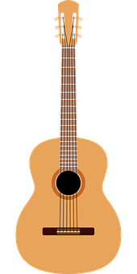
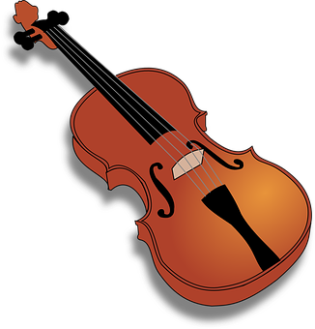

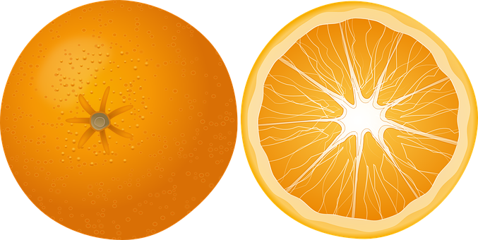
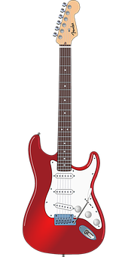



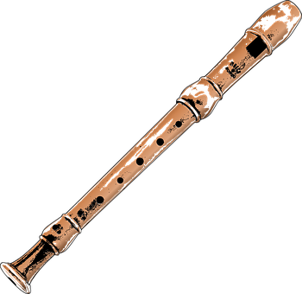
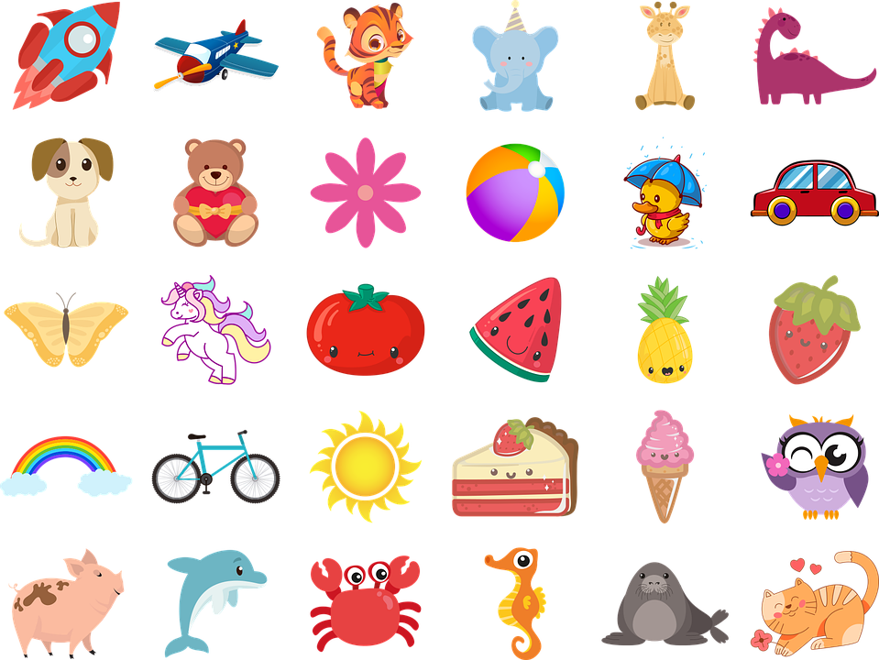
Follow up 4
otra = another | (la) vez = time
(la) imagen = image
B Escucha otra* vez*. ¿Qué imagen* es?
A Escucha. ¿Qué número es?
escuchar
E
2
Escribe el número en español 📝.
5
 | Número en español 📝
E
cuatro
E
1
1
doce
1
2
seis
2
3
nueve
3
3
4
4
cinco
4
5
siete
5
Notes:
Timing: 5 minutes
Aim: to practise aural comprehension of numbers, and revisiting vocabulary, connecting sound with meaning.
Procedure:
(Part A)
Read the instruction in Spanish & click to bring further instruction. Ensure it’s clear for pupils they should write the word rather than just the number.
Do [E] with them. Click to listen.
Click for answers
(Part B)
Click to bring further instruction & pictures. Pupils to listen one more time and match the statements (E-5) with the pictures.
Do [E] with them. Click to listen.
Transcript 1:
[E] Tengo cuatro [naranjas].
[1] Tienes doce [bicicletas].
[2] Tengo seis [instrumentos].
[3] Tengo nueve [animales].
[4] Tengo cinco [cartas].
[5] Tengo siete [lápices].
Transcript 2:
[E] Tengo cuatro naranjas.
[1] Tienes doce bicicletas.
[2] Tengo seis instrumentos.
[3] Tengo nueve animales.
[4] Tengo cinco cartas.
[5] Tengo siete lápices.
Unknown words and/or cognates:
otra [35] vez [59] imagen [384]
Source: Davies, M. & Davies, K. (2018). A frequency dictionary of Spanish: Core vocabulary for learners (2nd ed.). Routledge: London

Slide 6



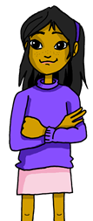
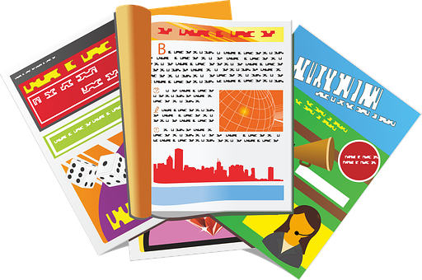
Follow up 5:
Tener: I have & you have.
[to have | having]
We have already seen the verb tener means ‘to have’.
I
You
tengo
To refer to I, we use ‘______’.
tienes
To refer to you, we use ‘_______’.
Tengo dos instrumentos.
Tienes cuatro revistas.
You have four magazines.
I have two instruments.
⚠ To talk about something in the plural (more than one), Spanish often adds an ‘s’ to the end of the noun ending in –o, -a or –e.
Notes:
Timing: 10 minutes (2 slides)
Aim: To revisit tener in 1st and 2nd person singular.
Procedure:
Read the grammar explanation on tener (to have).
Elicit English translation for the Spanish examples provided.

Slide 7
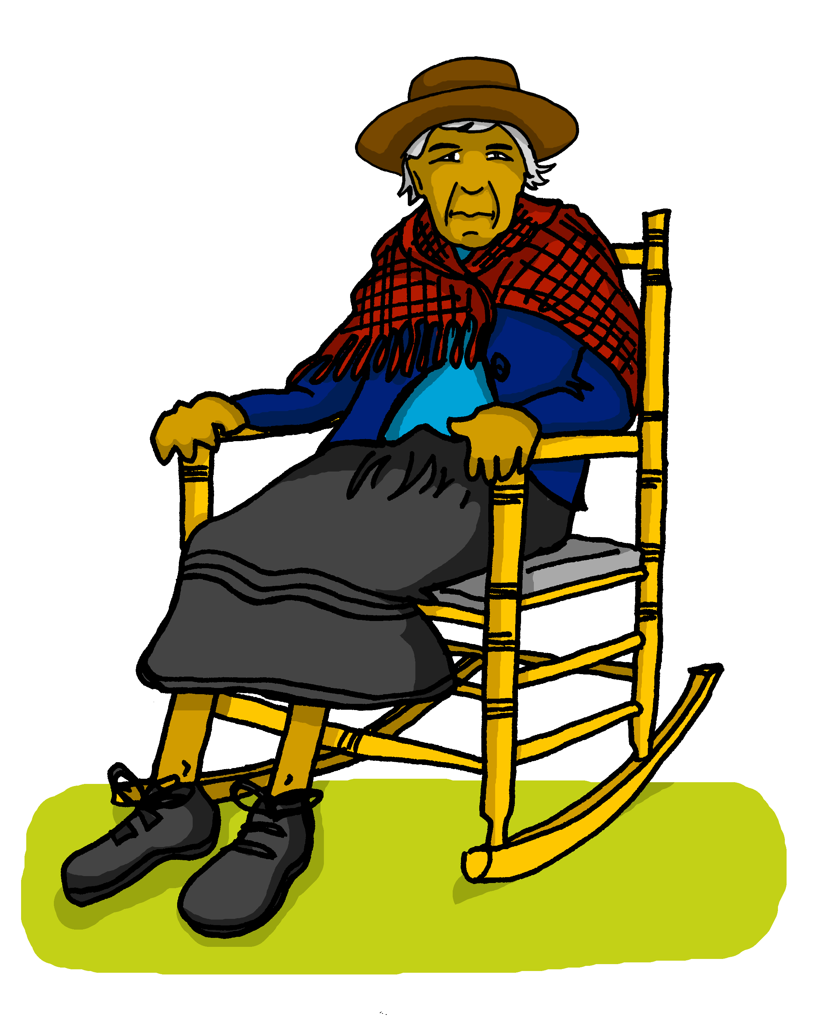

Follow up 5:
Quique manda* mensajes a la abuela.
Lee las frases*. ¿Quién es?
Marca ✅.
leer
E
3
Quique (I) | Abuela Valeria (you)
Quique
Quique
Tengo cinco mensajes.
¡Tienes un ordenador viejo!
E
1
4
1
Quique
Quique
Tengo
¿Tienes cuatro libros interesantes?
2
una hermana nerviosa.
3
4
2
5
Quique
¡Tienes
Quique
5
seis perros!
¿Tienes doce camas?
mandar = to send, sending
las = the (f., pl.)| (la) frase = sentence
Notes:
Timing: 5 minutes (slide 2/2)
Aim: to practise written comprehension of tener in the 1st and 2nd persons singular.
Procedure:
Read the title & click to explain the context of the task.
Click to bring further instructions in Spanish.
Do [E] with them to model the task and draw their attention to the verb (tengo). Is it Sofía talking about her or is she talking to her grandma (you).
Pupils complete 1-5.
Click through the animations to bring up answers. If desired, click on the numbered buttons to hear sentence audio.
Ask pupils to translate the verbs
Unknown words and/or cognates:
las [1] mandar [588] frase [1036]
Source: Davies, M. & Davies, K. (2018). A frequency dictionary of Spanish: Core vocabulary for learners (2nd ed.). Routledge: London

Slide 8

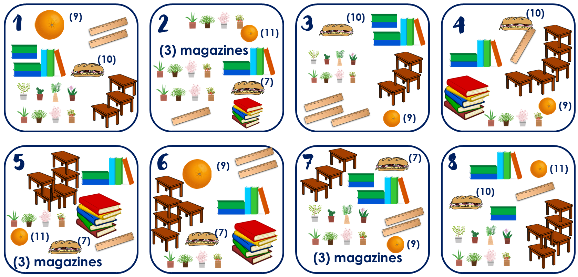
Follow up extra :
Escribe un número en secreto (1-8) 📝.
Tu compañero adivina.
Sí 😊
¿Tienes tres reglas?
¿Tienes siete bocadillos?
¿Tienes cinco mesas?
hablar
¡Tienes el número 3!
No…
¡Sí…!
No…
escribir = to write, writing
adivina= guesses
Notes:
Timing: 5 minutes (two slides)
Aim: to practise oral production of ‘tienes’, numbers and key vocabulary. Aural comprehension of key vocabulary & numbers.
Note: This version of the speaking task expects students to retrieve a wider range of vocabulary as well as numbers, and use the correct form of ‘tener’ (2nd person singular). There is an alternative version on the next slide, which includes the vocabulary. That version still requires students to use the correct verb form and question syntax/intonation, and correct number.
Procedure:
1. Read the instruction in Spanish and ask pupils to choose one card and write a number (NB. Some pupils would benefit from a printed copy of the cards).
2. Click to bring up the instructions and clarify “adivina”.
3. Click through the animations to model an example. The card in the example is number 3. Emphasize the importance of asking the full question using ‘tienes…?’
Unknown words and/or cognates:
advivinar [2201] escribir [198]
Source: Davies, M. & Davies, K. (2018). A frequency dictionary of Spanish: Core vocabulary for learners (2nd ed.). Routledge: London

Slide 9

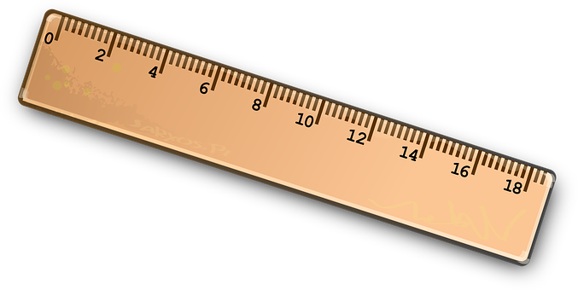
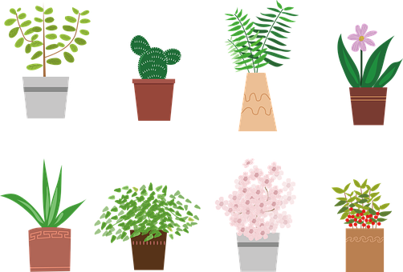
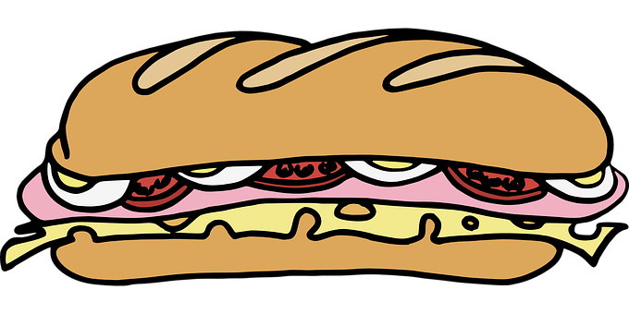


handout follow up 5 (cards)
1
(9)
2
3
(10)
(10)
4
(11)
(3) magazines
(10)
(7)
(9)
(9)
5
6
7
(7)
8
(9)
(11)
(10)
(11)
(7)
(7)
(9)
(3) magazines
(3) magazines
Notes:
DISPLAY DURING THE SPEAKING TASK

Slide 10
handout follow up 5 (cards)
1
(9) naranjas
(7) libros
(2) reglas
(8) plantas
(10) bocadillos
(3) mesas
2
(11) naranjas
(10) libros
(1) regla
(12) plantas
(7) bocadillos
(3) revistas
3
(9) naranjas
(7) libros
(3) reglas
(8) plantas
(10) bocadillos
(3) mesas
4
(9) naranjas
(10) libros
(1) regla
(4) plantas
(10) bocadillos
(5) mesas
5
(11) naranjas
(10) libros
(1) regla
(4) plantas
(7) bocadillos
(5) mesas
6
(9) naranjas
(10) libros
(2) reglas
(4) plantas
(7) bocadillos
(5) mesas
7
(9) naranjas
(7) libros
(2) reglas
(8) plantas
(7) bocadillos
(3) mesas
8
(11) naranjas
(7) libros
(1) regla
(8) plantas
(10) bocadillos
(5) mesas
Notes:
Note: Alternative format for the speaking activity, giving more support. It is often beneficial to repeat speaking tasks. In this instance, students could first use this supported version of the task, and then repeat the task with a different partner, referring only to the picture table on the previous slide.

Slide 11




Follow up [extra] :
Escribe en inglés 📝:
Can you get at least 15 points?
 | la puerta | la mesa | el dibujo
 | el profesor | por (la mañana) | la hermana
 | la mañana | la habitación | tiene
 | el campo | descansar | la tarde
 | tres | cinco | doce
 | cuatro | tienes | nueve
 | once | ocho | seis
vocabulario
door
table
drawing
vocabulario
x3
teacher (m)
in
sister
monring
room
s/he has
x2
countryside
to relax, relaxing
afternoon
three
five
twelve
four
You have
nine
x1
eleven
eight
six
Notes:
Timing: 6 minutes
Aim: to practise written comprehension of vocabulary for this week and previous weeks.
Procedure:
1. Pupils need to write the English for as many words as possible, aiming to get at least 15 points (but more if possible).
2. Click for English answers.

Slide 12
¡adiós!
amarillo

Slide 13
Follow up [extra] 1
Follow up [extra] :
Escribe en inglés 📝:
Can you get at least 15 points?
 | la puerta | la mesa | el dibujo
 | el profesor | por (la mañana) | la hermana
 | la mañana | la habitación | tiene
 | el campo | descansar | la tarde
 | tres | cinco | doce
 | cuatro | tienes | nueve
 | once | ocho | seis
vocabulario
vocabulario
x3
x2
x1
Notes:
HANDOUT

