Slide 1





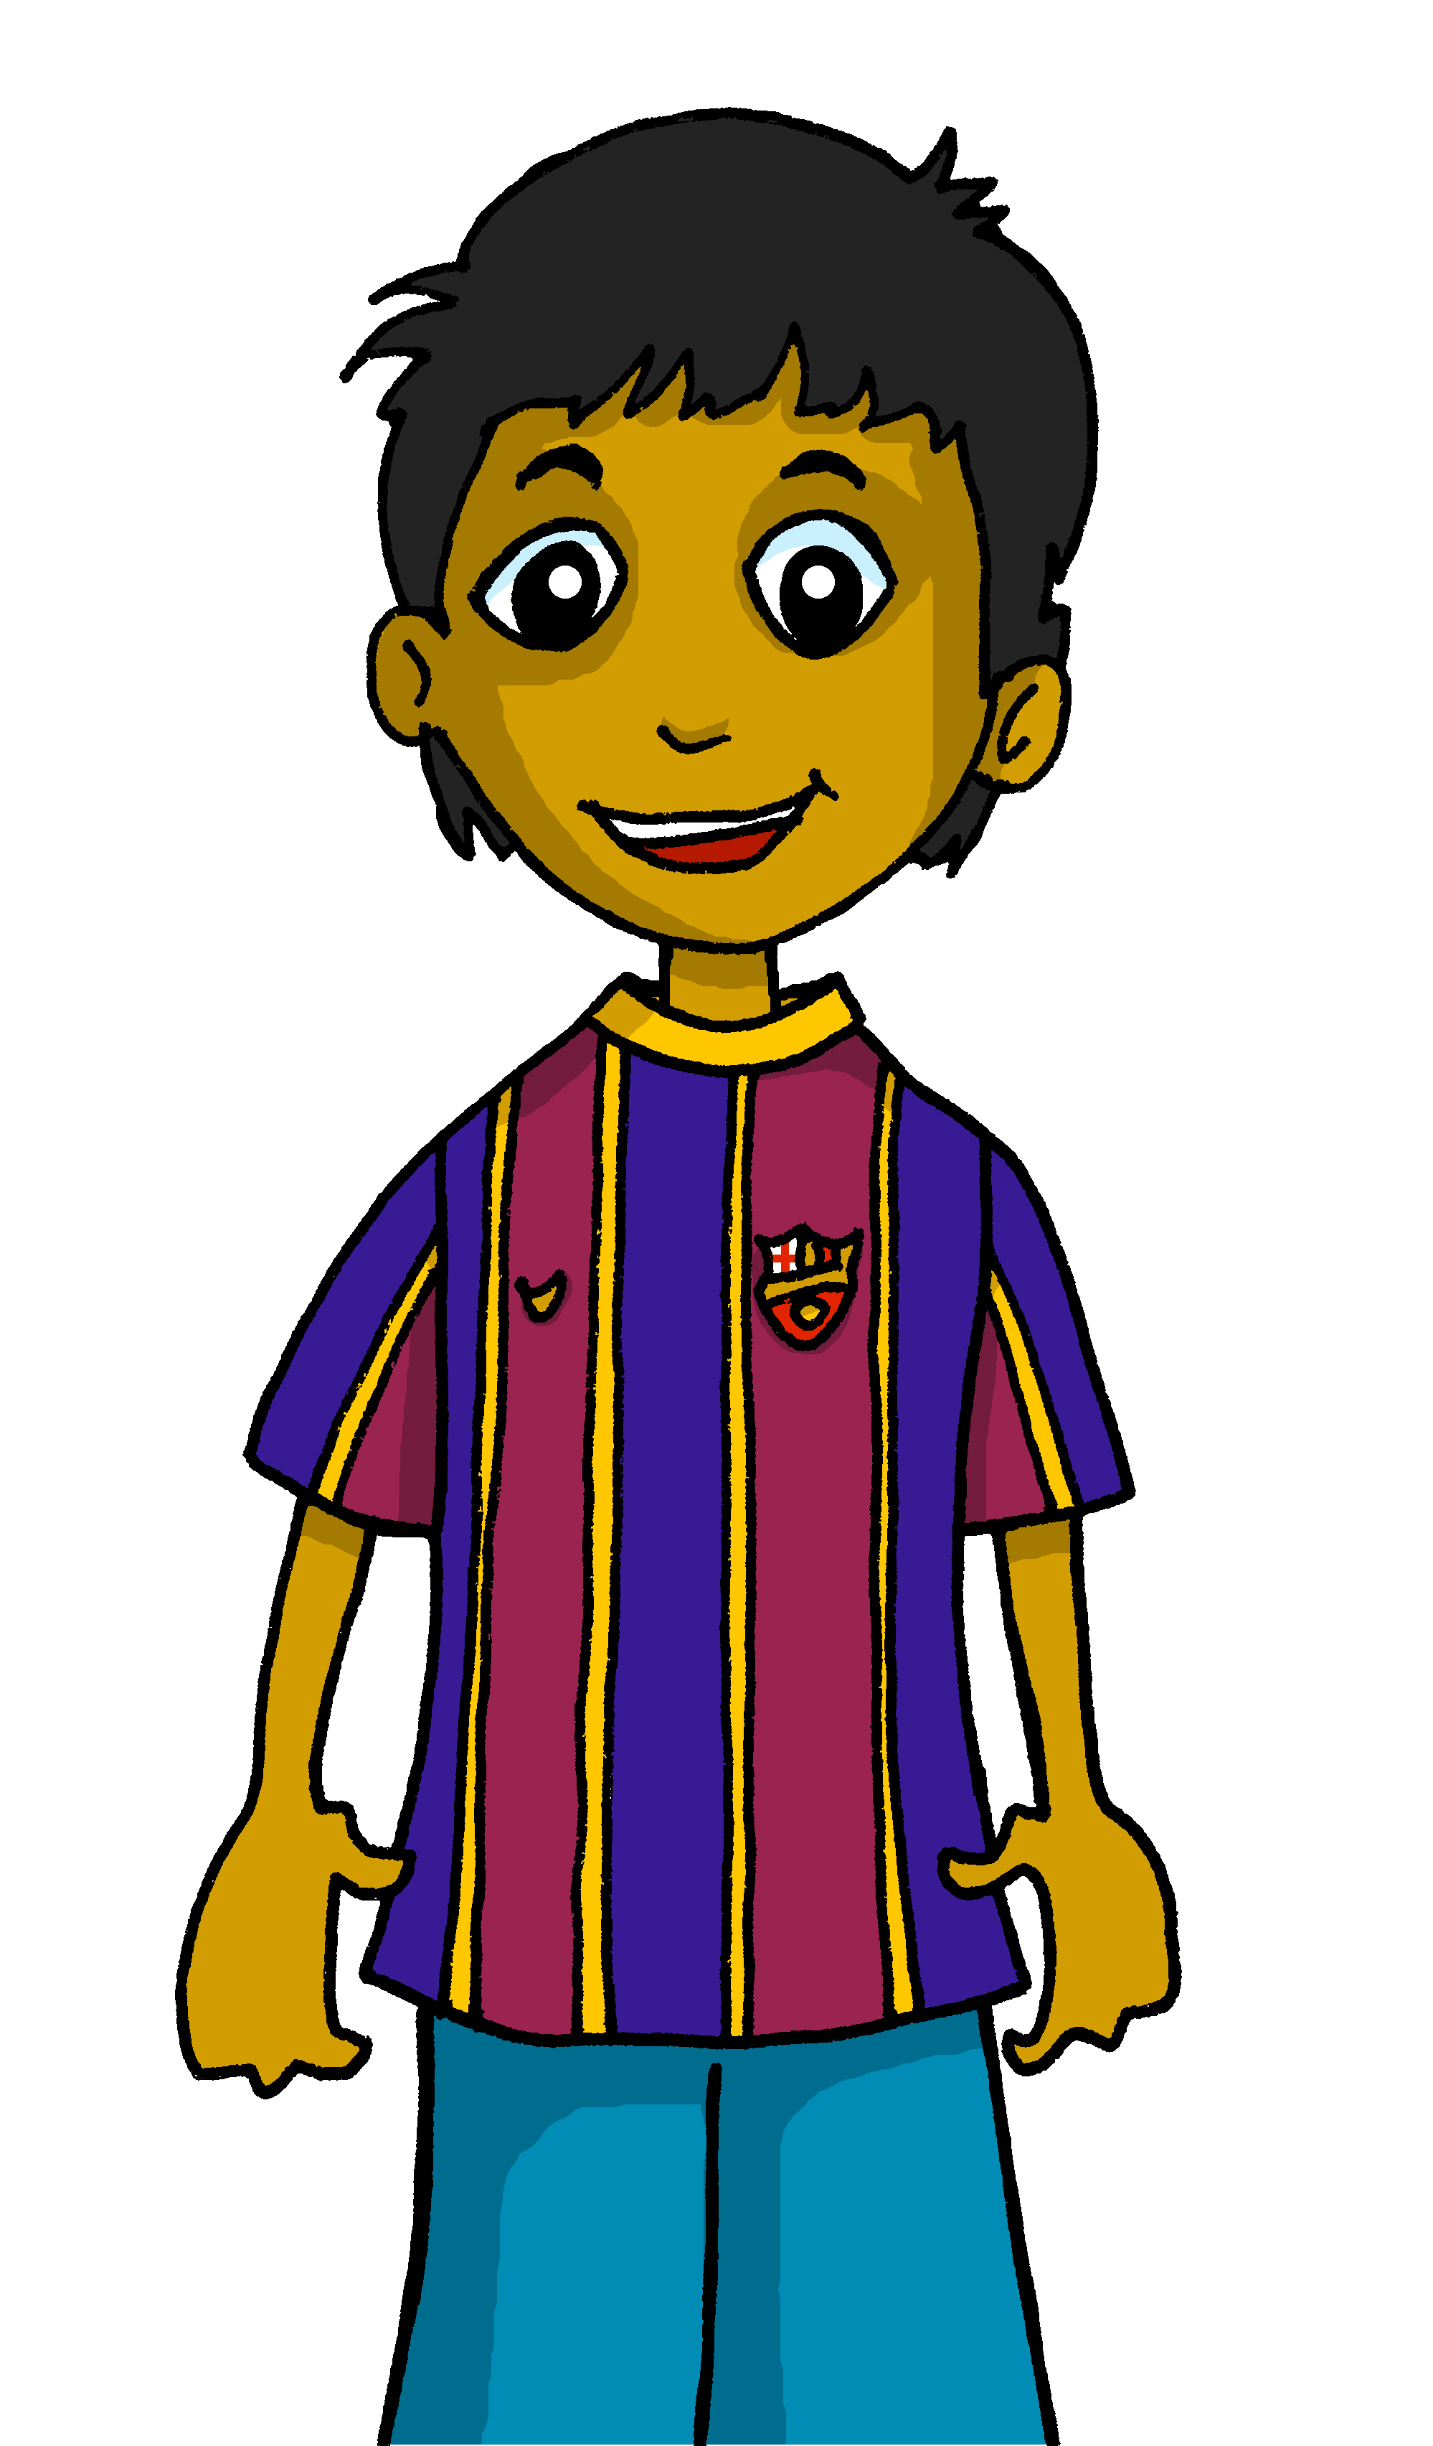

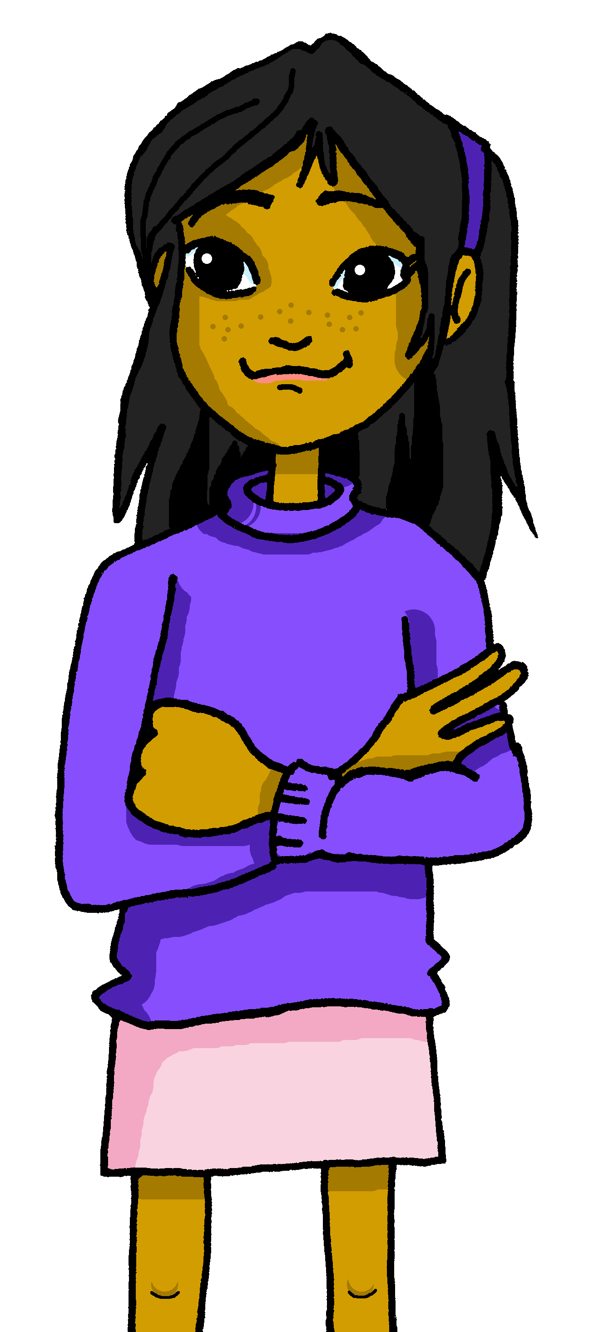

Saying what I and others do
Mi comida
amarillo
Follow ups 1-5
Notes:
Artwork by Steve Clarke. All additional pictures selected are available under a Creative Commons license, no attribution required.
The frequency rankings for words that occur in this PowerPoint which have been previously introduced in the resources are given in the SOW (excel document) and in the resources that first introduced and formally re-visited those words.
For any other words that occur incidentally in this PowerPoint, frequency rankings will be provided in the notes field wherever possible.
SSC: que [2325]
Vocabulary: comer [347] hacer, hago, hace [26] responder (a) [464] actividad [344] bocadillo [>5000] ejercicio [1162] naranja [2924] ordenador [2624]
Glossed words: pareja [893] practicar [1595] preparar(se) [570]
Revisit 1: montar [1446] pasear [1741] bicicleta [3684] estadio [2581] madre [226], padre [162] ciudad [178] el [1] la [1] de2 [2] por1 [15]
Revisit 2: tener [19] tengo [19] barco [1384] bolsa [1581] caballo [907] cama [609] libro [230] planta [768] un [6] una [6]
Source: Davies, M. & Davies, K. (2018). A frequency dictionary of Spanish: Core vocabulary for learners (2nd ed.). Routledge: London
Glossed words: escribir [198] preparar(se) [570] practicar [1595] pareja [893]
Source: Davies, M. & Davies, K. (2018). A frequency dictionary of Spanish: Core vocabulary for learners (2nd ed.). Routledge: London

Slide 2





Follow up 1:
pronunciar
[que]
paquete
They all sound like ‘k’ ☺.
[ca]
cama
[co]
contar
⚠ This is a different sound: ‘th’
[ce]
centro
Notes:
Timing: 5-7 minutes [4 slides]
Aim: To practise the pronunciation of Spanish words with the SSC [que] in contrast with [ce] and [ca] [co] [cu].

Slide 3

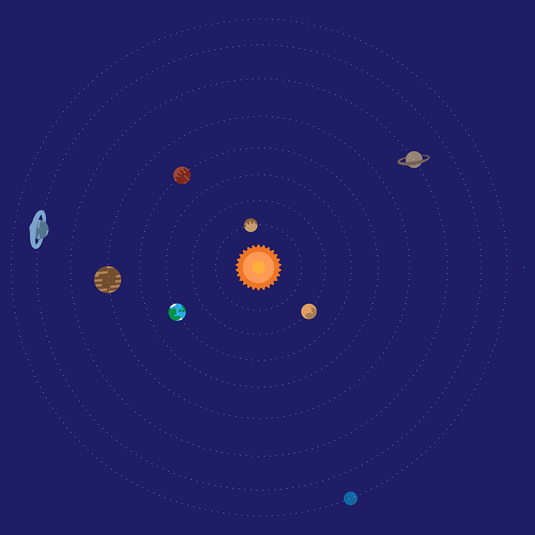

Follow up 1:
Turno 1: Persona A habla 🗣
Persona B marca 📝✅
Space is full of valuable words.
pronunciar
queso
cena
máscara
cera
cocer
quemar
esqueleto
campo
bosque
Notes:
Timing: 5-7 minutes [3 slides]
Aim: To practise the pronunciation of Spanish words with the SSC [que] and [ce].
Procedure:
Pupils work in pairs to practise and recognise correct pronunciation.
Divide the class in A & B before explaining the task.
Click to bring up the instruction in Spanish. Pupil A reads the words aloud and pupil B checks their pronunciation. There are 9 words in total.
NB. There is a handout at the end of the presentation of pupils can simply write 1-9 in their books and tick or cross.
Click once to make the spaceship appear (This animation is timed - don’t click again until all words have appeared). Pupil A pronounces the words.
Pupil B turns their back to the board, listens and ticks the words pronounced correctly.
Move to next slide for Persona B’s turn.
Frequency of unknown words and cognates:
queso [3187] cena [2542] máscara [3340] quemar [1648] cocer [>5000] cera [>5000] esqueleto [>5000] bosque [1444]
Source: Davies, M. & Davies, K. (2018). A frequency dictionary of Spanish: Core vocabulary for learners (2nd ed.). Routledge: London

Slide 4
Follow up 1:
Turno 2: Persona B habla 🗣
Persona A marca 📝✅
tanque
escena
chaqueta
maceta
buque
caracol
raqueta
cesta
esquema
Notes:
Procedure:
Pupil A turns their back to the board.
Click to start the animation.
Pupil B pronounces the words. A listens and ticks the words pronounced correctly.
Move to slide 4 to show the value of each word. Pupils can compare their results and another round can be played with the same words or swapping A/B.
Frequency of unknown words and cognates:
tanque [4823] escena [1089] chaqueta [4565] maceta [>5000] buque [3923] caracol [4518] raqueta [>5000] cesta [>5000] esquema [2770]
Source: Davies, M. & Davies, K. (2018). A frequency dictionary of Spanish: Core vocabulary for learners (2nd ed.). Routledge: London

Slide 5

Follow up 1:
How much are your words worth?
pronunciar
Persona B
Persona A
tanque 💰
escena 💰💰
chaqueta 💰
maceta 💰
buque 💰💰
caracol 💰💰
raqueta 💰
cesta 💰💰
esquema 💰
queso 💰
cena 💰
máscara 💰
quemar 💰💰
cocer 💰💰
cera 💰
esqueleto 💰💰
campo 💰
bosque 💰💰
Notes:
Procedure:
Pupils can view their results and another round can be played with the same words or swapping A/B.
Frequency of unknown words and cognates:
queso [3187] cena [2542] máscara [3340] quemar [1648] cocer [>5000] cera [>5000] esqueleto [>5000] bosque [1444]
tanque [4823] escena [1089] chaqueta [4565] maceta [>5000] buque [3923] caracol [4518] raqueta [>5000] cesta [>5000] esquema [2770]
Source: Davies, M. & Davies, K. (2018). A frequency dictionary of Spanish: Core vocabulary for learners (2nd ed.). Routledge: London

Slide 6

Follow up 2
A Escucha. ¿Qué palabra es?
escuchar
E
a | the
horse | city
1
a | the
computer | room
B Escribe la palabra.
2
a | the
the | a/an
___ ________ | una pelota
el ordenador | ___ ________
___ ________ | una cama
___ ________ | una madre
el campo | ___ ________
___ ________ | una país
bed | bike
el caballo
3
a | the
mother | father
un ordenador
4
a | the
stadium | countryside
la cama
la madre
5
a | the
park | country
un campo
el país
Notes:
Timing: 5 minutes
Aim: to practise aural comprehension of this week’s new vocabulary and revisit definite and indefinite articles; connect sound with meaning.
Procedure:
(Part A)
Read the instruction in Spanish.
Do [E] with them. Click to listen. Pupils circle the correct article.
Click for answer.
Complete items 1-5 and click to correct with the class.
(Part B)
1. Write the word with the correct article.
2. Click to correct.
Transcript 1:
[E] un caballo
[1] el ordenador
[2] una cama
[3] una madre
[4] el campo
[5] un país

Slide 7
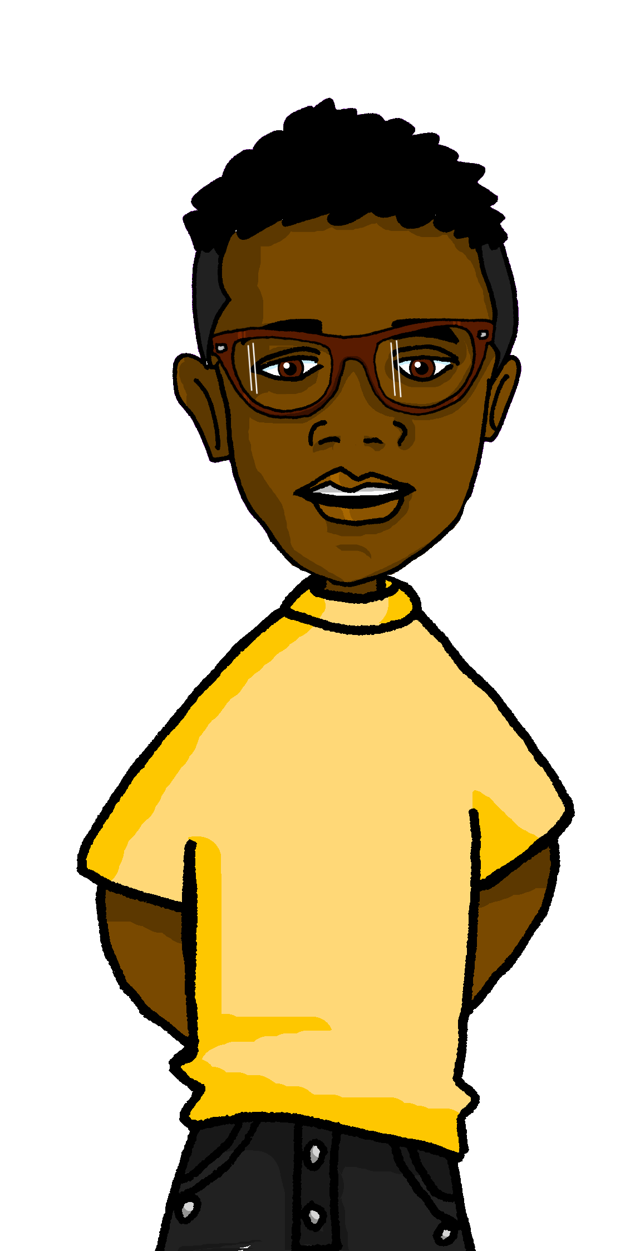
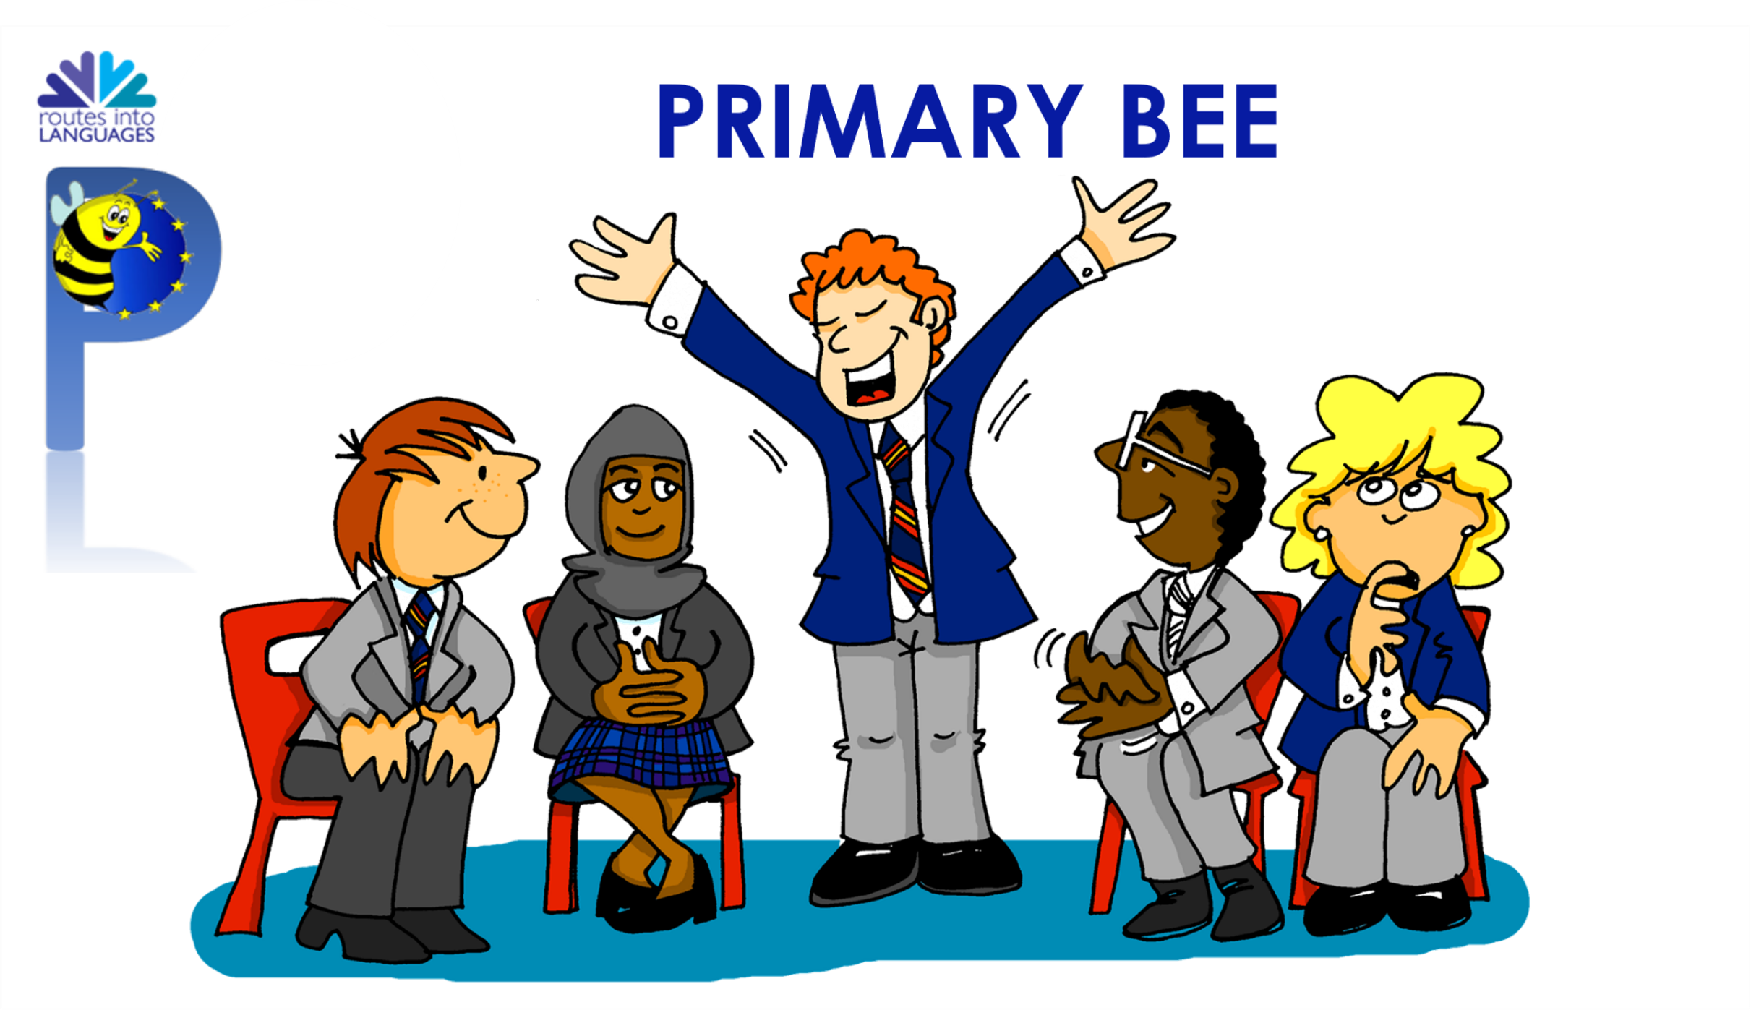
Follow up 3: The Primary Bee
practica = he practises
hablar
Max practica para Primary Bee.
¿Cómo se dice ‘to respond’ en español?
¡No sé!
¡Correcto!
responder
If you don’t know, say
‘¡No sé!’
Notes:
Timing: 5 minutes
Aim: to introduce the concept of the Primary Bee. (We hope pupils would take part in this in Y5 or 6) and revisited vocabulary introduced in week 6, together with revisit 1 and 2 (as per SOW).
Procedure:
1. Read the speech bubble on the left to establish the context (Max is practising for the Spanish Primary Bee in his school, Krina is helping him).
2. Click through to bring up the speech bubbles and model the task
Notes taken from the Primary Bee Teachers’ Pack (2022):
The aim of the Primary Bee is for students in Years 5 & 6 who have started learning a foreign language ab initio in KS2 to practise and improve their vocabulary, pronunciation and memory skills in the target language (French, Spanish and German). Native or bilingual students, as well as those who communicate in or are exposed to the language on a regular basis at home (speaking and/or listening), are not eligible to compete. It is the classroom teacher’s responsibility, with careful consideration of the ethos of the competition, to decide whether or not a student falls into this category.
Words and phrases have been selected according to the work of NCELP (National Centre for Excellence in Language Pedagogy) which highlights the importance of word frequency in informing vocabulary learning, particularly during the early stages of language development. The list includes many high-frequency words (e.g., some numbers, some colours, some verbs, days of the week, question words and a number of common verbs to help early learners to acquire a robust knowledge of verb vocabulary. These most common verbs are included in the infinitive and 3rd person singular forms; these two verb forms have been shown to provide a very useful linguistic core that can subsequently be further developed. For information we publish the word lists, indicating the word frequency.
preparar(se) [570]

Slide 8
Follow up 3: The Primary Bee
¿Cómo se dice ____ en español?
Practica en parejas.
hablar
Ask your partner how to say these words in Spanish. Then swap roles.
¡Correcto!
If you don’t know, say ‘¡No sé!’
1. to do, make
2. to eat, eating
3. to reply, replying
4. activity
5. exercise
6. sandwich
7. computer
8. orange
9. to go for a walk
10. to ride, riding
11. stadium
12. father
13. city
14. of, from
15. to have, having
16. a, an (f)
17. plant
18. bag
19. through, around
20. bed
1 minuto
No sé!
Always say the words for ‘the’ (el, la) with nouns.
E.g. el estadio.
INICIO
practicar = to practise, practising
(la) pareja = partner
Notes:
Timing: 5 minutes
Aim: to introduce the concept of the Primary Bee. (We hope pupils would take part in this in Y5 or 6) and revisit vocabulary introduced in week 6, together with revisit 1 and 2 (as per SOW).
Procedure:
1. Read the instruction in Spanish and click (X3) to bring up the language needed for the task (¿Cómo se dice en español? = How do you say X in Spanish? | ¡Correcto! | ¡No sé! = I don’t know!). Note that the question ‘¿Cómo se dice en español?’ is introduced in this lesson for the first time.
2. Pupils take turns to translate as many words as possible in a minute (Click ‘inicio’ to start the timer).
NB. Teachers might want to go through the words as a whole class first. Several rounds can be played first with Knowledge Organisers too. Pupils should be encouraged to complete at least one round without KOs to ensure knowledge retrieval.
Frequency of unknown words:
practicar [1595] pareja [893]
Source: Davies, M. & Davies, K. (2018). A frequency dictionary of Spanish: Core vocabulary for learners (2nd ed.). Routledge: London

Slide 9


Follow up 4:
Knowing who does what
[–er verbs: ‘I’,‘you’ & ‘she’]
Remember, to mean ‘I’, ‘s/he,it’ or ‘you’ with a verb, the verb ending changes.
I
you
S/he, it
Como un bocadillo.
Comes un bocadillo.
Come un bocadillo.
In English, the verb also changes
(adds –s) for s/he, it.
I eat a sandwich.
You eat a
sandwich.
S/he eats a
sandwich.
Note: ‘I do’ is different from the usual pattern.
Hago una actividad.
Haces una actividad.
Hace una actividad.
I do an activity.
You do an activity.
S/he does an activity.
Notes:
Timing: 10 minutes in total (2 slides) Grammar info (3 minutes) + reading task (7 minutes)
Aim: to revisit singular persons in the present tense for –er verbs.
Procedure:
Click through the animations to present the new information.
Elicit English translations for the Spanish examples provided. Two sets of examples are provided here (comer and hacer).

Slide 10

Follow up 4:
Quique escribe a Sofía.
escribe = write
Lee. Es Quique (I), Sofía (you) o la abuela* (she)?
Escribe las frases en inglés 📝.
leer
1 | Haces un dibujo en papel.
Escribe el verbo 📝
1
You do a drawing on paper.
 | Aprendo el vocabulario con el profesor.
2
I learn the vocabulary with the teacher (m).
 | Responde a un mensaje de mamá.
la profesora
3
[I]
[you]
[she]
She replies to a message from mum.
 | Hago un ejercicio en inglés.
2
aprendo
1 haces
3 responde
4
You understand the text in English.
4
hago
5 lee
 | Lee un libro en la clase.
5
She reads a book in the classroom.
Notes:
Timing: 7 minutes
Aim: to practise written recognition of definite articles and their connection with corresponding nouns; to practise comprehension of new and previously taught vocabulary.
Procedure:
Ensure that the context is clear. Quique has writes some messages to Sofíá.
Pupils read the sentence and record the verb under the appropriate heading: I, you or she.
They then translate the sentence (this can be done orally with the whole class or written, and then checked).
Click to reveal answers.
Frequency of unknown words:
escribir [198]
Source: Davies, M. & Davies, K. (2018). A frequency dictionary of Spanish: Core vocabulary for learners (2nd ed.). Routledge: London

Slide 11


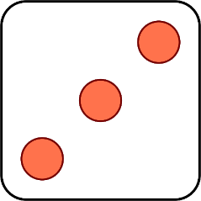
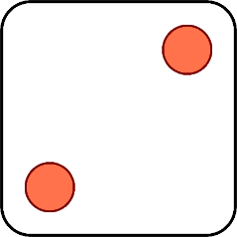


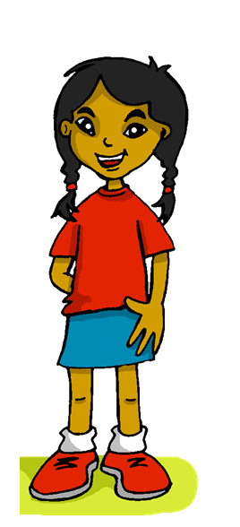
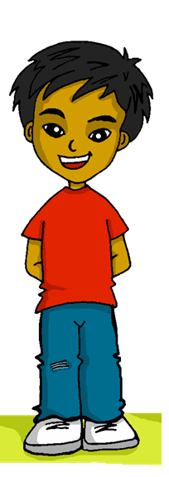
Follow up 5:
Habla en español.
Aprendo…
hablar
Responde a…
Hago…
Como
Haces…
Lee…
[información] 💡
[an] orange
[a] sandwich
[the] activity
[a] magazine
[a] message
[the] exercise
Spanish
[a] book
[the] letter
1 | S/he
2 | You
3 | I
4 | S/he
5 | You
6 | I
1 | reply
2 | eat
3 | read
4 | do / make
5 | learn
6 | do / make
Notes:
Timing: 5 minutes
Aim: to practise oral production of singular persons of 4 –ER verbs; definite and indefinite articles.
Procedure:
1. Click to ‘roll’ the dice.
2. Pupils translate the verbs and nouns whose numbers correspond to the respective dice to make a short sentence. They say the answer chorally and use one of the options from ‘información extra’ to form a logical sentence.
3. Click to reveal the correct verb phrase.
4. Repeat until all six combinations have been said.

Slide 12
¡adiós!
amarillo

Slide 13
Handout: Follow up 1
|
|
|
|
|
|
|
|
|
|
|
|
|
|
|
|
|
|
|
|
|
|
|
✂
Follow up 1:
Persona B escucha 🎧
Persona A escucha 🎧:
 | ✅❌
queso
cena
máscara
quemar
cocer
cera
esqueleto
campo
bosque
 | ✅❌
tanque
escena
chaqueta
maceta
buque
caracol
raqueta
cesta
esquema
Notes:
Pupil handout

