Slide 1
español, con Quique

Slide 2
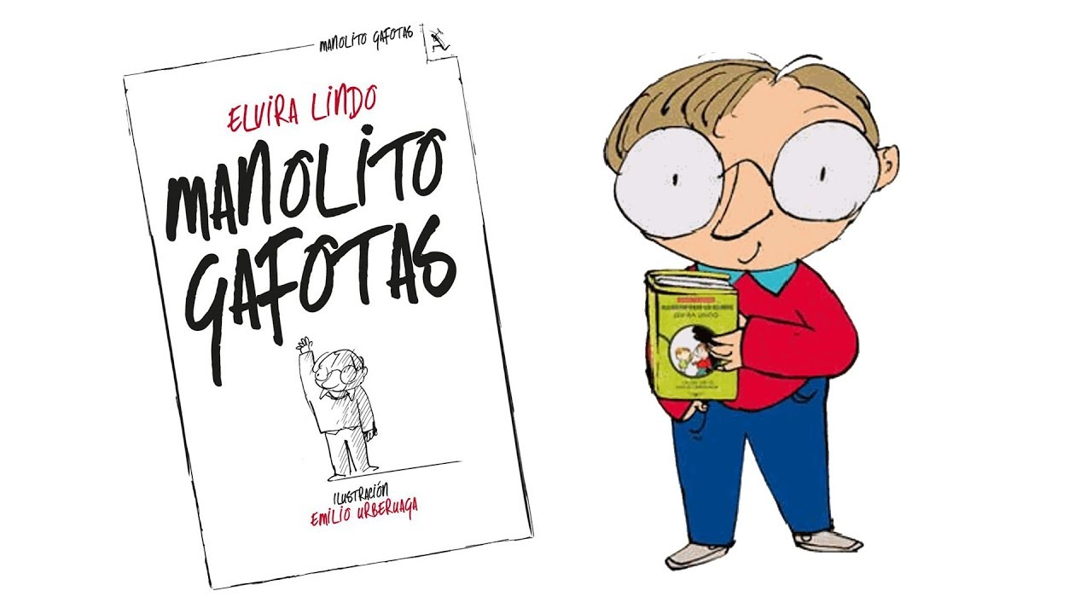
Saying what I and others do
El club de leer
amarillo
- -er verbs: I vs. s/he
- SSC [ca] [co] [cu] vs.
[ga] [go] [gu]
Notes:
Artwork by Steve Clarke. All additional pictures selected are available under a Creative Commons license, no attribution required.
Manolito Gafotas – Illustration by Emilio González Urberuaga
The frequency rankings for words that occur in this PowerPoint which have been previously introduced in the resources are given in the SOW (excel document) and in the resources that first introduced and formally re-visited those words.
For any other words that occur incidentally in this PowerPoint, frequency rankings will be provided in the notes field wherever possible.
SSC: cama [609] cosa [69] cucaracha [>5000] ganar [295] lago [2151] gusano [4217]
Vocabulary: aprender [428] leer [209] carta [627] noticia [859] revista [920] español [262] inglés [583] de² [2]
Revisit 1: visitar [792] iglesia [437] mamá [675] museo [1114] papá [865] parque [1354] plaza [806] con [14]
Revisit 2: qué [50] día [65] lunes [1370] martes [3101] miércoles [1816] jueves [1650] viernes [1259] sábado [1179] domingo [693]
Glossed words: bailar [1323] cantar [717] gemela [>5000] él [9] ¿quién? [132]
Source: Davies, M. & Davies, K. (2018). A frequency dictionary of Spanish: Core vocabulary for learners (2nd ed.). Routledge: London

Slide 3
pronunciar
[ca]
cama
[co]
contar
[cu]
cucaracha
Notes:
Timing: 1 minute
Aim: To apply SSC [a] [o] [u] in combination with [c]
Procedure:
Click to trigger [ca] and get students to repeat. Click to bring the image too.
Bring [co] and [cu] and get students to apply their understanding of [c] + [o] / [u] in combination

Slide 4
[ga]
ganar
pronunciar
[go]
lago
[gu]
gusano
Notes:
Timing: 1 minute
Aim: To revisit SSC [ga] [go] [gu]
Procedure:
To recap and elicit the pronunciation of the individual SSC [ga] [go] [gu]
Click to bring the picture & get students to repeat (with gesture, if using).
Gesture suggestion for ganar: lift your fist up in two goes.
Gesture suggestion for lago: rowing – two movements
Gesture suggestion for gusano: with index finger, lift up and down three times.

Slide 5
¿Qué significa ‘leer’?
Escucha y canta.
¿Qué significa ‘pasear’?
¡Qué divertido! translates as ‘What fun!’
hablar
¡y cantar!
to search, searching
to visit, visiting
to read, reading
to go for a walk, going for a walk
cantar
bailar
pasear
leer
bailar = to dance, dancing
cantar = to sing, singing
Notes:
Timing: 3 minutes
Aim: To revisit the concept of infinitive verbs with 3 previously introduced –ar verbs and introduce 1 –er verb (leer).
Procedure:
Play the video once so pupils familiarise with the tune. (Click in the middle to trigger the audio).
Click to bring up speech bubble to clarify meaning.
Before encouraging pupils to sing along, elicit pronunciation of the key four verbs in the song (cantar, bailar, pasear, leer). Cantar and bailar are unknown so they are glossed, pasear is revisited from week 3 and meaning of leer is established in the video.
Click to play the video (do as many times as it feels appropriate for your classes).
Click to bring up possible translations for ‘pasear’ first and then ‘leer’ and elicit meaning from pupils.
Frequency of unknown words:
bailar [1323] cantar [717]
Song by Primaria Bolivia.
https://www.youtube.com/watch?v=Y1PgZSSwFJc&ab_channel=PrimariaBolivia

Slide 6
vocabulario
¿Qué es en inglés?
¡Excelente!
3. la noticia
8. leer
5. inglés
6. de
1. el libro
10. aprender
9. un instrumento
2. una revista
4. una carta
7. español
book
English
to learn, learning
a magazine
a letter
news
of, about
to read, reading
Spanish
an instrument
Notes:
Timing: 5 minutes Aim: to practise written comprehension and spoken pronunciation of vocabulary.
Procedure: 1. Students write 1-10 in books.
2. Ask students to say the Spanish word and write down the English translation before the word has faded away (5 sec per word)
3. Click for English translation to be highlighted. 4. Repeat for all 11 items.
5. Check answers by eliciting the Spanish from students, (i.e. so that they are translating back from their written English into spoken Spanish).
Note: Students have not yet done numbers but will be taught them explicitly in Week 7. However, in the next few weeks, certain activities will prime for them. Here the teacher can say the number when eliciting the answers, but support understanding by holding up the appropriate number of fingers each time. Obviously, the items proceed in number order in any case, so the finger gesture is more to draw learners attention to the sound – meaning connection of the number with the Spanish word for that number.

Slide 7
Knowing who does what
⚠ We don’t need pronouns because the verb ending tells us who is doing the action.
[–er verbs: ‘I’ versus ‘s/he, it’]
Some Spanish infinitives end in –er
We know to mean ‘I’ & ‘s/he, it’ with a verb, the verb ending changes.
To mean ‘I’ with a verb, we remove –er and add -o.
To mean ‘s/he, it’ with a verb, we remove –ar and add –e.
Ejemplo: aprender
I
s/he, it
Aprendo español en clase.
Aprende español en clase.
I learn Spanish in class.
S/he learns Spanish in class.
Notes:
Timing: 3 minutes
Aim: to introduce 1st person singular for –er verbs, building on the concept of the infinitive.
Procedure:
Click through the animations to present the new information.
Elicit English translations for the Spanish examples provided.

Slide 8
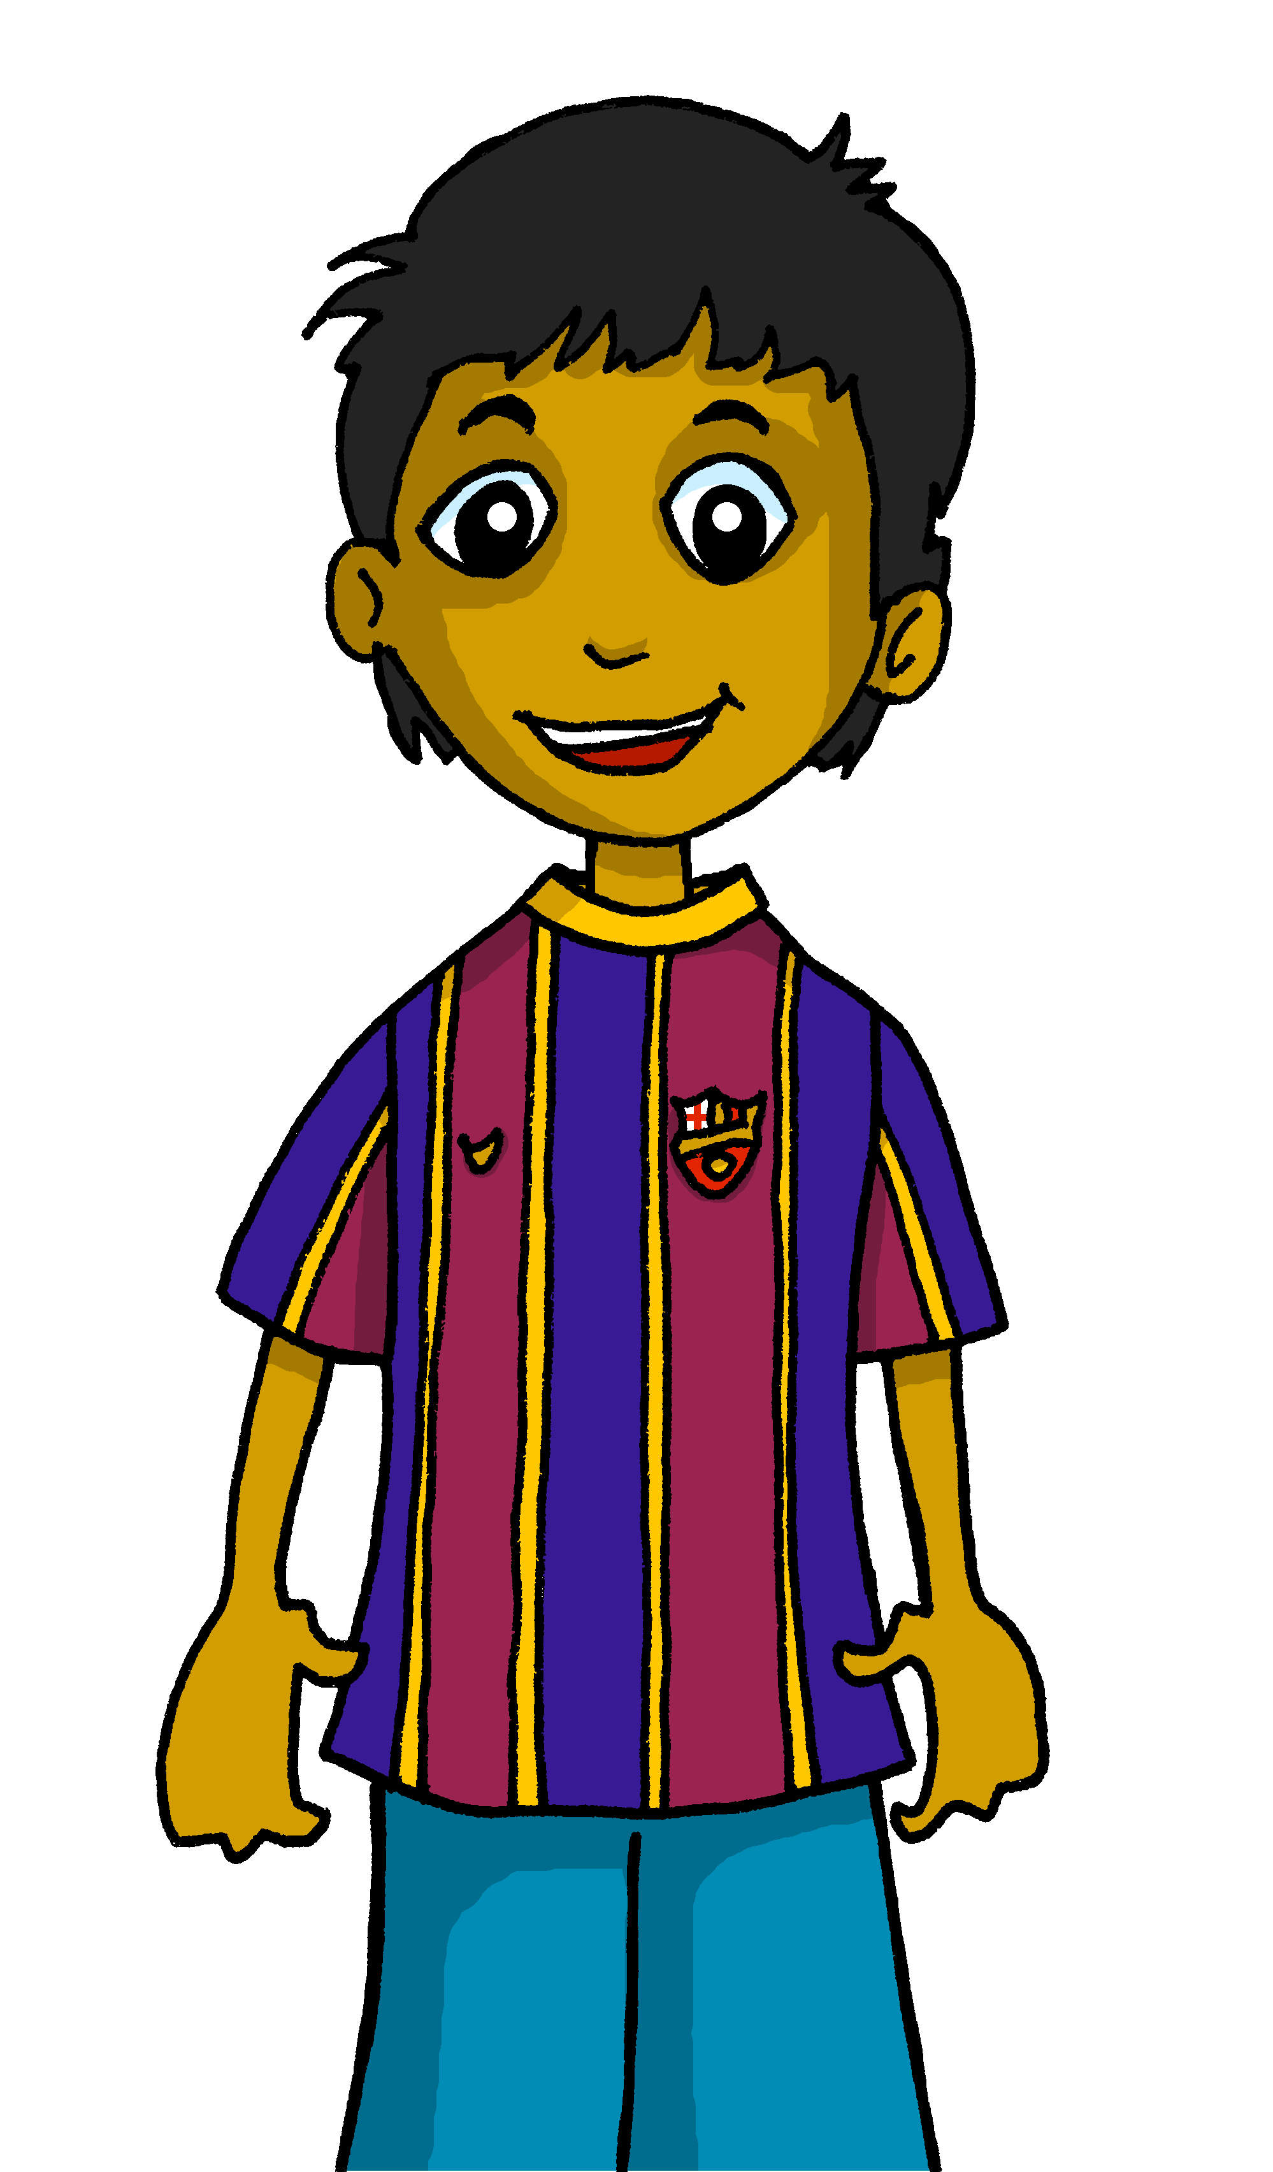
escuchar
En el club de leer
Quique habla de él* y Rubén.
¿Quién es? Marca ✅
¿Qué es?
¿Quién? = Who?
él = he/him
 | Quique (I) | Rubén (he)
Información extra
a book | a magazine
information about… England | Spain
in Spanish | English
a letter | a book
information about… England | Spain
an interesting book | piece of news
E
1
2
3
4
5
Notes:
Timing: 7 minutes
Aim: to practise aural recognition of 1st and 3rd person of –er verbs (singular)
Procedure:
Read the title and click to bring up the instructions in Spanish. Pupils need to identify to which person each statement refers to (I / HE)
Do the example (E).
Click to bring up the answers.
Pupils to listen out to understand more information form each sentences. Pupils can either write 1A/B.C, etc.. or if they have the print out they can put a X in the correct box. Some pupils can also write the word in English.
Click to bring up answers (tick and English words) and get pupils check their answers.
Transcript:
[E] Leo una revista.
Aprende información de España.
Leo en inglés.
Lee una carta
Aprendo información de Inglaterra.
Leo una noticia interesante.
Glossed words: él [9] ¿quién? [132]

Slide 9
Personal ‘a’
In Spanish, after verbs such as ‘visitar’ [to visit, visiting], we need to use ‘a’ if what we see or visit is a person or a pet.
This does not happen in English!
Compara
place or object
person or animal
Visito el museo.
Visito a un amigo.
I visit the museum.
I visit a friend.
Notes:
Timing: 2 minutes
Aim: to introduce the notion of personal ‘a’ with two key infinitive verbs.
Procedure:
Read the grammar explanation on gender in Spanish.
Click to bring up examples of singular masculine and feminine nouns.

Slide 10
leer
¡Mi gemela* es diferente!
la gemela = female twin mi = my | él = he/him
¿Quién? = Who?
Quique habla de él* y Sofía.
¿Quién* es? Marca ✅
¿Necesita ‘a’o no?
 | Sofía (she) | Quique (I)
E. Aprende una palabra.
E
1. Busco a mi profesora.
1
2. Lee una carta en inglés.
3. Leo información de un
país interesante.
2
3
4. Aprendo con una revista.
5. Visito a papá en la oficina.
4
la oficina = office
5
Notes:
Timing: 10 minutes (2 slides)
Aim: to practise written comprehension of t 1st & 3rd person singular verb endings with the 2 –er verbs introduced, and 2 more –ar verbs; personal ‘a’
NB. –AR verbs on this task are only used in the 1st first singular
Procedure:
Read the title & click to explain the context of the task. In part 1 of this task, pupils aim to identify the correct person of the verb (I/she).
Do [E] with them. Draw their attention to the verb and the ending (Aprende). Is it Quique talking about himself or is she talking about something Sofía does?
Click to bring up the answer.
Pupils to complete 1-5.
Click through the animations to bring up answers.
NB: This is a reading task, but audio is provided to assist the teacher, if needed.
NNB: Please note – meaning is checked in the next slide.
Part 2 [translation task – next slide]
Pupils to complete the translation task.
Click through the animations to bring up answers.
Glossed words: él [9] gemela [>5000] ¿quién? [132]

Slide 11
leer
Escribe 📝 en inglés.
 | She __________ a word.
 | I _______ for my _____________.
 | He ________ a _______ in English.
 | ____ _________ information _______ an interesting country.
 | ___ ______ with ____ ______________.
 | ___ _________ ______ in the office.
E
learns
1
look
teacher (f)
2
reads
letter
3
I
read
about
4
I
a magazine
learn
5
I
dad
visit
escribe = write
Notes:
Aim: to practise written comprehension of t 1st & 3rd person singular verb endings with a range of regular –er/-ar verbs.
Procedure:
(slide 2). Read the instruction (traduce las frases al inglés).
Pupils to complete the translation task.
Click through the animations to bring up answers.
Teachers can ask further questions such as ‘How do we it’s a female teacher’?.
escribir [198]

Slide 12
¡adiós!
amarillo

