Slide 1


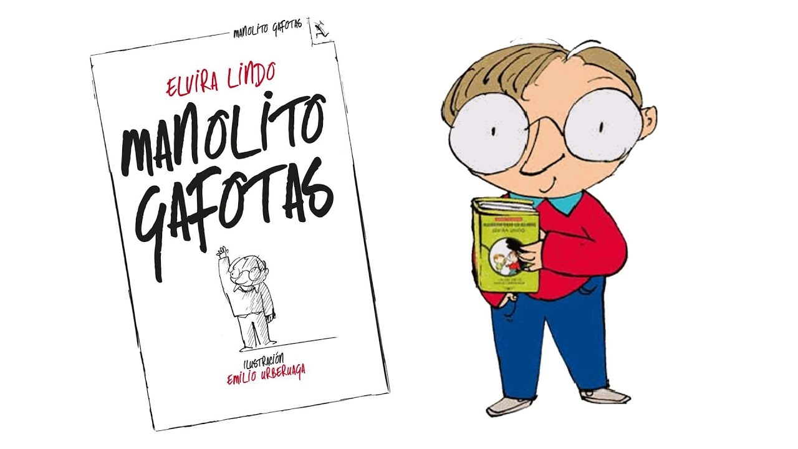
Saying what I and others do
El club de leer
amarillo
Follow ups 1-5
Notes:
Artwork by Steve Clarke. All additional pictures selected are available under a Creative Commons license, no attribution required.
Manolito Gafotas – Illustration by Emilio González Urberuaga
The frequency rankings for words that occur in this PowerPoint which have been previously introduced in the resources are given in the SOW (excel document) and in the resources that first introduced and formally re-visited those words.
For any other words that occur incidentally in this PowerPoint, frequency rankings will be provided in the notes field wherever possible.
SSC: cama [609] cosa [69] cucaracha [>5000] ganar [295] lago [2151] gusano [4217]
Vocabulary: aprender [428] leer [209] carta [627] noticia [859] revista [920] español [262] inglés [583] de² [2]
Revisit 1: visitar [792] iglesia [437] mamá [675] museo [1114] papá [865] parque [1354] plaza [806] con [14]
Revisit 2: qué [50] día [65] lunes [1370] martes [3101] miércoles [1816] jueves [1650] viernes [1259] sábado [1179] domingo [693]
Glossed words: corregir [2351] enemigo [1066] nombre [215] oro [863] personaje [595] respuesta [488] famoso [997] los [1]
Source: Davies, M. & Davies, K. (2018). A frequency dictionary of Spanish: Core vocabulary for learners (2nd ed.). Routledge: London

Slide 2


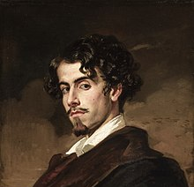

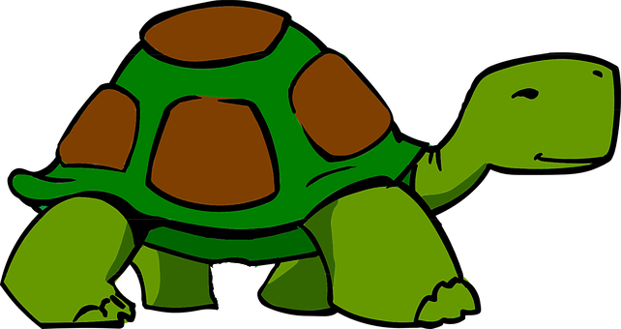

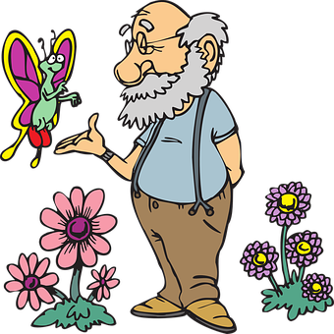




Follow up 1a
[ga][go][gu] [ca][co][cu]
[A] Escucha y escribe 📝.
pronunciar
[I do]
tortuga
Gus
hago
concha
Curro
segundo
gorro
liga
Notes:
Timing: 5 minutes
Aim: to practise transcribing[ga] [go] [gu] [ca] [co] [cu] in unknown words.
Procedure:
Read the explanation and ensure pupils understand the task.
Click to play each audio.
Pupils write down the missing letters (or the whole word, if they prefer/have time).
Elicit answers from pupils (giving them additional read aloud practice).
Click to reveal the answers.

Slide 3
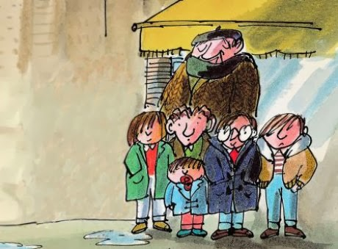
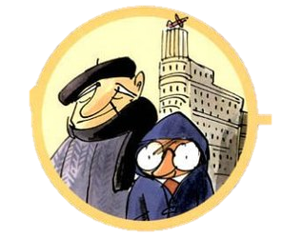


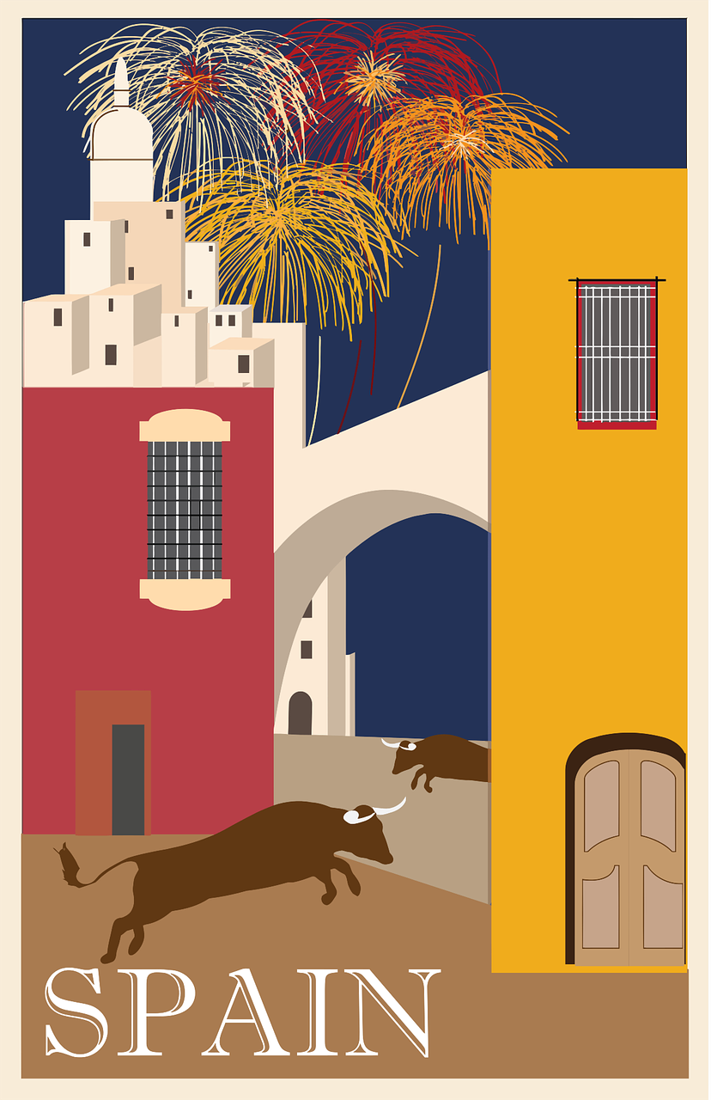

Follow up 1b/c
[ga][go][gu] [ca][co][cu]
[C] Lee los nombres.
los= the (plural, masculine)
nombre = name
enemigo = enemy
[B] Escucha y lee los nombres.
pronunciar
Susana (la amiga)
Manolito gafotas
60
segundos
Nicolás
(el abuelo)
“El Imbécil”
Catalina (la mamá)
Orejones (el amigo)
‘Manolito Gafotas’ es un libro famoso* en España.
Manolo García (el papá)
INICIO
Notes:
Timing: 3 minutes
Aim: to present a very famous book among children in Spain, ‘Manolito Gafotas’ and allow pupils to practise a range of SSC (including [ga][go][gu] [ca][co][cu])
NB. SSC [j] has not been introduced yet.
Procedure:
Read the ‘cultura’ box and clarify meaning.
Click to bring up instruction. Pupils listen and repeat chorally.
Click again to bring up the instruction for part C of the task. Pupils to work in pairs to practise reading the names of the characters aloud.
Click inicio to start the timer.
Frequency of unknown words and cognates:
enemigo [1066] nombre [215] famoso [997] los [1]

Slide 4



Follow up 2 :
Escribe en inglés 📝.
leer
una revista
español
aprender
la noticia
5
de
4
un libro
buscar
inglés
3
2
una carta
leer
1
Notes:
Timing: 5 minutes (two slides)
Aim: to practise written comprehension of vocabulary.
Procedure:
Tell pupils to be ready to write the English meanings of key vocabulary There will be 10 altogether and they should prepare to work from the bottom of the slide, left to right.
Explain the scenario – it’s raining and the raindrops will splash down and cover the words. They need to write the Spanish (but also be prepared to translate). Tell them they will have 5 seconds to get a headstart on the rain.
Click to start number animation.
Click once more to start raindrops. The timing has been carefully set! Don’t click again or all the raindrops will appear at once.
When finished move to the next slide to check answers.

Slide 5
Follow up 2 :
corregir = to correct
(la) respuesta = answer
Corrige las respuestas ✅.
leer
una revista
español
a magazine
Spanish
aprender
la noticia
de
to learn, learning
news
of, about
un libro
inglés
buscar
a book
to look for, looking for
English
una carta
leer
a letter
to read, reading
Notes:
Procedure:
Elicit responses from the bottom, left to right, from pupils.
Click to bring up a written version of the answer.
Frequency of unknown words and cognates:
respuesta [488] corregir [2351]

Slide 6





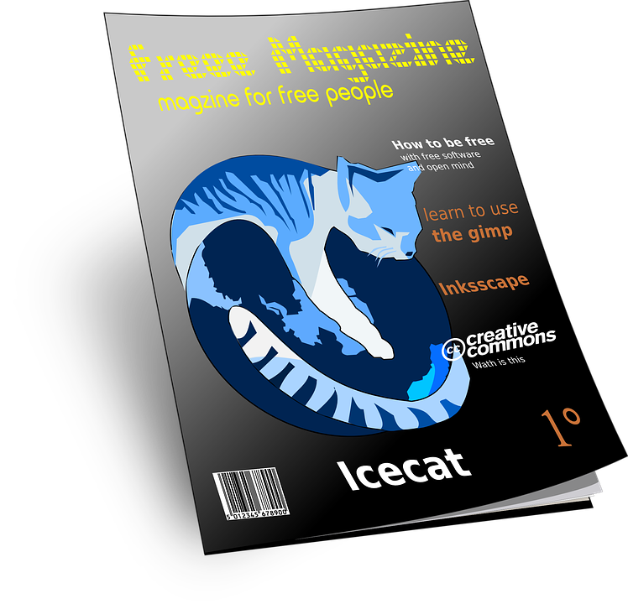
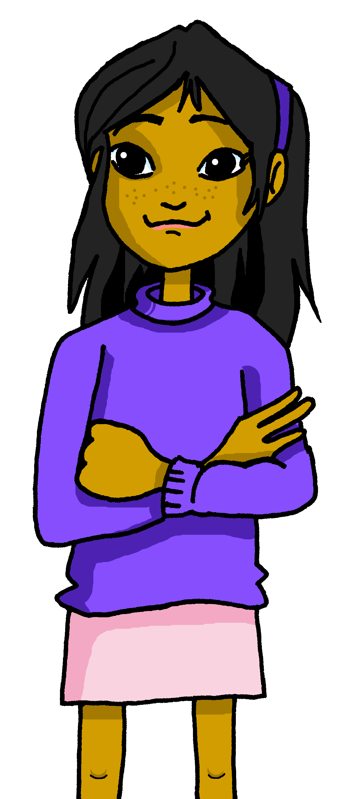
Follow up 3:
Yes/no questions
[–er verbs: ’I’ & ‘s/he, it’]
Remember! Turn a statement into a yes/no question by making
your voice go up at the end.
Leo un libro.
I read a book.
¿Leo un libro?
Do I read a book?
This works for any verb and any person (e.g., I, you, s/he).
¿Lee una revista?
Does she read a magazine?
Notes:
Timing: 10 minutes
Aim: to revisit 1st & 3rd person singular of –er verbs & raised intonation
Procedure:
1. Click to bring up each new part of the explanation.
2. Elicit the English for the Spanish examples after each animated question mark.
Source: Davies, M. & Davies, K. (2018). A frequency dictionary of Spanish: Core vocabulary for learners (2nd ed.). Routledge: London

Slide 7

Follow up 3:
B Escucha otra vez.
A Escucha. ¿Qué palabra es?
Use the correct words to
translate what you hear.
There are some extra ones!
escuchar
¿Es una pregunta? Escribe ¿? o .
E
I learn | s/he learns | I read
c | Spanish| English
 | (a piece of news| a letter| in Spanish | in English
 | with mum| with dad
 | in class | in the park
 | a book | a magazine| of | English | Spanish
 | on Monday | Tuesday | a piece of news
E
Does s/he learn
Spanish?
1
I visit | s/he reads | I read
. . . . . . . . . . . . . . . . . . . . . . . . . . . . . . . . . . . . . .
2
s/he learns | I learn | I see
1
I read
a letter
in English.
. . . . . . . . . . . . . . . . . . . . . . . . . . . . . . . . . . . . . .
3
I learn | s/he learns | s/he rides
2
S/he learns
with mum.
. . . . . . . . . . . . . . . . . . . . . . . . . . . . . . . . . . . . . ...
4
I learn | s/he reads | I see
3
Do I learn
in the park?
I read | I use | s/he uses
. . . . . . . . . . . . . . . . . . . . . . . . . . . . . . . . . . . . . .
5
4
S/he reads
a magzine
of Spanish.
In English, it’s more natural to say ‘a Spanish magazine’.
. . . . . . . . . . . . . . . . . . . . . . . . . . . . . . . . . . . . . .
E | 1 | 2 | 3 | 4 | 5
?
.
.
?
.
?
5
Do I read
a piece of news
on Tuesday?
. . . . . . . . . . . . . . . . . . . . . . . . . . . . . . . . . . . . . .
Notes:
Timing: 10 minutes
Aim: to practise aural comprehension of this week’s new vocabulary and revisiting adjectives from week 2-6. Connecting sound with meaning.
Procedure:
(Part A)
Read the instruction in Spanish & click to bring further instruction.
Do [E] with them. Click to listen. Pupils circle the correct words & write ? Or . According to whether it’s a statement or a question NB. Some puplis would benefit from working on a handout. Alternatively, they can use numbers 1,2,3.
Click for answers
(Part B)
1. Pupils listen to 1-5 and write the sentences, selecting from the options given (there are additional words that are not needed).
Click to reveal answers.
Transcript for parts A and B:
[E] ¿Aprende español?
[1] Leo una carta en inglés.
[2] Aprende con mamá.
[3] ¿Aprendo en el parque?
[4] Lee una revista de español.
[5] ¿Leo una noticia el martes?

Slide 8
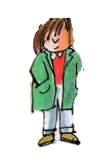

Follow up 4:
El personaje secreto
el personaje = character
Escribe el nombre de un personaje* (e.g., Nicolás).
hablar
Manolito
Susana
With your partner, ask questions to guess each other’s secret character.
learns
an instrument
reads
reads
a letter
reads
Does s/he…. read/learn?
learns
English
reads
a letter
¿Lee una carta?
¡Es Nicolás!
¡Sí!
¿Lee?
¡No!
¡Sí!
“El Imbécil”
Nicolás
reads
learns
a word
learns
English
reads
learns
an instrument
learns
English
Notes:
Time: 5 minutes
Aim: To use raised intonation and adjectival agreement in oral production to guess their partner’s characters.
Read the title in Spanish and click to bring a brief explanation of the instructions.
Tell students they are going to work in pairs. Partners take it in turns to ask yes/no questions to try to figure out the other player’s character. The partner guessing needs to use raised question intonation and the correct verb and noun to narrow down their options correctly!
Click to bring the speech bubbles to make sure students are clear about what the exchange should look like (¿Lee? / Sí / No). When the answer is ‘sí’ all those who do not have ‘read’ as an activity are eliminated (‘El Imbécil’).
Click to bring up the question ¿Lee una carta? When the answer is ‘Sí’ this eliminates Manolito and Susana are eliminated as they don’t read a letter, meaning the answer is Nicolás.
2. Teachers can model another round with the whole class (getting students to ask the questions) before getting them started in pairs.
3. Give students 30 seconds to write down 3 names.
4. The aim is to work with your partner, to identify all 3 people as quickly as possible.
NB. Print the template slide at the end of this PPT, in A5 so that students can cross out as they play.
personaje [595]

Slide 9

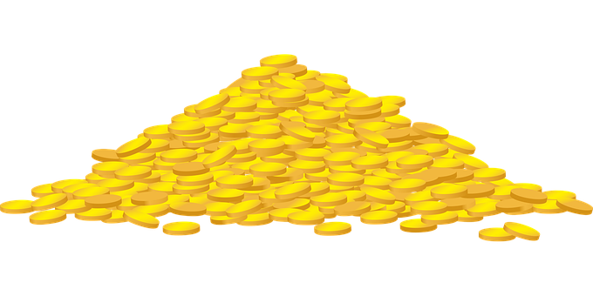










Follow 5:
¿Dónde está el oro*?
Write logical sentences to find gold and jewels!
el oro = gold
escribir
in | in | a | in* the afternoon | a | a
 |  | ¡No es posible! |  | ¡No es posible!
 |  | ¡No es posible! |  | ¡No es posible!
(f)
(f)
(m)
I read
S/he
reads
I learn
S/he
learns
= 5
= 10
Notes:
Timing: 10 minutes
Aim: to practise written production of 1st and 3rd person singular of –er verbs in sentences with indefinite article and revisited vocabulary.
Procedure:
Explain that they need find as many coins and jewels by writing correct sentences. In total there are 15 gold coins and 6 jewels to collect. Rubies are worth 5 coins and emeralds are worth 10 coins.
A pupil selects a sentence starter from the vertical axis and a noun from the horizontal axis and makes a sentence e.g. Leo en español; Leo en inglés, etc. They need to use the correct indefinite article. The genders of the nouns are given next to the pictures.
Hover over the chosen square and click to reveal what is beneath.
Repeat with different pupils selecting different squares until they have found all the gold coins and jewels. Pupils keep track of the gold/jewels they collect.
NB. They lose one coin if they get ‘no es posible’. This is because it’s not a logical sentence.
Leo en español.
Leo en inglés.
Leo una noticia.
Leo por la tarde.
Leo una revista.
Leo un libro.
---
Lee en español.
Lee en inglés.
Lee una noticia.
Lee por la tarde.
Lee una revista.
Lee un libro.
---
Aprendo en español.
Aprendo en inglés.
Aprendo una noticia. [x]
Aprendo por la tarde.
Aprendo una revista. [x]
Aprendo un libro.
---
Aprende en español.
Aprende en inglés.
Aprende una noticia. [x]
Aprende por la tarde.
Aprende una revista. [x]
Aprende un libro.
oro [863]

Slide 10




Follow up [extra]:
Escribe en inglés: Can you get at least 15 points?
 | el día | sábado | domingo
 | ¿qué? | miércoles | jueves
 | la plaza | con | viernes
 | visitar | la iglesia | el museo
 | de | la noticia | inglés
 | la revista | el libro | español
 | aprender | leer | la carta
vocabulario
(the) day
Saturday
vocabulario
Sunday
x3
What?
Wednesday
Thursday
(the) square
with
Friday
x2
to visit, visiting
(the) church
(the) museum
of, about
news
English
(the) magazine
(the) book
Spanish
x1
to learn, learning
to read, reading
(the) letter
Notes:
Timing: 6 minutes
Aim: to practise written comprehension of vocabulary for this week and previous weeks.
Procedure:
1. Pupils need to write the English for as many words as possible, aiming to get at least 15 points (but more if possible).
2. Click for Spanish answers.

Slide 11
Follow up:
Escribe en español: Can you get at least 15 points?
 | Saturday | (the) day | Wednesday
 | Thursday | Sunday | What?
 | Friday | to visit, visiting | with
 | (the) museum | (the) square | (the) church
 | (the) magazine | (the) book | (the) news
 | English | to learn, learning | to read, reading
 | Spanish | (the) letter | of, about
sábado
el día
miércoles
vocabulario
vocabulario
x3
¿Qué?
jueves
domingo
viernes
visitar
con
x2
el museo
la plaza
la iglesia
la revista
el libro
la noticia
inglés
aprender
leer
x1
español
la carta
de
Notes:
Timing: 6 minutes
Aim: to practise written production of vocabulary for this week and previous weeks.
Procedure:
1. Pupils need to write the Spanish for as many words as possible, aiming to get at least 15 points (but more if possible).
2. Click for Spanish answers.

Slide 12
¡adiós!
amarillo

Slide 13
Handout
Follow up 4
¿Does s/he…?
Nicolás
Manolito
(learns English)
Tuesday
(reads a magazine)
Monday
¡Sí! / ¡No!
Susana
Manolo
(reads a news item)
Wednesday
(reads a book)
Sunday
Orejones (el amigo)
‘El Imbecil’
(visits a museum)
Tuesday
(learns Spanish)
Monday
Catalina
(visits the church)
Wednesday
Notes:
Master slide for guess who game. Print the template slide in A5 so that students can cross out as they play.

Slide 14
Handout - Follow up [extra]:
Follow up [extra]:
Escribe en inglés: Can you get at least 15 points?
 | día | sábado | domingo
 | qué | miércoles | jueves
 | la plaza | con | viernes
 | visitar | la iglesia | el museo
 | de | la noticia | inglés
 | la revista | el libro | español
 | aprender | leer | la carta
vocabulario
vocabulario
x3
x2
x1
Notes:
Timing: 6 minutes
Aim: to practise written comprehension of vocabulary for this week and previous weeks.
Procedure:
1. Pupils need to write the English for as many words as possible, aiming to get at least 15 points (but more if possible).
2. Click for Spanish answers.

Slide 15
Handout - Follow up [extra]:
Follow up [extra]:
Escribe en inglés: Can you get at least 15 points?
 | Saturday | day | Wednesday
 | Thursday | Sunday | What?
 | Thursday | to visit, visiting | with
 | museum | square | church
 | magazine | book | news
 | English | to learn, learning | to read, reading
 | Spanish | letter | of
vocabulario
x3
x2
x1
Notes:
Timing: 6 minutes
Aim: to practise written production of vocabulary for this week and previous weeks.
Procedure:
1. Pupils need to write the Spanish for as many words as possible, aiming to get at least 15 points (but more if possible).
2. Click for Spanish answers.

