Slide 1
Saying what I and others do
Por la tarde
amarillo
pm
Follow ups 1-5
Notes:
Artwork by Steve Clarke. All additional pictures selected are available under a Creative Commons license, no attribution required.
The frequency rankings for words that occur in this PowerPoint which have been previously introduced in the resources are given in the SOW (excel document) and in the resources that first introduced and formally re-visited those words.
For any other words that occur incidentally in this PowerPoint, frequency rankings will be provided in the notes field wherever possible.
SSC: ganar [295] lago [2151] gusano [4217]
Vocabulary: descansar [1749] campo [342] habitación [1069] tarde [392] por² [15]
Revisit 1: buscar [179] crear [239] presentar [235] pronunciar [1990] usar [317] información [326] país [109] importante [171] divertido [2465] interesante [616]
Revisit 2: eres [7] (recycle adjectives) de1 [2] Inglaterra [n/a] España [n/a] Perú [n/a]
Glossed words:
colorear [>5000] hacer [26] referirse [553] abuela [783] hasta [60] luego [150] bonita [891]
Source: Davies, M. & Davies, K. (2018). A frequency dictionary of Spanish: Core vocabulary for learners (2nd ed.). Routledge: London

Slide 2
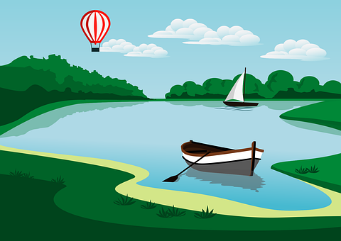
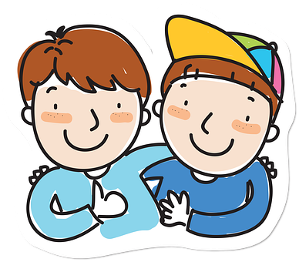
Follow up 1
[ga] [go] [gu]
Escucha y completa la rima.
lo = it
su = his/her
el bigote – whiskers
alargado - long
Mi [1] _ _ to [2] _ _ s odia el [3] fue _ _
el [4] domin_ _ y el [5] la_ _.
Tiene un [6] ami_ _ [7] _ _ sano
y [8] _ _s lo* tiene
en su* [9] bi_ _te* [10] alar_ _do
😠
ga
Gu
go
Sun
45 segundos
go
go
go
gu
Gu
go
ga
B Practica el poema con tu pareja.
INICIO
Notes:
Timing: 5 minutes
Aim: to develop phonological awareness of [ga] [go] [gu]
Procedure:
Part A
Pupils write 1 – 7.
Either click to hear each line of the poem individually OR play the slower version of the whole poem (green play icon – bottom right).
Click to correct answers – pictures appear to clarify meaning.
Listen to the poem spoken a little faster (blue play button – bottom right).
Part B
Procedure:
1. Click on ‘inicio’ to start the timer.
2. Pupils work in pairs to recite the poem.
Transcript Mi gato Gus odia el fuego
el domingo y el lago.
Tiene un amigo gusano
y Gus lo tiene
en su bigote alargado.
NB. All bold words in Part A are unknown to pupils (pictures are provided to clarify meaning).
Frequency of unknown words and/or cognates:
odiar [2211] amigo [210] bigote [3716] fuego [884] gusano [4217] lago [2151] alargado [>5000] su [12] lo [10]
Source: Davies, M. & Davies, K. (2018). A frequency dictionary of Spanish: Core vocabulary for learners (2nd ed.). Routledge: London

Slide 3
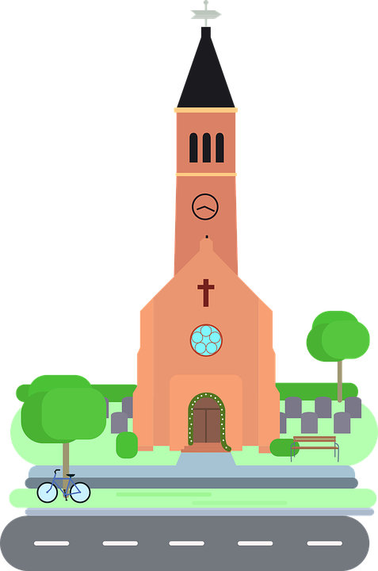
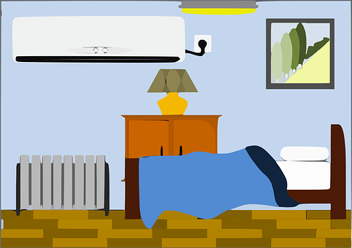
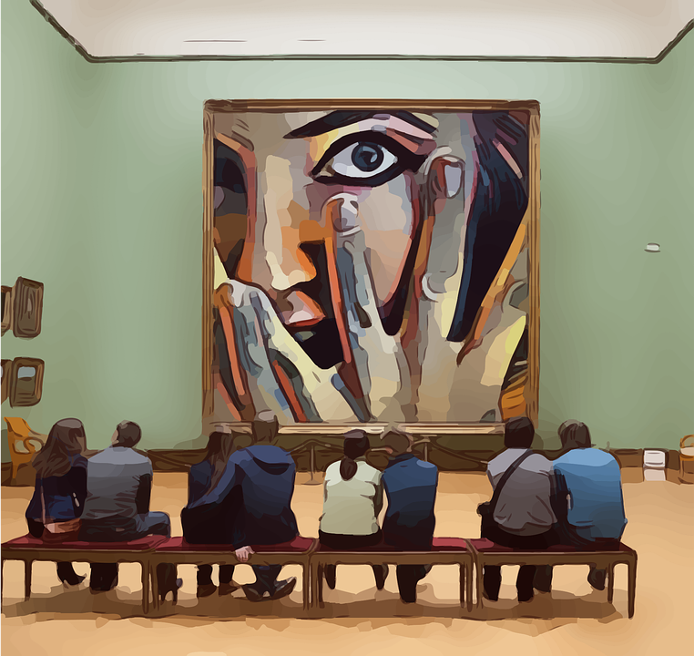
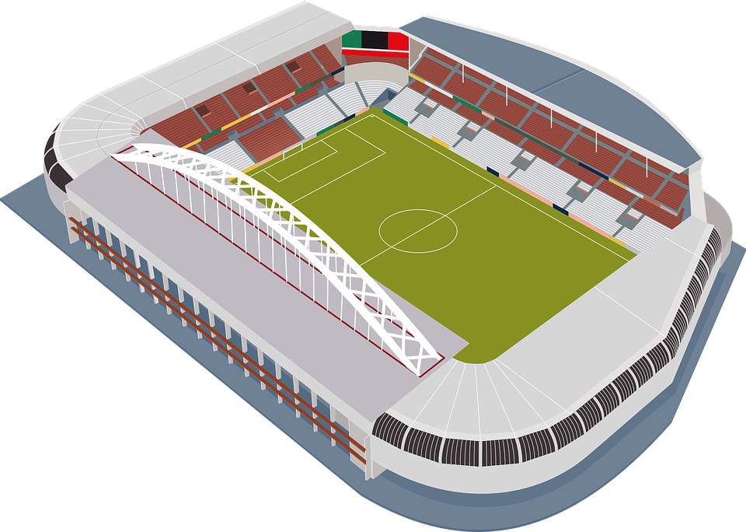
Follow up 2
Escucha y lee. ¿Es ‘el’ o ‘la’ ‘un’ o ‘una’?
- - -
escuchar
vocabulario
[el]
[un]
- - -[ ]- - -
pm
__ lápiz a pencil
__ mensaje a message
__ museo a museum
__ estadio the stadium
__ tarde
the afternoon
__ habitación
the room
__ plaza the square
__ ciudad a city
__ iglesia a church
__ país a country
__ campo
the countryside
[la]
[una]
- - -
Notes:
Timing: 5 minutes
Aim: to practise aural distinction between definite and indefinite article; to revisit new vocabulary in sound and writing, and with English meanings.
Procedure:
Click for each word to appear with audio (without article).
Pupils say ‘el’, ‘la’, ‘un’, ‘una’, depending on the noun’s gender.
Click again for it to disappear into the corresponding pacperson’s mouth.
Transcript un museo
el estadio
la tarde
un país
una ciudad
el campo
la plaza
un lápiz
una iglesia
la habitación
un mensaje

Slide 4
Follow up 3:
Knowing who does what
⚠ We don’t need pronouns because the verb ending tells us who is doing the action.
[–ar verbs: ‘I’, ‘you’, ‘s/he, it’]
In Spanish, the words for ‘I’ and ‘s/he’ (pronouns) are often unnecessary.
To mean ‘I’ with a verb, we remove –ar and add -o.
Paseo.
I (go for a) walk.
To mean ‘you’ with a verb, we remove –ar and add –as.
Paseas.
You (go for a) walk.
To mean ‘s/he, it’ with a verb, we remove –ar and add –a.
Pasea.
S/he (goes for a) walk.
Notes:
Timing: 2 minutes
Aim: to revisit 1st, 2nd & 3rd person singular of –ar verbs.
Procedure:
Click through the animations to present the new information.
Elicit English translations for the Spanish examples provided.

Slide 5
Follow up 3:
colorea = colour in
Lee ¿Qué persona es?
leer
Colorea*.
usa
rojo (I)
amarillo (you)
azul (s/he).
usa
usas
usas
pasea
pasea
visito
visito
visitas
visitas
presenta
presenta
busco
busco
descanso
descanso
monta
monta
Notes:
Timing: 10 minutes (4+6)
Aim: To aid comprehension of 1st, 2nd and 3rd person singular.
Pupils write 1 – 5 and complete the tasks.
Click each individual bubble (not the verb inside, the blue surrounding) to bring up answers.
Note – if pupils don’t have colours they can simply create 3 x categories shapes/columns, label them and write the words into them.
colorear [>5000]

Slide 6
Follow up 3:
hacen = they do
Quique y Sofía hacen* actividades por la tarde.
leer
¿Quién es? Marca ✅
Quique (I) | Sofía (she)
E
¿Qué?
parque plaza
museo iglesia
mensaje palabra
bolsa instrumento
iglesia campo
tarde estadio
Pasea por la plaza.
1
Visita el museo.
2
Busco una palabra nueva.
3
Uso un instrumento divertido.
4
Monta en bicicleta por el campo.
5
Descanso por la tarde.
Notes:
Timing: 10 minutes (4+6)
Aim: To practise written comprehension of 1st and 3rd person singular and connect these to their meaning; to identify nouns from the indefinite articles; to understand new and previously taught nouns and adjectives.
Part 1
Procedure:
Read the scenario with pupils. They should understand that Quique is writing about what Sofía and he do in the afternoon. He has smudged some of his writing, though. Can they still work out who does what?
Do the first one with pupils. They work out ‘quién’ by looking at the verb ending (o / a), they work out ‘qué’ by looking at the article,. Click to work through the task in small steps, highlighting in pink the relevant parts of the sentence.
Pupils write 1 – 5 and complete the tasks.
Click to correct.
Click the blue buttons to hear the sentences. This can be used as a ‘listen and check’.
Transcript: Pasea por la plaza.
Visita el museo.
Busco una palabra nueva.
Uso un instrumento divertido.
Monta en bicicleta por el campo.
Descanso por la tarde.
Frequency of unknown words and cognates:
hacer [26]

Slide 7
Follow up 3:
As part of his English homework, Quique has tried to translate his list into English but he’s made some mistakes. Can you help him?
The verb ending also changes in English ☺.
leer
E
Pasea por la plaza.
E | You go for a walk around a city .
1 | She looks for the stadium .
2 | She looks for the new word.
3 | I create an important instrument .
4 | I ride her bike in the bedroom.
5 | She goes for walk in an afternoon.
She
goes
the
square.
1
Visita el museo.
visits
museum
2
Busco una palabra nueva.
I look for
a
3
Uso un instrumento divertido.
use
a fun
4
Monta en bicicleta por el campo.
She rides
countryside.
5
Descanso por la tarde.
I relax
the
Notes:
Timing: 4 minutes
Aim: To practise written comprehension of 1st and 3rd person singular and connect these to their meaning; to identify nouns from the indefinite articles; to understand new and previously taught nouns and adjectives.
Part 2
Procedure:
Read the scenario with pupils.
Do the first one with pupils.
Pupils write 1 – 5 and complete the tasks.
Click to correct.

Slide 8
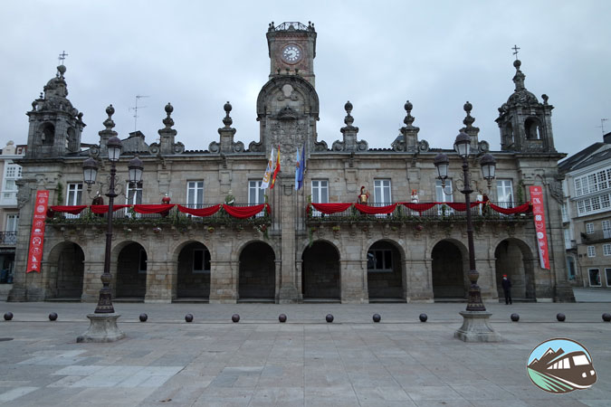
Follow up 4:
Quique está en una plaza muy importante de Lugo: La ‘Plaza España’ o ‘Plaza Mayor’.
leer
‘Plaza Mayor’ is the main square in many towns and cities in Spain. In Latin America, the main square is ‘Plaza de Armas’.
Notes:
Timing: 1 minute
Aim: to locate the photo used in the stimulus for the speaking task.
Text translation: Quique is in a very important square in Lugo.

Slide 9
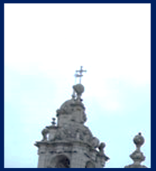
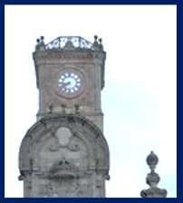
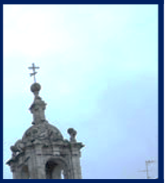
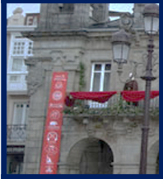
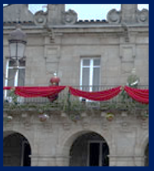
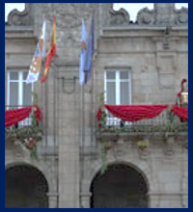
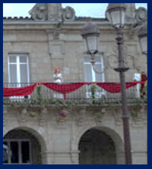
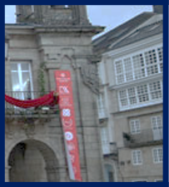
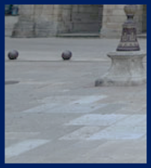
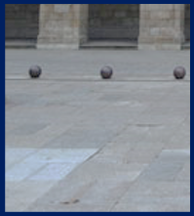
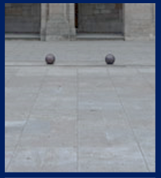
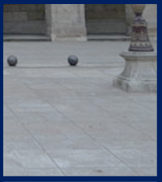
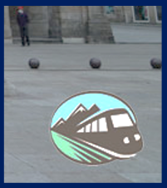
Follow up 4:
¿Dónde está Quique? [1/5]
hablar
to go for a walk
to look for
to ride
to visit
to relax
I
You
s/he
Notes:
Timing: 5 minutes
Aim: to correctly use 1^{st,} 2nd and 3rd person singular verbs in oral production.
Procedure:
Pupils select a verb form on the vertical axis with an adjective along the horizontal axis.
They translate the short sentence (e.g. I – to walk = Camino) to identify the square where they think Sofía is.
Click on the square to reveal what is beneath.
Note: pupils might benefit from revisiting the infinitive verbs again before starting the activity. (i.e., caminar, cantar, nadar, comprar, escuchar).
(!) Quique is hidden behind….
Buscas

Slide 10
Follow up 4:
¿Dónde está Quique? [2/5]
hablar
to go for a walk
to look for
to ride
to visit
to relax
I
You
s/he
Notes:
Timing: 5 minutes
Aim: to correctly use 1^{st,} 2nd and 3rd person singular verbs in oral production.
Procedure:
Pupils select a verb form on the vertical axis with an adjective along the horizontal axis.
They translate the short sentence (e.g. I – to walk = Camino) to identify the square where they think Sofía is.
Click on the square to reveal what is beneath.
Note: pupils might benefit from revisiting the infinitive verbs again before starting the activity. (i.e., caminar, cantar, nadar, comprar, escuchar).
(!) Quique is hidden behind….
Montas

Slide 11
Follow up 4:
¿Dónde está Quique? [3/5]
hablar
to go for a walk
to look for
to ride
to visit
to relax
I
You
s/he
Notes:
Timing: 5 minutes
Aim: to correctly use 1^{st,} 2nd and 3rd person singular verbs in oral production.
Procedure:
Pupils select a verb form on the vertical axis with an adjective along the horizontal axis.
They translate the short sentence (e.g. I – to walk = Camino) to identify the square where they think Sofía is.
Click on the square to reveal what is beneath.
Note: pupils might benefit from revisiting the infinitive verbs again before starting the activity. (i.e., caminar, cantar, nadar, comprar, escuchar).
(!) Quique is hidden behind….
Paseo

Slide 12
Follow up 4:
¿Dónde está Quique? [4/5]
hablar
to go for a walk
to look for
to ride
to visit
to relax
I
You
s/he
Notes:
Timing: 5 minutes
Aim: to correctly use 1^{st,} 2nd and 3rd person singular verbs in oral production.
Procedure:
Pupils select a verb form on the vertical axis with an adjective along the horizontal axis.
They translate the short sentence (e.g. I – to walk = Camino) to identify the square where they think Sofía is.
Click on the square to reveal what is beneath.
Note: pupils might benefit from revisiting the infinitive verbs again before starting the activity. (i.e., caminar, cantar, nadar, comprar, escuchar).
(!) Quique is hidden behind….
Pasea

Slide 13
Follow up 4:
¿Dónde está Quique? [5/5]
hablar
to go for a walk
to look for
to ride
to visit
to relax
I
You
s/he
Notes:
Timing: 5 minutes
Aim: to correctly use 1^{st,} 2nd and 3rd person singular verbs in oral production.
Procedure:
Pupils select a verb form on the vertical axis with an adjective along the horizontal axis.
They translate the short sentence (e.g. I – to walk = Camino) to identify the square where they think Sofía is.
Click on the square to reveal what is beneath.
Note: pupils might benefit from revisiting the infinitive verbs again before starting the activity. (i.e., caminar, cantar, nadar, comprar, escuchar).
(!) Quique is hidden behind….
Visita

Slide 14
Follow up 5:
(la) abuela = grandma
hasta luego = until then (see you later)
bonita = pretty
B Traduce la postal.
Lee y escribir
¡[Hello] abuela*!
¡Hola Ángela!
[I am] en [the countryside] con Quique [and] estoy muy [happy].
[In] [the afternoon], [I ride] [my bicycle] and Quique [relaxes] en [the bed]. Mi madre [visits] [the museum] [with] mi [father]. Mi familia es muy [important]. También [I go for a walk] [around] [the square] de Lugo. [It is] bonita*. [Do you go for a walk] en Lima? Hasta luego* 👋,
Ángela Flores García
Quique
Notes:
Timing: 8 minutes
Aim: to correctly use a range of present tense verb forms and key vocabulary from this week.
Procedure:
Pupils could number 1-16 for the gaps and translate each [prompt] into Spanish.
Go to the next slide to check answers and listen to a recording of the text.
abuela [783] hasta [60] luego [150] bonita [891]

Slide 15
Follow up 4:
(la) abuela = grandma
hasta luego = see you later
bonita = pretty
B Escribe la postal en español.
Lee y escribir
¡Hola abuela!
¡[Hello] abuela*!
¡Hola Ángela!
Estoy en el campo con Quique
[I am] en [the countryside] con Quique
y estoy muy contenta.
[and] estoy muy [happy].
[In] [the afternoon], [I ride] [my bicycle]
Por la tarde, monto en bici
Ángela Flores García
and Quique [relaxes] en [the bed].
y Quique descansa en la cama.
Mi madre visita
Mi madre [visits]
Mi familia es muy [important].
el museo con mi padre.
[the museum] [with] mi [father].
Mi familia es muy importante.
También paseo por la plaza de Lugo.
También [I go for a walk] [around] [the square] de Lugo.
[It is] pretty.
[Do you go for a walk] en Lima?
Es bonita.
¿Paseas por Lima?
Hasta luego* 👋,
Quique
Notes:
Timing: 8 minutes
Aim: to correctly usec a range of present tense verb forms and key vocabulary from this week.
Procedure:
Click to reveal answers and click the .mp3 player to listen to a recording of the text.
abuela [783] hasta [60] luego [150] bonita [891]

Slide 16
Follow up extra:
Escribe en español: Can you get at least 15 points?
 | you are (trait) | Spain | from
 | interesting (m/f) | important (m/f) | England
 | fun (m) | (the) information | (the) country
 | to create, creating | to look for, looking for | to use, using
 | countryside | around, in | to ride, riding
 | afternoon | in (with time) | the (f)
 | to relax, relaxing | room | the (m)
eres
España
de
vocabulario
x3
interesante
importante
Inglaterra
divertido
la información
el país
x2
usar
crear
buscar
el campo
por
montar
la tarde
por
la
x1
descansar
la habitación
el
Notes:
Timing: 6 minutes
Aim: to practise written production of vocabulary for this week and previous weeks.
Procedure:
1. Pupils need to write the Spanish for as many words as possible, aiming to get at least 15 points (but more if possible).
2. Click for Spanish answers.
pasar [68] visitar [792] mamá [675] mañana [402] papá [865] semana [301] tiempo [80] por² [15]
Revisit 1: cantar [717] escuchar [281] hablar [90] necesitar [276] español [262] frase [1037] inglés [583] fantástico [2501] importante [171] normal [1000]
Revisit 2: eres [7] (recycle adjectives) de1 [2] Inglaterra [n/a] España [n/a] Perú [n/a]

Slide 17
Handout: Follow up extra:
Follow up extra:
Escribe en español: Can you get at least 15 points?
 | you are (trait) | Spain | from
 | interesting (m/f) | important (m/f) | England
 | fun (m) | (the) information | (the) country
 | to create, creating | to look for, looking for | to use, using
 | countryside | around, in | to ride, riding
 | afternoon | in (with time) | the (f)
 | to relax, relaxing | room | the (m)
vocabulario
x3
x2
x1
Notes:
Timing: 6 minutes
Aim: to practise written production of vocabulary for this week and previous weeks.
Procedure:
1. Pupils need to write the Spanish for as many words as possible, aiming to get at least 15 points (but more if possible).
2. Click for Spanish answers.
pasar [68] visitar [792] mamá [675] mañana [402] papá [865] semana [301] tiempo [80] por² [15]
Revisit 1: cantar [717] escuchar [281] hablar [90] necesitar [276] español [262] frase [1037] inglés [583] fantástico [2501] importante [171] normal [1000]
Revisit 2: eres [7] (recycle adjectives) de1 [2] Inglaterra [n/a] España [n/a] Perú [n/a]

