Slide 1


español, con Quique

Slide 2

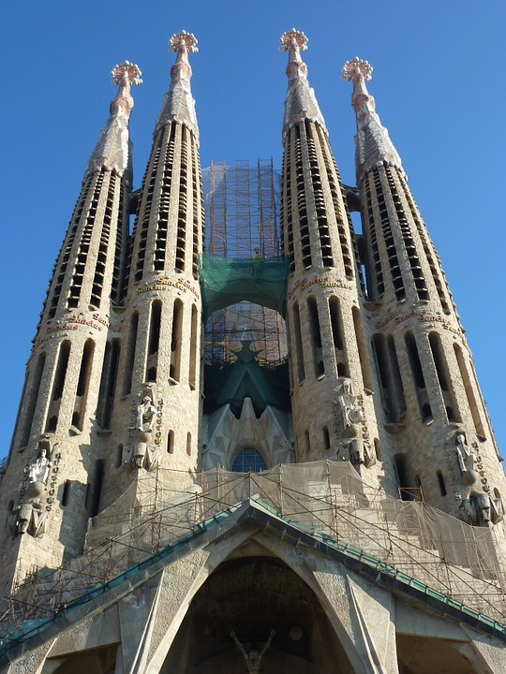
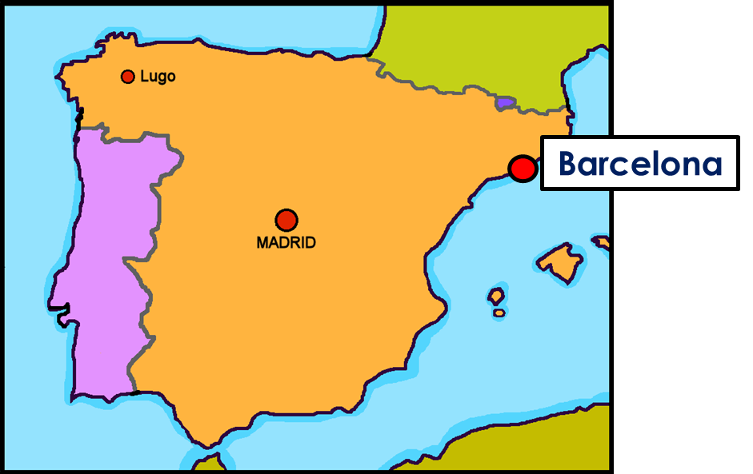


Saying what I and others do
Barcelona
amarillo
- Singular definite articles: el, la
- SSC [ga] [go]
Notes:
Artwork by Steve Clarke. All additional pictures selected are available under a Creative Commons license, no attribution required.
The frequency rankings for words that occur in this PowerPoint which have been previously introduced in the resources are given in the SOW (excel document) and in the resources that first introduced and formally re-visited those words.
For any other words that occur incidentally in this PowerPoint, frequency rankings will be provided in the notes field wherever possible.
SSC: ganar [295] lago [2151]
Vocabulary: montar [1446] pasear [1741] bicicleta [3684] estadio [2581] madre [226], padre [162] ciudad [178] el [1] la [1] de² [2] por¹ [15]
Revisit 1: animal [322] cosa [69] instrumento [1042] papel [393] raro [1005] nuevo [94] viejo [225]
Revisit 2: ser [7] soy [7] es [7] siempre [96] normalmente [1696] (recycle adjectives)
Glossed words: playa [1475] hacer [26]
Source: Davies, M. & Davies, K. (2018). A frequency dictionary of Spanish: Core vocabulary for learners (2nd ed.). Routledge: London

Slide 3


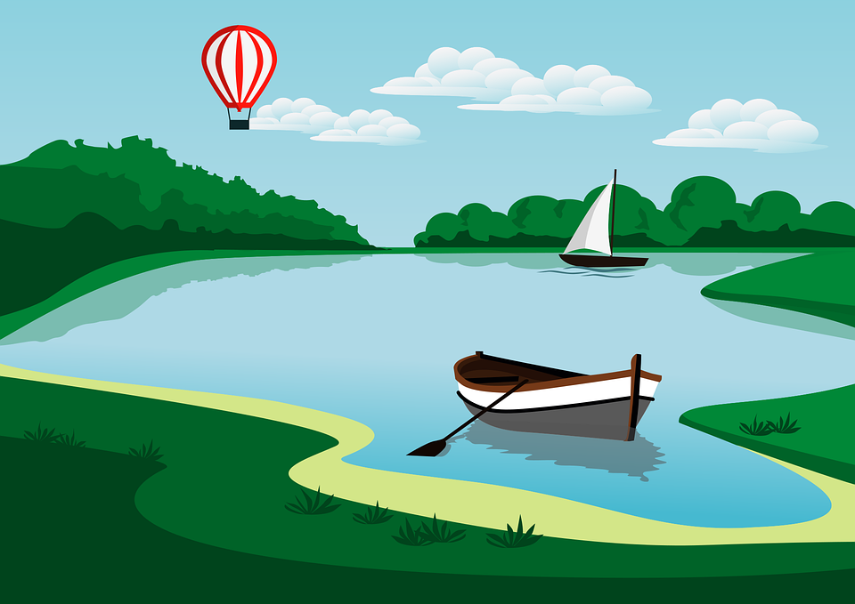
pronunciar
[ga]
ganar
[go]
lago
Notes:
Timing: 1 minute
Aim: to introduce SSC [ga] [go]
Procedure:
To recap and elicit the pronunciation of the individual SSC [ga] [go]
Click to bring the picture & get students to repeat (with gesture, if using).
Gesture suggestion for ganar: lift your fist up in two goes.
Gesture suggestion for lago: rowing – two movements

Slide 4




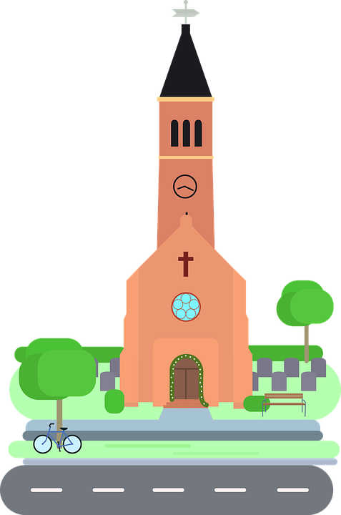
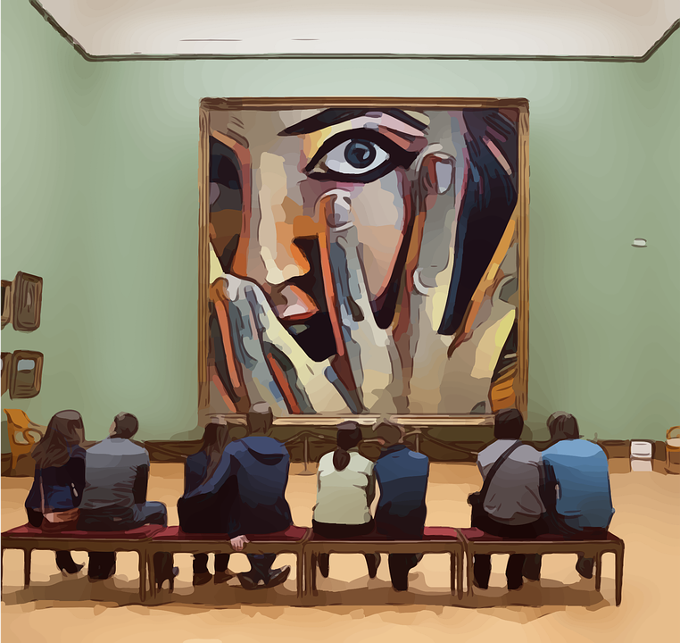
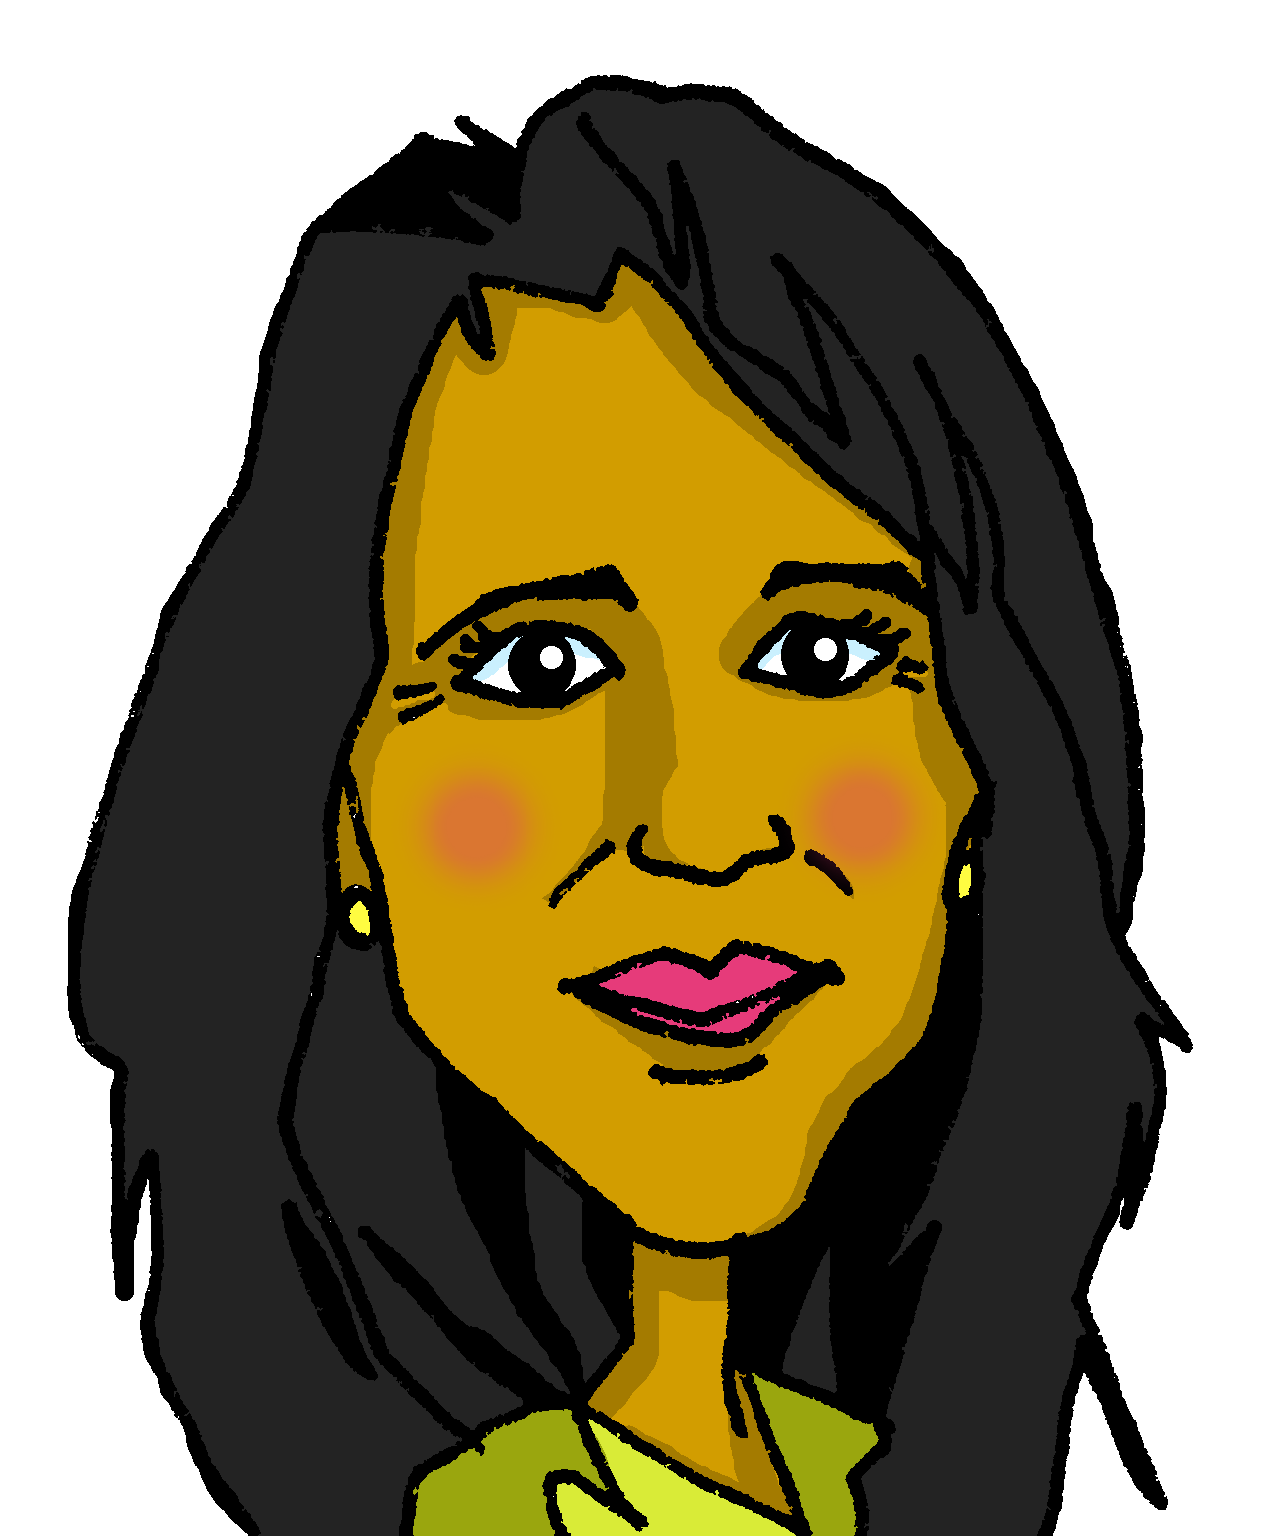
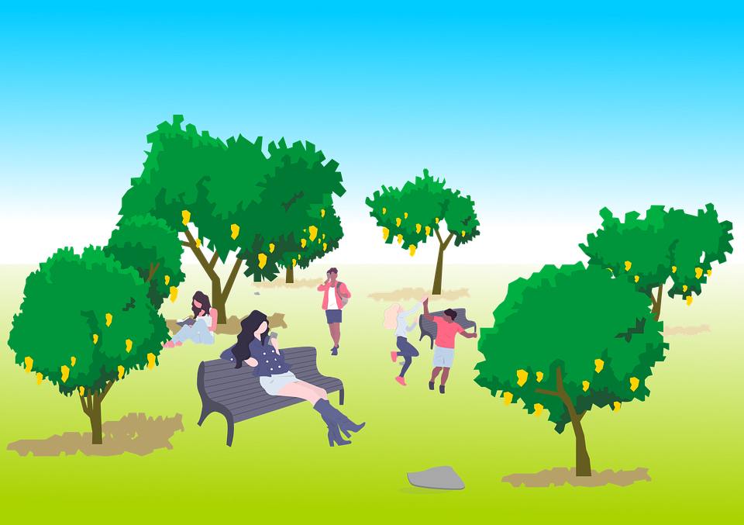

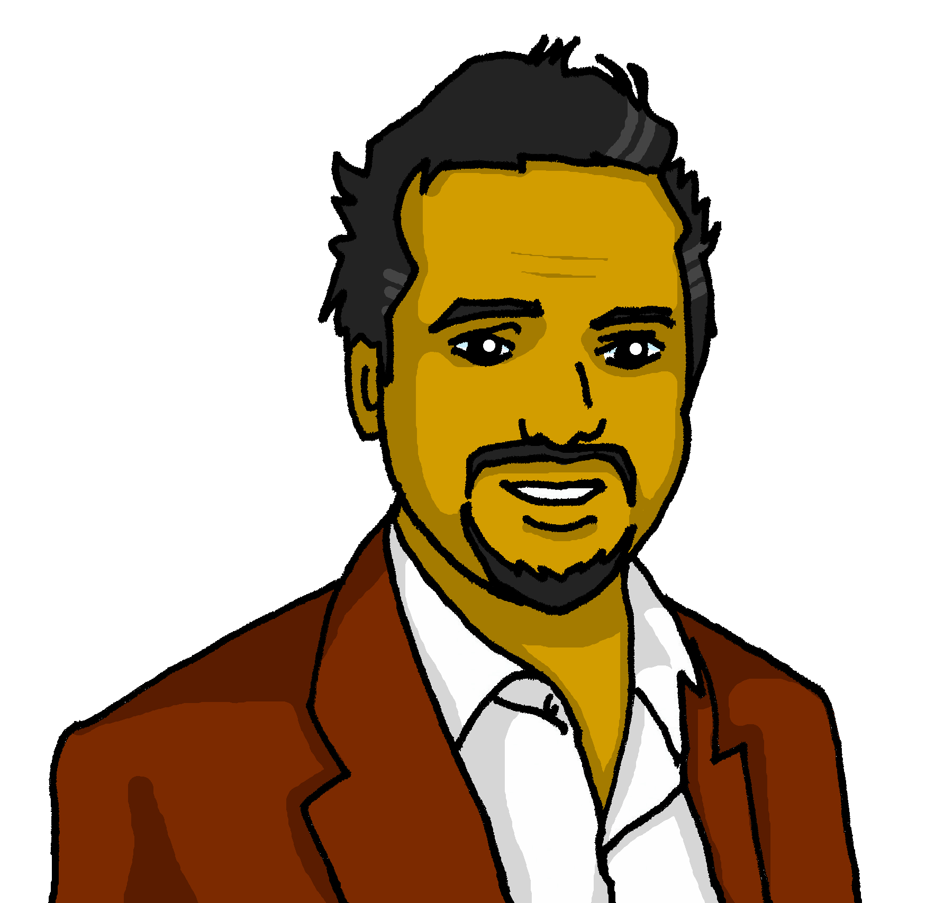
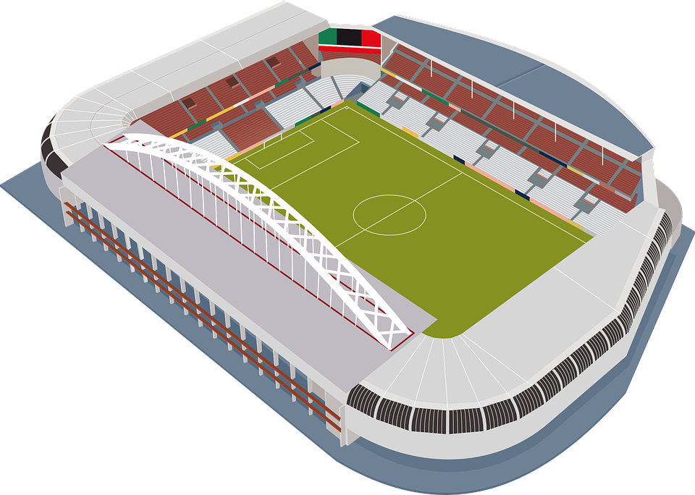
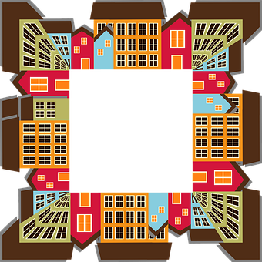
vocabulario
Escucha y lee. ¿Es ‘un’ o ‘una’?
escuchar
[un]
[una]
__ estadio
a stadium
__ ciudad
a city
__ parque
a park
__ museo
a museum
__ padre
a father
__ madre
a mother
__ plaza
a square
__ iglesia
a church
Notes:
Timing: 5 minutes
Aim: to practise aural distinction between un and una; to present the new vocabulary for this week in sound and writing, and with English meanings. 4 new items and 4 revisited from last week.
Procedure:
Click for each word to appear with audio (without article).
Pupils say ‘un’ or ‘una’, depending on the noun ending.
Click again for it to disappear into the corresponding pacperson’s mouth.
Transcript

Slide 5

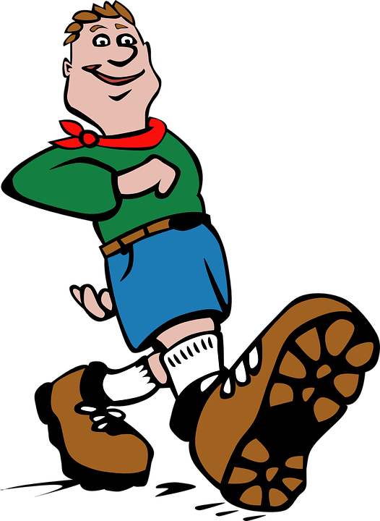



vocabulario
Escucha y repite.
[from, of]
de
[to go for a walk, going for a walk]
[to ride, riding]
⚠ You know de means from. E.g. Soy de España.
It can also mean ‘of’:
pasear
montar (en)
⚠ In English, we use more than one word for por:
La casa de Quique.
The house of Quique or
Quique’s house.
[through, around, along]
Camino por la ciudad.
I walk through the city.
La clase de inglés.
The class of English or
The English class.
Camino por el parque.
I walk around the park.
por
Just use the English meaning that sounds right to you.
Camino por la playa*.
I walk along the beach.
la playa = (the) beach
Notes:
Timing: 3 minutes
Aim: to introduce key vocabulary for this week.
Procedure:
1. Teacher clicks through animations to present and elicit practice of the new words.
Note: there is additional information for the prepositions ‘de’ and ‘por’.
playa [1475]

Slide 6

Definite articles: singular & plural
This is grammatical, not biological gender! A house (una casa) is not female, it is a feminine noun.
[the]
Remember! In Spanish, things, as well as people and animals, are either masculine or feminine. We say that they have gender.
To say a (or an) in Spanish use un before a masculine noun and una before a feminine noun.
To say the before a singular noun, you use ‘el’ or ‘la’.
Masculine
Feminine
una
a church
___ iglesia
un
la
the church
___ museo
a museum
el
the museum
la
the city
una
el
the park
___ ciudad
a city
un
___ parque
a park
un
the stadium
el
___ estadio
a stadium
___ bicicleta
the bicycle
una
la
a bicycle
Notes:
Timing: 3 minutes
Aim: to revisit grammatical gender and singular indefinite articles; to introduce singular definite articles (el, la)
Procedure:
Read the grammar explanation on gender in Spanish & indefinite articles.
Click to bring up examples of singular masculine and feminine nouns.
Elicit the indefinite article from pupils and the English meaning of each noun.
Click each time to reveal the answer.
Click to make examples of nouns with singular definite article disappear.
Click to bring up the explanation for “the” in the singular form.
Repeat as in steps 2-5.

Slide 7
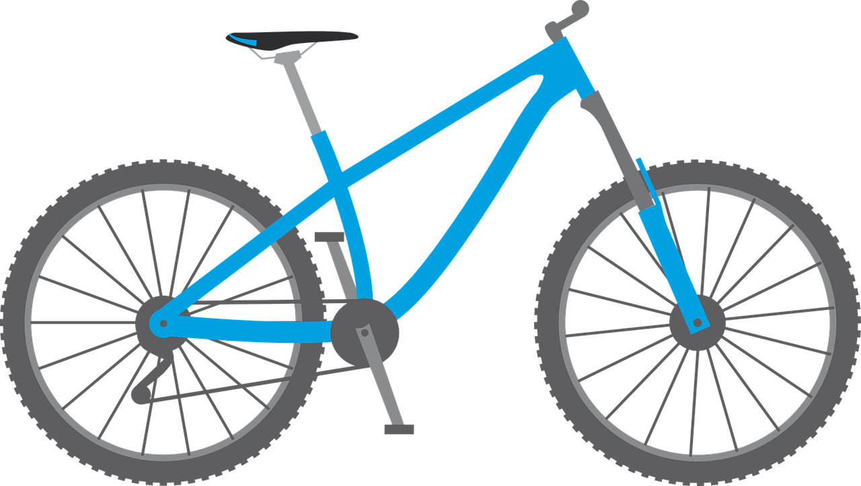
vocabulario
Escucha y repite el vocabulario.
⚠ In English, we say ‘bike’. In Spanish, say ‘bici’.
montar en bici =
to ride a bike, to go by bike.
[(the) mother]
[(the) father]
la madre
el padre
[(the) stadium]
[(the) city]
[(the) bicycle]
el estadio
la ciudad
la bicicleta
Notes:
Timing: 2 minutes
Aim: to practise key vocabulary for this week.
Procedure:
Teacher clicks through animations to present and elicit practice of the new words.

Slide 8




leer
El diario de Quique:
Quique está en Barcelona.
¿Es Quique (‘I’) o Sofía (‘she’)?
¿Dónde? Escribe 📝
Quique (I) | Sofía (she) | Where?
E
Paseo por el ciudad | parque Gaudí.
1
park
Monto en bici por la ciudad| parque.
city
Visita el estadio | casa Camp Nou.
2
stadium
3
Paseo por la parque | plaza.
square
4
Busca palabras en catalán en el iglesia | museo.
museum
Notes:
Timing: 7 minutes
Aim: to practise written comprehension of definite and indefinite articles & key vocabulary for this week; to revisit 1st & 3rd person singular verb endings with a range of regular –ar verbs.
Procedure:
Read the title and instructions.
Pupils write I or she for each verb and decide the location, connecting the definite article ‘the’ with the correctly-gendered noun.
Click through the animations to bring up answers, eliciting whole sentence meanings at the same time.
If desired, click on the audio buttons to hear the full sentences as part of the feedback process.
Transcript:
E. Paseo por el parque de Gaudí.
Monto en bici por la ciudad.
Visita el estadio Camp Nou.
Paseo por la plaza.
Busca palabras en catalán en el museo.
Image attribution:
Martí8888, CC BY-SA 4.0 via Wikimedia Commons

Slide 9
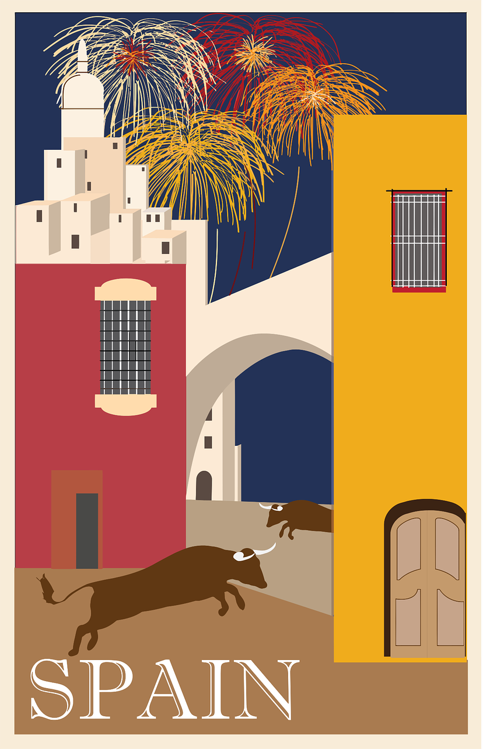

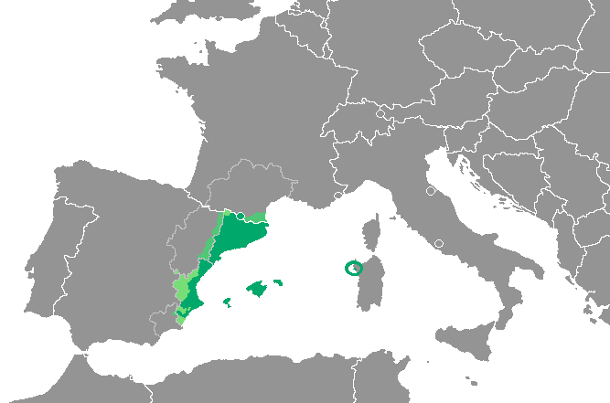
cultura
Catalan is an official language in Catalonia, Valencia, the Balearic islands and Andorra. In Valencia, the language is called ‘valenciano’.
Many of its words are similar to Spanish.
¡Bon dia!
¡Buenos días!
¡Adéu!
¡Adiós!
Notes:
Timing: 1 minute
Aim: to explain the meaning of ‘catalan’ and present additional information about the language.
Procedure:
1. Read through the information with pupils.
2. Click to hear the pronunciation of the two Catalan words and compare with the Spanish words.
Further information re Catalan:
Catalan is the official language of Andorra and the co-official language of three autonomous communities in eastern Spain: Catalonia, Valencia Community and the Balearic islands. It is spoken by 9,000,000 people in Spain in total. It is closely related to Spanish, French and Italian.

Slide 10

escuchar
Quique habla de su viaje a Barcelona.
Escucha otra vez. ¿ Quién es?
Escucha: ¿Es el o la?
Marca ✅❌
¿Es al aire libre?
¿dónde?
Q (I), S (she)
al aire libre
 | el | la
 | el | la
 | el | la
 | el | la
 | el | la
 | el | la
E
Quique (I)
E
playa | estadio
1
ciudad | museo
1
Quique (I)
2
iglesia | casa
2
Sofía (she)
3
plaza | parque
3
Quique (I)
4
bicicleta | estadio
4
Sofía (she)
5
plaza| parque
5
Sofía (she)
al aire libre = in the open air
Notes:
Timing: 5 minutes
Aim: to practise aural recognition of el / la and its connection with an appropriate noun; to practise understanding of 1st and 3rd person present tense –AR verbs and overall comprehension of sentences made up of this week and previous weeks’ vocabulary.
Procedure:
Read the title and the instructions in Spanish.
Do the example (E). (Note: some learners will benefit from being able to circle the words on the sheet).
Click to bring up the answers.
Pupils write (or circle) the correct article and identify the place.
Pupils check their answers.
Click to bring up a 2nd set of audio buttons to hear the whole sentence. This time pupils need to identify who is doing the activity and whether the activity takes places outdoors (al aire libre) or indoors.
Click to confirm the answers. Note that ‘Paseo por el estadio’ could be understood as an indoor (in the shop / museum of the stadium) or outdoor (in the pitch).
Transcript:
E. Paseo por [el] estadio.
Busco información en [el] museo.
Visita [la] iglesia de Gaudí.
Paseo por [el] parque.
Busca [el] estadio.
Pasea por [la] plaza.

Slide 11
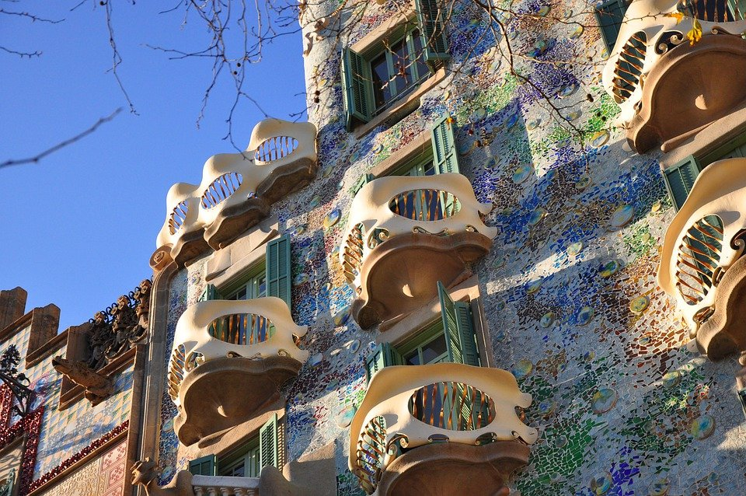

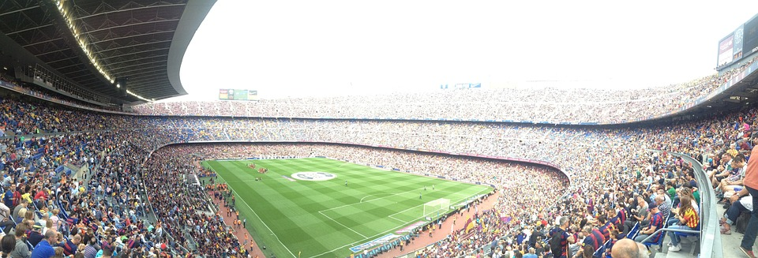
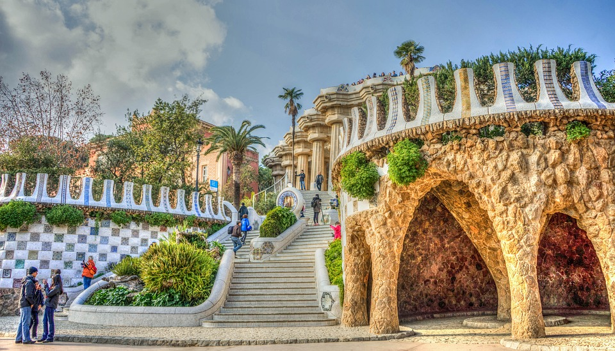
hablar
¿Qué hace* Quique en Barcelona?
visita
pasea
usa
monta
busca
Remember to use ‘por’ after ‘pasear’.
Habla en español.
También uso palabras en catalán, por ejemplo, ‘gràcies’ y
‘bon dia’.
1
la
2
el
___ casa Batlló
___ estadio Camp Nou
3
el
4
la
___ Parque Güell
___ Sagrada Familia
hace = does
Notes:
Timing: 4 minutes
Aim: to introduce some further information about Barcelona; to practise distinction between el and la.
Procedure:
Give pupils 2-3 minutes with a partner to say a whole sentence for 1-4, using the correct definite article. NB. For La Sagrada Familia draw pupils’ attention to the ending (-a) and ask them to consider the gender before choosing the correct definite article.
Elicit the correct form of the definite article and click to reveal the answers.
Teachers can also elicit full sentences at this stage. Note that there are several options for some of the sentences (Visita la casa Batlló OR busca la casa Batlló). Possible answers are on separate slides (11-14) if required.
Click to bring up speech bubble with information re the second official language for Catalonia. Teachers can encourage pupils to work out the meaning of these two words (thank you / good morning).
Frequency of unknown vocabulary:
hacer [26]

Slide 12
hablar
¿Qué hace* Quique en Barcelona?
visita
pasea
usa
monta
busca
Habla en español [1/4].
Visita la casa Batlló.
Pasea por la casa Batlló.
1
la
Busca la casa Batlló.
___ casa Batlló
Notes:
Slide with support for possible answers 1/4

Slide 13
hablar
¿Qué hace* Quique en Barcelona?
visita
pasea
usa
monta
busca
Remember to use ‘por’ after ‘pasear’.
Habla en español [2/4].
Visita el estadio Camp Nou.
2
Pasea por el estadio Camp Nou.
el
___ estadio Camp Nou
Busca el estadio Camp Nou.
Notes:
Slide with support for possible answers 2/4

Slide 14
hablar
¿Qué hace* Quique en Barcelona?
visita
pasea
usa
monta
busca
Remember to use ‘por’ after ‘pasear’.
Habla en español [3/4].
Pasea por el Parque Güell.
Busca el Parque Güell.
3
el
___ Parque Güell
Visita el Parque Güell.
Monta en bicicleta por el Parque Güell.
Notes:
Slide with support for possible answers 3/4

Slide 15
hablar
¿Qué hace* Quique en Barcelona?
visita
pasea
usa
monta
busca
Remember to use ‘por’ after ‘pasear’.
Habla en español [4/4].
Visita la Sagrada Familia.
Pasea por la Sagrada Familia.
4
la
___ Sagrada Familia
Busca la Sagrada Familia.
Notes:
Slide with support for possible answers 4/4

Slide 16
¡adiós!
amarillo

