Slide 1

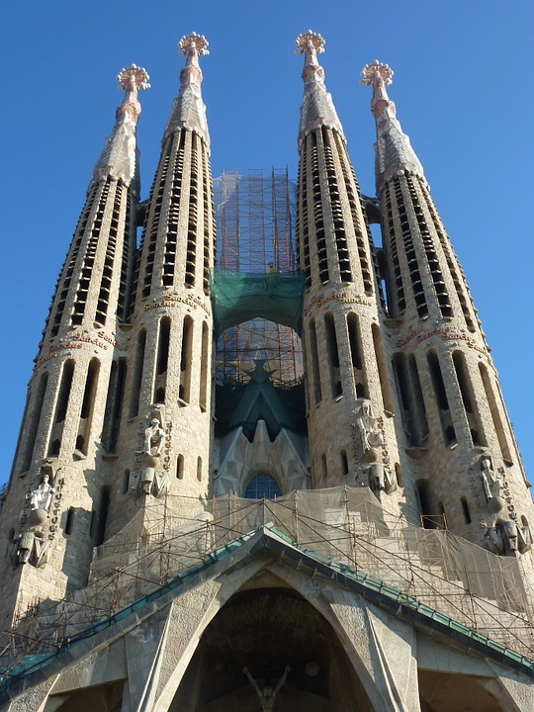
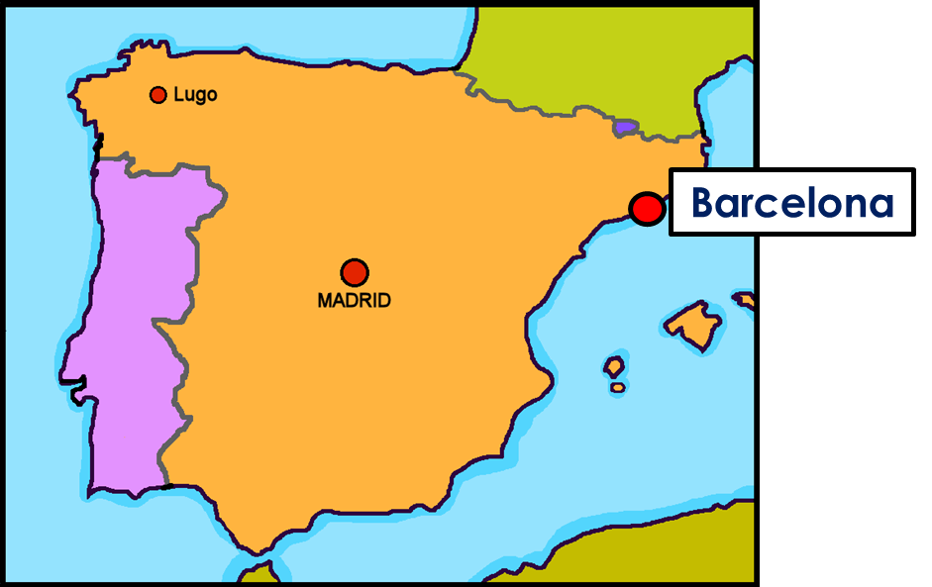


Saying what I and others do
Barcelona
amarillo
Follow ups 1-5
Notes:
Artwork by Steve Clarke. All additional pictures selected are available under a Creative Commons license, no attribution required.
The frequency rankings for words that occur in this PowerPoint which have been previously introduced in the resources are given in the SOW (excel document) and in the resources that first introduced and formally re-visited those words.
For any other words that occur incidentally in this PowerPoint, frequency rankings will be provided in the notes field wherever possible.
SSC: ganar [295] lago [2151]
Vocabulary: montar [1446] pasear [1741] bicicleta [3684] estadio [2581] madre [226], padre [162] ciudad [178] el [1] la [1] de² [2] por¹ [15]
Revisit 1: animal [322] cosa [69] instrumento [1042] papel [393] raro [1005] nuevo [94] viejo [225]
Revisit 2: ser [7] soy [7] es [7] siempre [96] normalmente [1696] (recycle adjectives)
Glossed words: playa [1475] hacer [26]
Source: Davies, M. & Davies, K. (2018). A frequency dictionary of Spanish: Core vocabulary for learners (2nd ed.). Routledge: London

Slide 2





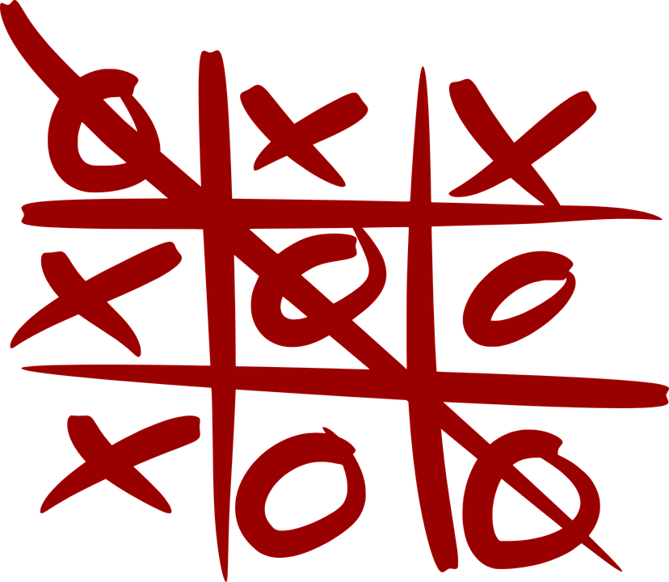





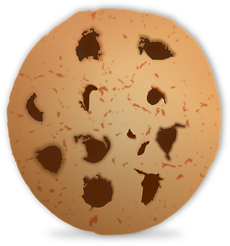

Follow up 1
[ga] ganar
[go] lago
A Escucha. ¿Qué sonido es?
B Lee las palabras en orden alfabético.
Marca
domingo
ganar
fuego
 | ga | go
 |  |  | _ _ ma
 |  |  | _ _ fas
 |  |  | pe _ _ r
 |  |  | al _ _
 |  |  | jue _ _
 |  |  | _ _ lleta
 |  |  | _ _ tas
gota
pegar
45
segundos
E
g o
algo
lago
gato
1
g a
tengo
juego
ga
pagar
mago
2
3
go
[something]
algo
gato
mago
4
go
domingo
gota
pagar
5
ga
fuego
juego
pegar
6
go
ganar
lago
tengo
INICIO
Notes:
Timing: 5 minutes
Aim: to develop phonological awareness of [go] in contrast with [ga]
Procedure:
Part A
Click to bring up the instruction.
Click to bring up the table table and do example together (E).
Students tick and/or write the correct sound [ga] [go]
Part B
Procedure:
Read the instruction in Spanish.
Ensure meaning of ‘orden alfabético’ is clear and elicit first word from a volunteer.
3. Click on ‘inicio’ to start the timer.
4. Elicit responses from students. Answers are animated (one click per word).
Transcript
[E] goma
[1] gafas
[2] pegar
[3] algo
[4] juego
[5] galleta
[6] gotas
NB. All words in Part A are unknown to pupils (pictures are provided to clarify meaning). In Part B, we include both the two source words (lago / ganar) and a words already encountered in the SOW (gato, tengo, domingo). Pictures are provided for unknown words.
mago [4573] negar [770] pegar1 [1135] algo [110] juego [409] pagar [377] fuego [884] gafas [>5000] gotas [2391] galleta [>5000] goma [4437]

Slide 3


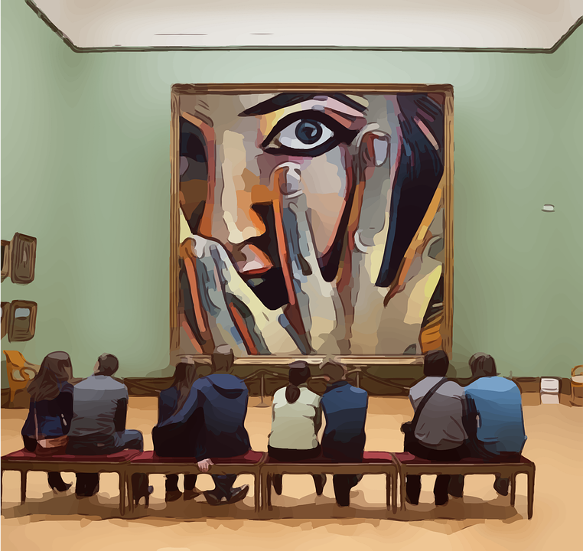

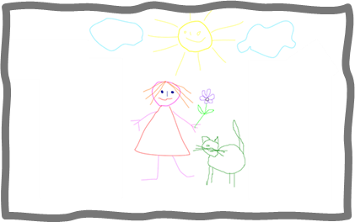
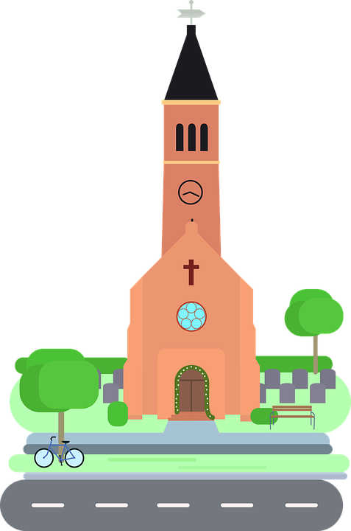
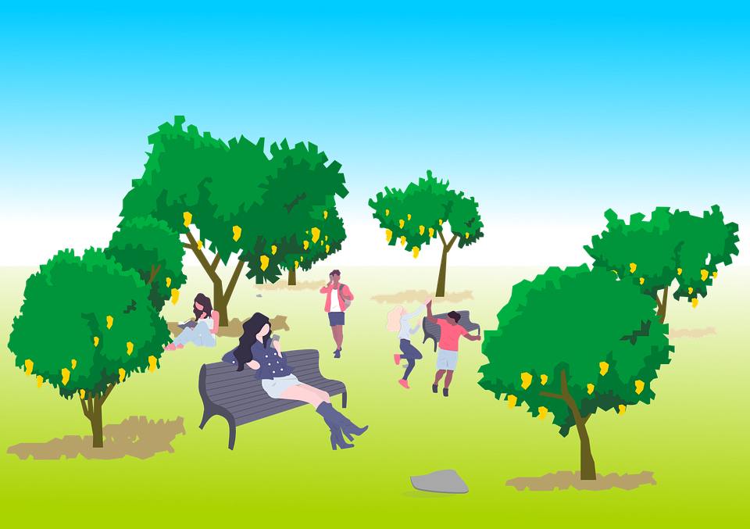

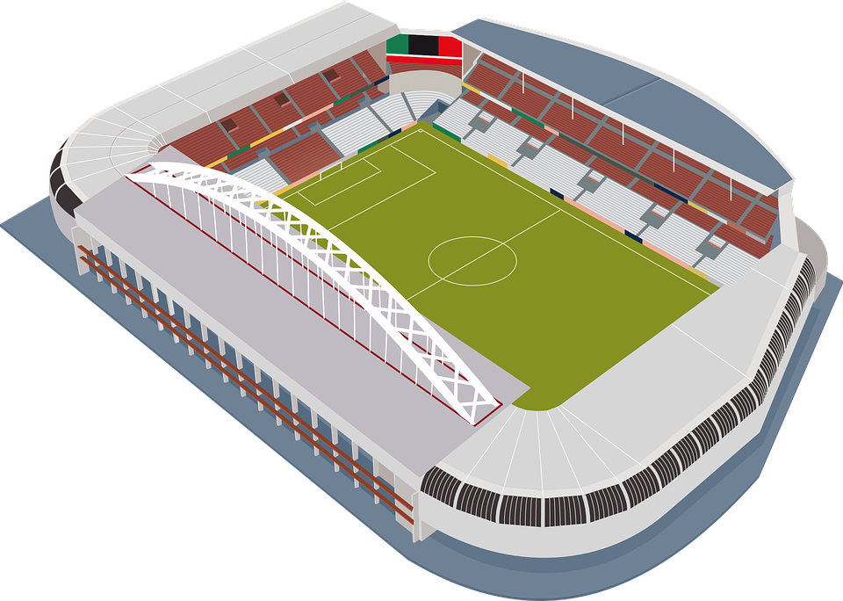
Follow up 2:
[A] Escribe “un” / “una” o “el” / “la”.
vocabulario
 | definite (the) | indefinite (a/an)
 | ____ iglesia | ____ iglesia
 | ____ dibujo | ____ dibujo
 | ____ plaza | ____ plaza
 | ____ museo | ____ museo
 | ____ ciudad | ____ ciudad
 | ____ estadio | ____ estadio
 | ____ parque | ____ parque
[B] Escribe el número.
4
E
la
una
E
1
el
un
3
E
1
la
una
E
2
3
el
un
una
6
4
la
E
E
E
5
el
un
6
el
un
5
2
E
E
Notes:
Timing: 5 minutes
Aim: to practise written recall of definite and indefinite articles with previously taught vocabulary; to practise written recall of word meanings.
Procedure:
1. Do E of part A with pupils and click to correct.
2. Pupils write 1 – 6 and complete them (Note: they do not need to copy out the nouns as well).
3. Click to feed back responses.
4. Click to bring up part B of the activity.
5. Do E with pupils to model the task.
6. Pupils write 1-6 and the English meaning.
7. Click to reveal the answers in number order next to the matching pictures.
9. If required, click audio buttons to reinforce the new definite articles with the nouns.
Transcript:
Ejemplo: la iglesia | una iglesia
1. el dibujo | un dibujo
2. la plaza | una plaza
3. el museo | un museo
4. la ciudad | una ciudad
5. el estadio | un estadio
6. el parque | un parque

Slide 4


Follow up 3:
Knowing who does what
⚠ We don’t need pronouns because the verb ending tells us who is doing the action.
[–ar verbs: ‘I’ versus ‘s/he, it’]
In Spanish, the words for ‘I’ and ‘s/he’ (pronouns) are often unnecessary.
To mean ‘I’ with a verb, we remove –ar and add -o.
To mean ‘s/he, it’ with a verb, we remove –ar and add –a.
⚠ In English we say ‘I ride my bike’ or ‘s/he rides his/her bike’, but we do not use the possessive in Spanish but rather ‘en’.
Ejemplo: llevar
I
s/he, it
Monto en bici
Monta en bici.
I ride my bike.
S/he rides his/her bike.
Notes:
Timing: 5 minutes
Aim: to revisit 1st and 3rd person singular for –ar verbs, building on the concept of the infinitive.
Procedure:
Click through the animations to present the new information.
Elicit English translations for the Spanish examples provided.

Slide 5

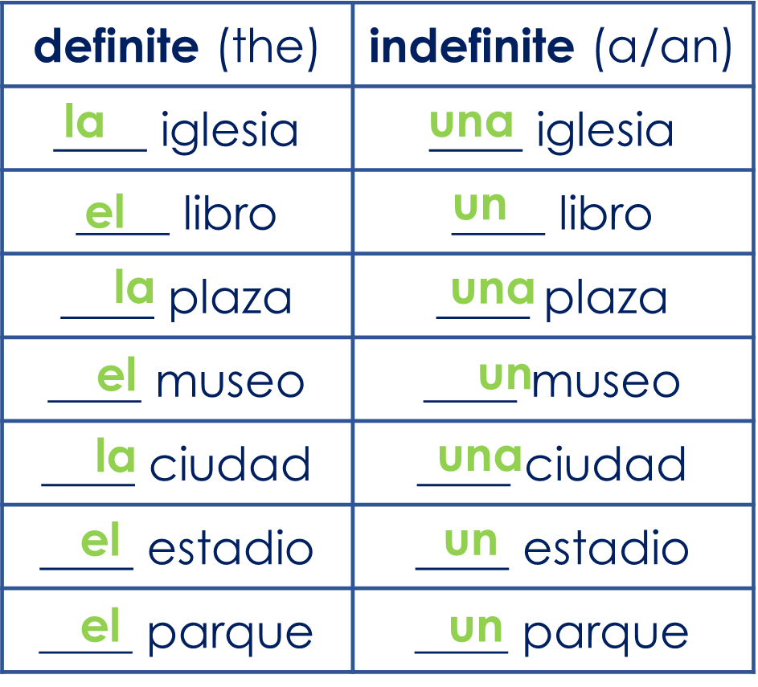

Follow up 3:
Lee la frase en español y en inglés.
[1/5]
leer y hablar
around
I walk _______ the city.
paseo
pasea
______ por ____________.
Paseo
la ciudad
Notes:
Timing: 5 minutes
Aim: to practise using the correct person of the verb in a supported, oral interpreting task.
Procedure:
Click to bring up gapped English and Spanish sentence prompts.
Pupils say the two sentences aloud, selecting the correct English and Spanish words.
Click to bring up answers to complete the sentences in English, then Spanish.
Repeat for the rest of the items.

Slide 6
Follow up 3:
Lee la frase en español y en inglés.
[2/5]
leer y hablar
a book
interesting
Sofía uses ___ ______ with _________ information.
uso
usa
Sofía ______ un libro con información interesante.
usa
Notes:
[2/5]

Slide 7
Follow up 3:
Lee la frase en español y en inglés.
[3/5]
leer y hablar
She walks
with
__________ through the park _____ dad.
I walk
she walks
Pasea ______ ___ _________ con papá.
por
el
parque
Notes:
[3/5]

Slide 8
Follow up 3:
Lee la frase en español y en inglés.
[4/5]
leer y hablar
a
important
I visit _ museum and the _________ stadium.
I visit
she visits
_______ un museo y ___ _______ importante.
Visito
el estadio
Notes:
[4/5]

Slide 9
Follow up 3:
Lee la frase en español y en inglés.
[5/5]
leer y hablar
through
She rides her bike _______ an interesting park.
monto
monta
_______ en bicicleta por ___ _______ interesante.
Monta
un parque
Notes:
[5/5]

Slide 10
Follow up 4:
Asking questions
Remember! Turn a statement into a yes/no question by making your voice go up at the end.
⚠ Remember that there is no word for ‘do/does’ in Spanish questions.
⚠ Remember that there is no word for ‘do/does’ in Spanish questions.
Monto en bici.
I ride my bike.
¿Monto en bici?
Do I ride my bike?
Monta en bici.
S/he rides his/her bike.
¿Monta en bici?
Does s/he ride his/her bike?
Notes:
Timing: 10 minutes (five slides)
Aim: to recap raised intonation in questions.
Procedure:
1. Click to bring up each new part of the explanation.
2. Elicit the English for the Spanish examples after each animated question mark.

Slide 11


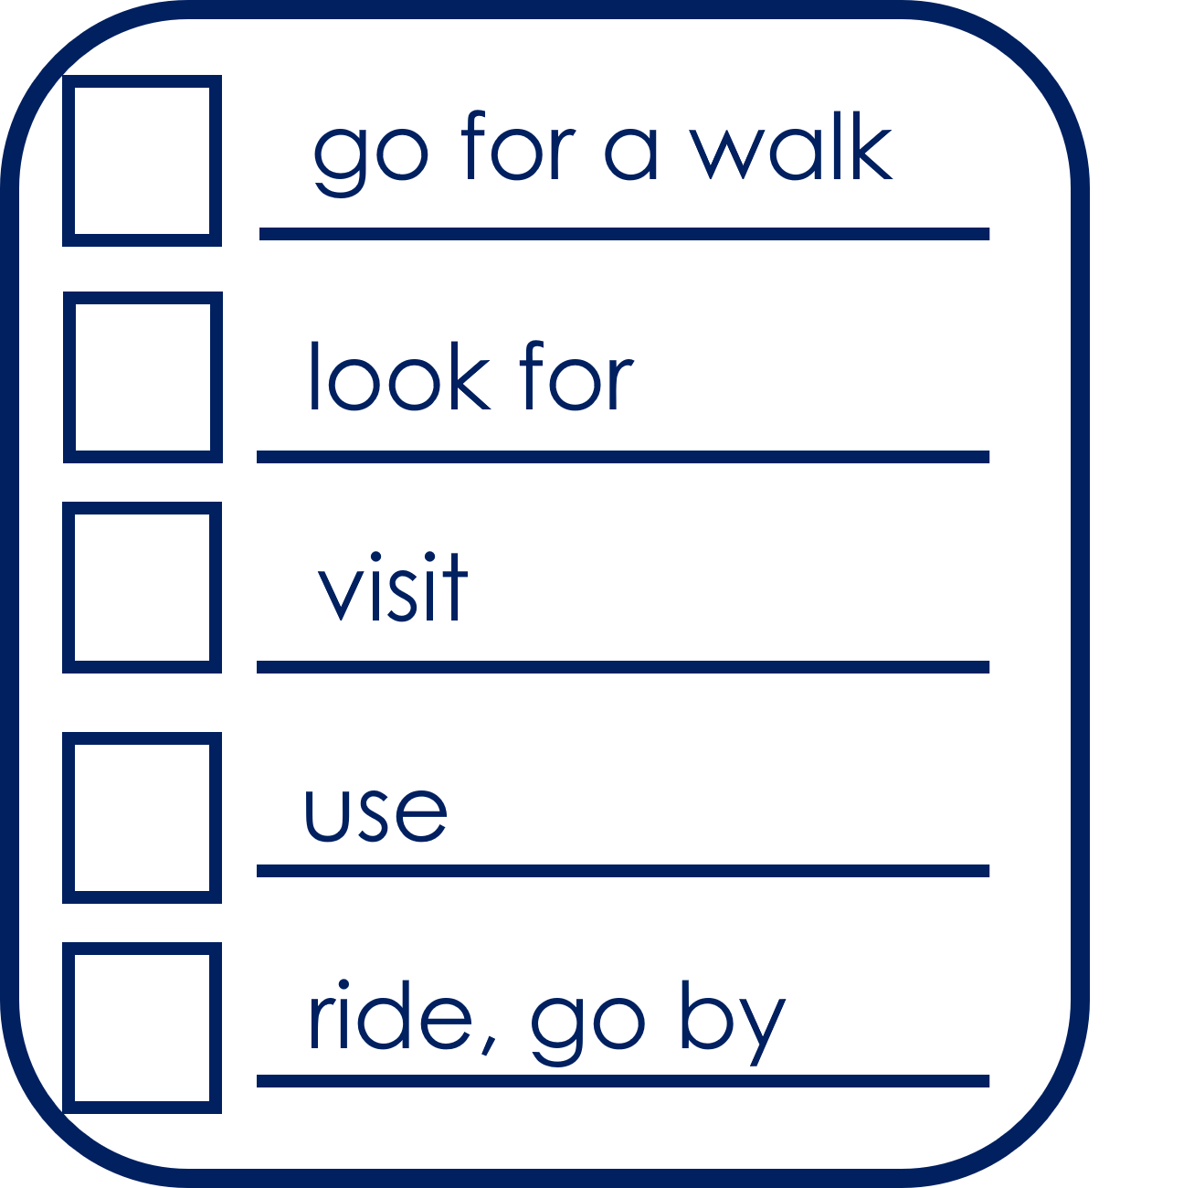



Follow up 4:
What does Quique do? And Sofía?
Pregunta (¿?) y marca
hablar
Persona A
Turno 1
Person A
Use your prompt card to ask questions.
E.g. ¿Busca el museo?
Person B
Use your card to answer ‘yes’ or ‘no.
Persona B
Escucha y responde.
Then swap roles.
Notes:
Timing: 10 minutes
Aim: to develop fluency in using 3rd person singular of –ar verbs using intonation questions.
Procedure:
1. Divide the class into A and B. Pupils can work in pairs or work chorally, in two class halves.
2. Pupil A asks questions to find out what Luis does, and where.
3. Pupil B answers “yes / no” according to their card (a card describing what Luis or Sofía does).
This is Pupil A’s task – Turno 1.
If needed, first practise further with the class. Elicit the question forms of the verbs and then of the locations from pupils, and then click the audio buttons to check.
Move forward for “turno 2” and model further if necessary.

Slide 12
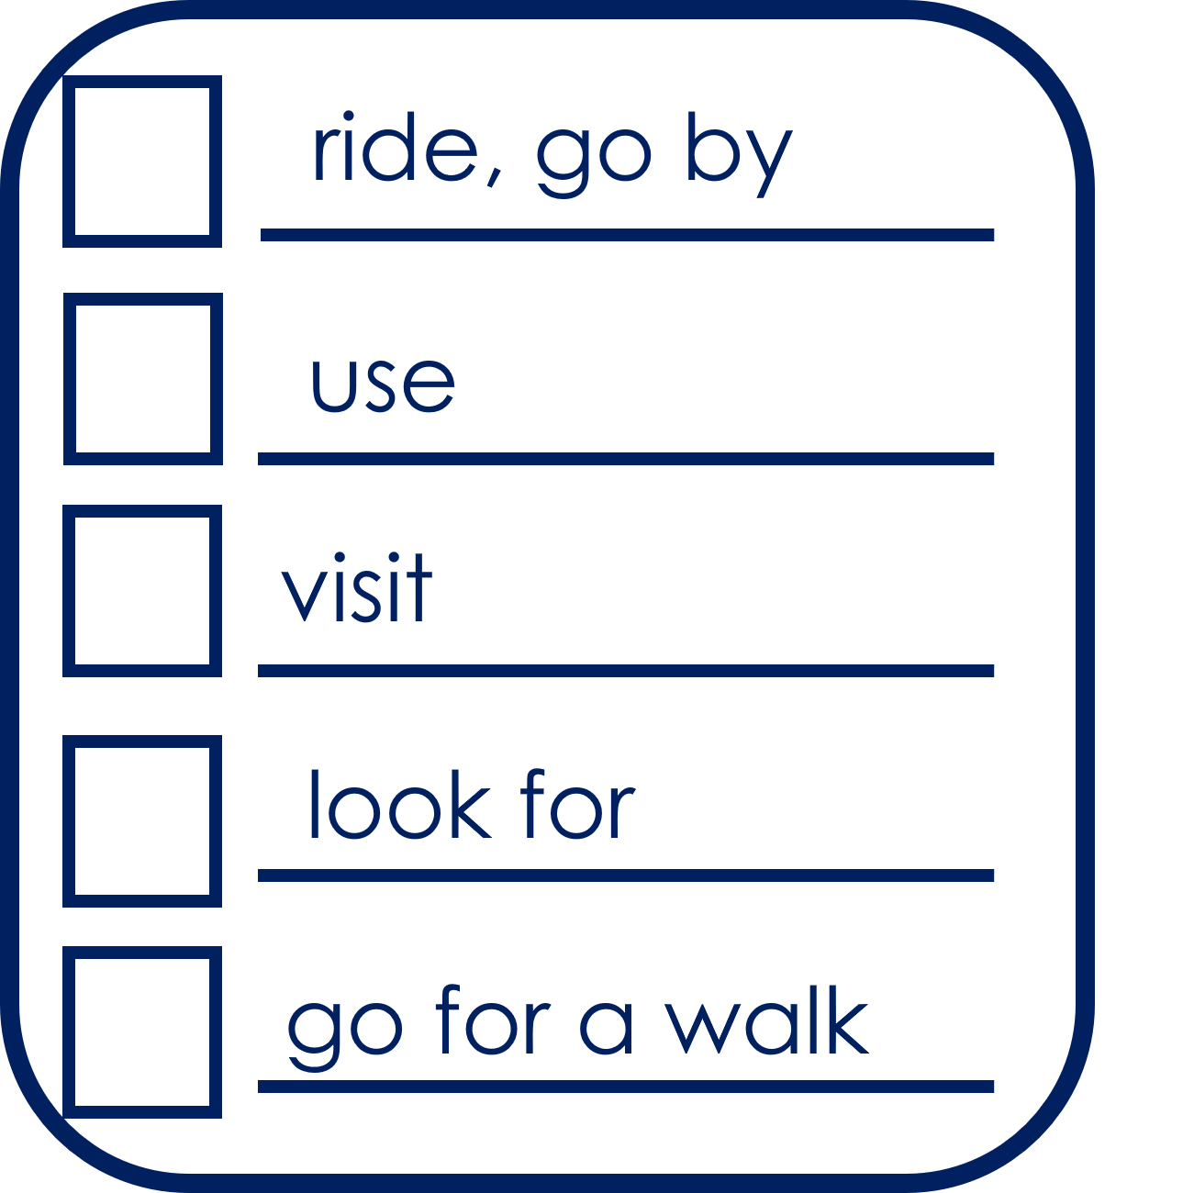
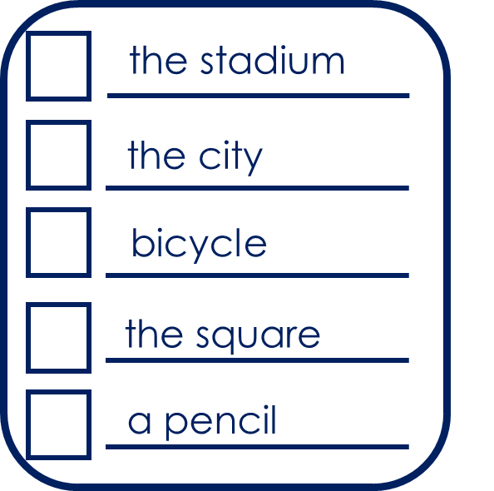
Follow up 4:
What does Quique do? And Sofía?
Pregunta (¿?) y marca
hablar
Persona B
Turno 2
Person B
Use your prompt card to ask questions.
E.g., ¿Visita la ciudad?
Person A
Use your card to answer ‘yes’ or ‘no.
Persona A
Escucha y responde.
Notes:
Timing: 10 minutes (FIVE slides)
Aim: to develop fluency in using 3rd person singular of –ar verbs using intonation questions.
Procedure:
1. Divide the class into A and B. Pupils can work in pairs or work chorally, in two class halves.
2. Pupil A asks questions to find out what Luis does, and where.
3. Pupil B answers “yes / no” according to their card (a card describing what Luis or Sofía does).
This is Pupil A’s task – Turno 1.
If needed, first practise further with the class. Elicit the question forms of the verbs and then of the locations from pupils, and then click the audio buttons to check.
Move forward for “turno 2” and model further if necessary.

Slide 13

Follow up 4
Respuestas para…
hablar
Persona A
go for a walk
a book
look for
the park
visit
the museum
use
bicycle
ride
the church
Notes:
ANSWER SLIDE
Pupils will have noted answers on their task sheets.
Procedure:
Click to reveal answers for pupils to check.

Slide 14
Follow up 4
Respuestas para …
hablar
Persona B
ride, go by
the stadium
use
the city
visit
bicycle
look for
the square
go for a walk
a pencil
Notes:
ANSWER SLIDE
Pupils will have noted answers on their task sheets.
Procedure:
Click to reveal answers for pupils to check.

Slide 15



Follow 5:
Escribe en español: Can you get at least 15 points?
 | s/he, it is (trait) | always | usually
 | from, of | to be, being (trait) | I am (trait)
 | (the) thing | (the) paper | (the) instrument
 | raro (m) | new (m) | old (f)
 | the (m) | the (f) | through, around, along
 | (the) stadium | (the) bicycle | (the) city
 | to go for a walk, going for a walk | to ride, riding | (the) father
es
siempre
normalmente
vocabulario
vocabulario
x3
de
ser
soy
la cosa
el papel
el instrumento
x2
raro
nuevo
vieja
el
la
por
el estadio
la bicicleta
la ciudad
x1
pasear
montar (en)
el padre
Notes:
Timing: 6 minutes
Aim: to practise written production of vocabulary for this week and previous weeks.
Procedure:
1. Pupils need to write the Spanish for as many words as possible, aiming to get at least 15 points (but more if possible).
2. Click for Spanish answers.

Slide 16



to print
Persona A
Persona B
1 Pregunta y marca
1 Escucha y responde.
|
|
|
|
|
|
|
|
|
|
|
|
|
|
goes for a walk through
looks for
2 Pregunta y marca
2 Escucha y responde.
Notes:
HANDOUT

Slide 17
Follow up EXTRA:
Follow up 5:
Escribe en español: Can you get at least 15 points?
 | s/he, it is (trait) | always | usually
 | from, of | to be, being (trait) | I am (trait)
 | (the) thing | (the) paper | (the) instrument
 | raro (m) | new (m) | old (f)
 | the (m) | the (f) | through, around, along
 | (the) stadium | (the) bicycle | (the) city
 | to go for a walk, going for a walk | to ride, riding | (the) father
vocabulario
vocabulario
x3
x2
x1
Notes:
Timing: 6 minutes
Aim: to practise written production of vocabulary for this week and previous weeks.
Procedure:
1. Pupils need to write the Spanish for as many words as possible, aiming to get at least 15 points (but more if possible).
2. Click for Spanish answers.

