Slide 1
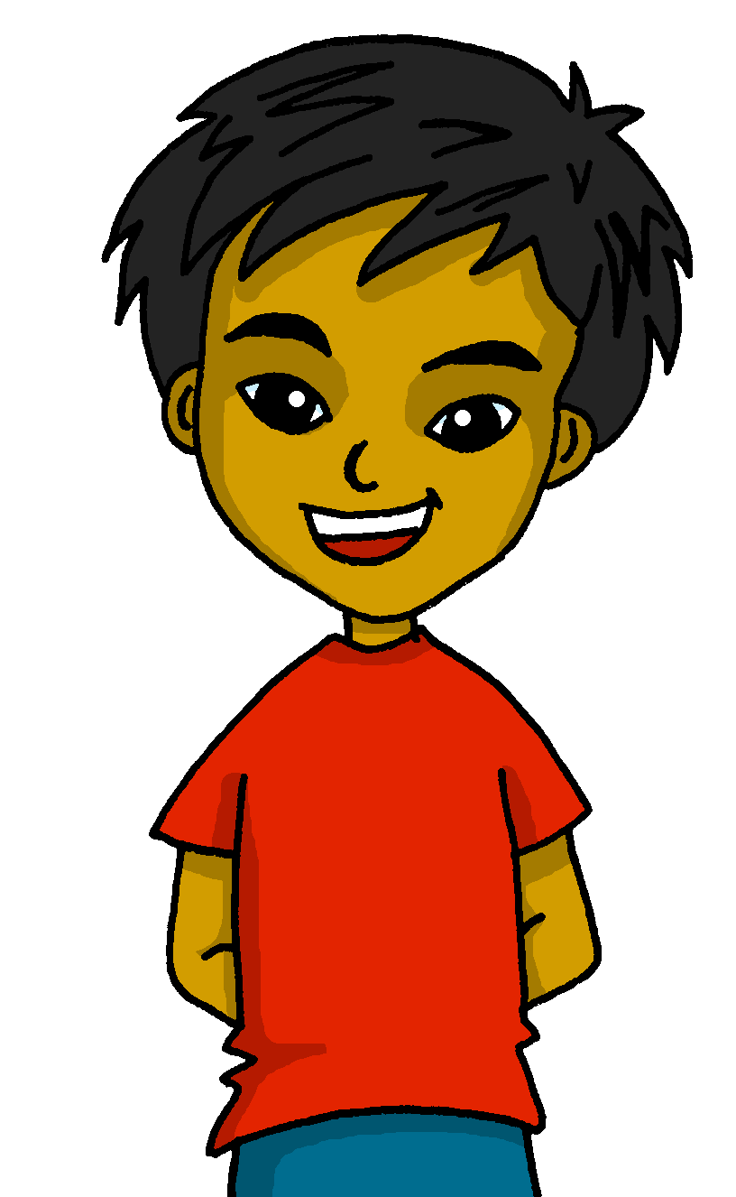
español, con Quique

Slide 2
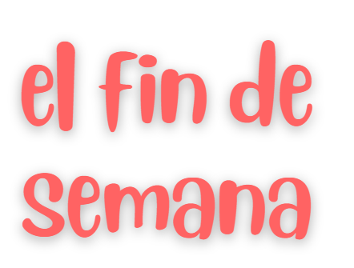
Saying what I and others do
- -ar verbs: infinitives; I vs. s/he
- SSC [l] [ll]
amarillo
Notes:
Artwork by Steve Clarke. All additional pictures selected are available under a Creative Commons license, no attribution required.
The frequency rankings for words that occur in this PowerPoint which have been previously introduced in the resources are given in the SOW (excel document) and in the resources that first introduced and formally re-visited those words.
For any other words that occur incidentally in this PowerPoint, frequency rankings will be provided in the notes field wherever possible.
SSC: libro [1477]
Vocabulary: visitar [792] iglesia [437] mamá [675] museo [1114] papá [865] parque [1354] plaza [806] con [14] Revisit 1: tienes [19] hoja [916] idea [247] lápiz [3740] mensaje [847] palabra [192] regla [1380] Revisit 2: feliz [908] imposible [1418] increíble [1642] ¿dónde? [161]
Glossed words: l / ll cluster: llama [3059] amarillo [>5000] collar [4362] llover [2134] camello [>5000] lobo [3816] paloma [3182] lavar [1676]
Glossed: desastre [2532] ordenar [1184] comparar [1597] su [12] fin [182] semana [301]
Source: Davies, M. & Davies, K. (2018). A frequency dictionary of Spanish: Core vocabulary for learners (2nd ed.). Routledge: London

Slide 3
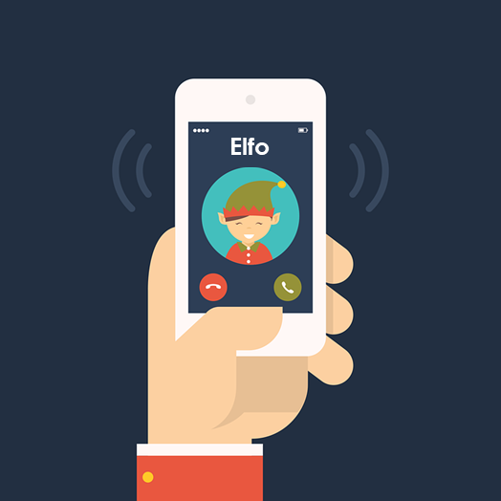
[l]
libro
pronunciar
[ll]
llamar
Notes:
Timing: 1 minute
Aim: To revisit SSC [l] [ll]
Procedure:
To recap and elicit the pronunciation of the individual SSC [ll] [l]
Click to bring the picture & get students to repeat (with gesture, if using).
Gesture suggestion for libro: use two hands to pretend to open a book
Gesture suggestion for llamar: with your right hand, pretend to answer the phone, then repeat with the left hand. Two gestures = two syllables of the word.

Slide 4
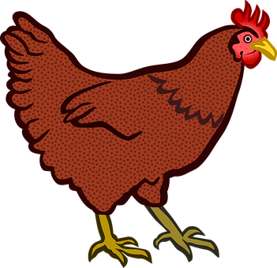
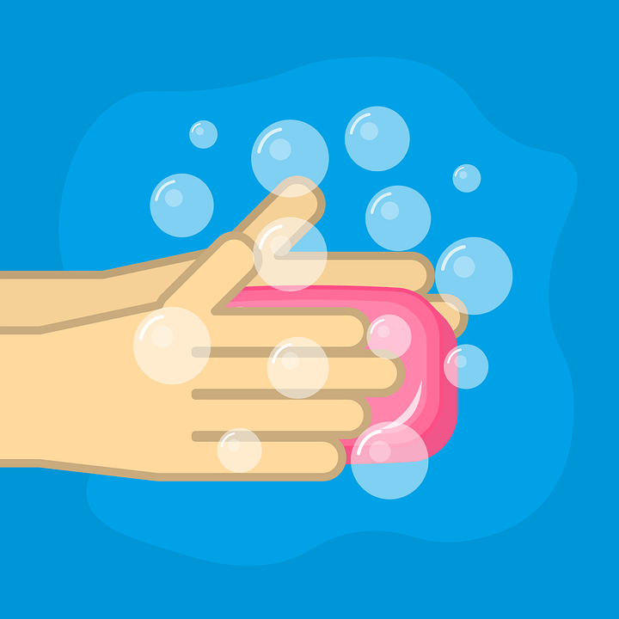
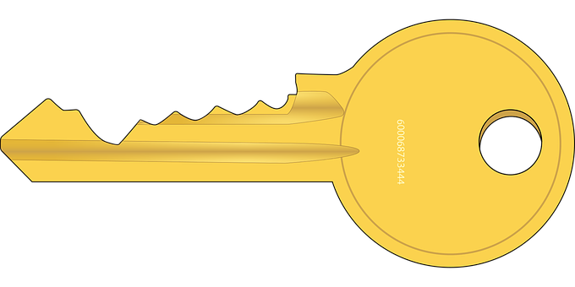
Practica con tu compañero/a.
[l] [ll]
Escucha y escribe.
pronunciar
[something]
60
gallina
poll o
a l go
co l or
medalla
mo l ino
llave
l avar
0
INICIO
Notes:
Timing: 3 minutes
Aim: To revisit SSC [l] [ll]
Procedure:
Pupils write 1-8 and either [l] [ll]
Click to listen.
Click again to reveal the pictures and the answers.
Click inicio for pupils to pronounce all of the words.
Click on each image to hear it, if desired.
Transcript: 1. gallina
2. pollo
3. algo
4. color
5. medalla
6. molino
7. llave
8. lavar
Frequency of unknown words:
algo [110] gallina [3153] pollo [3577] color [358] medalla [4103] molino [>5000] llave [1853] lavar [1676]

Slide 5
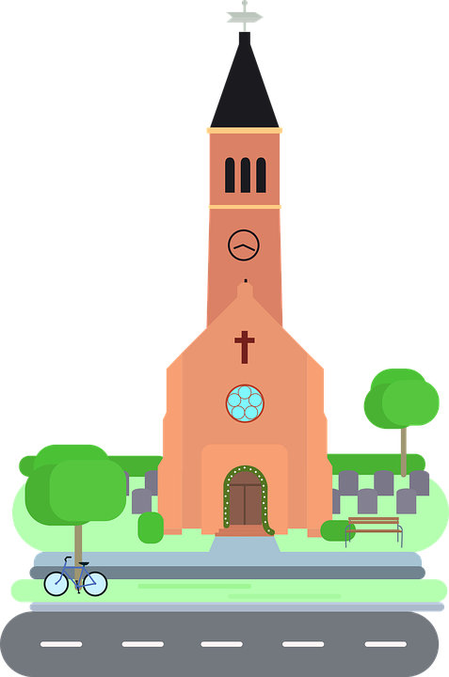
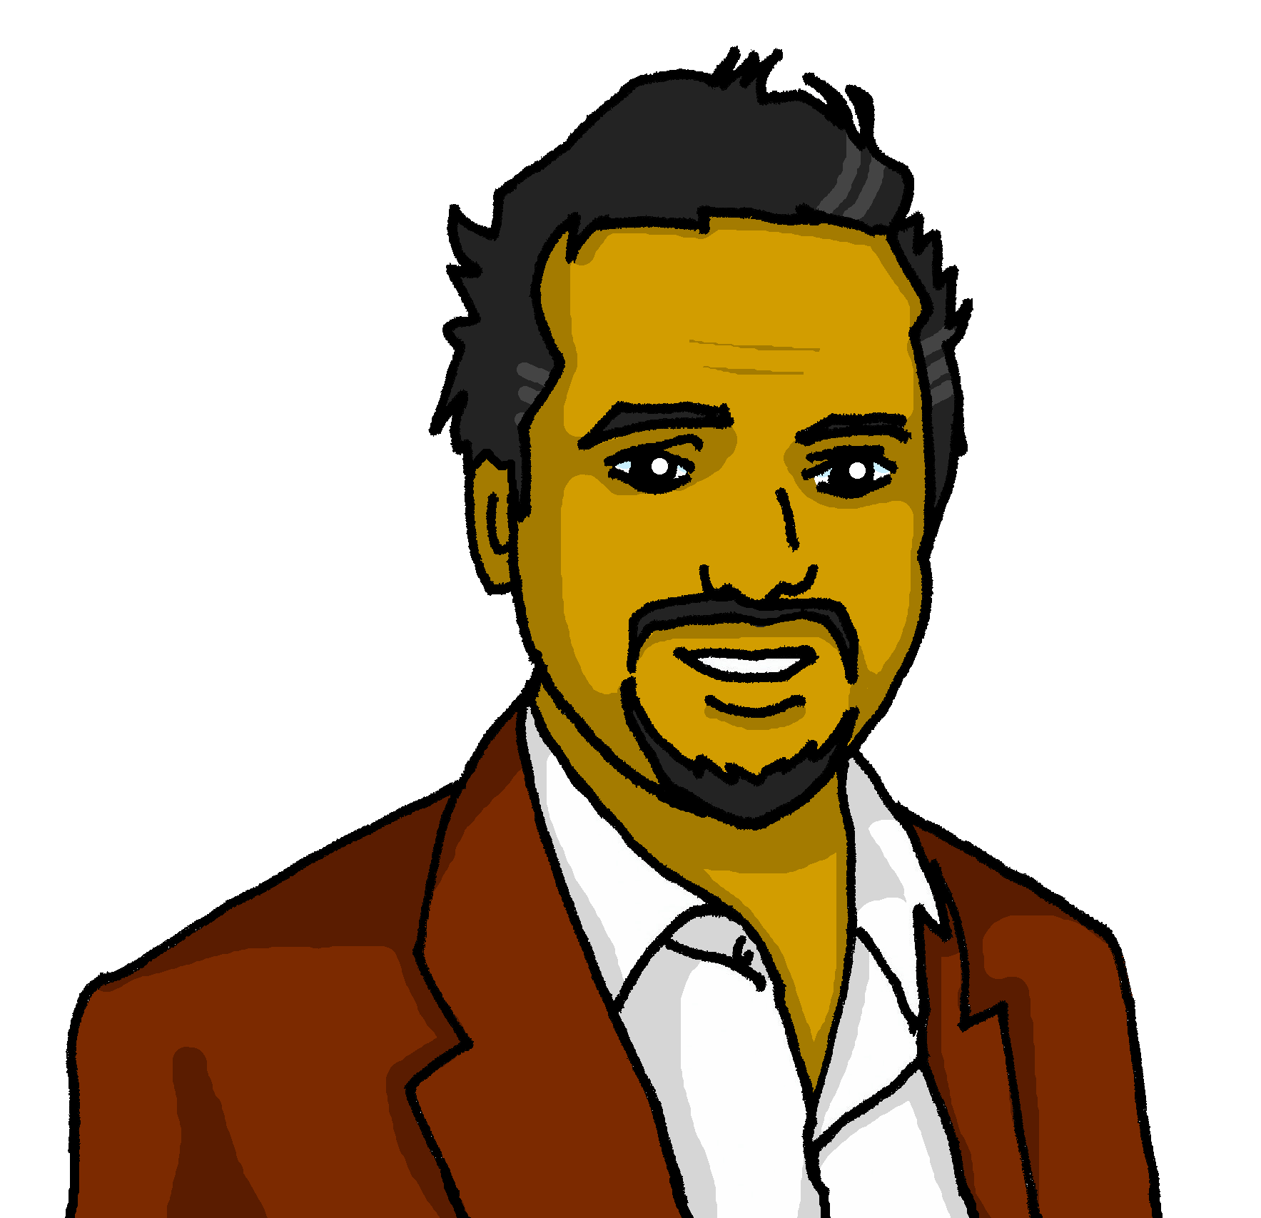
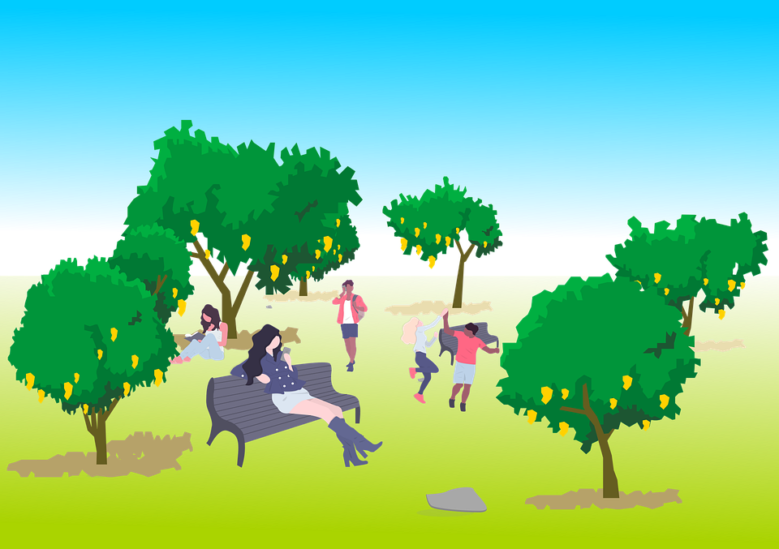
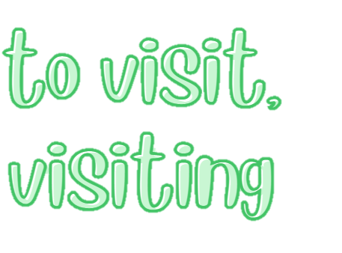
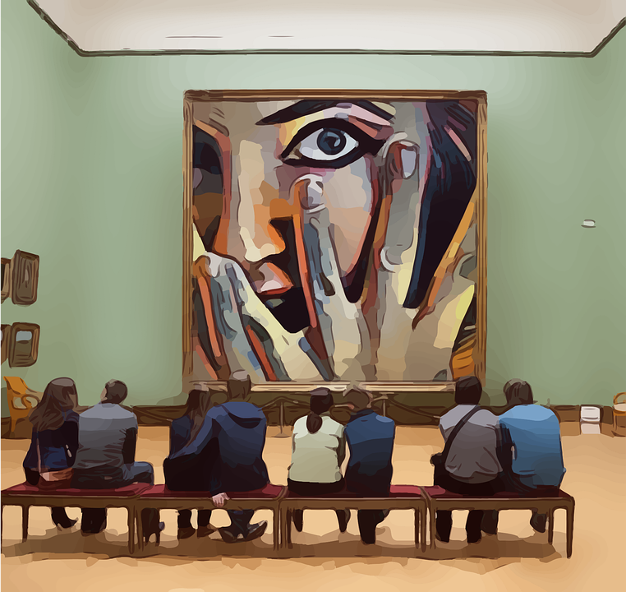
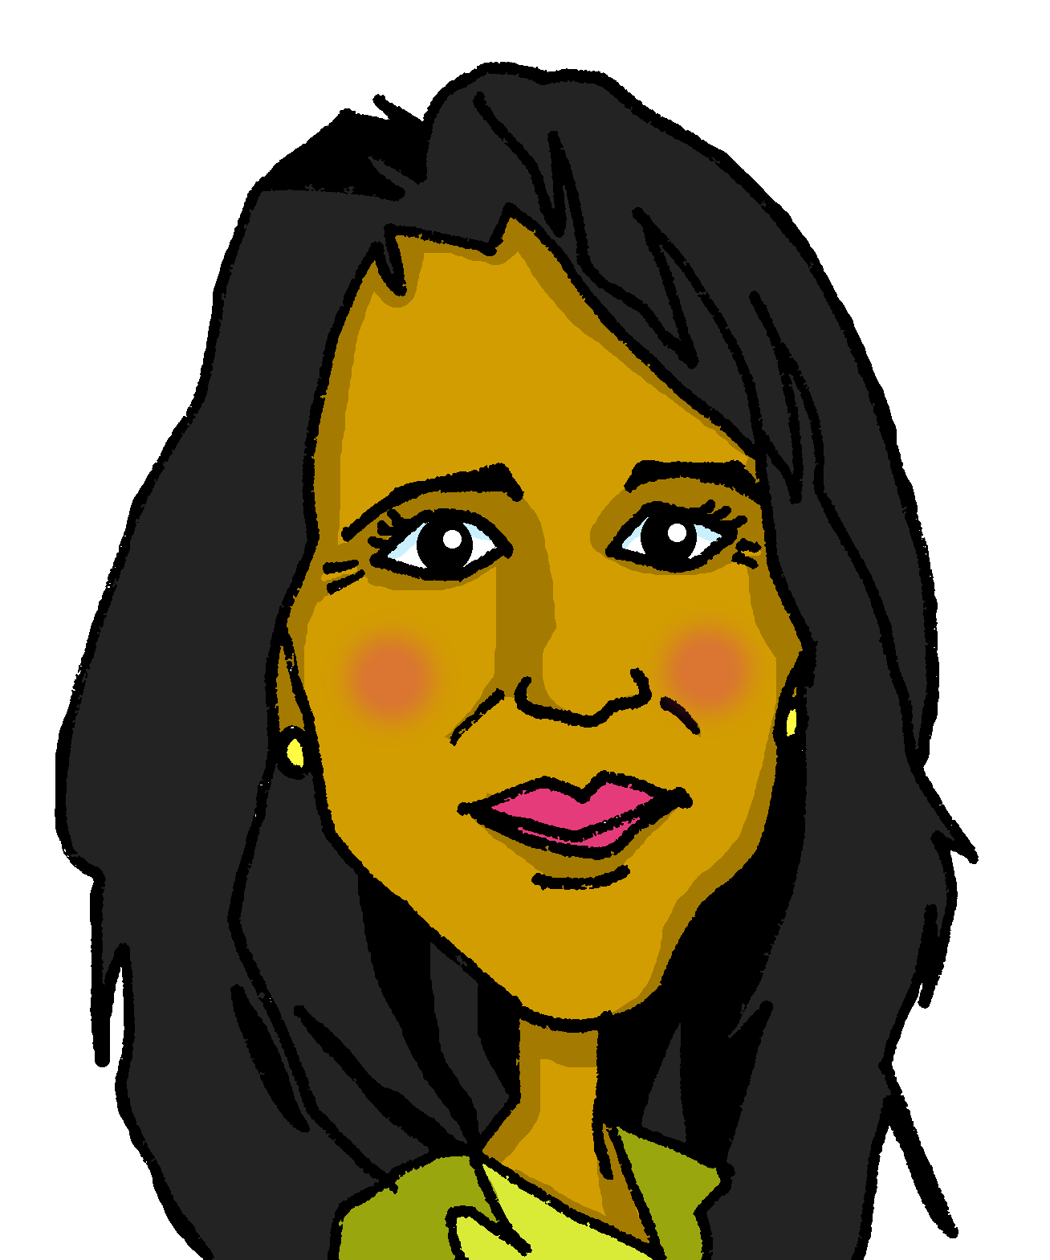
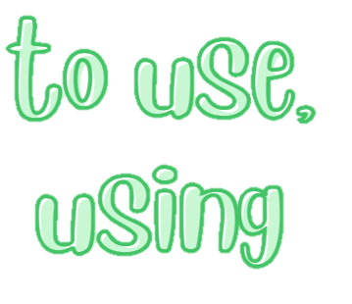
vocabulario
¿Cómo es en español?
la iglesia
papá
el parque
con
visitar
to visit, visiting
el museo
with
dad
to search, searching
museum
square
mum
to visit, visiting
to use, using
church
church
park
park
with
to search, searching
mum
to use, using
museum
square
dad
mamá
buscar
la plaza
usar
Notes:
Timing: 5 minutes
Aim: to present and practise written comprehension and read aloud of two items of previously taught vocabulary that we revisit this week and the
eight new words.
Procedure: 1. Click for an English item. Elicit pronunciation of the Spanish from pupils.
2. Click to cover the Spanish word with a picture.
3. Continue with the remaining items.
4. Optional at this stage: elicit the Spanish from pupils, (English prompts reappear on each mouse click) this time without written Spanish support.
Transcript / Order of words:

Slide 6
palabras
Lee y ordena* el vocabulario.
¡Qué desastre*!
Quique has mixed up all his flashcards.
hablar
00
un
___ museo a museum
una
00
___ plaza a square
00
___ hoja a sheet, leaf
00
___ país a country
00
___ mamá a mum
00
00
00
___ cosa a thing
___ animal an animal
___ dibujo a drawing
00
___ parque a park
00
___ papá a dad
00
00
___ idea an idea
___ palabra a word
el desastre = disaster ordenar = to organise
Notes:
Timing: 3 minutes (one slide)
Aim: to introduce key vocabulary for the context of weekend and weekday activities.
Procedure: Pupils either work in pairs or chorally as a class, reading the Spanish words out loud, including the correct article, and the English meanings.
Order of words in the activity:
un museo
una plaza
un país
una cosa
un animal
un parque
una idea
una palabra
una hoja
un dibujo
un papá
una mamá
desastre [2532] odernar [1184]

Slide 7
Knowing who does what
It is also the form of a verb you see in a dictionary.
[–ar verbs: ‘I’]
We have learned that the infinitive form of a verb often describes its general meaning.
In Spanish, the infinitive often ends in –ar.
Ejemplo:
Es interesante visitar un museo.
It’s interesting to visit a museum.
In Spanish, also use the infinitive to start sentences.
Visitar un museo es interestante.
In English, the infinitive is often written ‘to …’.
Visiting a museum is interesting.
To mean ‘I’ with a verb, the verb ending changes.
But in English at the start of a sentence we usually say ‘…ing’.
We remove –ar and add –o.
Ejemplo:
visitar
+ o
➜
Visito un museo.
I visit a museum.
Notes:
Timing: 3 minutes
Aim: to introduce 1st person singular for –ar verbs, building on the concept of the infinitive from last week’s lesson.
Procedure:
Click through the animations to present the information.
Elicit English translations for the Spanish examples provided.

Slide 8
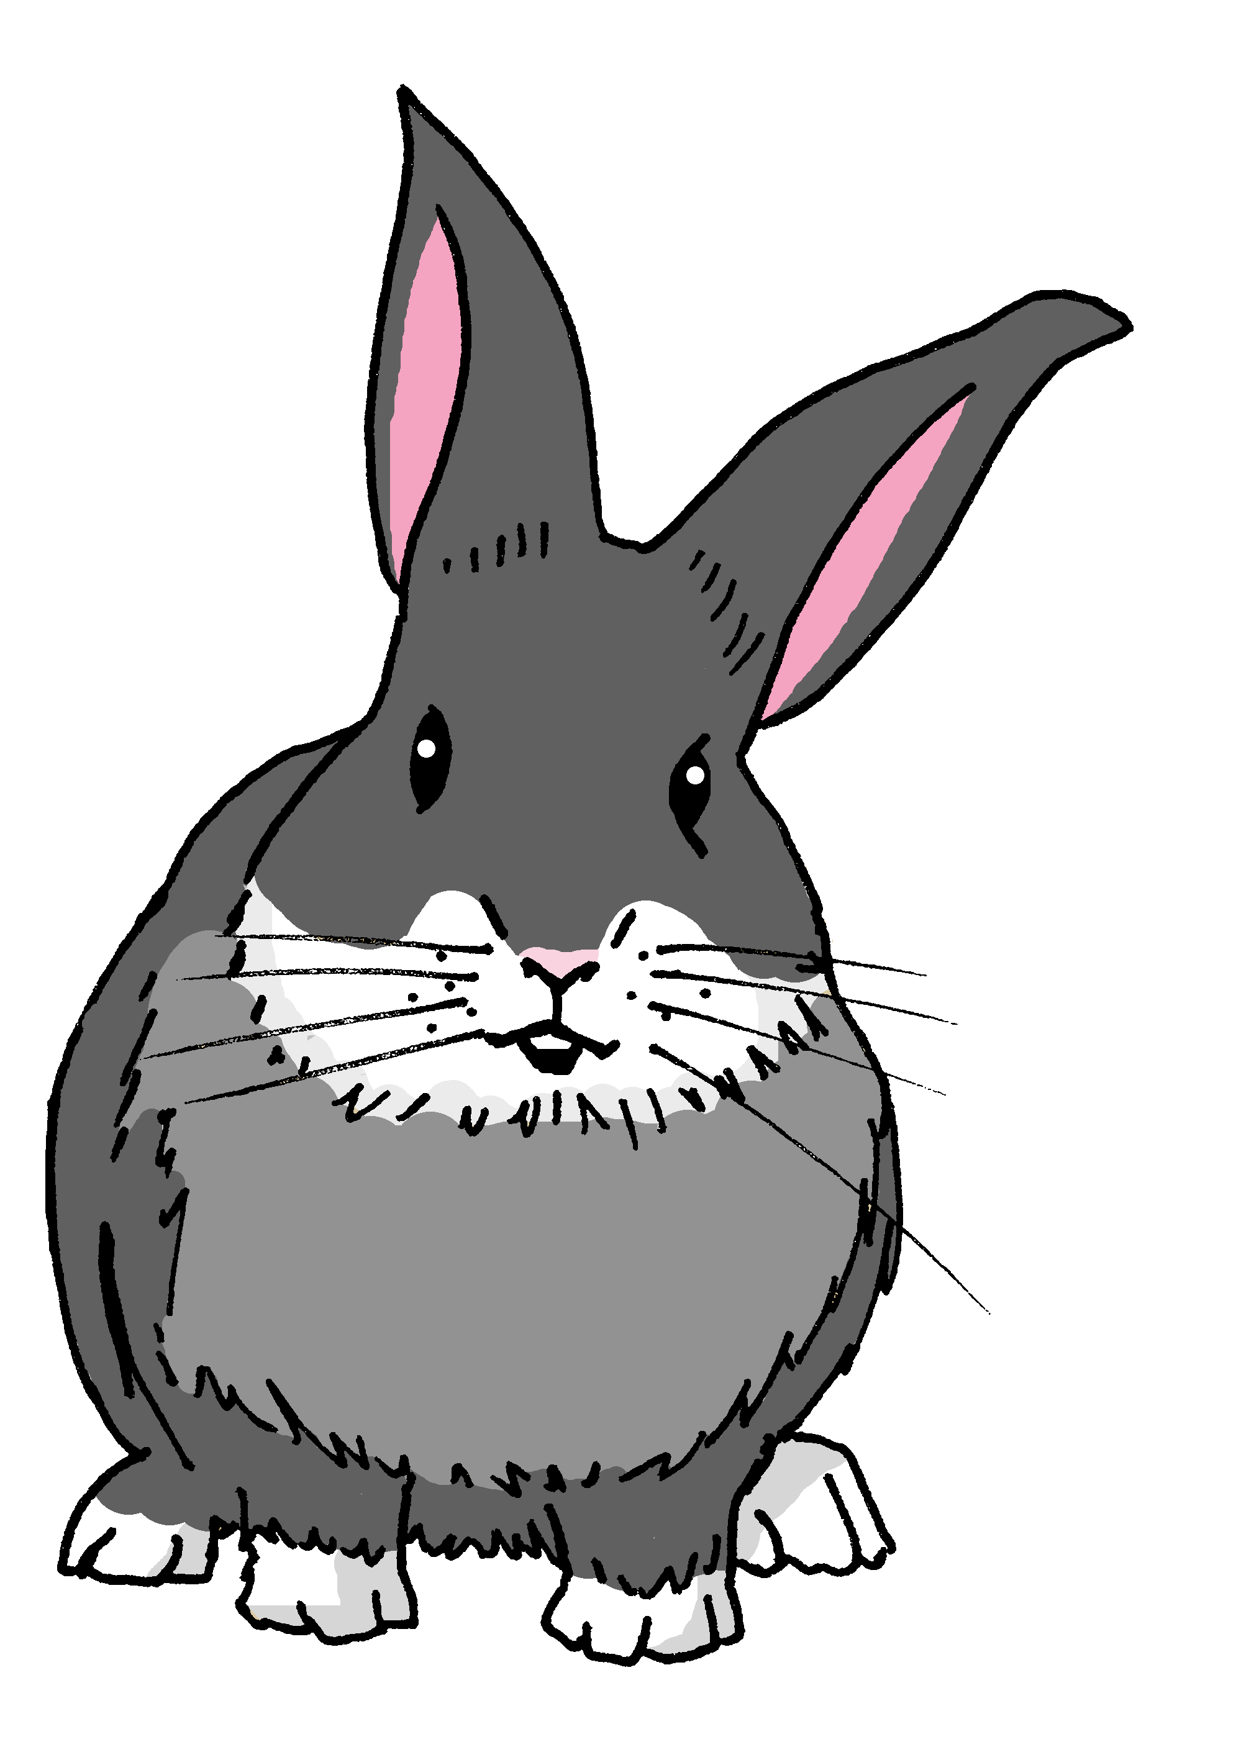
leer
Agua 💧 en los deberes* de Quique.
¡Manchita!
¡Lo siento!
Manchita has spilled water all over Quique’s English homework.
Lee las frases y marca .
Escribe el verbo en inglés .
Visitar una iglesia es interesante.
E
deberes = homework
General meaning | I
-Iffffalk-
Visiting a church is interesting.
Uso un libro en clase.
verbo
1
Iwpm
visiting
I use a book in class.
E
2
Crear es importante.
I use
Creating is important.
-tosintttg-
1
3
Buscar cosas es divertido.
creating
2
Searching for things is fun.
ttttistng
ttttistng
4
Visito un museo con mamá.
buscar
3
I visit a museum with mum.
Ineiyed
4
I visit
Notes:
Timing: 7 minutes
Aim: to practise written comprehension of key –ar verbs VS. infinitive verbs, including both possible translation into English (to __ / ing)
Procedure:
Read the title & click to explain the context of the task
Click to bring further instructions in Spanish.
Do [E] with them to model the task and draw their attention to the verb (hablo). Is it the general meaning or does it refer to ‘I’?
Pupils complete 1-5.
Click through the animations to bring up answers.
Ask pupils to translate the verbs into English. Remind students about the translation of the infinitive form of the verb in Spanish.
E. Visitar una iglesia es interesante.
Uso un libro en clase.
Crear es importante.
Es divertido buscar cosas.
Visito un museo con mamá.
Deber [2197]

Slide 9
Knowing who does what
⚠ We don’t need pronouns because the verb ending tells us who is doing the action.
[–ar verbs: ‘I’ versus ‘s/he, it’]
In Spanish, the words for ‘I’ and ‘s/he’ (pronouns) are often unnecessary.
To mean ‘I’ with a verb, we remove –ar and add -o.
To mean ‘s/he, it’ with a verb, we remove –ar and add –a.
Ejemplo: visitar
I
s/he, it
Visito un museo.
Visita una iglesia.
I visit a museum.
S/he visits a church.
Notes:
Timing: 3 minutes
Aim: to introduce 1st person singular for –ar verbs, building on the concept of the infinitive.
Procedure:
Click through the animations to present the new information.
Elicit English translations for the Spanish examples provided.

Slide 10
escuchar
Quique compara* su* fin de semana* con mamá
Escucha. ¿Quién es?
Escribe el verbo en español .
Marca .
Quique (I) | Mamá (she)
verbo
info extra
E
presenta
information
1
visito
a museum
2
creo
un dibujo
visita
una iglesia
3
compara = s/he compares
su = his/her
fin = end
(la) semana = week
4
visito
un parque
5
busca
una plaza
Notes:
Timing: 7 minutes
Aim: to practise aural recognition of 1st vs. 3rd person singular of –AR verbs in the present tense.
Procedure:
Read the context and click to bring up further instruction.
Pupils write 1-5 in their books.
Click to listen to the example. Quique is speaking Pupils tick whether they can hear the 1st person (I-Quique) or 3rd person singular (Mamá – she)
Do the example with them.
Play 1-5.
Go through answers for 1-5
Click to bring up part 2 of the task- at this time of listening pupils write the verb and any extra information in English.
Transcript:
E. Presenta información.
Visito un museo.
Creo un dibujo.
Visita una iglesia.
Visito un parque.
Busca una plaza.
comparar [1597] su [12] fin [182] semana [301]

Slide 11
¡adiós!
amarillo

