Slide 1

Saying what I and others do
amarillo
Follow ups 1-5
Notes:
Artwork by Steve Clarke. All additional pictures selected are available under a Creative Commons license, no attribution required.
The frequency rankings for words that occur in this PowerPoint which have been previously introduced in the resources are given in the SOW (excel document) and in the resources that first introduced and formally re-visited those words.
For any other words that occur incidentally in this PowerPoint, frequency rankings will be provided in the notes field wherever possible.
SSC: libro [1477]
Vocabulary: buscar [179] crear [239] presentar [235] usar [317] información [326] país [109] importante [171] divertido [2465] interesante [616] bien [78]
Revisit 1: tiene [19] dibujo [1726] hermano [333] hermana [3409] mesa [525] perro [888] profesor, profesora [501] puerta [274]
Revisit 2: clase [320] [en clase] cómodo [2237] pesado [2166] positivo [1188] ahora [81]
Glossed words: peligro [1170] abierto [654] extinción [4707] el/la [1] su [12] primo [1451]
Source: Davies, M. & Davies, K. (2018). A frequency dictionary of Spanish: Core vocabulary for learners (2nd ed.). Routledge: London

Slide 2

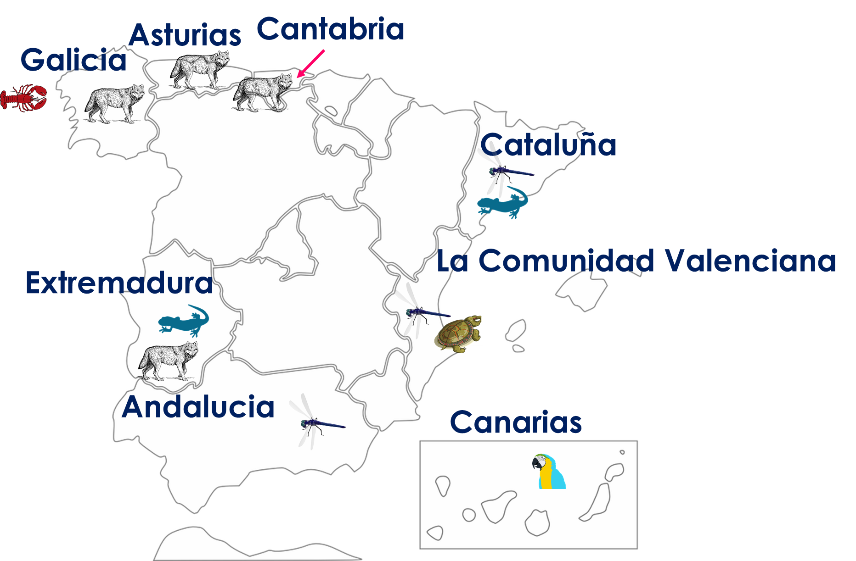
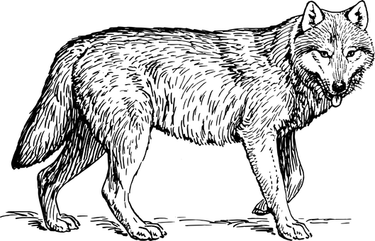

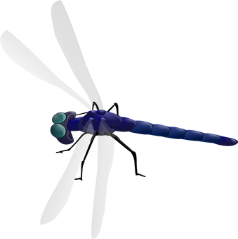

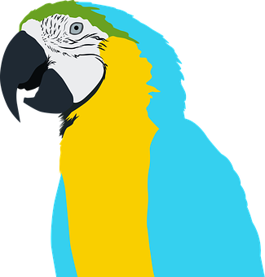
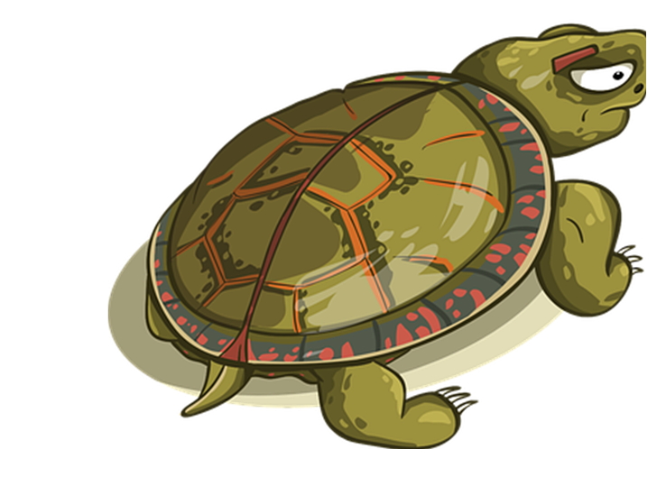

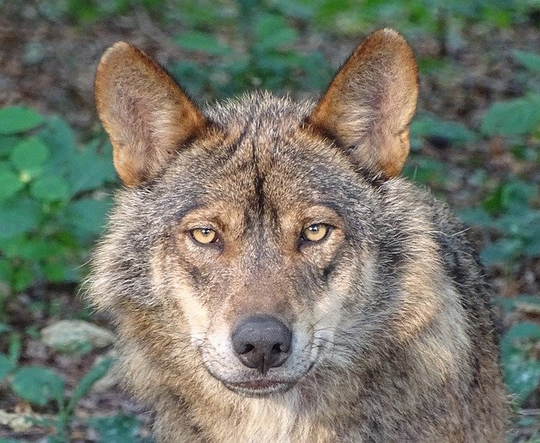

Follow up 1
[l] libro
A Escucha. Escribe 1-6 y A-F en orden.
B Observa el mapa. Completa frases.
Galicia
 | animal
 | [A] un lobo ibérico
 | [B] una salamandra
 | [C] una libélula
 | [D] una langosta
 | [E] un loro
 | [F] un galápago
__________ tiene ______
___________
un
3
lobo ibérico
2
6
1
5
4
El lobo ibérico está en peligro de extinción* ☹.
el = the (m) / la = the (f)
en peligro de extinción = endangered
Notes:
Timing: 5 minutes
Aim: to develop phonological awareness of [L]
Procedure:
Part A
Click to bring up the instruction.
Pupils write 1-6 before they listen and A-F as they listen, in the order in which they hear the animals.
Click to correct.
Part B
Click to bring up the instruction.
Partners A and B take it in turns to say sentences about the animals in different regions.
Read the information about el lobo ibérico.
Teachers circulate to listen to pupils’ pronunciation and praise/correct as necessary.
Transcript (Part A)
[1] una langosta
[2] una salamandra
[3] un lobo ibérico
[4] un galápago
[5] un loro
[6] una libélula

Slide 3


Follow up 2:
Vocabulario
¡Excelente!
vocabulario
3. divertido
8. información
5. importante
6. usar
1. presentar
10. increíble
9. buscar
2. vocabulario
4. crear
7. un país
to present, presenting
important
incredible
vocabulary
to create, creating
fun
to use, using
information
a country
to look for, looking for
Notes:
Timing: 5 minutes (two slides)
Aim: to practise written comprehension and spoken pronunciation of vocabulary.
Procedure:
1. Students write 1-10 in books.
2. Ask students to say the Spanish word and write down the English translation before the word has faded away (5 sec per word)
3. Click for English translation to be highlighted.
4. Repeat for all 11 items.
5. Go to next slide to check answers.
Note: Students have not yet done numbers but will be taught them explicitly in Term 2 Week 7. However, in the next few weeks, certain activities will prime for them. Here the teacher can say the number when eliciting the answers, but support understanding by holding up the appropriate number of fingers each time. Obviously, the items proceed in number order in any case, so the finger gesture is more to draw learners attention to the sound – meaning connection of the number with the Spanish word for that number.
ANSWERS
1. presentar
2. vocabulario
3. divertido
4. crear
5. importante
6. usar
7. un país
8. información
9. buscar
10. increíble

Slide 4
Follow up 2:
Respuestas
vocabulario
divertido
información
importante
usar
presentar
increíble
buscar
vocabulario
crear
un país
to present, presenting
important
incredible
vocabulary
to create, creating
fun
to use, using
information
a country
to look for, looking for
Notes:
Procedure:
1. Click to animate an English prompt.
2. Elicit the Spanish word from pupils.
3. Click to bring up the Spanish word (plus audio in the audio version).
4. Repeat for all the words.
Transcript:
1. presentar
2. importante
3. increíble
4. vocabulario
5. crear
6. divertido
7. usar
8. información
9. un país
10. buscar

Slide 5

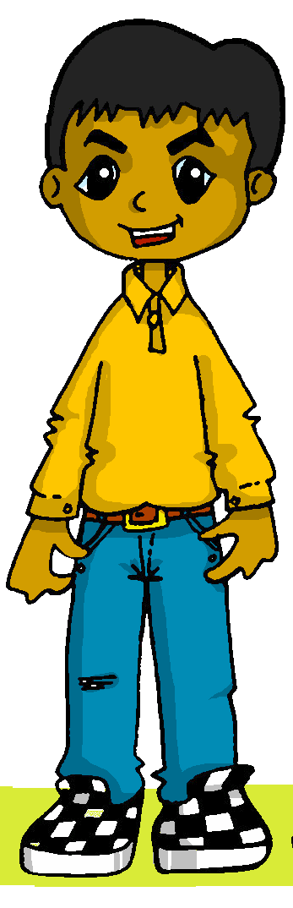




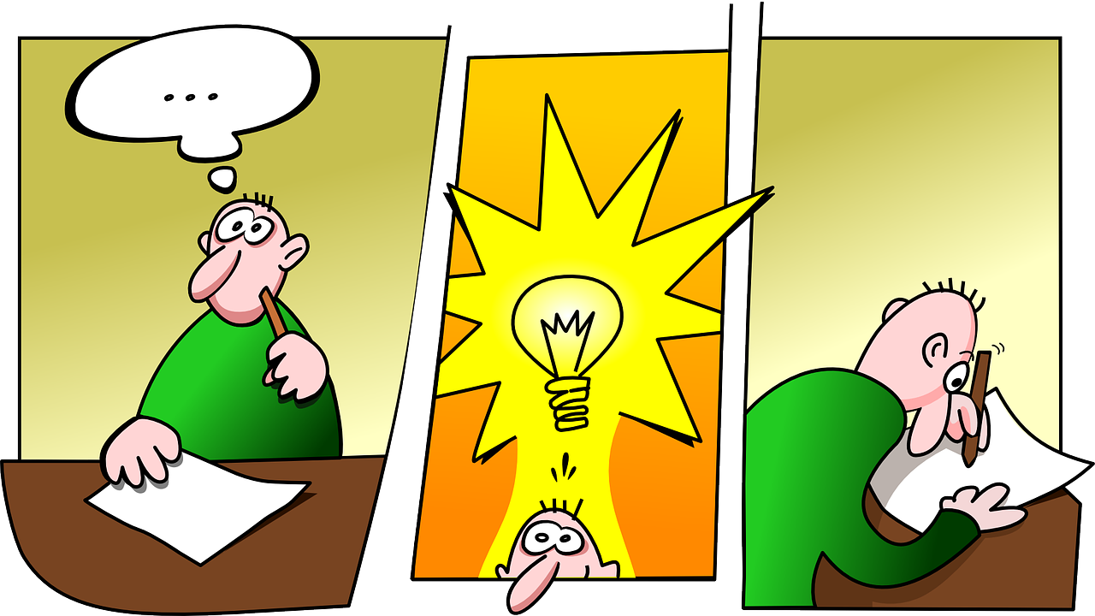

Follow up 3:
Quique habla con su* primo*, Luis.
Escucha. ¿Qué infinitivo es?
escuchar
Escribe la letra, y el adjetivo en inglés.
A
B
 | imagen | adjetivo | información extra
E
B
interesting
vocabulary
1
A
important
in class
[to create, creating]
[to present, presenting]
information of a country
2
C
fun
3
A
impossible
a new word
C
D
4
D
incredible
Spanish
5
C
fun
a new word
[to look for looking for]
[to use, using]
su = his/her
(el) primo = male cousin
Notes:
Timing: 5 minutes
Aim: to practise aural comprehension of this week’s new vocabulary. Connecting sound with meaning.
Procedure:
Read the title / context of the activity.
Click x2 to bring up instruction in Spanish. First time they listen to it, pupils to write the letter. Second time, pupils aim to write down the English meaning of the adjective. Most able pupils can attempt to write down any extra information.
To support pupil, elicit Spanish for A-D.
Do the example with them. Click to listen and bring up answer.
Pupils listen to 1-5.
Click to reveal answers.
Transcript:
Ej. Es interesante presentar vocabulario.
Es importante crear en clase.
Buscar infomación de un país es divertido.
Crear una palabra nueva es imposible.
Es increíble usar español.
Es divertido buscar una palabra nueva.
el/la [1] su [12] primo [1451]

Slide 6

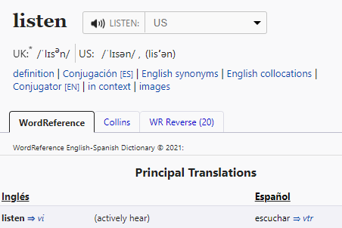

Follow up 4:
Infinitives [-ar verbs]
The infinitive form of a verb is the form you see in a dictionary.
[to ______]
Remember the infinitive often describes the general meaning of the verb.
In English, this is often written ‘to + verb’.
Ejemplo
Es interesante buscar información.
It’s interesting to look for for information.
You can also begin a sentence with the infinitive:
In this case, the Spanish infinitive is translate with the –ing form of the verb.
Ejemplo
Buscar información es interesante.
Looking for information is interesting.
Notes:
Timing: 10 minutes (3 slides in total)
Aim: to revisit the rule for the translation of the infinitives into English.
Procedure:
1. Click to bring up each new part of the explanation.
2. Elicit the English for the Spanish examples.

Slide 7



Follow up 4:
B Marca el verbo correcto ✅
leer
A Lee las frases.
 | Frase en español
 | Es importante usar vocabulario nuevo.
 | Presentar información en español es increíble.
 | Es divertido buscar una palabra.
 | Buscar una respuesta es interesante.
 | Crear en clase es importante.
 | Es divertido buscar información de un país.
verbo en inglés
to use | using | to look for | looking for
to present | presenting | to create | creating
presenting | to present | to look for | looking for
to look for | looking for | to use | using
to create | creating | to look for | looking for
using | to use | looking for | to look for
E
1
2
3
4
5
Notes:
Timing: 5 minutes
Aim: to revisit the position of the infinitive in Spanish and its translation into English.
Procedure:
Read the instruction in Spanish.
Click to bring up further instruction and clarify meaning.
Do the example with pupils. Paying attention to the position of the infinitive, pupils to identify the correct translation.
Pupils do 1-5.
Go through answers
Es importante usar vocabulario nuevo.
Presentar información en español es increíble.
Es divertido buscar una palabra.
Buscar una respuesta es interesante.
Crear en clase es importante.
Es divertido buscar información de un país.

Slide 8

Follow up 4:
B Escribe las frases en inglés.
escribir
bien = well
 | Frase en español | Frase en inglés
 | Es importante usar vocabulario nuevo.
 | Presentar información en español es increíble.
 | Es divertido buscar una palabra.
 | Buscar una respuesta es interesante.
 | Crear en clase es importante.
 | Es divertido buscar información de un país.
It’s important to use new vocabulary.
E
1
Presenting information in Spanish is incredible
2
It’s fun to look for a word.
3
Looking for an answer is interesting.
4
Creating in class is important.
It’s fun to look for information about a country.
5
Notes:
Timing: 5 minutes
Aim: to practise written comprehension of infinitives and adjectives.
Procedure:
Read the instruction in Spanish.
Pupils use their notes from [A] to translate the sentences.

Slide 9

Follow up 5
Persona B Lee una frase.
Persona A Lee una frase.
Turno 1
hablar
Turno 2
Persona A traduce.
Persona B traduce.
vocabulario
un país
un lápiz
un dibujo
una hoja
una palabra
un mensaje
una idea
una regla
en español
en inglés
en clase
importante
imposible
interesante
increíble
divertido
raro
crear
usar
buscar
presentar
es
traduce = s/he trasnlates
¡tiempo!
INICIO
Notes:
Timing: 5 minutes
Aim: To provide production practice (speaking) in question formation with question words.
Procedure:
1. In pairs, students take turns to create a sentence using a word from each set that makes sense. Note that not all combinations are possible.
2. In pairs, pupils translate their partners; sentence into English.
3. For higher challenge, suggest that only the student creating the sentences faces the board. This ensures that the listener relies only on the aural input for understanding.

Slide 10
Follow up [extra]:
Escribe 5 frases en español.
escribir
vocabulario
un país
un lápiz
un dibujo
una hoja
una palabra
un mensaje
una idea
una regla
en español
en inglés
en clase
importante
imposible
interesante
increíble
divertido
raro
to create
to use
to look for
to present
es
Notes:
Timing: 5-8 minutes
Aim: to practise guided written production of infinitives in combination with nouns and adjectives introduced this week and in previous weeks.
Procedure:
Pupils write 1 to 5 sentences (left to right).
Teachers can monitor understanding of the vocabulary revisited by asking pupils to also translate their sentences.
NB. Teachers can also choose the sentences for pupils to translate. Pupils could work in mini whiteboards.

