Slide 1

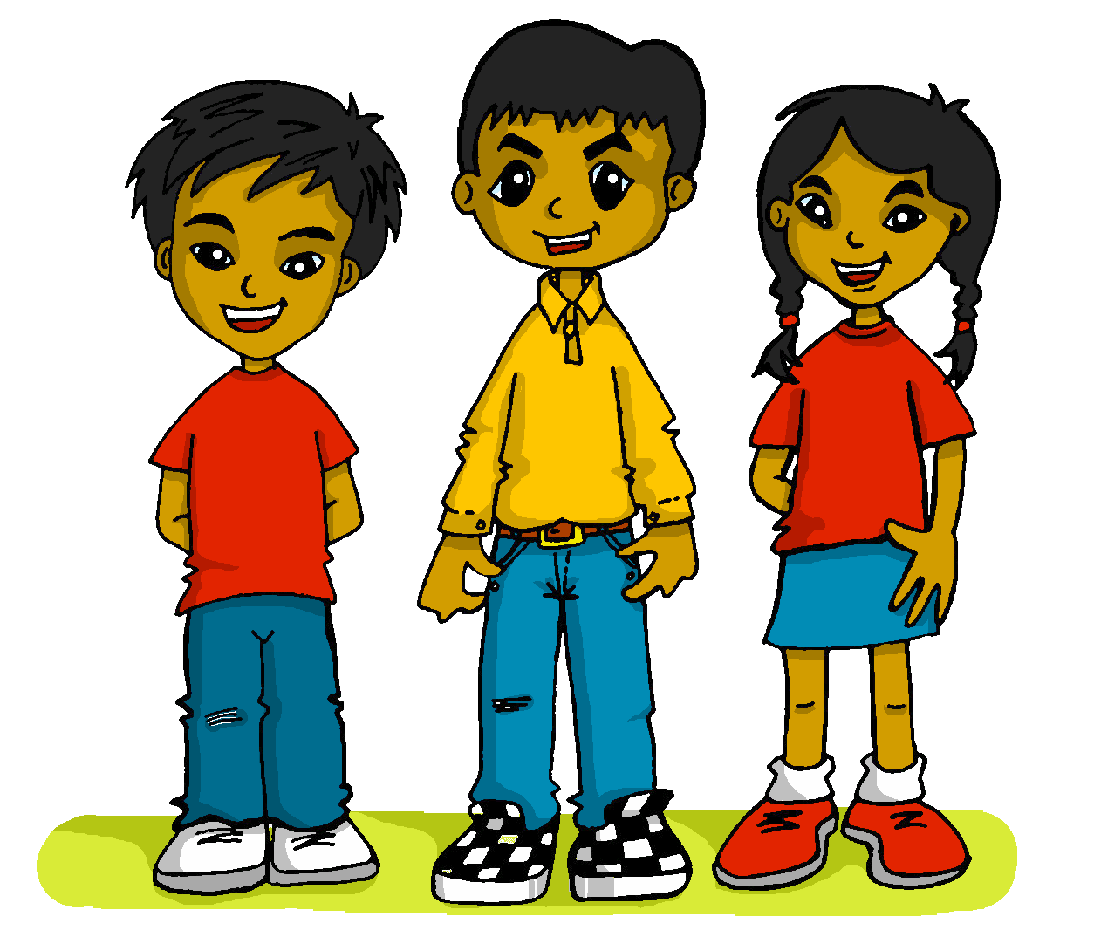
Saying how many and describing things
amarillo
- Phonics quiz
- Easter activities
Notes:
Artwork by Steve Clarke. All additional pictures selected are available under a Creative Commons license, no attribution required.
This lesson includes a phonics assessment of the SSC practised this term and a few from last term. The ratio of old to new SSC is approximately 50:50.
Word frequency:
pegamento [>5000] largo [300] singular [3669] nido [4017] pilar [3996] pillar [4901] nene [4061] furioso [3650] duque [4685] quinto [1586] compra [1662] cena [2542] cocinar [3074] almorzar [4018]
Source: Davies, M. & Davies, K. (2018). A frequency dictionary of Spanish: Core vocabulary for learners (2nd ed.). Routledge: London

Slide 2


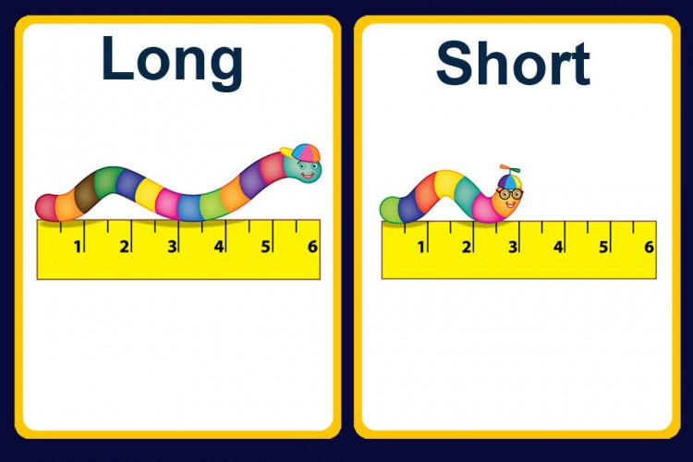
pronunciar
[ga]
[go]
pronunciar
pegamento
largo
Notes:
Phonics quiz
Timing: flexible during Week 11
Procedure:
Print out one set of these 14 phonics cards.
Working with one pupil at a time, elicit the pronunciation of each word.
Say: You have not learnt these words, but you have learnt how to read aloud these sounds, so just have a go at reading each word aloud.
Focus only on the accurate pronunciation of the target SSC and tolerate any other inaccuracies.
Use the pupil scoring sheet at the end of this presentation to assess SSC knowledge and give feedback.
Note: Whilst working with individual children, others can be doing the Easter activities at the end of this presentation.
2

Slide 3
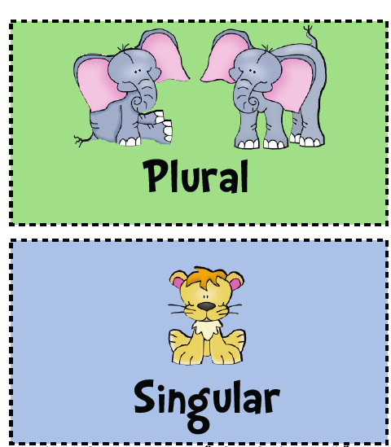

pronunciar
[gu]
[i]
pronunciar
[nest]
singular
nido
Notes:
3

Slide 4

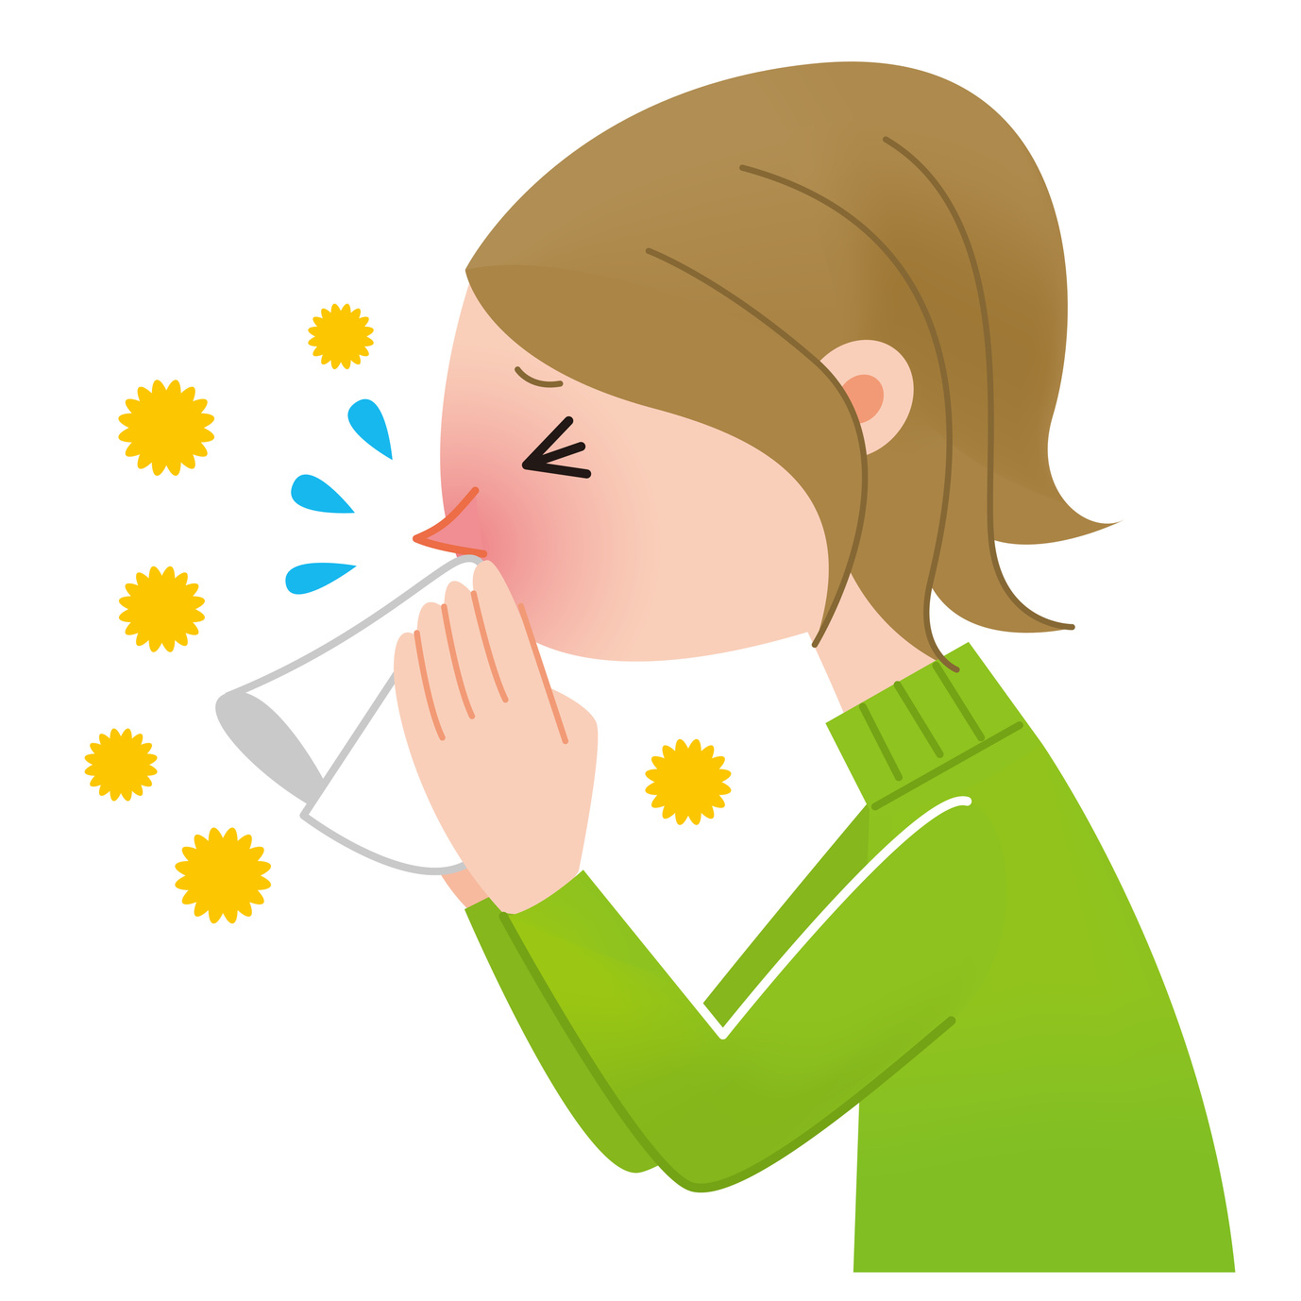
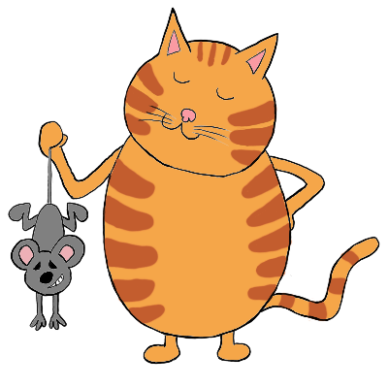
pronunciar
[l]
[ll]
pronunciar
[to catch]
pilar
pillar
Notes:
4

Slide 5


pronunciar
[e]
[u]
pronunciar
[little child, kid]
nene
furioso
Notes:
5

Slide 6
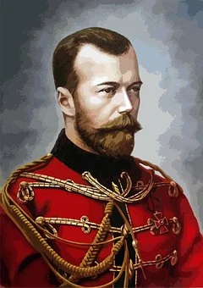

pronunciar
[que]
[qui]
pronunciar
duque
quinto
Notes:
6

Slide 7
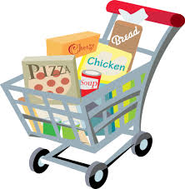

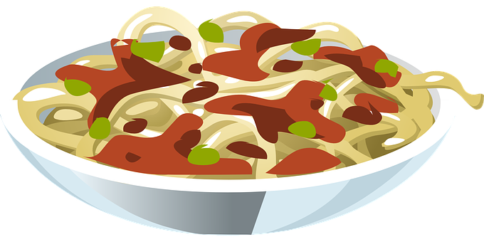
pronunciar
[co]
[ce]
pronunciar
[dinner]
compra
cena
Notes:
7

Slide 8
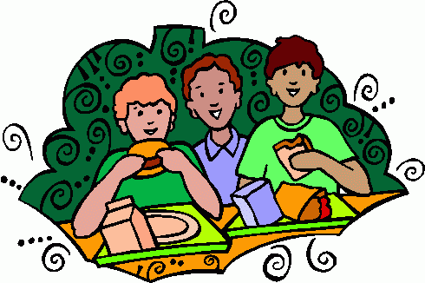
pronunciar
[ci]
[z]
pronunciar
[to have lunch]
cocinar
almorzar
Notes:
8

Slide 9
pronunciar
Pupil name:
Pupil name:
SSC and word | px
pegamento
largo
singular
nido
pilar
pillar
nene
furioso
duque
quito
compra
cena
cocinar
almorzar
SSC and word | px
pegamento
largo
singular
nido
pilar
pillar
nene
furioso
duque
quito
compra
cena
cocinar
almorzar
Notes:
Pupil feedback and assessment sheet
9

Slide 10


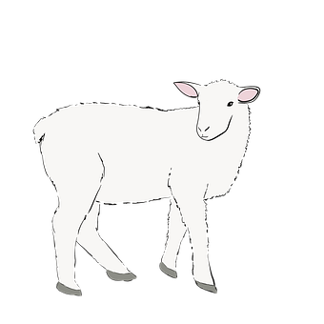
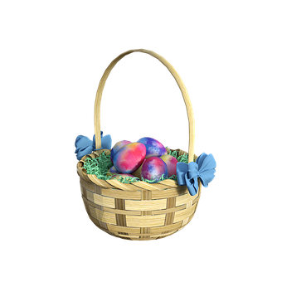
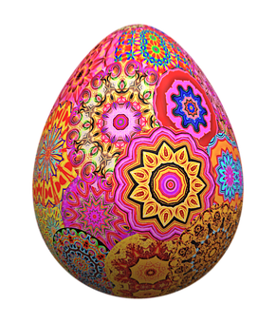
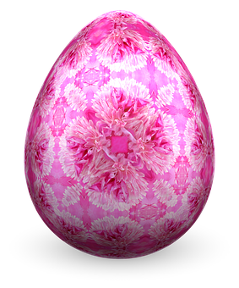




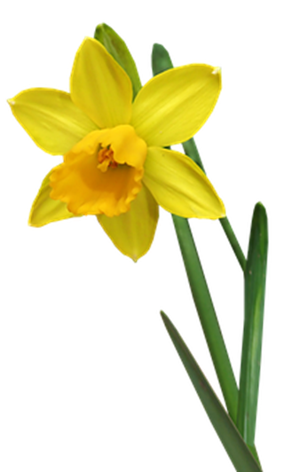

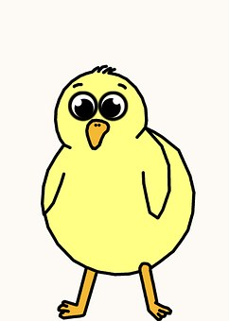
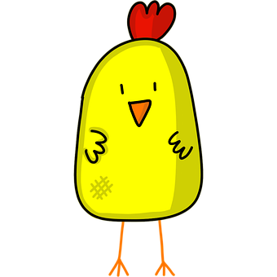
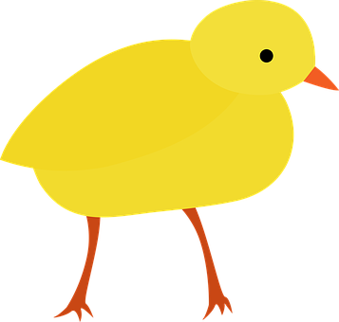
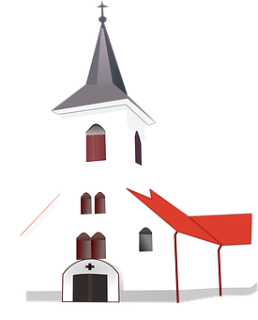


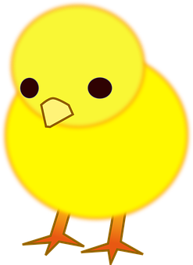
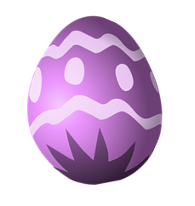
Actividad
1. Fill in the missing numbers on the eggs.
3. Count the Easter pictures and write how many you see.
¿Qué? | ¿Cuántos?
pollitos
corderos
cestas
narcisos
conejos
iglesias
huevos
cinco [5]
uno
dos
tres
cuatro
cinco
seis
siete
ocho [8]
2. Match each chick to an egg. Write the English translations below.
cuatro [4]
A
B
C
doce [12]
canta
canto
escucha
escuchas
hablas
dibujo
siete [7]
dos [2]
I
she
I
you
he
you
once [11]
I sing
she sings
he listens
you listen
I draw
you speak
_________
_________
________
_________
_____________
__________
Notes:
Timing: 10-15 mins (independent)
Aim: to provide written practice of Spanish numbers 1-12 and reading comprehension of singular verb endings and meanings.
This activity is designed as a worksheet for pupils to complete independently after completing assessments. Worksheet at end of this presentation. Answers on this slide. It should be used in conjunction with the next slide for activity 3.
Pupils fill in the missing Spanish numbers to complete the sequence.
Pupils match a chick to an appropriate egg by looking at the pronouns and verb endings. They then write the English translation below each chick.
Pupils count up the number of each type of Easter picture on the next slide in a kind of ‘I spy’ activity and write the number in Spanish.

Slide 11


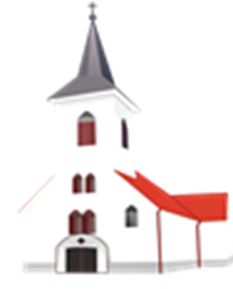



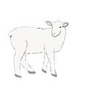
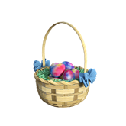


Uno, dos, tres
¿Qué ves? ¿ qué ves?
Notes:
‘I spy’ slide to be used for Activity 3 on previous slide/ worksheet.

Slide 12
Actividad
1. Fill in the missing numbers on the eggs.
3. Count the Easter pictures and write how many you see.
¿Qué? | ¿Cuántos?
pollitos
corderos
cestas
narcisos
conejos
iglesias
huevos
uno
tres
cinco
siete
2. Match each chick to an egg. Write the English translations below.
A
B
C
canta
canto
escucha
escuchas
hablas
dibujo
I
she
I
you
he
you
_________
_________
________
_________
_____________
__________
Notes:
HANDOUT

Slide 13

Teacher audio version
SSC and word | px
pegamento
largo
singular
nido
pilar
pillar
nene
SSC and word | px
furioso
duque
quito
compra
cena
cocinar
almorzar
Notes:
Teacher audio version for preparation
13

