Slide 1
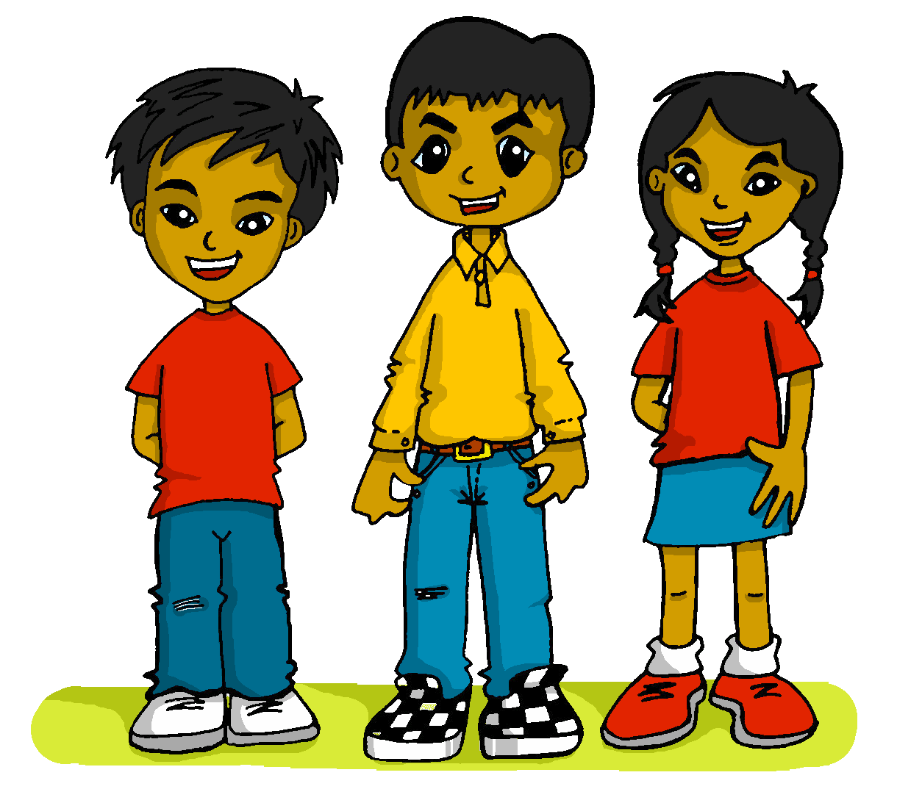
español, con Quique

Slide 2
Saying how many and describing things
amarillo
- Knowledge quiz
Notes:
Artwork by Steve Clarke. All additional pictures selected are available under a Creative Commons license, no attribution required.
The frequency rankings for words that occur in this PowerPoint which have been previously introduced in the resources are given in the SOW (excel document) and in the resources that first introduced and formally re-visited those words.
For any other words that occur incidentally in this PowerPoint, frequency rankings will be provided in the notes field wherever possible.
This lesson includes an assessment of the vocabulary and grammar knowledge from the first two terms of this year’s course. There is a phonics assessment in Week 11. Note: there are no follow up activities this week, but there is an Easter activity at the end of the quiz. This could be used in a follow up slot, more than once, during this week, as appropriate. The quiz can be completed on paper with pupils writing numbered answers. Alternatively there is a word document for printing. There is an answer sheet for teachers. Alternatively, answers are provided on slides for pupils to correct their own or a partner’s.
Source: Davies, M. & Davies, K. (2018). A frequency dictionary of Spanish: Core vocabulary for learners (2nd ed.). Routledge: London

Slide 3
escuchar
Vocabulary
At home, Nina speaks Aymara, a language spoken by Aymara people of Peru and Bolivia. She is learning Spanish at school, like you. Help Nina by answering the questions in this quiz.
A For each question, put a cross (x) under the English meaning that matches what you hear.
You will hear each Spanish word twice. Choose one correct answer only.
 | A | B | C | D
1. | eye | ear | orange | exercise
 | ☐ | ☐ | ☐ | ☐
2. | nine | Thursday | ten | Friday
 | ☐ | ☐ | ☐ | ☐
3. | what? | how many? | comfortable | how?
 | ☐ | ☐ | ☐ | ☐
1
2
3
Notes:
Timing: 20-25 minutes (all assessment slides)
Aim: to practise aural comprehension of vocabulary taught in terms 1 and 2 (weeks 1-23) of the course.
Procedure:
1. Click the audio buttons to play each item. (The words are recorded twice with a pause to allow pupils to process the information).
2. Pupils can either write 1C, etc.. or if they have the assessment on a print out they can put a X in the correct box.
3. After items 1-3, continue to the next slide to complete the remainder of the task.
Transcript:
1. oreja…..oreja
2. jueves…..jueves
3. cómo…..cómo 4. descansar…..descansar
5. hoy…..hoy
6. hacer…..hacer

Slide 4
escuchar
Vocabulary
A For each question, put a cross (x) under the English meaning that matches what you hear.
You will hear each Spanish word twice. Choose one correct answer only.
 | A | B | C | D
4. | to rest | to create | to present | to be (location)
 | ☐ | ☐ | ☐ | ☐
5. | hello | sheet | today | there is/are
 | ☐ | ☐ | ☐ | ☐
6. | I do | to learn | to do, make | to use
 | ☐ | ☐ | ☐ | ☐
4
5
6
Notes:
Timing: 20-25 minutes (all assessment slides)
Aim: to practise aural comprehension of vocabulary taught in weeks 1-23 of the course.
Procedure:
1. Click the audio buttons to play each item. (The words are recorded twice with a pause to allow pupils to process the information).
2. Pupils can either write 1C, etc.. or if they have the assessment on a print out they can put a X in the correct box.
Transcript:
1. oreja…..oreja
2. jueves…..jueves
3. cómo…..cómo
4. descansar…..descansar
5. hoy…..hoy
6. hacer…..hacer

Slide 5
escuchar
Vocabulary
B For each question, put a cross (x) under the type of word you hear. You will hear each Spanish word twice. Choose one correct answer only.
This word is a good example of …
 | A | B | C | D
Ej. | food ☐ | a place ☐ | an object ☐ | a greeting ☐
1. | a country ☐ | a day of the week ☐ | an object ☐ | a number ☐
2. | a greeting ☐ | a colour ☐ | a place ☐ | a part of the body ☐
3. | a mood or character ☐ | a day of the week ☐ | a number ☐ | an action ☐
4. | a number ☐ | an action ☐ | a place ☐ | an object ☐
1
2
3
4
5
Notes:
Procedure:
1. Click the audio buttons to play each item. (The words are recorded twice with a pause to allow pupils to process the information).
2. Pupils can either write 1C, etc.. or if they have the assessment on a print out they can put a X in the correct box.
3. When complete, continue to the next task.
Transcript:
estadio..…estadio
revista…..revista
boca…boca
once…..once
responder…..responder

Slide 6
escuchar
Grammar
C Put a cross (x) next to the person or people that the sentence is about. You will hear each Spanish sentence twice.
1. | I | ☐ | you | ☐ | he/she | ☐
2. | I | ☐ | you | ☐ | he/she | ☐
3. | I | ☐ | you | ☐ | he/she | ☐
4. | I | ☐ | you | ☐ | he/she | ☐
5. | I | ☐ | you | ☐ | he/she | ☐
 | I | ☐ | you | ☐ | he/she | ☐
1
2
3
4
5
6
Notes:
Procedure:
1. Click the audio buttons to play each item. (The words are recorded twice with a pause to allow pupils to process the information).
2. Pupils can either write 1C, etc.. or if they have the assessment on a print out they can put a X in the correct box.
3. When complete, continue to the reading.
Transcript:
1. Monto en bicicleta.
2. Paseas por la ciudad.
3. Aprendes la información.
4. Busca un parque.
5. Hace una actividad.
6. Uso un instrumento.

Slide 7
leer
A Translate the underlined Spanish word to complete each English sentence.
1. Aprendo el libro. I _____________ the book.
2. Hay cinco días There are ___________ days.
3. La idea es divertida. The idea is_____________ .
4. ¿Usas un lápiz? Do you use ___________?
5. ¿Responde a la profesora? Is s/he _____________ the teacher?
6. Tiene tres dedos. It has three _____________ .
7. Estoy en el campo. I am in ___________________.
8. El país es interesante. The _____________ is interesting.
9. La habitación es rara. The __________ is strange.
10. El mensaje es en inglés. The message is _____________ .
Notes:
Aim: to practise written recall of previously taught vocabulary.
Procedure:
Ensure that the task is clear.
Pupils could write 1 – 10 and the individual English word meanings (or they could fill in if they have printed assessment sheets).

Slide 8
escribir
B Translate the underlined English words to complete the Spanish sentence.
1. I visit the church with dad. Visito la iglesia _____ __________. (write two words)
2. You are from Spain. _________ _____ España. (write two words)
3. The square is old. ______ __________ es vieja. (write two words)
4. You are in class. Estás ____ __________. (write two words)
5. Eating is important. __________ es importante. (write one word)
6. What? A dog? ¿__________? ¿un perro? (write one word)
7. I’m reading a piece of news. Leo una ___________. (write one word)
8. It’s important to do exercise in the afternoon. (write three words)
Es importante hacer ejercicio ____ ____ __________.
Notes:
Aim: to practise written production of previously taught vocabulary.
Procedure:
Ensure that the task is clear.
Pupils could write 1 – 10 and the individual English word meanings (or they could fill in if they have printed assessment sheets).

Slide 9
escribir
C Write the opposite word in Spanish.
1. ¡Buenas tardes! - ________________ 2. allí - _____________ 3. no - __________________
4. el pie - ______________
5. el padre - ________
Notes:
Aim: to practise written production of previously taught vocabulary.
Procedure:
Ensure that the task is clear.
Pupils could write the answers only (or they could fill in if they have printed assessment sheets).

Slide 10
leer
Grammar
Like English, Aymara doesn’t have grammatical gender and adjectives go before the noun. Verb forms are different, too. Help Nina with her Spanish grammar by answering the questions in this part of the quiz.
A
1 | ☐ I ☐ you _{[singular]} ☐ she, he, it | Tengo una regla. |  | 4 | ☐ I ☐ you _{[singular]} ☐ she, he, it | Lee en español.
2 | ☐ I ☐ you _{[singular]} ☐ she, he, it | Buscas información. |  | 5 | ☐ I ☐ you _{[singular]} ☐ she, he, it | Presento la idea.
3 | ☐ I ☐ you _{[singular]} ☐ she, he, it | Crea un dibujo. |  | 6 | ☐ I ☐ you _{[singular]} ☐ she, he, it | Estás contento.
Notes:
Aim: to practise written recall of previously taught grammar.
Procedure:
Ensure that the task is clear.
Pupils could write the correct English pronouns (or they could fill in if they have printed assessment sheets).

Slide 11
leer
Grammar
B Put a (X) next to the English meaning that seems best for the Spanish word in bold.
1. Es importante tener ideas. | a) having | ☐
 | b) to have | ☐
2. Leer es interesante. | a) to read | ☐
 | b) reading | ☐
C Put a (X) next to the words that could finish this sentence. Remember the personal ‘a’.
1. Veo a ... | a) mamá. | ☐
 | b) un animal. | ☐
2. Visito... | a) un hermano de Juan. | ☐
 | b) el museo. | ☐
Notes:
Aim: to practise written recall of previously taught grammar.
Procedure:
Ensure that the task is clear.
Pupils could write the correct English pronouns (or they could fill in if they have printed assessment sheets).

Slide 12
escribir
D Write the Spanish word for ‘a’. 1. _______ ordenador (m) 2. _______ mesa (f)
E Write the Spanish word for ‘the’.
1. ________ puerta. (f) 2. ________ español. (m) F Write the Spanish word for ‘some’. 1. _______ dibujos (mpl) 2. _______ cartas (fpl)
G Write the Spanish word for ‘how many’.
1. ¿ ________ palabras? (fpl) 2. ¿ ________ bocadillos? (mpl)
Notes:
Aim: to practise written production of previously taught grammar
Procedure:
Ensure that the task is clear.
Pupils could write the answers only (or they could fill in if they have printed assessment sheets).

Slide 13
Saying how many and describing things
amarillo
- Knowledge quiz
Notes:
Artwork by Steve Clarke. All additional pictures selected are available under a Creative Commons license, no attribution required.
The frequency rankings for words that occur in this PowerPoint which have been previously introduced in the resources are given in the SOW (excel document) and in the resources that first introduced and formally re-visited those words.
For any other words that occur incidentally in this PowerPoint, frequency rankings will be provided in the notes field wherever possible.
This lesson includes an assessment of the vocabulary and grammar knowledge from the first two terms of this year’s course. There is a phonics assessment in Week 11. Note: there are no follow up activities this week, but there is an Easter activity at the end of the quiz. This could be used in a follow up slot, more than once, during this week, as appropriate. The quiz can be completed on paper with pupils writing numbered answers. Alternatively there is a word document for printing. There is an answer sheet for teachers. Alternatively, answers are provided on slides for pupils to correct their own or a partner’s.
Source: Davies, M. & Davies, K. (2018). A frequency dictionary of Spanish: Core vocabulary for learners (2nd ed.). Routledge: London

Slide 14
escuchar
Vocabulary
At home, Nina speaks Aymara, a language spoken by Aymara people of Peru and Bolivia. She is learning Spanish at school, like you. Help Nina by answering the questions in this quiz.
A For each question, put a cross (x) under the English meaning that matches what you hear.
You will hear each Spanish word twice. Choose one correct answer only.
 | A | B | C | D
1. | eye | ear | orange | exercise
 | ☐ | ☐ | ☐ | ☐
2. | nine | Thursday | ten | Friday
 | ☐ | ☐ | ☐ | ☐
3. | what? | how many? | comfortable | how?
 | ☐ | ☐ | ☐ | ☐
1
2
3
Notes:
Timing: 20-25 minutes (all assessment slides)
Aim: to practise aural comprehension of vocabulary taught in terms 1 and 2 (weeks 1-23) of the course.
Procedure:
1. Click the audio buttons to play each item. (The words are recorded twice with a pause to allow pupils to process the information).
2. Pupils can either write 1C, etc.. or if they have the assessment on a print out they can put a X in the correct box.
3. After items 1-3, continue to the next slide to complete the remainder of the task.
Transcript:
1. oreja…..oreja
2. jueves…..jueves
3. cómo…..cómo 4. descansar…..descansar
5. hoy…..hoy
6. hacer…..hacer

Slide 15
escuchar
Vocabulary
A For each question, put a cross (x) under the English meaning that matches what you hear.
You will hear each Spanish word twice. Choose one correct answer only.
 | A | B | C | D
4. | to rest | to create | to present | to be (location)
 | ☐ | ☐ | ☐ | ☐
5. | hello | sheet | today | there is/are
 | ☐ | ☐ | ☐ | ☐
6. | I do | to learn | to do, make | to use
 | ☐ | ☐ | ☐ | ☐
4
5
6
Notes:
Timing: 20-25 minutes (all assessment slides)
Aim: to practise aural comprehension of vocabulary taught in weeks 1-23 of the course.
Procedure:
1. Click the audio buttons to play each item. (The words are recorded twice with a pause to allow pupils to process the information).
2. Pupils can either write 1C, etc.. or if they have the assessment on a print out they can put a X in the correct box.
Transcript:
1. oreja…..oreja
2. jueves…..jueves
3. cómo…..cómo
4. descansar…..descansar
5. hoy…..hoy
6. hacer…..hacer

Slide 16
escuchar
Vocabulary
B For each question, put a cross (x) under the type of word you hear. You will hear each Spanish word twice. Choose one correct answer only.
This word is a good example of …
 | A | B | C | D
Ej. | food ☐ | a place ☐ | an object ☐ | a greeting ☐
1. | a country ☐ | a day of the week ☐ | an object ☐ | a number ☐
2. | a greeting ☐ | a colour ☐ | a place ☐ | a part of the body ☐
3. | a mood or character ☐ | a day of the week ☐ | a number ☐ | an action ☐
4. | a number ☐ | an action ☐ | a place ☐ | an object ☐
1
2
3
4
5
Notes:
Procedure:
1. Click the audio buttons to play each item. (The words are recorded twice with a pause to allow pupils to process the information).
2. Pupils can either write 1C, etc.. or if they have the assessment on a print out they can put a X in the correct box.
3. When complete, continue to the next task.
Transcript:
estadio..…estadio
revista…..revista
boca…boca
once…..once
responder…..responder

Slide 17
escuchar
Grammar
C Put a cross (x) next to the person or people that the sentence is about. You will hear each Spanish sentence twice.
1. | I | ☐ | you | ☐ | he/she | ☐
2. | I | ☐ | you | ☐ | he/she | ☐
3. | I | ☐ | you | ☐ | he/she | ☐
4. | I | ☐ | you | ☐ | he/she | ☐
5. | I | ☐ | you | ☐ | he/she | ☐
 | I | ☐ | you | ☐ | he/she | ☐
1
2
3
4
5
6
Notes:
Procedure:
1. Click the audio buttons to play each item. (The words are recorded twice with a pause to allow pupils to process the information).
2. Pupils can either write 1C, etc.. or if they have the assessment on a print out they can put a X in the correct box.
3. When complete, continue to the reading.
Transcript:
1. Monto en bicicleta.
2. Paseas por la ciudad.
3. Aprendes la información.
4. Busca un parque.
5. Hace una actividad.
6. Uso un instrumento.

Slide 18
leer
A Translate the underlined Spanish word to complete each English sentence.
1. Aprendo el libro. I _____________ the book.
2. Hay cinco días There are ___________ days.
3. La idea es divertida. The idea is_____________ .
4. ¿Usas un lápiz? Do you use ___________?
5. ¿Responde a la profesora? Is s/he _____________ the teacher?
6. Tiene tres dedos. It has three _____________ .
7. Estoy en el campo. I am in ___________________.
8. El país es interesante. The _____________ is interesting.
9. La habitación es rara. The __________ is strange.
10. El mensaje es en inglés. The message is _____________ .
learn
five
fun/funny
a pencil
answering
fingers
the country(side)
country
room
in English
Notes:
Aim: to practise written recall of previously taught vocabulary.
Procedure:
Ensure that the task is clear.
Pupils could write 1 – 10 and the individual English word meanings (or they could fill in if they have printed assessment sheets).

Slide 19
escribir
B Translate the underlined English words to complete the Spanish sentence.
1. I visit the church with dad. Visito la iglesia _____ __________. (write two words)
2. You are from Spain. _________ _____ España. (write two words)
3. The square is old. ______ __________ es vieja. (write two words)
4. You are in class. Estás ____ __________. (write two words)
5. Eating is important. __________ es importante. (write one word)
6. What? A dog? ¿__________? ¿un perro? (write one word)
7. I’m reading a piece of news. Leo una ___________. (write one word)
8. It’s important to do exercise in the afternoon. (write three words)
Es importante hacer ejercicio ____ ____ __________.
con papá
Eres de
La plaza
en clase
Comer
Qué
noticia
por la tarde
Notes:
Aim: to practise written production of previously taught vocabulary.
Procedure:
Ensure that the task is clear.
Pupils could write 1 – 10 and the individual English word meanings (or they could fill in if they have printed assessment sheets).

Slide 20
escribir
C Write the opposite word in Spanish.
1. ¡Buenas tardes! - ________________ 2. allí - _____________ 3. no - __________________
4. el pie - ______________
5. el padre - ________
¡Buenos días!
aquí
sí
la cabeza
la madre
Notes:
Aim: to practise written production of previously taught vocabulary.
Procedure:
Ensure that the task is clear.
Pupils could write the answers only (or they could fill in if they have printed assessment sheets).

Slide 21
leer
Grammar
Like English, Aymara doesn’t have grammatical gender and adjectives go before the noun. Verb forms are different, too. Help Nina with her Spanish grammar by answering the questions in this part of the quiz.
A
1 | ☐ I ☐ you _{[singular]} ☐ she, he, it | Tengo una regla. |  | 4 | ☐ I ☐ you _{[singular]} ☐ she, he, it | Lee en español.
2 | ☐ I ☐ you _{[singular]} ☐ she, he, it | Buscas información. |  | 5 | ☐ I ☐ you _{[singular]} ☐ she, he, it | Presento la idea.
3 | ☐ I ☐ you _{[singular]} ☐ she, he, it | Crea un dibujo. |  | 6 | ☐ I ☐ you _{[singular]} ☐ she, he, it | Estás contento.
Notes:
Aim: to practise written recall of previously taught grammar.
Procedure:
Ensure that the task is clear.
Pupils could write the correct English pronouns (or they could fill in if they have printed assessment sheets).

Slide 22
leer
Grammar
B Put a (X) next to the English meaning that seems best for the Spanish word in bold.
1. Es importante tener ideas. | a) having | ☐
 | b) to have | ☐
2. Leer es interesante. | a) to read | ☐
 | b) reading | ☐
C Put a (X) next to the words that could finish this sentence. Remember the personal ‘a’.
1. Veo a ... | a) mamá. | ☐
 | b) un animal. | ☐
2. Visito... | a) un hermano de Juan. | ☐
 | b) el museo. | ☐
Notes:
Aim: to practise written recall of previously taught grammar.
Procedure:
Ensure that the task is clear.
Pupils could write the correct English pronouns (or they could fill in if they have printed assessment sheets).

Slide 23
escribir
D Write the Spanish word for ‘a’. 1. _______ ordenador (m) 2. _______ mesa (f)
E Write the Spanish word for ‘the’.
1. ________ puerta. (f) 2. ________ español. (m) F Write the Spanish word for ‘some’. 1. _______ dibujos (mpl) 2. _______ cartas (fpl)
G Write the Spanish word for ‘how many’.
1. ¿ ________ palabras? (fpl) 2. ¿ ________ bocadillos? (mpl)
un
una
la
el
unos
unas
Cuántas
Cuántos
Notes:
Aim: to practise written production of previously taught grammar
Procedure:
Ensure that the task is clear.
Pupils could write the answers only (or they could fill in if they have printed assessment sheets).

