Slide 1
español, con Quique

Slide 2
Describing me and others
amarillo
- Gender & articles
- tener’: 1st person singular
- SSC [ce]
Notes:
Artwork by Steve Clarke. All additional pictures selected are available under a Creative Commons license, no attribution required.
The frequency rankings for words that occur in this PowerPoint which have been previously introduced in the resources are given in the SOW (excel document) and in the resources that first introduced and formally re-visited those words.
For any other words that occur incidentally in this PowerPoint, frequency rankings will be provided in the notes field wherever possible.
Vocabulary: tener [19] tengo [19] bolígrafo [>5000] cuaderno [3301] caballo [907] barco [1384] pelota [2270] planta [768] un [6] una [6]
SSC: centro [317]
Source: Davies, M. & Davies, K. (2018). A frequency dictionary of Spanish: Core vocabulary for learners (2nd ed.). Routledge: London

Slide 3
pronunciar
[ce]
centro
Notes:
Timing: 1 minute
Aim: To introduce SSC [ce]
Procedure:
Introduce and elicit the pronunciation of the individual SSC [ce] and then the source word ‘centro’ (with gesture, if using).
Click to bring the picture & get students to repeat (with gesture, if using).

Slide 4
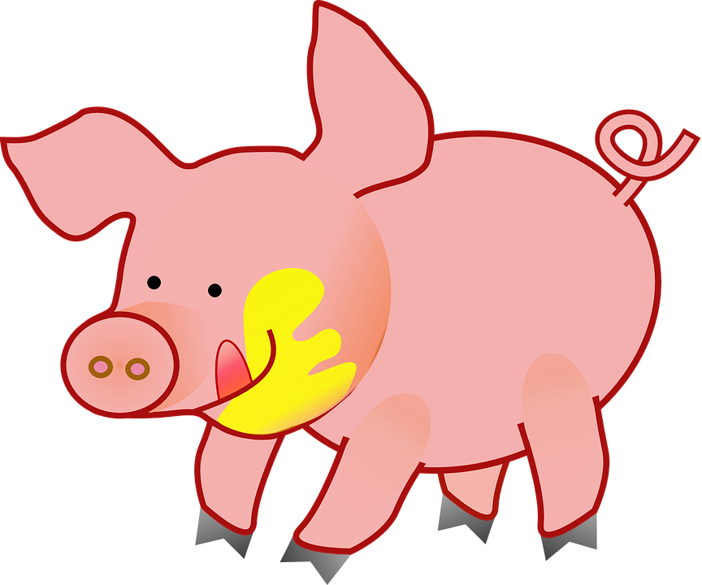
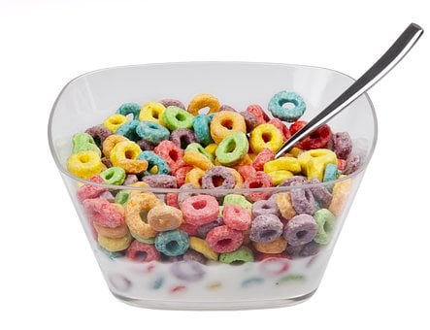
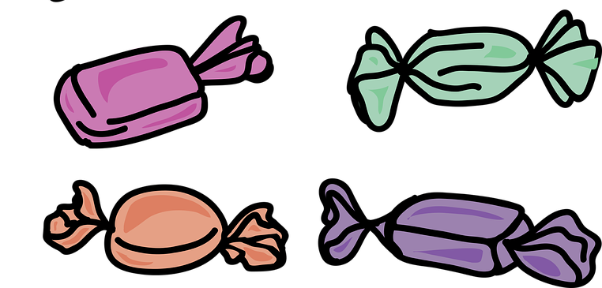
pronunciar
Escucha: ¿Cuántas veces escuchas [ce]?
Marca
La cerdita Celia come caramelos y cena cereales.
Practica con tu compa؜ñero.
12:30
19:30
Notes:
Timing: 2 minutes
Aim: To develop phonological awareness of [ce]
Procedure:
Teacher reads the instruction in Spanish. Use gesture to ensure meaning of ‘cuántas veces’ is clear. Click x1 to bring up the rest of the instruction (‘marca’). Pupils to keep a tally of how many times they hear [ce]
Click to bring up answers (x4 in total)
Click to bring up next task. Pupils to practise the sentence out loud (it combines [ce] with previously met SSC [ca] [co] [cu].

Slide 5
Gender in Spanish
Many masculine nouns in –o whereas many feminine nouns often end in –a.
Indefinite articles: a/an
Things and animals, as well as people, have a gender in Spanish. This means that they are either masculine or feminine:
To say a (or an) in Spanish before a noun, you use un or una, depending on whether the noun is masculine or feminine.
Masculine
Feminine
un
universo
a universe
una
idea
an idea
un
caballo
an bed
a horse
una
cama
a boat
a plant
un
barco
una
planta
Notes:
Timing: 3 minutes
Aim: to introduce grammatical gender and singular indefinite articles (un/una).
Procedure:
Read the grammar explanation on gender in Spanish.
Click x3 to bring examples of masculine nouns
Click x3 to bring examples of feminine nouns.
Click x3 to bring masculine indefinite article.
Elicit English meaning from students and click x3 to bring answers.
Click x3 to bring feminine indefinite articles.
Elicit English meaning from students and click x3 to bring answers.
These example nouns are all taken from the SSC source/cluster words from weeks 1-8 except teléfono [866]. Students should already familiar with these from their phonics learning.

Slide 6
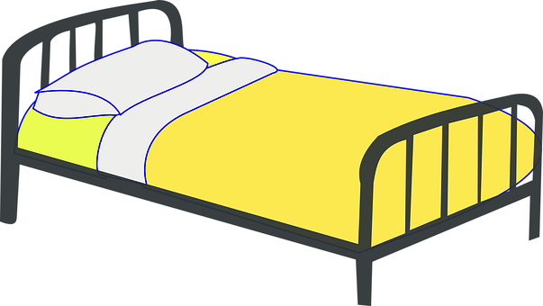
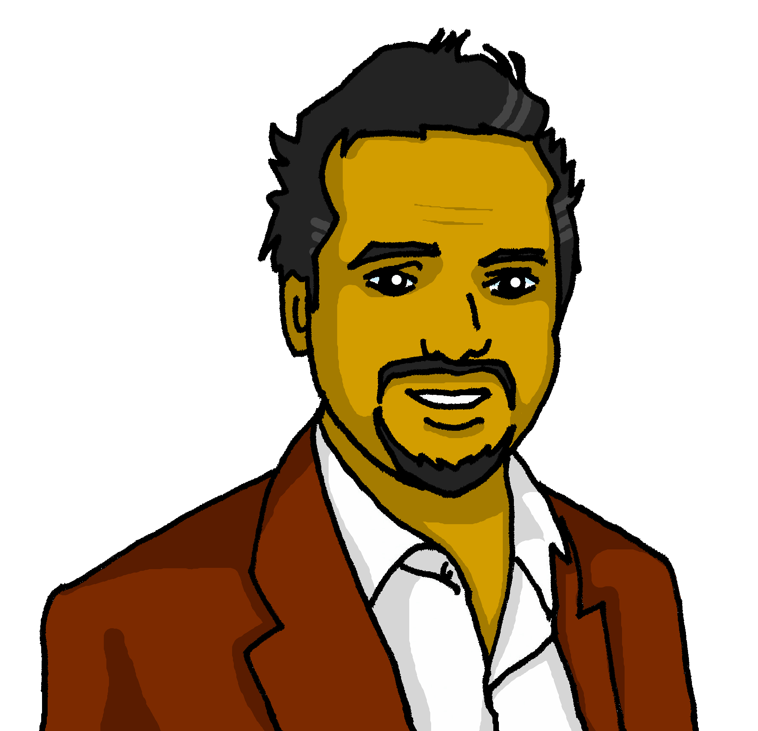
escuchar
La cama de Sofía
Sofía needs to tidy up her bed. Pedro, her dad, is not impressed.
Pedro lee la lista.
¿Menciona un o una?
 | un / una | planta | teléfono
 | un / una | libro | fruta
 | un / una | instrumento | bolsa
 | un / una | cama | barco
 | un / una | caballo | cucaracha
E
E
1
1
¡Qué desastre, Sofía!
2
2
3
3
4
4
Notes:
Timing: 4 minutes
Aim: to practise aural distinction of un / una and their association with a set of masculine and feminine nouns.
Procedure:
Read the title & click to bring up the instructions in Spanish.
Do the example (E). (Note: some learners will benefit from being able to circle the words on the sheet). Draw their attention to the nouns – selecting the correct article will help them work out which noun is correct in this and the next task (Reading task in next slide – focus on meaning).
Click to bring answers.
Click to bring up a 2nd set of audio buttons to hear the article and noun together.
Pupils check their answers.
Click to confirm the answers.
Transcript
Ej. Una [planta]
Un [libro]
Una [bolsa]
Un [barco]
Un [caballo]

Slide 7
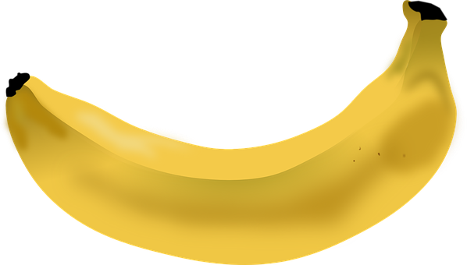
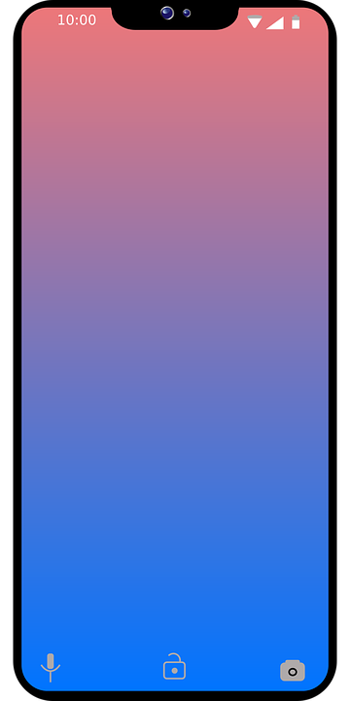
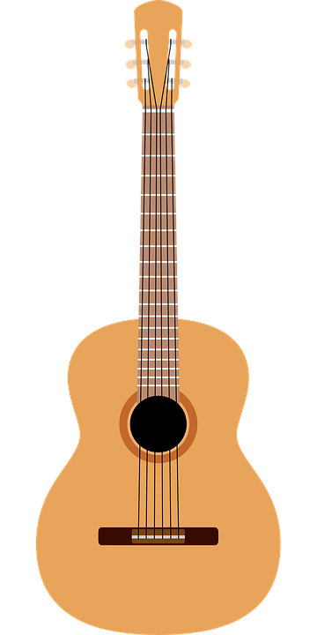
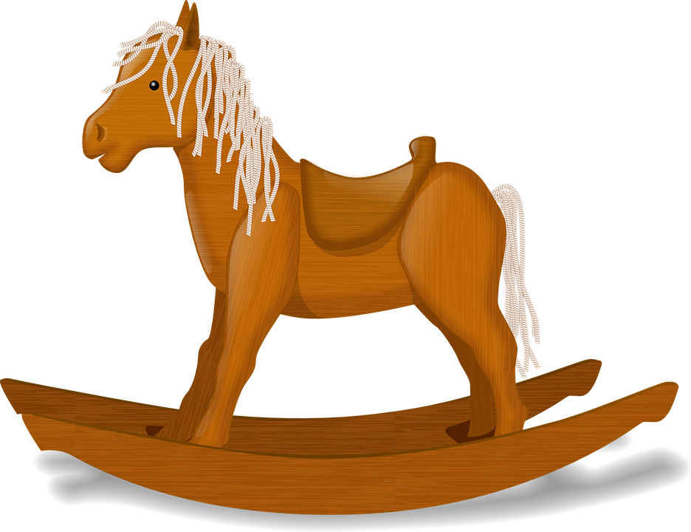
leer
Lee y escribe dos listas en inglés.
¿Qué es normal? ¿Qué es raro?
un / una | planta | teléfono
un / una | libro | fruta
un / una | instrumento | bolsa
un / una | cama | barco
un / una | caballo | cucaracha
a plant
a phone
a book
a piece of fruit
a bag
an instrument
a boat
a bed
a horse
a cockroach
Notes:
Timing: 4 minutes
Aim: to practise written comprehension of the new vocabulary.
Procedure:
1. Ensure that pupils understand the task. Pedro, Sofía’s dad, has strong (strange) opinions. He thinks some items are normal to be on S’s bed, and others are strange. They need to identify and list in English the 5 items that he thinks are normal to find on Sofía’s bed, and the 5 items that he thinks are strange to have on a bed. 2. Pupils write the words in English.
3. Click to reveal answers. (NB. This is likely to open up a debate – ask them to give their opinions! E.g., ¿una planta? ¿es normal?)
4. Note: the pictures are provided to give additional support for word comprehension as pupils have only met these words briefly, at the start of the lesson.

Slide 8
Tener: 1st person singular
[to have | having]
[I have]
In Spanish the verb tener means ‘to have’.
To say ‘I have’ we say ‘tengo’.
Tengo un libro.
Tengo una planta en una bolsa.
I have a book.
I have a plant in a bag.
Notes:
Timing: 2 minutes
Aim: to introduce ‘tener’ & 1st person singular.
Procedure:
Read the grammar explanation on tener (to have).
Elicit English translation for the Spanish examples provided.

Slide 9
hablar y escuchar
¡A hablar!
Persona B: Round 1
Persona B: Round 1
 | un / una
1. Tengo | ___ | planta
 | Which noun must it be?
1
una
Person A says: Tengo una… (but not the noun!)
Person B hears ‘una’ and ticks the correct noun. Is it ‘teléfono’ or ‘planta’?
You have to be very clear when you say un or una!
Tengo una…
Tengo un…
Notes:
Timing: 1 minute (plus 6 minutes for the task)
Aim: to model the speaking task.
Procedure:
1. Click to model each step and explain it. 2. Then give out the handouts. (two slides at the end of the presentation)

Slide 10
hablar y escuchar
Corrige las respuestas
Persona A: Round 1
Persona B: Round 1
 | un / una
1. Tengo | ___ | caballo
2. Tengo | ___ | cama
3. Tengo | ___ | bolsa
4. Tengo | ___ | libro
5. Tengo | ___ | barco
 | Which noun must it be?
1
2
3
4
5
un
una
una
un
un
Notes:
DO NOT DISPLAY DURING THE TASK Timing: 1 minute
Aim: to give feedback to all pupils on Round 1.
Procedure:
Elicit the half sentence for number 1 from A pupils.
Click to reveal the correct article.
Elicit the noun from B pupils.
Click to confirm the correct noun.
Continue for items 2 – 5.
Then go to the next slide to give feedback on Round 2.

Slide 11
hablar y escuchar
Corrige las respuestas
Persona B: Round 2
Persona A: Round 2
 | un / una
1. Tengo | ___ | planta
2. Tengo | ___ | barco
3. Tengo | ___ | libro
4. Tengo | ___ | cama
5. Tengo | ___ | bolsa
 | Which noun must it be?
1
2
3
4
5
una
un
un
una
una
Notes:
DO NOT DISPLAY DURING THE TASK Timing: 1 minute
Aim: to give feedback to all pupils on Round 2.
Procedure:
Elicit the half sentence for number 1 from B pupils.
Click to reveal the correct article.
Elicit the noun from A pupils.
Click to confirm the correct noun.
Continue for items 2 – 5.

Slide 12
vocabulario
Escribe en inglés: Can you get at least 15 points?
 | estás | allí | ¿dónde?
 | soy | aquí | estoy
 | sano | increíble | estar
 | siempre | ser | de1
 | tener | una cama | una
 | una bolsa | un | un caballo
 | un barco | tengo | una planta
You are (trait)
there
Where?
x3
I am (trait)
here
I am (state)
healthy
incredible
to be / being (state)
x2
always
to be / being (trait)
from
to have / having
a bed
a / an (feminine)
a bag
a / an (masculine)
a horse
x1
a boat
I have
a plant
Notes:
Timing: 6 minutes
Aim: to practise written comprehension of vocabulary from last week and this week.
Procedure: 1. Give pupils a blank grid. They fill in the English meanings of any of the words they know, trying to reach 15 points in total.
Note: The most recently learnt and practised words are pink, words from the previous week are green and those from two weeks ago are blue, thus more points are awarded for them, to recognise that memories fade and more effort (heavy lifting!) is needed to retrieve them.

Slide 13
¡adiós!
amarillo

Slide 14
Vocab - handout
Escribe en inglés: Can you get at least 15 points?
 | estás | allí | ¿dónde?
 | soy | aquí | estoy
 | sano | increíible | estar
 | siempre | ser | de1
 | tener | una cama | una
 | una bolsa | un | un caballo
 | un barco | tengo | una planta
vocabulario
x3
x2
x1
Notes:
Timing: 6 minutes
Aim: to practise written comprehension of vocabulary from last week and this week.
Procedure: 1. Give pupils a blank grid. They fill in the English meanings of any of the words they know, trying to reach 15 points in total.
Note: The most recently learnt and practised words are pink, words from the previous week are green and those from two weeks ago are blue, thus more points are awarded for them, to recognise that memories fade and more effort (heavy lifting!) is needed to retrieve them.

Slide 15
hablar y escuchar
Persona A
Persona A: Round 1
Persona A: Round 2
 | Which noun must it be?
1
2
3
4
5
 | un / una
1. Tengo | ___ | caballo
2. Tengo | ___ | cama
3. Tengo | ___ | bolsa
4. Tengo | ___ | libro
5. Tengo | ___ | barco
un
una
una
un
un
Notes:
Person A handout

Slide 16
hablar y escuchar
Persona B
Persona B: Round 1
Persona B: Round 2
 | Which noun must it be?
1
2
3
4
5
 | un / una
1. Tengo | ___ | planta
2. Tengo | ___ | barco
3. Tengo | ___ | libro
4. Tengo | ___ | cama
5. Tengo | ___ | bolsa
una
un
un
una
una
Notes:
Person B handout

