Slide 1
Saying what I and others have
amarillo
Follow ups 1-5
Notes:
Artwork by Steve Clarke. All additional pictures selected are available under a Creative Commons license, no attribution required.
The frequency rankings for words that occur in this PowerPoint which have been previously introduced in the resources are given in the SOW (excel document) and in the resources that first introduced and formally re-visited those words.
For any other words that occur incidentally in this PowerPoint, frequency rankings will be provided in the notes field wherever possible.
Vocabulary: tener [19] tengo [19] bolígrafo [>5000] cuaderno [3301] caballo [907] barco [1384] pelota [2270] planta [768] un [6] una [6]
SSC: centro [317]
Source: Davies, M. & Davies, K. (2018). A frequency dictionary of Spanish: Core vocabulary for learners (2nd ed.). Routledge: London

Slide 2
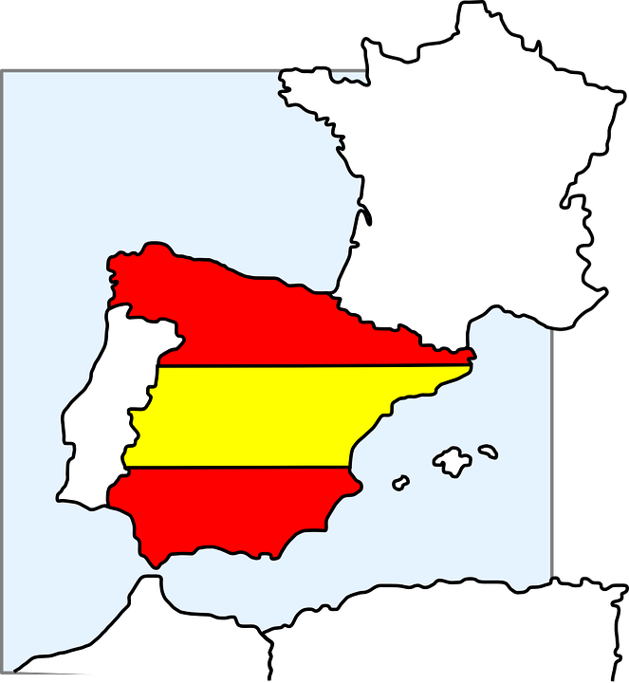
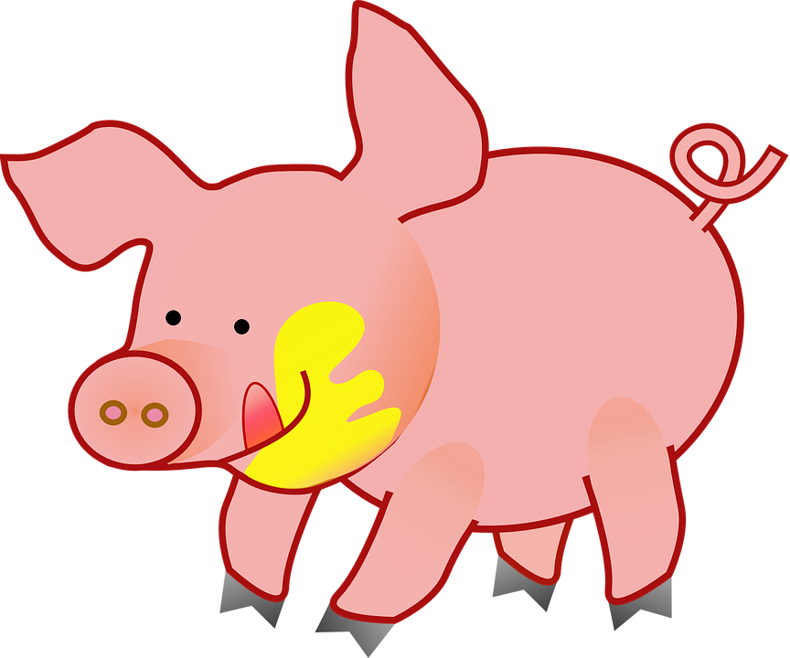
Follow up 1
Ceuta is a Spanish city on the
north coast of Africa and
it borders with Morocco!
[ce]
Albacete
A Pronuncia las palabras.
pronunciar
Ceuta
cebra
30
pecera
cosa
S
maceta
cero
Cáceres
cena
0
cerdo
Barcelona
INICIO
Notes:
Timing: 5 minutes
Aim: to practise SSC [ce] in a read aloud task. Procedure: 1. Partner A writes down 5 of the words on the slide. 2. Partner B, without seeing A’s list, says all the words on the slide as quickly as possible, trying to match all of Partner A’s list before the 30 seconds is up. If s/he succeeds s/he has won the round, if not all five words have been said, Partner B wins the round. 3. Swap roles. 4. Ask students to identify the four Spanish cities & click to bring up answer.
5. Bring up speech bubble – explanation on Ceuta.
Note: this activity can be repeated a couple of times.

Slide 3
Follow up 2:
B Escucha.
Use the correct words to
rewrite the sentences.
There might be extra ones!
A Escucha. ¿Qué palabra es?
escuchar
E
I have | he is (t) | I am (t)
una
tengo
bolsa
es
1
bed | boat | horse
E
Tengo una bolsa.
2
to have, having | I have | to be, being (t)
día
caballo
hoy
tengo
un
1
Tengo un caballo.
3
Tuesday | Wednesday | Friday
es
día
hoy
miércoles
2
Hoy es miércoles.
4
ready | lost | impossible
tener
tengo
cama
un
una
es
3
Tengo una cama.
es
está
hoy
lunes
preparado
4
Hoy es lunes. Está preparado.
Notes:
Timing: 10 minutes
Aim: to practise aural comprehension of this week’s new vocabulary and revisiting previous vocabulary. Connecting sound with meaning.
Procedure:
(Part A) Click to listen. Students circle the correct word (if they have the sheet printed). If not, they can use numbers 1,2,34. Click for answers.
(Part B) Students listen to 1-5 and write the sentences, selecting from the options given (there are additional words that are not needed).
Click to reveal answers.
Elicit the meaning in English of the 5 sentences from activity B.
Transcript:
E. Tengo
barco
tener
jueves
preparado
Transcript 2
Ej. Tengo una bolsa.
Tengo un caballo.
Hoy es miércoles.
Tengo una cama.
Hoy es lunes. Está preparado.

Slide 4
Follow up 3:
Clasifica las palabras.
libro bolsa instrumento caballo idea
fruta barco planta cama
leer
un
una
libro
bolsa
instrumento
idea
caballo
fruta
barco
planta
cama
Notes:
Timing: 5 minutes
Aim: To practise days of the week and adjectives in reading comprehension.
Procedure:
1. Read the instruction in Spanish.
2. Pupils to identify the gender of the nouns (all nouns introduced in week 9, including some previous nouns encountered in SSC)) and write down the words in the correct column.
3. Answers appear on click in the order the words are listed (top left to right) to allow individual students to volunteer answers.

Slide 5
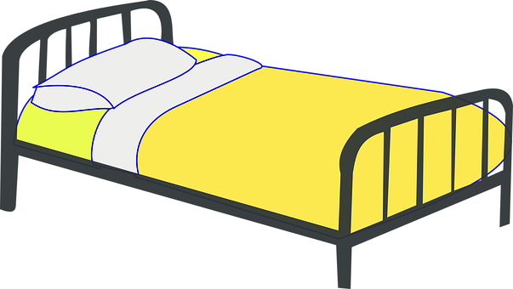
Follow up 4
: Lee la frase con tu pareja.
un
hablar
_ _ _ g _
planta.
Tengo
una
a
b
c
¡tiempo!
INICIO
Notes:
Timing: 5 minutes
Aim: Guided oral production of ‘tengo’, singular indefinite articles & week 9 vocabulary.
(6 slides)
Procedure:
Read the instructions in Spanish. Pupils have 10-15 seconds to say the full sentence in Spanish, deciding on the indefinite article.
Click inicio to start timer.
Click to bring up answers.
Click to bring up pictures and check meaning (first 4 slides).

Slide 6
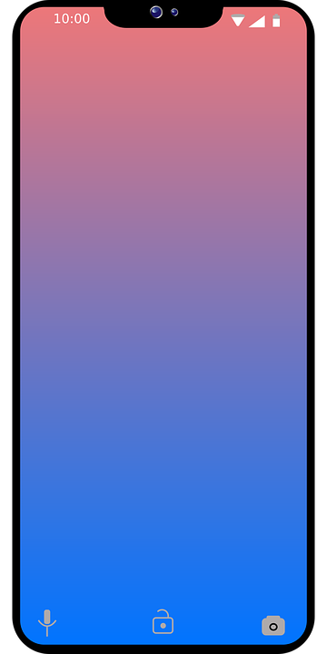
Follow up 4
: Lee la frase con tu pareja.
un
hablar
Tengo
libro.
_ _ _ _ _
una
a
b
c
¡tiempo!
INICIO

Slide 7
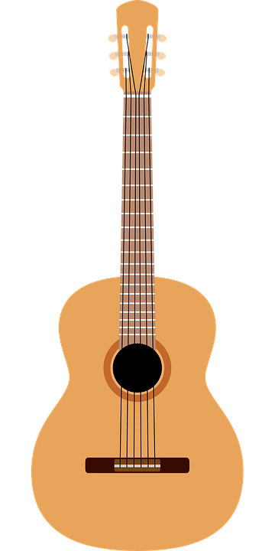
Follow up 4
: Lee la frase con tu pareja.
un
hablar
________
cama.
Tengo
una
a
b
c
¡tiempo!
INICIO

Slide 8
Follow up 4
: Lee la frase con tu pareja.
hablar
un
barco.
I have
a
boat.
Tengo
¡tiempo!
INICIO

Slide 9
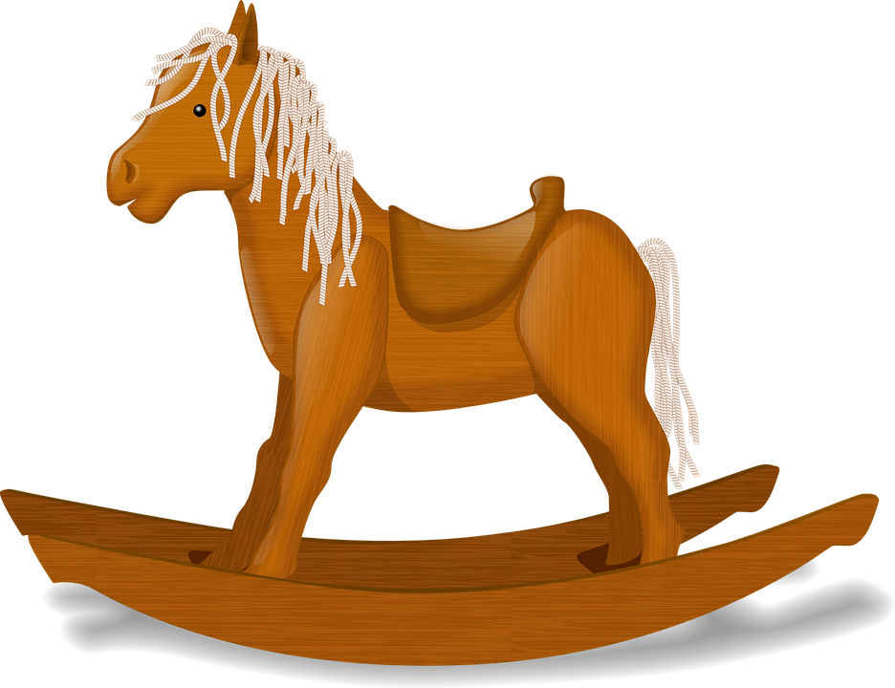
Follow up 4
: Lee la frase con tu pareja.
hablar
Tengo
un
caballo.
I have a horse.
¡tiempo!
INICIO

Slide 10
Follow up 4
: Lee la frase con tu pareja.
hablar
Tengo
una
bolsa.
I have a bag.
¡tiempo!
INICIO

Slide 11
Follow up 5:

Escribe: ¡Bingo!
Write one different Spanish word from this week into each square.
escribir
a / an (feminine) | a plant
I have | a book
a bag | a horse
to have / having | a bed
a boat | a / an (masculine)
Notes:
Timing: 5 minutes
Aim: to practise written production of this week’s new language.
Procedure: 1. Pupils choose any 9 of the words from the English table and write them into their grid in Spanish.
2. Teacher then calls out the Spanish for any of the 9 words in the table in whichever order.
3. Pupils call Bingo when they have any three in a row (vertical, horizontal, or diagonal) and then again for the first full house.

Slide 12
Follow up extra:
Escribe en español: Can you get at least 15 points?
 | you are (state) | here | normally
 | I am (trait) | there | it is (trait)
 | to be, being (trait) | to be, being (state) | always
 | incredible (m/f) | healthy (f) | from
 | to have, having | a bed | a/an (f)
 | a bag | a/an (m) | a horse
 | a boat | I have | a plant
estás
aquí
normalmente
vocabulario
vocabulario
x3
soy
allí
es
ser
estar
siempre
x2
increíble
sana
de
tener
una cama
una
una bolsa
un
un caballo
x1
un barco
tengo
una planta
Notes:
Timing: 6 minutes
Aim: to practise written production of vocabulary for this week and previous weeks.
Procedure:
1. Pupils need to write the Spanish for as many words as possible, aiming to get at least 15 points (but more if possible).
2. Click for Spanish answers.

Slide 13
Follow up extra: Handout
Follow up extra:
Escribe en español: Can you get at least 15 points?
 | you are (state) | here | normally
 | I am (trait) | there | it is (trait)
 | to be, being (trait) | to be, being (state) | always
 | incredible (m/f) | healthy (f) | from
 | to have, having | a bed | a/an (f)
 | a bag | a/an (m) | a horse
 | a boat | I have | a plant
vocabulario
vocabulario
x3
x2
x1
Notes:
Timing: 6 minutes
Aim: to practise written production of vocabulary for this week and previous weeks.
Procedure:
1. Pupils need to write the Spanish for as many words as possible, aiming to get at least 15 points (but more if possible).
2. Click for Spanish answers.

