Slide 1
Describing me and others
amarillo
Follow ups 1-5
Notes:
Artwork by Steve Clarke. Pronoun pictures from NCELP (www.ncelp.org). All additional pictures selected from Pixabay and are available under a Creative Commons license, no attribution required.
Frequency of new vocabulary and phonics:
- Vocabulary: qué [50] día [65] lunes [1370] martes [3101] miércoles [1816] jueves [1650] viernes [1259] sábado [1179] domingo [693]
- Phonics: source words: casa [106] dos [64] elefante [>5000] idea [247] universo [1603] + cluster: cama [609] contar [172] cucaracha [>5000]
The frequency rankings for words that occur in this PowerPoint which have been previously introduced in these resources are given in the SOW and in the resources that first introduced and formally re-visited those words.
For any other words that occur incidentally in this PowerPoint, frequency rankings will be provided in the notes field wherever possible.

Slide 2
Follow up 1
[ca] [co] [cu]
A Escucha. ¿Qué sonido es?
 | ca | co | cu
 |  |  |  | _ _ l e
 |  |  |  | _ _ n
 |  |  |  | _ _ m a
 |  |  |  | _ _ e n t a
 |  |  |  | _ _ a n d o
 |  |  |  | _ _ b r a
B ¡Practica el trabalenguas!
E
c o
Cuando Carmen come coles en el cole, Cata cuenta cabras en la cama.
1
c o
2
c a
3
c u
4
c u
5
c a
Notes:
Timing: 5 minutes
Aim: to develop phonological awareness of [ca] [co] [cu].
Procedure:
Click to bring up the instruction.
Click to bring table and do example together (E).
Pupils tick and/or write the correct sound [ca] [co] [cu].
4. Click to Bring Part B and read instructions.
5. Clarify the meaning of ‘trabalenguas’ (tongue twister).
6. Practise as a whole class and then allow pupils to practise it again in pairs.
Transcript [EJ] cole
[1] con
[2] cama [3] cuenta
[4] cuando
[5] cabra

Slide 3
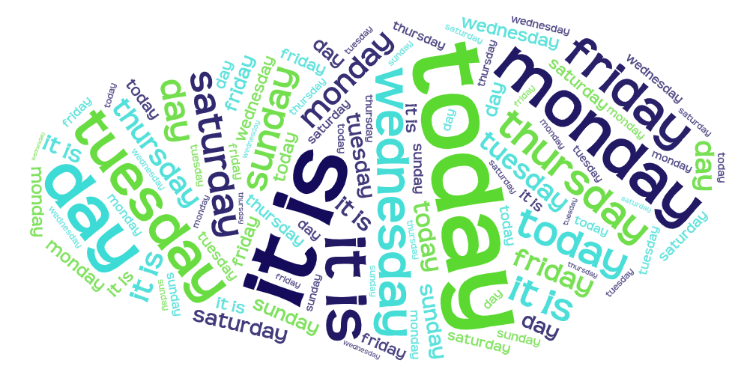
Follow up 2:
B Escucha.
A Escucha. ¿Qué palabra es? Escribe en inglés.
Fill in the missing English words.
escuchar
Sunday
E
today
1. Today is ____________. I am (feeling) ___________.
2. _________ are you? _______ it’s Monday.
3. ___ ___ Thursday? Or _________?
4. It is _____________ and ___ ___ (feeling) sad.
5. ______ ____ feeling incredible _________.
6. You are (looking) ________ today! _____ day is it?
happy
1
Saturday
Where
Today
2
day
Is it
3
it is/is
Tuesday
It is Friday.
Wednesday
I
am
4
5
Monday
S/he
is
today
6
Today is Tuesday.
smart
What
Notes:
Timing: 5 minutes
Aim: to practise aural comprehension of this week’s new vocabulary and revisiting adjectives from week 2-6. Connecting sound with meaning.
Procedure:
(Part A) Click to listen. Pupils write the correct word or phrase in English. The word cloud is a scaffold as all the words are there.
Click to reveal answers.
(Part B) Pupils listen to the example and 1-5 and write the missing English words.
Click to reveal answers.
Transcript:
Ejemplo: hoy
sábado
día
es
es viernes.
lunes
hoy es martes.
Transcript:
1. Hoy es domingo. Estoy feliz. 2. ¿Dónde estás? ¡Hoy es lunes!
3. ¿Es jueves? ¿O martes? 4. Es miércoles y estoy triste. 5. Está increíble hoy. 6. ¡Estás elegante hoy! ¿Qué día es?

Slide 4
Follow up 3:
Lee: ¿Qué día es? ¿Cómo está?
Quique is writing in his diary.
What day is it?
How is he feeling?
así que = so
Completa las frases en inglés.
lunes
incredible
1. Quique is (feeling) ____________ on Tuesday.
2. Quique is (feeling) positive but ______________ on ______________.
3. On ____________, Quique is (feeling) very calm.
4. Quique is well on ____________ so he is __________ in class.
5. On ______________ he is ______________ at home.
6. Qique is feeling lost on ___________.
7. On _______ he is feeling impossible.
martes
Estoy sano así que estoy presente en clase.
¡Estoy increíble! :D
jueves
annoying
Thursday
miércoles
Sunday
¡Es jueves! Hoy estoy positivo pero pesado.
Estoy cómodo en casa.
martes
Monday
domingo
Estoy perdido ☹.
present
¡Estoy muy tranquilo!
Wednesday
comfortable
viernes
Estoy imposible. ☹☹
Tuesday
Friday
Notes:
Timing: 5 minutes
Aim: To practise days of the week and adjectives in reading comprehension.
Procedure:
1. Read the title
2. Click x2 to bring instructions in English Point at the different days of the week in which Quique has written in his diary (jueves / viernes / lunes …).
3. Click x2 to bring English & Spanish instructions.
4. Do number 1 with pupils – draw pupils’ attention to the day of the week in sentence 1 (Tuesday), elicit translation into Spanish and ask them to find ‘martes’ in Quique’s diary.

Slide 5
Follow up 4
¡Rápido!
¡Escapa!
Con tu compañero, traduce.
hablar
I am (state)
Use the hints to help you.
e l _ g _ _ t _
r _ p _ d _
l _ n _ _
e _ t_ y
c _ r _ _ s _
h _ _
e _
n _ _ v_ _ s _
e _ t _ s
s _ r _ _
¿C_ m _?
slow
serious
30s
fast
how
you are (state)
it is (trait)
nervous
elegant
today
INICIO
Notes:
Timing: 2 minutes
Aim: to revisit vocabulary (adjectives + I am [temporary]). Pupils translate the words orally to find their way out of the maze.
(2 slides)
Procedure:
Read the instructions in Spanish. You can elicit English translation from pupils – ‘rápido’ is revisited; escapar [899] is used for the purpose of the activity.
Click to bring up the Spanish instruction – clarify that they need to find their way out by translating the words into Spanish. Draw their attention to the hints and go through the list to prepare pupils for the activity. The ‘state’ refers to estar and ‘trait’ to ser.
Click ‘inicio’ to start the timer.

Slide 6
Follow up 4
¡Rápido! ¡Traduce!
Con tu compañero, traduce.
hablar
INICIO
Notes:
Timing: 2 minutes
Aim: to practise pronunciation and meaning recall of this week’s new and revisited vocabulary.
Procedure:
Pupils work in pairs. Pupil A calls out a word in English to test his/her partner, who must find and say the word in Spanish as quickly as possible.
To complete a ‘round’ in 60 seconds, all words must have been translated once.
Click ‘inicio’ to start the timer.
Then swap roles and repeat the activity.

Slide 7
Follow up 5:
Escribe en español.
escribir
¿Qué día es?
¿Cómo estás?
Notes:
Timing: 10 minutes
Aim: to practise written production of es, the days of the week, estoy and adjectives.
Procedure:
Pupils write a set of short statements, following the model: Hoy es (lunes). Estoy cansado/a.

Slide 8
Follow up 5:
Canta en español.
cantar
lunes, lunes, martes lunes, martes, miércoles, jueves
jueves, jueves, viernes sábado, domingo, domingo.
Notes:
OPTIONAL
Aim: to practise oral production then oral recall of the days of the week in a song; the timing of the song offers a low stakes, enjoyable way to compel faster recall.
Procedure:
Read instruction in Spanish.
Click to hear the first line of the song. Pupils repeat.
Click 2nd button to hear line 2, together. Pupils repeat, (multiple times, as necessary).
Click 3rd button to hear line 3. Pupils repeat.
Click 4th button to hear and repeat line 4 of the song.
Encourage them to translate it so they are sure they know what the lines mean.
Click the music icon bottom right of the slide to hear and practise all four lines of the song, once through.
Click the player to play the whole song, four times over. Pupils join in and sing along.
Click to bring up splats to cover parts of the words. There are three successive clicks to cover increasing amounts of the text.
Pupils try to continue singing with the text obscured.
Final challenge – pupils turn away from the board entirely or shut their eyes and sing.
Note: the tune is the theme tune to the Flintstones, which pupils may or may not be familiar. It should not matter, as the tune is catchy. ☺

Slide 9
Follow up 5:
Escribe en español: Can you get at least 15 points?
 | comfortable | You are (temp.) | lost
 | You are (perm.) | I am (perm.) | ill
 | today | now | impossible
 | lost | s/he it is (perm.) | incredible
 | Friday | Monday | Wednesday
 | Tuesday | day | I am (temp.)
 | What? | Thursday | Saturday
cómodo
estás
perdido
vocabulario
x3
eres
soy
enfermo
hoy
ahora
imposible
x2
perdido
es
increíble
viernes
lunes
miércoles
martes
día
estoy
x1
¿Qué?
jueves
sábado
Notes:
OPTIONAL
Timing: 6 minutes
Aim: to practise written production of vocabulary for this week and previous weeks.
Procedure:
1. Pupils need to write the Spanish for as many words as possible, aiming to get at least 15 points (but more if possible).
2. Click for Spanish answers.
Note: The most recently learnt and practised words are pink, words from the previous week are green and those from two weeks ago are blue, thus more points are awarded for them, to recognise that memories fade and more effort (heavy lifting!) is needed to retrieve them.

