Slide 1
Describing me and others
amarillo
Follow ups 1-5
Notes:
Artwork by Steve Clarke. All additional pictures selected are available under a Creative Commons license, no attribution required.
The frequency rankings for words that occur in this PowerPoint which have been previously introduced in NCELP resources are given in the NCELP SOW and in the resources that first introduced and formally re-visited those words.
- Vocabulary: eres [7] (recycle adjectives) de1 [2] Inglaterra [n/a] España [n/a] Perú [n/a]
- SSC: casa [106] dos [64] elefante [>5000] idea [247] universo [1603] + cluster: vaca [2775] ñu [>5000] ratón [3415] colibrí [>5000] pez [3579]
For any other words that occur incidentally in this PowerPoint, frequency rankings will be provided in the notes field wherever possible.
Source: Davies, M. & Davies, K. (2018). A frequency dictionary of Spanish: Core vocabulary for learners (2nd ed.). Routledge: London

Slide 2
Follow up 1
[a] [e] [i] [o] [u]
A Escucha. ¿Qué número tiene el sonido…?
B Complete the poem with a name that rhymes.
[1]
2
Con a, la vaca __________.
‘o’ is number ________.
Maca
blanca
1
2
3
Con e, el bebé ____________.
Enrique
verde
[2]
3
‘e’ is number ________.
Con i, el colibrí ___________.
Soli
aquí
1
2
3
Con o, el ratón ___________.
Camarón
marrón
[3]
2
‘u’ is number ________.
Con u, el unicornio _______.
1
2
3
Ugo
único
Enrique marrón Maca único aquí Ugo Soli
Camarón verde blanca
[4]
2
‘i’ is number ________.
1
2
3
C Add another word that rhymes or half-rhymes.
Notes:
Timing: 5 minutes
Aim: to practise aural comprehension of the SSC [a] [e] [i] [o] [u].
Procedure:
Click to bring up the prompts.
Click on each audio symbol to listen to the words.
Click for the number answers. Pictures appear to clarify meaning.
Transcript Part A: [1]
1 vaca 2 ratón
3 España
[2]
1 ñu
2 dos
3 pez
[3] 1 elefante
2 universo
3 colibri
[4]
1 casa
2 colibrí
3 Perú
Aim: to develop phonological awareness of [a] [e] [i] [o] [u] and identify patterns of rhyme.
Procedure:
Click to bring up the instruction.
Click to bring the first verse.
Click to bring the different options (there are 2 for the first 4 verses, only 1 for verse 5).
Clarify meanings & identify proper nouns.
Click to bring possible answers for verse 1.
Click to bring the other four verses & give students to choose their own combinations.
Click to bring answers (x7)
Part C
Procedure:
Click to bring up the instruction & boxes

Slide 3
Follow up 2:
Escribe en inglés: Can you get at least 15 points?
 | estoy | perdido/perdida | ¿dónde?
 | aquí | está | preparado/preparada
 | cómodo/cómoda | ahora | pesado/positiva
 | ¿cómo? | hoy | siempre
 | es | normalmente | positivo/positiva
 | soy | España | eres
 | Inglaterra | active/activa | de
I am (state)
lost
Where?
vocabulario
x3
here
s/he, it is (state)
ready
comfortable
now
annoying
x2
How?
today
always
s/he, it is (origin)
normally
positive
I am (origin)
Spain
You are (origin)
x1
England
active
from
Notes:
Timing: 5 minutes
Aim: to practise written comprehension of vocabulary for this week and previous weeks.
Procedure:
1. Pupils need to write the English for as many words as possible, aiming to get at least 15 points (but more if possible).
2. Click for English answers.

Slide 4
Follow up 3:
Remember to use capital letters and a full stop at the end.
A Escucha. ¿Qué verbo es?
escuchar
Write down the number in the table.
B Escucha. Use the correct words to translate the sentences. There are extra ones!
E
2
4
are you
comfortable
is it
healthy
E
Is it comfortable?
1
3
5
from
you are
in
Ecuador
I am
1
I am from Ecuador.
I am | You are | S/he, it is
I am
you are
positive
active
2
E
You are active.
1
2
annoying
today
is he
always
am I
3
3
4
5
Am I always annoying?
now
positive
you are
I am
normally
4
You are normally positive.
Can you spot the question?
Notes:
Timing: 5 minutes
Aim: to practise aural comprehension of the verbs ‘soy’ and ‘es’, connecting them with meaning each time.
Procedure:
Read the instructions.
Click to bring the question & encourage students to recognise the questions.
Students write the correct letter/numbers in the table, and a question mark when they identify the questions.
Click for answers.
Transcript:
Ej. ¿Es cómodo?
Soy de Ecuador
Eres activa
¿Soy siempre pesado?
¿Eres positiva?
Es de España.
Timing: 3 minutes
Aim: to practise aural comprehension of ‘soy’, ‘eres’ & ‘es’, time phrases & key adjectives, connecting with meaning each time.
Students listen and write down the meaning of the sentences, selecting from the options given (there are additional words that are not needed).
Transcript:
Ej. ¿Es cómodo?
Soy de Ecuador
Eres activa
¿Soy siempre pesado?
Eres normalmente positivo.

Slide 5
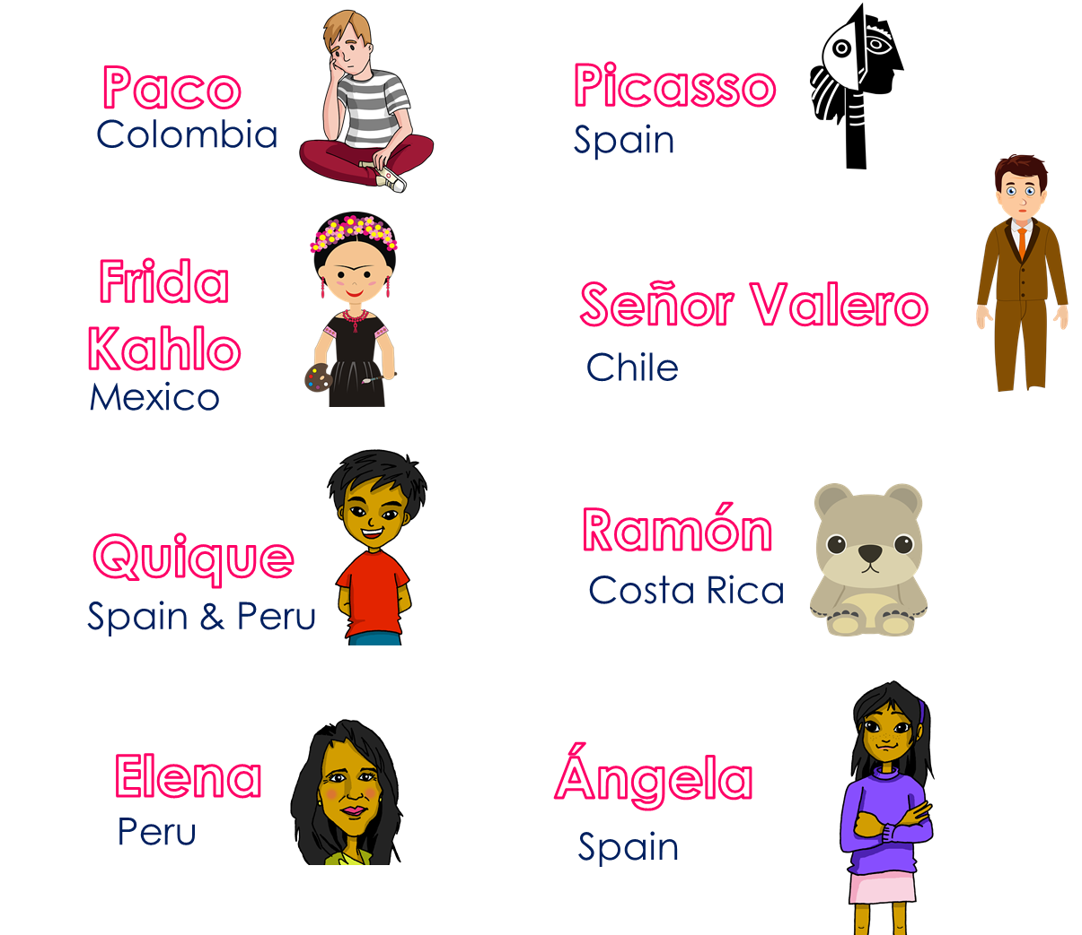
Follow up 4:
Pregunta y adivina:
Ask your partner questions to guess their secret character.
hablar
¿Eres de Perú?
60
¿Eres Elena?
¿Eres de España?
¿Eres de…?
¡No soy de España!
Sí / No soy…
¡Sí, soy de Perú!
¡Sí, soy Elena!
0
INICIO
Notes:
Time: 8-10 minutes
Aim: To use raised intonation and adjectival agreement in oral production to guess their partner’s characters as quickly as possible.
Read the title in Spanish and click to bring a brief explanation of the instructions.
Tell students they are going to work in pairs. Partners take it in turns to ask yes/no questions to try to figure out the other player’s character. The partner guessing needs to use raised question intonation and the correct adjectival agreement to narrow down their options correctly! Explain this to the pupils - they have to pronounce the adjective correctly, with the correct ending, otherwise their partner cannot guess who they are.
Click x2 to bring the speech bubbles to make sure students are clear about what the exchange should look like (¿Eres de ..? / Sí / No).
Click x2 to model an example & read the speech bubbles (“¿Eres de España?” / ¡No!). Show students on the board how that means Picasso / Quique / Ángela are not the secret character & click to bring X shape to cover her. Click x2 to trigger the next question (¿Eres de Perú?) The response is “Yes” so we now know it’s Elena.
Teachers can model another round with the whole class (getting students to ask the questions) before getting them started in pairs.
3. Give students 30 seconds to write down 4 names (mixture of nationalities). Click on “Inicio” to trigger timer.
4. Display next slide while they are working in paris.
NB. Print the template slide (slide 20) in A5 so that students can cross out as they play.
At the end of the game, point out to them that grammar features (in this case masc/fem adjective endings) often help us to pinpoint the correct meaning more quickly, but not always!
Adjectives used in the task:

Slide 6
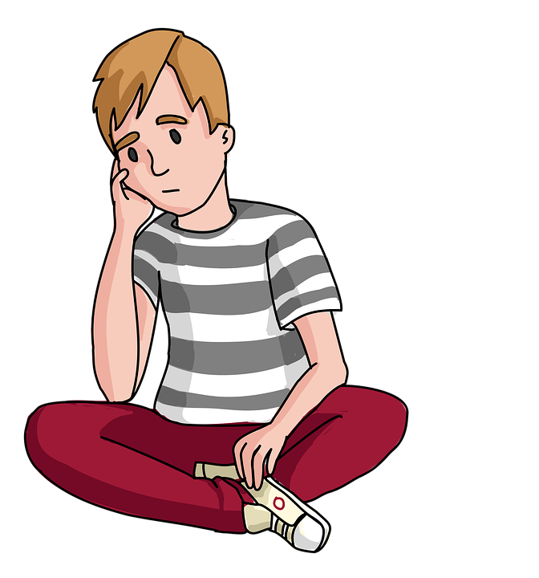
Follow up 4:
Pregunta y adivina:
Paco
Picasso
¿Eres de…?
hablar
Colombia
Spain
Frida Kahlo
Señor Valero
Chile
Mexico
Ramón
¡Sí, soy de…!
Quique
Costa Rica
Spain & Peru
¡No soy de …!
Elena
Ángela
Peru
Spain

Slide 7
Follow up 5
Escribe en español.
1 | I am healthy.
2 | You are from Peru.
3 | S/he is from Spain.
4 | I’m from England.
escribir
Soy sano.
¿Soy sano?
Eres de Perú.
¿Eres de Perú?
Es de España.
¿Es de España?
Soy de Inglaterra
¿Soy de Inglaterra?
Can you make these sentences into a question?
España
Inglaterra
Notes:
Timing: 5-8 minutes
Aim: to produce full sentences using ‘soy’ & ‘eres’ with permanent attributes & origin + using ‘de’
Read the instructions in Spanish.
Ask students to complete translate the sentences into Spanish, using the correct verb (‘soy’ & ‘eres’).
Encourage early finishers to turn the statements into questions, paying attention to question marks & practise raised intonation out loud.

Slide 8
Follow up:
Escribe en español: Can you get at least 15 points?
 | Where? | I am (state) | ready
 | S/he is (state) | here | lost
 | now | always | How?
 | annoying | today | comfortable
 | normally | I am (origin) | active
 | you are (origin) | England | s/he, it is (origin)
 | Spain | from | positive
¿dónde?
estoy
preparado
preparada
vocabulario
x3
está
aquí
perdido
perdida
ahora
siempre
¿cómo?
x2
pesado
pesada
hoy
cómodo
cómoda
normalmente
soy
activo
activa
eres
Inglaterra
es
x1
positivo
positiva
España
de
Notes:
Timing: 6 minutes
Aim: to practise written production of vocabulary for this week and previous weeks.
Procedure:
1. Pupils need to write the Spanish for as many words as possible, aiming to get at least 15 points (but more if possible).
2. Click for Spanish answers.

