Slide 1

Describing me and others
amarillo
Follow ups 1-5
Notes:
Artwork by Steve Clarke. Pronoun pictures from NCELP (www.ncelp.org). All additional pictures selected from Pixabay and are available under a Creative Commons license, no attribution required.
Frequency of new vocabulary:
feliz [908] imposible [1418] increíble [1642] ¿dónde? [161]+ revisiting week 2-4 adjectives
Source: Davies, M. and Davies, K. (2018). A frequency dictionary of Spanish: Core vocabulary for learners (2nd ed.). Routledge: London
The frequency rankings for words that occur in this PowerPoint which have been previously introduced in these resources are given in the SOW and in the resources that first introduced and formally re-visited those words.
For any other words that occur incidentally in this PowerPoint, frequency rankings will be provided in the notes field wherever possible.
Source: Davies, M. & Davies, K. (2018). A frequency dictionary of Spanish: Core vocabulary for learners (2nd ed.). Routledge: London

Slide 2

Follow up 1
Say each word in Spanish before it disappears.
normalmente
es
activo
sana
siempre
soy
¿cómo?
activa
hoy
feliz
ser
sano
Notes:
Timing: 5 minutes (two slides)
Aim: to practise spoken production and recall of this week and last week’s vocabulary.
Procedure:
1. Click to bring up the first word.
2. Pupils read the word aloud in Spanish before it disappears.
3. Continue for all 12 words.
4. A final click bring ups all the words again. Click on each to hear it pronounced, if desired.
5. Continue to the next slide.

Slide 3
Follow up 1
Say each word in Spanish before the English word disappears.
normally
(s/he, it) is
active (m)
healthy (f)
always
(I) am
how?
active (f)
today
happy
to be, being
healthy (m)
Notes:
Timing: 5 minutes (two slides)
Aim: to practise spoken production and recall of this week and last week’s vocabulary.
Procedure:
1. Click to bring up the first word.
2. Pupils read the word aloud in Spanish before it disappears.
3. Continue for all 12 words.
4. A final click bring ups all the words again. Click on each to hear it pronounced, if desired.
5. Continue to the next slide.

Slide 4

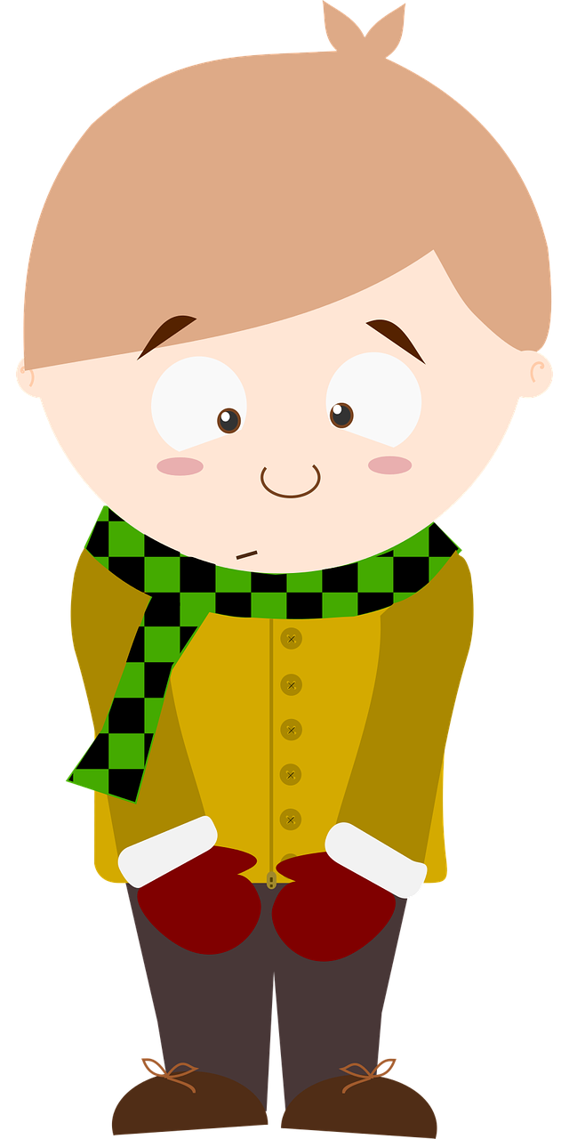

Follow up 2
Sometimes we refer to people by name in a sentence:
Emilio is always serious.
In Spanish, we often don’t need to use the pronoun.
Emilio es serio siempre.
He is (generally) nervous.
Here we use the pronoun he because we don’t need to repeat Emilio.
⚠ This means that es can mean is and he is, she is, it is.
Es nervioso.
[is]
[He is]
Notes:
Timing: 5 minutes (two slides)
Aim: to draw attention to pronouns in English and Spanish and the multiple meanings of ‘es’ (is, he is, she is, it is).
Procedure:
Click to present the information.
Ensure pupils’ understanding of the key term ‘pronoun’.

Slide 5

Follow up 2:
Lee las frases.
Iker es tranquilo siempre.
Normalmente Irene es feliz.
¿Es Isabel curiosa? No, es seria.
¿Cómo es Quique? Siempre es feliz.
¿ Es nerviosa? No, Eva es seria.
Write the English meaning of es for each sentence, and the meaning of the whole sentence, if you can:
leer
1
Iker is always calm.
2
Irene is usually happy.
3
Is Isabel curious? No, she is serious.
4
How is Quique (generally)?
He is always happy.
5
Is she (generally) nervous?
No, Eva is serious.
Notes:
Procedure:
Pupils write 1 – 5 and the English translation of es as best fits each sentence.
Click to trigger answers.
Note:
Pupils have already practised a similar task with está sentences. This time they are asked to translate the full sentences to practise additional vocabulary, too.

Slide 6

Follow up 3
Say the Spanish sentence.
You do not need all of the words!
siempre
hablar
ser
es
15
Normalmente es activa.
Normally she is active.
sana
activa
S
normalmente
soy
0
activo
INICIO
Notes:
Time: 6-8 minutes (8 slides)
Aim: to practise oral sentence building, deciding between the target features of soy | es and masculine | feminine adjective forms.
Procedure:
1. Click for English sentence and Spanish prompt words.
2. Click inicio to start the timer.
3. Pupils select from the words given to create and say the sentence out loud before the time elapses.
4. Click for the Spanish sentence to appear.

Slide 7
Follow up 3
Say the Spanish sentence.
⚠ In Spanish put siempre and normalmente at the start OR at the end but not in the middle of the sentence.
You do not need all of the words!
siempre
hablar
ser
es
15
Siempre es sano.
He is always healthy.
sana
sano
S
normalmente
soy
0
activo
INICIO
Notes:
[2/8]

Slide 8
Follow up 3
Say the Spanish sentence.
⚠ In Spanish put siempre and normalmente at the start OR at the end but not in the middle of the sentence.
You do not need all of the words!
siempre
hablar
ser
es
15
Soy feliz normalmente.
I am usually happy.
positivo
pesado
S
normalmente
soy
0
feliz
INICIO
Notes:
[3/8]

Slide 9
Follow up 3
Say the Spanish sentence.
You do not need all of the words!
normalmente
imposible
hablar
soy
15
I am always incredible.
Siempre soy increíble.
increíble
positiva
S
ser
es
siempre
0
INICIO
Notes:
[4/8]

Slide 10
Follow up 3
Say the Spanish sentence.
You do not need all of the words!
normalmente
pesada
hablar
soy
15
He is usually annoying.
Normalmente es pesado.
imposible
pesado
S
ser
es
siempre
0
INICIO
Notes:
[5/8]

Slide 11
Follow up 3
Say the Spanish sentence.
You do not need all of the words!
normalmente
pesada
hablar
soy
15
ser imposible
to be/being imposible
imposible
pesado
S
ser
es
siempre
0
INICIO
Notes:
[6/8]

Slide 12
Follow up 3
Say the Spanish sentence.
You do not need all of the words!
normalmente
pesada
hablar
soy
15
Ser imposible es pesado.
Being imposible is annoying.
imposible
pesado
S
ser
es
siempre
0
INICIO
Notes:
[7/8]

Slide 13
Follow up 3
Say the Spanish sentence.
You do not need all of the words!
normalmente
pesada
hablar
soy
15
Es positiva siempre.
She is always positive.
positiva
positivo
S
ser
es
siempre
0
INICIO
Notes:
[8/8]

Slide 14



Follow up 4
Translate the words and find a quick route to the finish line.
El Gran Premio
Salida
activo
feliz
active (m)
happy
impossible
imposible
pesada
positiva
annoying (f)
incredible
positive (f)
increíble
sano
healthy (m)
I am
s/he, it is
to be|being
soy
es
pesado
ser
annoying (m)
normalmente
siempre
sana
normally
always
healthy (f)
Fin
Notes:
Timing: 5 minutes
Aim: to practise written comprehension of this week’s and previous weeks’ vocabulary.
Procedure:
1. Students work in pairs or small group and take it in turns to translate words into English to find a path from the start to the finish line. They can move through the squares horizontally or vertically, but not diagonally.
2. The listening student(s) monitor(s) translation. If a student gets a translation wrong, they cannot proceed to that square. Classmates correct and the student must find a different path.
3. The student who makes it to the end in the fewest number of moves is the winner.
4. Click to reveal answers, going through pronunciation of each word and paying particular attention to the pronunciation of the cognates.
Note: for (m) and (f) pupils should say e.g. active (boy), healthy (girl).

Slide 15
Follow up 5
Pupil A reads six sentences.
Pupil B listens and writes M (male), F (female) or M/F (male/female) if it could be either.
hablar
60
Pupil A
1 | Es sano.
2 | Es feliz.
3 | Es positiva.
4 | Es increíble.
5 | Es activa.
6 | Es pesado.
Pupil B
1 | Es positivo.
2 | Es imposible.
3 | Es sana.
4 | Es feliz.
5 | Es pesada.
6 | Es activo.
M
M
M/F
M/F
S
F
F
M/F
M/F
F
F
M
M
0
INICIO
Notes:
Time: 5 minutes
Aim: to practise aural comprehension of masculine and feminine adjectives.
Pupil B turns away from the board. S/he needs something to write on.
Click for Pupil A’s six sentences to appear. Pupil A reads each sentence to his/her partner.
3.Pupil B listens and writes M (male), F (female), M/F (male/female) if it could be either.
4. Pupils swap roles and repeat the task with the 2nd set of prompts.

