Slide 1
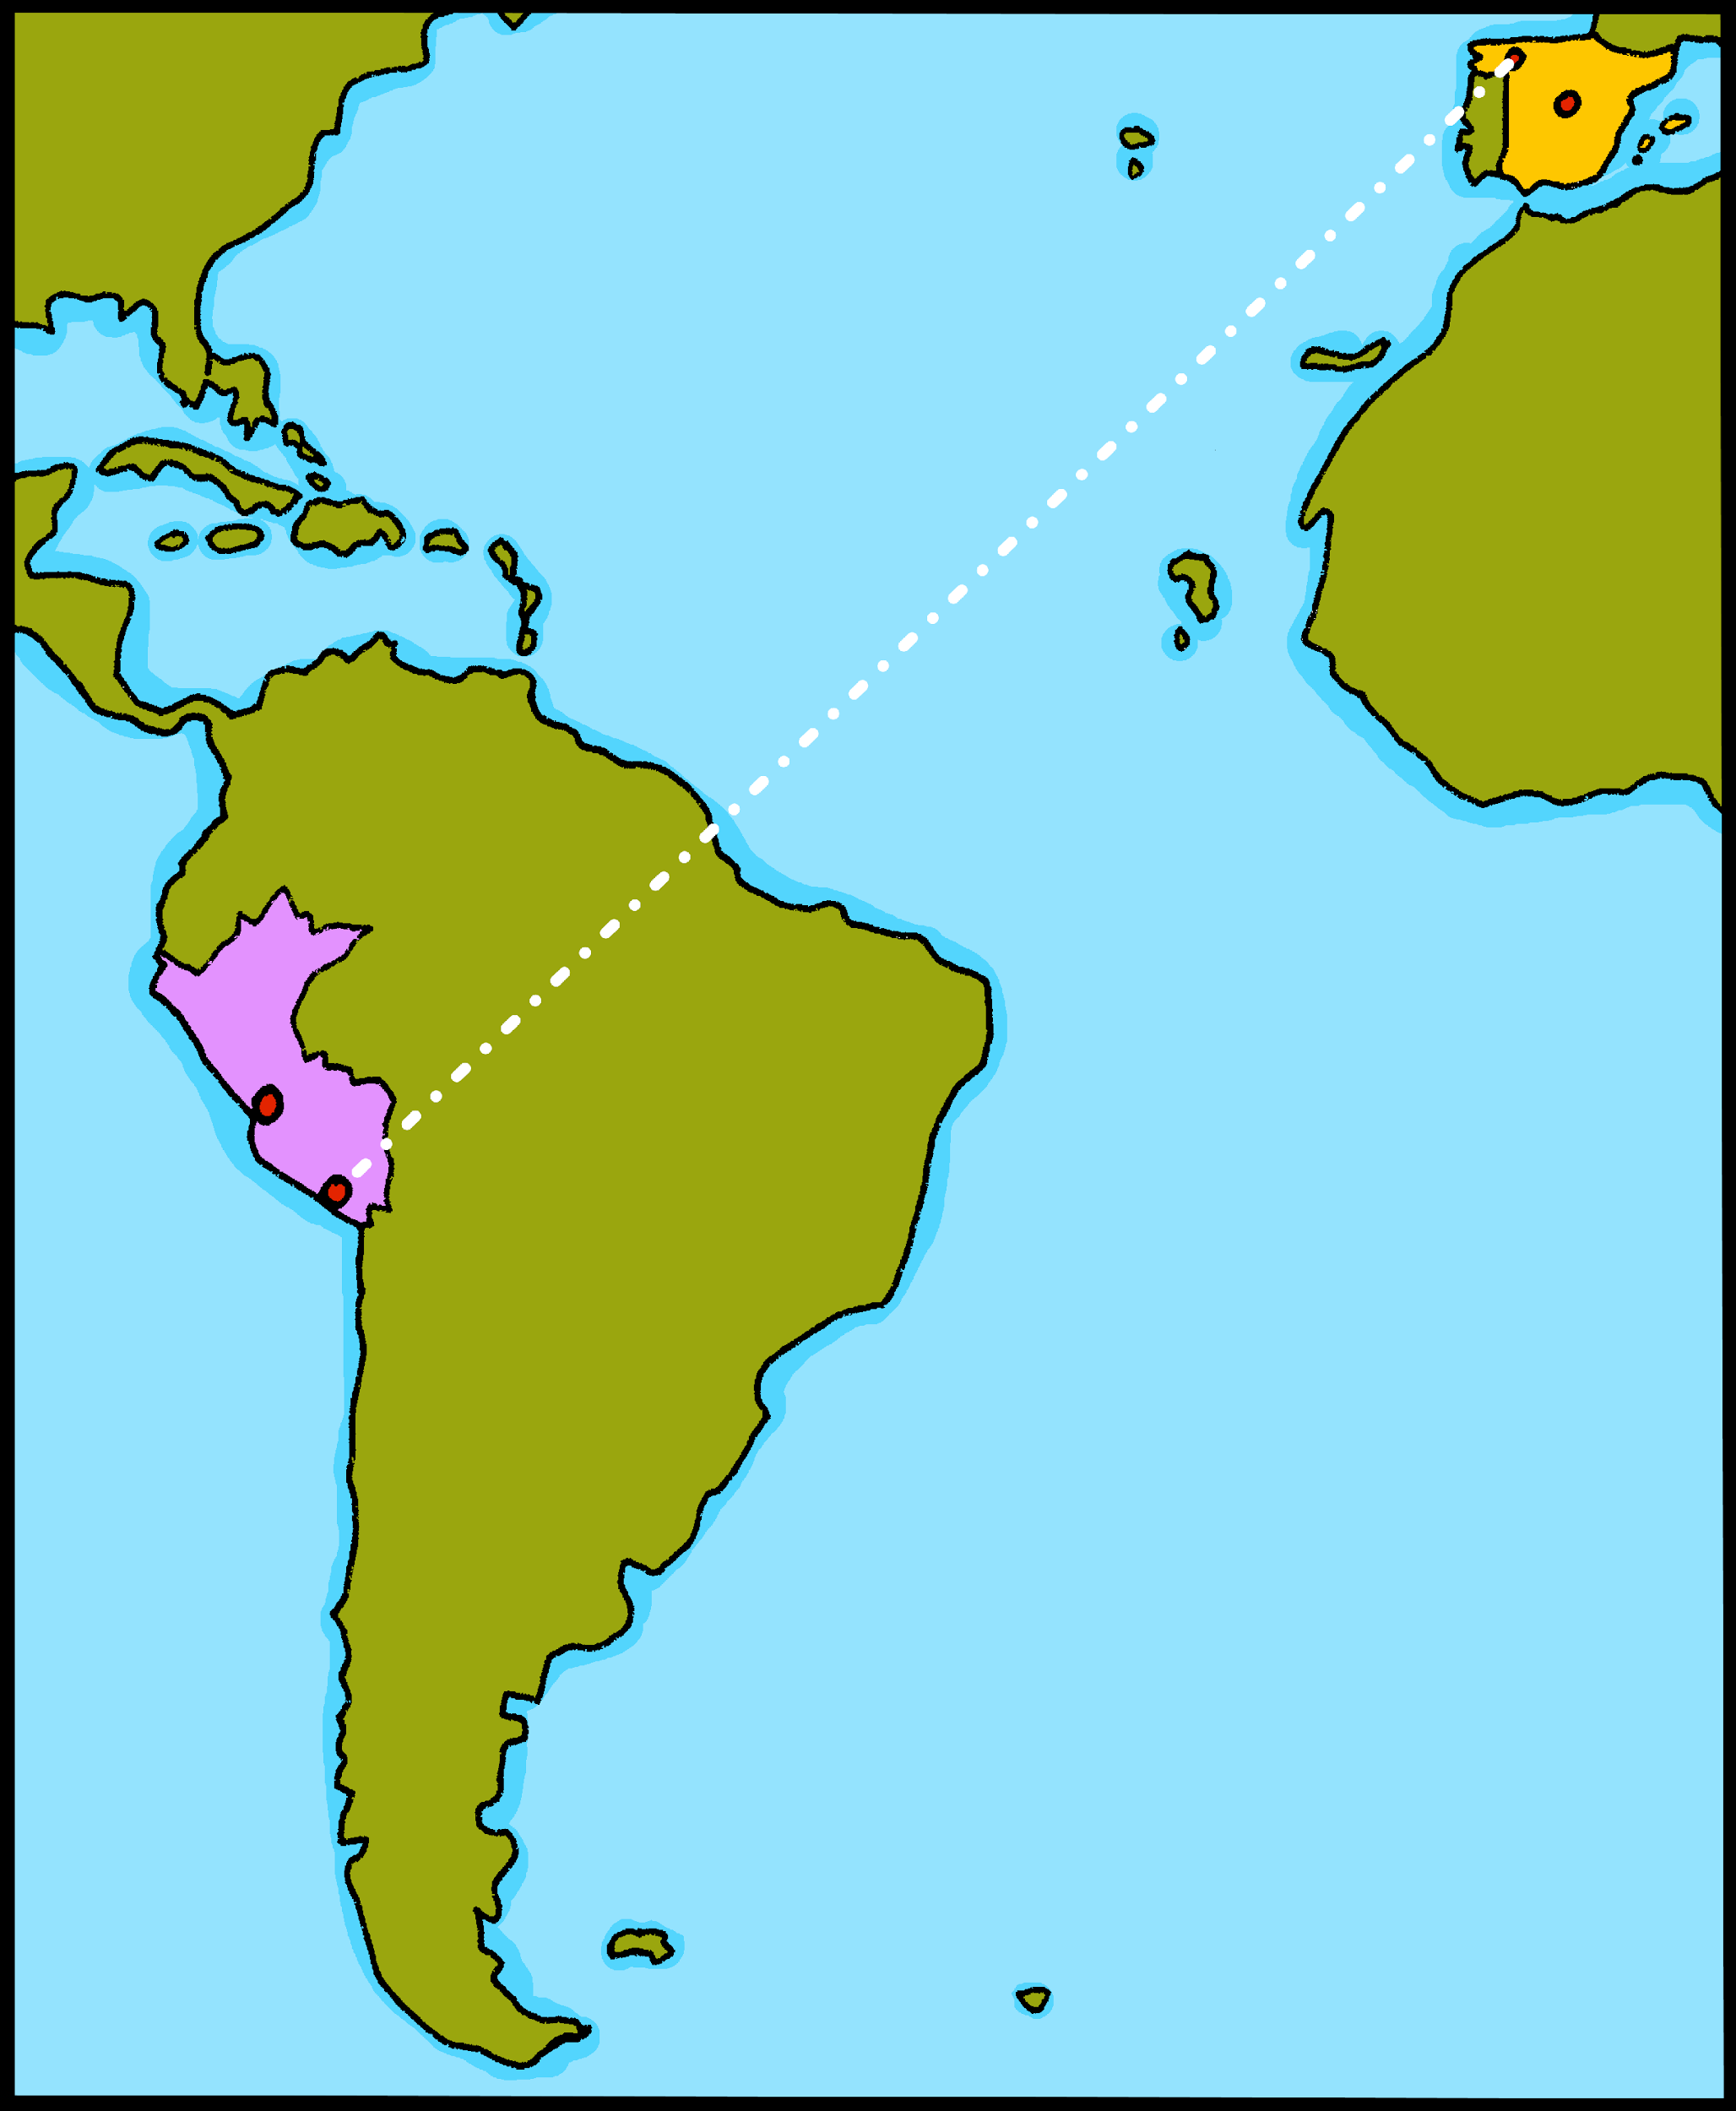
¡hola!

Slide 2
Describing me and others
amarillo
Estar: estoy, está , estás for temporary state
SSC [e]
Notes:
Artwork by Steve Clarke. Pronoun pictures from NCELP (www.ncelp.org). All additional pictures selected from Pixabay and are available under a Creative Commons license, no attribution required.
Frequency of new vocabulary and phonics:
Phonics: [i] source word: idea [247]
Vocabulary: clase [320] [en clase] cómodo [2237] [1642] pesado [2166] positivo [1188] ahora [81]
Source: Davies, M. & Davies, K. (2018). A frequency dictionary of Spanish: Core vocabulary for learners (2nd ed.). Routledge: London
The frequency rankings for words that occur in this PowerPoint which have been previously introduced in resources are given in the full SOW and in the resources that first introduced and formally re-visited those words. For any other words that occur incidentally in this PowerPoint, frequency rankings will be provided in the notes field wherever possible.

Slide 3
[i]
idea
pronunciar
Notes:
Timing: 1 minute
Aim: To introduce SSC [i]
Procedure:
Introduce and elicit the pronunciation of the individual SSC [i] and then the source word ‘idea’ (with gesture, if using).
Click to bring up the picture and get pupils to repeat (with gesture, if using).
Pupils to practise in pairs.
Note: This is a brief introduction to the SSC for this week. Pupils will practise this and other SSC in the follow ups this week.
Gesture: Point with index finger to temple and then into the air, miming a sudden ‘eureka’ moment!

Slide 4
escuchar
Escucha y escribe.
1
2
3
está
estoy
estás
¿en inglés?
I am / you are / s/he is
Notes:
Timing: 2 minutes
Aim: to revisit the three forms of estar encountered so far (estoy, estás, está).
Procedure:
Read the instructions in Spanish.
Ask pupils to write numbers 1-3.
Click on number one to play the sound.
Tell pupils the word they hear.
Click elsewhere on the slide to reveal answers (x3).
Click one more time to prompt the question ¿en inglés?
Elicit translation into English from pupils. Click one more time to reveal the three options (I am / you are / s/he) should they need further support.
Answers:
1. está – s/he is
2. estoy – I am
3. estás – you are

Slide 5
vocabulario
Reordena las sílabas ¿qué es en inglés?
a) sen pre te
presente
_________
lost
b) ti ac vo
activo
_________
ill / sick
c) di do per
perdido
_________
present
d) no sa
sano
_________
prepared
e) fer mo en
enfermo
_________
active
f) pa do pre ra
_________
healthy
preparado
Notes:
Timing: 3 minutes
Aim: To revisit key adjectives from weeks 1&2.
Procedure:
Read the instruction in Spanish.
Click to trigger the answer for the first jumbled adjective – click one more time to trigger the arrow that links the word with the English meaning.
Elicit Spanish words from pupils (a-f), click once to trigger the Spanish word & one more time to link the Spanish word with the English translation.

Slide 6
hablar
Escucha a tu compañero y traduce la frase al español.
Can you climb to the top of the ladder?
Your partner will ask you to translate a sentence.
Use the clues to translate the sentence.
¿Correcta? Climb up one step!
¿Incorrecta? Start from the bottom again!
How high up can you get in one minute?
Take turns to be the teacher ☺
¡H_ l_! E_t_y _qu_ .
Hoy estoy perdido.
Today I am lost.
→ Hoy estoy perdido.
Notes:
Timing: 5 minutes (3 slides)
Aim: to bring together the three forms of estar learned so far (estoy, está, está) + adjectives from week 1 + 2. The aim is for pupils to translate correctly as many sentences as they can in 1 minute.
Procedure:
Read the instruction in Spanish (Escucha a tu compañero y traduce la frase al español).
Click to trigger instructions in English.
Pair pupils and ask them to choose A or B.
Next two slides have the 1 minute timer for each turn (A + B)
Note: the final two slides in the presentation are handouts to be printed for this activity.

Slide 7
hablar
Escucha a tu compañero y traduce la frase al español.
Can you climb to the top of the ladder?
Persona B is the teacher.
60
S
0
¡Hola! ….
¡H_ l_! E_t_y _qu_ .
INICIO

Slide 8
hablar
Escucha a tu compañero & traduce la frase al español.
Can you climb to the top of the ladder?
Persona A is the teacher.
60
S
0
¡Hola! ….
¡H_ l_! E_t_y _qu_ .
INICIO

Slide 9
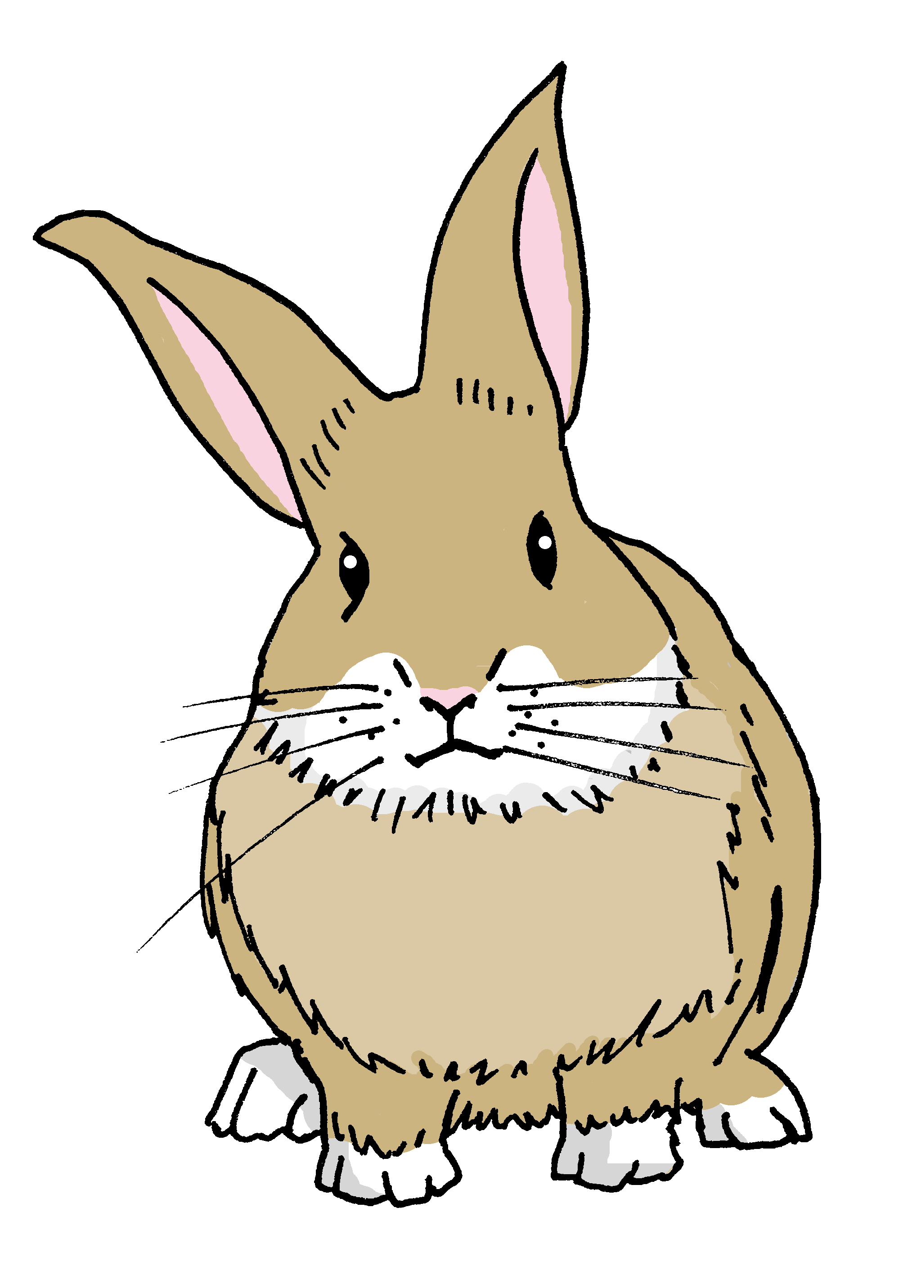
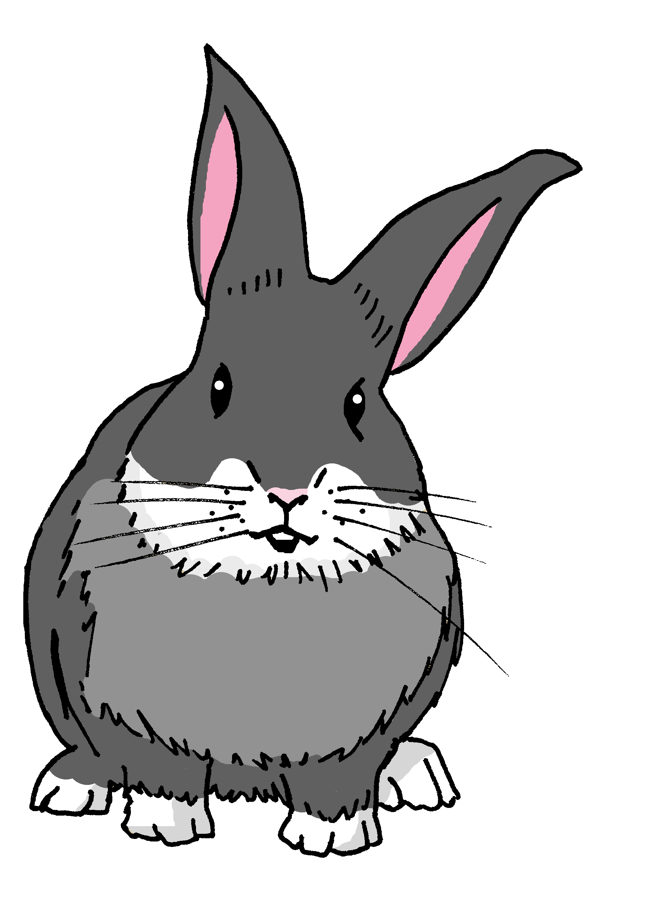
Gender and agreement on adjectives
In Spanish, adjectives change depending on whether the person or animal they describe is male or female.
Adjectives that are masculine (end in ‘o’) change to an ‘a’ when the person or animal being described is female.
Pancho está enfermo.
Manchita está enferma.
Pancho is ill.
Manchita is ill.
Notes:
Timing: 2 minutes
Aim: to use the feminine form of regular adjectives (-o changing to –a) when describing people (and animals).
Procedure:
Present the information about gender and adjective agreement.
Elicit the English translation for the Spanish examples provided.
Note: here we practise singular regular adjective agreement with people and animals. Soon we will also introduce inanimate feminine and masculine nouns and teach the concept of grammatical (not biological) gender more explicitly.

Slide 10
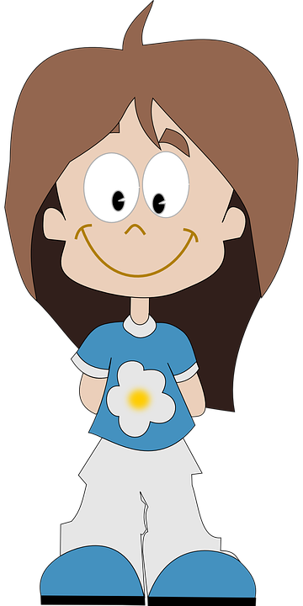
leer
Ursula está… ahora.
hablar
positivo
positiva
Notes:
Timing: 3 minutes (5 slides)
Aim: to practise written recognition of the masculine and feminine adjective forms when describing people and animals and introduce three new items of vocabulary (positivo (positive), pesado (annoying) and cómodo (comfortable)).
[Check that they know that Santi is a male name! He’s Rubén’s dog.]
Procedure:
Read the phrases out loud, pointing at the two options for the gap.
Pupils read the whole sentence out loud, selecting the correct form of the adjective. [Elicit meanings of positivo, pesado and cómodo as this is the first time they come across these new words].
Repeat for the next six slides.

Slide 11
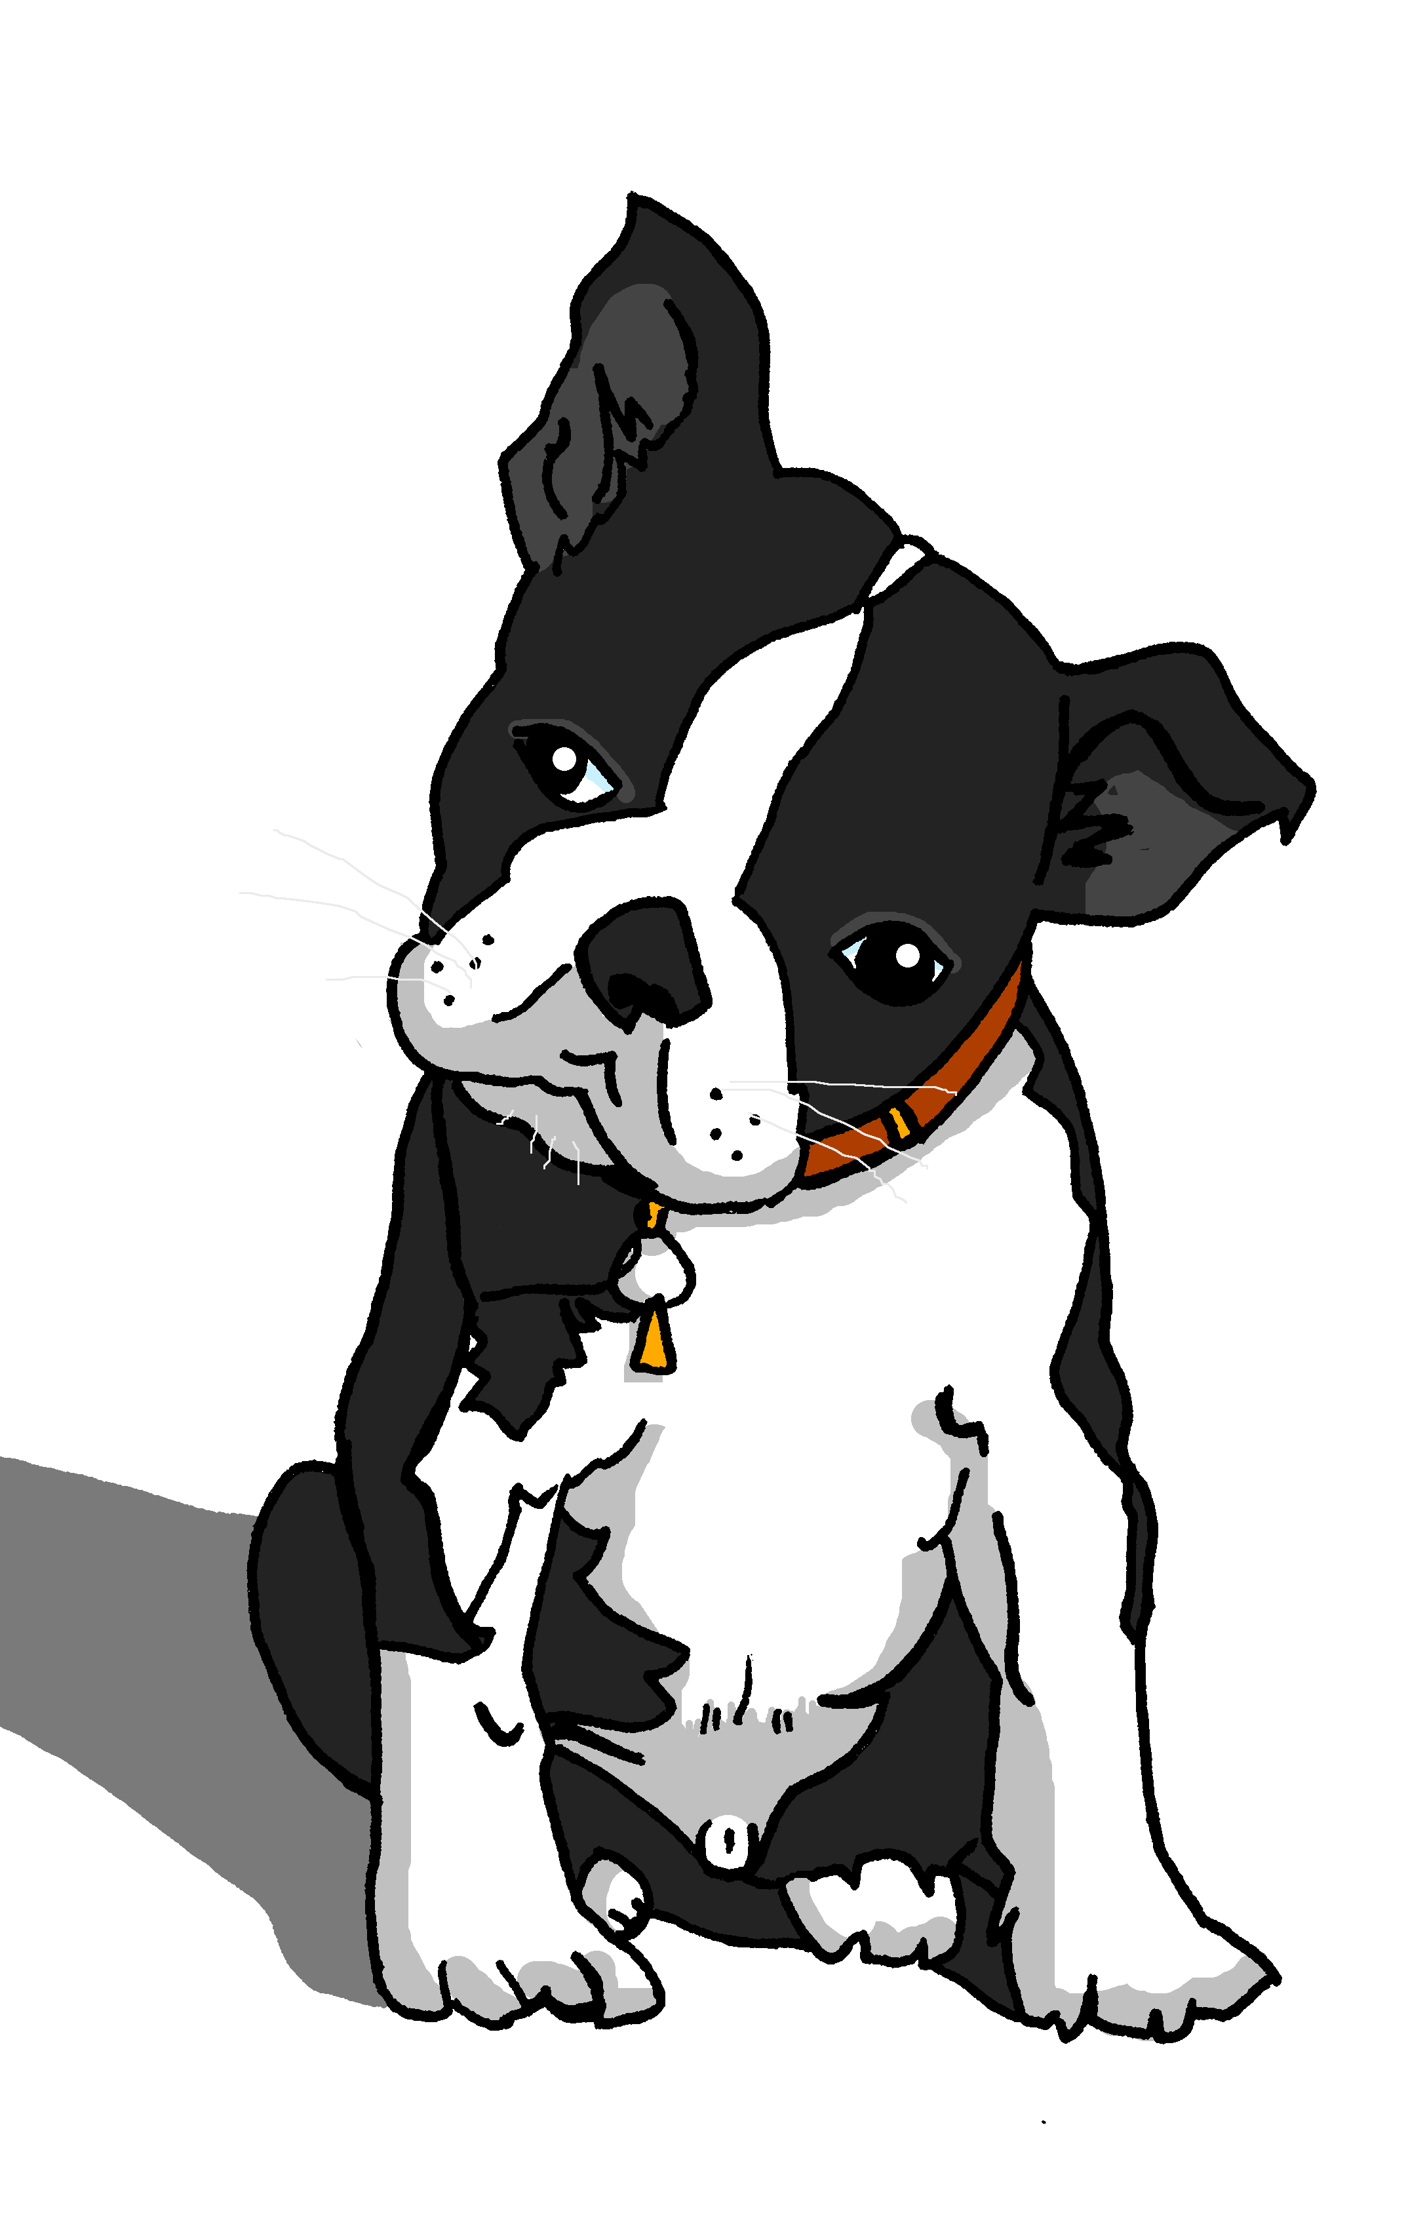
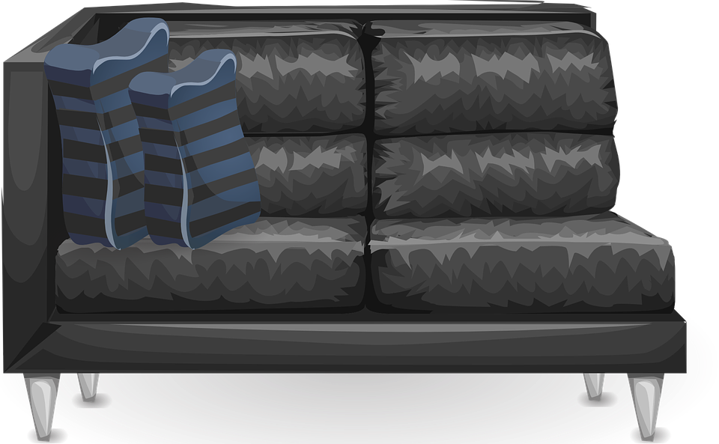
leer
Santi está ... ahora en casa.
hablar
cómoda
cómodo
Notes:
[Check that they know that Santi is a male name! He’s Rubén’s dog.]

Slide 12
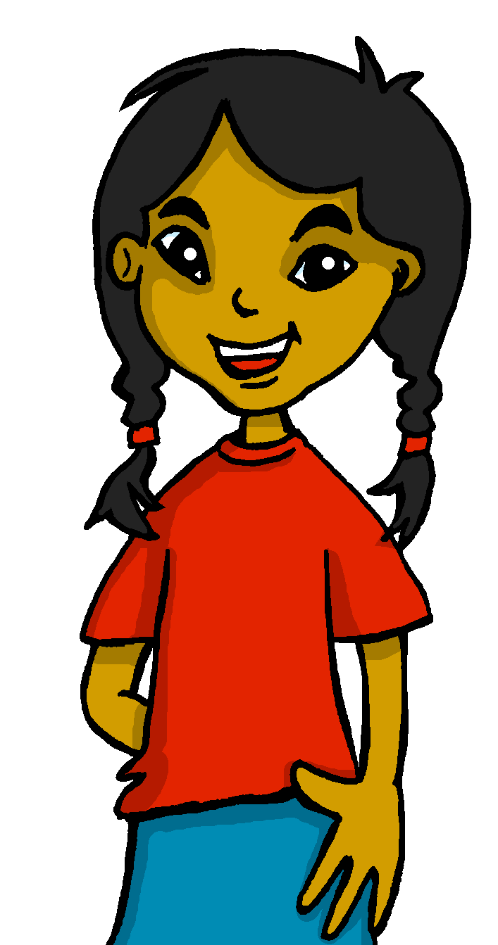
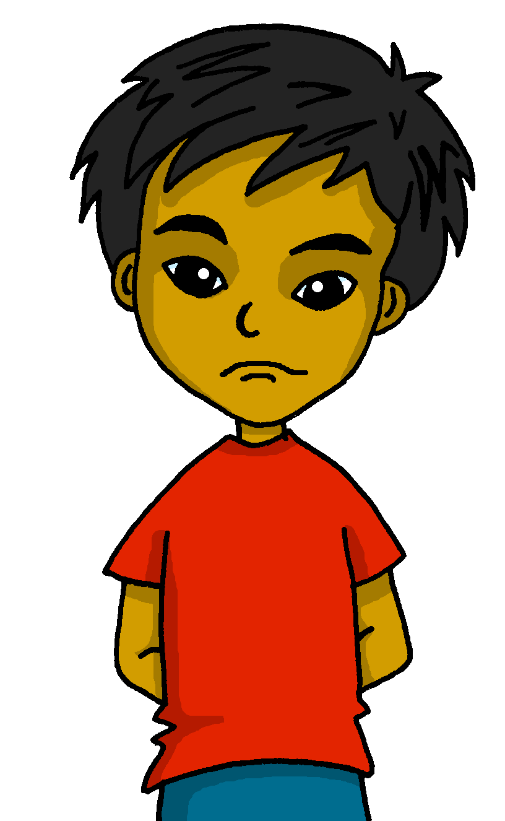
leer
Sofía está… ahora.
hablar
pesada
pesado

Slide 13
leer
La señora está… en clase.
hablar
preparada
preparado

Slide 14
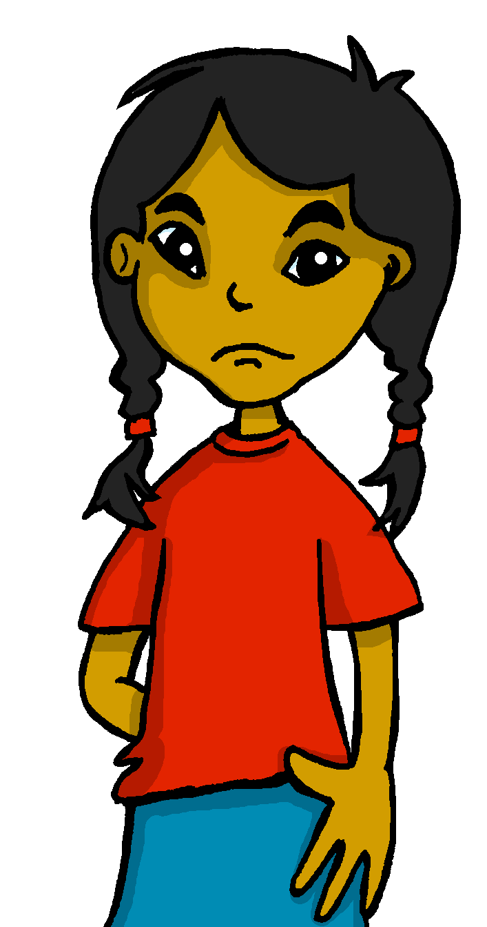
leer
Quique está … hoy en clase.
hablar
pesado
pesada

Slide 15
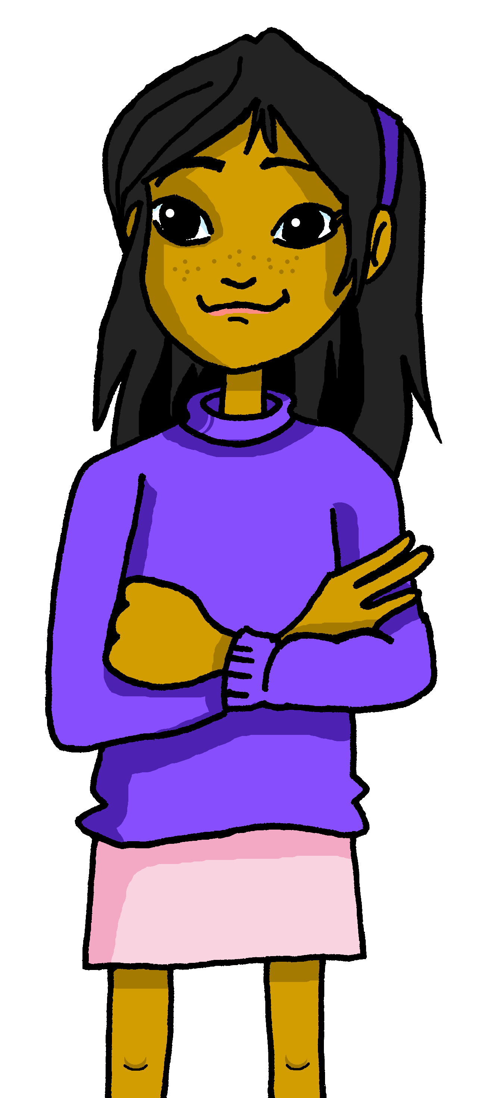
escuchar
Escucha a Ángela.
¿A quién describe?
Listen and write down the correct adjective. Who is Ángela describing?
 |  |  |  |  | Sofía | Quique
 | positivo | positiva | perdido | perdida
 | perdido | perdida | pesado | pesada
 | cómodo | cómoda | positiva | positivo
 | sano | sana | enfermo | enferma
 | activo | activa | sano | sana
 | cómodo | cómoda | activo | activa
 | pesado | pesada | sana | sano
E
1
2
3
4
5
6
Notes:
Timing: 5 minutes
Aim: to practise aural comprehension of the adjective ending in order to recognise the gender of the character being described.
Procedure:
Read the instructions in Spanish out loud.
Click to reveal the instruction in English.
Do the example with them.
Pupils write 1-6 in their books. (Note: some learners will benefit from being able to circle the words on the sheet).
Ask them to write the adjective they hear & decide if Sofía is describing Santi (a male dog) or Irene (a female tortoise). They will hear each sentence twice.
Transcript:
EJ. Está perdido.
Está pesada.
Está cómoda hoy.
Está sano ahora.
¿Ahora? ¡Ahora está activa!
Hoy está cómodo.
Está sana ahora.

Slide 16
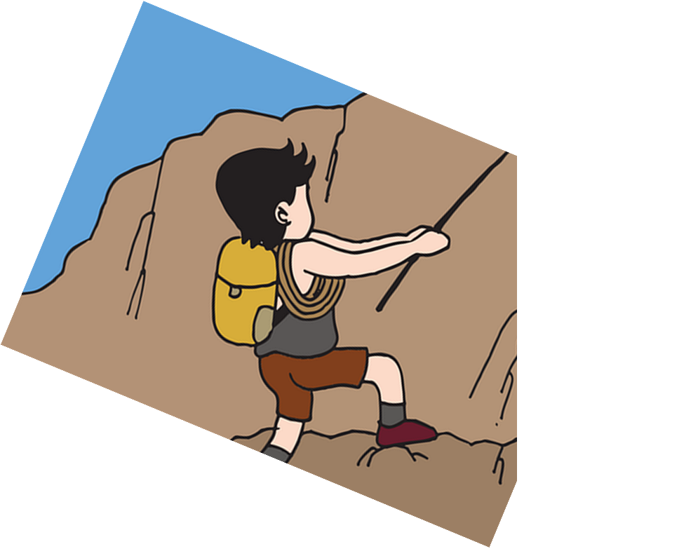
hablar
She is comfortable now.
5
4
hoy
ahora
en clase
en casa
3
cómodo
cómoda
nervioso
nerviosa
2
estoy
estás
está
1
Notes:
Timing: 3 minutes
Aim: to use the correct form of the adjective in oral production.
Procedure:
Tell pupils they need to use the words, starting from the bottom, to climb up the mountain (And translate the sentence!).
Ask pupils to work in pairs to practise first.
Click to trigger the timer (5 seconds per sentence).
Ask a volunteer from a pair to say the Spanish sentence out loud – next slide reveals the answer.
Repeat with the next 3 sentences (there are 4 in total).

Slide 17
hablar
She is comfortable now.
hoy
ahora
en clase
en casa
cómodo
cómoda
nervioso
nerviosa
estoy
estás
está
Notes:
ANSWER

Slide 18
hablar
I am ill today.
5
4
hoy
ahora
en clase
en casa
3
activo
activa
enfermo
enferma
2
estoy
estás
está
1

Slide 19
hablar
I am ill today.
hoy
ahora
en clase
en casa
activo
activa
enfermo
enferma
estoy
estás
está
Notes:
ANSWER

Slide 20
hablar
He is active at home now.
5
hoy
ahora
4
sí
en clase
allí
en casa
3
pesada
pesado
activa
activo
2
estoy
estás
está
1

Slide 21
hablar
He is active at home now.
hoy
ahora
sí
en clase
allí
en casa
pesada
pesado
activa
activo
estoy
estás
está

Slide 22
hablar
I am annoying at home today.
[Manchita]
5
hoy
ahora
4
siempre
aquí
en clase
en casa
3
sana
preparada
pesada
pesado
2
estoy
estás
está
1

Slide 23
hablar
I am annoying at home today.
[Manchita]
hoy
ahora
siempre
aquí
en clase
en casa
sana
preparada
pesada
pesado
estoy
estás
está

Slide 24
vocabulario
Escribe en inglés: Can you get at least 15 points?
 | aquí | allí | estoy
 | buenas tardes | ¿dónde? | ausente
 | ¿cómo? | activo | clase
 | perdido | sano | preparado
 | enfermo | estás | ahora
 | está | hoy | cómodo
 | pesado | en clase | activo
x3
x2
x1
Notes:
Timing: 6 minutes
Aim: to practise written comprehension of vocabulary from last week and this week.
Procedure: 1. Give pupils a blank grid. They fill in the English meanings of any of the words they know, trying to reach 15 points in total.
Note: The most recently learnt and practised words are pink, words from the previous week are green and those from two weeks ago are blue, thus more points are awarded for them, to recognise that memories fade and more effort (heavy lifting!) is needed to retrieve them.

Slide 25
¡adiós!
amarillo

Slide 26
Persona A
H _ _ e_t_ p_rd_d_.
E_t_ s e_f_rm_ h_y.
E_t_ y s_n_.
Say to Persona B
E_t_ pr_ p_rad_.
Today I am lost → Hoy estoy perdido.
You are prepared today → Estás preparado hoy.
E_t_ a_ t_ v_.
S/he is active → Está activo.
¡H_l_! E_t_ y pr_s_nt_.
You are ill → Estás enfermo.
I am healthy → Estoy sano.
Hello! S/he is absent. → ¡Hola! Está ausente.
Notes:
Handout Persona A

Slide 27
Persona B
H_ _ e_t_y p_rd_d_.
E_t_ _ pr_p_r_d_ h_y.
E_t_ a_t_v_.
Say to Persona A
E_t_ _ en_ _ rm_.
Today s/he is lost → Hoy está perdido.
You are ill today → Estás enfermo hoy.
E_t_y s_n_.
I am healthy → Estoy sano.
S/he is prepared → Está preparado.
¡H_l_! E_t_ aus_nt_.
S/he is active → Está activo.
Hello! I am present → ¡Hola! Estoy presente.
Notes:
Handout Persona B

