Slide 1
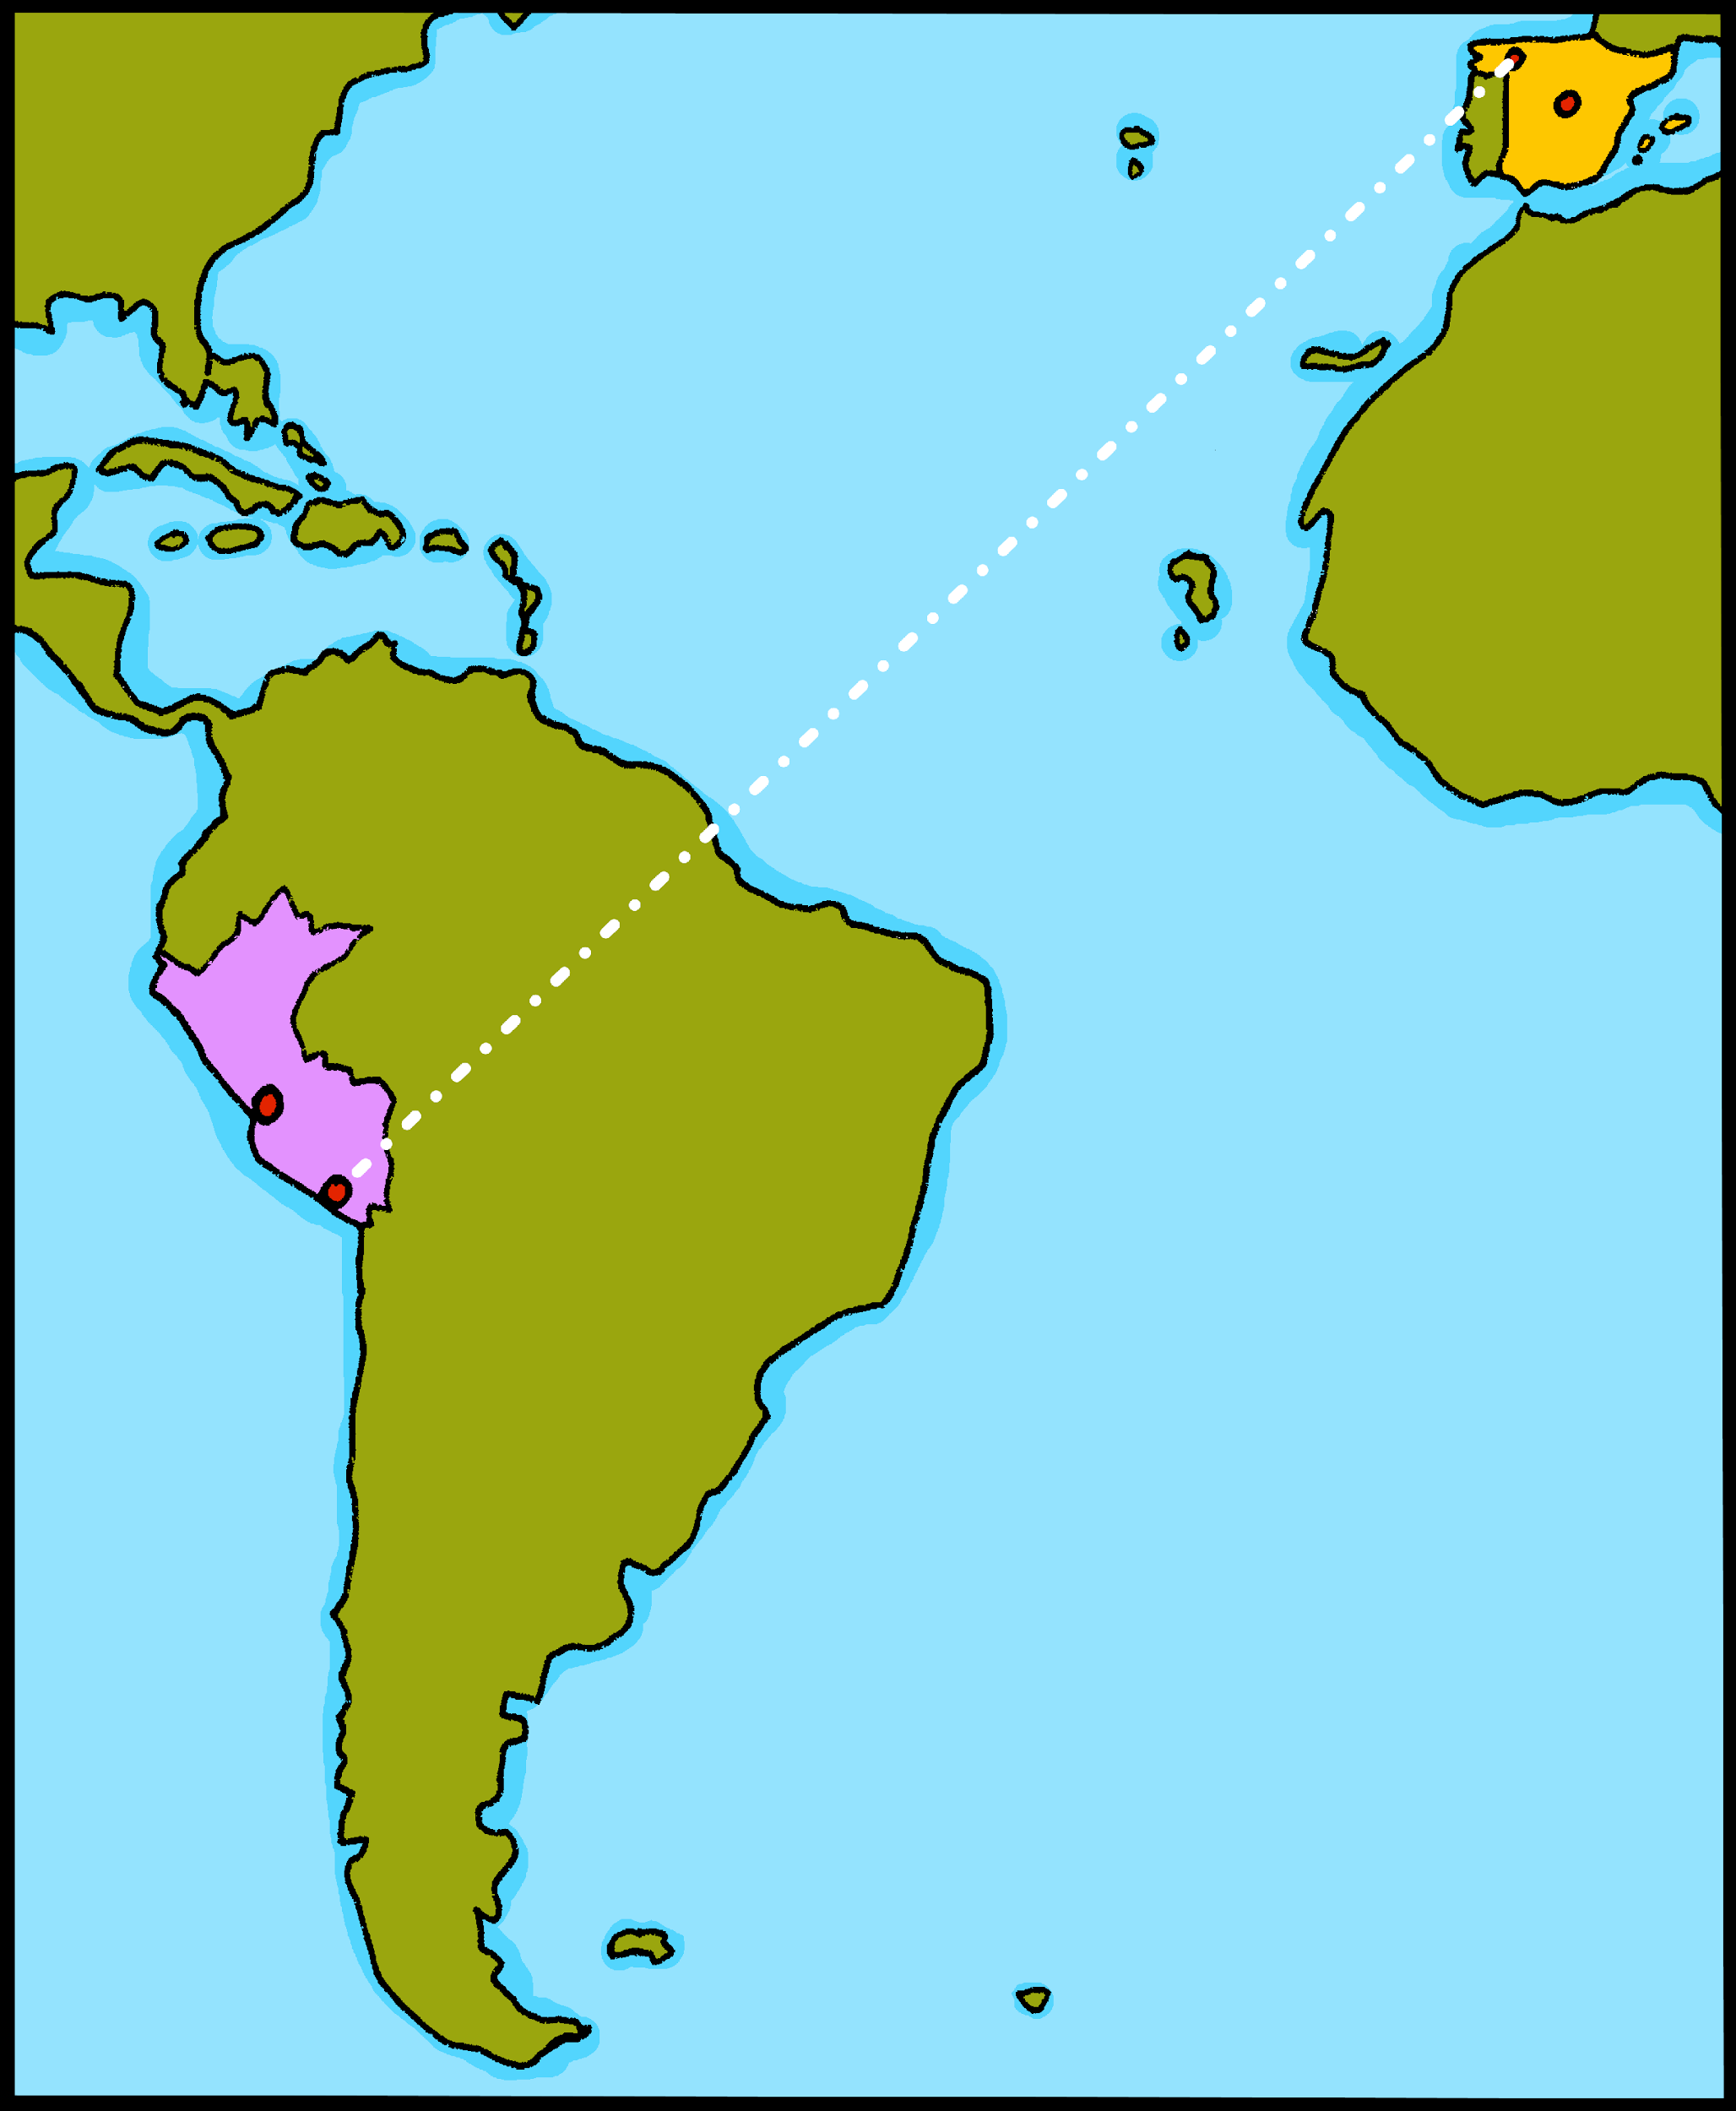
¡hola!

Slide 2
Describing me and others
amarillo
Estar: estoy, está , estás for temporary state
SSC [e]
Notes:
Artwork by Steve Clarke. All additional pictures selected are available under a Creative Commons license, no attribution required.
New vocabulary:
activo [1278] enfermo [1092] perdido [1899] preparado [2092] sano [1961] hoy [167] ¿cómo? [151]
The frequency rankings for words that occur in this PowerPoint which have been previously introduced in the resources are given in the SOW (excel document) and in the resources that first introduced and formally re-visited those words.
For any other words that occur incidentally in this PowerPoint, frequency rankings will be provided in the notes field wherever possible.
Source: Davies, M. & Davies, K. (2018). A frequency dictionary of Spanish: Core vocabulary for learners (2nd ed.). Routledge: London

Slide 3
[e]
elefante
pronunciar
Notes:
Timing: 1 minute
Aim: To introduce SSC [e]
Procedure:
Introduce and elicit the pronunciation of the individual SSC [e] and then the source word ‘elefante’ (with gesture, if using).
Click to bring the picture & get pupils to repeat (with gesture, if using).
Pupils to practise in pairs.

Slide 4
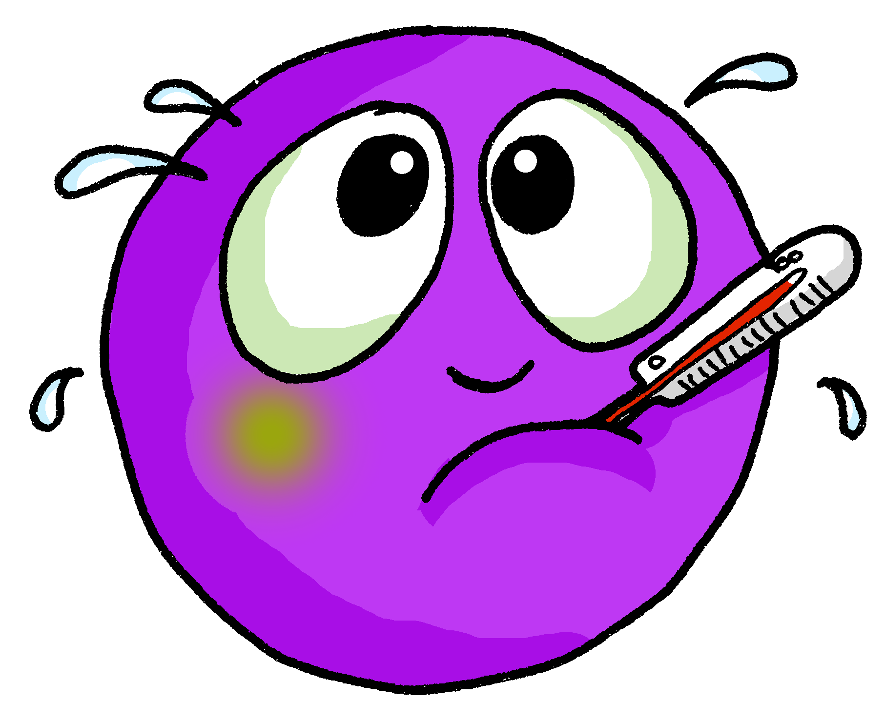
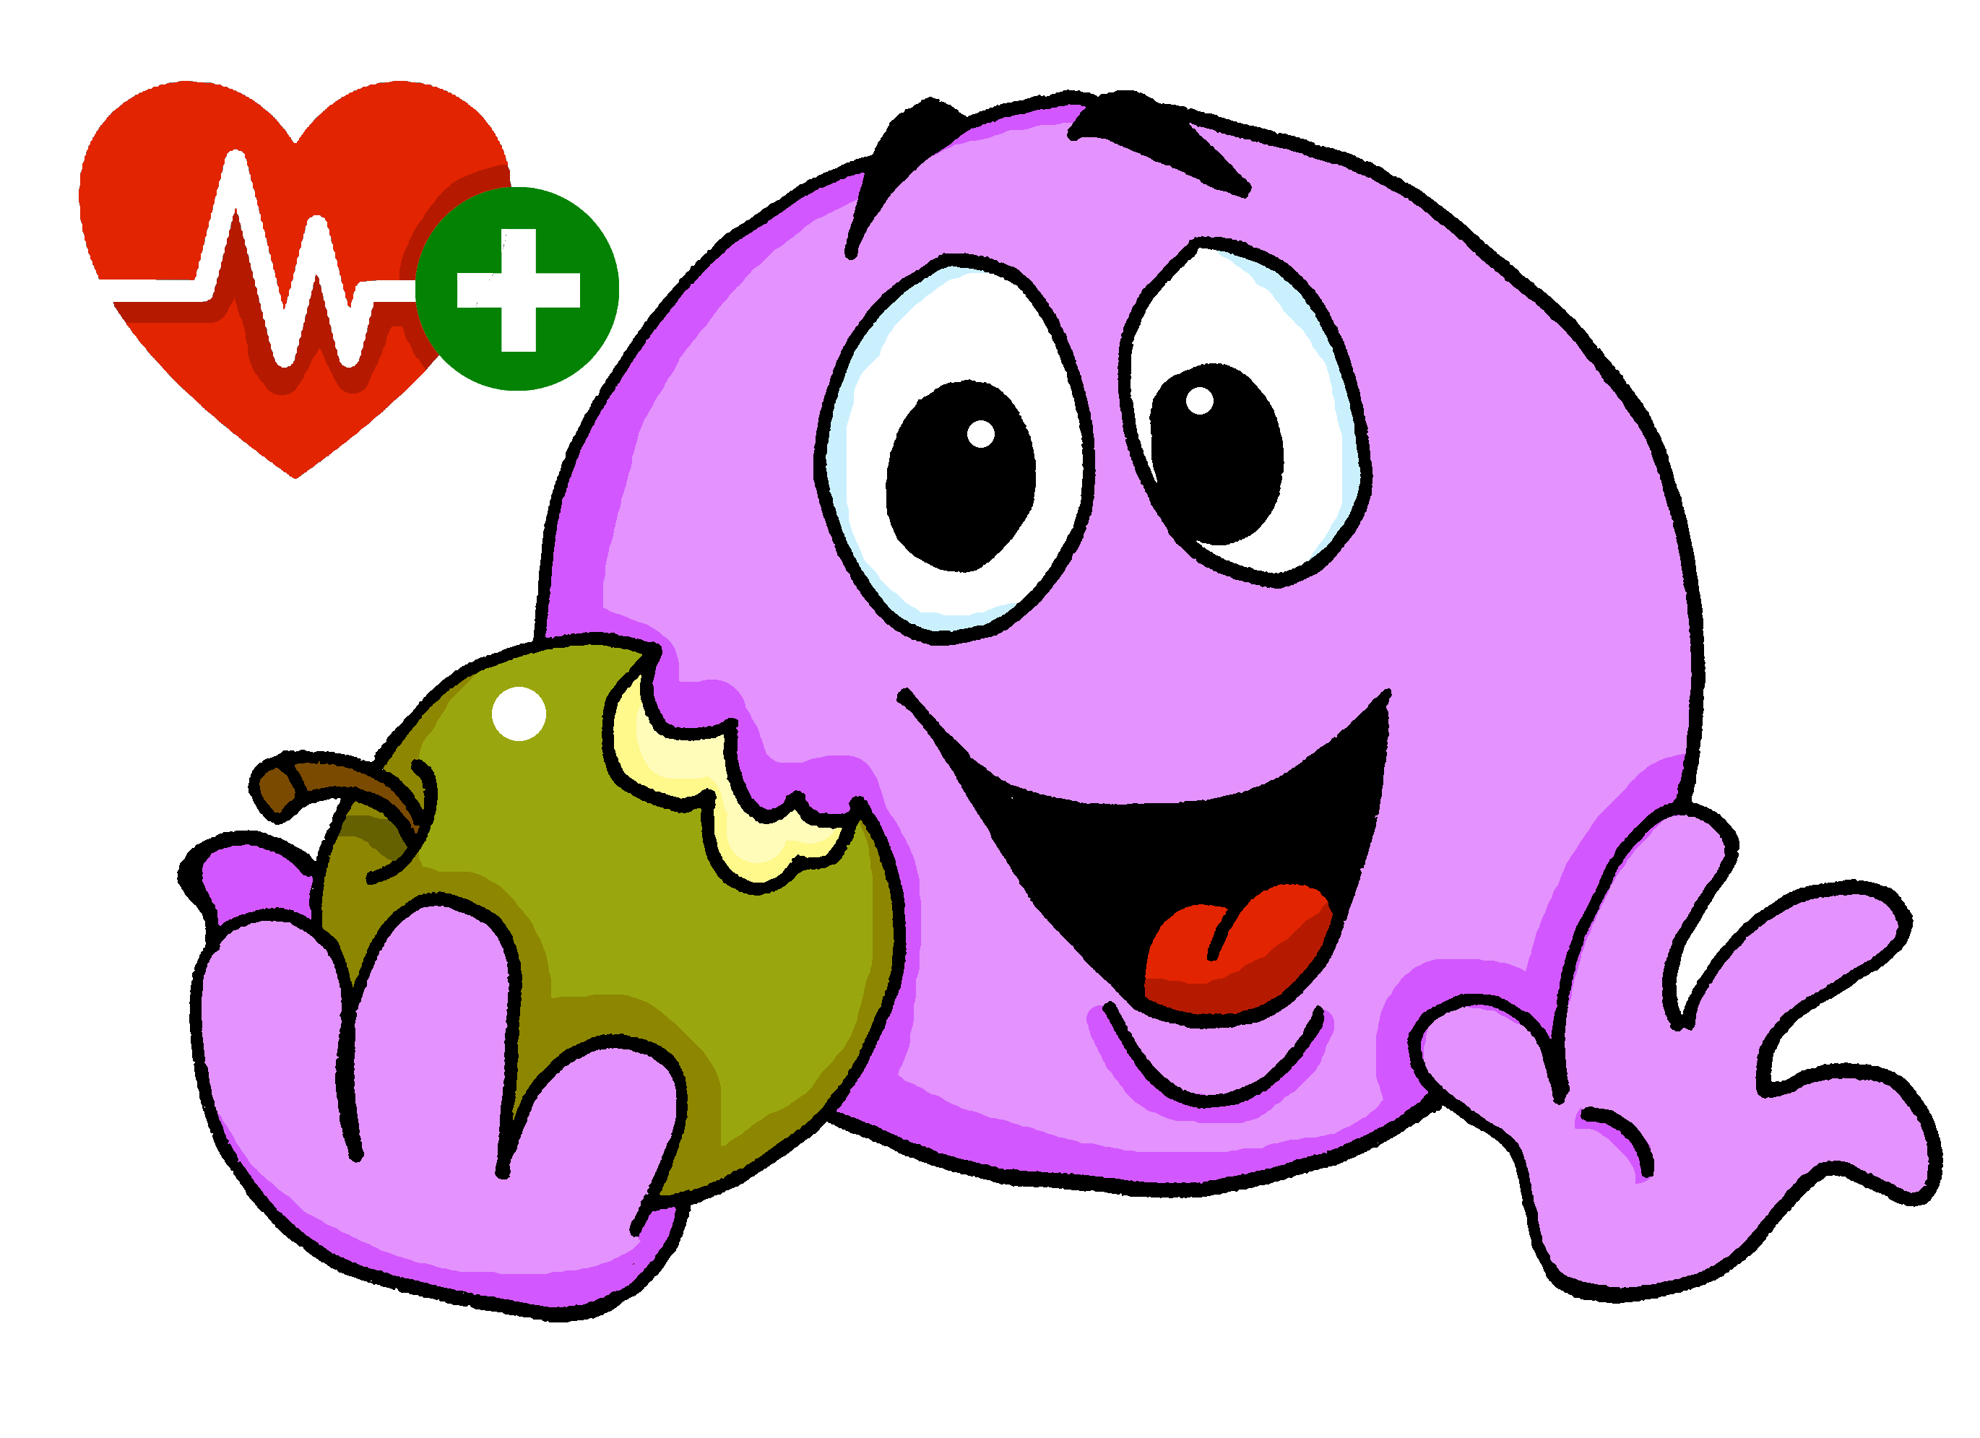
pronunciar
activo
enfermo
preparado
sano
perdido
Notes:
Timing: 3 minutes
Aim: to introduce 5 new items of vocabulary.
Procedure:
Click to trigger the picture and the word.
Say the Spanish word and get pupils to repeat.
Elicit English meaning.
Repeat with the other 4 adjectives.
Note: 3 of the 5 new vocabulary items contain this week’s SSC [e]. Draw pupils’ attention to this.

Slide 5
pronunciar
activo
perdido
lost
Notes:
Timing: 3 minutes
Aim: to embed the meaning of the new words.
Procedure:
1. Read the two Spanish words out loud to model pronunciation. Elicit the right answer from pupils.
2. Repeat with the next four slides.

Slide 6
pronunciar
preparado
perdido
prepared / ready

Slide 7
pronunciar
activo
enfermo
sick / ill

Slide 8
pronunciar
activo
sano
healthy

Slide 9
pronunciar
perdido
activo
active
Notes:
Timing: 3 minute
Aim: To embed the meaning of the new words.
Procedure:
Read the two Spanish words out loud to model pronunciation. Elicit the right answer from students.
2. Repeat with the next four slides.

Slide 10
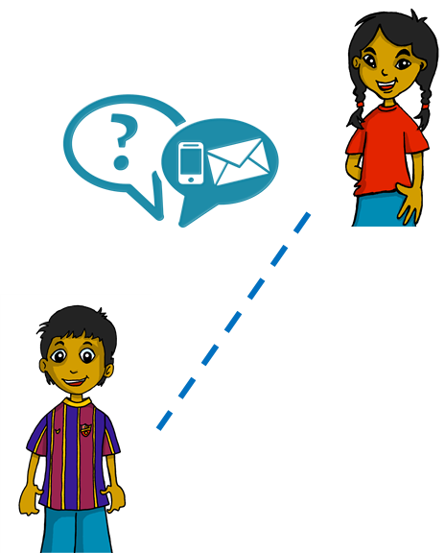
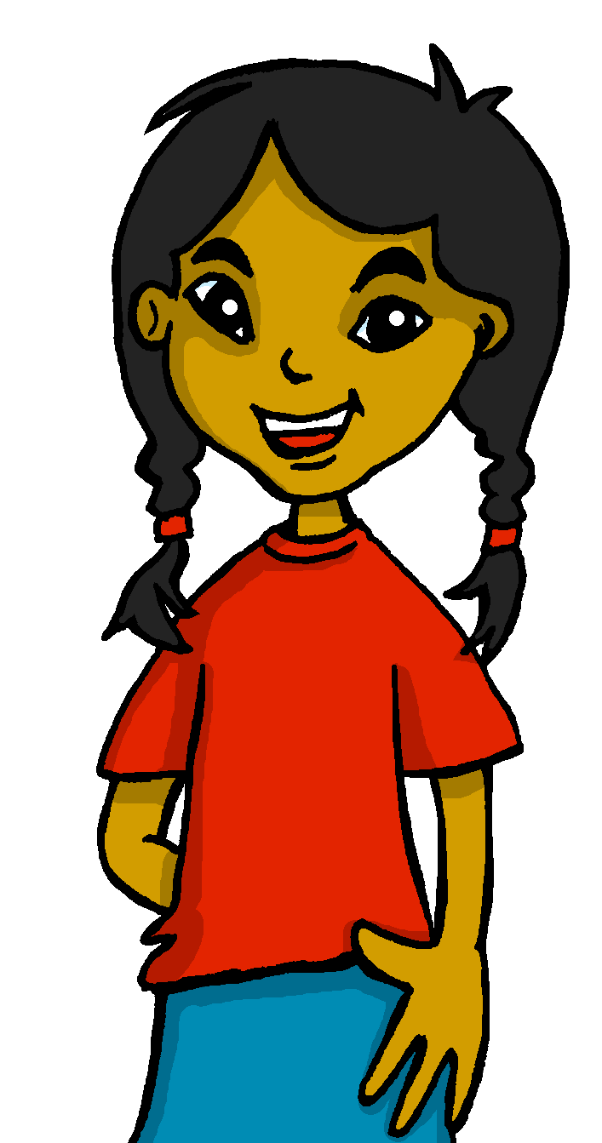
estar
[to be | being]
We have already learned that In Spanish the verb estar means ‘to be’ when describing location.
Sofíá, ¿Estás en Perú?
Sí, estoy en Cusco.
Sofía, Are you in Peru?
Yes, I am in Cusco.
We also use estar when describing mood or temporary state.
⚠ In English, we often use a verb with
‘-ing’ to talk about a temporary state (‘right now’). For example:
I am feeling tired /You are being silly.
Estoy preparado.
I am ready.
Estás activo.
I am (feeling) ready.
You are active.
You re (feeling) active.
Notes:
Timing: 3 minutes
Aim: to build on their prior knowledge of the use of estar for location, to learn to use estar (I am / you are) for temporary state.
Procedure:
Read the grammar recap on estar for location, and new explanation on estar for temporary state. Make sure pupils are clear about the I / you pictures as these will come up in consecutive lessons.
Elicit English translations for the Spanish examples provided.

Slide 11
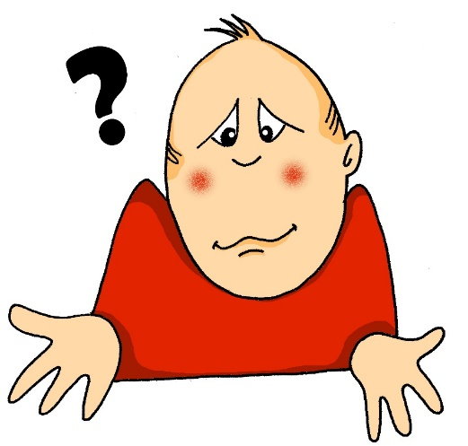
¿Cómo?
pronunciar
how?
¿Cómo estás?
¿Cómo estás hoy?
[How are you?]
[How are you today?]
Rachel Hawkes / Emma Marsden
Notes:
Timing: 1 minute
Aim: To introduce question word ¿cómo? (how) and the final new word for this lesson, hoy (today).
Procedure:
Click to trigger picture and word.
Pupils listen to teacher (or audio) and repeat cómo (include gesture if desired)
Tell pupils the meaning ‘how’ and click to display the English.
Click to trigger the first question: ¿cómo estás?
Elicit the meaning from pupils.
Click to reveal the meaning.
Repeat for ¿cómo estás hoy? (Note: this is the first time pupils have seen this word. They will need to be told the meaning (today)).

Slide 12
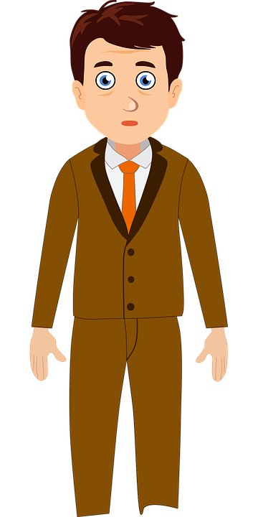
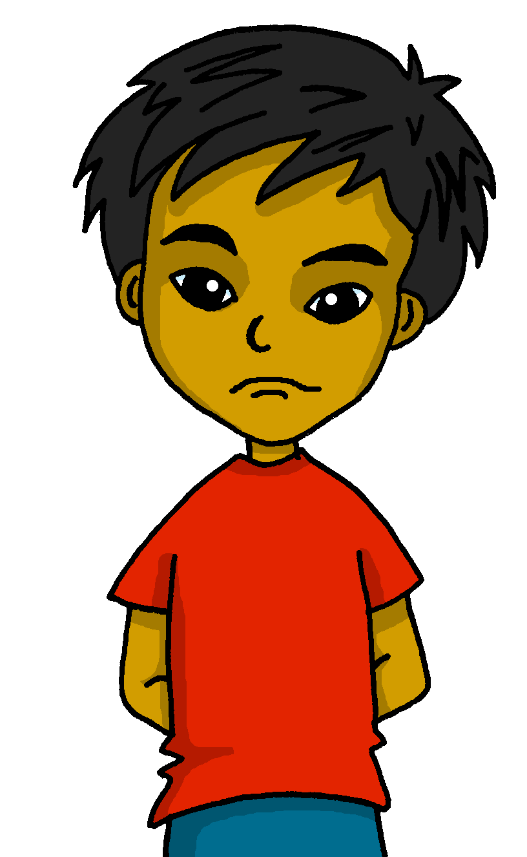
Quique, ¿cómo estás?
Ángela, ¿estás?
Quique, ¿estás?
El señor Valero
No, está ausente.
Sí, estoy aquí.
Estoy perdido.
Quique
Ángela
Notes:
Timing: 3 minutes (two slides)
Aim: to practise hearing and reading questions and answers using estoy, estás, está, recycling vocabulary from previous lesson and new vocabulary from this lesson.
Procedure:
Click to bring up the teacher calling the first pupil. Teacher says: “Quique, ¿estás?”
Click to bring up Quique’s answer: “Sí, estoy aquí.”
Click to bring the teacher’s next call. “Quique, ¿cómo estás?”.
Click to bring up Quique’s answer: “Estoy perdido”.
Click to bring up the teacher’s next call. “Ángela, ¿estás?”
Click to bring up Quique’s answer: ”No, está ausente.”
Ensure meanings are clear and practise pronunciation.
NB. Adjectival agreement will be introduced and practised next week. That is why this week’s lesson focuses only on male/masculine characters.

Slide 13
estar
[to be | being]
Remember that we use estar (‘to be’) when describing location and mood or temporary state.
To say s/he is, use está.
Está sano
¿Está enfermo?
He is healthy.
Is he ill?
Spanish uses two question marks – the one at the front is upside down!
In Spanish, change a statement into a question by raising your voice at the end.
Notes:
Timing: 3 minutes Aim: to remind pupils of the two uses for estar; to recap how to form raised intonation questions (introduced in week 2).
Procedure:
1. Click to trigger the information.
2. Elicit English translations for the Spanish examples provided. 3. Practise in pairs, saying either a question or a statement, and partners translate into English what they hear.

Slide 14
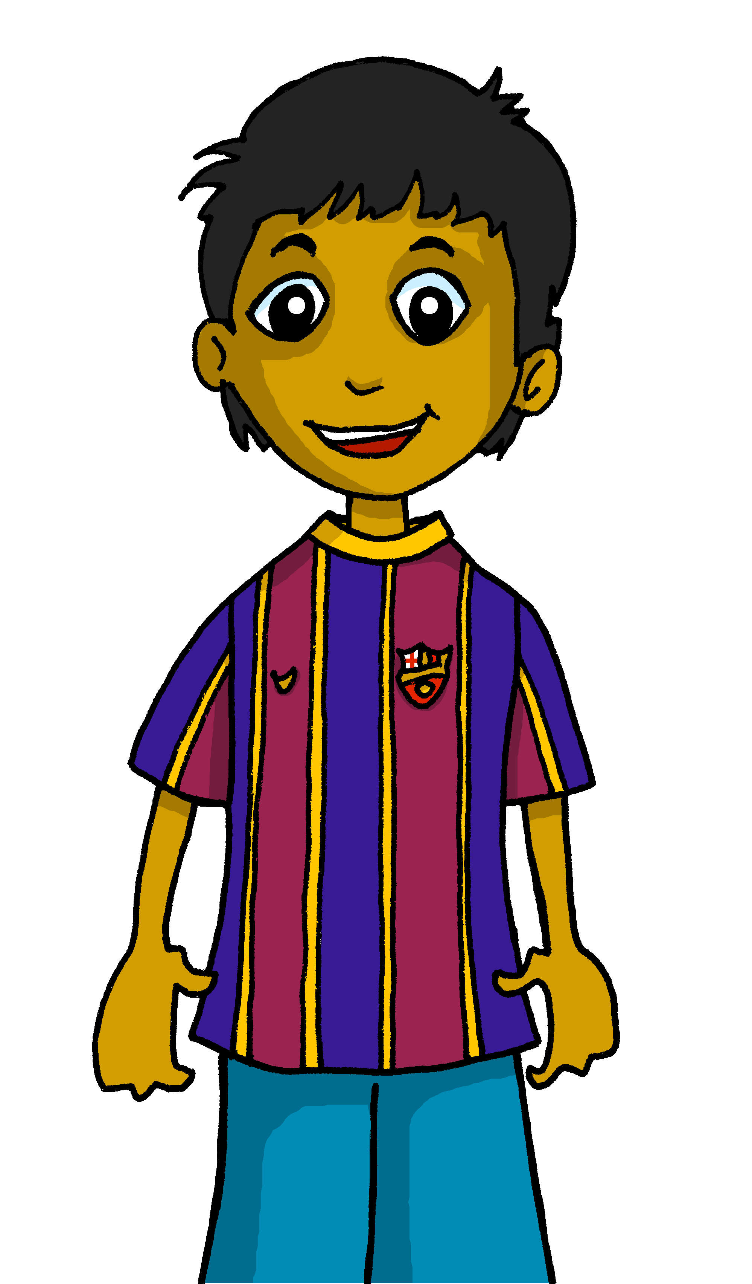
Escucha a Rubén. ¿A quién describe?
A) Marca ‘I’, ‘you’ o ‘he’.
escuchar
 | Rubén (I) | You | He
B) Escribe el número.
Listen again. Where can you hear the following adjectives?
E
1
ill
lost
ready
healthy
active
5
2
2
6
3
4
1
5
3
6
Can you spot the questions?
E
Notes:
Timing: 8 minutes
Aim: to practise aural comprehension of the verbs ‘estoy’, ‘está’ ‘estás’ and recognise the person of the verb they refer to.
Procedure:
1. Ask pupils to write 1-6 in their books.
2. Read the instruction in Spanish from the board.
3. Tell them that they will hear Quique talking about herself, to one of his friends, or about one of his friends.
4. Do the example with them.
5. Play 1-6. Pupils identify to whom Quique refers (himself, talking to a friend or about one of his friends) and write I, you, he.
6. Play the six utterances again. Remind them about the raised intonation and also the question word ‘cómo?’.
Challenge pupils to put their hands up when they hear the two questions.
Part 2
7. Play utterances one more time. This time pupils need to identify where they can hear the adjectives & write down the number of the sentence in which they are mentioned.
Part 2
6. Play it one more time. This time students need to identify where they can hear the adjectives & write down the number of the sentence in which they are mentioned.
Script
EJ. Está activo.
¿Estás preparado?
Estás perdido.
Estoy sano.
¿Cómo estás hoy?
Está enfermo.
Hoy estoy perdido.

Slide 15
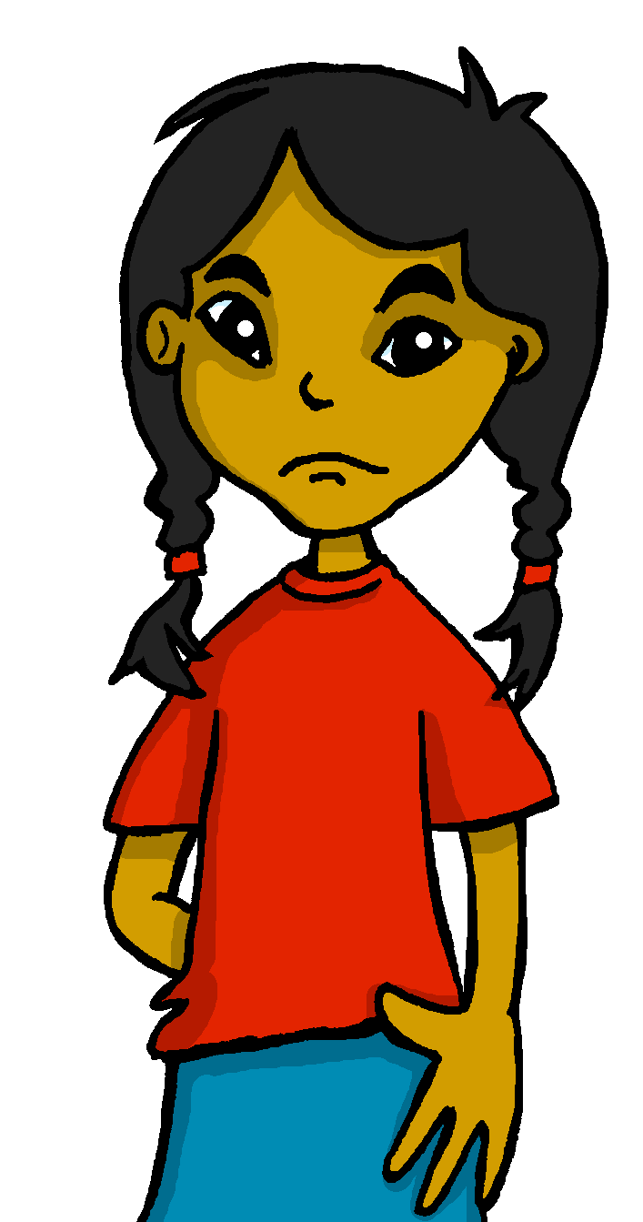
En casa
Sofía ¿dónde está Pancho?
¡Hoy está perdido en casa!
Quique
Sofía
dónde - where
Notes:
Timing: 3 minutes (two slides)
Aim: to set the scene for the speaking activity that follows.
Procedure:
Click to bring up Quique’s question: “¿Sofía, dónde está Pancho?”
Click to bring up Sofía’s answer: ¡Hoy está perdido en casa!

Slide 16
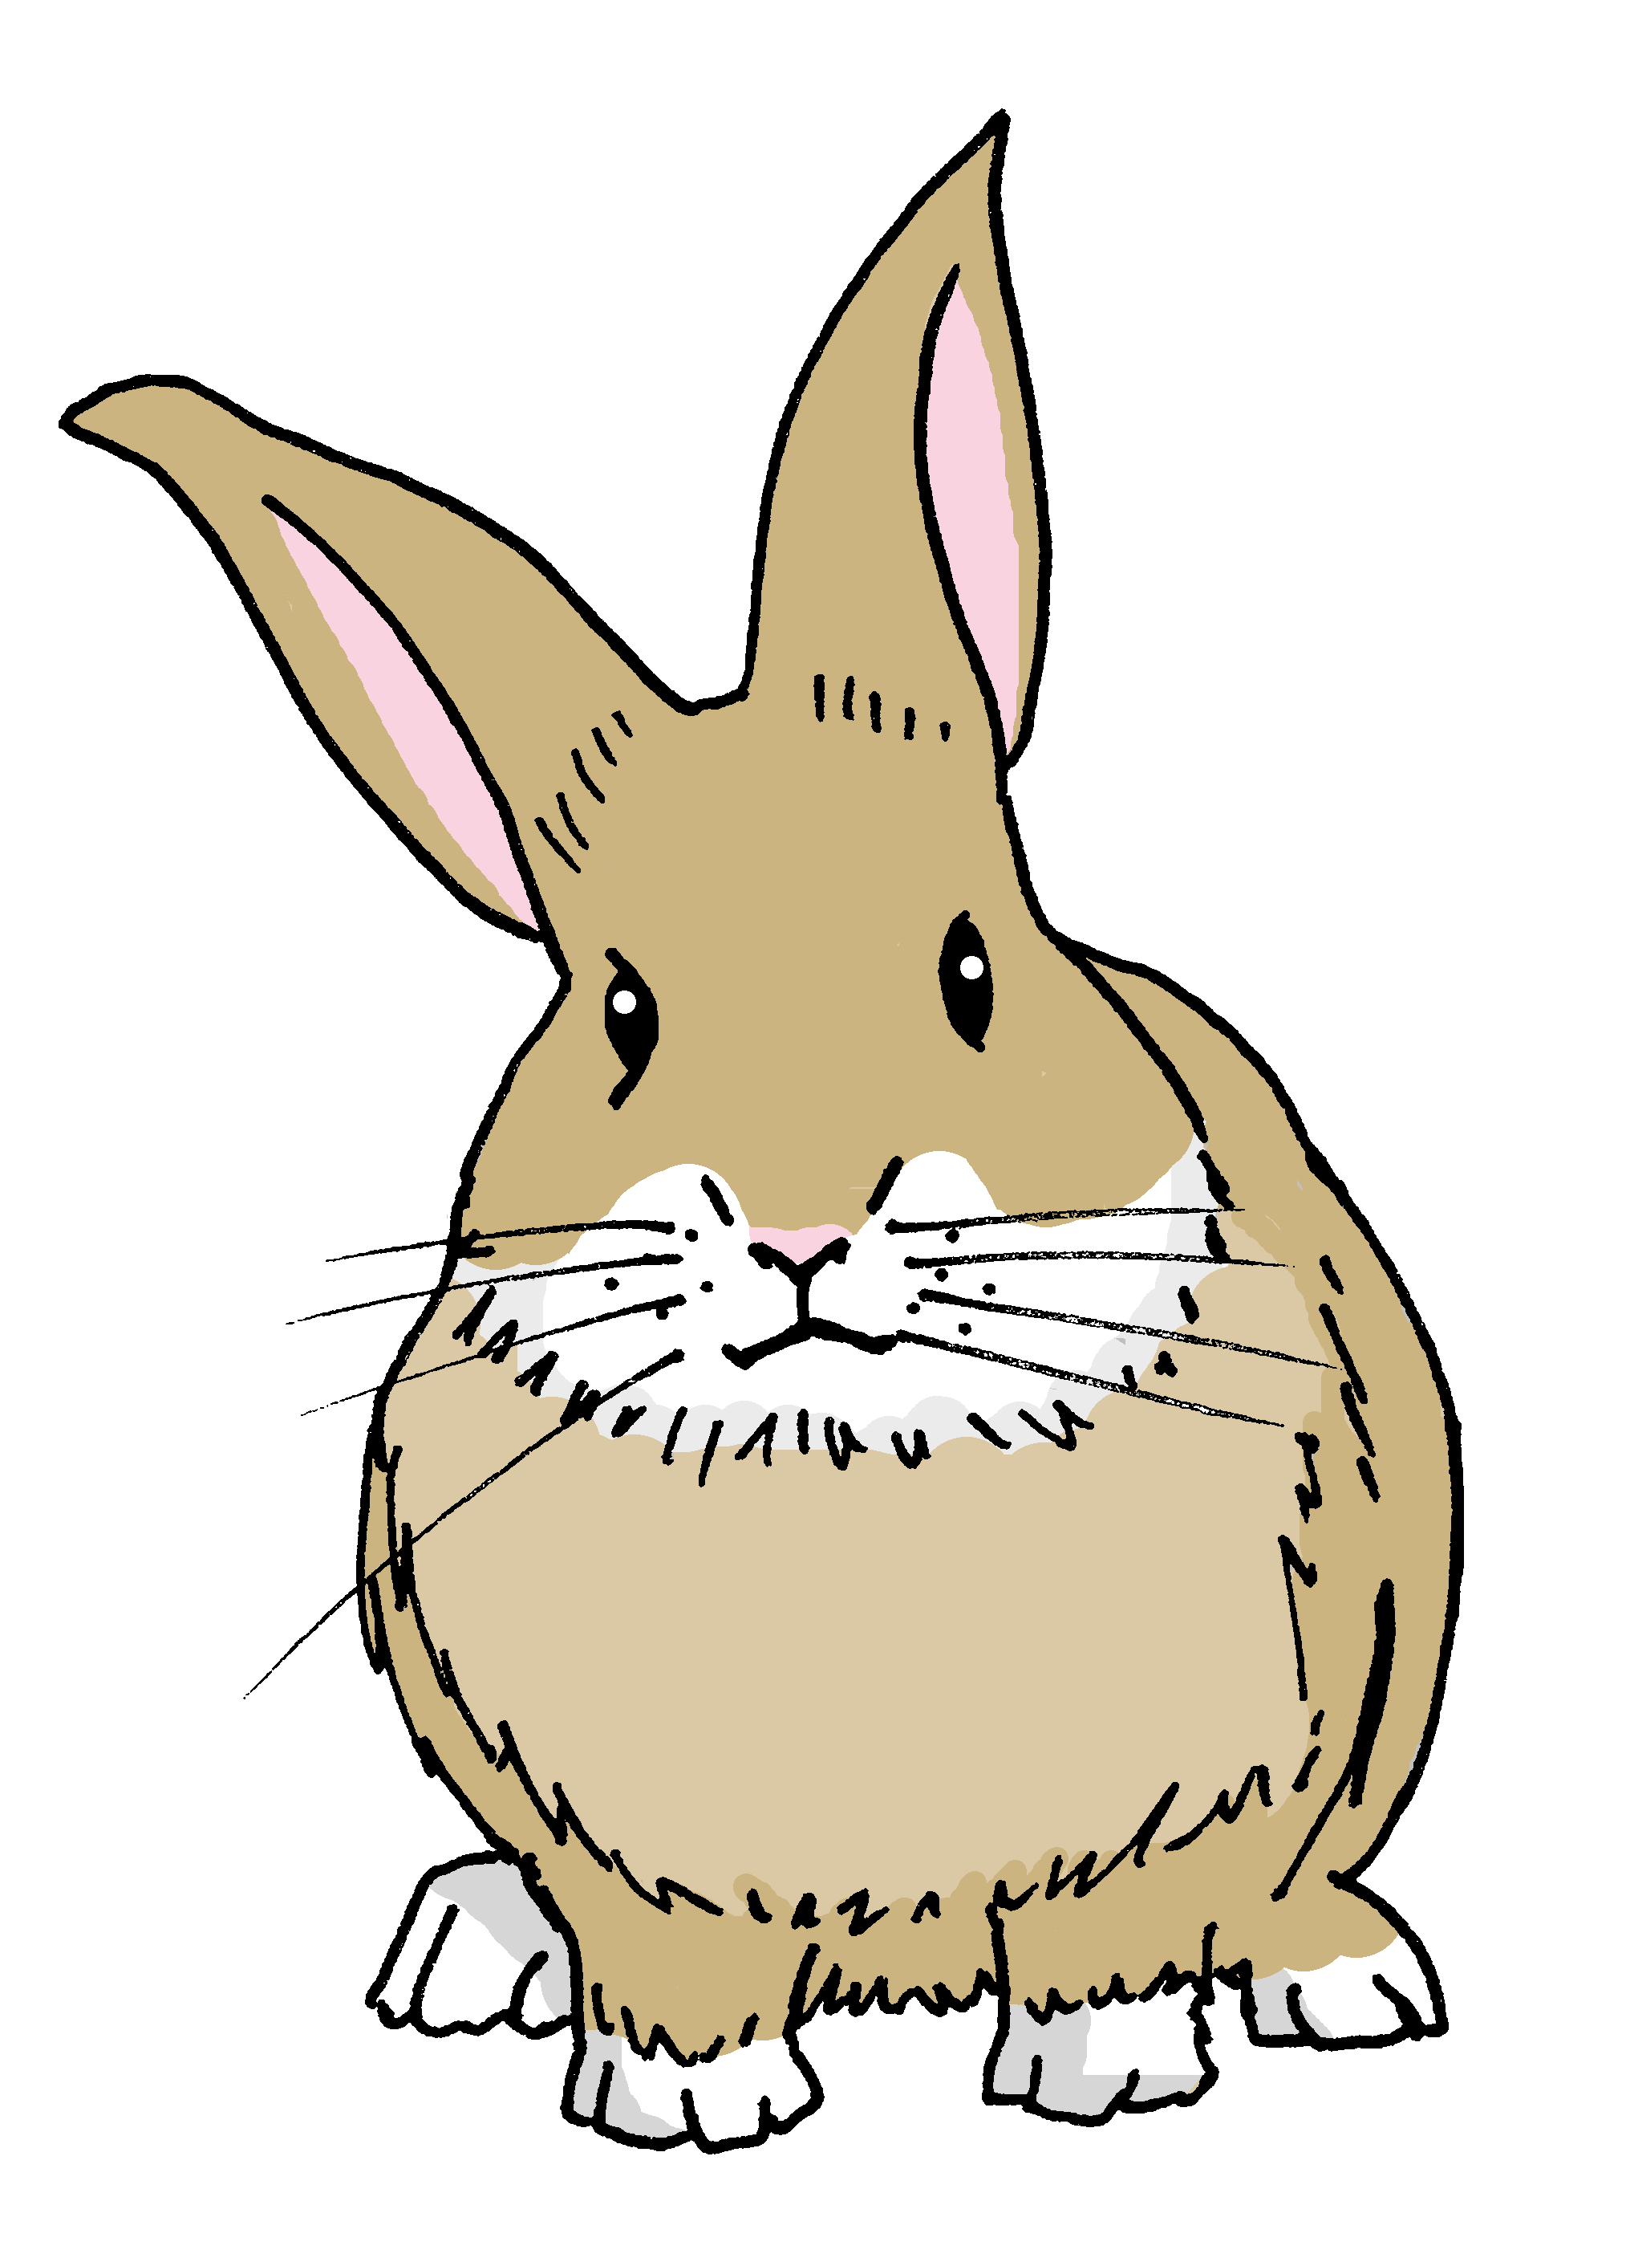
¡Oh no! Pancho está perdido.
Estoy perdido.
Notes:
Procedure:
Read the heading and speech bubble.
Ensure pupil understanding.
Note: There are two rabbits in the resources. Pancho (male) and brown, Manchita (female) and grey.

Slide 17
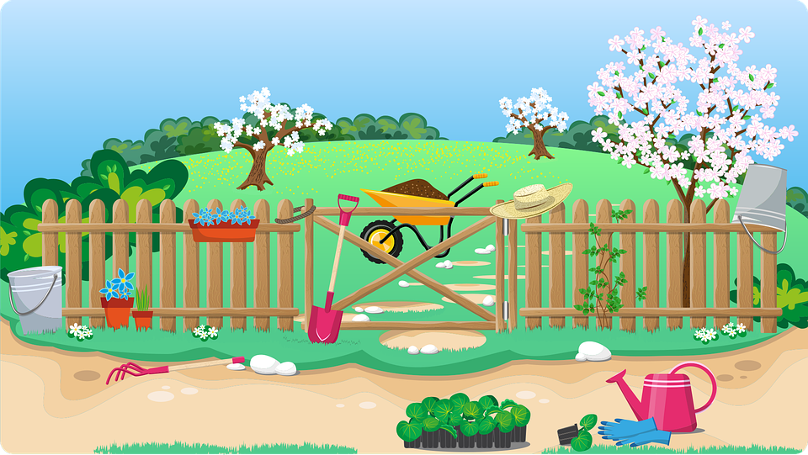
lost
ready
ill
active
healthy
hablar
I am
You are
He is
Está activo.
Notes:
Timing: 2 minutes (or more, if time allows) (3 slides – more in follow up)
Aim: to correctly use the verbs ‘estoy’, ‘está’ and ‘estás’ in oral production, together with newly learnt vocabulary items.
Procedure:
Pupils select a verb form on the vertical axis with an adjective along the horizontal axis.
They translate the short sentence to identify the square where they think Pancho (the rabbit) is.
Click on the square to reveal what is beneath.
Note: pupils might benefit from revisiting the adjectives again before starting the activity.
(!) Pancho is hidden behind… He is active / está activo.

Slide 18
lost
ready
ill
active
healthy
I am
You are
He is
Estás preparado.
Notes:
Pancho is hidden behind… You are ready / Estás preparado.

Slide 19
lost
prepared
ill
active
healthy
I am
You are
He is
Está perdido.
Notes:
Pancho is hidden behind… He is lost. / Está perdido.

Slide 20
¡adiós!
amarillo
Notes:
Timing: 8 minutes
Aim: to practise listening out for the verbs ‘estoy’, ‘está’ ‘estás’ and process the person of the verb they refer to.
Procedure:
1. Ask pupils to write 1-6 in their books.
2. Read the instruction in Spanish from the board.
3. Tell them that they will hear Ángela talking about herself or one of her friends.
4. Do the example with them.
5. Play 1-6. Students to identify to whom Ángela refers (herself – one of her friends) and tick the correct box.
Challenge students to identify the two questions. Remind them about the raised intonation.
Part 2
6. Play it one more time. This time students need to identify where they can hear the adjectives & write down the number of the sentence in which they are mentioned.
Script
EJ. Estoy contento.
Está serio.
¿Estás cansado?
Estoy serio.
Está nervioso ahora.
Estás tranquilo.
¿Cómo estás ahora?

