Slide 1
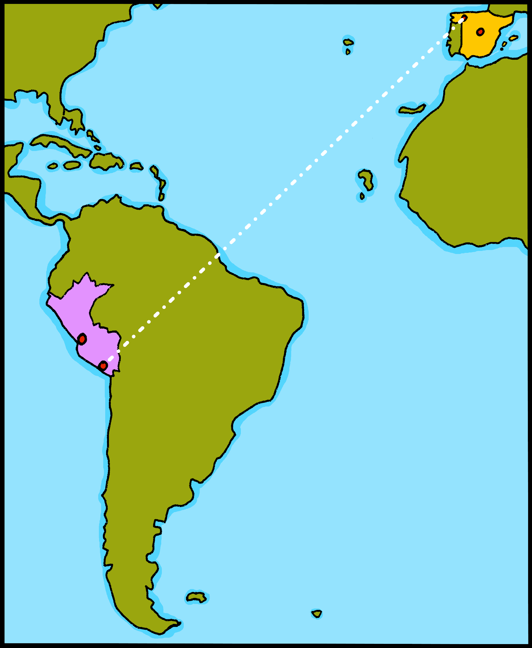
¡hola!

Slide 2
Describing me and others
Estar: estoy, está,
estás for location
SSC [u]
amarillo
Notes:
Artwork by Steve Clarke. Pronoun pictures from NCELP (www.ncelp.org). All additional pictures selected from Pixabay and are available under a Creative Commons license, no attribution required.
Frequency of new vocabulary and phonics:
Phonics: [u] source word: universe [1603]
Vocabulary: estás [21] ¿dónde? [161] sí [45] no [11] en1 [5] ¡Buenos días! [103/65] ¡Buenas tardes! [103/392] Source: Davies, M. and Davies, K. (2018). A frequency dictionary of Spanish: Core vocabulary for learners (2nd ed.). Routledge: London
The frequency rankings for words that occur in this PowerPoint which have been previously introduced in these resources are given in the SOW and in the resources that first introduced and formally re-visited those words.
For any other words that occur incidentally in this PowerPoint, frequency rankings will be provided in the notes field wherever possible.

Slide 3
[u]
universo
pronunciar
Notes:
Timing: 1 minute
Aim: To introduce SSC [u]
Procedure:
Introduce and elicit the pronunciation of the individual SSC [u] and then the source word ‘universo’ (with gesture, if using).
Click to bring on the picture and get students to repeat (with gesture, if using).

Slide 4
pronunciar
¡Buenos días!
Good morning!
¡Buenas tardes!
Good afternoon!
Notes:
Timing: 1 minute
Aim: To introduce buenos días / buenas tardes.
Procedure:
Introduce and elicit the pronunciation of the phrases, practising orally with the visual support, then providing the word.
Ensure that literal and equivalent English meanings are clear.

Slide 5
1
2
Good morning!
Good afternoon!
Notes:
Timing: 1 minute
Aim: To recognise ‘buenos días’ and ‘buenas tardes’
Procedure:
Teachers say one of the phrases and students use their finger to show which picture corresponds to the phrase.

Slide 6
estar
[to be | being]
In Spanish the verb estar means ‘to be’ when describing location.
Estoy aquí.
Está allí.
I am here.
He is there.
She is there.
Notes:
Timing: 1 minute
Aim: to revisit estar (to be for location).
Procedure:
Present the grammar explanation of “estar”, “estoy” and “está”. Make sure pupils are clear about the I / you pictures as these will come up in consecutive lessons.
Elicit English translation for the Spanish examples provided.

Slide 7
estar
[to be | being]
To say you are, use estás.
Estás presente.
Estás en España.
In Spanish, change a statement into a question by raising your voice at the end.
You are present.
You are in Spain.
¿Estás presente?
¿Estás en España?
Are you present?
Are you in Spain?
Notes:
Timing: 1 minute
Aim: to introduce estás (you are).
Procedure:
Present the grammar explanation of “estar” and “estás”.
2. Elicit English translations for the Spanish examples provided).
Note: Raised intonation questions will be practised formally again in Week 5.

Slide 8
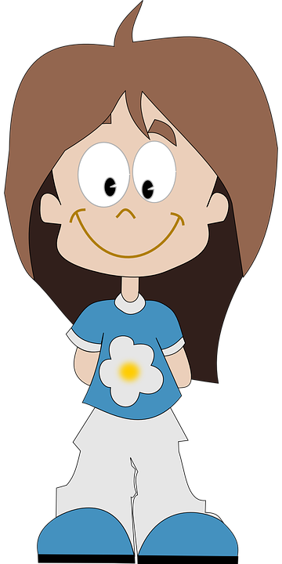
Quique, ¿estás?
Úrsula, ¿estás allí?
Sí, presente
Sí
Úrsula
Quique
Notes:
Timing: 3 minutes (two slides)
Aim: to practise written comprehension and matching sound to print of “estás” questions, recycling vocabulary from previous lesson.
Procedure:
Click to bring up the teacher calling the first pupil. Teacher says: “Úrsula, ¿estás allí?”
Click to bring up Úrsula’s answer: “sí.”
Click to bring the teacher’s next call. “Quique ¿estás?”.
Click to bring up Quique’s answer: “Sí, presente”. Ensure meaning is clear and practise pronunciation.
Note: practise pronunciation of “Quique” as they haven’t learned [que] / [qui] yet.

Slide 9
Escucha. La señora Mora is taking the register now.
Is it a question or a statement? Write ¿…? or .
escuchar
 | Luis, estás presente
 | Tula, estás presente
 | Alonso, estás allí
 | Manu, estás presente
 | Buena, estás aquí
 | Raúl, estás presente
 | Rubio, estás allí
leer
E
.
1
¿
?
2
¿
?
3
¿
?
4
.
5
.
6
¿
?
Notes:
Timing: 5 minutes
Aim: to practise attending to raised intonation question intonation in aural comprehension with written support. To then practise processing the two structures for meaning.
Procedure:
1. Ask pupils to write 1-6 in their books.
2. Tell them that they will hear a statement or a question using the verb ‘estás’ (you are).
3. When they listen they should decide if it is a question or a statement. They could be asked to note Q or S.
4. Then they should punctuate the questions and statements with ¿…? or . 5. Click to reveal the answers. 6. Ensure that the English meanings are clear. You are vs Are you.
Transcript:
Luis, estás presente.
Tula, ¿estás presente?
Alonso, ¿estás allí?
Manu, ¿estás presente?
Buena, estás aquí.
Raúl, estás presente.
Rubio, ¿estás allí?

Slide 10
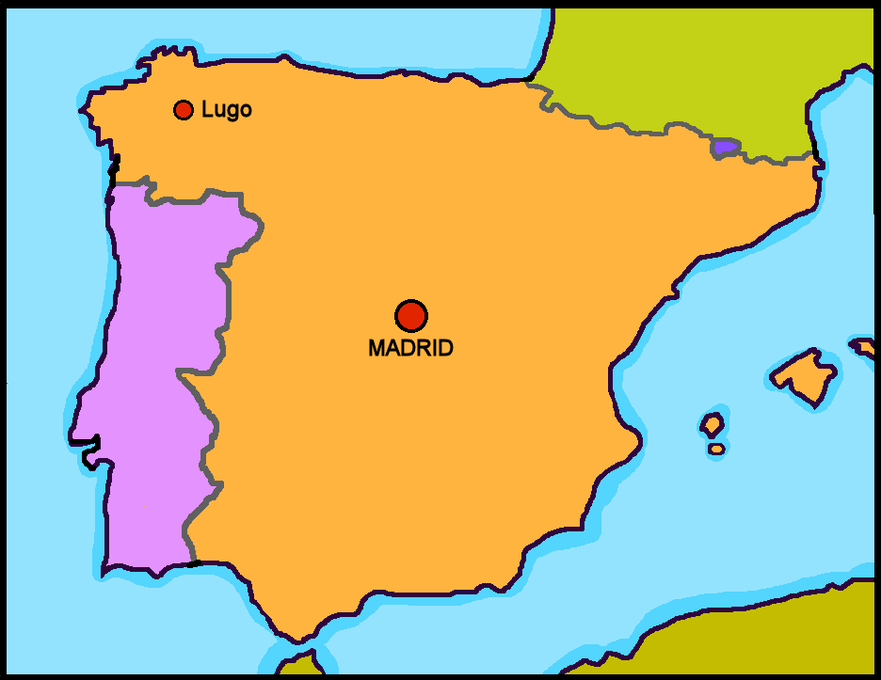
¿Granada está en España?
hablar
No, está en Inglaterra.
Barcelona
Sí, está en España.
Granada
Notes:
Timing: 2 minutes (four slides)
Aim: to present intonation questions using ‘está’ and responses using ‘está’ as ‘it is (in/located)’. Last lesson they practised ‘está’ meaning she / he is.
Procedure:
Ask students “¿Granada está en España?” and read out loud the two options, using the names in the map to model their options.
A student reads the option he/she thinks is the correct out loud.
Click for the correct answer to be highlighted.
Elicit the translation of 'está’ so that it is clear to them that ‘está’ stands for two words in English, here - it and is.
Notes: i) In the next series of slides we extend practice answering the question ¿XXX está en YYY? and answering with Sí or No. ii) Note that we are not doing negative sentences yet. The negative answers give a positive answer. No, está en… (No, it is in…). iii) The names of cities and countries do contain SSCs [a] and [u] and several SSCs not encountered before.

Slide 11
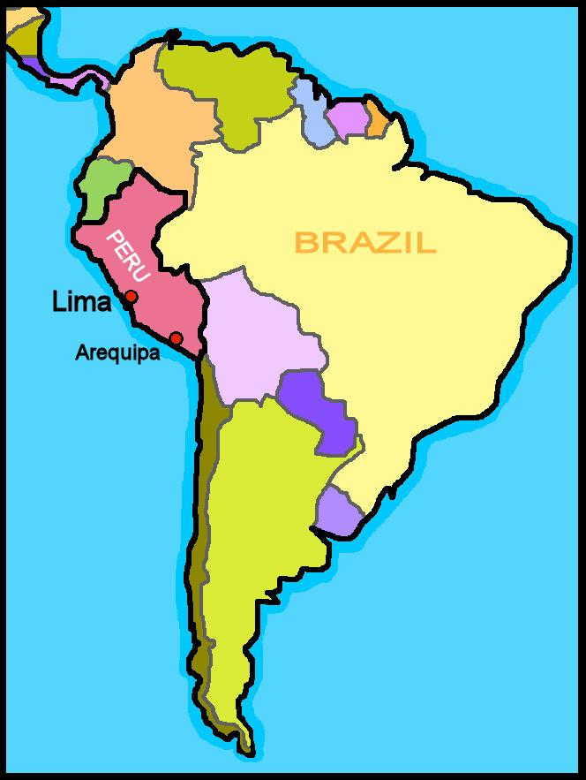
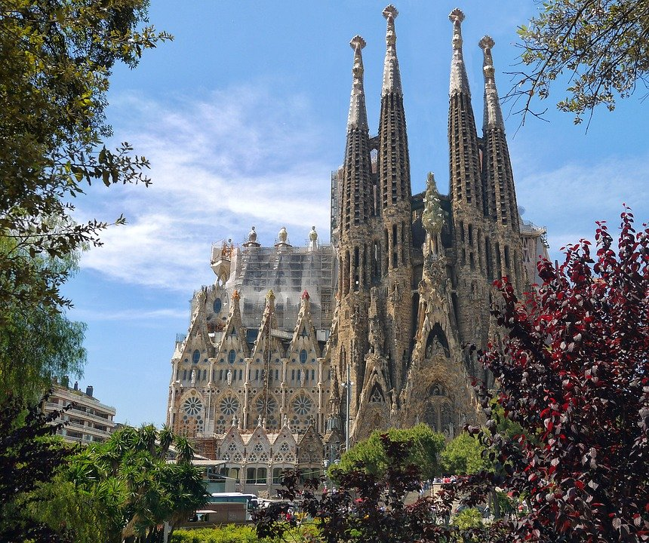
¿La Sagrada Familia está en Perú?
hablar
Sí, está en Perú.
No, está en España.

Slide 12
¿La Sagrada Familia está en Barcelona ?
hablar
Sí, está en Barcelona.
Barcelona
No, está en Madrid.
Granada

Slide 13
¿Quique está en Madrid?
hablar
Sí, está en Madrid.
No, está en Lugo.
Granada

Slide 14
Quique gets lots of messages from his friends.
1
you are
leer
Estoy en España. ☺
I am
2
4
she/he is
she/he is
Estoy en Arequipa. ☺
Está en Málaga. ☺
you are
I am
3
5
are you
you are
¿Estás en Inglaterra?. ☺
Estás en Perú. ☺
I am
you are
Notes:
Timing: 5 minutes
Aim: to understand ‘estoy’ + ‘estás’ + ‘está’ in a reading task.
Procedure:
Read the context. Tell students Quique is receiving messages from different friends.
Read the first message. Ask students to tell you if the message says ‘I am’ or ‘you are’.
Click to reveal the answer.
Continue with items 2 – 5.

Slide 15
You are going to talk about places with your partner. Write down the prompts 1-6.
hablar
Persona A
Persona B
1 | I am…
2 | I am…
3 | you are…
4 | I am…
5 | you are…
6 | you are…
1 | I am…
2 | you are…
3 | I am…
4 | you are…
5 | I am…
6 | you are…
Notes:
Timing: 10 minutes (four slides)
Aim: to practise spoken production of ‘estoy’ + ‘estás’.
Procedure:
Read the instructions.
Students are in pairs A + B. They write down the six corresponding prompts.

Slide 16
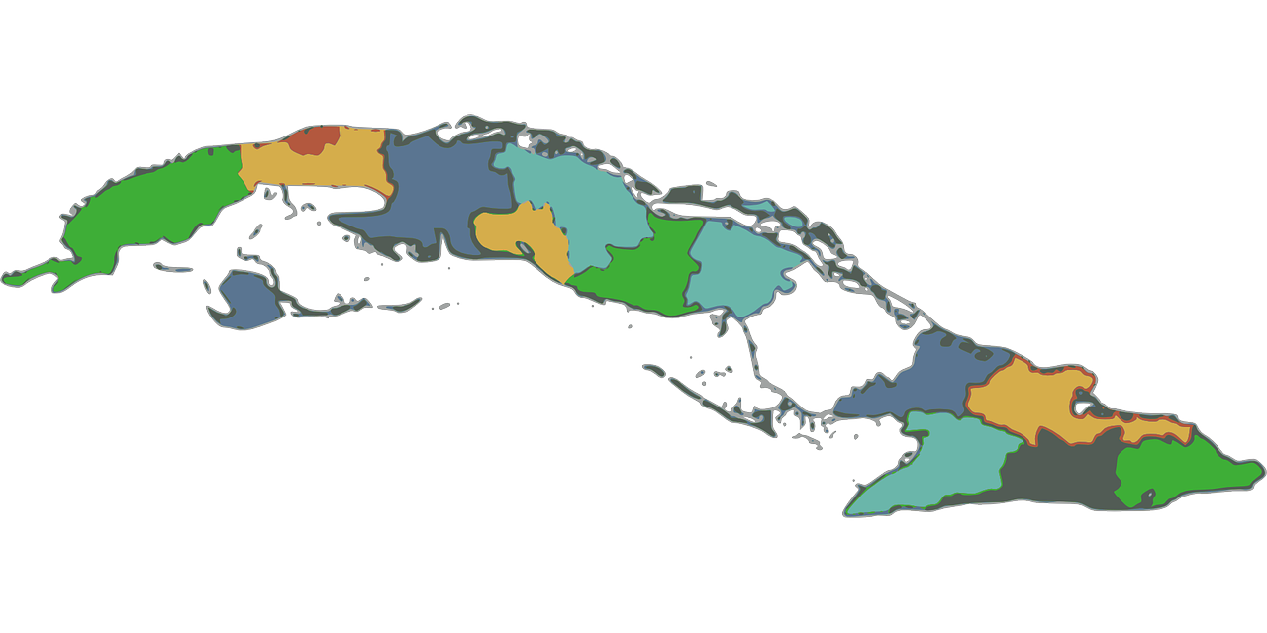
Example:
Estoy…
…en Cuba.
hablar
Persona A
Persona B

in Cuba.
1 | I am…
You are
Perú
I am
Cuba
Notes:
Aim: to model the task.
Procedure:
Click to bring up each element of the task.
Explain that students are building sentences together.
Model how Persona B has to listen to Persona A’s verb to know which location to respond.
Tell students that there are six sets of places for each person and they will both have a turn to play each role.

Slide 17
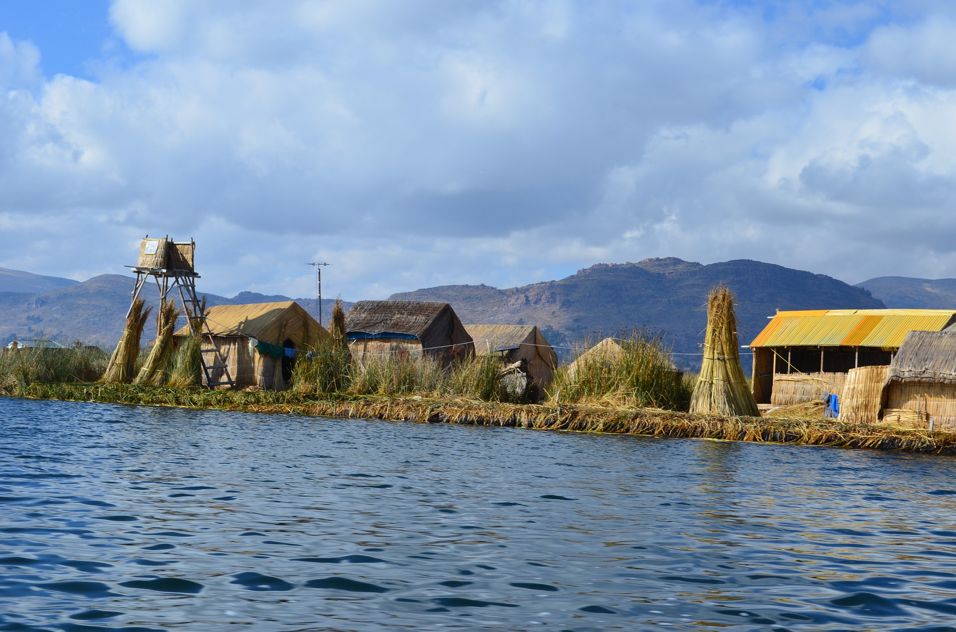
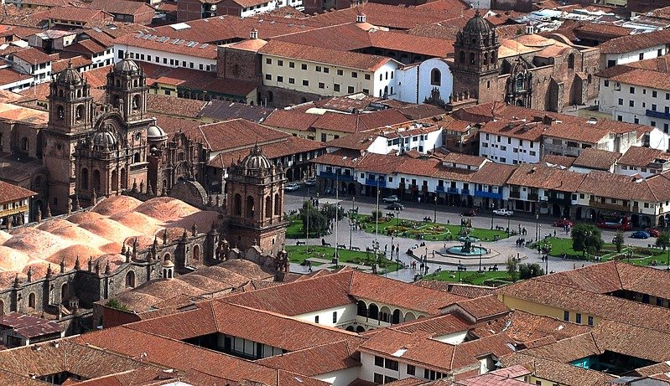
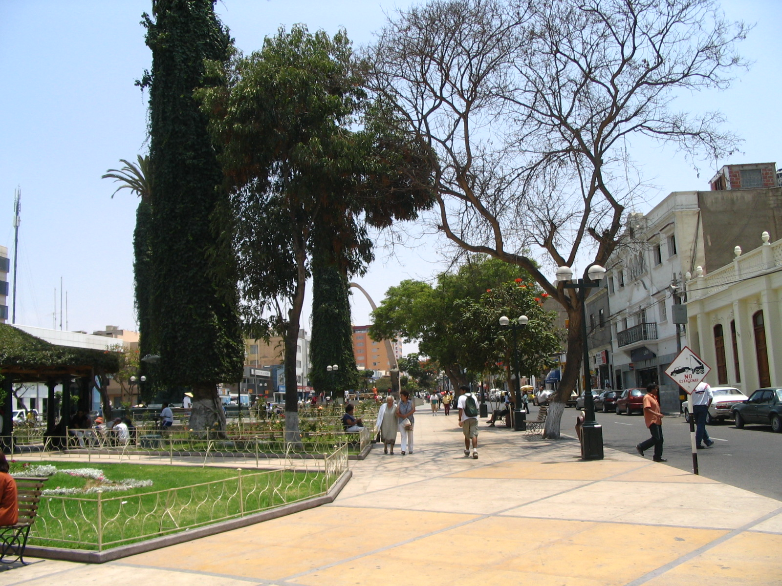
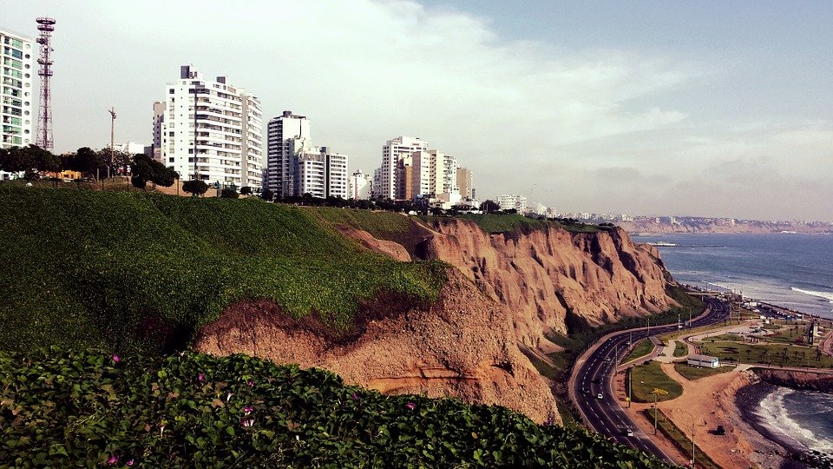
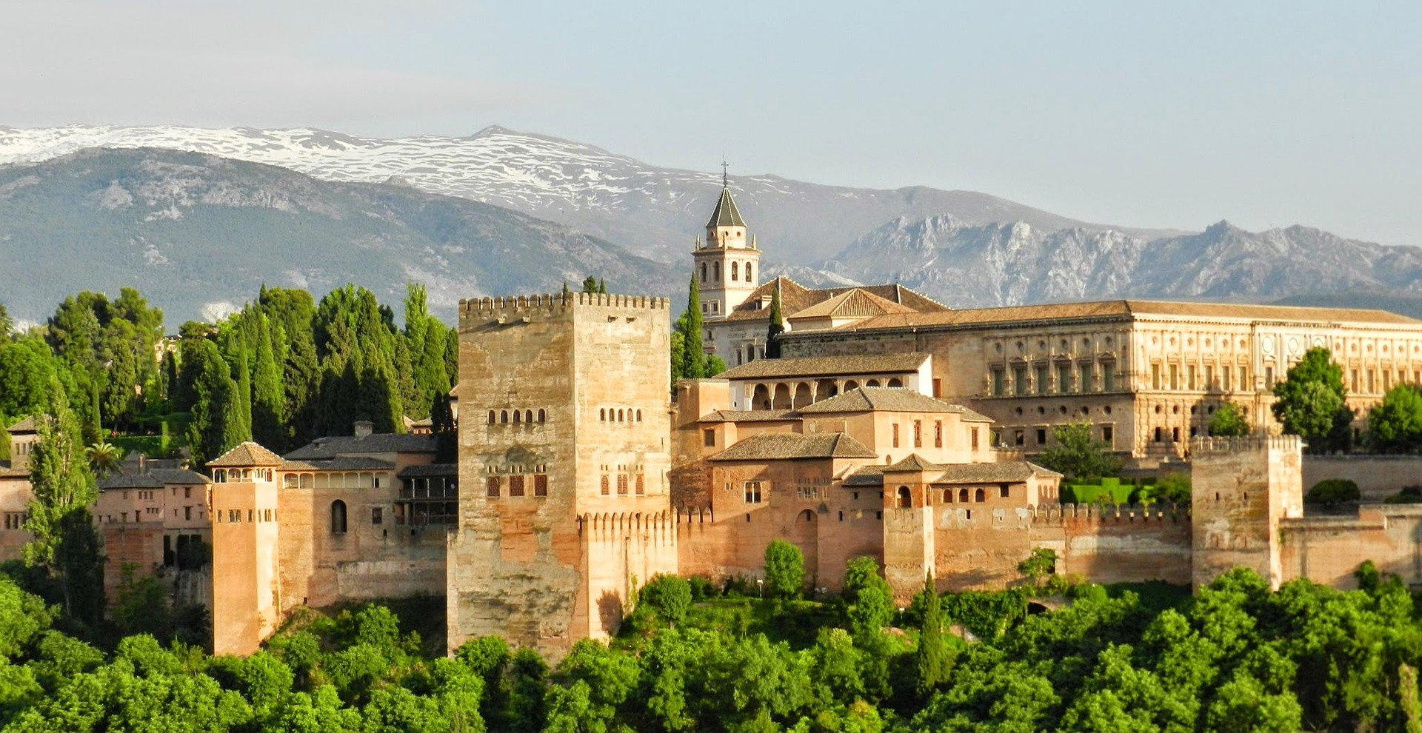
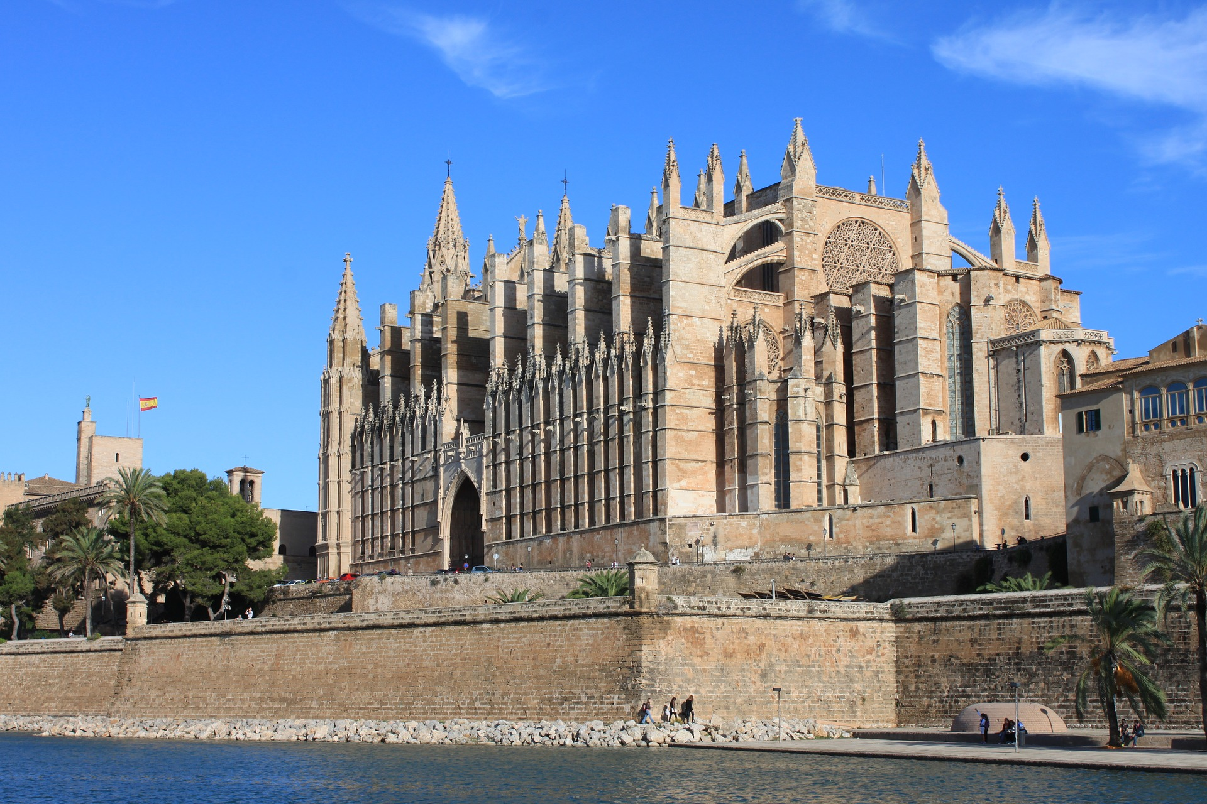
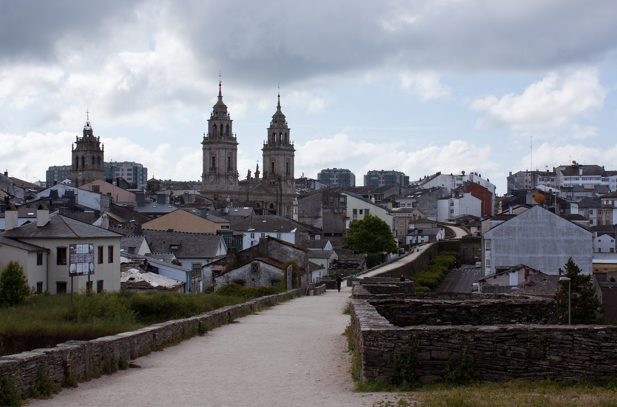
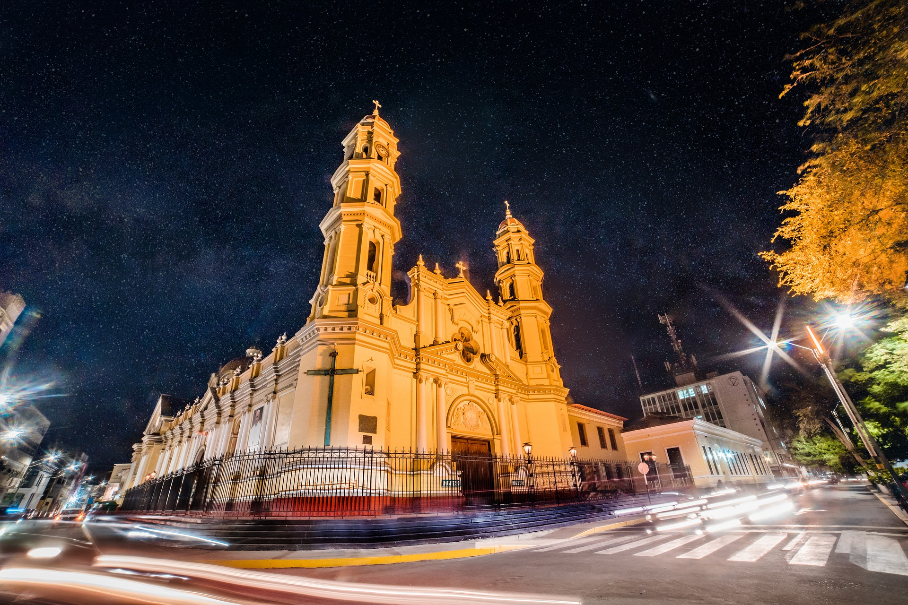
Persona B
1 | 2 | 3
4 | 5 | 6
hablar
España
Puno
Cusco
you are
you are
I am
Perú
Lima
I am
I am
you are
Tacna
Granada
Palma
Inglaterra
I am
you are
I am
Lugo
Piura
España
you are
I am
you are
Notes:
Do not click to bring up the places until Person A has turned away from the board.
Procedure:
Person A turns away from the board with his/her list of prompts.
Click to bring up the place options.
Person A says his/her first verb ‘estoy’.
Person B answers accordingly ‘en Perú’
Person A records the answer.
Continue with items 2 – 6.
Then swap roles using the next slide.
Attributions: Tacna: By Vanished user j123kmqwfk56jd at the English-language Wikipedia, CC BY-SA 3.0, https://commons.wikimedia.org/w/index.php?curid=42863565

Slide 18
Persona A
1 | 2 | 3
4 | 5 | 6
Inglaterra
hablar
Piura
Granada
you are
you are
I am
I am
España
Puno
Palma
I am
you are
Cuba
Cusco
I am
you are
I am
Tacna
Perú
Lima
you are
Lugo
I am
you are
Notes:
Do not click to bring up the places until Person B has turned away from the board.
Procedure:
Person B turns away from the board with his/her list of prompts.
Click to bring up the place options.
Person B says his/her first verb ‘estoy’.
Person A answers accordingly ‘en España’
Person B records the answer.
Continue with items 2 – 6.

Slide 19
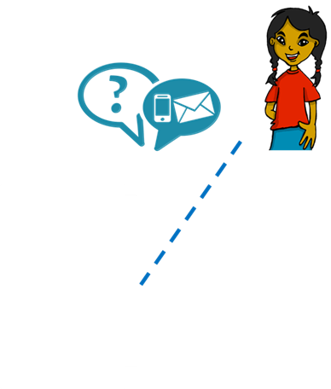
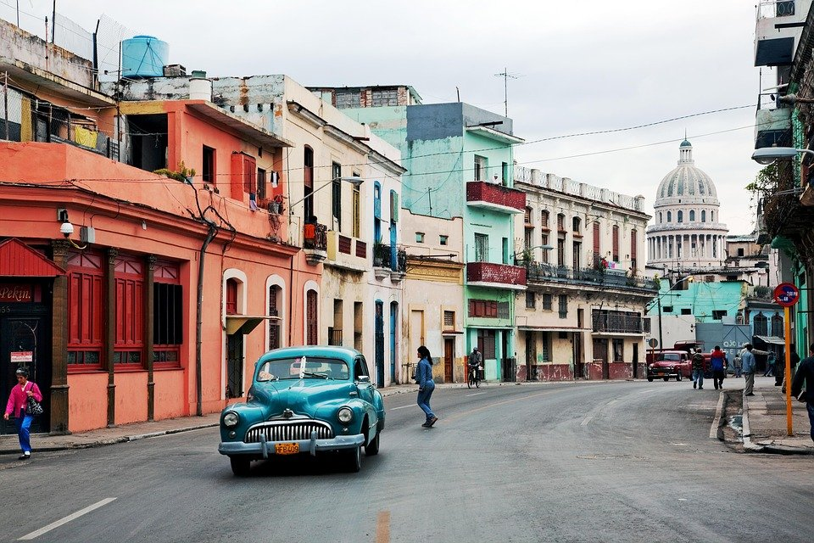
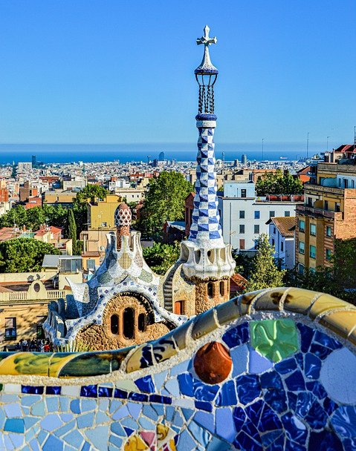
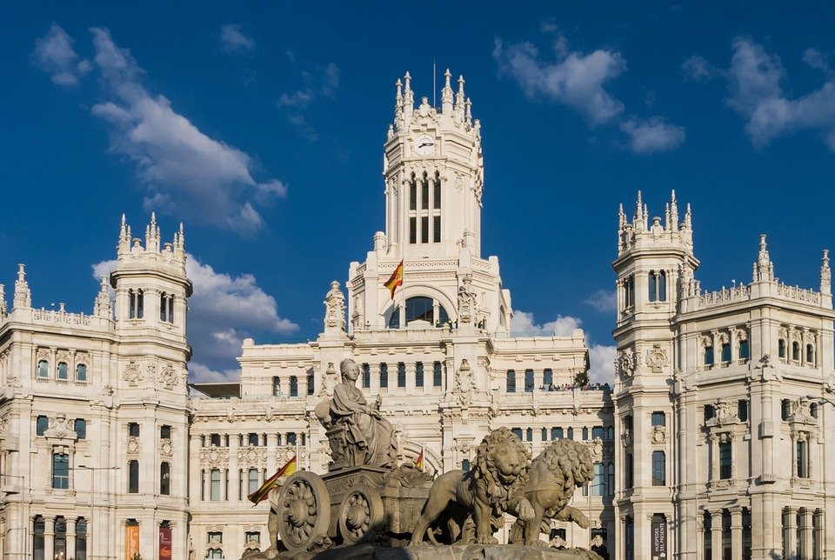
Quique is texting Ángela
dónde - where
Lee: ¿Dónde está Quique?
Cuba
leer
La Habana
Perú
Cusco
España
Barcelona
Madrid
Cusco
Quique está en ________________
Notes:
Note: if needed, this task can be done as one of the five follow ups during the week. It is repeated as Follow up 2 for the week.
Timing: 5 minutes
Aim: to read and understand “estoy” + “estás” in a reading task.
Procedure:
Read the instructions. Tell students Quique is texting Ángela and we need to figure out where Quique is.
Read the options in order to practise SSCs and develop students’ awareness of Spanish speaking countries and cities. Model pronunciation of “Barcelona” as students haven’t encountered [c] yet.
Then play the video with the message exchange (hover the cursor over the word ‘message’ to see play button).
Click to bring the prompt to answer the question “¿Dónde está Quique?”
Click to bring answer and elicit full answer from students.
Note: dónde is glossed here. It is used incidentally in this task, in which predominantly raised intonation questions are practised. Dónde will be introduced formally next week.

Slide 20
¡adiós!
amarillo

