Slide 1
Describing me and others
amarillo
Follow ups 1-5
Notes:
Artwork by Steve Clarke. Pronoun pictures from NCELP (www.ncelp.org). All additional pictures selected from Pixabay and are available under a Creative Commons license, no attribution required.
Frequency of new vocabulary and phonics:
Phonics: [u] source word: universe [1603]
Vocabulary: estás [21] ¿dónde? [161] sí [45] no [11] en1 [5] ¡Buenos días! [103/65] ¡Buenas tardes! [103/392] Source: Davies, M. and Davies, K. (2018). A frequency dictionary of Spanish: Core vocabulary for learners (2nd ed.). Routledge: London
The frequency rankings for words that occur in this PowerPoint which have been previously introduced in these resources are given in the SOW and in the resources that first introduced and formally re-visited those words.
For any other words that occur incidentally in this PowerPoint, frequency rankings will be provided in the notes field wherever possible.

Slide 2
Follow up 1:
universo
[u]
casa
[a]
A Listen. Which number is it?
C Listen to these Spanish speakers introduce themselves. What are their names? Fill the gaps with [a] or [o] or [u].
‘Universo’ is number ________.
Remember that proper nouns start with a capital letter!
‘Casa’ is number _______.
E
S o l
1
2
_
1
L u i s a
_
_
2
G a l o
_
_
3
3
M a n u
_
_
B Draw it!
4
S e g u n d o
_
_
Universo
Casa
5
Y u l a n d a
_
_
_
Notes:
Timing: 10 minutes (but can be split into two parts A/B | C to do on different days, as required)
Aim: to practise aural comprehension and written production of the SSC [a] and [u].
Procedure:
Click to bring up the prompts.
Click on each audio symbol to listen to the words.
Click for the number answers.
Click to bring up task B. Give a time limit for the drawing (e.g., 30 seconds for each).
Click to bring up task C.
Click on E to hear the ejemplo (example). Students write down the missing letters and volunteer the name.
Click for answer.
Continue with items 1-5.
Transcript Part A: [1] Clase [2] Universo [3] Casa
Part C:
[ejemplo] Sol [1] Luisa [2] Galo [3] Manu
[4] Segundo
[5] Yulanda

Slide 3
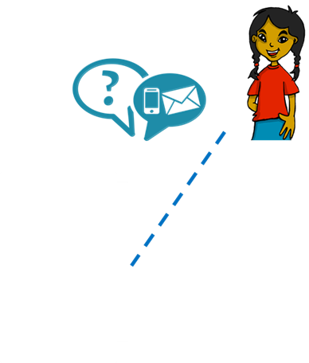
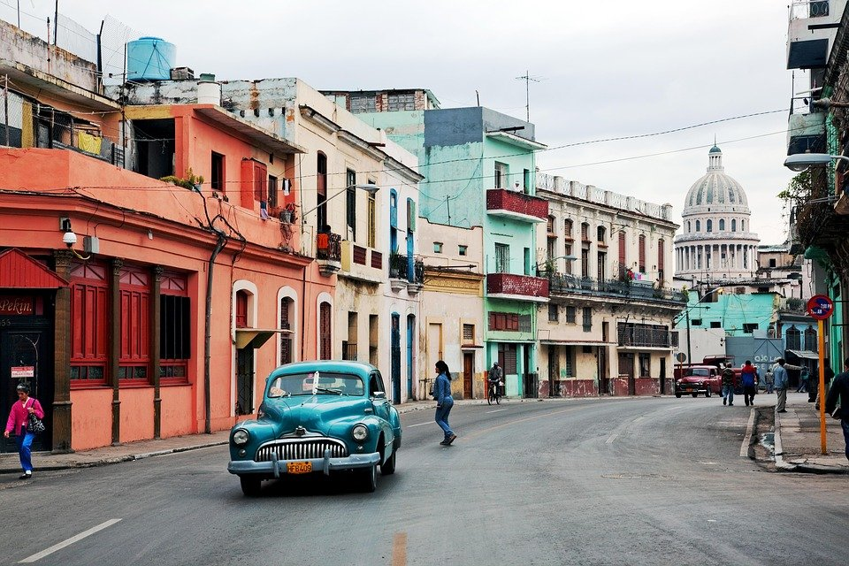
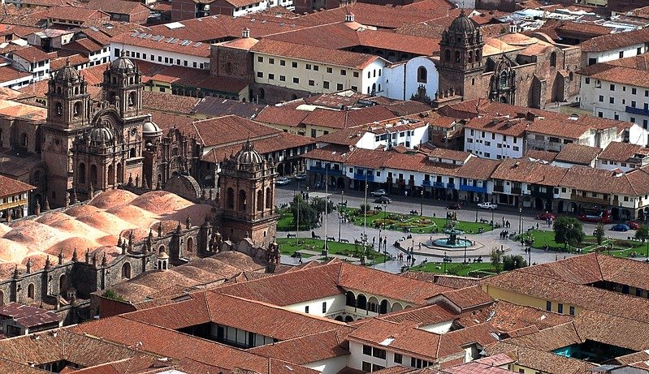
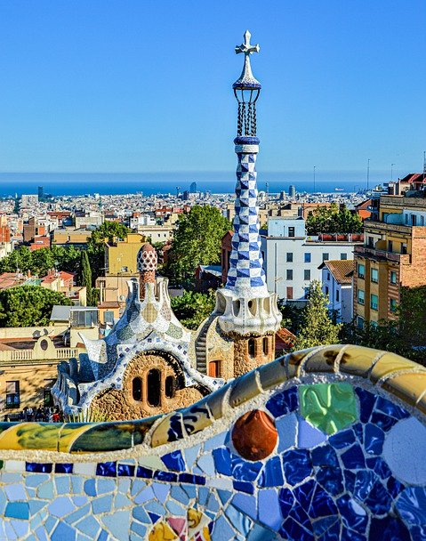
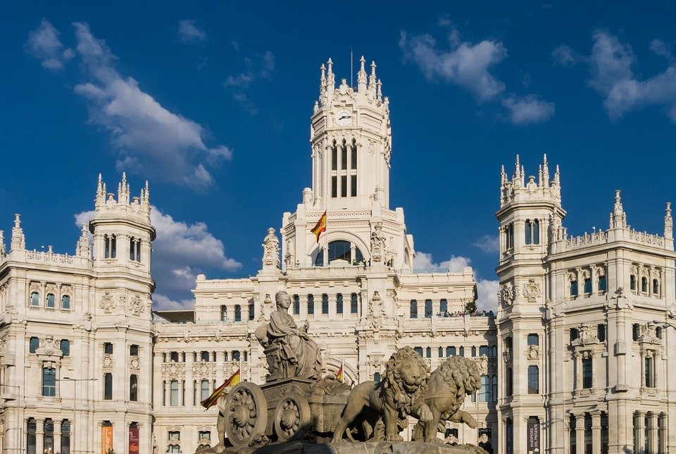
Follow up 2:
Quique texts Ángela.
Lee: ¿Dónde está Quique?
dónde - where
Cuba
leer
La Habana
Perú
Cusco
España
Barcelona
Madrid
Cusco
Quique está en ________________
Notes:
This task may have been done in the lesson, but here it is repeated for additional reading practice. If students are seeing this for the first time, follow the task instructions below. If they have already done the task, then follow the additional suggestions.
Aim: to read and understand “estoy” + “estás” in a reading task.
Procedure:
Read the instructions. Tell students Quique is texting Ángela and we need to figure out where Quique is.
Read the options in order to practise SSCs and develop students’ awareness of Spanish speaking countries and cities. Model pronunciation of “Barcelona” as students haven’t encountered [c] yet.
Then play the video with the message exchange (hover the cursor over the word ‘message’ to see play button).
Click to bring the prompt to answer the question “¿Dónde está Quique?”
Click to bring answer and elicit full answer from students.
Note: dónde is glossed here. It is used incidentally in this task, in which predominantly raised intonation questions are practised. Dónde will be introduced formally next week.
Additional task suggestions: 1. Divide the class in half (Ángela and Quique) and ask them to read along with the text messages as they appear.
2. Elicit pronunciations of the place options, too, focusing in particular on the [u], [o] and [a] sounds, which have been taught.

Slide 4
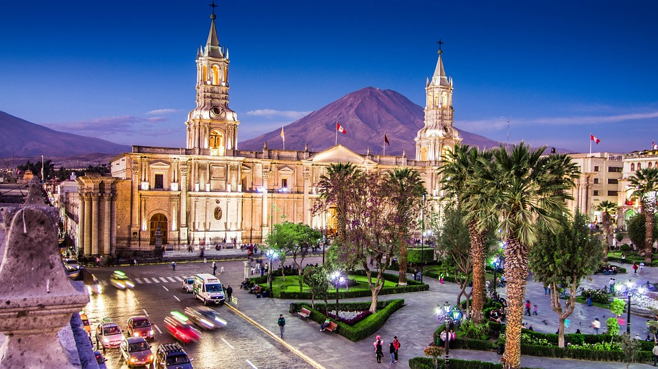
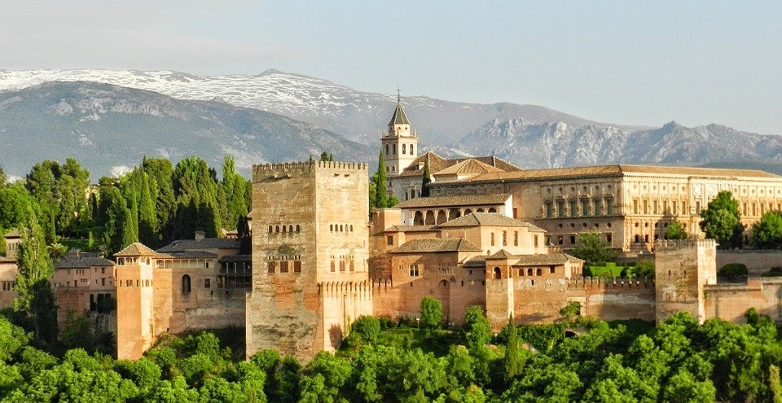
Follow up 3:
¿Dónde está Ángela? Ask Quique..
dónde - where
hablar
¿Está en … ?
Arequipa
Cusco
Perú
Sí
No
Madrid
Granada
España
Granada
Ángela está en ________________
Notes:
Timing: 5 minutes
Aim: To practise asking yes/no intonation questions with “está”.
Procedure:
Read the instructions. Tell students we now need to find where Ángela is so they need to ask him. (Angela’s picture is hidden behind the correct place).
Read the options in order to practise SSCs. Model pronunciation of “Barcelona” and particularly “Arequipa”.
Ask for volunteers to ask Quique, starting by asking the country. Click on the picture to listen to Quique’s response. The sound plays on clicking each of the pictures (Perú / Cusco / Arequipa / España / Madrid / Granada).
Click to bring up the prompt to answer the question “¿Dónde está Ángela?”
Click to bring up the answer.
Transcript: [Cusco] No. [Madrid] No. [Arequipa] No. [Granada] Sí, está en Granada.

Slide 5
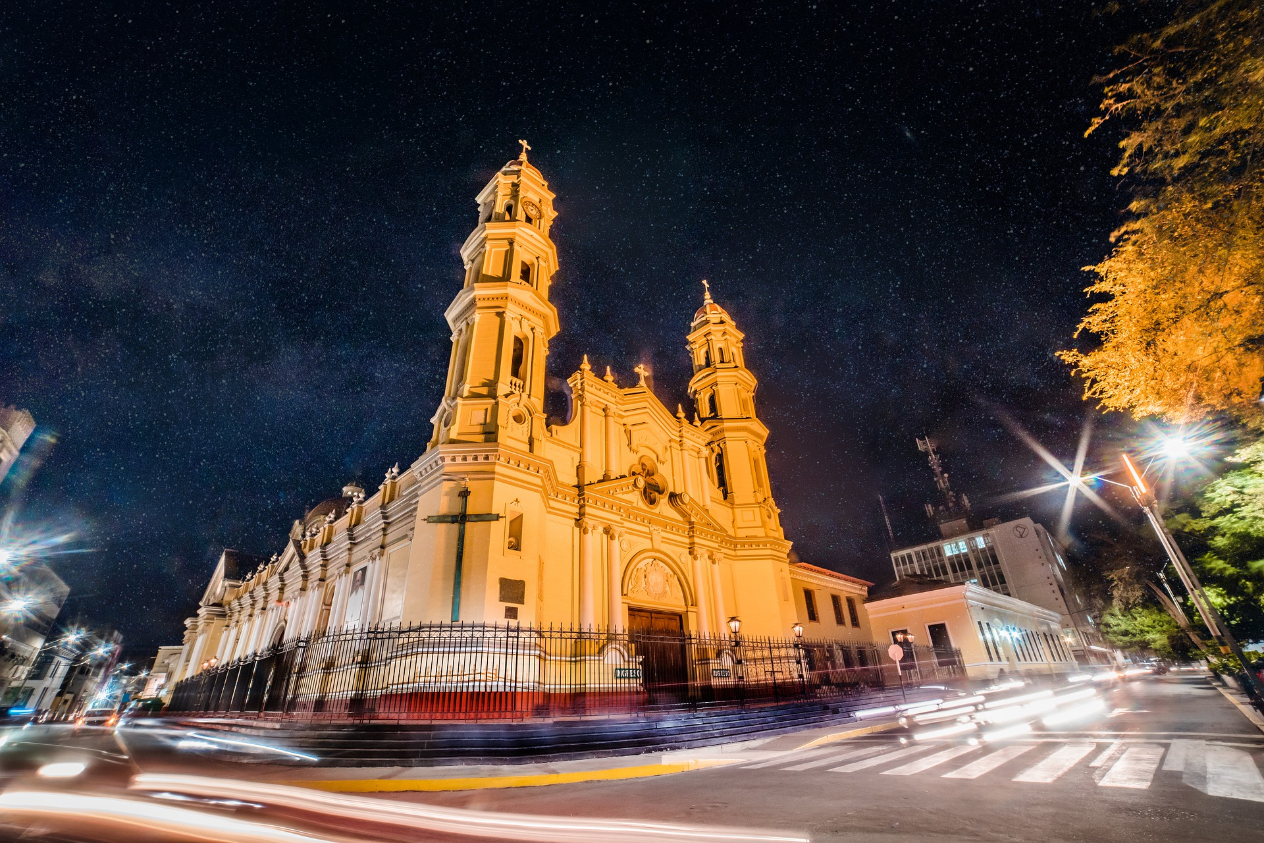
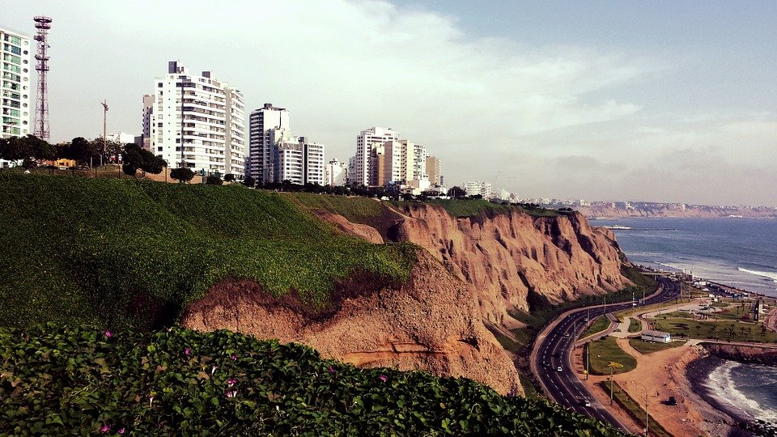
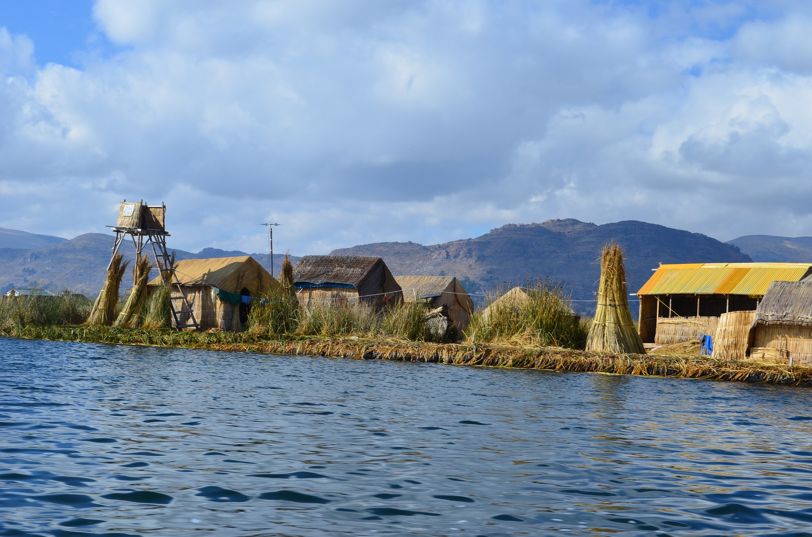
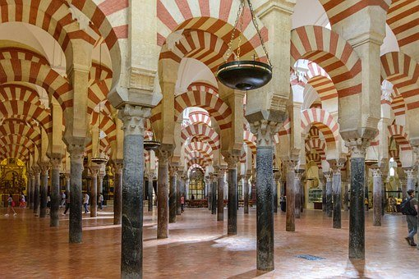
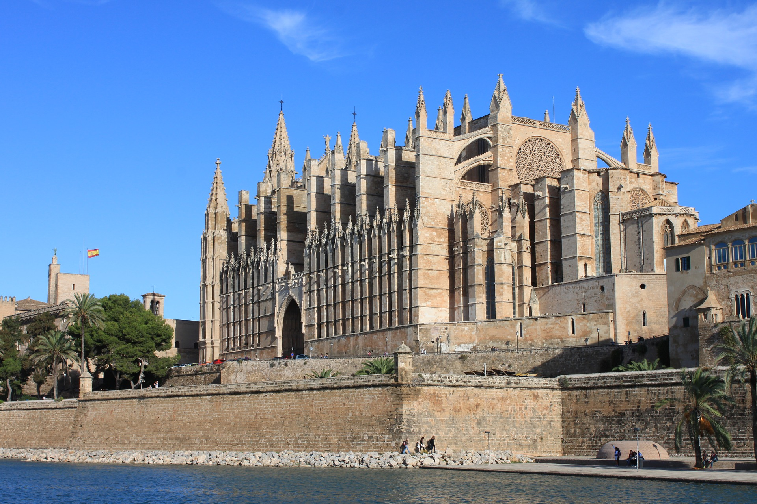
Follow up 4:
Lima
Piura
Sí, estoy en Lima.
Choose one city and write down the name.
hablar
Perú
Take turns to guess the name of the city where your partner is!
Puno
60
¿Estás en … ?
S
Córdoba
Granada
Sí
No
España
Palma
¡Estás en Lima!
Madrid
0
INICIO
Notes:
Timing: 5 minutes
Aim: to practise “estás” with yes/no questions and statements.
Procedure:
Ask students to write down the name of one of the cities displayed making sure their partners don’t see it.
Go through the different cities to ensure they know how to pronounce them (Arequipa will need more practice!).
Model the dialogue by choosing yourself a city and getting individual students to try to guess your city (the animated example is Lima). Students should start asking the country, then the cities (this will develop cultural/geographical awareness).
Click to model the statement when they guess your city (¡Estás en Lima!). You can click also on the picture of Lima to reveal the statement: Sí, estoy en Lima.
Click on “inicio” to start the timer.

Slide 6
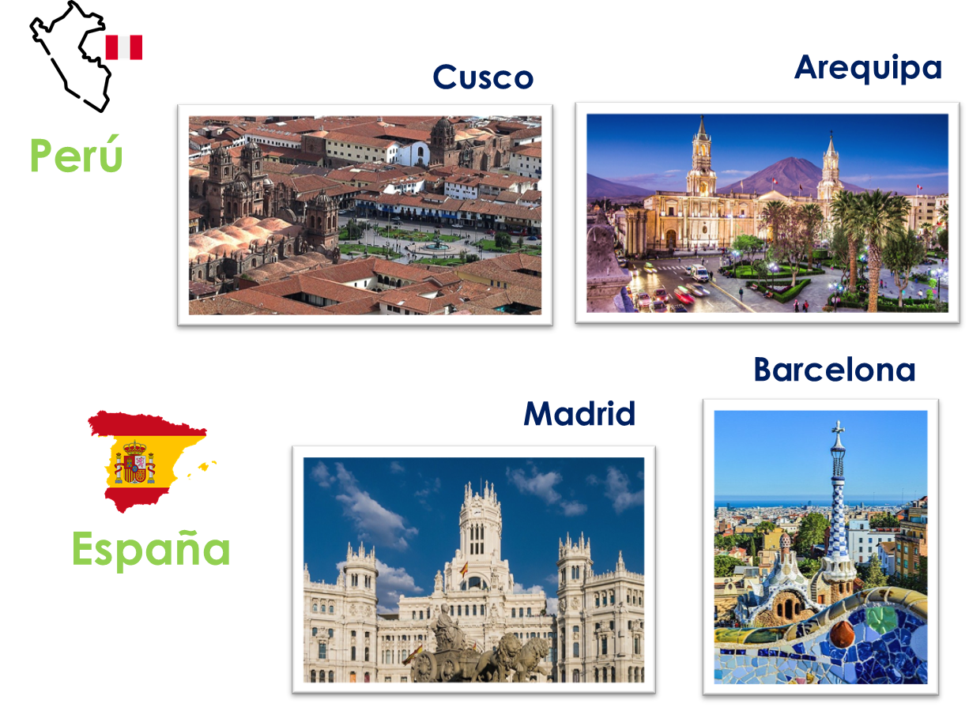
Follow up 5:

Escribe.
Choose the city and country.

escribir
1 _____________________________
Estás en Madrid, en España.
(You are in____________).

Estoy en Cusco, en Perú.
2 _____________________________
(I am in ____________).

3 _____________________________
Está en Barcelona, en España.
(She is in ____________).
Notes:
Timing: 5 minutes
Aim: To use “estoy”, “estás” & “estás” to produce whole sentences.
Procedure:
Ask students to write down three sentences of their choice, using you are, I am & She is + the country and city of their choice. If they know any other Spanish speaking cities, they can bring their own ideas.
Click to bring up possible answers.
Elicit the answers that students have written.

