Slide 1
Describing me and others
Estar: estoy + está for location
SSC [a] [o]
amarillo
Notes:
Artwork by Steve Clarke. Pronoun pictures from NCELP (www.ncelp.org). All additional pictures selected from Pixabay and are available under a Creative Commons license, no attribution required.
Frequency of new vocabulary and phonics:
Phonics: [a] [o] source words: casa [106] dos [64]
Vocabulary: estar [21] estoy [21] está [21] presente [1114] ausente [>5000] aquí [130] allí [197] hola [1245]
to be - I am, s/he is (estar)
Source: Davies, M. & Davies, K. (2018). A frequency dictionary of Spanish: Core vocabulary for learners (2nd ed.). Routledge: London
The frequency rankings for words that occur in this PowerPoint which have been previously introduced in these resources are given in the SOW and in the resources that first introduced and formally re-visited those words.
For any other words that occur incidentally in this PowerPoint, frequency rankings will be provided in the notes field wherever possible.
Note that this first lesson of the year teaches language that can be continuously recycled as lesson routine every lesson in Y3/4. The idea would be that the class teacher (whether or not s/he teaches the class Spanish) can re-use the language as part of the daily routine with the class.

Slide 2
[a]
casa
pronunciar
Notes:
Timing: 1 minute
Aim: To introduce SSC [a] + [o]
Procedure:
Introduce and elicit the pronunciation of the individual SSC [a] and then the source word ‘casa’ (with gesture, if using).
Click to bring on the picture and get students to repeat (with gesture, if using).

Slide 3
[o]
dos
pronunciar
Notes:
Timing: 1 minute
Aim: To introduce SSC [a] + [o]
Procedure:
Introduce and elicit the pronunciation of the individual SSC [a] and then the source word ‘dos’ (with gesture, if using).
Click to bring on the picture and get students to repeat (with gesture, if using).

Slide 4
[o]
dos
pronunciar
[a]
casa
Notes:
Timing: 1 minute
Aim: To introduce SSC [a] [o]
Procedure:
Practise pronunciation of the individual SSC [a] [o] – elicit the source word again ‘casa’ & ‘dos’ (with gesture, if using).

Slide 5
pronunciar
[a]
casa
[o]
dos
Notes:
Timing: 1 minute
Aim: To practise key SSC [a] [o] & source words (casa – dos).
Procedure:
Elicit the SSC and the source words again ‘casa’ & ‘dos’ (with gesture, if using).
Pupils point at the right picture & work in pairs to practice action (if provided) and sound
Extra: give students 30 seconds to practise in pairs – one uses the gesture, the other says the correct source word (casa / dos) OR one says the key individual SSC [a] [o] and the other students says the source word.

Slide 6
Hola, Paco.
Hola, Ana.
ausente
presente
Ana
Paco
Notes:
Timing: 1 minute
Aim: to introduce two new vocabulary items for this lesson.
Procedure:
Click to bring up the teacher calling the first pupil. Teacher says: “Hola, Ana.”
Click to bring up Ana’s answer: “presente.” Ensure meaning is clear and practise pronunciation.
Click to bring the teacher’s next call. “Hola, Paco”.
Click to bring up Ana’s answer: “ausente”. Ensure meaning is clear and practise pronunciation.

Slide 7
estar
[to be | being] (with location)
In Spanish the verb estar means ‘to be’ when describing location.
Estoy
I am
Está
it / he / she is
Estoy presente.
I am present.
Está presente.
She /he / it is present.
Notes:
Timing: 5 minutes
Procedure:
Read the grammar explanation on “estar”, “estoy” & “está”. Make sure pupils are clear about the s/he/I pictures as these will come up in consecutive lessons.
Elicit English translation for the Spanish examples provided. Draw their attention to “presente” as a cognate.

Slide 8
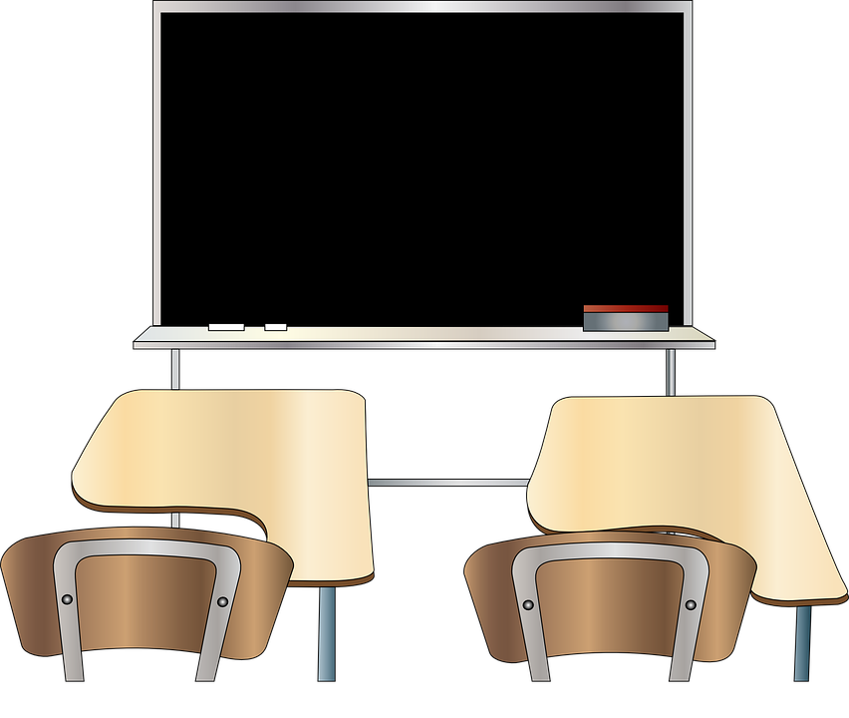
El señor Lorca has taken the register.
Complete the sentences.
¿está presente o ausente?
leer
La lista
E | Lucía está | ausente. | presente.
1 | Ana está | ausente. | presente.
2 | Manolo está | ausente. | presente.
3 | Paloma está | ausente. | presente.
4 | Carlos está | ausente. | presente.
5 | Paco está | ausente. | presente.
6 | Pablo está | ausente. | presente.
7 | Olga está | ausente. | presente.
8 | Carlota está | ausente. | presente.
en clase
en casa
Lucía
Ana
Pablo
Carlota
Carlos
Paloma
Olga
Manolo
Paco
Notes:
Timing: 5 minutes Aim: to practise written comprehension of the vocabulary ‘presente’ and ‘ausente’ in sentence context. Note: this activity does not practise the grammar as the 3rd person ‘está’ is used throughout. Irregular verb forms (such as estoy) are learnt as individual vocabulary items, and the intention is not to focus on a pattern of verb endings in this lesson, but rather to teach and learn two highly frequent verb forms. The next activity focuses on differentiating estoy and está.
Procedure:
Go through the list of names “en clase” & “en casa”
Make sure pupils understand “presente” & ausente” as well as “clase” & “casa” and the meaning of “en”.
Do the example (E) with them – read the whole sentence “Lucía está – ausente OR presente”.

Slide 9
Escucha. La señora Mora is taking the register now.
Who answers with ‘I am’ about themselves?
Who answers with ‘s/he is’ about someone else?
escuchar
Marca
Now write down the verb (‘estoy’ OR ‘está’)
 | Coral
 | Lara
 | Lorna
 | Tamara
 | Carlos
 | Paloma
 | Gaspar
The pupil (I) | Someone else (s/he)
verbo
inglés
E
estoy
I am
1
está
s/he is
2
estoy
I am
3
estoy
I am
4
está
s/he is
5
estoy
I am
6
está
s/he is
Notes:
Timing: 5 minutes
Aim: to practise aural comprehension of the verbs ‘estoy’ and ‘está’. To then practise recall of the two verb meanings in written comprehension.
Procedure:
1. Ask pupils to write 1-6 in their books, with two headings ‘I’ and ‘S/he’ to the side.
2. Tell them that they will hear sentences using the verbs ‘estoy’ (I am) and ‘está’ (she or he is).
3. The first time they listen, they should decide I or s/he and tick the right column.
4. The second time they listen, they should write the verb they hear to practise connecting the sound and written form of the verbs. 5. Click to bring up the answers and elicit the English meanings of ‘estoy’ and ‘está’ each time.
Transcript:
Coral? ¡Hola! Estoy aquí
Lara? Está ausente
Lorna? Estoy presente
Tamara? Estoy aquí
Carlos? Está allí
Paloma? Estoy aquí
Gaspar? Está allí

Slide 10
Santi…
Sara...
[there]
Sara
allí
[here]
aquí
Santi
Notes:
Timing: 1-2 minutes
Aim: to introduce two new vocabulary items for this lesson.
Procedure:
Click to bring up the teacher calling the first pupil. Teacher says: “Santi...”
Click to bring up Santi’s answer: “Estoy aquí.” The English meaning appears, too. Ensure meaning is clear and practise pronunciation.
Click to bring the teacher’s next call. “Hola, Sara”.
Click to bring up Santi’s answer: “Sara está allí.” The English meaning appears, too. Ensure meaning is clear and practise pronunciation.

Slide 11
Escucha. What extra information do they give?
escuchar / leer
E | Coral? | Estoy | presente | ausente | aquí | allí
1 | Lara? | Está | presente | ausente | aquí | allí
2 | Lorna? | Estoy | presente | ausente | aquí | allí
3 | Tamara? | Estoy | presente | ausente | aquí | allí
4 | Carlos? | Está | presente | ausente | aquí | allí
5 | Paloma? | Estoy | presente | ausente | aquí | allí
6 | Gaspar? | Está | presente | ausente | aquí | allí
E
1
2
3
4
5
6
Notes:
Timing: 3 minutes
Aim: to practise ausente, presente, aquí, allí, hola in context; to provide additional practice of the verb forms estoy and está (procedure stage 4).
Procedure:
1. Go through the meaning of ausente [>5000] presente [1114] aquí [130] allí [197] again.
2. Tell them that they will hear the sentences one more time
3. Ask pupils to write the words they can hear. (Note: some learners will benefit from being able to circle the words on the sheet). 4. Elicit the English meanings from pupils in whole class feedback, paying attention to whether the verb is I am or s/he is.
Script:
Coral? ¡Hola! Estoy aquí
Lara? Está ausente
Lorna? Estoy presente
Tamara? Estoy aquí
Carlos? Está allí
Paloma? Estoy aquí
Gaspar? Está allí

Slide 12
After lunch, el señor Lorca takes the register again.
To whom does each English statement refer?
1 | Coral? | Está ausente.
2 | Lara? | Está aquí.
3 | Lorna? | Estoy aquí.
4 | Tamara? | Está aquí.
5 | Carlos? | Está allí.
6 | Paloma? | Estoy aquí.
7 | Gaspar? | Está allí.
leer
Lorna
Paloma
Lara
Tamara
1 I’m here.
2 She / he is there.
3 She / he is here.
4 She / he is absent.
Carlos
Gaspar
Coral
Notes:
Timing: 5 minutes
Aim: to consolidate pupils’ ability to understand the meanings of estoy, está, ausente, presente, aquí, allí, in writing. Note that we have not tested aural comprehension of estoy and está. This will be a focus in one of the mini sessions to follow in the same week.
Procedure:
1. Read 1 (I’m here) and ask pupils to whom this statement refers.
2. Read the example and elicit translation in English. Coral – Está ausente. Does that translate as “I’m present”?
3. Repeat process with 2 & 3 to guide pupils to work out that Lorna is the answer for 1) I’m present.
N.B Depending on the class you can do this as a whole class activity, in pairs or individually.

Slide 13
¡adiós!
amarillo
Notes:
Note: if you have additional lesson time beyond 30 minutes, there are three further practice activities to use.

Slide 14
Hello! I’m here.
5
hablar
¡Hola! | Estoy | presente.
 | Está | ausente.
 |  | aquí.
 |  | allí.
4
3
¡H_ _ _! E_ t_ _ _q_í
¡Hola! Estoy aquí.
2
1
Notes:
Timing: 5 minutes (for 5 slides)
Aim: to practise oral production of the new language, connecting form and meaning, using estoy, está, ausente, presente, aquí, allí.
Procedure:
1. Read the English sentence and direct pupils to use the frame to translate the sentence.
2. Break down the translation into individual words – hello is “Hola” but I’m – is it “estoy” or “está”. Do the same with “here”
4. Tell them we’re going to go through a couple of similar examples and that they need to say the sentence out loud before the time is up.
5. Draw their attention to the help provided at the bottom should they need it.
N.B This activity works very well as a pair work activity. Allocate 10-15 seconds for pupils to say the sentence out loud in their pairs a couple of times, then ask for volunteers.

Slide 15
Hello! She’s here.
5
hablar
¡Hola! | Estoy | presente.
 | Está | ausente.
 |  | aquí.
 |  | allí.
4
3
2
¡H_ _ _! E_ t _ a _ _í
¡Hola! Está aquí.
1

Slide 16
Hello! She’s absent.
5
hablar
¡Hola! | Estoy | presente.
 | Está | ausente.
 |  | aquí.
 |  | allí.
4
3
¡H_ _ _! E_ t _ a _ s_ _ t_
¡Hola! Está ausente.
2
1

Slide 17
Hello! I’m present.
5
hablar
¡Hola! | Estoy | presente.
 | Está | ausente.
 |  | aquí.
 |  | allí.
4
3
¡H_ _ _! E_ t _ y pr _ s_ _ t_
¡Hola! Estoy presente.
2
1

Slide 18
Hello! She’s there.
5
hablar
¡Hola! | Estoy | presente.
 | Está | ausente.
 |  | aquí.
 |  | allí.
4
3
¡Hola! Está allí.
2
¡H_ _ _! E_ t _ a_ _ í.
1

Slide 19
Who’s in class?
Tell a classmate who is in the class.
hablar
¡Hola! | Estoy | presente.
 | Está | ausente.
 |  | aquí.
 |  | allí.
60
Segundos
0
INICIO
Notes:
Timing: 3 minutes
Aim: to practise using estoy, está, ausente, presente, aquí, allí, when answering the register.
Procedure:
Tell pupils they have 1 minute to practise in pairs (using “estoy” + “está” to answer the register & tell who is / isn’t in class).

Slide 20
Who’s in class?
Tell a classmate who is in the class.
hablar
Hello! | I am | present.
 | He / she is | absent.
 |  | here.
 |  | here.
60
Segundos
0
INICIO
Notes:
Timing: 3 minutes
Aim: to practise using estoy, está, ausente, presente, aquí, allí, when answering the register.
Procedure:
Tell pupils they have 1 minute to practise in pairs (using “estoy” + “está” to answer the register & tell who is / isn’t in class).

