Slide 1
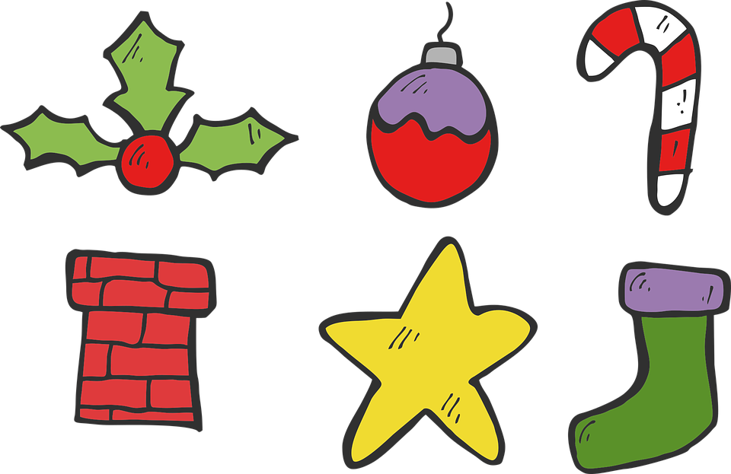

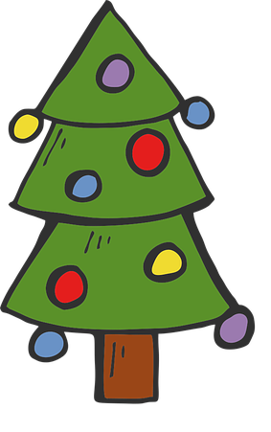

español, con Sofía
¡Feliz Navidad!

Slide 2

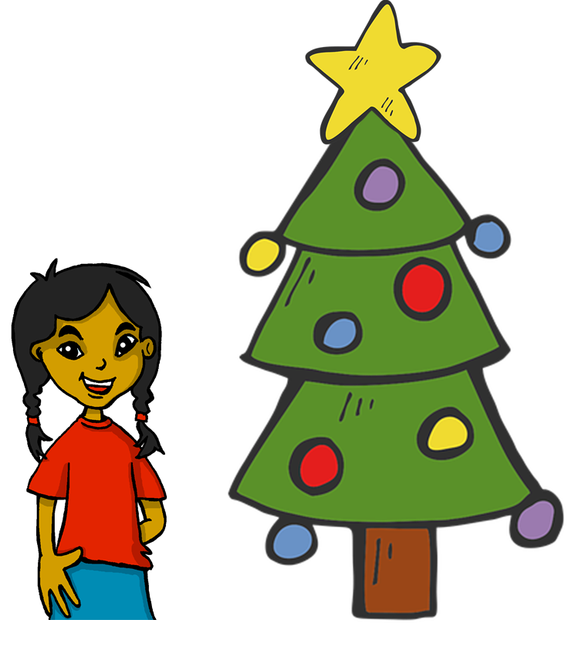
Describing me and others
amarillo
Knowledge quiz
A Christmas carol
Notes:
Artwork by Steve Clarke. All additional pictures selected are available under a Creative Commons license, no attribution required.
The frequency rankings for words that occur in this PowerPoint which have been previously introduced in the resources are given in the SOW (excel document) and in the resources that first introduced and formally re-visited those words.
For any other words that occur incidentally in this PowerPoint, frequency rankings will be provided in the notes field wherever possible.
This lesson includes an assessment of the vocabulary and grammar knowledge from the first 12 weeks of the course. There is a phonics assessment in Week 14.
Note: there are no follow up activities this week, but there is a Christmas carol at the end of the quiz. This could be used in a follow up slot, more than once, during this week, as appropriate.
The quiz can be completed on paper with pupils writing numbered answers. Alternatively there is a word document for printing.
There is an answer sheet for teachers. Alternatively, answers are provided on slides for pupils to correct their own or a partner’s.
Glossed words: el villancico [>5000]
= Christmas carol
Source: Davies, M. & Davies, K. (2018). A frequency dictionary of Spanish: Core vocabulary for learners (2nd ed.). Routledge: London

Slide 3

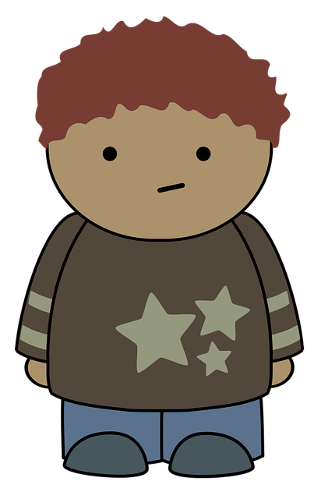
escuchar
Vocabulary
At home, Apo speaks Quechua, a language spoken by many people from Peru, Bolivia and Ecuador. He is learning Spanish at school, like you. Help Apo by answering the questions in this quiz.
A For each question, put a cross (x) under the English meaning that matches what you hear.
You will hear each Spanish word twice. Choose one correct answer only.
 | A | B | C | D
Ej. | active | impossible | positive | incredible
 | ☐ | ☐ | ☐ | ☐
1. | to be (trait) | to have | to be (state) | am (state)
 | ☐ | ☐ | ☐ | ☐
2. | comfortable | prepared | lost | healthy
 | ☐ | ☐ | ☐ | ☐
3. | bag | boat | bed | horse
 | ☐ | ☐ | ☐ | ☐
Ej.
1
2
3
Notes:
Timing: 20-25 minutes (all assessment slides)
Aim: to practise aural comprehension of vocabulary taught in weeks 1-12 of the course.
Procedure:
1. Click the audio buttons to play each item. (The words are recorded twice with a pause to allow pupils to process the information).
2. Pupils can either write 1C, etc.. or if they have the assessment on a print out they can put a X in the correct box.
3. Note that the first item can be completed, with support from the teacher, as an example. It is NOT included in the overall total marks.
3. After items 1-4, continue to the next slide to complete the remainder of the task.
Transcript:
Ejemplo. positivo
1. ser
2. perdido
3. bolsa
4. hoy
5. dibujo
6. dónde

Slide 4
escuchar
Vocabulary
A For each question, put a cross (x) under the English meaning that matches what you hear.
You will hear each Spanish word twice. Choose one correct answer only.
 | A | B | C | D
4. | today | always | a/one day | usually
 | ☐ | ☐ | ☐ | ☐
5. | plant | drawing | door | table
 | ☐ | ☐ | ☐ | ☐
6. | from | in | how | where
 | ☐ | ☐ | ☐ | ☐
4
5
6
Notes:
Timing: 20-25 minutes (all assessment slides)
Aim: to practise aural comprehension of vocabulary taught in weeks 1-12 of the course.
Procedure:
1. Click the audio buttons to play each item. (The words are recorded twice with a pause to allow pupils to process the information).
2. Pupils can either write 1C, etc.. or if they have the assessment on a print out they can put a X in the correct box.
3. Note that the first item can be completed, with support from the teacher, as an example. It is NOT included in the overall total marks.
3. After items 1-4, continue to the next slide to complete the remainder of the task.
Transcript:
Ejemplo. positivo
1. estar
2. perdido
3. bolsa
4. hoy
5. dibujo
6. dónde

Slide 5
escuchar
Vocabulary
B For each question, put a cross (x) under the type of word you hear.
You will hear each Spanish word twice. Choose one correct answer only.
This word is a good example of …
 | A | B | C | D
Ej. | an object ☐ | food ☐ | a day of the week ☐ | a family member ☐
1. | a day of the week ☐ | a greeting ☐ | a question word ☐ | mood or character ☐
2. | a country ☐ | a day of the week ☐ | a family member ☐ | a colour ☐
3. | mood or character ☐ | an object ☐ | furniture ☐ | a greeting ☐
4. | location ☐ | mood or character ☐ | a colour ☐ | a question word ☐
Ej.
1
2
3
4
Notes:
Procedure:
1. Click the audio buttons to play each item. (The words are recorded twice with a pause to allow pupils to process the information).
2. Pupils can either write 1C, etc.. or if they have the assessment on a print out they can put a X in the correct box.
3. Note that the first item can be completed, with support from the teacher, as an example. It is NOT included in the overall total marks.
4. When complete, continue to the reading.
Transcript:
Ejemplo. martes
1. Buenos días!
2. hermana
3. pesado
4. allí

Slide 6
escuchar
Grammar
C Put a cross (x) next to the person or people that the sentence is about.
You will hear each Spanish sentence twice.
1. | I | ☐ | you | ☐ | he/she | ☐
2. | I | ☐ | you | ☐ | he/she | ☐
3. | I | ☐ | you | ☐ | he/she | ☐
4. | I | ☐ | you | ☐ | he/she | ☐
5. | I | ☐ | you | ☐ | he/she | ☐
1
2
3
4
5
Notes:
Procedure:
1. Click the audio buttons to play each item. (The words are recorded twice with a pause to allow pupils to process the information).
2. Pupils can either write 1C, etc.. or if they have the assessment on a print out they can put a X in the correct box.
3. Note that the first item can be completed, with support from the teacher, as an example. It is NOT included in the overall total marks.
4. When complete, continue to the reading.
Transcript:
1. Estás presente.
2. Tengo un instrumento.
3. Está enfermo hoy.
4. Normalmente soy activa.
5. Tienes una idea nueva.

Slide 7

leer
A Translate the underlined Spanish word to complete each English sentence.
1. Tengo un perro. I have a _____________ .
2. Elena está perdida. Elena is _____________ .
3. Tienes una hoja. You have a _____________ .
4. Es nuevo? ______ it new?
5. Es un mensaje. It’s a _____________ .
6. Estoy preparado. I am _____________ .
7. ¿Qué eres? ___________ are you?
8. ¿Cómo es la puerta? What is the _____________ like?
9. Hoy es viernes. Today it’s ___________.
10. Señora Vázquez tiene una regla. Ms Vázquez has a _____________ .
Notes:
Aim: to practise written recall of previously taught vocabulary.
Procedure:
Ensure that the task is clear.
Pupils could write 1 – 10 and the individual English word meanings (or they could fill in if they have printed assessment sheets).

Slide 8

escribir
B Translate the underlined English words to complete the Spanish sentence.
1. It’s a bed. Es _____ __________. (write two words)
2. Quique is comfortable. Quique está _____________. (write one word)
3. To be healthy is important. _________ sano es importante. (write one word)
4. Good morning! ¡ ___________ _______! (write two words)
5. Thursday is a word. Jueves es una ________. (write one word)
6. From where? Madrid? ¿____ dónde? ¿Madrid? (write one word)
7. To have an idea is incredible. ___________ una idea es increíble. (write one word)
8. It’s paper. Es _______________. (write one word)
Notes:
Aim: to practise written production of previously taught vocabulary.
Procedure:
Ensure that the task is clear.
Pupils could write 1 – 10 and the individual English word meanings (or they could fill in if they have printed assessment sheets).

Slide 9
escribir
C Write the opposite word(s) in Spanish.
1. sano - ________________
2. la hermana - _____________
3. allí - __________________
4. nuevo - ______________
5. ¡Buenos días! - ________
Notes:
Aim: to practise written production of previously taught vocabulary.
Procedure:
Ensure that the task is clear.
Pupils could write the answers only (or they could fill in if they have printed assessment sheets).

Slide 10
leer
Grammar
Quechua doesn’t have gendered words for ‘a’ and ‘the’. Adjectives and verbs are also very different from Spanish. Help Apo with his Spanish grammar by answering the questions in this part of the quiz.
1 | ☐ I ☐ you _{[singular]} ☐ she, he, it | Tengo un animal. |  | 4 | ☐ I ☐ you _{[singular]} ☐ she, he, it | Eres de Cambridge.
2 | ☐ I ☐ you _{[singular]} ☐ she, he, it | Estás presente. |  | 5 | ☐ I ☐ you _{[singular]} ☐ she, he, it | Tiene una idea.
3 | ☐ I ☐ you _{[singular]} ☐ she, he, it | Está en Inglaterra. |  | 6 | ☐ I ☐ you _{[singular]} ☐ she, he, it | Estoy en clase.
Notes:
Aim: to practise written recall of previously taught grammar.
Procedure:
Ensure that the task is clear.
Pupils could write the correct English pronouns (or they could fill in if they have printed assessment sheets).

Slide 11
leer
Grammar
B Put a (X) next to two words that could finish this sentence about Diego (a boy).
 | Tick two boxes.
1. Diego es _______. | a) imposible | ☐
 | b) positiva | ☐
 | c) pesada | ☐
 | d) activo | ☐
 | e) vieja | ☐
Put a (X) next to two words that could finish this sentence about Marta (a girl).
 | Tick two boxes.
2. Marta es _______. | a) raro | ☐
 | b) increíble | ☐
 | c) sana | ☐
 | d) viejo | ☐
 | e) activo | ☐
Notes:
Aim: to practise written recall of previously taught grammar.
Procedure:
Ensure that the task is clear.
Pupils could write the correct English pronouns (or they could fill in if they have printed assessment sheets).

Slide 12
leer
Grammar
C Write the words in each box in the correct order.
1. | una imposible cosa | Correct order:_________________________________________
2. | profesor postivo un | Correct order:_________________________________________
3. | cómoda una cama | Correct order:_________________________________________
4. | lápiz un nuevo | Correct order:_________________________________________
Notes:
Aim: to practise written recall of previously taught grammar.

Slide 13
escribir
D Write the Spanish word for ‘a’.
1. _______ barco (m)
2. _______ planta (f)
E Write the Spanish for the English given in brackets.
1. ________ una mesa. (I have)
2. ________ miércoles. (it is)
3. ________ increíble hoy. (I am)
4. ¿ ________ positiva siempre? (you are)
Notes:
Aim: to practise written production of previously taught vocabulary.
Procedure:
Ensure that the task is clear.
Pupils could write the answers only (or they could fill in if they have printed assessment sheets).

Slide 14
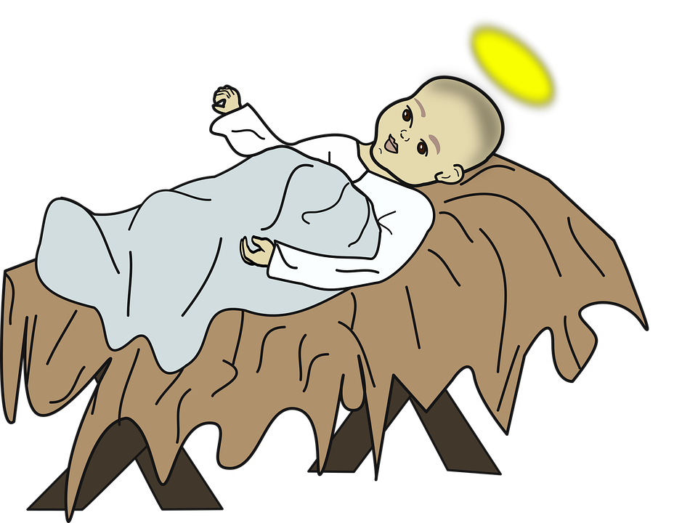
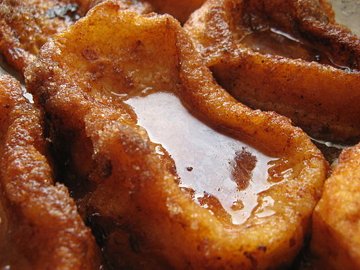
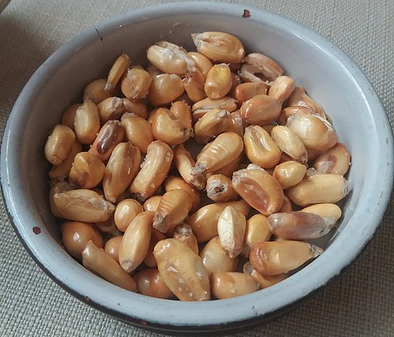


escuchar
A ‘huayno’ is a popular type of music and dance from Peru that goes back more than 500 years.
Un huayno: Niño Manuelito
A Escucha y completa el huayno:
Baby Jesus, what do you want to eat?
Baby Jesus, what do you want to eat?
French toasts covered in honey,
French toasts covered in honey,
Niño Manuelito ¿qué quieres comer?
Niño Manuelito ¿qué quieres comer?
Torrejitas fritas envueltas en miel,
Torrejitas fritas envueltas en miel,
[Estribillo]
Mi canchita te la traigo,
molidita te la traigo
aquí te traigo el buen café
para María y San José. (x 2)
[Chorus]
My corn I bring you,
all ground up I bring it to you
here I bring you good coffee
for Mary and Joseph. (x 2)
This is a Christmas ‘huayno’. In the mountains of Peru they call Baby Jesus ‘Niño Manuelito’- Manuelito is the pet name from Manuel, short for Emmanuel, another name for Jesus in the bible.
Song sung by Jeanette Cabrera for www.mamalisa.com
Notes:
Timing: flexible (two slides)
Note: the majority of this lesson will be taken up with the vocabulary and grammar parts of the assessment. However, this Christmas carol can fit in either at the end of this week’s lesson or in the follow up time this week. There are no other follow up materials this week, as we anticipate schools will be busy at this time of term.
Aim: to enjoy a Peruvian Christmas carol; to join in with the song whilst listening and reading.
Procedure:
1. Click to listen to the song. The words are spread out over two slides. Click to move on to the 2nd slide – the audio will continue.
Note: the song could be included in a nativity at the point where the shepherds arrive to visit Baby Jesus, or be sung as part of a Christmas assembly.
Transcript:
Niño Manuelito ¿qué quieres comer?
Niño Manuelito ¿qué quieres comer?
Torrejitas fritas envueltas en miel,
Torrejitas fritas envueltas en miel.
Chorus:
Mi canchita te la traigo,
molidita te la traigo
aquí te traigo el buen café
para María y San José
aquí te traigo el buen café
para María y San José.
Yo como pastora, te traigo mis ovejas
Yo como pastora, te traigo mis ovejas
unas trasquiladas y otras sin orejas
unas trasquiladas y otras sin orejas.
Tune: https://www.mamalisa.com/?t=es&p=4542
Images:
Torrijas - Eduardo, CC BY-SA 2.0 via Wikimedia Commons
Canchita - MiguelAlanCS, CC BY-SA 4.0 via Wikimedia Commons

Slide 15
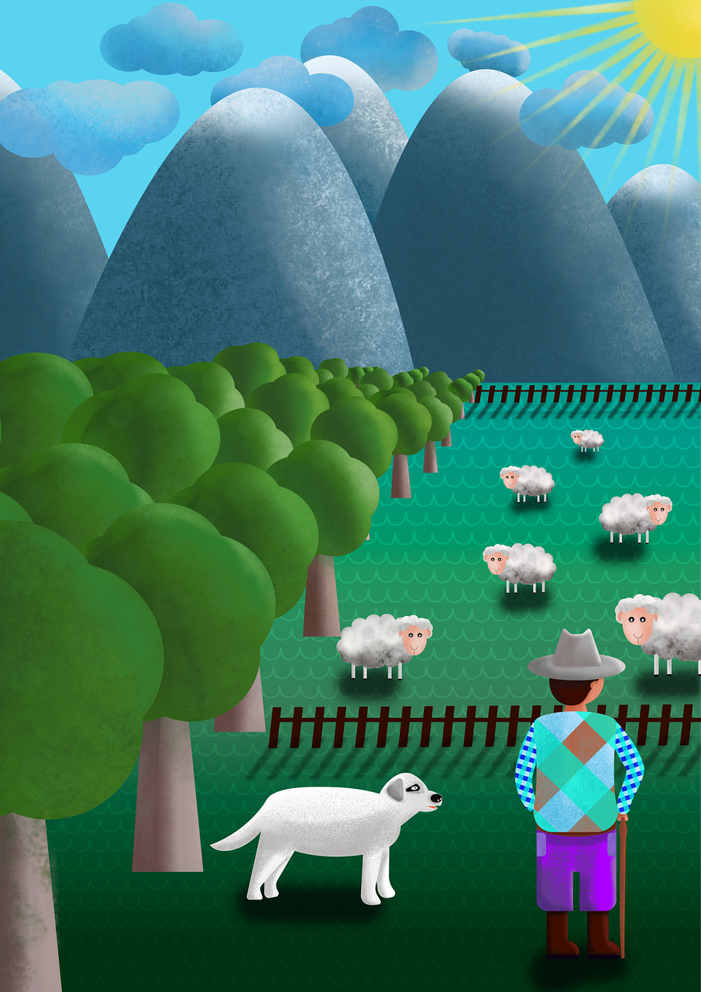
escuchar
Un huayno: Niño Manuelito
Yo como pastora, te traigo mis ovejas Yo como pastora, te traigo mis ovejas
unas trasquiladas y otras sin orejas
unas trasquiladas y otras sin orejas
Me as a shepherdess, I bring you my sheep
Me as a shepherdess, I bring you my sheep some shorn and some without ears
some shorn and some without ears
[Estribillo] (chorus)
Mi canchita te la traigo,
molidita te la traigo
aquí te traigo el buen café
para María y San José (x 2)
[Chorus]
My corn I bring you,
all ground up I bring it to you
here I bring you good coffee
for Mary and Joseph. (x 2)
B ¡Canta el huayno!
Song sung by Jeanette Cabrera for www.mamalisa.com
Notes:
2/2

Slide 16
¡adiós!
amarillo

Slide 17

escuchar
Vocabulary
At home, Apo speaks Quechua, a language spoken by many people from Peru, Bolivia and Ecuador. He is learning Spanish at school, like you. Help Apo by answering the questions in this quiz.
A For each question, put a cross (x) under the English meaning that matches what you hear.
You will hear each Spanish word twice. Choose one correct answer only.
 | A | B | C | D
Ej. | active | impossible | positive | incredible
 | ☐ | ☐ | ☐ | ☐
1. | to be (trait) | to have | to be (state) | am (state)
 | ☐ | ☐ | ☐ | ☐
2. | comfortable | prepared | lost | healthy
 | ☐ | ☐ | ☐ | ☐
3. | bag | boat | bed | horse
 | ☐ | ☐ | ☐ | ☐
Ej.
1
2
3
Notes:
Timing: 20-25 minutes (all assessment slides)
Aim: to practise aural comprehension of vocabulary taught in weeks 1-12 of the course.
Procedure:
1. Click the audio buttons to play each item. (The words are recorded twice with a pause to allow pupils to process the information).
2. Pupils can either write 1C, etc.. or if they have the assessment on a print out they can put a X in the correct box.
3. Note that the first item can be completed, with support from the teacher, as an example. It is NOT included in the overall total marks.
3. After items 1-4, continue to the next slide to complete the remainder of the task.
Transcript:
Ejemplo. positivo
1. ser
2. perdido
3. bolsa
4. hoy
5. dibujo
6. dónde

Slide 18
escuchar
Vocabulary
A For each question, put a cross (x) under the English meaning that matches what you hear.
You will hear each Spanish word twice. Choose one correct answer only.
 | A | B | C | D
4. | today | always | a/one day | usually
 | ☐ | ☐ | ☐ | ☐
5. | plant | drawing | door | table
 | ☐ | ☐ | ☐ | ☐
6. | from | in | how | where
 | ☐ | ☐ | ☐ | ☐
4
5
6
Notes:
Timing: 20-25 minutes (all assessment slides)
Aim: to practise aural comprehension of vocabulary taught in weeks 1-12 of the course.
Procedure:
1. Click the audio buttons to play each item. (The words are recorded twice with a pause to allow pupils to process the information).
2. Pupils can either write 1C, etc.. or if they have the assessment on a print out they can put a X in the correct box.
3. Note that the first item can be completed, with support from the teacher, as an example. It is NOT included in the overall total marks.
3. After items 1-4, continue to the next slide to complete the remainder of the task.
Transcript:
Ejemplo. positivo
1. estar
2. perdido
3. bolsa
4. hoy
5. dibujo
6. dónde

Slide 19
escuchar
Vocabulary
B For each question, put a cross (x) under the type of word you hear.
You will hear each Spanish word twice. Choose one correct answer only.
This word is a good example of …
 | A | B | C | D
Ej. | an object ☐ | food ☐ | a day of the week ☐ | a family member ☐
1. | a day of the week ☐ | a greeting ☐ | a question word ☐ | mood or character ☐
2. | a country ☐ | a day of the week ☐ | a family member ☐ | a colour ☐
3. | mood or character ☐ | an object ☐ | furniture ☐ | a greeting ☐
4. | location ☐ | mood or character ☐ | a colour ☐ | a question word ☐
Ej.
1
2
3
4
Notes:
Procedure:
1. Click the audio buttons to play each item. (The words are recorded twice with a pause to allow pupils to process the information).
2. Pupils can either write 1C, etc.. or if they have the assessment on a print out they can put a X in the correct box.
3. Note that the first item can be completed, with support from the teacher, as an example. It is NOT included in the overall total marks.
4. When complete, continue to the reading.
Transcript:
Ejemplo. martes
1. Buenos días!
2. hermana
3. pesado
4. allí

Slide 20
escuchar
Grammar
C Put a cross (x) next to the person or people that the sentence is about.
You will hear each Spanish sentence twice.
1. | I | ☐ | you | ☐ | he/she | ☐
2. | I | ☐ | you | ☐ | he/she | ☐
3. | I | ☐ | you | ☐ | he/she | ☐
4. | I | ☐ | you | ☐ | he/she | ☐
5. | I | ☐ | you | ☐ | he/she | ☐
1
2
3
4
5
Notes:
Procedure:
1. Click the audio buttons to play each item. (The words are recorded twice with a pause to allow pupils to process the information).
2. Pupils can either write 1C, etc.. or if they have the assessment on a print out they can put a X in the correct box.
3. Note that the first item can be completed, with support from the teacher, as an example. It is NOT included in the overall total marks.
4. When complete, continue to the reading.
Transcript:
1. Estás presente.
2. Tengo un instrumento.
3. Está enfermo hoy.
4. Normalmente soy activa.
5. Tienes una idea nueva.

Slide 21
leer
A Translate the underlined Spanish word to complete each English sentence.
1. Tengo un perro. I have a _____________ .
2. Elena está perdida. Elena is _____________ .
3. Tienes una hoja. You have a _____________ .
4. Es nuevo? ______ ______ new?
5. Es un mensaje. It’s a _____________ .
6. Está ausente. She is _____________ .
7. ¿Qué eres? ___________ are you?
8. ¿Cómo es la puerta? What is the _____________ like?
9. Hoy es viernes. Today it’s __________.
10. Señora Vázquez tiene una regla. Ms Vázquez has a _____________ .
dog
lost
sheet
Is it
message
absent
What
door
Friday
ruler
Notes:
Aim: to practise written recall of previously taught vocabulary.
Procedure:
Ensure that the task is clear.
Pupils could write 1 – 10 and the individual English word meanings (or they could fill in if they have printed assessment sheets).

Slide 22
escribir
B Translate the underlined English words to complete the Spanish sentence.
1. It’s a bed. Es _____ __________. (write two words)
2. Quique is comfortable. Quique está _____________. (write one word)
3. To be healthy is important. _________ sano es importante. (write one word)
4. Good morning! ¡ ___________ _______! (write two words)
5. Thursday is a word. Jueves es una ___________. (write one word)
6. From where? Madrid? ¿____ dónde? ¿Madrid? (write one word)
7. To have an idea is incredible. ___________ una idea es increíble. (write one word)
8. It’s paper. Es _______________. (write one word)
una cama
cómodo
Ser
Buenos días
palabra
De
Tener
papel
Notes:
Aim: to practise written production of previously taught vocabulary.
Procedure:
Ensure that the task is clear.
Pupils could write 1 – 10 and the individual English word meanings (or they could fill in if they have printed assessment sheets).

Slide 23
escribir
C Write the opposite word(s) in Spanish.
1. sano - ________________
2. la hermana - _____________
3. allí - __________________
4. viejo - ______________
5. ¡Buenos días! - _______ _________
enfermo
el hermano
aquí
nuevo
¡Buenas tardes!
Notes:
Aim: to practise written production of previously taught vocabulary.
Procedure:
Ensure that the task is clear.
Pupils could write the answers only (or they could fill in if they have printed assessment sheets).

Slide 24
leer
Grammar
Quechua is quite different from Spanish. Help Apo with his Spanish grammar by answering the questions in this part of the quiz.
1 | ☐ I ☐ you _{[singular]} ☐ she, he, it | …tengo un animal. |  | 4 | ☐ I ☐ you _{[singular]} ☐ she, he, it | … eres de Cambridge.
2 | ☐ I ☐ you _{[singular]} ☐ she, he, it | …estás presente. |  | 5 | ☐ I ☐ you _{[singular]} ☐ she, he, it | … tiene una idea.
3 | ☐ I ☐ you _{[singular]} ☐ she, he, it | …está en Inglaterra. |  | 6 | ☐ I ☐ you _{[singular]} ☐ she, he, it | … estoy en clase.
Notes:
Aim: to practise written recall of previously taught grammar.
Procedure:
Ensure that the task is clear.
Pupils could write the correct English pronouns (or they could fill in if they have printed assessment sheets).

Slide 25
leer
Grammar
B Put a (X) next to two words that could finish this sentence about Diego (a boy).
 | Tick two boxes.
1. Diego es _______. | a) imposible | ☐
 | b) positiva | ☐
 | c) pesada | ☐
 | d) activo | ☐
 | e) vieja | ☐
Put a (X) next to two words that could finish this sentence about Marta (a girl).
 | Tick two boxes.
2. Marta es _______. | a) raro | ☐
 | b) increíble | ☐
 | c) sana | ☐
 | d) viejo | ☐
 | e) activo | ☐
Notes:
Aim: to practise written recall of previously taught grammar.
Procedure:
Ensure that the task is clear.
Pupils could write the correct English pronouns (or they could fill in if they have printed assessment sheets).

Slide 26
leer
Grammar
C Write the words in each box in the correct order.
1. | una imposible cosa | Correct order:_________________________________________
2. | profesor positivo un | Correct order:_________________________________________
3. | cómoda una cama | Correct order:_________________________________________
4. | lápiz un nuevo | Correct order:_________________________________________
una cosa imposible
un profesor positivo
una cama cómoda
un lápiz nuevo
Notes:
Aim: to practise written recall of previously taught grammar.

Slide 27
escribir
D Write the Spanish word for ‘a’.
1. _______ barco (m)
2. _______ planta (f)
E Write the Spanish for the English given in brackets.
1. ________ una mesa. (I have)
2. ________ miércoles. (it is)
3. ________ increíble hoy. (I am)
4. ¿ ________ positiva siempre? (you are)
un
una
Tengo
Es
Estoy
Eres
Notes:
Aim: to practise written production of previously taught vocabulary.
Procedure:
Ensure that the task is clear.
Pupils could write the answers only (or they could fill in if they have printed assessment sheets).

