Slide 1


español, con Quique

Slide 2





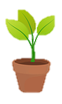
Describing me and others
amarillo
- tener’: 1st & 3rd person singular
- post-nominal adjective gender agreement
- SSC [z]
Notes:
Artwork by Steve Clarke. All additional pictures selected are available under a Creative Commons license, no attribution required.
The frequency rankings for words that occur in this PowerPoint which have been previously introduced in the resources are given in the SOW (excel document) and in the resources that first introduced and formally re-visited those words.
For any other words that occur incidentally in this PowerPoint, frequency rankings will be provided in the notes field wherever possible.
Vocabulary: animal [322] botella [1878] cosa [69] instrumento [1042] papel [393] raro [1005] nuevo [94] viejo [225]
Revisit 1: tener [19] tengo [19] barco [1384] caballo [907] cama [609] camisa [1873] libro [230] planta [768] silla [1271] zapato [1477] un [6] una [6]
Revisit 2: activo [1278] enfermo [1092] perdido [1899] preparado [2092] sano [1961] hoy [167] ¿cómo? [151]
SSC: zapato [1477]
Glossed words:
escribir [198] leer [209] cartón [4136] chapa [>5000] club [1320] miembro [540] planeta [1496] tira [>5000] reciclado [>5000] rojo [534] típico [1934]
de [2] el [1]
Source: Davies, M. & Davies, K. (2018). A frequency dictionary of Spanish: Core vocabulary for learners (2nd ed.). Routledge: London

Slide 3

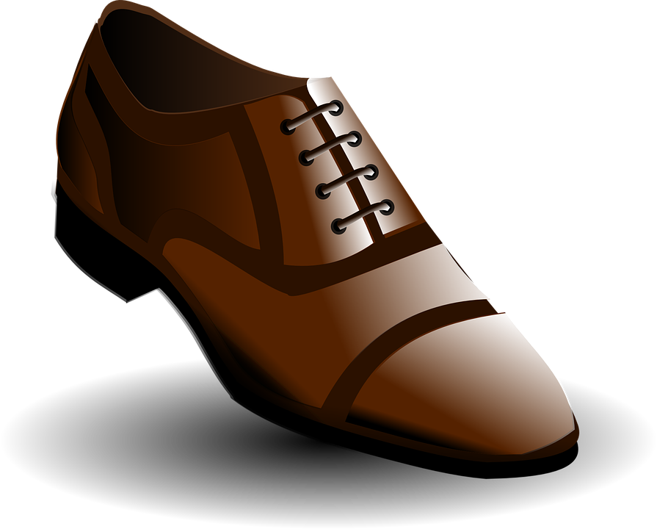
[z]
zapato
pronunciar
[Z] always comes before the letters [a] [o] [u]
[z] sounds the same as [c] in front of [e] [i]
Notes:
Timing: 1 minute
Aim: to introduce SSC [z]
Procedure:
Introduce and elicit the pronunciation of the individual SSC [z] and then the source word ‘zapato’ (with gesture, if using).
Click to bring the picture & get pupils to repeat (with gesture, if using).
Suggested gesture:
https://www.signbsl.com/sign/shoe
Hold the left hand, palm up, fingers pointing up to create a cupped/cradling shape. Quickly pass the right hand over and through the left, palm down, fingers straight and pointing forwards, to simulate a foot going into a shoe. (Best watched on video on link above, first clip on the left).

Slide 4

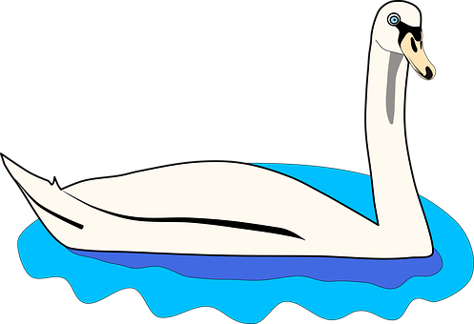

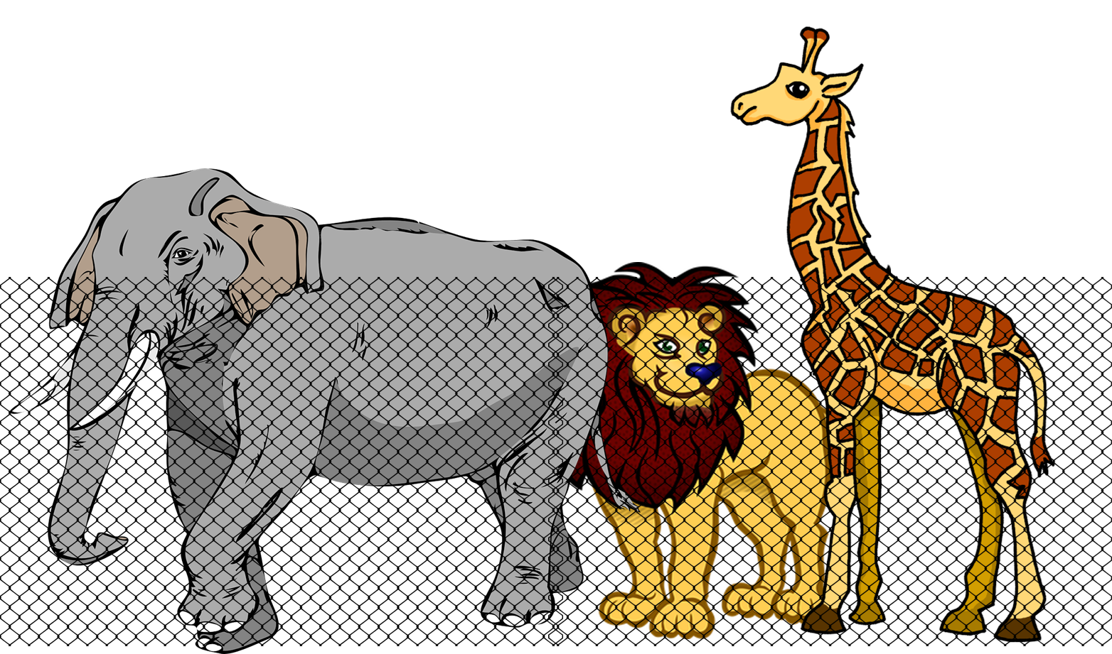




Con tu pareja, pronuncia.
Note! In Latin America [z] and [c] (before e and i)are like [s].
pronunciar
60
zapato
cisne
zoo
paz
zarzamora
cereza
azúcar
cinco
0
START
Notes:
Timing: 4 minutes
Aim: to apply the spelling rule for SSC [z] (before a, o, u) and [c] (before e, i).
Procedure:
Remind pupils that [z] before a, o, u and [c] before e and i sound the same.
Ask pupils to pronounce the words. Click inicio to start the timer.
Then click on each word to listen and check.

Slide 5




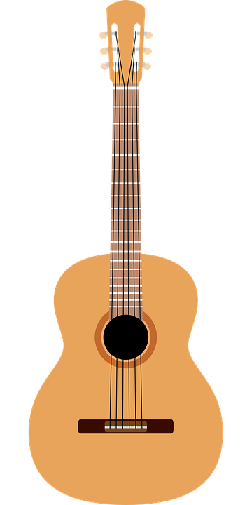
vocabulario
el = the
(el) planeta = planet
(el) miembro = member
del = of the
El club del planeta
Quique es miembro del club del planeta.
papel
una botella
un animal
raro
[odd, weird]
una cosa
[a thing]
nuevo
[new]
un instrumento
viejo
[old]
Notes:
Timing: 4 minutes
Aim: to introduce key vocabulary for the context of the lesson (school clubs – ).
Procedure:
Teacher reads the title.
Click to bring the Spanish words for the different items and elicit repetition from pupils.
NB. Further practice opportunity in next slide.
club [1320] miembro [540] planeta [1496] de [2] el [1]

Slide 6



hablar
El club del planeta
el = the
(el) planeta = planet
(el) miembro = member
del = of the
Clasifica el vocabulario.
leer
= noun
nombres
adjetivos
una planta
un instrumento
viejo
increíble
una botella
una cosa
sano
nuevo
papel
una mesa
cómodo
una puerta
an instrument
old
paper
comfortable
a table
incredible
a door
new
a thing
healthy
plant
a bottle
una planta
una botella
increíble
una puerta
viejo
cómodo
nuevo
una cosa
sano
un instrumento
papel
una mesa
Notes:
Timing: 5 minutes
Aim: to recap previously introduced vocabulary by being able to classify the words by their grammatical category.
Procedure:
Teacher reads the title of the activity (also the context of this lesson – A birthday party) and elicits English translation from pupils.
Click to bring Spanish instruction and read out loud. Draw pupils’ attention to the two categories (adjetivos & nombres). The first one is a cognate.
Pupils work in pairs to classify the words in the two categories, saying them aloud.
Elicit answers from pupils. Answers are animated (x2 clicks per word – x1 for exit animation + x1 for entrance) – left to right.
club [1320] miembro [540] planeta [1496] de [2] el [1]

Slide 7


Adjectives following the noun
In Spanish, many adjectives follow the noun:
Spanish tells you what it is, and then how it is.
un instrumento raro
una silla cómoda
a weird instrument
a comfortable chair
un amigo feliz
In English the adjective comes before the noun.
a happy (male) friend
Notes:
Timing: 2 minutes
Aim: to introduce postnominal adjective agreement.
Procedure:
Click through the animations to present the new information.
Elicit English translations for the Spanish examples provided.
NB. There is a separate slide with a reminder on regular agreement.

Slide 8


leer
Quique prepara el club.
Remember: In English, the adjective comes before the noun.
✍
Lee la lista.
Escribe en inglés.
E
un instrumento pesado
an annoying instrument
1
una hoja vieja
an old sheet
Write the indefinite article too (a/an).
2
una cosa rara
an odd thing
3
una palabra nueva
a new word
4
a lost animal
un animal perdido
5
a positive (female) friend
una amiga positiva
Usa las palabras.
sheet | lost | old | annoying | positive | odd
new | (female) friend | thing | word | animal | instrument
lee = read
escribe = write
Notes:
Timing: 5 minutes
Aim: to practise written comprehension vocabulary and processing of the word order change from Spanish to English.
Procedure:
Read the title.
Explain that this is a list of items for eco club.
Do [E] with them to model the task. Click through the animations to make obvious to pupils they will have to rephrase their translations to make them sound natural in English.
Note: Some pupils can approach the translation without looking at the words below.
escribir [198] leer [209]

Slide 9
Adjectives following the noun
⚠ Remember, adjectives change depending on whether they describe a masculine or feminine noun.
masculine noun
feminine noun
un dibujo raro
una planta pequeña
a weird drawing
a small plant
una palabra imposible
When an adjective ends in –e or -z it can describe a masculine OR a feminine noun.
an impossible word
un animal increíble
an incredible animal
Notes:
Timing: 3 minutes
Aim: to reintroduce adjective agreement, in combination with position of adjectives (postnominal).
Procedure:
Click through the animations to present the new information.
Elicit English translations for the Spanish examples provided.
Callout 1 reminds pupils about gender agreement of adjectives ending in –e & -z

Slide 10



escuchar
rojo
Quique y Sofía bring items to the club
Escucha otra vez. ¿Es Quique o Sofía?
Escucha y rodea el adjetivo correcto.
Marca
Escribe en inglés.
descripción | objeto
rojo / roja
cómodo /cómoda
nuevo / nueva
raro / rara
sano / sana
viejo / vieja
I have | you have
E
E
a pencil
1
1
a bed
2
2
a sheet
3
3
an instrument
4
4
a plant
5
5
paper
Notes:
Timing: 7 minutes
Aim: to practise both retrieval of vocabulary and processing of the word order change from Spanish to English; to revisit ‘tengo’ & ‘tienes’.
Procedure:
Read the context and click to bring up further instruction.
Pupils write 1-5 in their books
Click to listen to the example. Pupils circle / write the correct form of the adjective & write the object mentioned.
Complete the task with items 1-5 x2.
Click to reveal answers.
Click to bring up part 2 of the task (listening out for ‘tengo’ & ‘tienes’) with the 2nd set of audio buttons (with full sentences).
Pupils to listen one more time and identify who brings what to the eco club (Quique or Sofía).
Transcript:
E. Tienes un lápiz [rojo].
Tengo una cama [cómoda].
Tienes una hoja [nueva].
Tienes un instrumento [raro].
Tengo una planta [sana].
Tengo papel [viejo].
rojo [534]

Slide 11

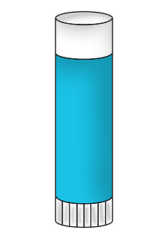
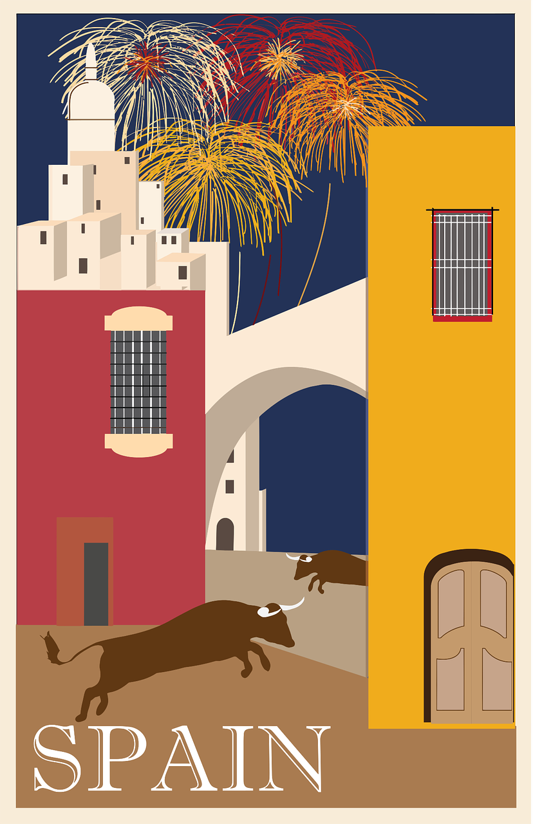

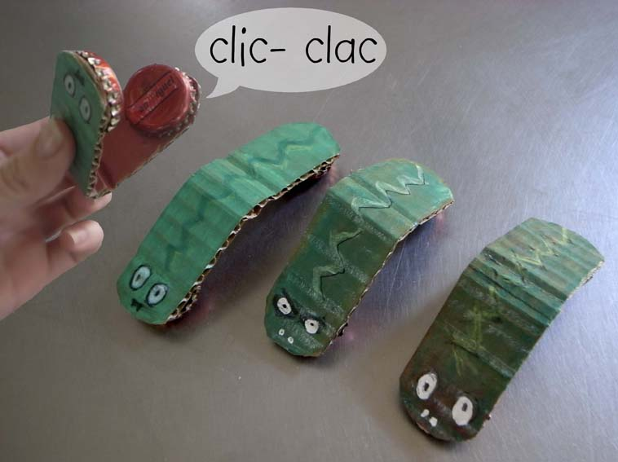
leer
Un instrumento reciclado*
Quique and Sofía are upcycling materials to make an instrument.
¿Qué es?
tiras* de cartón* y papel (12cm x 4cm)
pegamento
dos chapas* de botella
Clic, clac
Castañuelas. Un instrumento típico* de España
cartón = cardboard
chapa = cap
tiras = strips
reciclado = recycled
típico = typical
Notes:
Timing: 3 minutes - extra
Aim: to learn about castanets
Procedure:
Read the title and get pupils to get the instrument.
Read the materials with them and clarify meaning.
cartón [4136] chapa [>5000] tira [>5000] típico [1934] reciclado [>5000]

Slide 12
¡adiós!
amarillo

