Slide 1
Saying what I and others have
amarillo
Follow ups 1-5
Notes:
Artwork by Steve Clarke. All additional pictures selected are available under a Creative Commons license, no attribution required.
The frequency rankings for words that occur in this PowerPoint which have been previously introduced in the resources are given in the SOW (excel document) and in the resources that first introduced and formally re-visited those words.
For any other words that occur incidentally in this PowerPoint, frequency rankings will be provided in the notes field wherever possible.
Phonics: [ci] decir [32]
Vocabulary: tiene [19] dibujo [1726] hermano [333] hermana [3409] mesa [525] perro [888] profesor, profesora [501] puerta [274]
Revisit 1: eres [7] (recycle adjectives) de1 [2] Inglaterra [n/a] España [n/a] Perú [n/a]
Revisit 2: estar [21] estoy [21] está [21] presente [1114] ausente [>5000] aquí [130] allí [197] hola [1245]
Source: Davies, M. & Davies, K. (2018). A frequency dictionary of Spanish: Core vocabulary for learners (2nd ed.). Routledge: London

Slide 2
Follow up 1
[ci]
A Escucha.
Cuenta el sonido [ci].
B Escribe en la espalda.
Ahora escribe en español.
¡Pronuncia!
 | ci | palabra
 |  | di _ _ embre
 |  | con _ _en _ _ a
 |  | _ _ udad
 |  | pa _ _ en _ _ a
 |  | co _ _ na
E
|
c i
cima
cien
cocina
1
| |
c i
c i
diciembre
piscina
2
|
c i
cine
paciencia
3
| |
c i
c i
cielo
ciudad
4
|
c i
Notes:
Timing: 5 minutes
Aim: to develop phonological awareness of [ci] and to practise SSC [ci] in a read aloud task.
Procedure:
Click x2 to bring up the instruction & table. Clarify the meaning of ‘cuenta’ by drawing their attention to the picture.
Do example together (E).
Pupils tick how many ticks they hear the sound [ci]
4. Click x2 to bring further instruction and display words. Pupils listen one more time and write down the word. Encourage an increased level of challenge by not looking at the board.
5. Click to Bring Part B and read instructions.
5. Partner A write down 4 words from the board.
6. Partner A sits with their back to the board and partner B, with their finger, writes on partner A’s back the chosen words. Pupils A says the word aloud and spells it out. Partner B can award 1 point for correct pronunciation and another one for correct spelling.
7. Partner then swap roles.
Teachers circulate to listen to pupils’ pronunciation and praise/correct as necessary.
Transcript [EJ] diciembre
[1] conciencia
[2] ciudad [3] paciencia
[4] cocina

Slide 3
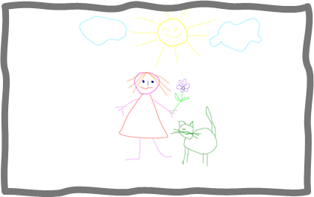
Follow up 2
[1/5]
Escucha y escribe.
escuchar y escribir
Tiene
1. _______ un dibujo y un barco.
3
I
s/he
2
a
b
c
1
¡escribe!
Notes:
Timing: 8 minutes
Aim: to practise listening out for the verbs ‘tengo’ and ‘tiene’ and process the person of the verb they refer to. To then practise processing the meaning of both the newly introduced and revisited vocabulary
Slide 1/5
Procedure:
Read the instructions in Spanish. The following instructions apply to the next 5 slides.
Tell students this is a delayed dictation activity. You will say a sentence out loud twice and they will have to retain that sentence in their working memory (picturing it in their heads!) for 3 seconds.
(NB. They can choose to use the help on the board or without looking – encourage students to choose their own level of challenge).
Click to start timer once you’ve played / read the sentence x2. Once the time is up, the instruction ‘escribe’ will come up and they need to write the whole sentence.
4. Click to show the sentence.
5. Click again to bring up the different pictures and elicit answer from students.
Tiene un dibujo y un barco.
Tiene una planta y una hermana.
Tengo un libro y un perro.
Tiene una mesa y un profesor.
Tengo una puerta y una mesa.

Slide 4
Follow up 2
[2/5]
Escucha y escribe.
escuchar y escribir
Tiene
2. _______ una planta y una hermana.
3
I
s/he
2
a
b
c
1
¡escribe!
Notes:
Timing: 8 minutes
Aim: to practise listening out for the verbs ‘tengo’ and ‘tiene’ and process the person of the verb they refer to. To then practise processing the meaning of both the newly introduced and revisited vocabulary
Slide 2/5
Procedure:
Read the instructions in Spanish. The following instructions apply to the next 5 slides.
Tell students this is a delayed dictation activity. You will say a sentence out loud twice and they will have to retain that sentence in their working memory (picturing it in their heads!) for 3 seconds.
(NB. They can choose to use the help on the board or without looking – encourage students to choose their own level of challenge).
Click to start timer once you’ve played / read the sentence x2. Once the time is up, the instruction ‘escribe’ will come up and they need to write the whole sentence.
4. Click to show the sentence.
5. Click again to bring up the different pictures and elicit answer from students.
Tiene un dibujo y un barco.
Tiene una planta y una hermana.
Tengo un libro y un perro.
Tiene una mesa y un profesor.
Tengo una puerta y una mesa.

Slide 5
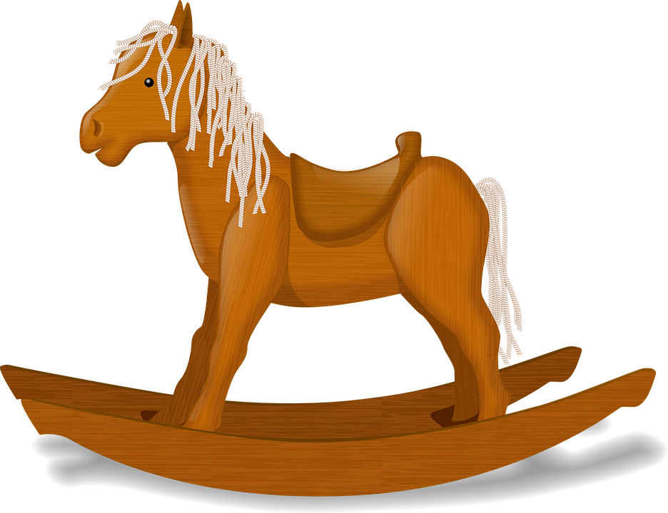
Follow up 2
[3/5]
Escucha y escribe.
escuchar y escribir
Tengo
1. _______ un libro y un perro.
3
I
s/he
2
a
b
c
1
¡escribe!
Notes:
Timing: 8 minutes
Aim: to practise listening out for the verbs ‘tengo’ and ‘tiene’ and process the person of the verb they refer to. To then practise processing the meaning of both the newly introduced and revisited vocabulary
Slide 3/5
Procedure:
Read the instructions in Spanish. The following instructions apply to the next 5 slides.
Tell students this is a delayed dictation activity. You will say a sentence out loud twice and they will have to retain that sentence in their working memory (picturing it in their heads!) for 3 seconds.
(NB. They can choose to use the help on the board or without looking – encourage students to choose their own level of challenge).
Click to start timer once you’ve played / read the sentence x2. Once the time is up, the instruction ‘escribe’ will come up and they need to write the whole sentence.
4. Click to show the sentence.
5. Click again to bring up the different pictures and elicit answer from students.
Tiene un dibujo y un barco.
Tiene una planta y una hermana.
Tengo un libro y un perro.
Tiene una mesa y un profesor.
Tengo una puerta y una mesa.

Slide 6
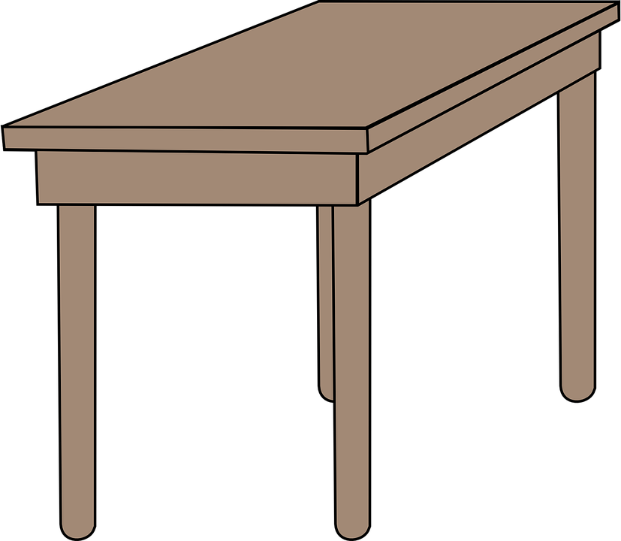
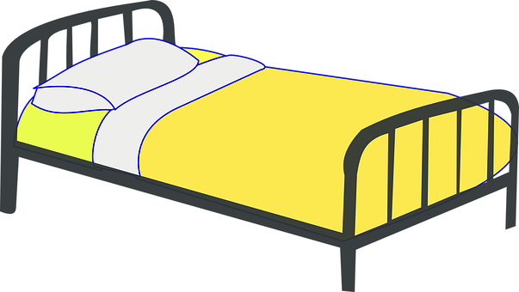
Follow up 2
[4/5]
Escucha y escribe.
escuchar y escribir
Tiene
1. _______ una mesa y un profesor.
3
I
s/he
2
a
b
c
1
¡escribe!
Notes:
Timing: 8 minutes
Aim: to practise listening out for the verbs ‘tengo’ and ‘tiene’ and process the person of the verb they refer to. To then practise processing the meaning of both the newly introduced and revisited vocabulary
Slide 4/5
Procedure:
Read the instructions in Spanish. The following instructions apply to the next 5 slides.
Tell students this is a delayed dictation activity. You will say a sentence out loud twice and they will have to retain that sentence in their working memory (picturing it in their heads!) for 3 seconds.
(NB. They can choose to use the help on the board or without looking – encourage students to choose their own level of challenge).
Click to start timer once you’ve played / read the sentence x2. Once the time is up, the instruction ‘escribe’ will come up and they need to write the whole sentence.
4. Click to show the sentence.
5. Click again to bring up the different pictures and elicit answer from students.
Tiene un dibujo y un barco.
Tiene una planta y una hermana.
Tengo un libro y un perro.
Tiene una mesa y un profesor.
Tengo una puerta y una mesa.

Slide 7
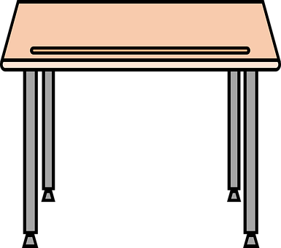
Follow up 2
[5/5]
Escucha y escribe.
escuchar y escribir
Tengo
1. _______ una puerta y una mesa.
3
I
s/he
2
a
b
c
1
¡escribe!
Notes:
Timing: 8 minutes
Aim: to practise listening out for the verbs ‘tengo’ and ‘tiene’ and process the person of the verb they refer to. To then practise processing the meaning of both the newly introduced and revisited vocabulary
Slide 5/5
Procedure:
Read the instructions in Spanish. The following instructions apply to the next 5 slides.
Tell students this is a delayed dictation activity. You will say a sentence out loud twice and they will have to retain that sentence in their working memory (picturing it in their heads!) for 3 seconds.
(NB. They can choose to use the help on the board or without looking – encourage students to choose their own level of challenge).
Click to start timer once you’ve played / read the sentence x2. Once the time is up, the instruction ‘escribe’ will come up and they need to write the whole sentence.
4. Click to show the sentence.
5. Click again to bring up the different pictures and elicit answer from students.
Tiene un dibujo y un barco.
Tiene una planta y una hermana.
Tengo un libro y un perro.
Tiene una mesa y un profesor.
Tengo una puerta y una mesa.

Slide 8
Follow up 4
Escucha y escribe.
Lee la frase con tu compañero/a.
[1/5]
hablar
You do not need all of the words!
20
tengo
caballo
barco
un
Tiene un caballo.
S/he has a horse.
S
tiene
una
en
0
¡tiempo!
START
Notes:
Timing: 5 minutes (5 slides)
Aim: to practise oral sentence building, deciding between the target features of tengo and tiene, un and una, and different vocabulary from this week.
Procedure:
1. Click for English sentence and Spanish prompt words. 2. Click Inicio to start the timer.
3. Pupils select from the words given to create and say the sentence out loud before the time elapses. 4. Click for the Spanish sentence to appear.

Slide 9
Follow up 4
Lee la frase con tu compañero/a.
[2/5]
hablar
You do not need all of the words!
20
tiene
cama
una
Tengo una cama y una planta.
I have a bed and a plant.
fruta
S
planta
una
y
tengo
0
¡tiempo!
START
Notes:
Timing: 5 minutes (5 slides)
Aim: to practise oral sentence building, deciding between the target features of tengo and tiene, un and una, and different vocabulary from this week.
Procedure:
1. Click for English sentence and Spanish prompt words. 2. Click Inicio to start the timer.
3. Pupils select from the words given to create and say the sentence out loud before the time elapses. 4. Click for the Spanish sentence to appear.

Slide 10
Follow up 4
Escucha y escribe.
Lee la frase con tu compañero/a.
[3/5]
hablar
You do not need all of the words!
20
tiene
clase
un
Tiene una puerta en clase.
S/he has a door in class.
libro
S
puerta
una
profesora
en
tengo
0
¡tiempo!
START
Notes:
Timing: 5 minutes (5 slides)
Aim: to practise oral sentence building, deciding between the target features of tengo and tiene, un and una, and different vocabulary from this week.
Procedure:
1. Click for English sentence and Spanish prompt words. 2. Click Inicio to start the timer.
3. Pupils select from the words given to create and say the sentence out loud before the time elapses. 4. Click for the Spanish sentence to appear.

Slide 11
Follow up 4
Escucha y escribe.
Lee la frase con tu compañero/a.
[4/5]
hablar
You do not need all of the words!
20
tiene
siempre
normalmente
dibujo
Siempre tengo un dibujo.
I always have a drawing.
la mesa
S
boli
una
tengo
un
perro
0
¡tiempo!
START
Notes:
Timing: 5 minutes (5 slides)
Aim: to practise oral sentence building, deciding between the target features of tengo and tiene, un and una, and different vocabulary from this week.
Procedure:
1. Click for English sentence and Spanish prompt words. 2. Click Inicio to start the timer.
3. Pupils select from the words given to create and say the sentence out loud before the time elapses. 4. Click for the Spanish sentence to appear.

Slide 12
Follow up 4
Escucha y escribe.
Lee la frase con tu compañero/a.
[5/5]
hablar
You do not need all of the words!
20
dibujo
siempre
tiene
profesora
Ahora tiene un profesor.
Now s/he has a (male) teacher.
ahora
S
tengo
profesor
normalmente
un
hoy
0
¡tiempo!
START
Notes:
Timing: 5 minutes (5 slides)
Aim: to practise oral sentence building, deciding between the target features of tengo and tiene, un and una, and different vocabulary from this week.
Procedure:
1. Click for English sentence and Spanish prompt words. 2. Click Inicio to start the timer.
3. Pupils select from the words given to create and say the sentence out loud before the time elapses. 4. Click for the Spanish sentence to appear.

Slide 13
Tener:
tiene
[to have | having]: s/he, it has
We know the verb tener means ‘to have’ or ‘having’.
To say s/he or it has, use ‘tiene’.
Tiene un libro.
S/he, it has a book.
Remember that ‘tiene’ can also just mean ‘has’.
Quique tiene una hermana.
Quique has a sister.
Notes:
Do before follow up 4
Timing: 1 minute
Aim: to revisit knowledge about tener and draw attention to the multiple translations of tiene.
Procedure:
Click through the paced animations to present the new knowledge.
Elicit English translations for the Spanish examples provided.

Slide 14
Follow up 4:
Escribe en español.
When translating [a] / [an], consider the gender of the noun.
[I have] [a] table. __________________
2. Rubén [has] [a] (male) dog. ________________________
3. [She has] [a] sister. ______________________
4. [I have] [a] horse and [a] plant.
_______________________________________
5. Quique [has] [a] drawing and an book.
__________________________________________
escribir
Tengo una mesa.
Rubén tiene un perro.
Tiene una hermana.
⚠ Don’t forget capital letters and full stops!
Tengo un caballo y una planta.
libro
Quique tiene un dibujo y un libro.
perro
hermana
y
caballo
dibujo
y
planta
mesa
Notes:
Timing: 8 minutes
Aim: to correctly use ‘tengo’ & ‘tiene’ in written production – retrieval of ‘a / an’.
Procedure:
Tell pupils to translate the sentences using the vocabulary from the lesson. They can use the words in the frame to support their writing but will have to think carefully about translating ‘I have’ and ‘s/he has’, as well as a /an.
Click to bring up reminder about a / an
Click to bring up reminder about punctuation and capital letters.

Slide 15
Follow up 5:
Escribe en español: Can you get at least 15 points?
 | there | s/he, it is (state) | here
 | hello | I am (state) | present
 | from | Spain | comfortable (m)
 | England | you are (trait) | ready (f)
 | s/he has | I have | a dog
 | a door | a table | a teacher (m)
 | a drawing | a teacher (f) | a sister
allí
está
aquí
vocabulario
x3
hola
estoy
presente
de
España
cómodo
x2
Inglaterra
eres
preparada
tiene
tengo
un perro
una puerta
una mesa
un profesor
x1
una hermana
un dibujo
una profesora
Notes:
Timing: 6 minutes
Aim: to practise written production of vocabulary for this week and previous weeks.
Procedure:
1. Pupils need to write the Spanish for as many words as possible, aiming to get at least 15 points (but more if possible).
2. Click for Spanish answers.

Slide 16
Handout: Follow up 5:
Follow up 5:
Escribe en español: Can you get at least 15 points?
 | there | s/he, it is (state) | here
 | hello | I am (state) | present
 | from | Spain | comfortable (m)
 | England | you are (trait) | ready (f)
 | s/he has | I have | a dog
 | a door | a table | a teacher (m)
 | a drawing | a teacher (f) | a sister
vocabulario
x3
x2
x1
Notes:
Timing: 6 minutes
Aim: to practise written production of vocabulary for this week and previous weeks.
Procedure:
1. Pupils need to write the Spanish for as many words as possible, aiming to get at least 15 points (but more if possible).
2. Click for Spanish answers.

