Slide 1
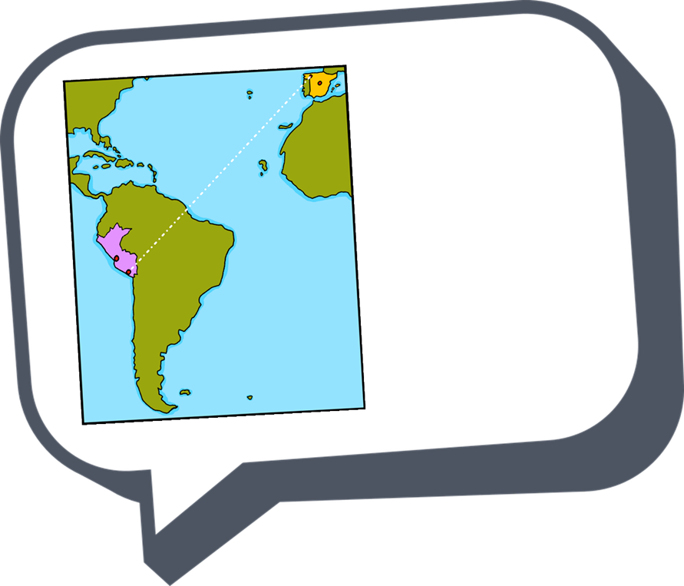




español - cover
Verde Term 2
¡hola!
español
Nombre : ……………………………………………….
Profesor (a) : ……………………………………..
Clase : ……………………………………………..

Slide 2
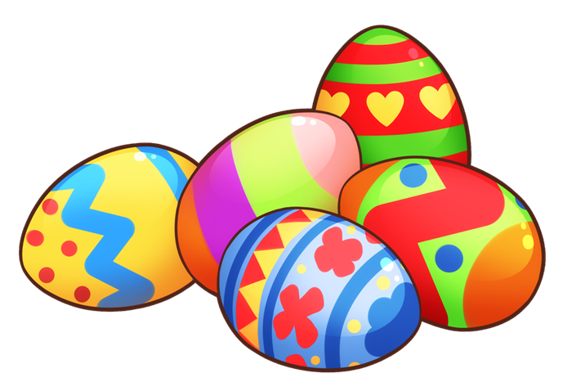
Contents
Contents | page
Introduction: La familia Mamani Flores | 1
Fonética | 2
Term 2 Learning Overview | 3
1. Understanding and talking about what we and others do on special days; comparing New Year’s traditions | 4-7
2. Talking about what we and others do in school | 8-12
3. Talking about what you and others do in language class; asking yes/no questions | 13-19
4. Talking about what I and others do at the weekend; using negative sentences | 20-23
5. Describing what I and others do in our free time | 24-28
6. Talking about the things I have in my suitcase; asking others what they have in their suitcase. | 29-34
7. Using ‘hay’ and ‘tiene’ to describe a city; Badajoz. | 35-40
8. Describing the geography of Peru: Talking about where I go, and s/he goes; using contraction ‘al’. | 41-45
9. Describing where you are and where you go; Using ‘ir’ and ‘estar’ to talk about a trip to Cördoba. | 46-50
10. Actividades de Pascua | 51-52

Slide 3

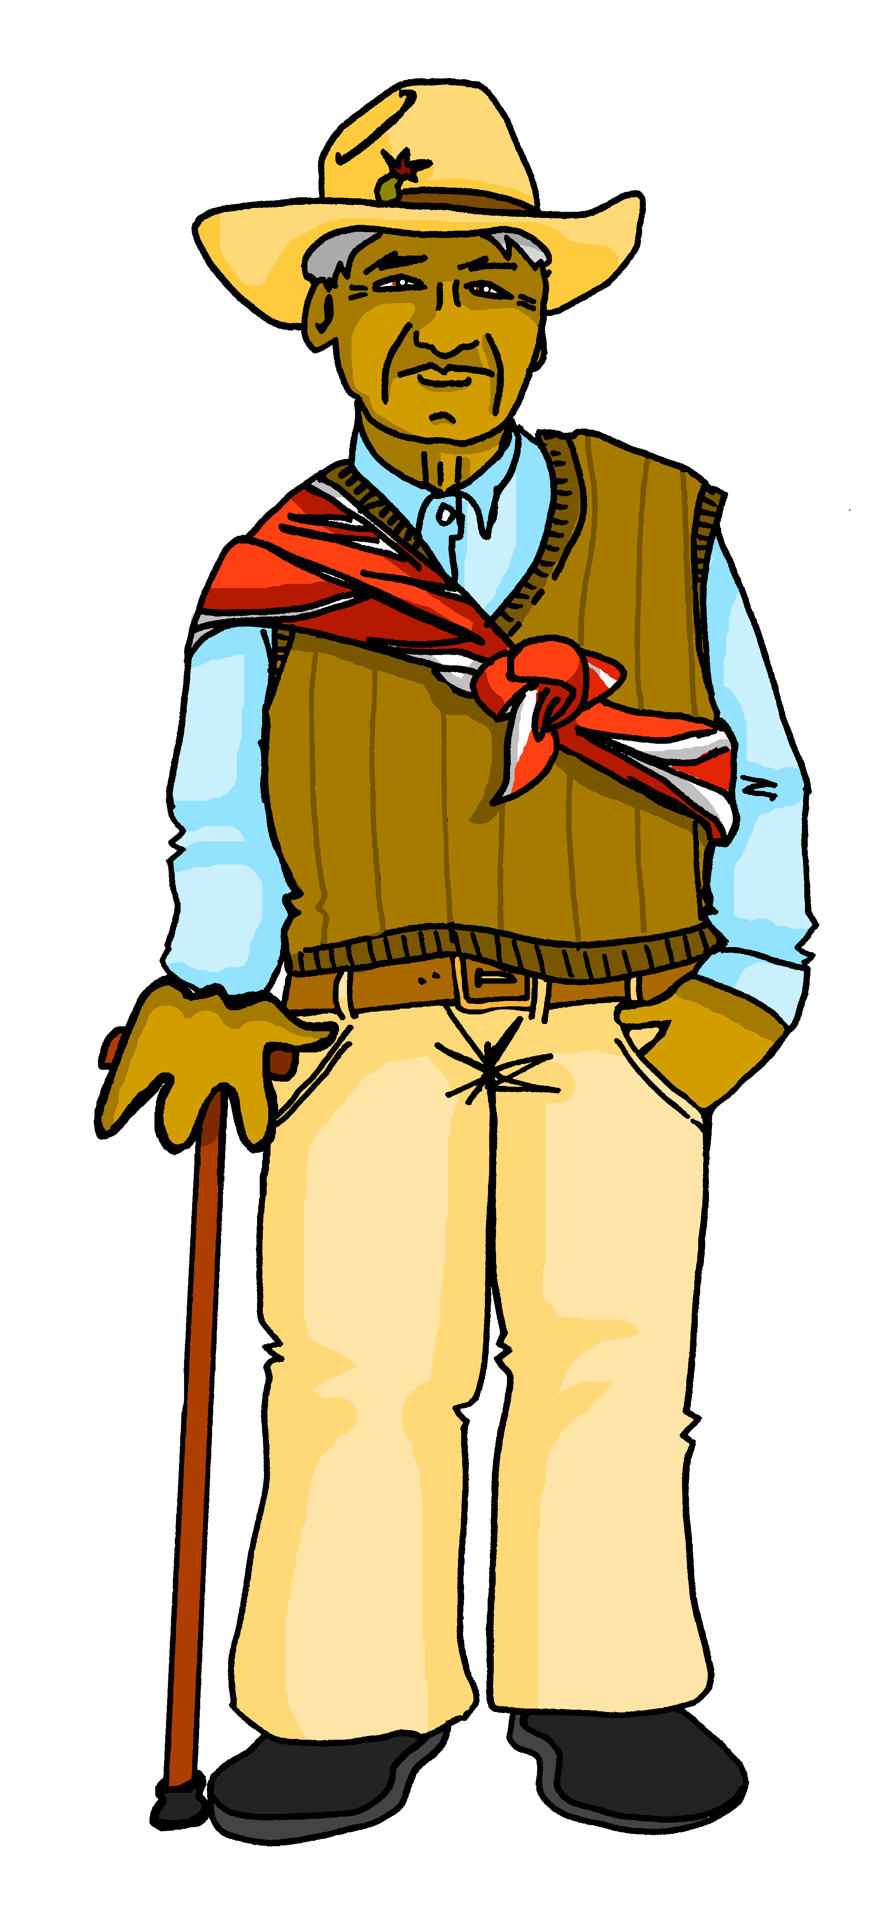

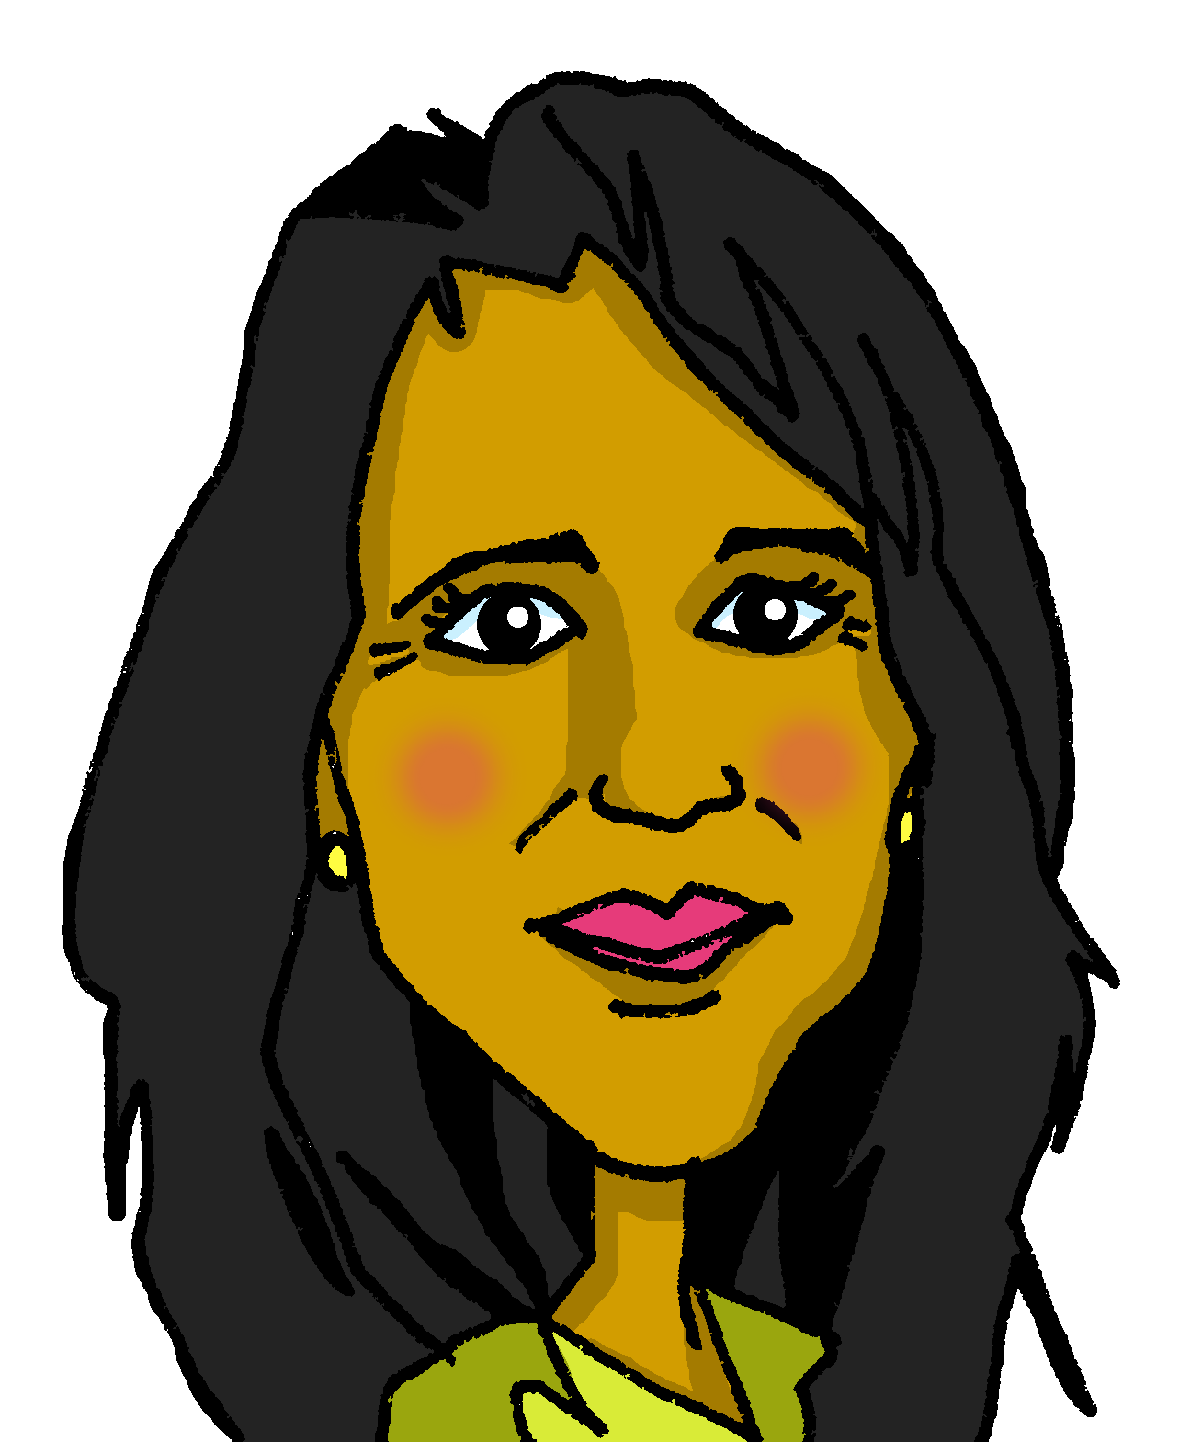
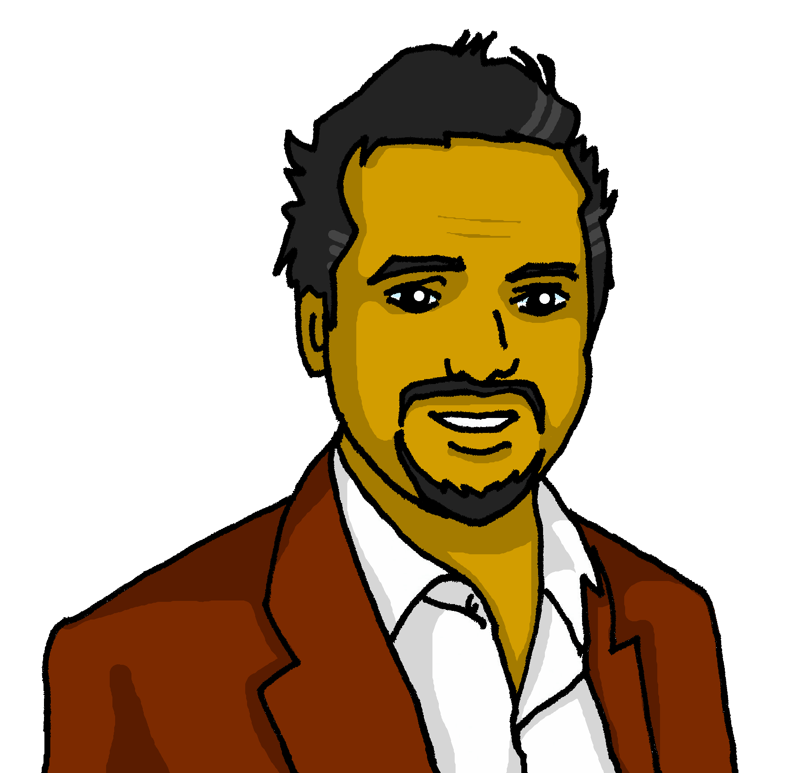

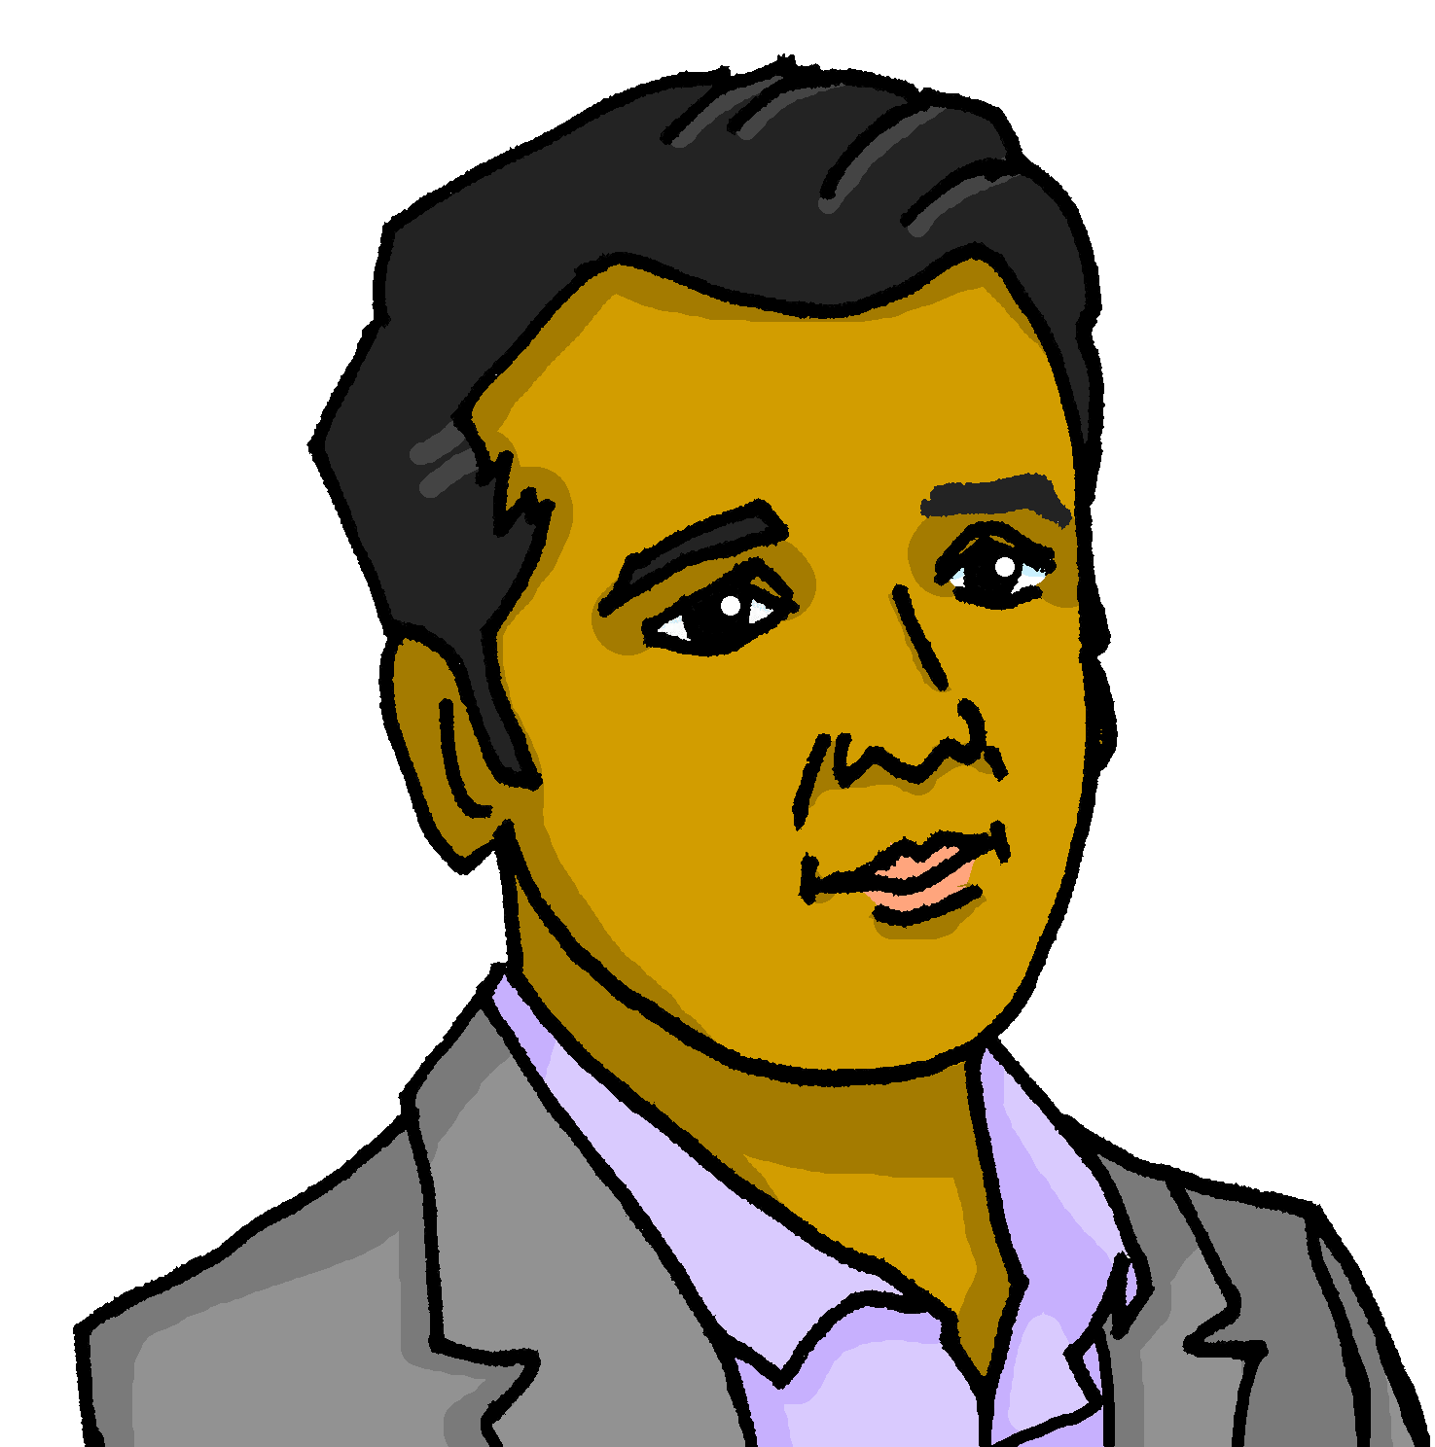
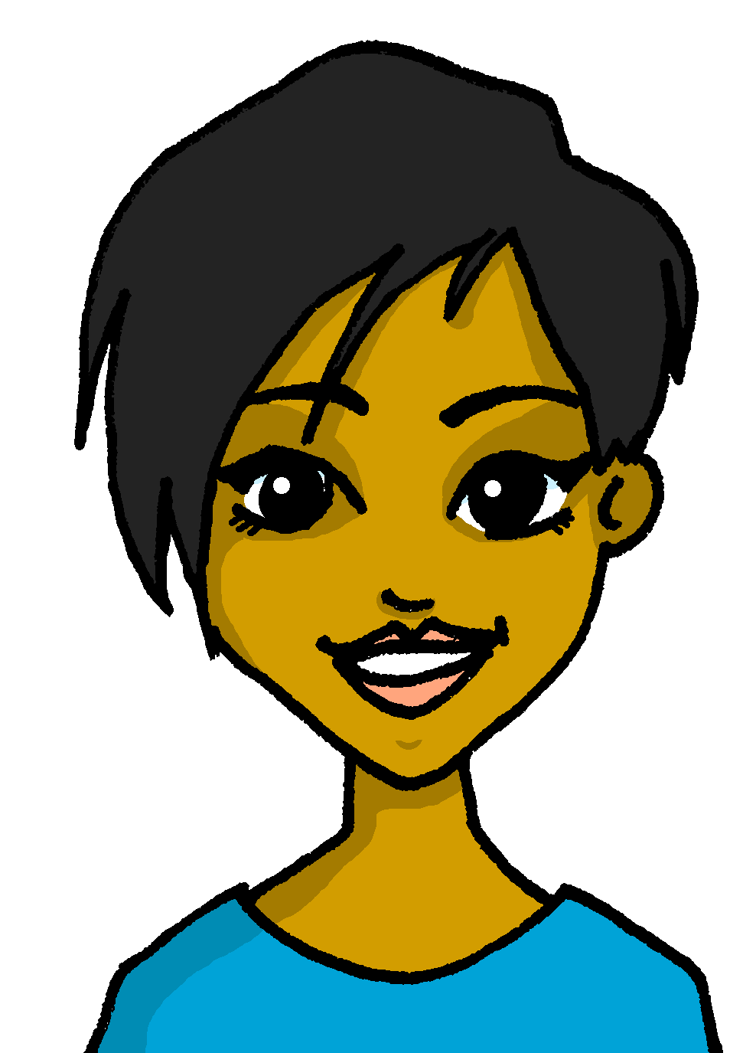

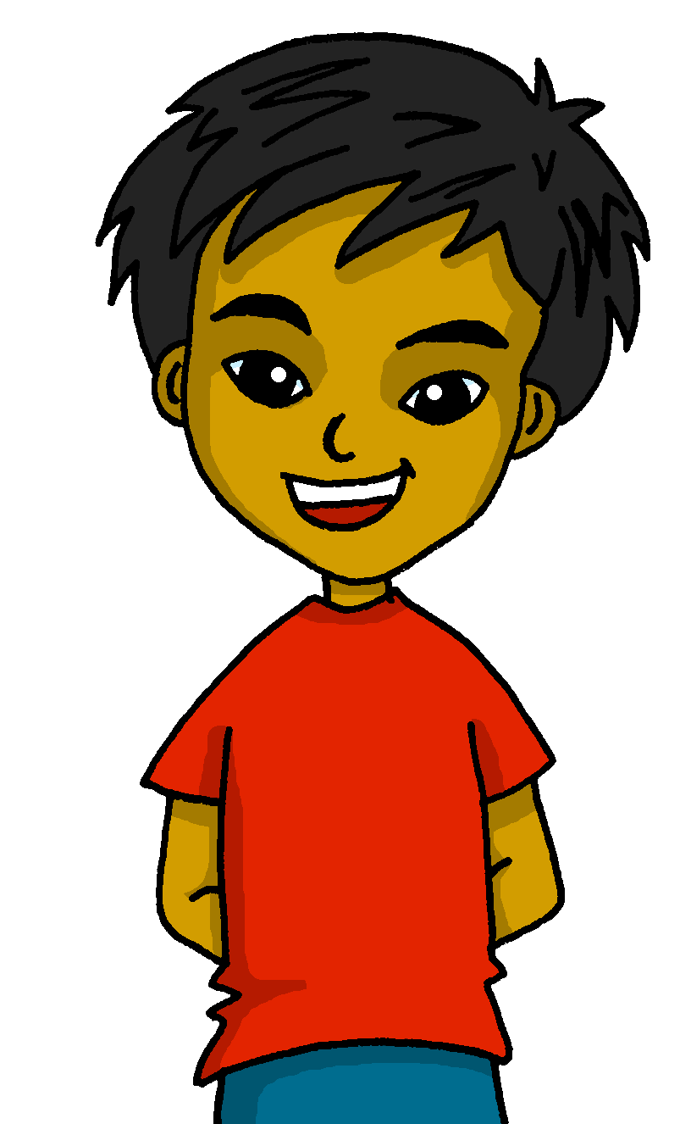
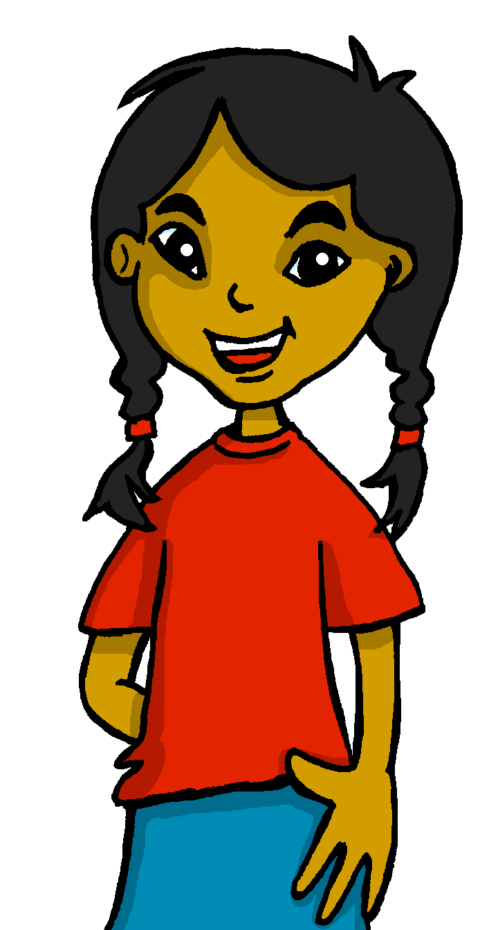
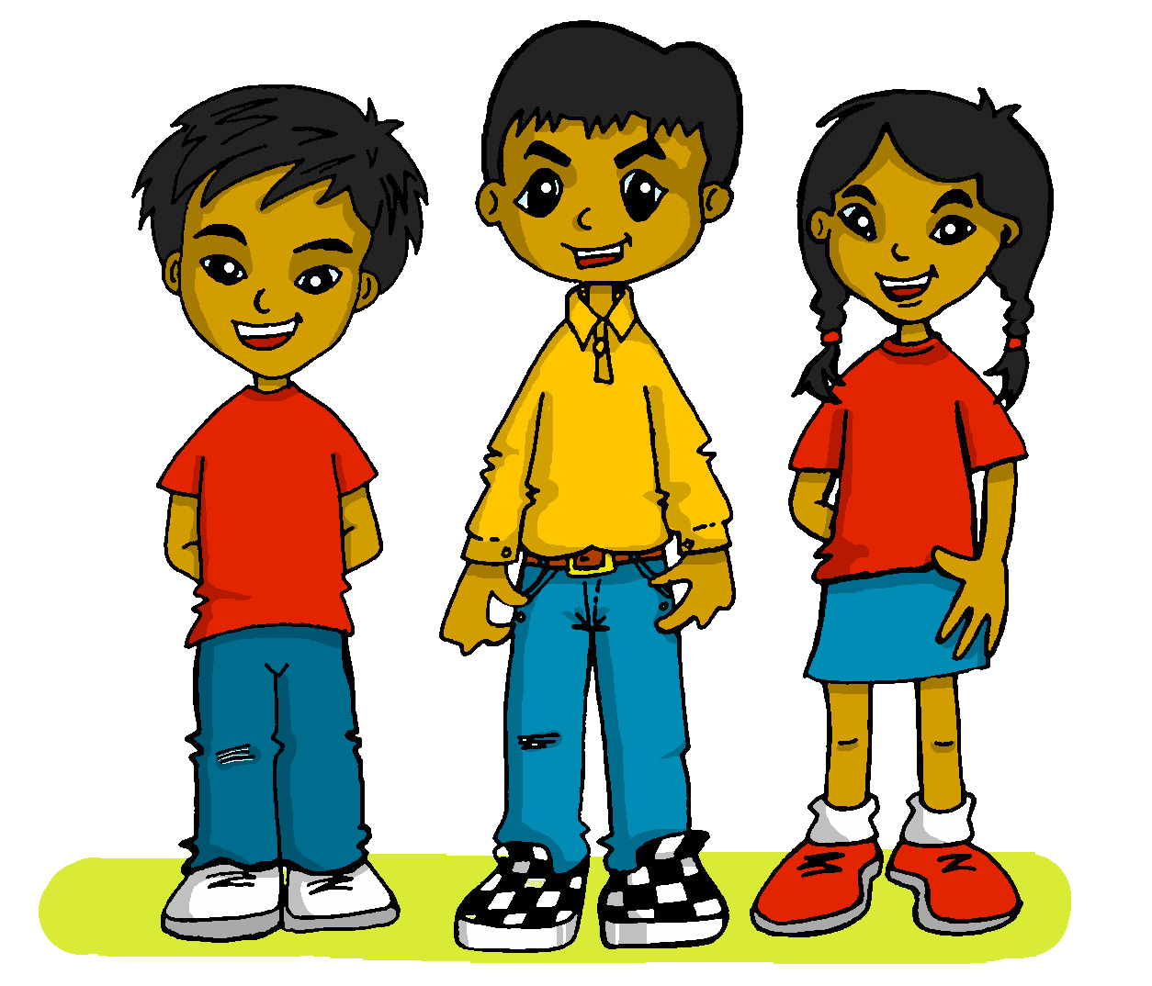

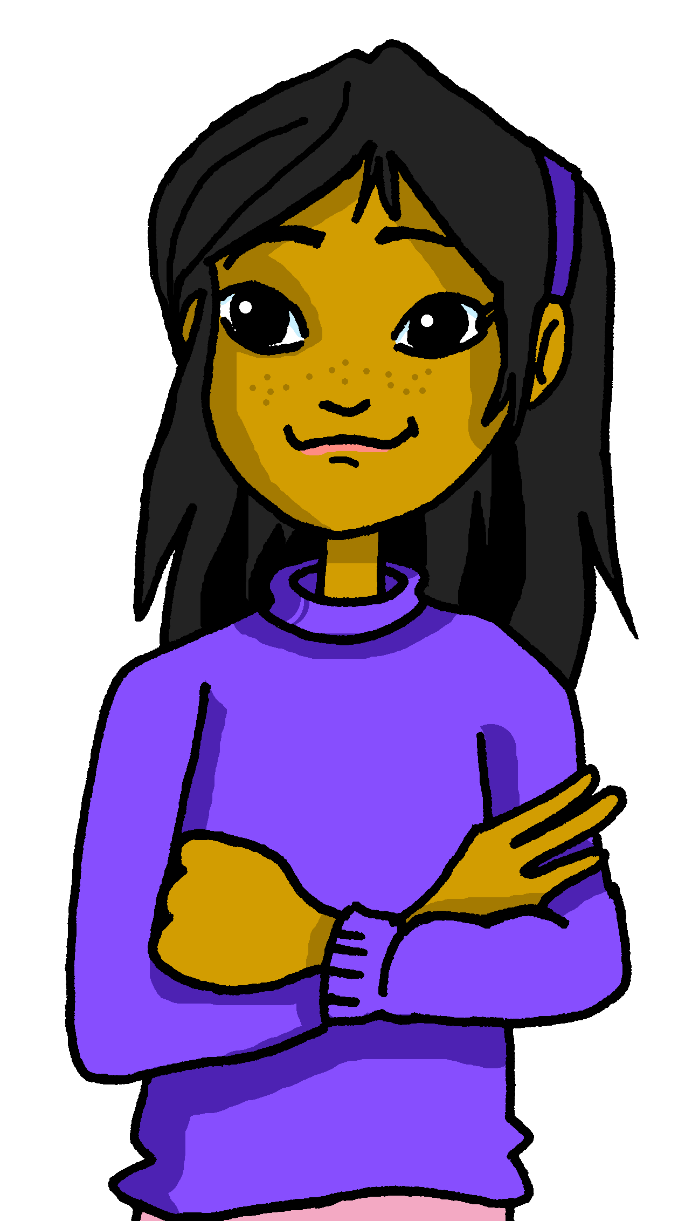
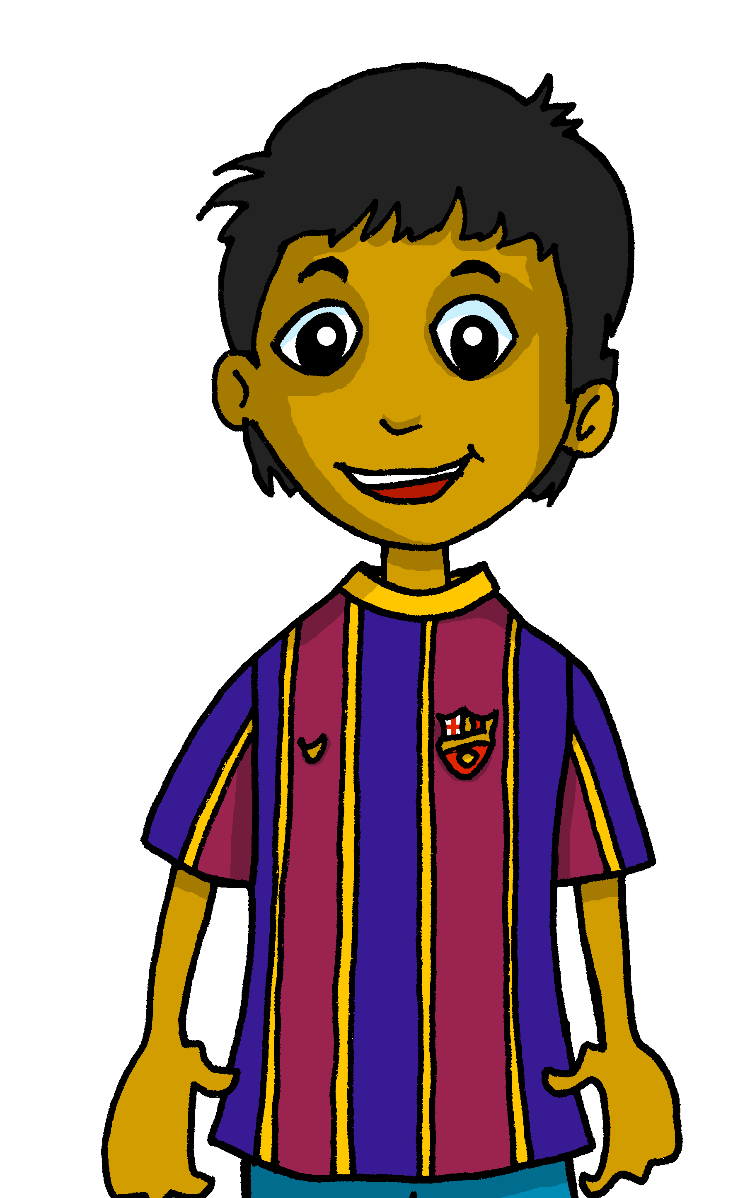
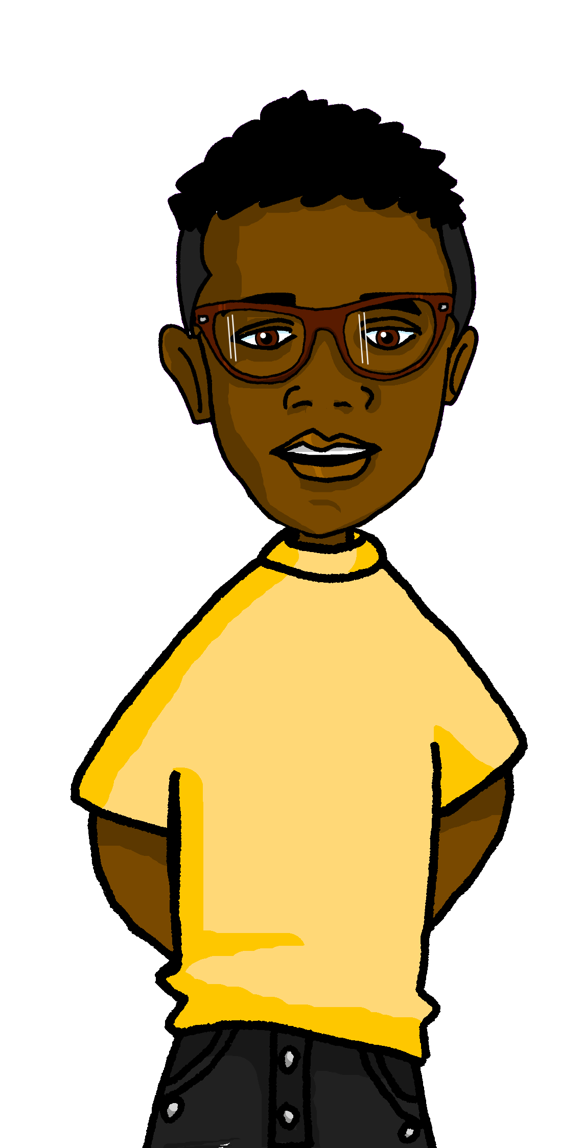
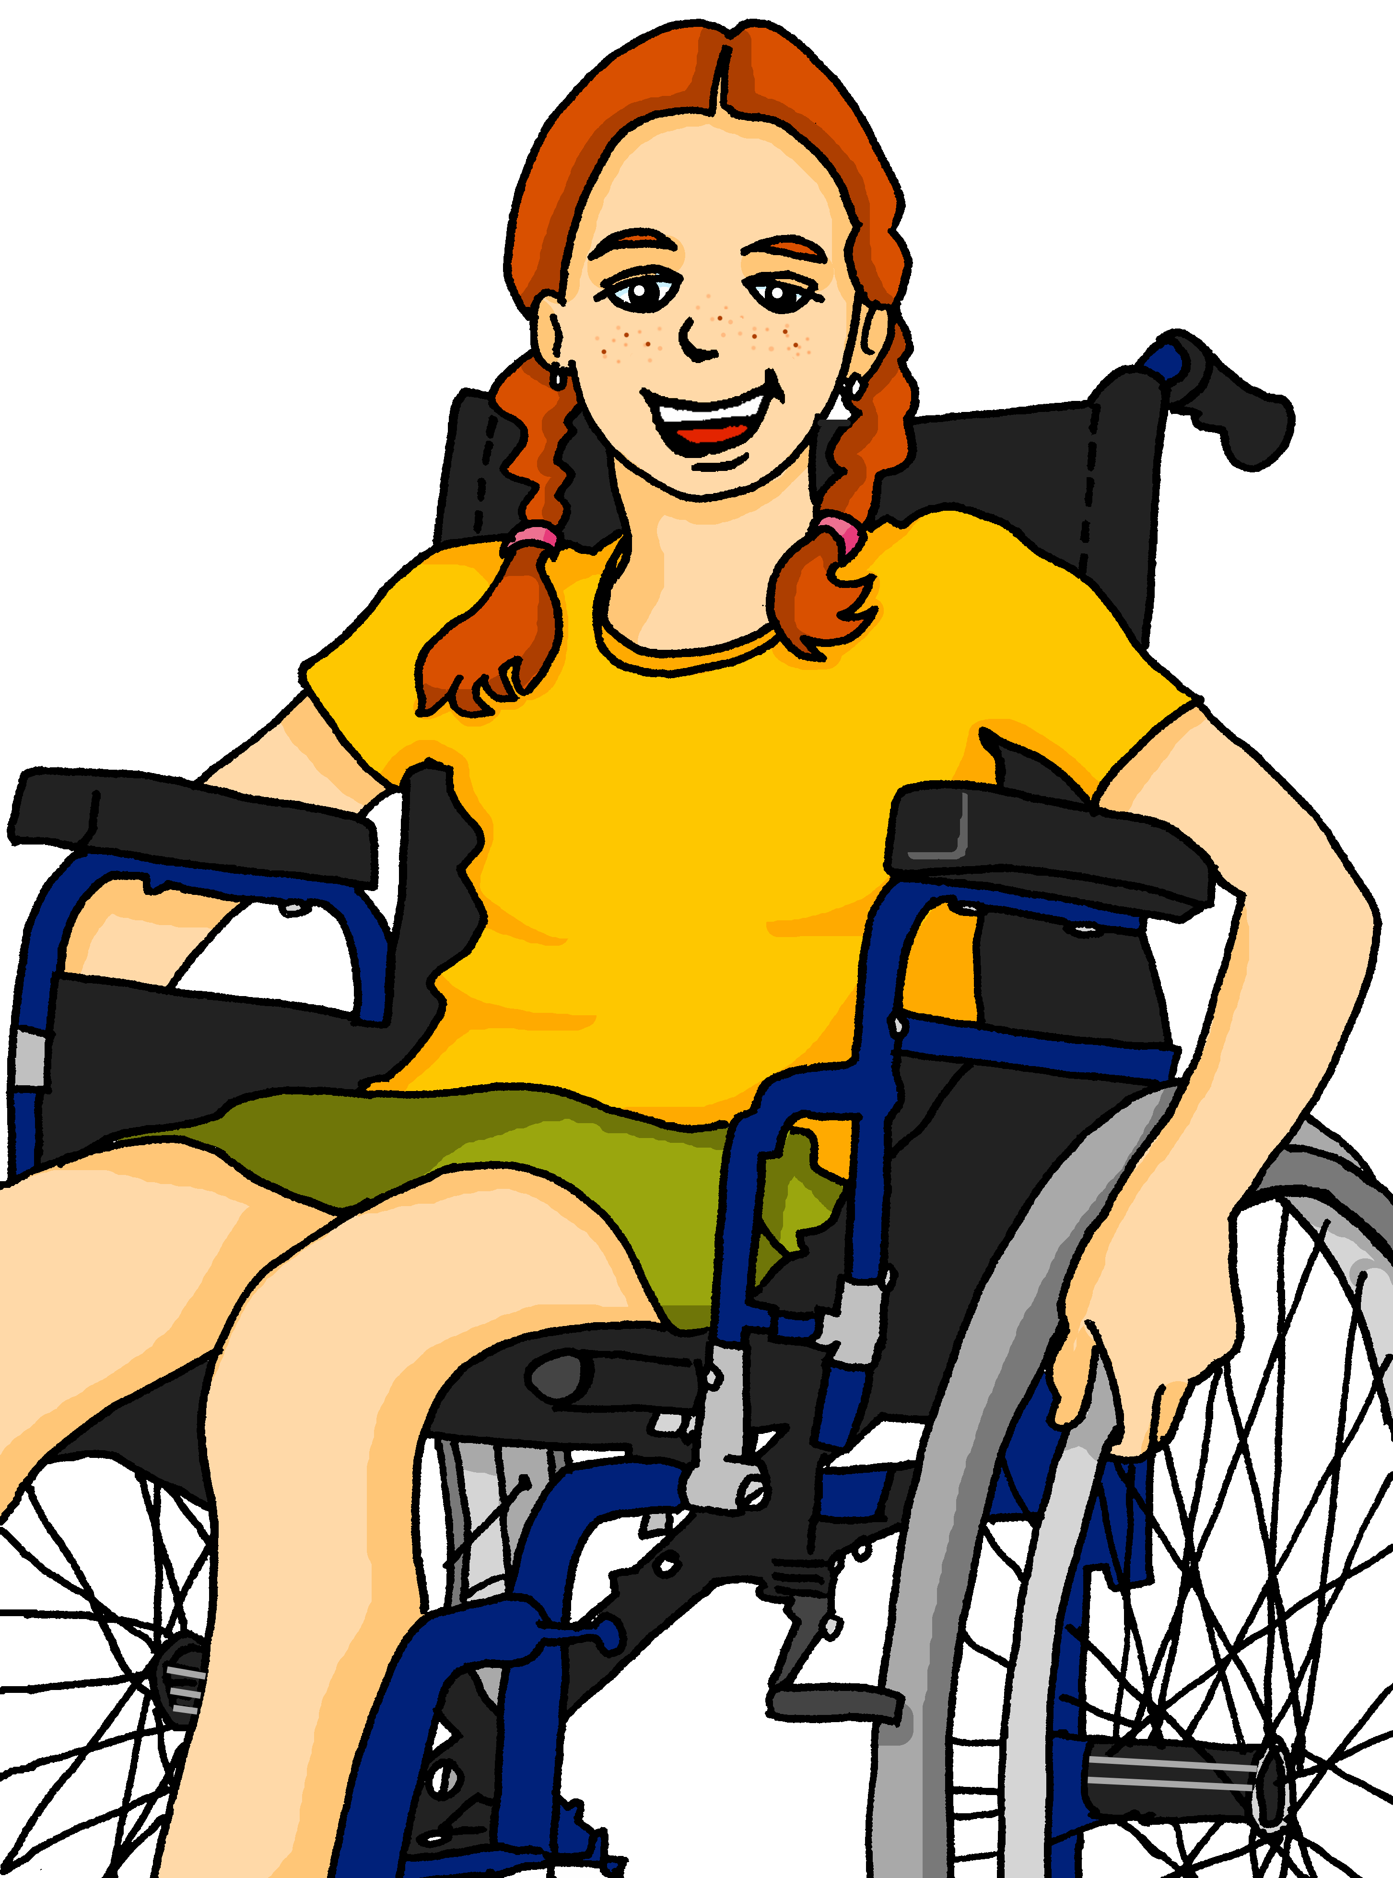
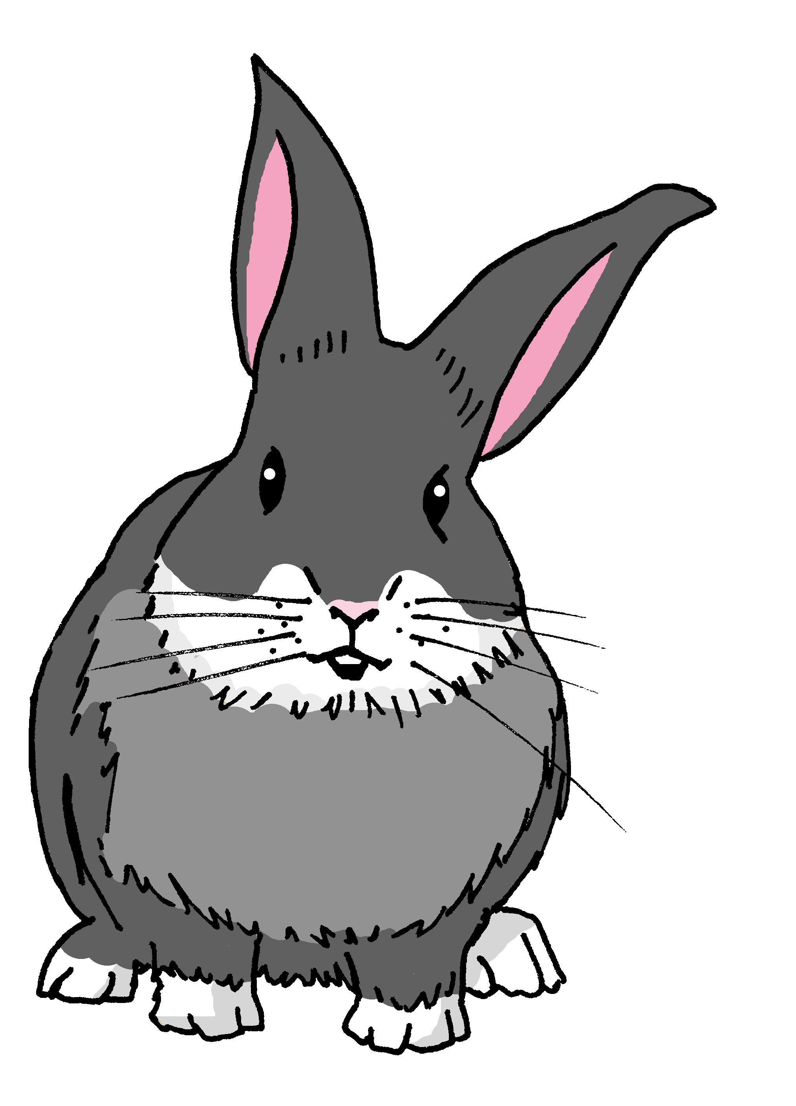
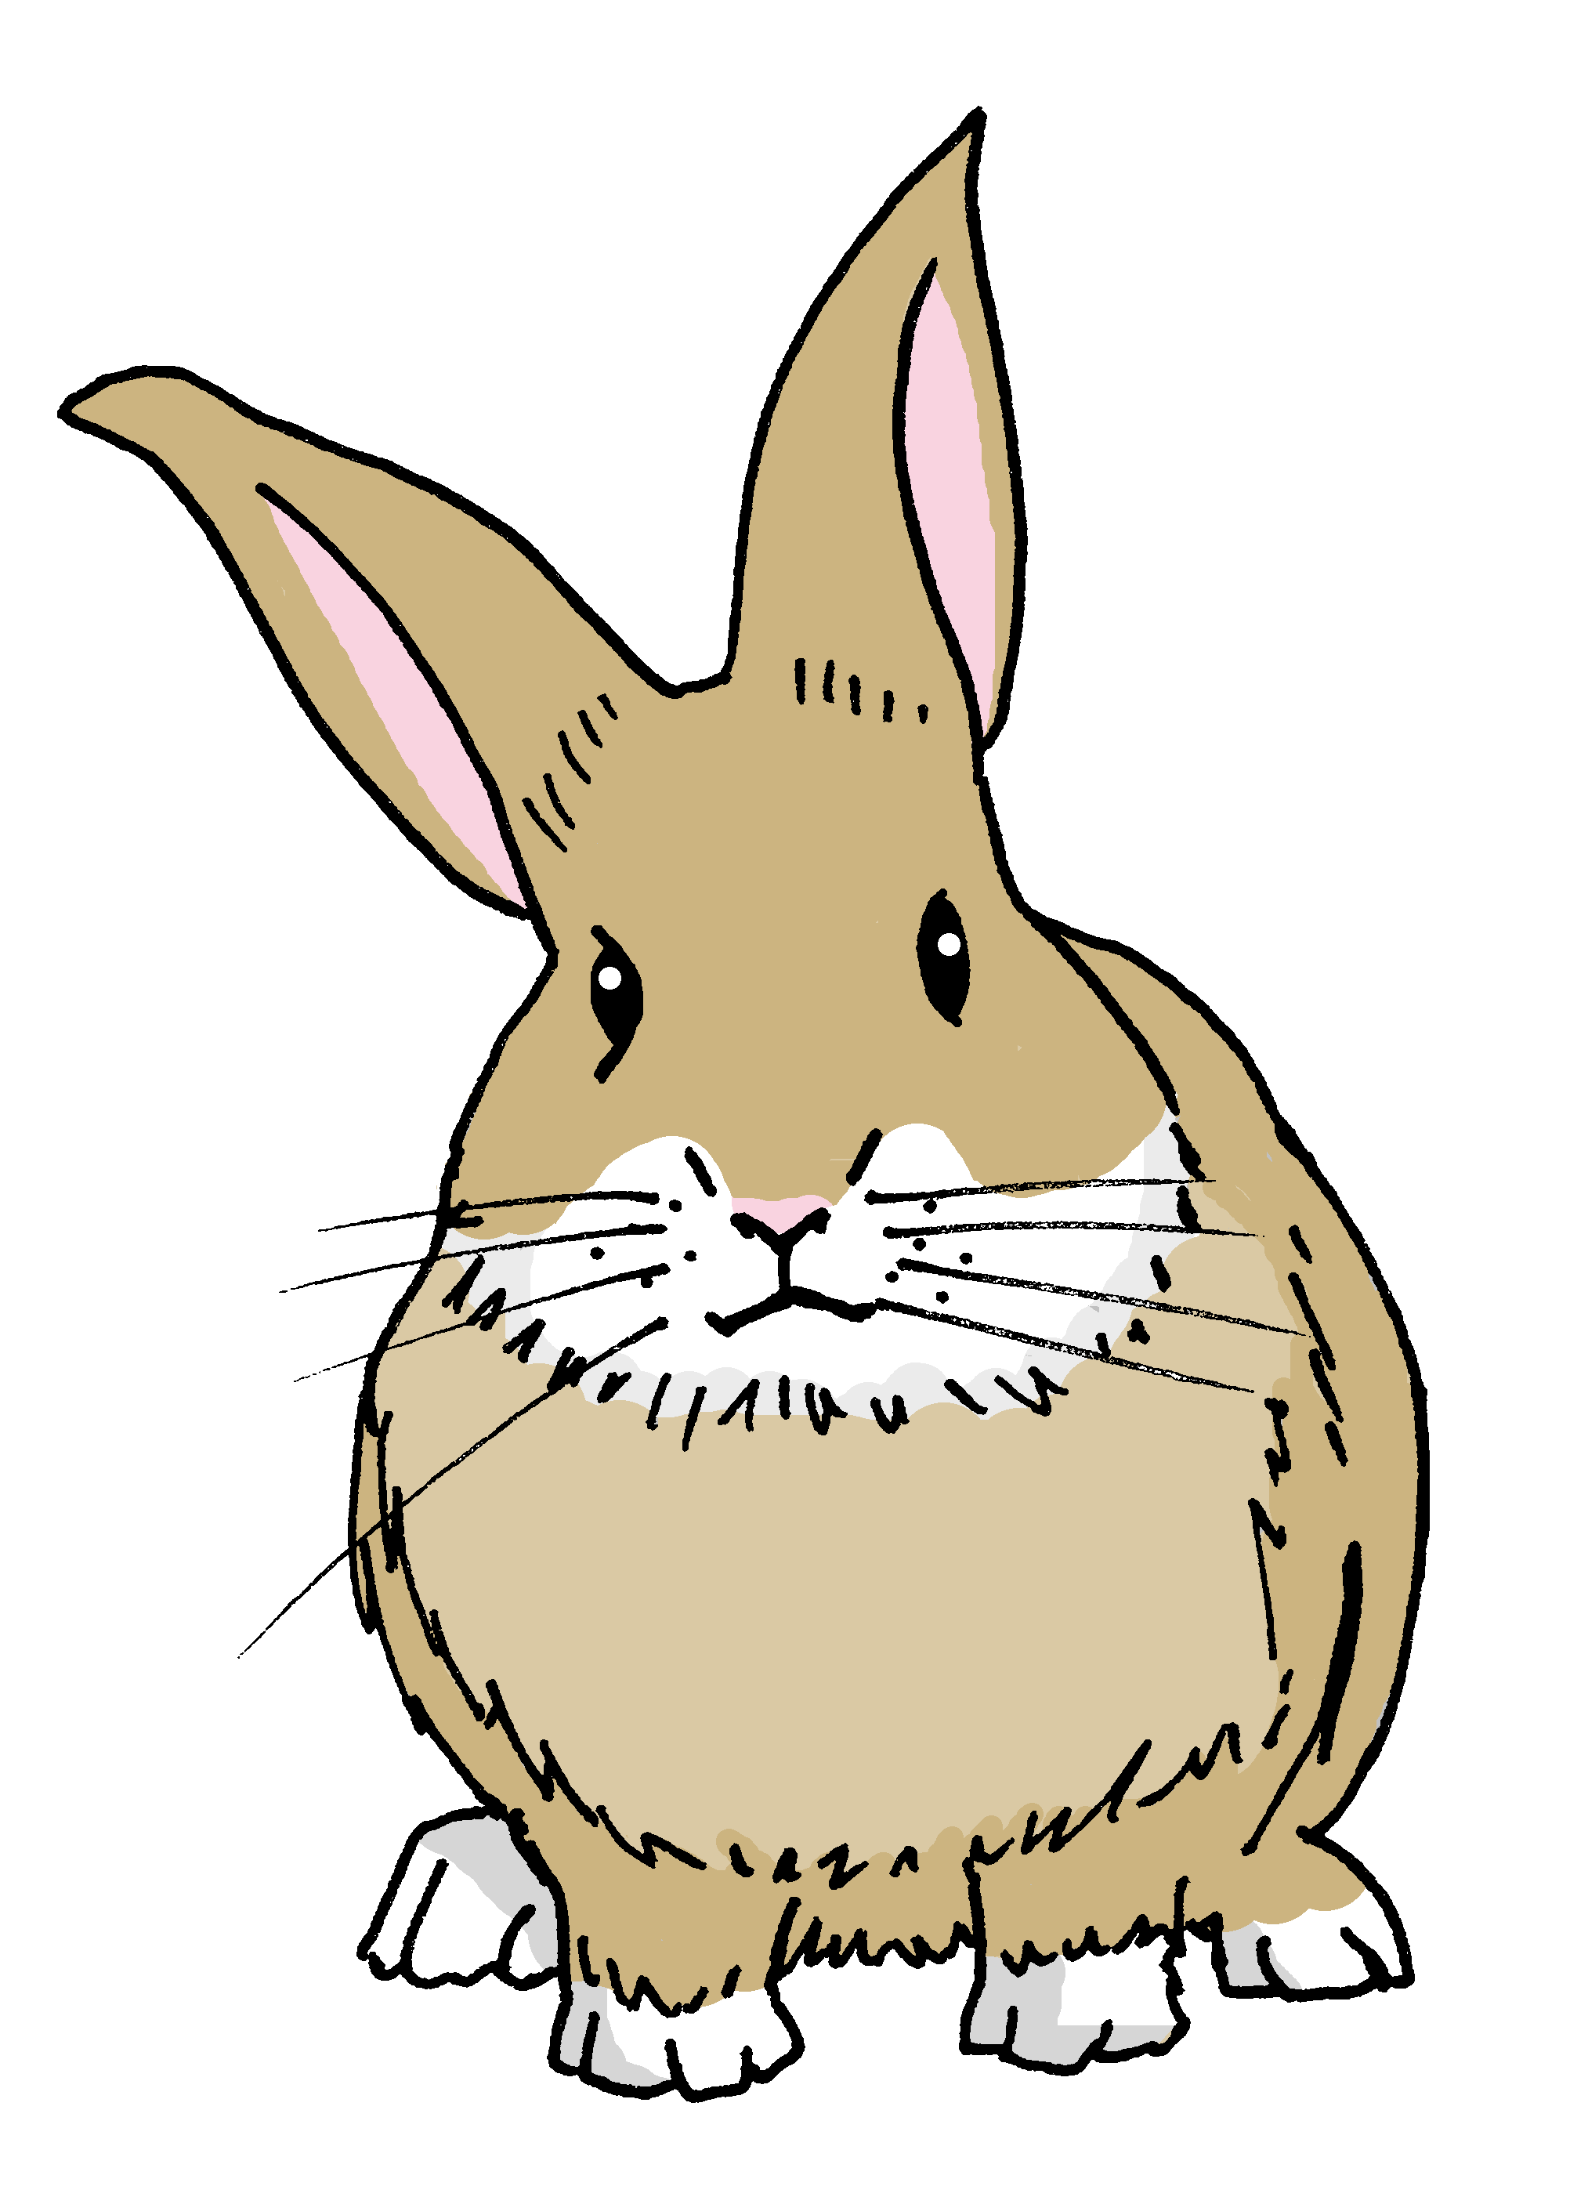
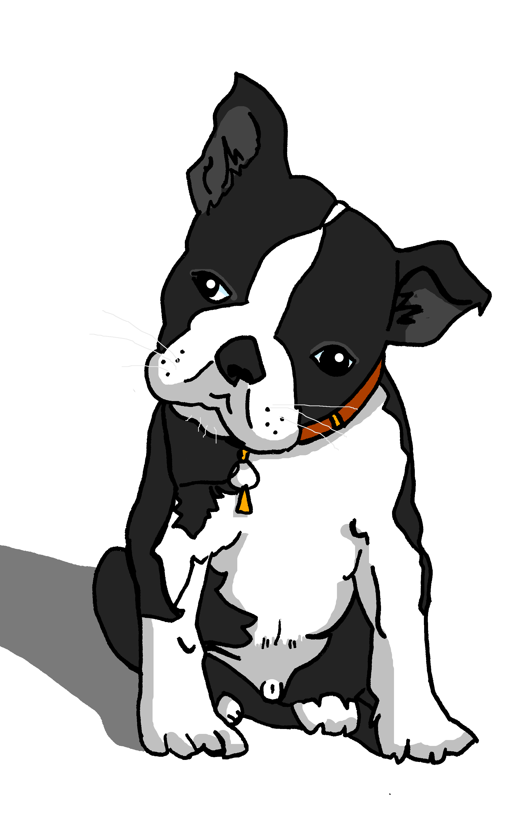
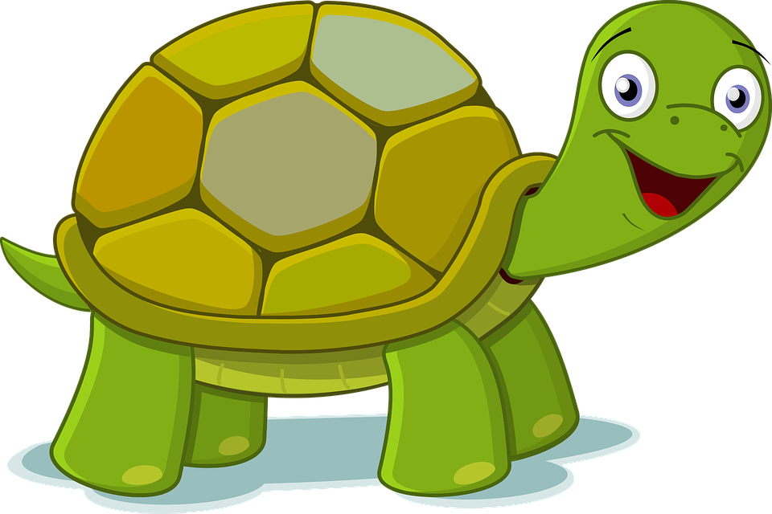




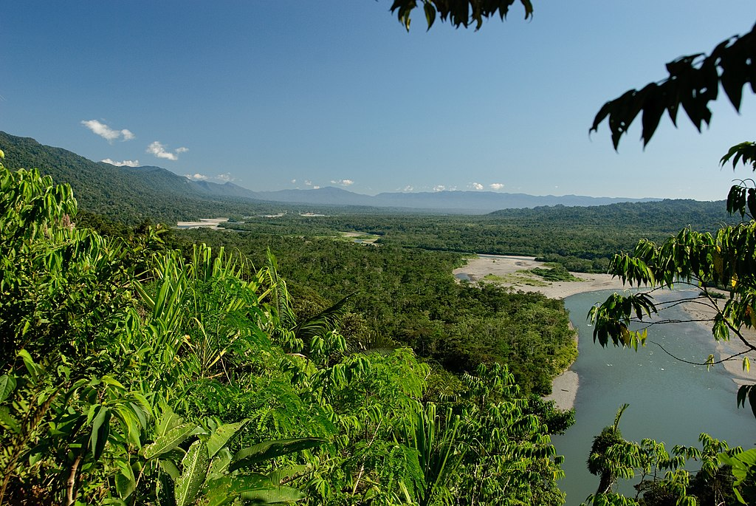
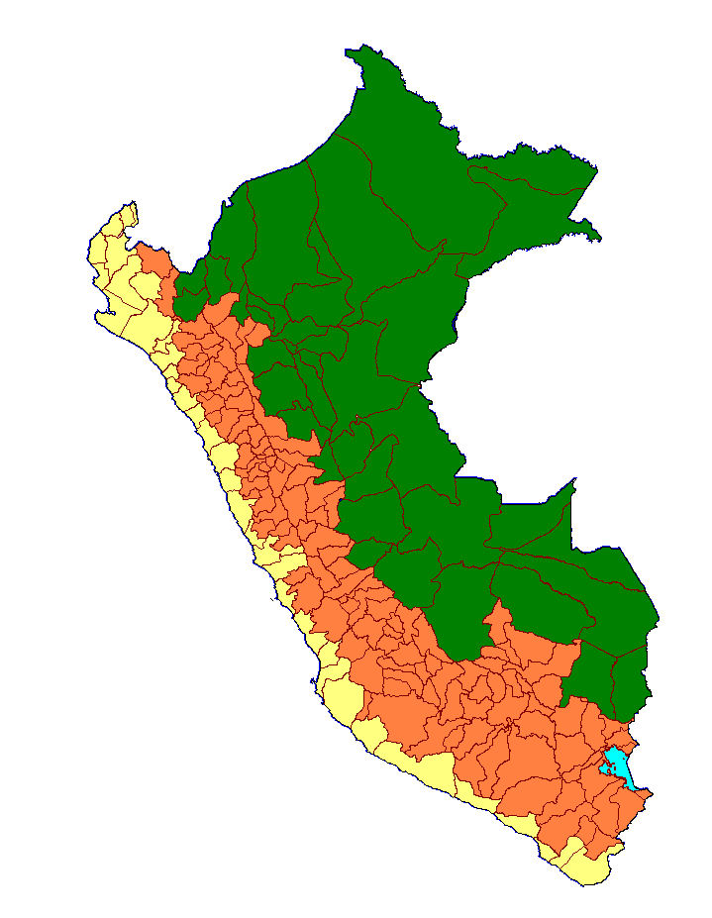
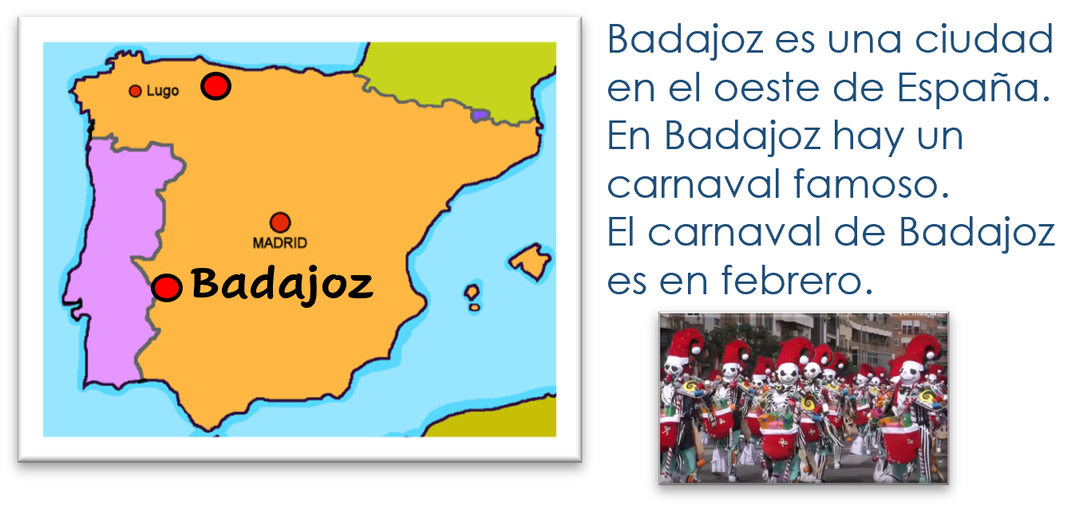
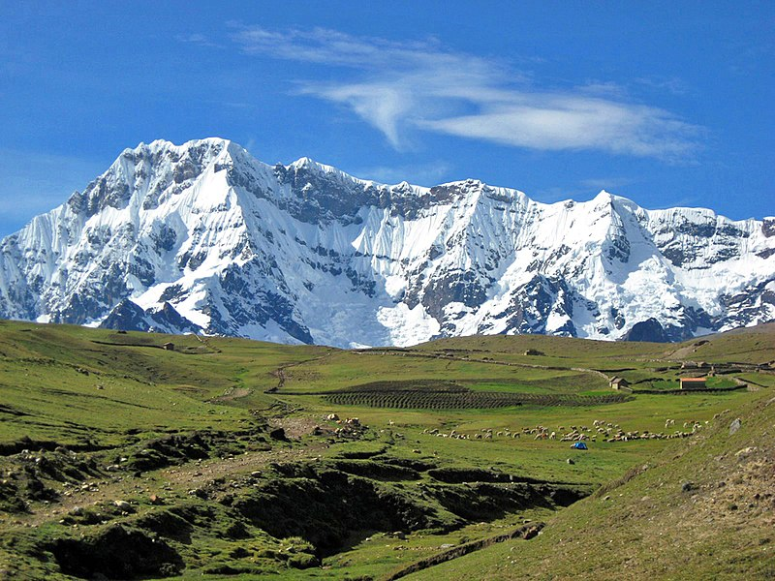
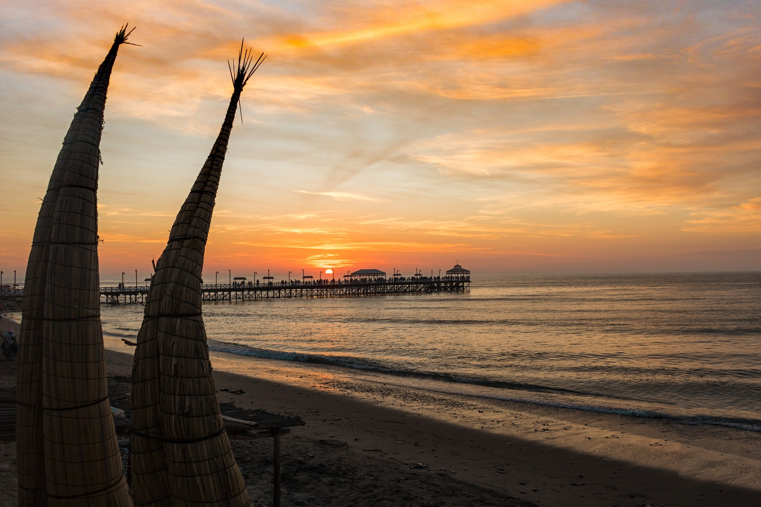

Characters
La familia Mamani Flores
Valeria
Miguel
Marisol
Elena
Pedro
Hugo
Jorge
Ceci
Quique
Sofía
Luis
amigos
Krina
mascotas
Rubén
Manchita
Pancho
Perú
Ángela
Max
Santi
Irene
➜
Perú tiene selva.
➜
➜
Perú tiene sierra.
➜
Perú tiene costa.
Spanish words can mean different things in different countries. In Peru and most of South America, carro means car. In Spain carro means cart or trolley.

Slide 4
Term overview
Term 2 learning
UNIT | Context CommunicationCulture | Key ideas (GRAMMAR) | PHONICS | VOCABULARY
Unit 1 (W1-6) | Saying what I and others do Traditions (Nochevieja) in school in language class at the weekend in free time in my suitcase | Talking about doing (we, they) regular AR verbs (plural) regular ER verbs (plural) yes/no questions negation (no) Plural possessive adjectives mis, tus | SSC [l] [ll] SSC [ga] [go] [gu] Stress pattern 1 Stress pattern 2 Stress pattern 3 SSC [que] [qui] | Range of –AR and –ER verbs Range of high-frequency nouns related to customs and traditions, free time and life at home and school Adverbs of frequency & location
Unit 2 (W7-9) | Saying where you’re going and what there is there Badajoz physical geography in Peru Córdoba | Talking about going Essential verb: to go, going – IR I go – voy you go – vas he goes – va she goes – va Preposition a (al, a la) | SSC [n] [ñ] SSC [v] [b] SSC [r] [rr] | Verb ir Numbers 1-31 (revisit) nouns for landscape features nouns for places in a city
Unit 3 (W11) | Revision / assessment Easter | Revisit key ideas | Revisit SSC | Revisit vocabulary

Slide 5




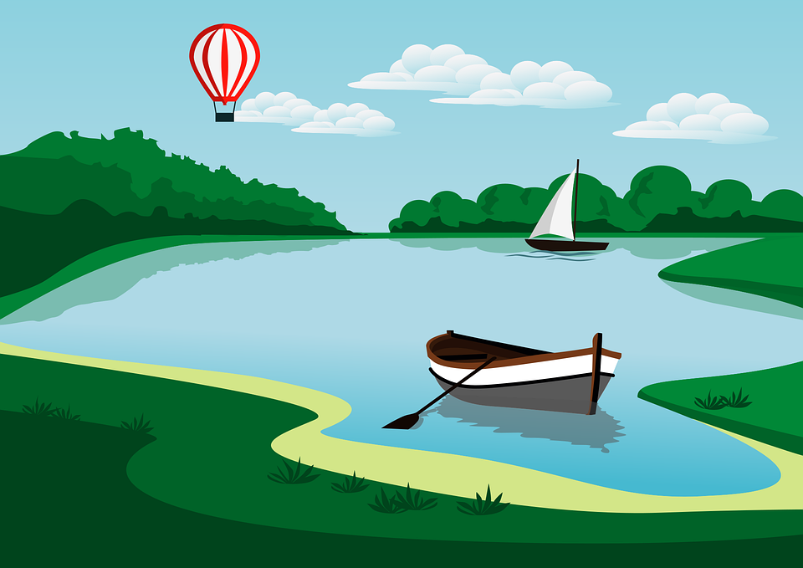









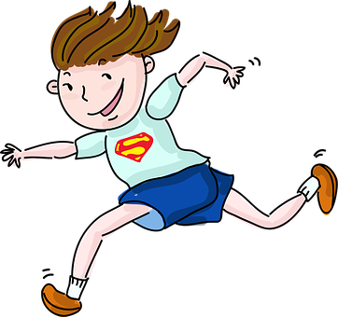
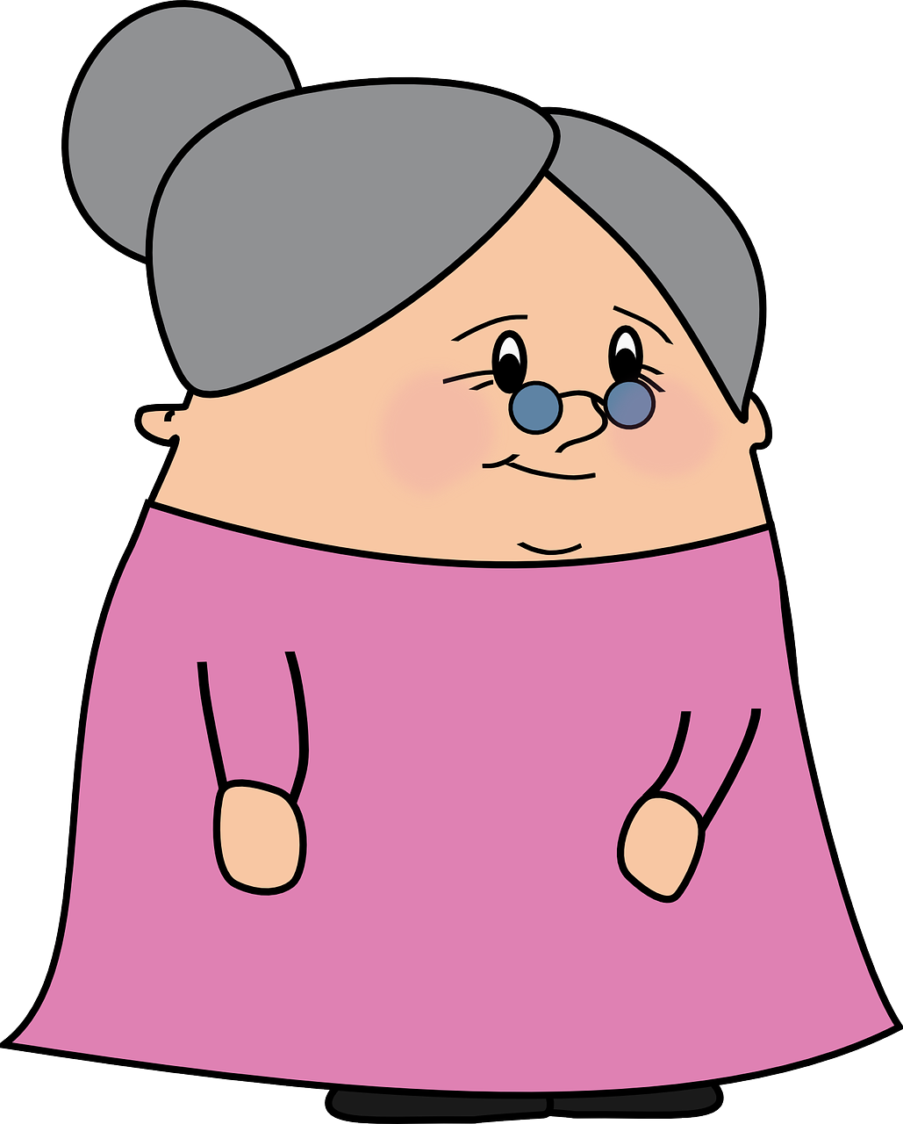


Phonics
Phonics
[l]
[ll]
[ga]
[go]
[gu]
libro
llamar
ganar
lago
gusano
Stress 1
Stress 2
In Spanish, we stress any vowel that has a written accent.
Where there is no written accent, stress the penultimate (second to last) syllable for any word ending in a vowel, ‘n’ or ‘s’.
árbol
corazón
último
nunca
orden
[last]
sabemos
[order]
[never]
[we know]
Stress 3
For all other words, stress the final syllable.
amor
profesional
verdad
[love]
[truth]
[que]
[qui]
[n]
[ñ]
paquete
quince
mano
español
[b]
[r]
[rr]
[v]
parar
correr
abuela
ver
[b] and
[v] sound the same in Spanish.

Slide 6



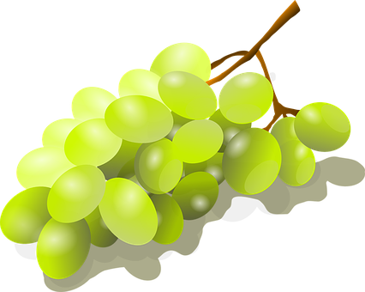




Verde term 1 week 1
Saying what I and others do
1
Verde term 2
pronunciar
AR verbs: we & they
Nochevieja
connecting sentences
[l]
[ll]
SSC: [l] [ll]
libro
llamar
Write down the key language for this week.
vocabulario
(la) carrera |  | (la) tarjeta |  | celebrar
mandar |  | común |  | especial
Knowing who does what
[–ar verbs: Singular forms vs. ‘we’]
gramática
In Spanish, the words for ‘I’ and ‘S/he, it’
(pronouns) are often unnecessary.
mando
mandas
manda
S/he, it sends
You send
I send
To mean ‘we’ with a verb, we remove –ar and add -amos.
Mandamos mensajes a la familia.
We don’t
We send messages to family.
need pronouns because the verb ending tells us who is doing the action.
Translate the examples.
Celebramos Navidad.
→ _______________________________.
Bailamos y cantamos.
→ _______________________________.
4

Slide 7



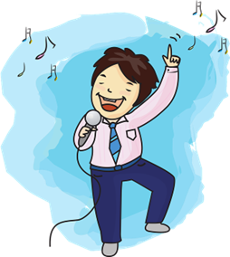
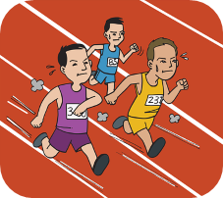



Verde term 1 week 1
Saying what I and others do
1
Verde term 2
leer
La Nochevieja en España
1
La Nochevieja es el día treinta y uno de diciembre.
Es un día especial porque celebramos el fin del año.
Es común comer doce uvas a medianoche.
2
3
to eat |  | porque |  | grapes
end |  | New Year’s Eve |  | year
midnight
escuchar
Sofíá habla de Navidad en casa y compara con Max.
Escucha y marca .
 | Sofíá y su familia | Krina
E
1
2
3
4
5
El verbo | Información extra en inglés
pre _ a _ _ _ _ _
Knowing who does what
gramática
[–ar verbs: ‘we’ vs. ‘they’]
To mean ‘we’ with a verb, we remove –ar and add -amos.
To mean ‘they’ with a verb, we remove –ar and add –an.
Ejemplo: celebrar
we
they
Celebramos con amigos.
Celebran con familiares.
We celebrate with friends.
They celebrate with relatives.
5
Notes:
gramática

Slide 8
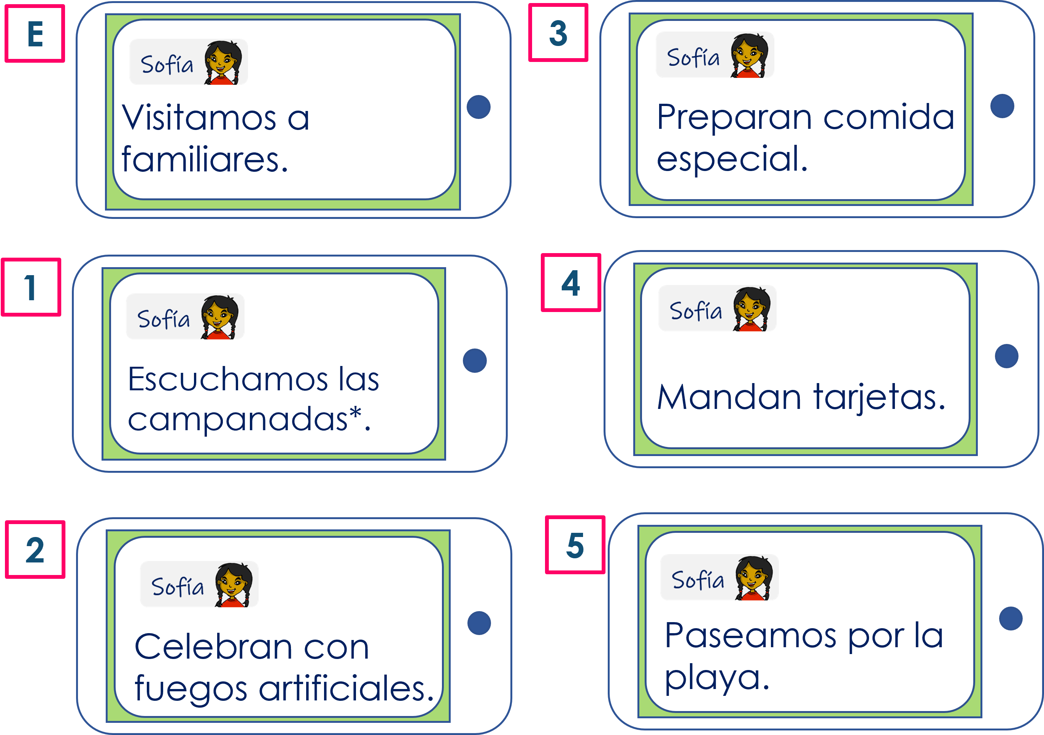
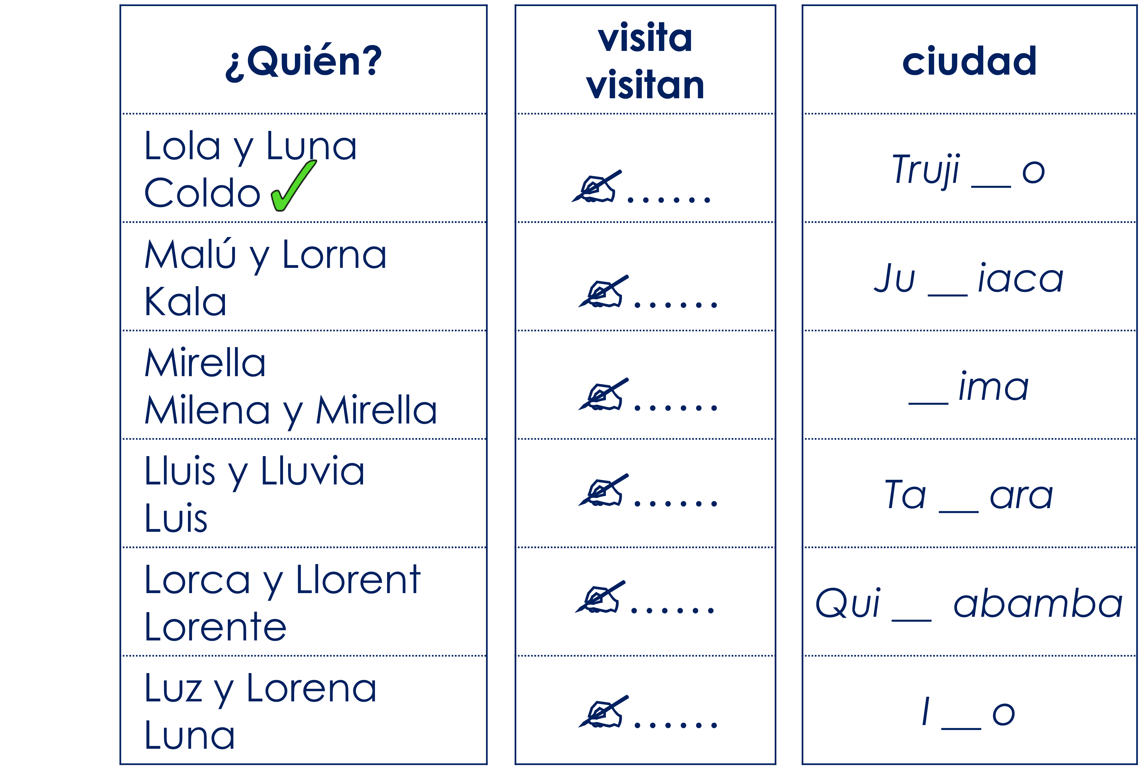
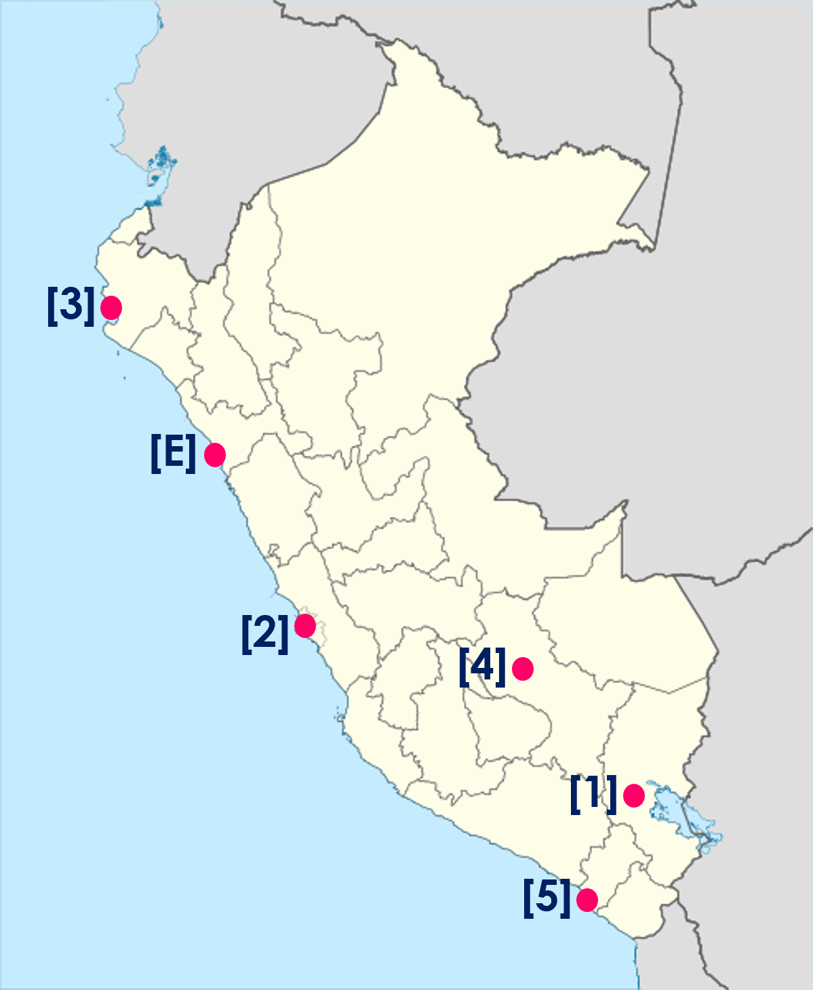
Verde term 1 week 1
Saying what I and others do
1
Verde term 2
leer
Sofía manda mensajes a Rubén. ¿Quién es?
Lee las frases y marca .
las campanadas = bell chimes
los fuegos artificiales = fireworks
 | Sofía y su familia (we) | Max y su familia (they)
E
1
2
3
4
5
pronunciar
Una visita por España. Escucha. ¿Quién es?
Marca y escribe el verbo. ¿Qué ciudad es?
Escribe [l] o [ll]
E
1
2
3
4
5
escuchar
Escucha y escribe en inglés.
Today is _________.
It’s my _________ Valeria’s _________.
Valeria ___________________.
___ _____ ________ ____ _____.
____ ______ ______ _______.
sobre = about
E
5
____ _____ ___ _____ ______.
In New Year’s Eve ____ _____ ________.
At home ____ _____ ________.
1
6
2
3
7
6
4
6

Slide 9


Verde term 1 week 1
Saying what I and others do
1
Verde term 2
Conjunctions
gramática
[Connecting sentences with ‘también’ and ‘pero’.]
‘también’ means also and too.
Ejemplo:
En Nochevieja preparamos comida especial y también celebramos con amigos.
En Nochevieja preparamos comida especial y celebramos con amigos también.
‘pero’ means but
‘También’
Ejemplo:
En España bailamos pero en Inglaterra escuchan música.
can follow y OR go to the end of the sentence.
escribir
Reescribe las frases.
1 | [we celebrate] Nochevieja [with] [family] [and] en Inglaterra [they cebrate] [with family] y amigos [too].
2 | En Nochevieja [we prepare] las doce uvas y [also] [we listen to] música.
3 | [They send] [cards] [but] [here] [we send] mensajes.
4 | [Here] [we participate] en [a race] [but] allí [they walk] por [the beach] o el campo.
6
7

Slide 10
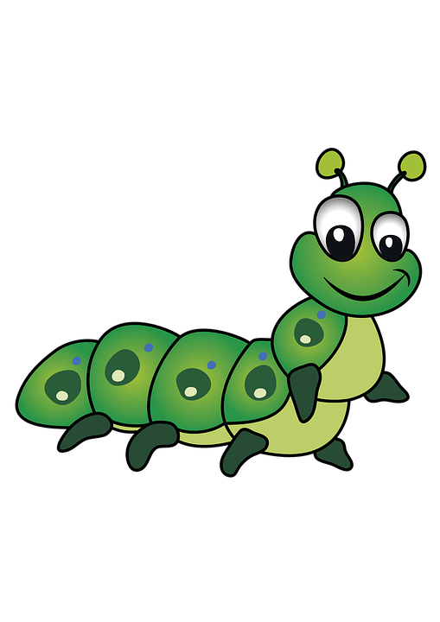




Verde term 1 week 2
Saying what I and others do
2
Verde term 2
pronunciar
Saying what we and others do in school – ER verbs: we & s/he, it
SSC [ga] [go] [gu]
[ga]
[go]
[gu]
ganar
lago
gusano
En el colegio
pronunciar
¡A practicar!
Escribe cinco palabras en secreto.
Tu compañero/a adivina*.
domingo
gusano
segundo
oruga
gorila
[to pay]
algo
gol
pagar
[something]
ganar
gusto
goma
juego
[taste]
Write down the key language for this week.
vocabulario
el aula |  | la tarea
el bocadillo |  | beber
el chocolate |  | comer
el patio |  | hacer
el salón |  | caliente
6
8

Slide 11

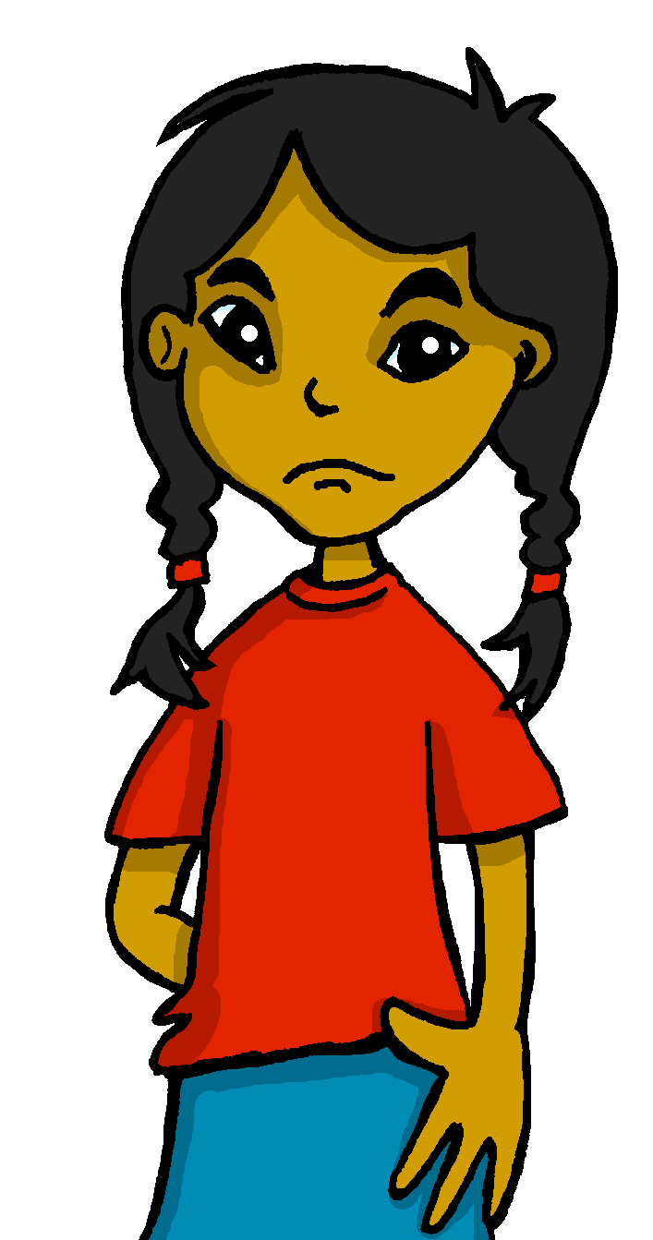


Verde term 1 week 2
Saying what I and others do
2
Verde term 2
Knowing who does what
gramática
[–er verbs: singular forms vs. ‘we’]
Remember that some Spanish infinitives ends in –er.
To mean ‘s/he, it’ with a verb, we remove –er and add –e.
To mean ‘we’ with a verb, we remove –er and add –emos.
Ejemplo
s/he
beber
we
Bebe un chocolate caliente.
Bebemos coca cola.
S/he drinks a hot chocolate.
We drink coca cola.
We don’t
need pronouns because the verb ending tells us who is doing the action.
leer
Agua 💧 en los deberes* de Sofía.
Pancho has spilled water all over Sofia’s English homework.
Lee las frases y marca.
¡Pancho!
¡Lo siento!
E
Aprendemos inglés.
We learn English.
1
Q & S (we) | Luis (he)
Hacemos la tarea juntos.
We do the task together.
2
Bebe un chocolate caliente.
He drinks a hot chocolate.
3
Aprende idiomas.
He learns languages.
4
Leemos en el aula.
We read in the classroom.
6
9

Slide 12



Verde term 1 week 3
Saying what I and others do
2
Verde term 2
escuchar
Escucha a Sofía. Marca la opción correcta y escribe el verbo.
Marca la opción correcta y escribe el verbo.
s/he ; we | verbo | completa la frase
s/he
we
s/he
we
s/he
we
s/he
we
s/he
we
s/he
we
E
1
2
3
4
5
escribir
Escribe en inglés. Can you get at least 15 points?
 | están | son | hoy
 | entre | siempre | también
 | el cine | el edificio | detrás (de)
 | tenemos | tienen | delante (de)
 | el aula | el patio | el salón
 | beber | caliente | la tarea
x3
x2
x1
6
10

Slide 13

Saying what I and others do
2
Verde term 2
escuchar
¿Qué palabra es?
1
2
3
4
5
6
7
playground | classroom | card
exercise | task | to wear
typical | common | special
we have | to have, having | they have
hot | comfortable | food
opposite | behind | in between
they are (state) | always | they are (trait)
leer
Escribe en inglés .
¡Llueve!
1 |  | 9
2 |  | 10
3 |  | 11
4 |  | 12
5 |  | 13
6 |  | 14
7 |  | 15
8 |  | 16
You can
challenge yourself by writing the word in Spanish, without looking at the board.
leer
Combina las palabras y escribe frases.
1 | Vemos | un chocolate | el patio.
2 | Comemos un | una película | en español.
3 | Bebe | unas | en el salón de actos.
4 | Aprende | bocadillo en el | caliente.
5 | Respondemos | a la profesora | palabras nuevas.
1 | ………………………………………………………………………………
2 | ………………………………………………………………………………
6
11

Slide 14
Saying what I and others do
2
Verde term 2
3 | ………………………………………………………………………………
4 | ………………………………………………………………………………
5 | ………………………………………………………………………………
escribir
Escribe frases en español.
 | drink(s) | a message | on the table
 | eats(s) | the teacher (f) | with the teacher
She | do(es), make(s) | a hot chocolate | in the playground
He | read(s) | a task | in English
We | learn(s) | the question | in the hall
 | understand(s) | an activity | on the computer
 | respond(s) (to) | the book | in Spanish
 | has, have | a game | with a partner
1
2
3
4
escribir
Escribe en español. Can you get at least 15 points?
 | they are [state] | they are [trait] | today
 | between | always | also, too
 | cinema | building | behind
 | we have | they have | opposite
 | classroom | playground | hall
 | to drink, drinking | hot | task
x3
x2
x1
6
12

Slide 15



Saying what I and others do
3
Verde term 2
pronunciar
En clase
Talking about what you and others do in class.
Stress 1
In Spanish, we stress any vowel that has a written accent.
Asking questions
árbol
fútbol
interés
[interest]
Write down the key language for this week.
vocabulario
aprender |  | beber |  | comer
correr |  | leer |  | a menudo
Knowing who does what
[–er verbs:’s/he, it’ vs. ‘you’]
gramática
To mean ‘s/he, it’ with a verb, we remove –er and add -e.
To mean ‘you’ with a verb, we remove –er and add -es.
S/he, it
you
Aprende sobre España.
Aprendes sobre Inglaterra.
She learns about Spain.
You learn about England.
¿Aprende sobre España?
¿Aprendes sobre Inglaterra?
Does she learn about Spain?
Do you learn about England?
To change
a statement into
a question, simply raise your voice at the end.
Translate the examples.
Aprende sobre Inglaterra, → _______________________________.
¿Aprendes sobre España? → _______________________________.
6
13

Slide 16

Saying what I and others do
3
Verde term 2
leer
Lee. ¿Cuál es el intruso? ¿Qué tiene en común?
1 | beber| comer| gafas
2 | cantante | especial | fácil
3 | a menudo* | correr | normalmente
4 | aula | patio | quince
5 | leer | aprender | chocolate
6 | tarea | inglés | español
7 | rubio | responder | comprender
escuchar
Una videollamada.
Max habla con Sofía sobre el colegio en Perú y en España.
Max habla. ¿Quién es? Marca .
Luis (he) | Sofía (you)
E
1
2
3
4
5
6
14

Slide 17
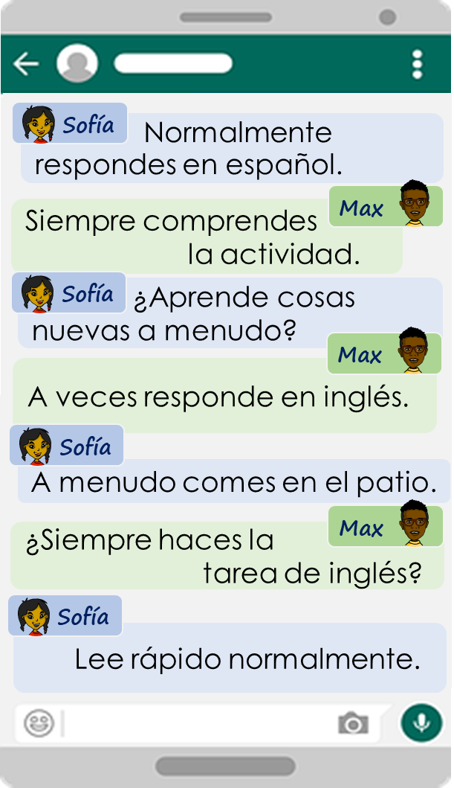
Saying what I and others do
3
Verde term 2
escuchar
Max habla. Escucha otra vez.
¿Es una pregunta o una frase?
Escribe el verbo.
verbo | ¿?
información extra
E
1
2
3
4
5
leer
Lee los mensajes de Sofía. Completa las frases en inglés.
E | _____ normally answer in _________.
1 | ____ always understand the __________.
2 | ____ ___ often learn _____ things?
3 | He _________ ______ in ___________.
4 | ____ ________ _______ in the playground.
5 | _____ ______ ________ do the English homework?
6 | ___ ____________ _______ quickly.
6
15

Slide 18








Saying what I and others do
3
Verde term 2
escuchar
Escucha. ¿Dónde está el estrés?
Escribe el acento.
 | ¿Quién?
 | Anton Gomez Padron
 | Monica Benitez Gonzalez
 | Alvaro Rodriguez Pendulo
 | Nicolas Lopez Fernandez
 | Ines Chavez Cordoba
In Spain and Latin
American countries, each person has two surnames. Traditionally, the first surname comes from the father, while the second surname the mother.
E
1
2
pronunciar
3
4
escuchar
[A] Escucha. ¿Qué palabra es?
blue | green | black
face | nose | hair
able | difficult | big
short | long | blond
the (pl. f) | the (pl. m) | how many? (f)
small | round | short
teacher (f) | there is/ are | s/he has
[B] Escucha y escribe la pregunta en inglés.
 | Does s/he …?
E
¿Hace ejercicio en el patio?
1
2
3
4
6
16

Slide 19



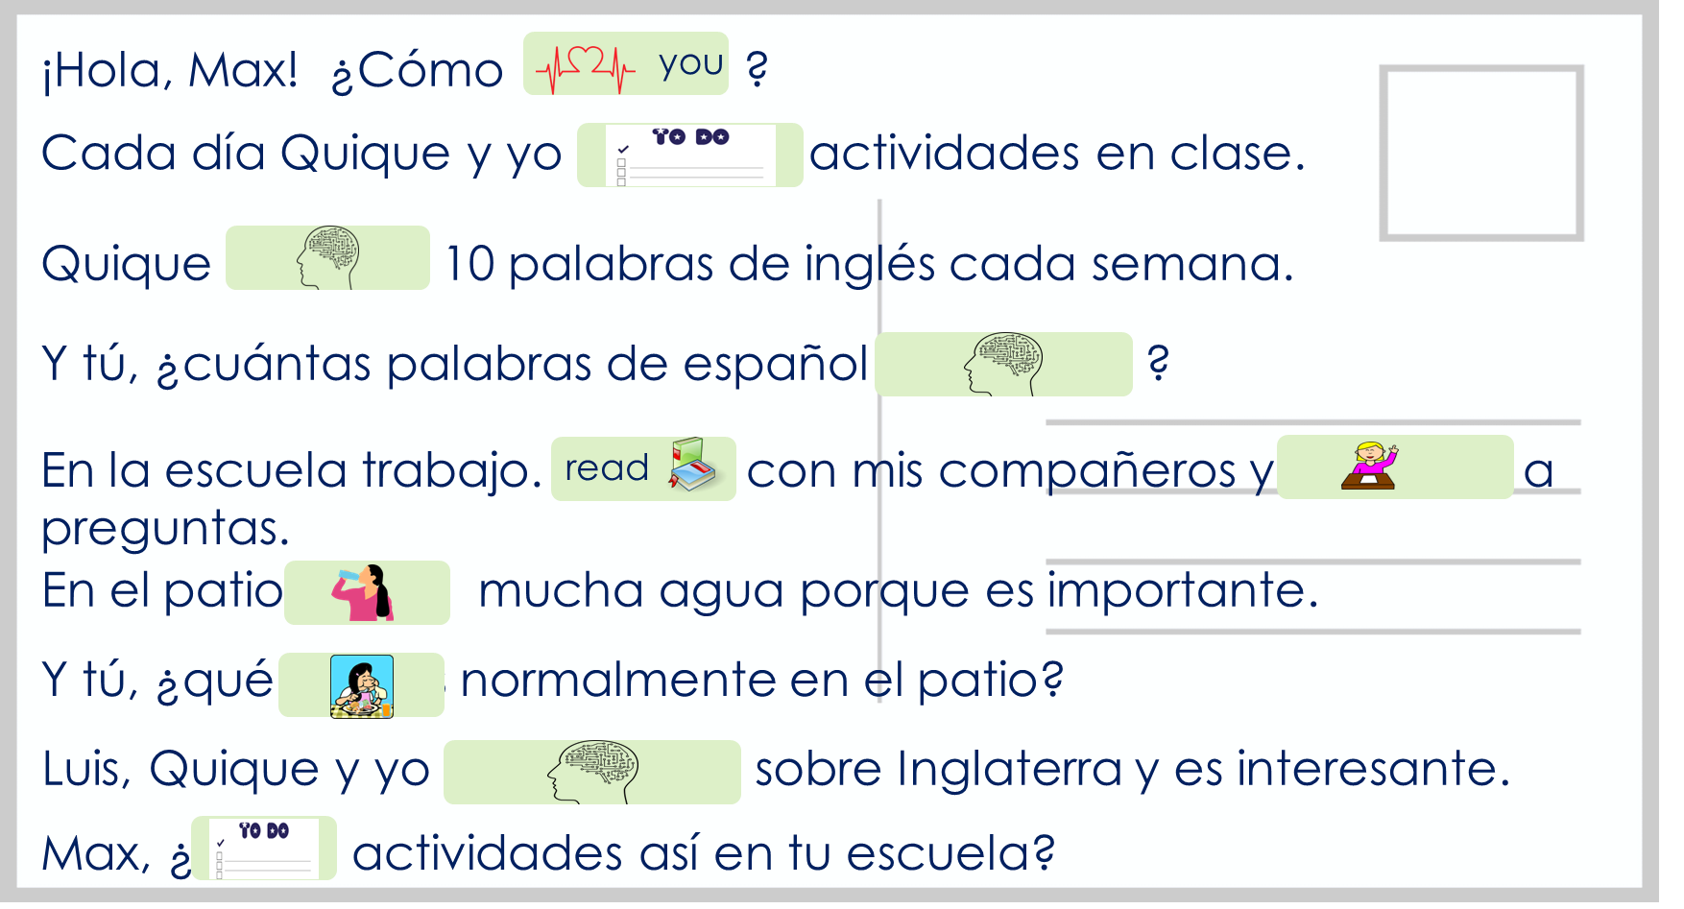
Saying what I and others do
3
Verde term 2
Knowing who does what
gramática
[-er verbs: ‘I’, ‘you’, s/he, it’]
Irregular verbs
Aprendo - ___ learn
Pongo - I put
Aprendes - ___ learn
Pones - ___ put
Aprende - ___ learns
Pones - ___ puts
leer
Sofía escribe a Krina.
She draws pictures
for some of the words for Krina to practise her Spanish.
1. | 7.
2. | 8.
3. | 9.
4. | 10.
5.
6.
6
17

Slide 20







Saying what I and others do
3
Verde term 2
hablar
Persona A: (Person B – turn to the next page.)
Round 2
Round 1
Your turn to ask!
Use your prompt card to ask questions.
Now listen to your partner and respond. Use your card to answer ‘yes’ or ‘no.
1) Pregunta y marca .
2) Escucha y responde.
leer
Escribe en inglés. Can you get at least 15 points?
 | redonda | Hay | ¿Cuántas?
 | rubio | oscura | difícil
 | las gafas | el ojo | tiene
 | el pelo | grande | la cara
 | a menudo | a veces | responder
 | aprender | comer | beber
x3
x2
x1
6
18

Slide 21
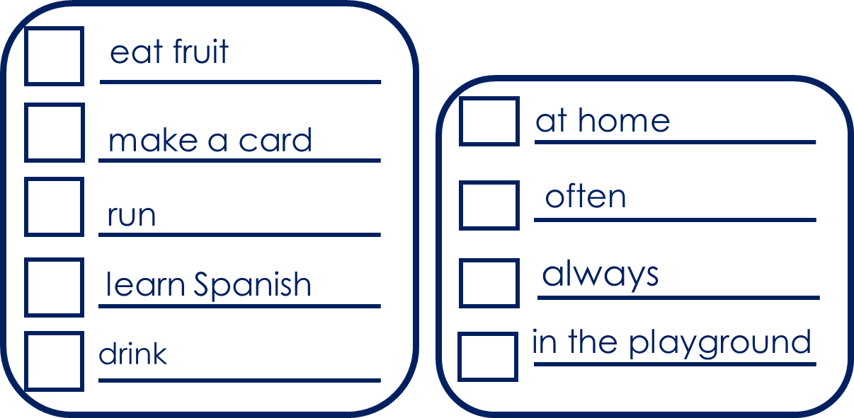

Saying what I and others do
3
Verde term 2
hablar
Persona B. (Person A – see previous page.)
Round 2
Your turn to ask!
Round 1
Your turn to respond!
Listen to your partner and respond. Use your card to answer ‘yes’ or ‘no’.
Now use your prompt card to ask questions.
1) Escucha y responde.
2) Pregunta y marca .
escribir
Escribe en español. Can you get at least 15 points?
 | round (f) | There is / are | How many? (f)
 | blonde (m) | dark (f) | difficult
 | glasses | eye | s/he has
 | hair | big | face
 | often | sometimes | to reply, replying
 | to learn, learning | to eat, eating | to drink, drinking
x3
x2
x1
6
199

Slide 22
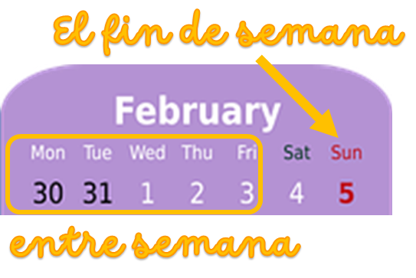
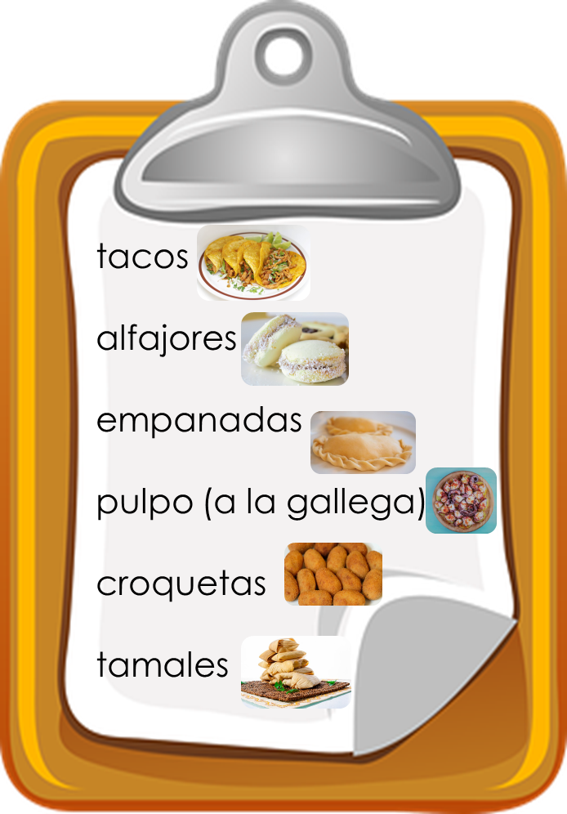
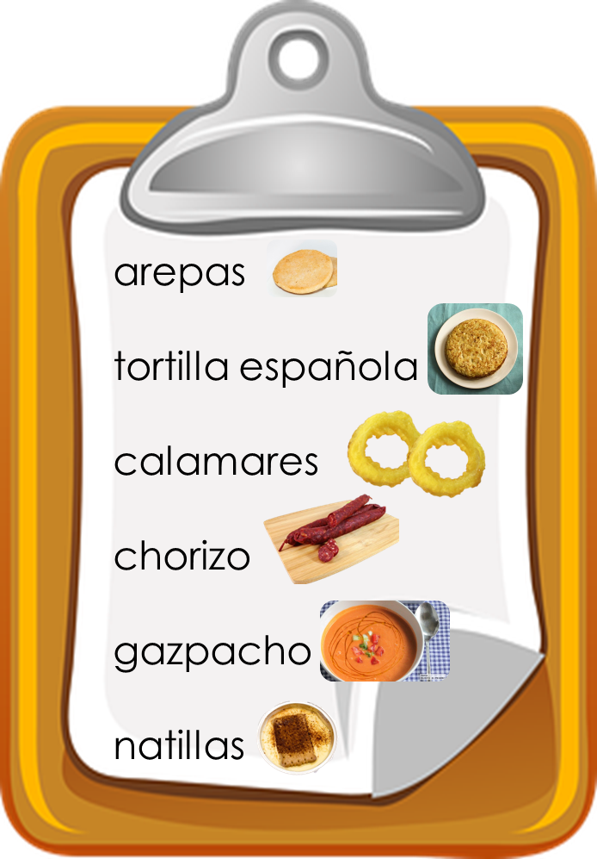
Saying what I and others do
4
Verde term 2
Stress 2
pronunciar
Talking about what I and others do at the weekend
Where there is no written accent, stress the penultimate
(second to last) syllable for any word ending in a vowel, ‘n’ or ‘s’.
Using negative sentences
nunca
sabemos
orden
[order]
[we know]
[never]
Write down the key language for this week.
vocabulario
(el) fin |  | (el) restaurante
(el) ruido |  | nunca
comer |  | ver
Knowing who does what
[–er verbs: ’s/he, it’ vs. ‘we’]
gramática
To mean ‘s/he, it’ with a verb, we remove –er and add -e.
To mean ‘we’ with a verb, we remove –er and add –emos.
S/he, it
you
Come en casa.
Comemos en un restaurante.
She eats at home.
We eat at a restaurant.
Translate the examples.
Comemos en casa. → _______________________________.
Come en un restaurante. → _______________________________.
pronunciar
Practica en parejas .
6
20

Slide 23

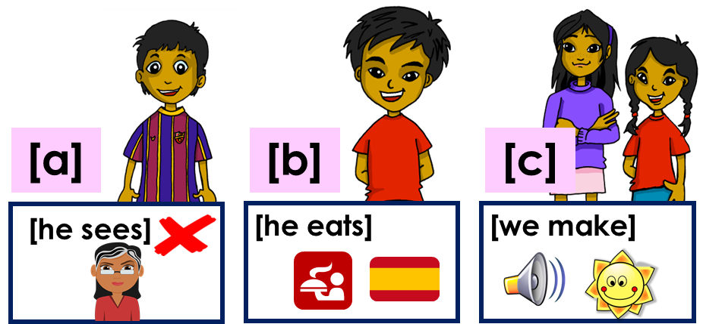
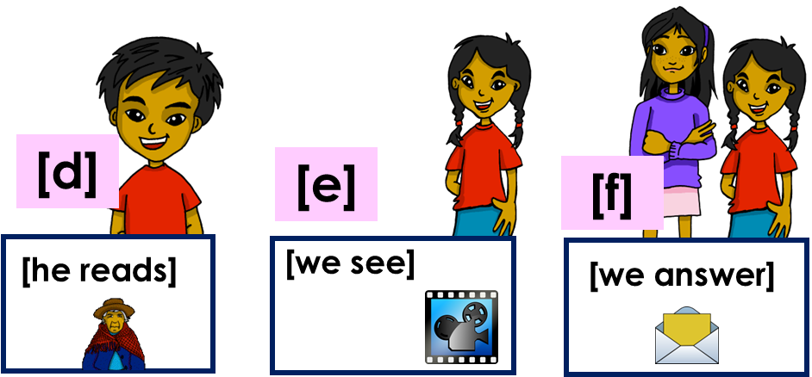
Saying what I and others do
4
Verde term 2
leer
Is Sofía talking about what she does with Ángela or what someone else does?
E. Siempre lee con la abuela.
Sofía y Ángela (we) | Someone else (s/he, it)
1. Nunca ve a su profesora.
2. Respondemos a mensajes.
3. Vemos una película en el cine..
E
4. Come en un restaurante español.
1
5. Hacemos ruido por la mañana.
2
(la) pizarra = board
3
4
[B] Lee otra vez*. ¿Qué imagen es? [a-f].
otra vez = again
Using the negative ‘no’
[no]
gramática
In Spanish, to say what you or others don’t do, put ‘no’ before the verb. This makes a negative.
No lee las noticias en el teléfono.
She doesn’t read the news on the phone.
No leemos las noticias en el ordenador.
We doen’t read the news on the computer.
This works for any
verb and any person (e.g., ‘I’, ‘you’, ‘s/he’, ‘we’.
6
21

Slide 24
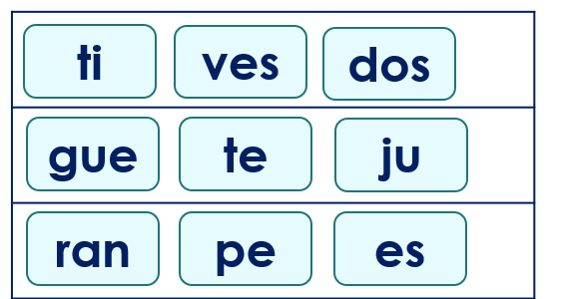
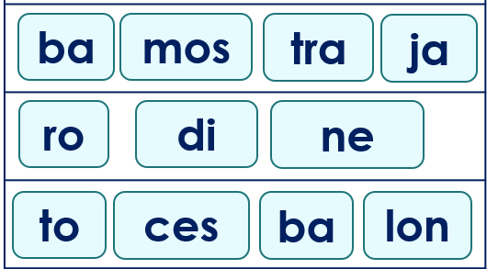
Saying what I and others do
4
Verde term 2
escuchar
¿La frase es positiva o negativa?
Marca .
Esucha otra vez. ¿Quién es? Escribe el verbo.
positiva | negativa
verbo | s/he | we
información extra
E
1
2
3
4
5
pronunciar
Escucha y ordena las sílabas.
¿Dónde está el estrés? Colorea la sílaba en rojo.
E
3
1
4
2
5
leer
Escribe en inglés. Can you get at least 15 points?
 | el puente | bastante | la piscina
 | la escuela | la compañera | el compañero
 | la carrera | especial | la tarjeta
 | común | mandar | celebrar
 | comer | comprender | hacer
 | nunca | aprender | a veces
 | el fin | el restaurante | el ruido
x3
x2
x1
6
22

Slide 25

Saying what I and others do
4
Verde term 2
ella = she, her
su = his/her
leer
Sofía habla sobre ella*, Max y Krina.
Escucha y completa el texto.
El fin de semana [1] __________ muchas cosas. Por ejemplo, [2] __________ chocolate caliente por la mañana porque es un día especial y a veces
[3] __________ en un restaurante. También [4] ______ ejercicio en el parque.
[5] _______ un amigo de Inglaterra. Su* nombre es Max. Entre semana [6] _______ muchas actividades y su amiga Krina [7] ________ deporte. A menudo [8] ________ un lilbro por la tarde también.
Lee otra vez. ¿Quién es? Escribe S [I], S&Q [we], K [she] o M [he].
Who…
does lots of things at the weekend?
does lots of things in class?
reads books about English history and culture?
learns lots of vocabulary in class?
has a friend from England?
eats (a piece of fruit) at break time?
eats a huge sandwich at break time?
drinks water at break time?
escribir
Escribe en español. Can you get at least 15 points?
 | (the) partner (m) | (the) swimming pool | (the) partner (f)
 | (the) bridge | (the) school | quite
 | to celebrate | (the) race | to send, sending
 | special | (the) card | common
 | to understand | to eat, eating | sometimes
 | never | to learn, learning | to do, make
 | end | restaurant | noise
x3
x2
x1
6
23

Slide 26






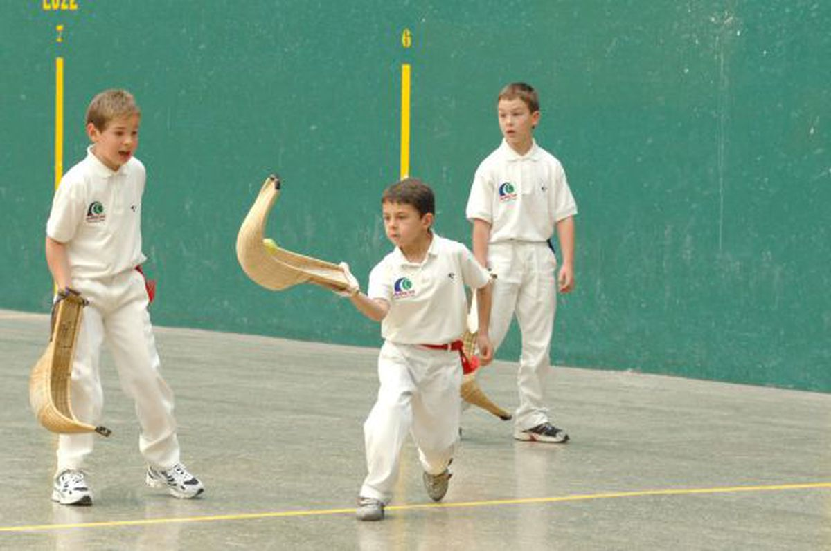
Saying what I and others do
5
Verde term 2
Stress 2
pronunciar
Describing what I and others do in free time
Where there is no written accent, stress the penultimate (second to last) syllable for any word ending in a vowel, ‘n’ or ‘s’.
Using –ar verbs: I, s/he, they
nunca
pasado
orden
casas
[order]
[past]
[never]
[houses]
El tiempo libre
Stress 3
For all other words, stress the final syllable.
feroz
calor
profesional
verdad
[heat]
[ferocious]
[truth]
Write down the key language for this week.
vocabulario
(la) cuerda |  | (el) escondite
(el) fútbol |  | (la) línea
(el) tenis |  | jugar
leer
Lee el texto y busca el vocabulario.
rackets
s/he loves
popular
a paddle
________
________
________
________
Sofía es muy activa* y ama el deporte. En clase aprende sobre deportes típicos en España, por ejemplo, la pelota vasca en el País Vasco. Necesitas una pelota pequeña y una paleta, la mano o raquetas diferentes. Es muy popular en México también.
s/he learns
too
hand
for example
________
________
________
________
6
24

Slide 27
Saying what I and others do
5
Verde term 2
Using ‘al’ & ‘a la’
[to the]
gramática
The verb ‘jugar’ is always followed by the preposition ‘a’ (‘to’).
Juego a la pelota.
Juego a las cards.
I play ball.
I play cards.
‘Juego a las cartas’ literally translates as ‘I play to the cards’.
When the noun is singular and masculine, a + el → al.
Juego al escondite.
I play hide and seek.
Translate the examples.
Juego a la cuerda. → _______________________________.
Juego al tenis. → _______________________________.
leer
Lee las frases. ¿Qué palabra es?
E | Juego ______ fútbol.
1 | Juego ______ cuerda.
2 | Juego ______ escondite.
3 | Juego ______ pelota.
4 | Juego ______ tenis.
a la | a las | al
a la | a las | al
a la | al | a los
a la | al | a la
al |a las | a la
Knowing who does what
[–ar verbs: ’s/he, it’ vs. ‘they’]
gramática
To mean ‘s/he, it’ with a verb, we remove –ar and add -a.
To mean ‘they’ with a verb, we remove –ar and add –an.
Notice!
‘jug’ →‘juega’.
S/he, it
they
Juega en el parque.
Juegan en el patio.
They play in the playground.
S/he plays in the park.
6
25

Slide 28


Saying what I and others do
5
Verde term 2
escuchar
Escucha. ¿Es Quique (he) o Ángela y Rubén (they)?
Marca .
Esucha otra vez. Escribe la información en inglés.
Quique (he) | A & R (they)
información extra
E
1
2
3
4
5
pronunciar
Pronuncia los equipos. ¿Dónde está el estrés?
escribir
Escribe en inglés. Can you get at least 15 points?
 | tienes | la iglesia | allí
 | hacer | unos | bonita
 | la mentira | el bocadillo | la verdad
 | el aula | el salón | caliente
 | beber | la tarea | la compañera
 | la cuerda | el escondite | pelota
 | el fútbol | el tenis | jugar
x3
x2
x1
6
26

Slide 29
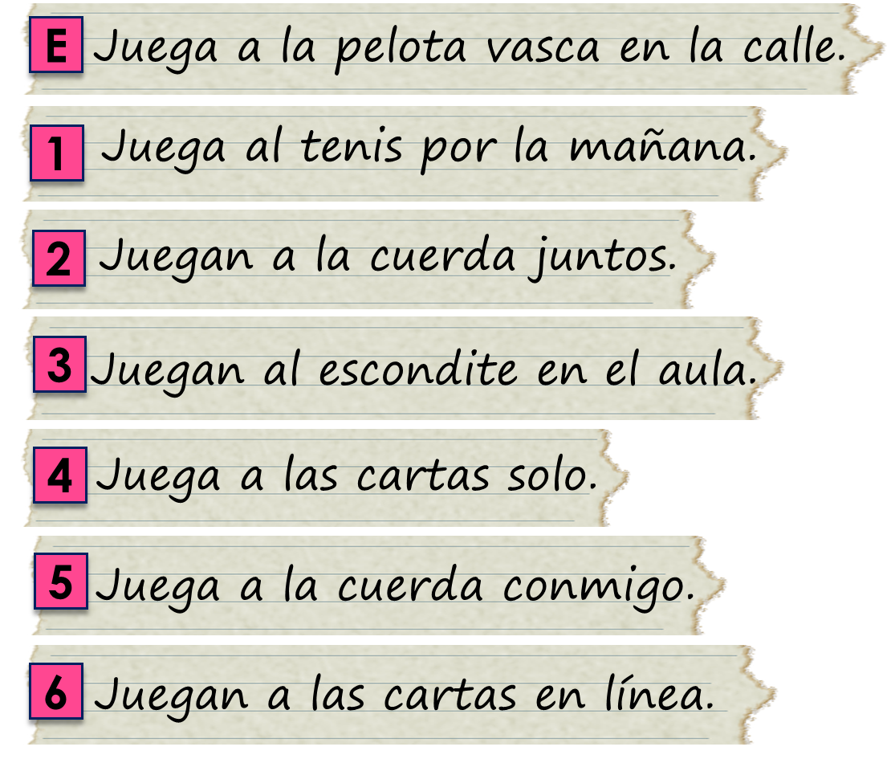

Saying what I and others do
5
Verde term 2
Using the verb ‘jugar’
[–ar verbs: ‘I’, ’s/he, it’ and ‘they’]
gramática
Some verbs do not follow the general rules.
The verb jugar is an example of this.
‘jug-’ changes to ‘jueg-’
I
S/he, it
they
Juego al fútbol.
Juega en el parque.
Juegan en el patio.
I play football.
S/he plays in the park.
They play in the playground.
leer
Lee:¿Es Quique, Max & Krina o los tres?
Completa el diagrama en español.
Quique
‘He’
los tres
Max + Krina
‘they’
‘He + they’
leer
Lee las frases otra vez y responde en inglés.
[A] Where does Quique play pelota vasca?
[B] How do Max and Krina play cards?
[C] How does Quique play cards?
[D] Where do Max and Krina play hide and seek?
[E] When does Quique play tennis?
[F] With whom does Quique play skipping?
[G] With whom do Max and Krina play skipping?
6
27

Slide 30
Saying what I and others do
5
Verde term 2
hablar
escribir
Trabajamos en grupos de 3. When it’s your turn to write a sentence, write it below.
1 | Quique plays football with (female) friends. ________________________________________________________________
2 | She plays cards in the room. ________________________________________________________________
3 | I play tennis with my brother. ________________________________________________________________
4 | They play skipping in the square. ________________________________________________________________
5 | I play football alone. ________________________________________________________________
6 | Rubén and Ángela play hide and seek in the park. ________________________________________________________________
escribir
Escribe en español. Can you get at least 15 points?
 | pretty (f) | church | there
 | school | square | some (f)
 | here | big | s/he has
 | to learn, learning | to read, reading | task
 | food | teacher (f) | partner (m)
 | to play, playing | ball | rope
 | tennis | football | hide and seek
x3
x2
x1
6
28

Slide 31
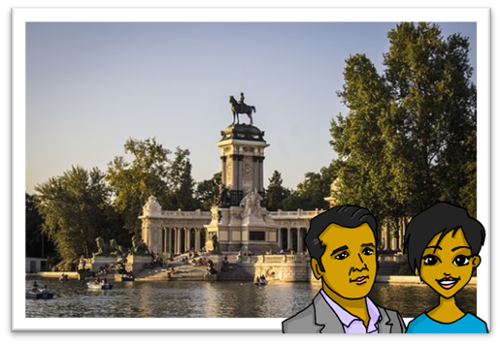
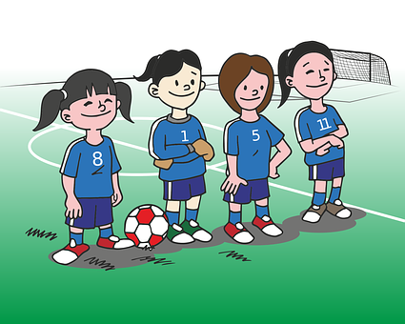
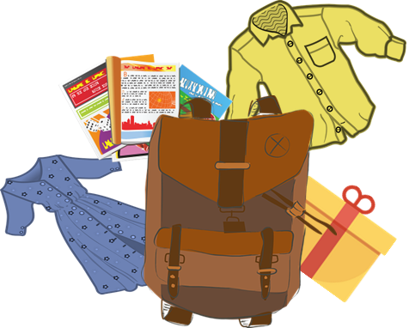
Saying what I and others do
6
Verde term 2
pronunciar
Talking about a trip to Madrid
[que]
[qui]
asking others about the things they have.
Jorge y Antonella
paquete
equipo
You know the SSC
Un viaje a Madrid
[ca], [co], [cu].
The same /k/ sound in front of ‘e’ is [que] because [ci] is always a soft ‘c’ sound. E.g. bicicleta.
Write down the key language for this week.
vocabulario
(la) camisa |  | (el) tío
(la) tía |  | (el) vestido
escuchar
Escucha. ¿Es ‘que’ o ‘qui’?
A Pa____to le picó un mos ____ to en un estan ____ de ____to.
Pa____ come ____so en un par____ de ____quén.
El ____jote está en el bos_____ con Sancho y su caballo.
1
[Paquito was bitten by a mosquito in a pond in Quito.]
2
[Paqui eats cheese in a park in Quequén]
3
[Quixote is in the forest with Sancho and his horse]
a shirt
leer
Lee el texto y busca el vocabulario.
__________
El tío Jorge está de vacaciones en España y la tía Antonella está con él. El fin de semana, mamá, papá, Quique y yo vamos a ir a Madrid así que* hoy preparo mi mochila para el viaje: un vestido y una camisa.
trip
_______
my
uncle
on holidays
dress
backpack
aunt
today
__
____
___________
_______
___________
_____
____
6
29

Slide 32




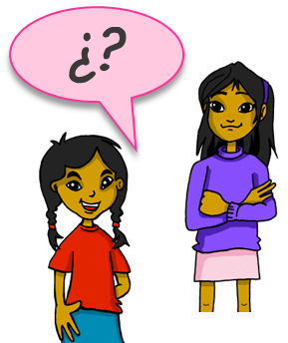
Saying what I and others do
6
Verde term 2
Talking about possessions in singular and plural
gramática
[my]
To say ‘my’ in Spanish before a singular or uncountable noun, use mi.
Tengo una cámara en mi mochila.
I have a camera in my bag.
To say ‘my’ in Spanish before a plural noun, use mis.
En mi mochila tengo mis libros.
It does not
In my bag I have my books.
matter whether the nouns are masculine or feminine.
leer
¿Qué tiene Sofía en la bolsa?
¿Qué menciona? Marca .
Lee y rodea. ¡Ojo ! It could be both.
E
mi | regalo | conejos
mis | lápices | cosas
mi | bicicletas | cuaderno
mi | cartas | vestido
mis | camisas | botella
mi | revistas | hermano
1
2
3
4
5
rodea = circle
Asking about possession: tener
gramática
[I have; you have; do you have?]
To change
a statement into
a question, simply raise your voice at the end.
Tengo una idea.
I have an idea.
Tengo - I have
Tienes una pregunta, Elena.
You have a question, Elena.
Tienes - ___ have
¿Tienes una pregunta, Elena?
Do you have a question, Elena?
¿Tienes? - ¿ ___ ___ have?
31
6
30

Slide 33







Saying what I and others do
6
Verde term 2
escuchar
¿Dónde están las cosas de Sofía? Sofía habla.
Quique tiene las cosas de Sofía en la mochila.
¿Quién es?
¿Qué es? Marca y escribe en inglés.
Sofía | Quique
? OR .
mi | mis
¿Qué?
E
1
2
3
4
5
Talking about possessions in singular and plural
gramática
[your]
To say ‘your’ in Spanish before a singular or uncountable noun, use tu.
¿Tienes una camisa en tu bolsa?
Do you have a shirt in your bag?
To say ‘your’ in Spanish before a plural noun, use tus.
¿Tienes tus camisas en tu bolsa?
Do you have your shirts in your bag?
leer
notas = notes
6
31

Slide 34






Saying what I and others do
6
Verde term 2
[B] Completa las frases en inglés.
 | ____ have my ______ in your ______ .
 | ____ __ have your ______ in my _____ ?
 | ____ _____ your ________ in my _____ .
 | ____ _____ have my ___________ for the uncle in your ________ ?
 | ____ _______ your ______ in my __________ .
 | ____ _______ my ______ on your ______ .
escuchar
Escucha y escribe el orden. ¿Es A B o B A? 📝.
Marca [ce], [ci], [que] o [qui].
 | A|B B|A | A | B
E |  | cepo [trap] | quepo [I fit in]
1 |  | quitar [to take off] | citar [to make a date]
2 |  | dice [says] | dique [dique]
3 |  | cena [dinner] | quena
4 |  | maqueta [sketch] | maceta [plant pot]
 |  | cien | quién
E
1
2
3
4
5
leer
[A] Escribe “a/an” & “some”. ¿Qué número es?
indefinite (a/an) | indefinite (some)
____ piscina | ____ piscinas
____ escuela | ____ escuelas
____ vestido | ____ vestidos
____ camisa | ____ camisas
____ plaza | ____ plazas
____ universidad | ____ universidades
____ museo | ____ museos
E
1
2
3
4
5
6
6
32

Slide 35





Saying what I and others do
6
Verde term 2
Asking about possession: tener
gramática
[I have; you have; do you have?; negative ‘no’]
We have already seen the verb tener means ‘to have’.
To say ‘I don’t’ have’, simply put ‘no’ before the verb. This makes a negative.
¿Tienes un vestido, Elena?
Do you have a dress, Elena?
No, no tengo un vestido.
No, I don’t have a dress.
No tengo un vestido.
I don’t have a dress.
hablar
Pregunta y adivina la foto de tu compañero/a.
adivina = guess
¿Tienes [some; a/an] [_____] en [your] habitación?
Sí, tengo [some; a/an] [_____] en [my] habitación.
No, no tengo [some; a/an] [_____] en [my] habitación.
leer
Escribe en inglés. Can you get at least 15 points?
 | la iglesia | la calle | histórico
 | de | el puente | solo
 | ¿dónde? | a menudo | el cine
 | aprender | beber | comer
 | el tío | tienes | tengo
 | la camisa | el vestido | la tía
x3
x2
x1
6
33

Slide 36


Saying what I and others do
6
Verde term 2
leer
El ordenador* tiene un problema 😨. Lee el mensaje con tu compañero/a.
mencionar = to mention, mentioning
para = in order to
porque = because
observar = to observe, observing
escribir
Escribe en español. Can you get at least 15 points?
 | church | street | bridge
 | only, alone | historical (f) | of, from
 | to drink, drinking | Where? | cinema
 | to learn, learning | to eat, eating | often
 | You have | dress | aunt
 | shirt | I have | uncle
x3
x2
x1
6
34

Slide 37



Saying where you are going
7
Verde term 2
pronunciar
Using ‘hay’ and ‘tiene’ to describe a city.
[n]
[ñ]
mano
español
Extremadura
Write down the key language for this week.
vocabulario
doce |  | dieciséis |  | veintiséis
trece |  | veinte |  | veintiocho
catorce |  | veintiuno |  | treinta
quince |  | veintitrés |  | treinta y uno
Hay
gramática
[there is; there are]
To say how many of something there are, use hay + number or + unos/unas (some):
Hay una fiesta importante allí.
Hay un pueblo aquí.
There is an important festival there.
There is a park there.
Plurals add –s to nouns ending in a vowel. Add –es to nouns ending in consonant.
Hay unos pueblos en Extremadura y unas fiestas importantes allí.
There are some towns in Extremadura and some important festivals there.
6
35

Slide 38



Saying where you are going
7
Verde term 2
Badajoz
Badajoz es una ciudad en el oeste de España, en la región* de Extremadura.
(el) oeste = west
(la) región = region
escuchar
Escucha y completa los espacios.
En Badajoz, [E] ______ un carnaval* muy famoso en febrero. Cada [1] ______ tiene un tema* y [2] ______ disfraces* de muchos [3] ______. Hay una banda con
[4] ____________ también. En las
[5] ____________ hay muchas personas que* [6] ___________ la fiesta: bailan y cantan al ritmo* de la música.
(la) carnaval = carnival |(el) tema = theme |disfraces = costumes |
que = who, that, which |(el) ritmo = rhythm
leer
Busca el vocabulario en el texto.
a band
they sing
each
instruments
many
………
………
………
……………..
………….
they dance
there is/are
too
famous
………
………
………
………….
Adjectives following the noun
We know many adjectives follow the noun.
gramática
When we describe more than one person or animal, we add an ‘s’ after ‘o’, ‘a’ and ‘e’:
unos pueblos pequeños
unas ciudades famosas
some small towns
some famous cities
unos pueblos importantes
unas fiestas importantes
some important towns
some important festivals
6
36

Slide 39






Saying where you are going
7
Verde term 2
leer
escribir
¿Qué hay en las fotos?
1. En la foto hay __________ personas con disfraces. Llevan sombreros __________.
2. En la foto hay __________ sombreros ___________.
3. En la foto hay __________ mochilas _____________.
1
Using the negative ‘no’
To say there isn’t or there aren’t, put no before the verb hay.
gramática
No hay una playa en Badajoz.
⚠ It is also possible to omit the article: No hay playa en Badajoz.
There isn’t a beach in Badajoz.
No hay playas en Badajoz.
⚠ There’s no Spanish word for ‘any’ in plural negative sentences.
There aren’t any beaches in Badajoz.
leer
¿Es correcto o incorrecto?
1. En la foto no hay animales.
2. En la foto hay guitarras.
3. En la foto no hay una niña con gafas.
4. En la foto hay cuatro niñas que tienen gafas naranjas en la cabeza.
1
2
3
4
6
37

Slide 40


Saying where you are going
7
Verde term 2
escuchar
Escucha y escribe. ¿Es [n] o [ñ]? 📝.
‘hay’ vs. ‘tiene’
To say ‘there is’ and ‘there are’, use hay.
gramática
En Badajoz hay unos puentes bonitos.
In Badajoz there are some pretty bridges.
To say ‘it has’, use tiene.
Badajoz tiene unos puentes históricos.
Badajoz has some historical bridges.
Sentences with tiene don’t usually start with en.
leer
Lee las frases y marca: ¿Es hay o tiene?
Escribe la segunda parte de la frase en inglés.
1. En Badajoz | tiene | hay | unas iglesias en el centro de la ciudad.
2. Badajoz | hay | tiene | una alcazaba (fuerte*) muy importante.
3. En la ciudad no | hay | tiene | playas.
1
2
3
6
38
38

Slide 41


Saying where you are going
7
Verde term 2
4. En la región | tiene | hay | unas zona de montañas, la Siberia Extremeña.
5. Badajoz | tiene | hay | unas fiestas importantes en febrero – el carnaval.
6. La zona | hay | tiene | temperaturas muy altas.
4
5
6
escuchar
Persona A: (Person B – turn to the next page.)
Round 1:
Your turn to talk!
Round 2:
Persona A: lee el número
Persona B: Escucha y escribe el número
Persona A: Escucha y escribe el número
Persona B: lee el número
 | veinticinco
 | treinta
 | veintisiete
 | veintidós
 | veintiocho
1
6
2
7
3
8
4
9
5
10
leer
Escribe en inglés. Can you get at least 15 points?
 | delante (de) | el edificio | tienen
 | hacer | a menudo | tenemos
 | el fin | el ruido | nunca
 | hay | beber | comprender
 | veintinueve | veinticuatro | veintiséis
 | treinta | once | doce
x3
x2
x1
6
39

Slide 42

Saying where you are going
7
Verde term 2
escuchar
Persona B: (Person A – turn to the previous page.)
Round 1:
Your turn to listen!
Round 2:
Persona B: Escucha y escribe el número
Persona A: lee el número
Persona B: lee el número
Persona A: Escucha y escribe el número
1
 | veintinueve
 | Treinta y uno
 | veinticuatro
 | veintiséis
 | veintitrés
6
2
7
3
8
4
9
5
10
escribir
Escribe en español. Can you get at least 15 points?
 | they have | (the) building | (the) cinema
 | in front (of) | Where? | we have
 | sometimes | (the) end | (the) noise
 | to do, make | to see, watch | often
 | eighteen | twenty-seven | fifteen
 | thirty-one | eleven | twelve
x3
x2
x1
escribir
Research another city in Spain or Latin America.
¿Qué hay? ¿Qué tiene?
6
40

Slide 43



Saying where you are going
8
Verde term 2
pronunciar
Describing a trip: Using ‘voy’ and ‘va.
[b]
[v]
Using ‘al’ and ‘a la’.
e r
[b] and
P ú
abuela
ver
[v] sound the same in Spanish.
Write down the key language for this week.
vocabulario
ir |  | voy |  | vas |  | va
a |  | (el) bosque |  | (la) isla |  | (el) lago
pronunciar
Lee la información sobre Perú con tu compañero/a.
1. En Perú hay 25 provincias. 2. Perú tiene costa*.
3. Vichayito es una playa muy Famosa en Piura.
4. Perú tiene sierra. 5. Perú tiene selva. 6. La Libertad tiene costa y sierra.
El Nevado de Ausangate
leer
¿Dónde está la ciudad? Completa las frases.
1. ________ está en el norte.
2. _________ está en el norte.
3. __________ está en el norte.
4. En el norte está el lago de Llanganucvo.
Piura
Pucallpa
Trujillo
Cusco
Lima
Puno
6
Arequipa
41

Slide 44





Saying where you are going
8
Verde term 2
leer
¿Dónde está la ciudad? Completa las frases.
1. ________ está en el sur.
2. _________ está en el sur.
3. __________ está en el sur.
4. El lago de Titicaca está en Puno.
1. ________ está en el este.
2. _________ está en el este.
3. __________ tiene muchos bosques.
Iquitos es la capital de la region de Loreto, done está el bosque tropical amazónico.
1. ________ está en el oeste.
2. _________ está en el oeste.
3. Las islas Ballestas están en el este, cerca de Paracas.
Using the verb ‘ir’
gramática
[I go vs. s/he goes]
Some verbs do not follow regular patterns.
The verb ‘ir’ (to go, going) is an irregular verb.
To say ‘I go’, we use ‘voy’.
I
S/he, it
Voy con mama.
Va con una amiga.
I go with mum.
She goes with a friend.
Quique va con una amiga (f).
Quique goes with a friend (f).
6
42

Slide 45




Saying where you are going
8
Verde term 2
escuchar
Sofía va de excursion con la escuela, y Luis también.
¿Quién es? Marca .
Sofía | Luis
información extra
Voy de excursión y Luis también va.
E
1
2
3
4
5
Using ‘al’ and ‘a la’
[to the]
gramática
The Spanish word ‘a’ means ‘to’:
Voy a Burgos.
I go to Burgos.
To mean ‘to the’ before a singular feminine noun, use ‘a la’.
To mean ‘to the’ before a singular masculine noun, use ‘al’.
Voy a la playa.
Voy al bosque.
I go to the beach.
I go to the forest.
leer
El viaje de Luis y Sofía. Sofía escribe: ¿Es ‘al’ o ‘a la’?
¿Qué frase es? Escribe el número. ¿Quién es?
 | I go | he goes to the mountain(s).
 | I go | he goes to the lake.
 | I go | he goes to the beach.
 | I go | he goes to the island.
 | I go | he goes to the river.
 | I go | he goes to the forest.
6
43

Slide 46

Saying where you are going
8
Verde term 2
escuchar
[A] Escucha y escribe [b] o [v].
 | _erde |  | _estido
 | ár_ol |  | tra_ajar
 | tam_ién |  | _onito
 | _erdad |  | _eintidós
 | ru_io |  | ner_ioso
[C] ¿Qué significan las palabras?
E
5
1
6
dress to work, working
22 blond
pretty truth
tree green
nervous also, too
2
7
3
8
4
9
pronunciar
[B] Practica con tu compañero/a.
leer
Lee el texto. Busca el vocabulario.
1. Luis va de excursión a Cusco y manda unos mensajes a Sofía. 2. Cusco es una ciudad en el sur de Perú. 3. Después va a Machu Picchu. 4. También va al lago Titicaca en Puno. 5. Es una excursión muy divertida.
lake
he goes
to the
to
after
city
he sends
South
_____
______
_____
__
______
______
_______
______
leer
Escribe en inglés. Can you get at least 15 points?
 | tiene | el/la cantante | la cara
 | la nariz | el ojo | pequeño
 | el hermano | la hermana | la carta
 | la habitación | jugar | la pelota
 | la isla | el bosque | va
 | ir | voy | el lago
x3
x2
x1
6
44

Slide 47

Saying where you are going
8
Verde term 2
leer
El ordenador* tiene un problema 😨. Lee el mensaje con tu compañero/a.
el ordenador = computer
escribir
Escribe el mensaje en inglés.
……………………………………….….……………………………………….….
……………………………………….….……………………………………….….
……………………………………….….……………………………………….….
……………………………………….….……………………………………….….
escribir
Escribe en español. Can you get at least 15 points?
 | eye | s/he has | small
 | face | singer | nose
 | to play, playing | (bed)room | sister
 | card | ball | brother
 | to go, going | s/he goes | I go
 | forest | lake | island
x3
x2
x1
6
45

Slide 48





Saying where you are going
9
Verde term 2
pronunciar
Córdoba
Talking about a trip to Córdoba: ‘voy’ and ‘vas’.
[r]
[rr]
Describing where you are and where you go.
parar
correr
Write down the key language for this week.
vocabulario
voy |  | vas |  | (el) primo
Using the verb ‘ir’
gramática
[I go vs. s/he goes]
We have learned that the verb ‘ir’ (to go, going) is an irregular verb.
To say ‘you go’, we use ‘vas’.
To say ‘I go’, we use ‘voy’.
I
you
Voy con papá.
Vas con mi primo.
I go with dad.
You go with my cousin.
Luis, el primo
escuchar
Escucha y escribe.
El viaje a _____________.
1
Voy al ______ de España con mi mamá, papá y Sofía.
La _________ es histórica y grande.
El primo Luis está ______.
2
3
el viaje = trip
6
46

Slide 49




Saying where you are going
9
Verde term 2
escuchar
Las actividades en Córdoba
¿Dónde va? ¿ Con quién? Marca y escribe.
Sofía (I) | Luis (you)
¿dónde? 📝
¿quién? 📝
E
1
2
3
4
5
Using ir & estar; ‘en’, ‘al’ and ‘a la’
[to go & to be (location) | in; to the]
gramática
The verb ‘estar’ means ‘to be’ when describing location.
Estás en el cine.
Estás en la costa.
You are at the cinema.
You are on the coast.
After estar, ‘en’ can mean ‘on’, ‘at’ or ‘in’.
Just choose the meaning that sounds right in each sentence.
remember
that a + el becomes ‘al’.
We generally use ‘a’ with the verb ir to mean ‘to’
We generally use ‘en’ with the verb estar .
leer
Luis manda mensajes. ¿Es ‘en’, ‘al’ o ‘a la’? ¿Es ‘you’ o ‘I’?
Write the phrase number and choose the correct options..
4 | Are you| am I on | to the bridge?
 | Do you go| Do I go in | to the church?
 | I am I You are in | to the hotel.
 | Do you go| Do I go in | to the streets in the centre?
 | I am | You are in | to the market.
 | Am I | are you in | to the museum with grandad?
6
47

Slide 50



Saying where you are going
9
Verde term 2
escuchar
Marca
[A] Escucha. ¿Qué sonido* es?
 | r | rr | palabra 📝
(el) sonido = sound
[B] Practica el trabalenguas.
leer
Escribe en inglés. Can you get at least 15 points?
 | el villancico | la tarjeta | común
 | la carrera | España | cantar
 | preparar | celebrar | mandar
 | la bicicleta | la camisa | la tía
 | el hermano | ¿dónde? | ¿qué?
 | el primo | estoy | la playa
 | va | vas | estás
x3
x2
x1
6
48

Slide 51

Saying where you are going
9
Verde term 2
leer
[A] Lee y completa las frases.
After ‘estoy’, ‘estás’ and ‘está’, we often use the preposition _______.
b) After ‘voy’, ‘vas’ and ‘va’, we use _______ before feminine nouns, and _______ before masculine nouns.
[B] Lee. ¿Qué verbo es? Escribe📝.
E
Va al estadio con mi papá. (s/he)
Estás en la habitación del hotel. (you)
Está en la iglesia de Córdoba. (s/he)
Vas a la calle con flores. (you)
Va al mercado famoso de la ciudad. (s/he)
Estás en el puente histórico. (you)
1
2
3
4
5
En mayo es el festival de los
patios* de Córdoba. Muchas calles están decoradas* con flores y hay un concurso*.
[C] Escribe las frases en inglés 📝.
E
1
2
3
4
5
6
49

Slide 52
Saying where you are going
9
Verde term 2
escribir
Escribe las palabras y completa las frases en inglés y en español.
 | She goes ____ ______ river ____ Córdoba.
 | ____ al ________ en Córdoba.
 | _____ _____ in ________ square ___ ____ morning.
 | Está ____ ____ plaza por la ___________.
 | I am ____ the market ______ _____ grandma.
 | ________ en ___ _________ con mi _____________.
 | Are you going ____ the __________ theatre?
 | _______ _______ ___________ famoso?
 | You are in ____ ___________ with _____ magazine.
 | _______ _____ la habitación ______ una ___________.
E
1
2
3
4
escribir
Escribe en español. Can you get at least 15 points?
 | to send, sending | (the) card | common
 | but | to buy, buying | typical
 | (the) race | to sing, singing | to listen, listening
 | (the) bear | to celebrate, celebrating | (the) aunt
 | (the) room | (the) sister | (the) bed
 | (the) cousin (f) | (the) square | s/he is (state, location)
 | you go | (the) market | I am (state, location)
x3
x2
x1
6
49
50

Slide 53



Actividades de Pascua
Verde term 2
10
vocabulario
[1] Crack the codes to find out the Spanish words.
Write them out next to the English word.
en español | en inglés
 | eggs
 | bunnies
 | lambs
 | daffodils
 | chicks
 | chocolate
 | baskets
 | kites
leer
[2] Read the poem. How many are there? Write the missing word from the poem.
Sorpresa, sorpresa*
Pues muchas cosas
Tengo en mi cesta
veintidós huevos de colores
y diecisiete pollitos pequeñitos.
También tengo siete cometas coquetas
demsiado grandes para mi cesta.
Doce narcisos amarillos
junto a quince corderos blancos
y nueve conejos nerviosos.
¿Dónde está el __________________?
¡Es lo más importante!
(la) sorpresa = surprise
coqueta = cute, charming
Lo más importante = the most important thing
6
51

Slide 54



Actividades de Pascua
Verde term 2
10
leer
[3] Colour each egg to match it to the correct basket. Write the English translations below.
escribir
[4] Write your ten favourite words in Spanish from this term with their English meanings.
6
52

