Slide 1
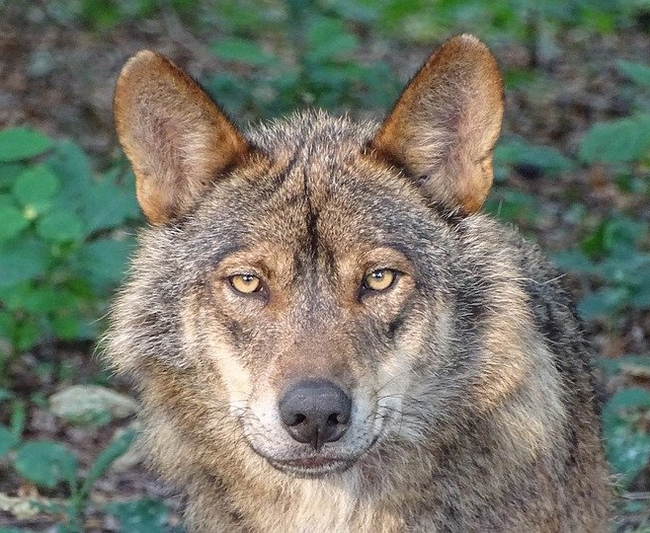
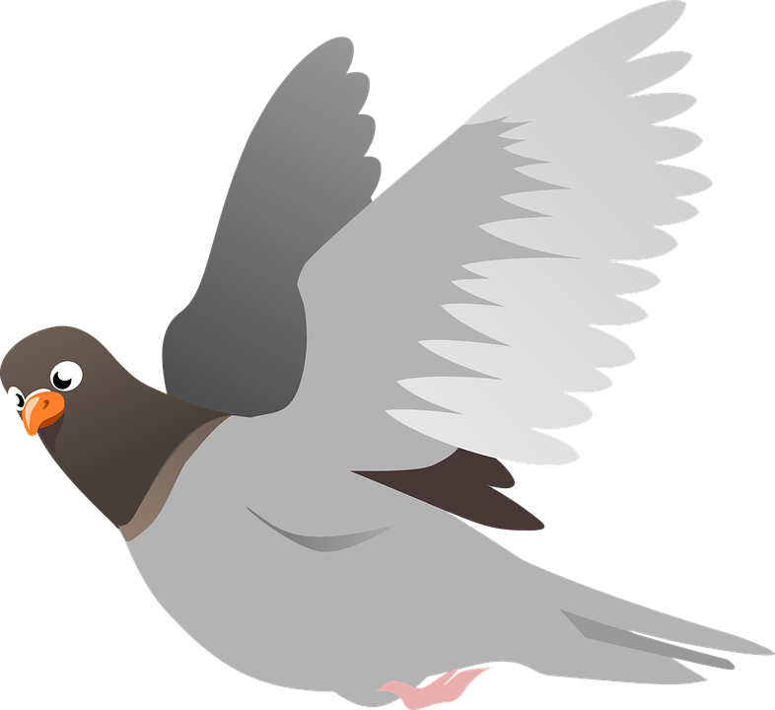
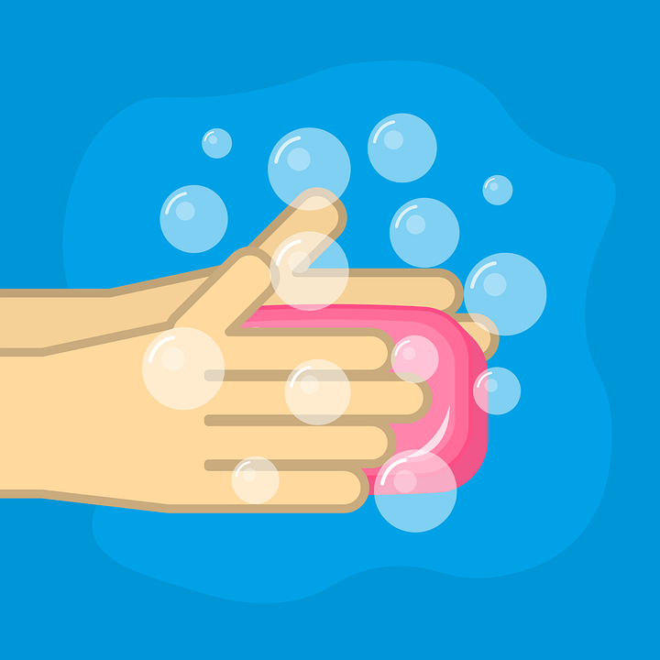
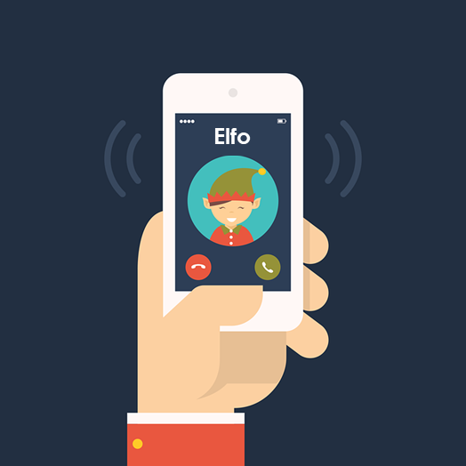
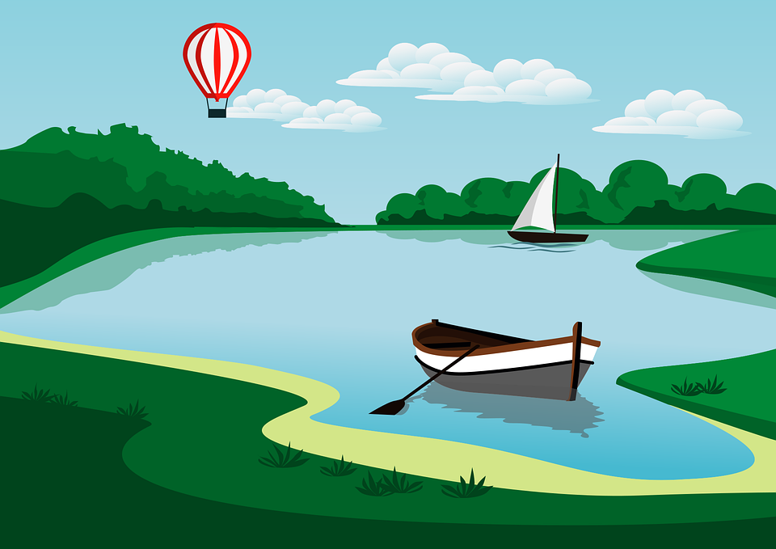
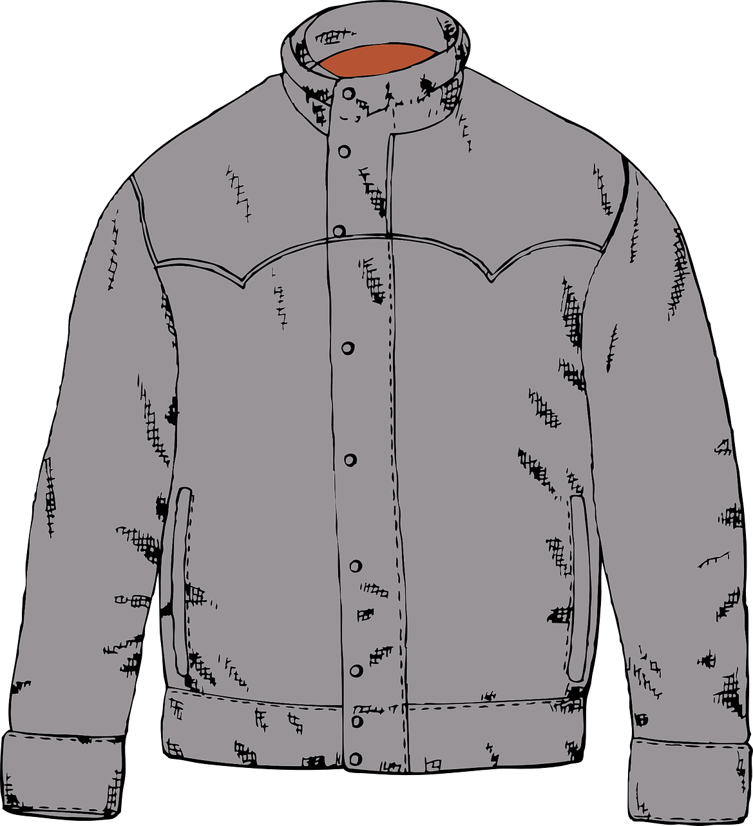
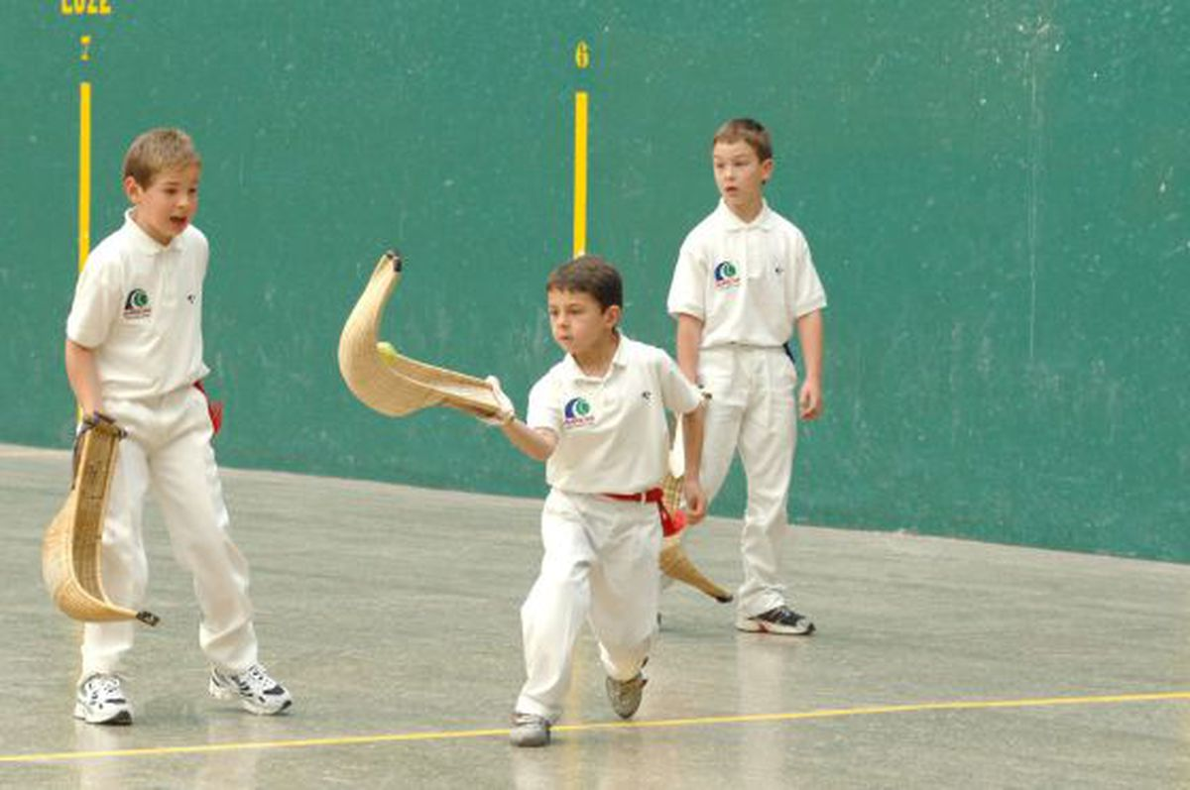
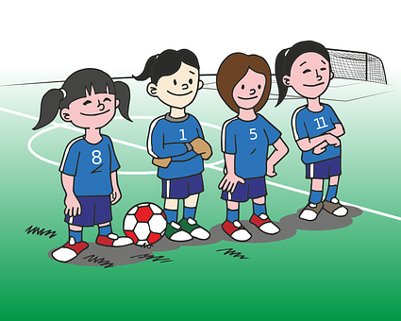
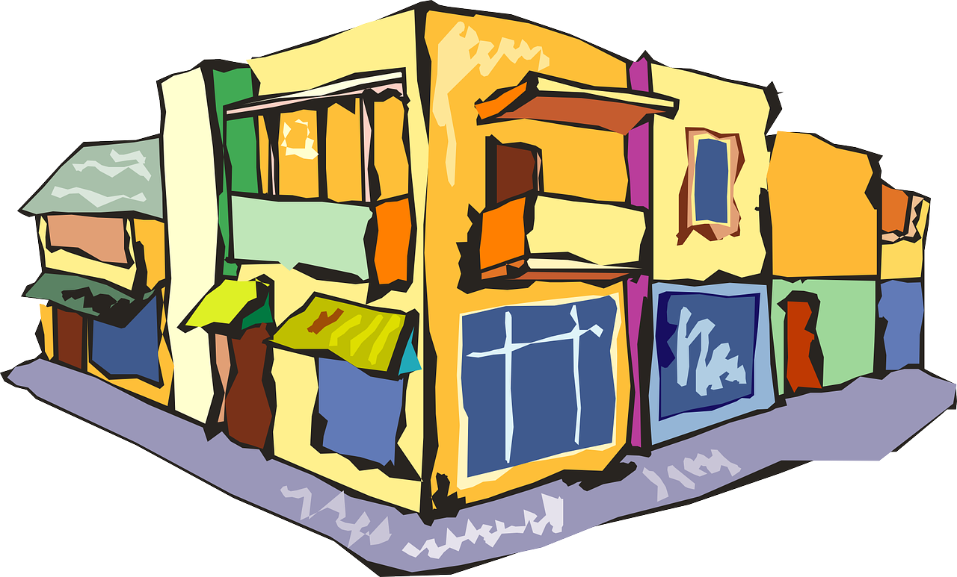
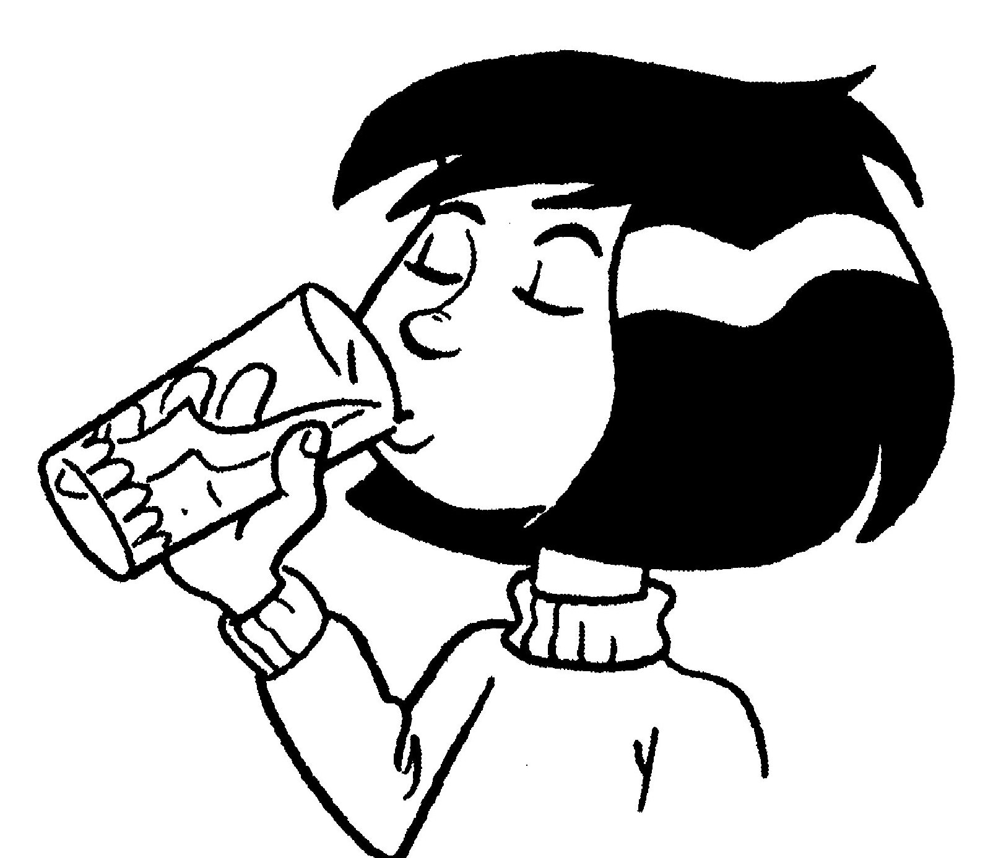
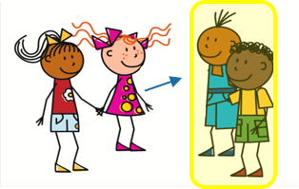
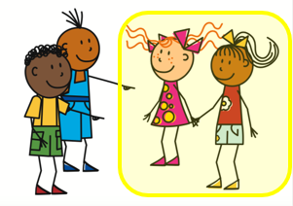
Verde Knowledge Organiser - Spring Term A
Las actividades
beber – to drink|drinking
celebrar – to celebrate|celebrating
mandar – to send|sending
La descripción
caliente – hot
común – common
especial - special
¿Cuándo?
a menudo – often
nunca - never
Las personas
el tío – uncle
la tía - aunt
¿Dónde?
el aula – classroom
el patio - playground
el restaurante – restaurant
el salón – hall, room
Las cosas
la camisa – shirt
la carrera - race
el chocolate - chocolate
la cuerda – rope
el escondite – hide and seek
el fin - end
el fútbol - football
el ruido - noise
la tarea - task
la tarjeta - card
el tenis - tennis
el vestido - dress
el villancico – Christmas carol
Phonics
[l] | libro | lobo | paloma | lavar | película
[ll] | llamar | amarillo | llover | camello | collar
[to call]
[ga] | ganar | [go] | lago | [gu] | gusano
Stress 1: When reading Spanish aloud, stress any vowel with a written accent.
árbol | último [last] | interés [interest] | corazón
Stress 2: Where there is no written accent, stress the penultimate (second to last) syllable for any word ending in a vowel, ‘n’ or ‘s’.
nunca [never] | pasado [past] | orden [order] | sacapuntas
Stress 3: For all other words, stress the final syllable.
amor [love] | profesional | feroz | verdad
[ferocious]
[que]
paquete
queso
bosque
chaqueta
La Pelota Vasca es un deporte típico en el País Vasco.
esquina
[qui]
equipo
quince
aquí
corner
Present tense –AR verbs | Present tense –ER verbs | Using the negative ‘no’
mandas
bebes
In Spanish, to say what you or others don’t do, put ‘no’ before the verb. This makes a negative.
you send
you drink
Saying ‘my’ and ‘your’
mando
manda
bebo
bebe
mi camisa – my shirt mis vestidos – my dresses tu ruido – your noise tus tarjetas – your cards
I send
mandar
s/he, it sends
I drink
beber
No bebe en el patio.
to send|sending
s/he, it drinks
S/he doesn’t drink in the playground.
to drink|drinking
No bebemos en el patio.
mandan
mandamos
beben
bebemos
We don’t drink in the playground.
⚠ It does not matter whether the nouns are masculine or feminine.
they send
we send
they drink
we drink
This works for any verb and any person (e.g., I, you, s/he, we).

Slide 2
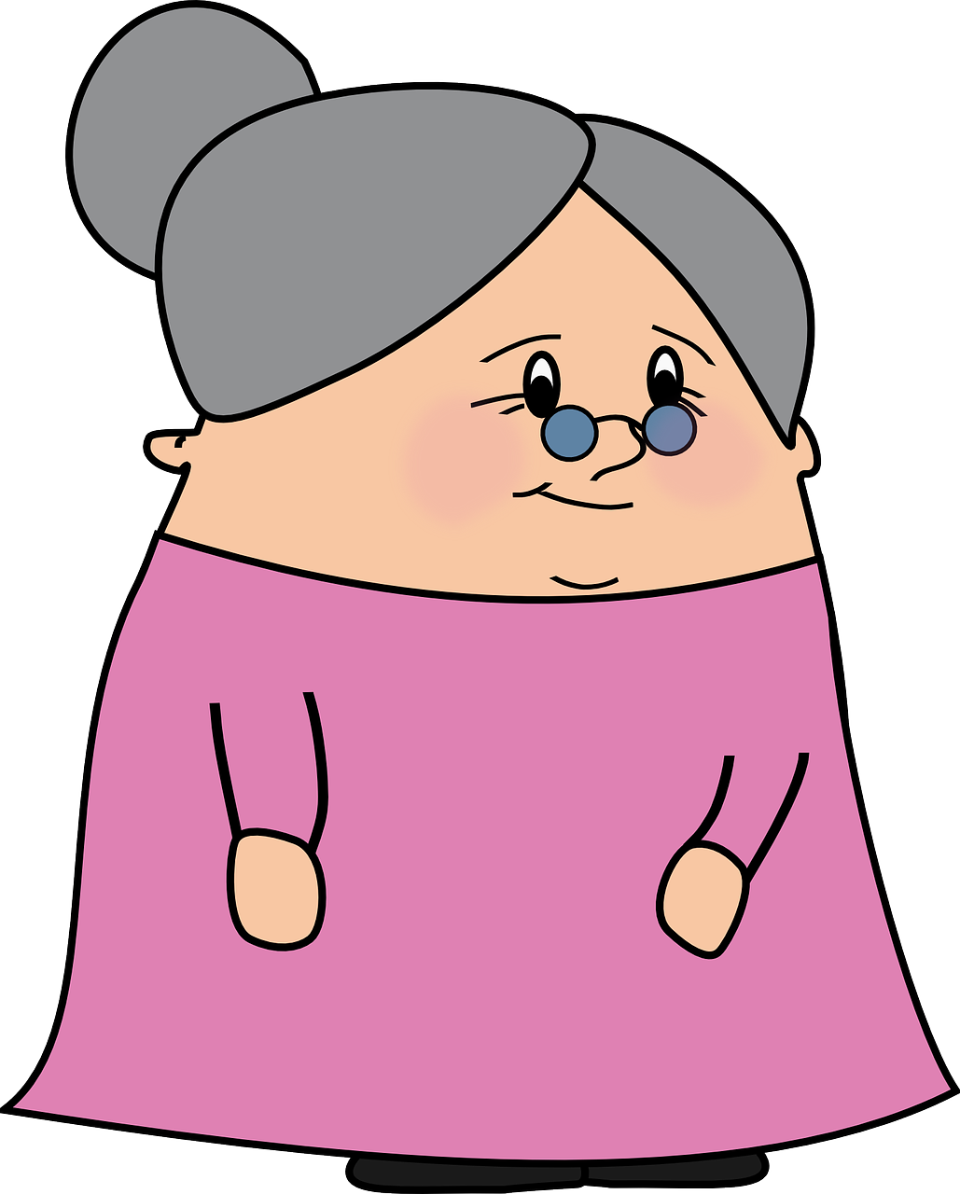
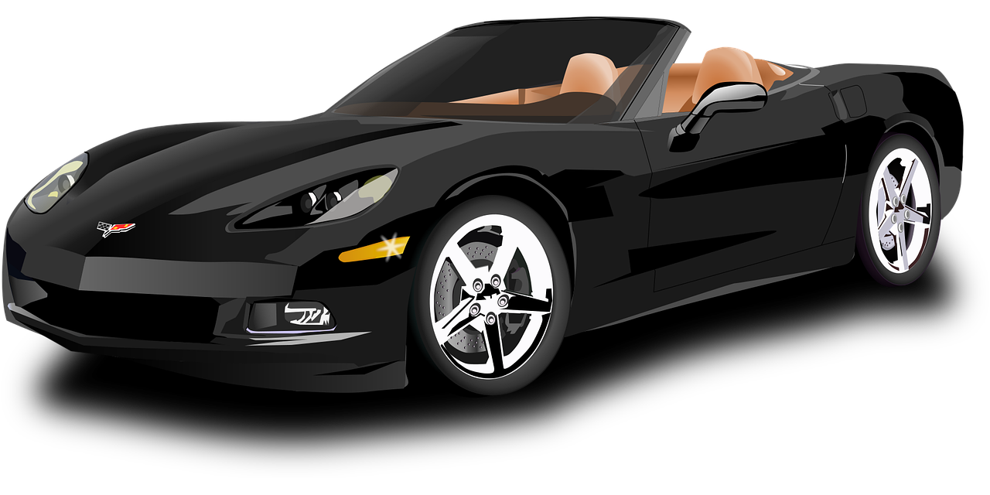
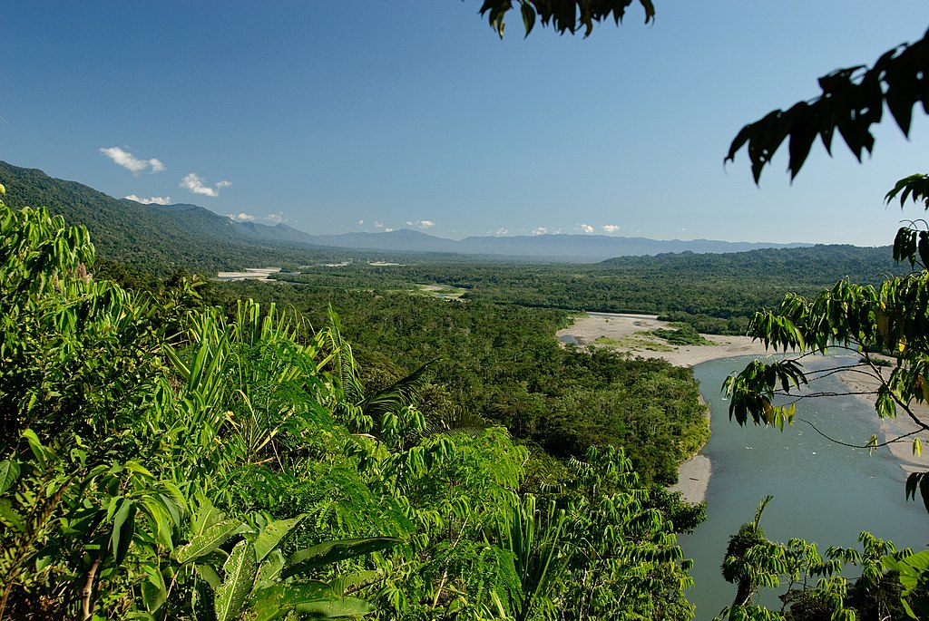
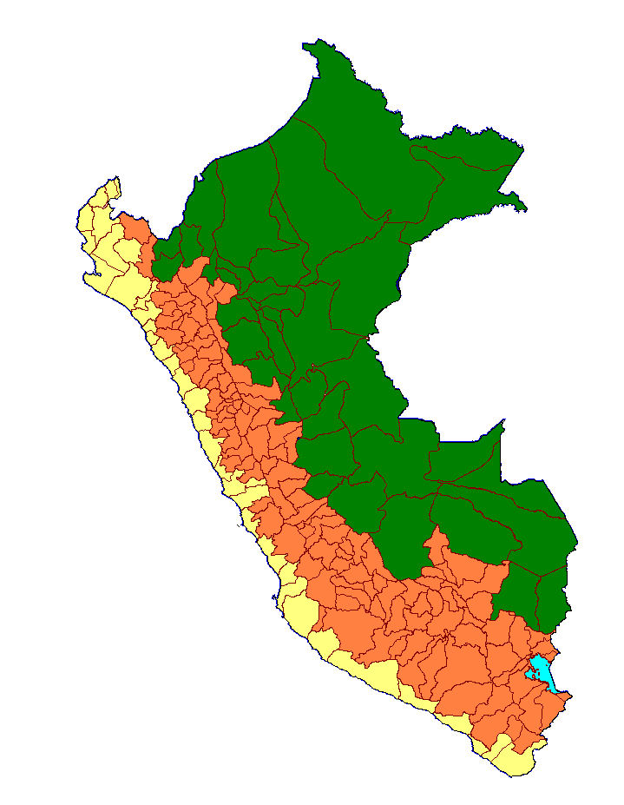
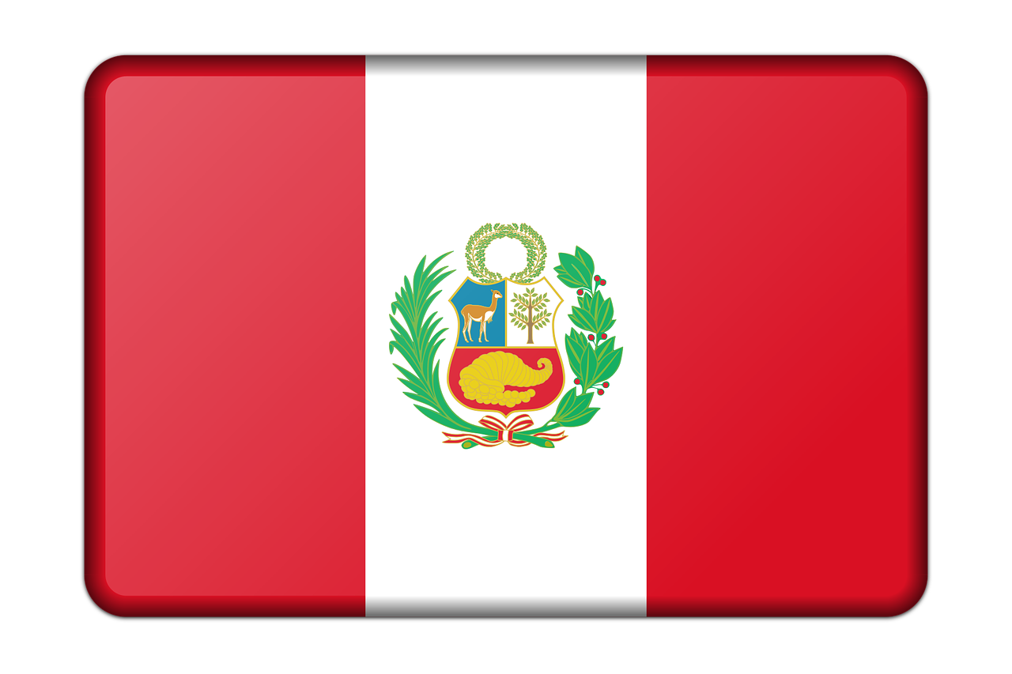
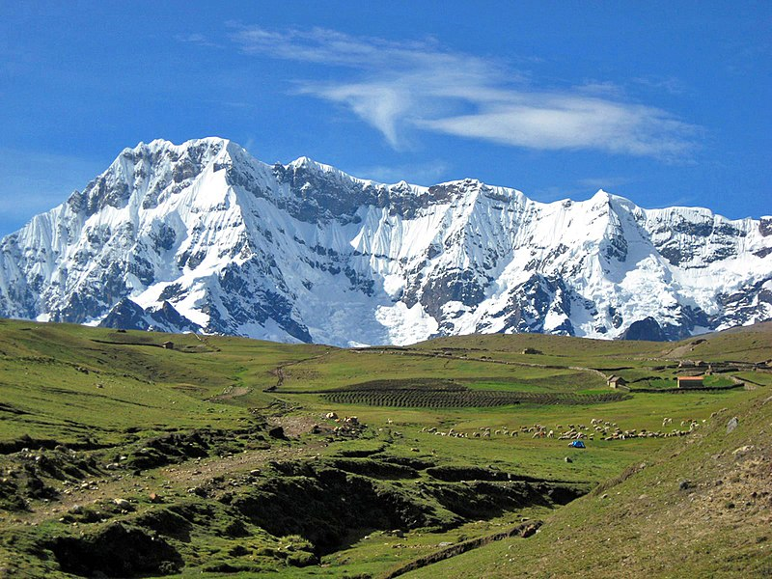
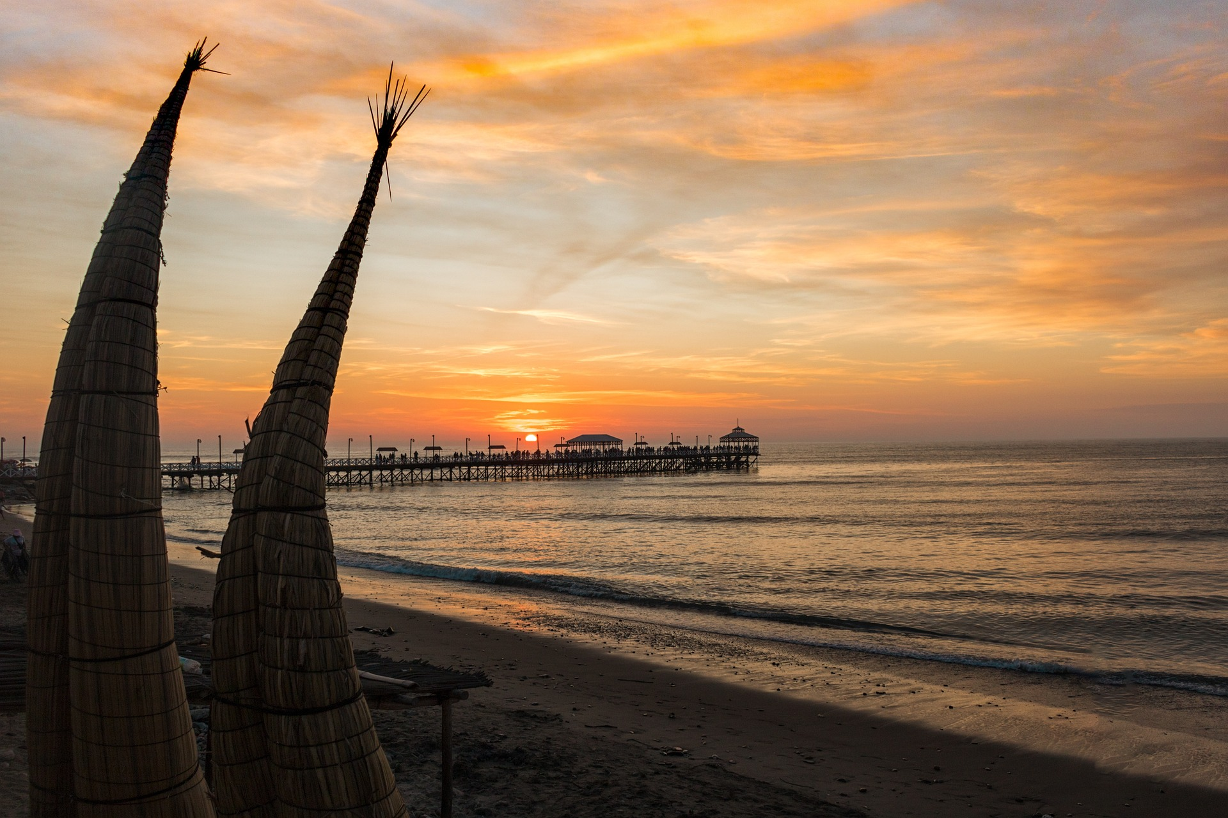
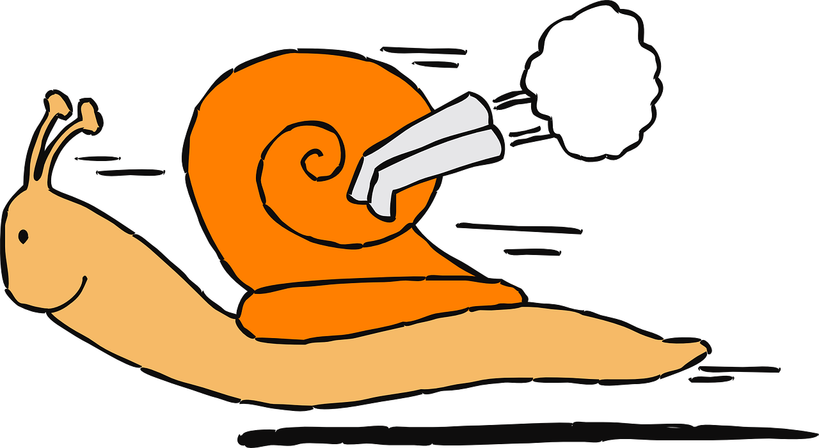
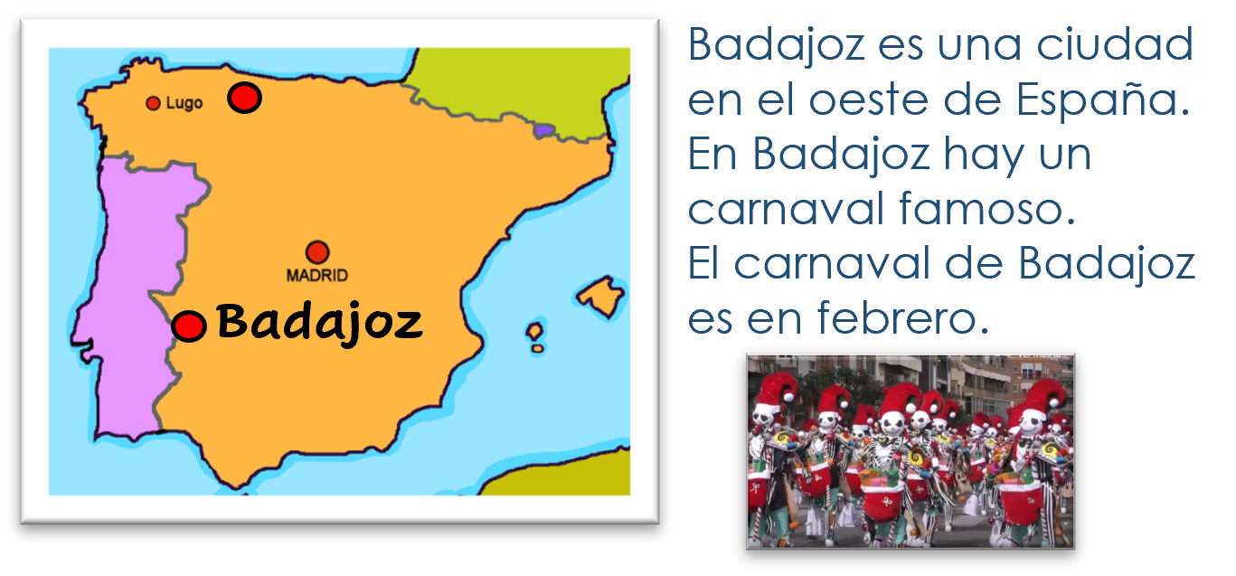
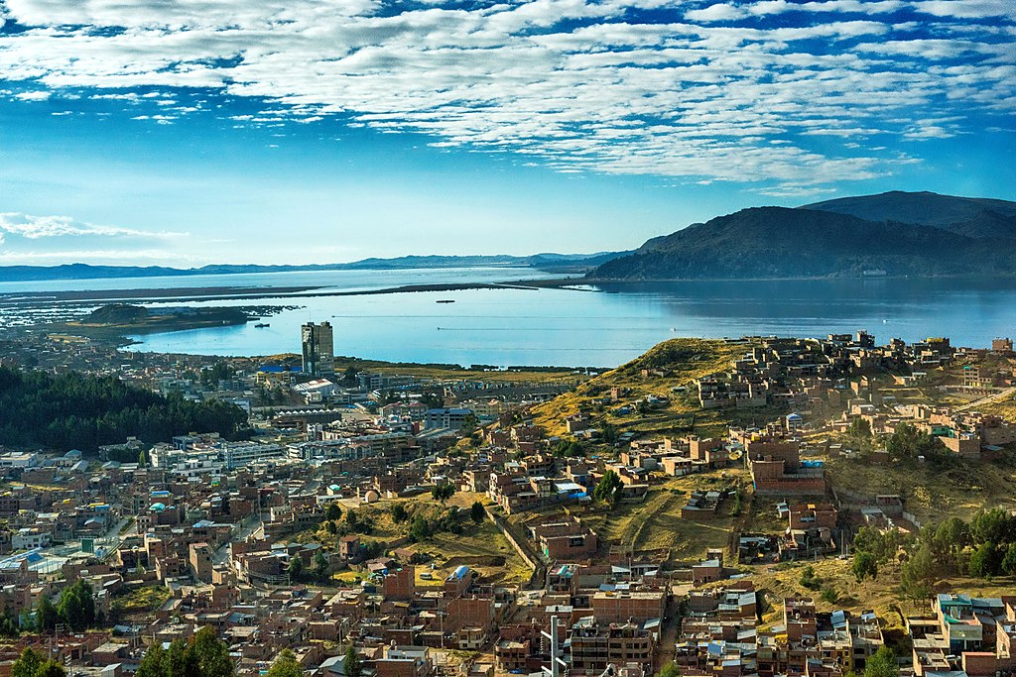
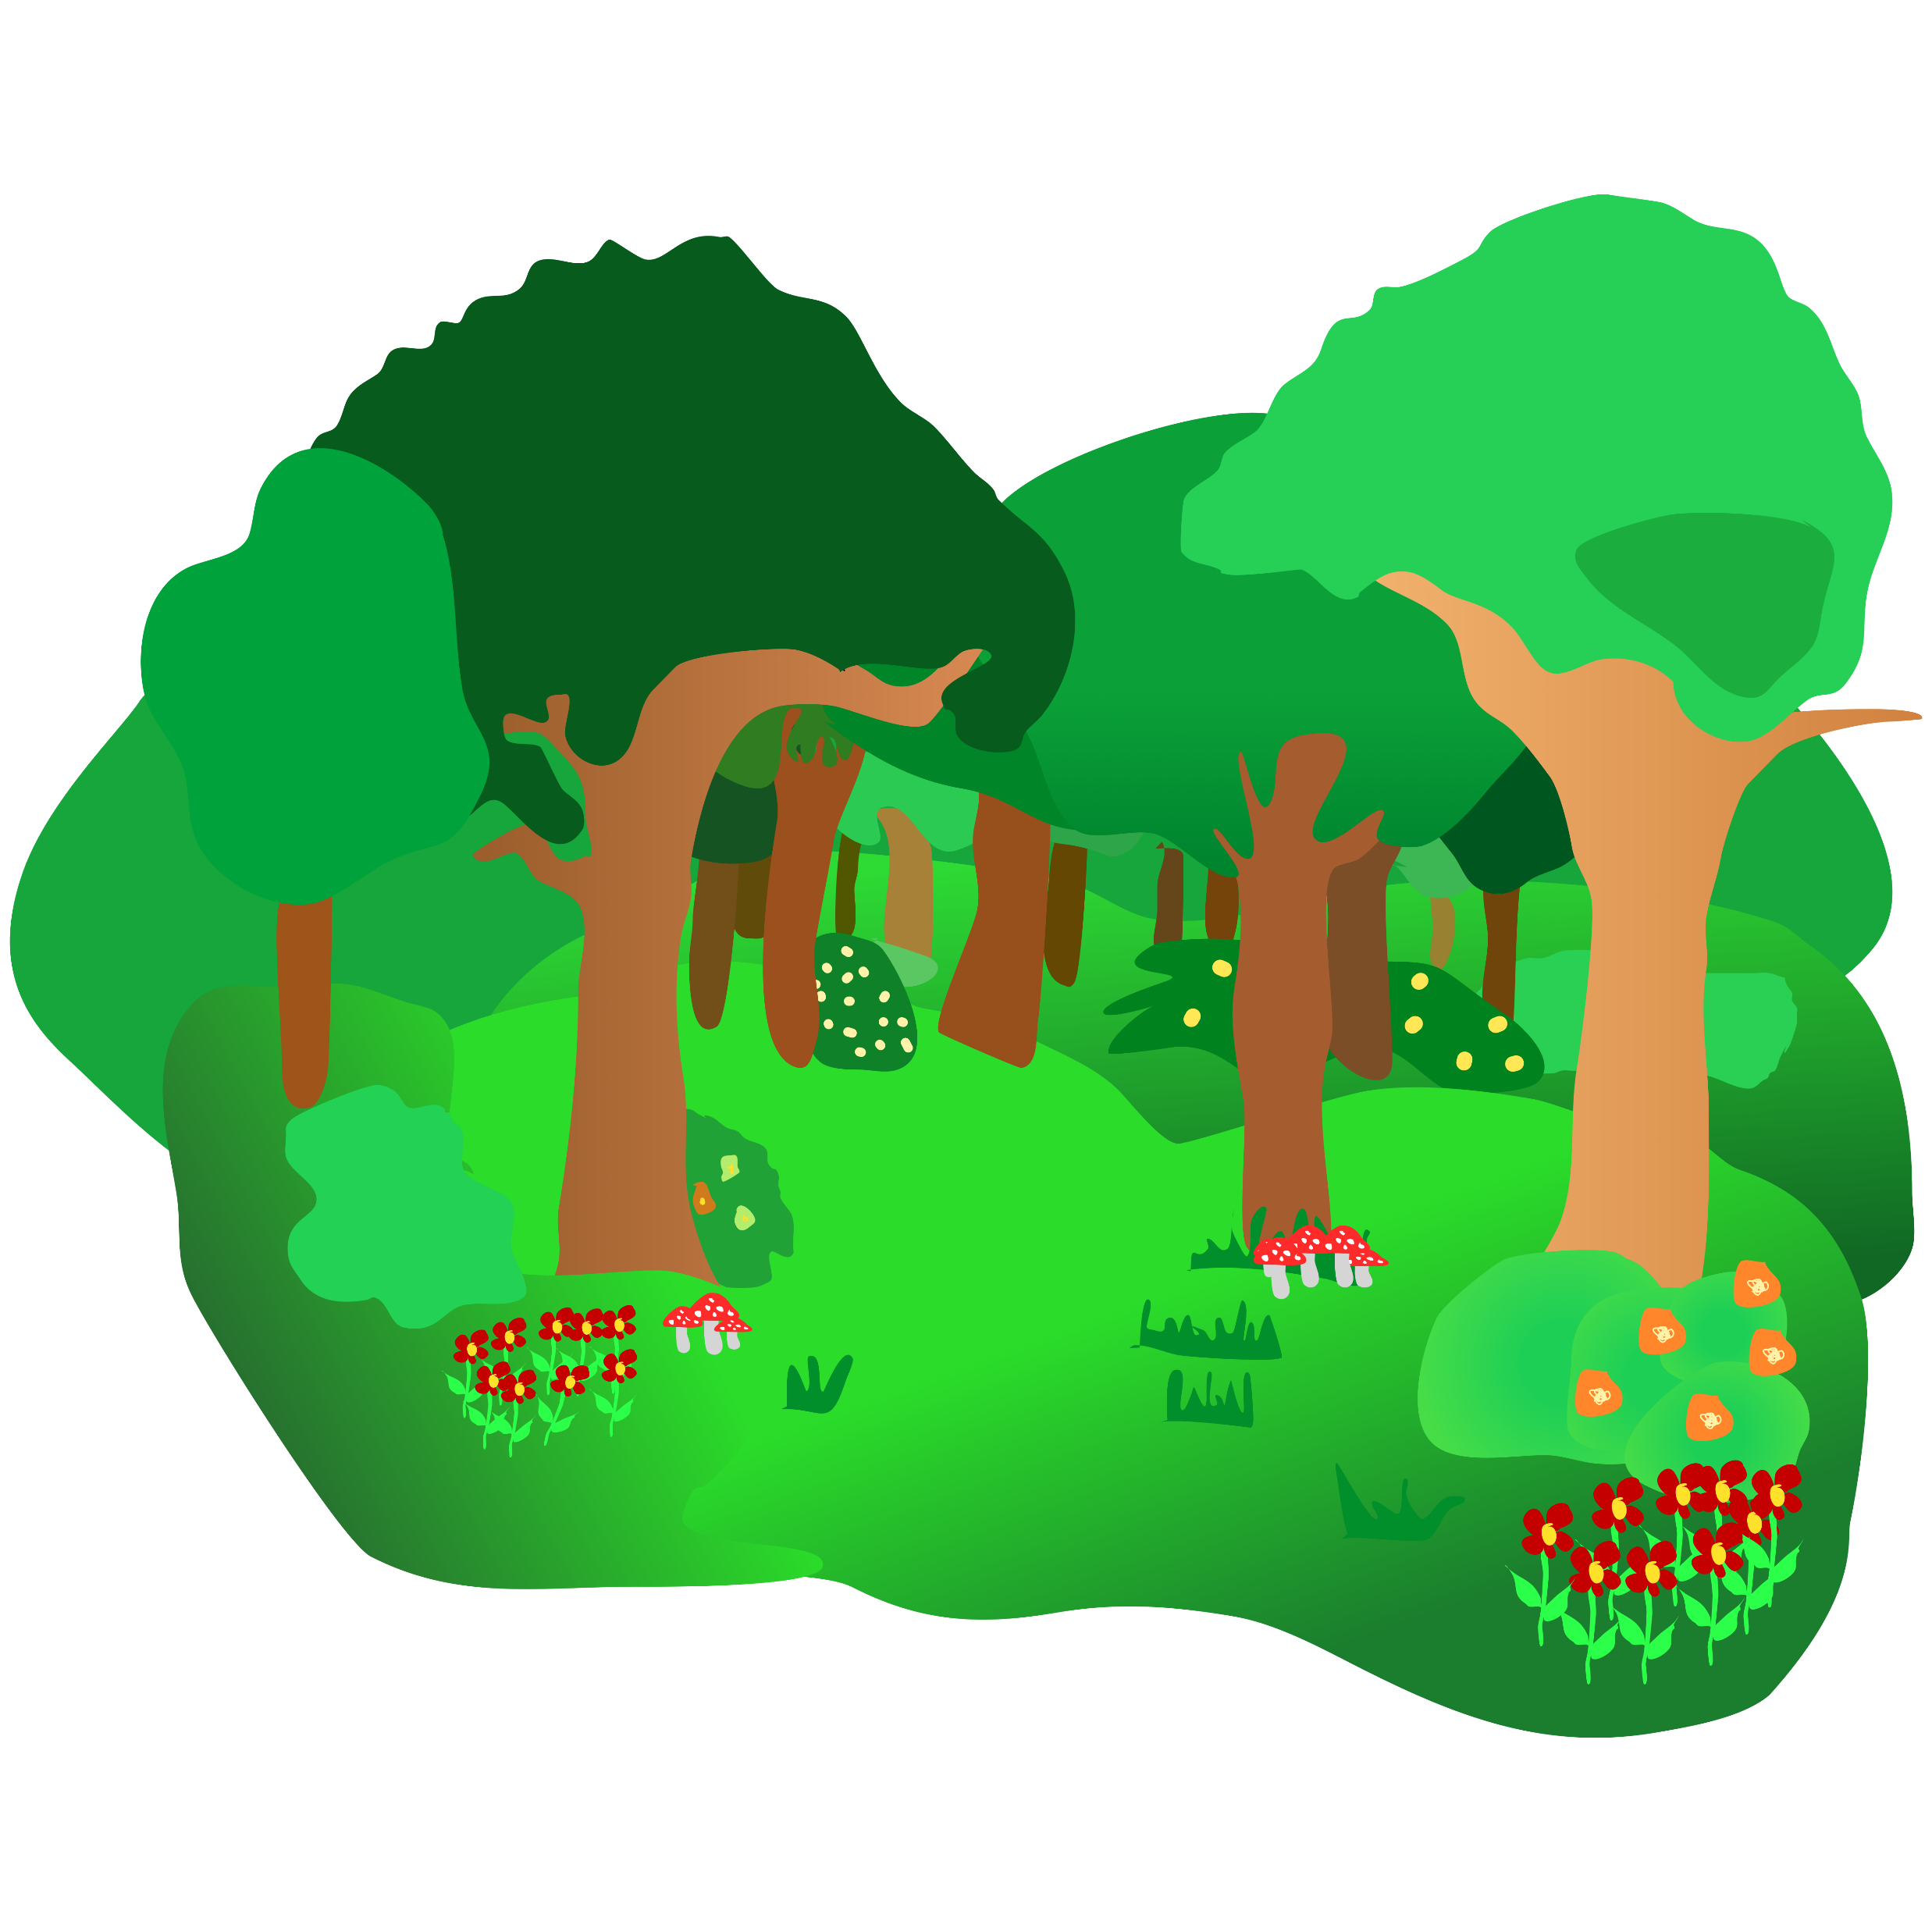
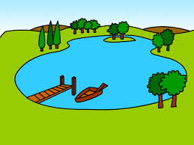
Verde Knowledge Organiser - Spring Term B
Los números
trece – 13
catorce – 14
quince – 15
dieciséis – 16 | veintiséis - 26
diecisiete – 17 | veintisiete – 27
dieciocho – 18 | veintiocho - 28
diecinueve – 19 | veintinueve – 29
veinte – 20
veintiuno – 21
veintidós – 22
veintitrés – 23
veinticuatro – 24
veinticinco - 25
treinta – 30
treinta y uno - 31
hay – there is, there are
Destinos (destinations)
ir – to go | going
voy – I go
vas – you go
va – s/he, it goes
el bosque - forest
la isla - island
el lago - lake
Las personas
el primo – male cousin
Phonics
➜
[n] | mano | novio | nube
[ñ] | español | niña | pañuelo
handkerchief
➜
➜
[v] | ver | vela | viento
[b] | abuela | banco | bolsa
[r] | parar | caro | pero
[rr] | correr | carro | perra
1.000.000
⚠ If the final syllable is stressed and the word ends in a vowel or ‘n’ or ‘s’, there is an accent on the final vowel.
➜
➜
➜
➜
Spanish words can mean different things in different countries. In Peru and most of South America, carro means car. In Spain carro means cart or trolley.
➜
Perú tiene selva.
The verb ir (to go|going) The verb ir is irregular. Other irregular verbs you know are ser, estar, tener, hacer. We call these the big 5! | Saying ‘to the’ To say ‘to the’ with a feminine noun, use a + la: a la isla – to the island To say ‘to the’ with a masculine noun, use a + el → al: al bosque to the forest al lago to the lake | Modismos (idioms) An idiom is s a phrase that has a meaning you cannot work out from its individual words.
➜
Perú tiene sierra.
➜
vas
en un dos por tres
➜
voy
you go
va
Perú tiene costa.
I go
s/he, it goes
ir
Literally…
to go| going
in a two times three
But it really means…
El lago Titicaca está entre Perú y Bolivia.
➜
in no time at all

